Slide 1
MAT Standards Evaluation and National Engagement Group
Jason Wallace
Senior Development Officer
Scottish Drugs Forum

Slide 2
MAT Standards Evaluation
111 people interviewed
95 in Community
16 males in Prison
Males 53 females 41
Age 24-64
SDF Volunteers who were still in Medication Assisted Treatment carried out 76% of all interviews
Core group of 8 volunteers
Participants felt they were listened too by peers
80% of participants felt that improvements could be made to

Slide 3
MAT Standards Evaluation
Access to prescribing
Same day - 8
Days - 17
Up to 2 weeks - 15
Up to 1 month - 30
2-3 month - 13
4 month plus - 6
Unsure - 4
Waiting list - 2

Slide 4
“I know every drug workers nightmare is giving out medication and then someone dying, but I really feel that I could have been up more”
Quotes from Participant
“having to take my medication in full view of everyone…I find demoralising”.
“About a month to 6 weeks…. I think I could maybe have got it quicker, but my drug use was erratic, and I was missing appointments”.
“I am happy with what I am at, it is not too much to get away and I feel responsible as I am promoted to the front of the chemist now, so it feels good”.
“I quite like going every second day, I go for a walk in the morning, I would be fine going every day. With lockdown it gets me out the house and gives me structure and routine.”

Slide 5
To provide a safe place for individuals who take drugs to express their views on the support needed.
Engagement group to be facilitated by staff with lived experience who will feed the information back to the relevant partners Scottish Government, Taskforce, Alcohol and Drug Partnership to support them in meeting the needs of the wider group.
Every Voice Matters (no matter where you are in your life)
Listening without conditions (Not always looking for the soluntions)
Signposting
Training
Identifying Gaps (Supporting Scottish Government, Taskforce, ADPs to improve the services they Fund)
National Engagement Group

Slide 6
National Engagement Group Benefits
Connecting with New/Disengaged clients
Building Relationships
Early warning of new drugs and trends on the streets
People represent themselves and their community in the decision making process
People become better informed of their Rights
People are able to Advocate for themselves in Services
People receive the type of services they need (Not what they are given)

Slide 7
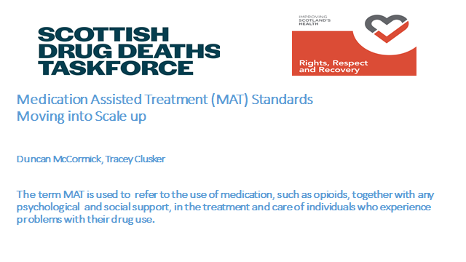

Slide 8
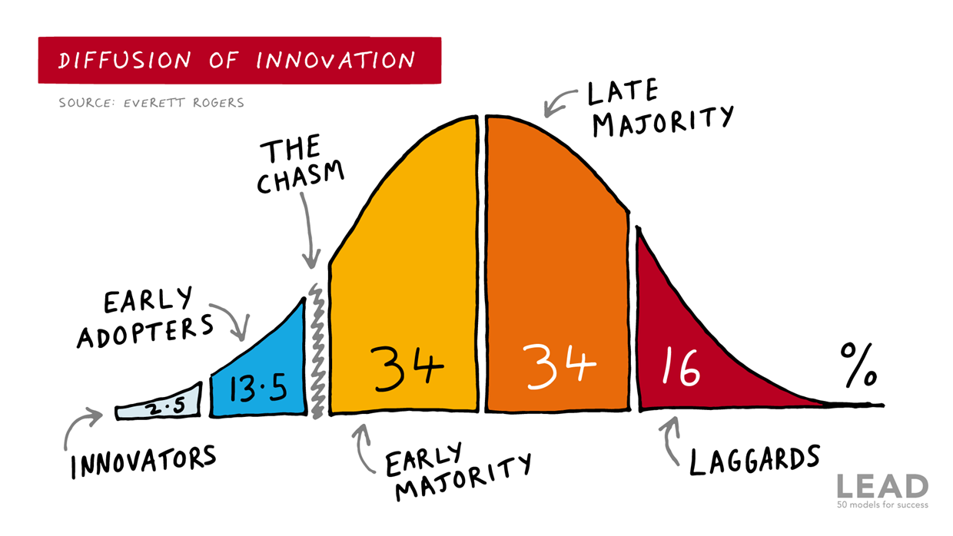

Slide 9
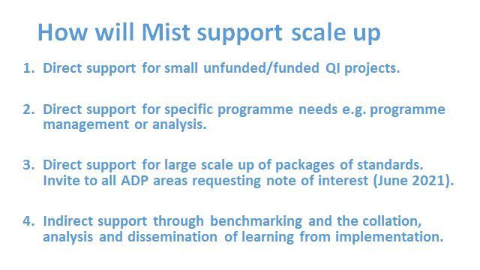

Slide 10
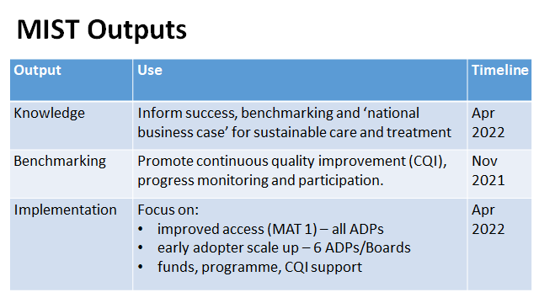

Slide 11
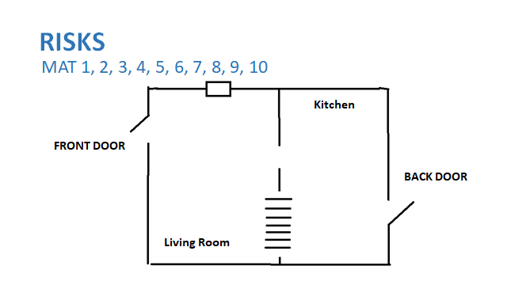

Slide 12
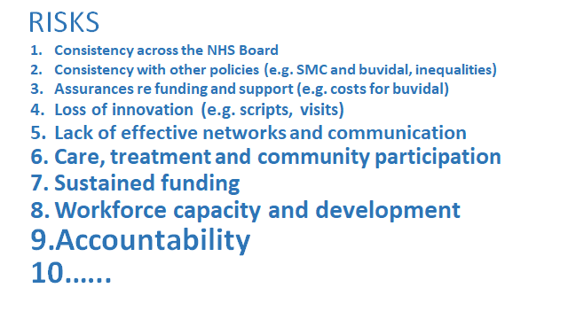

Slide 13
Renewing to Reduce Drug Deaths
David McCartney
Clinical Lead, Lothian’s & Edinburgh Abstinence Programme (LEAP) NHS Lothian

Slide 14
Why is residential rehab important?
MAT standards (principles):
  part of recovery oriented systems of care (ROSC); to support recovery; person-centred – person’s goals at the heart; option of well-planned supported detox with/without residential options.
National Clinical Guidelines (Orange Book)
  ‘important option’. Long established treatment intervention. Suited to higher complexity.
Evidenced in scientific literature including outcome study from Scotland
European norms: 11% vs <5% in Scotland
Drug and alcohol deaths, wider harms, impact on families, communities, costs to society
Lived experience – families and service users want this option: ‘rights’

Slide 15
What are the challenges?
Access to rehab is patchy, significant geographic variations, differing criteria
Funding is difficult to get (impossible in some areas)
Much still to understand – particularly around aftercare
Lack of knowledge & support, blocks, no standardisation
Lived experience:
  Professionals helping/hindering; lived-experience professionals; waiting ++; families; funding; number of ‘tries’; mental health as barrier; having to lie to meet criteria
Need to attract academic interest and develop the evidence base

Slide 16
What’s been done/to be done?
Working group reported last year - recommended
  Map services and pathways, capacity, need and demand
  Equitable access, standardised approach, simple pathways,
  Measure outcomes, develop research
SG Priorities of ↑capacity; improving pathways in and out of rehab – significantly increased resource
Implementing the recommendations – work already started
Consultation with ADPs to develop the work
Consultation with lived experience groups & other stakeholders

Slide 17
Thanks
david.mccartney@nhslothian.scot.nhs.uk

