Slide 1
Health, Wellbeing and COVID-19 – People’s Experiences and Priorities for the Future
Sara Redmond, Director of Development and Improvement, The Health and Social Care Alliance Scotland

Slide 2
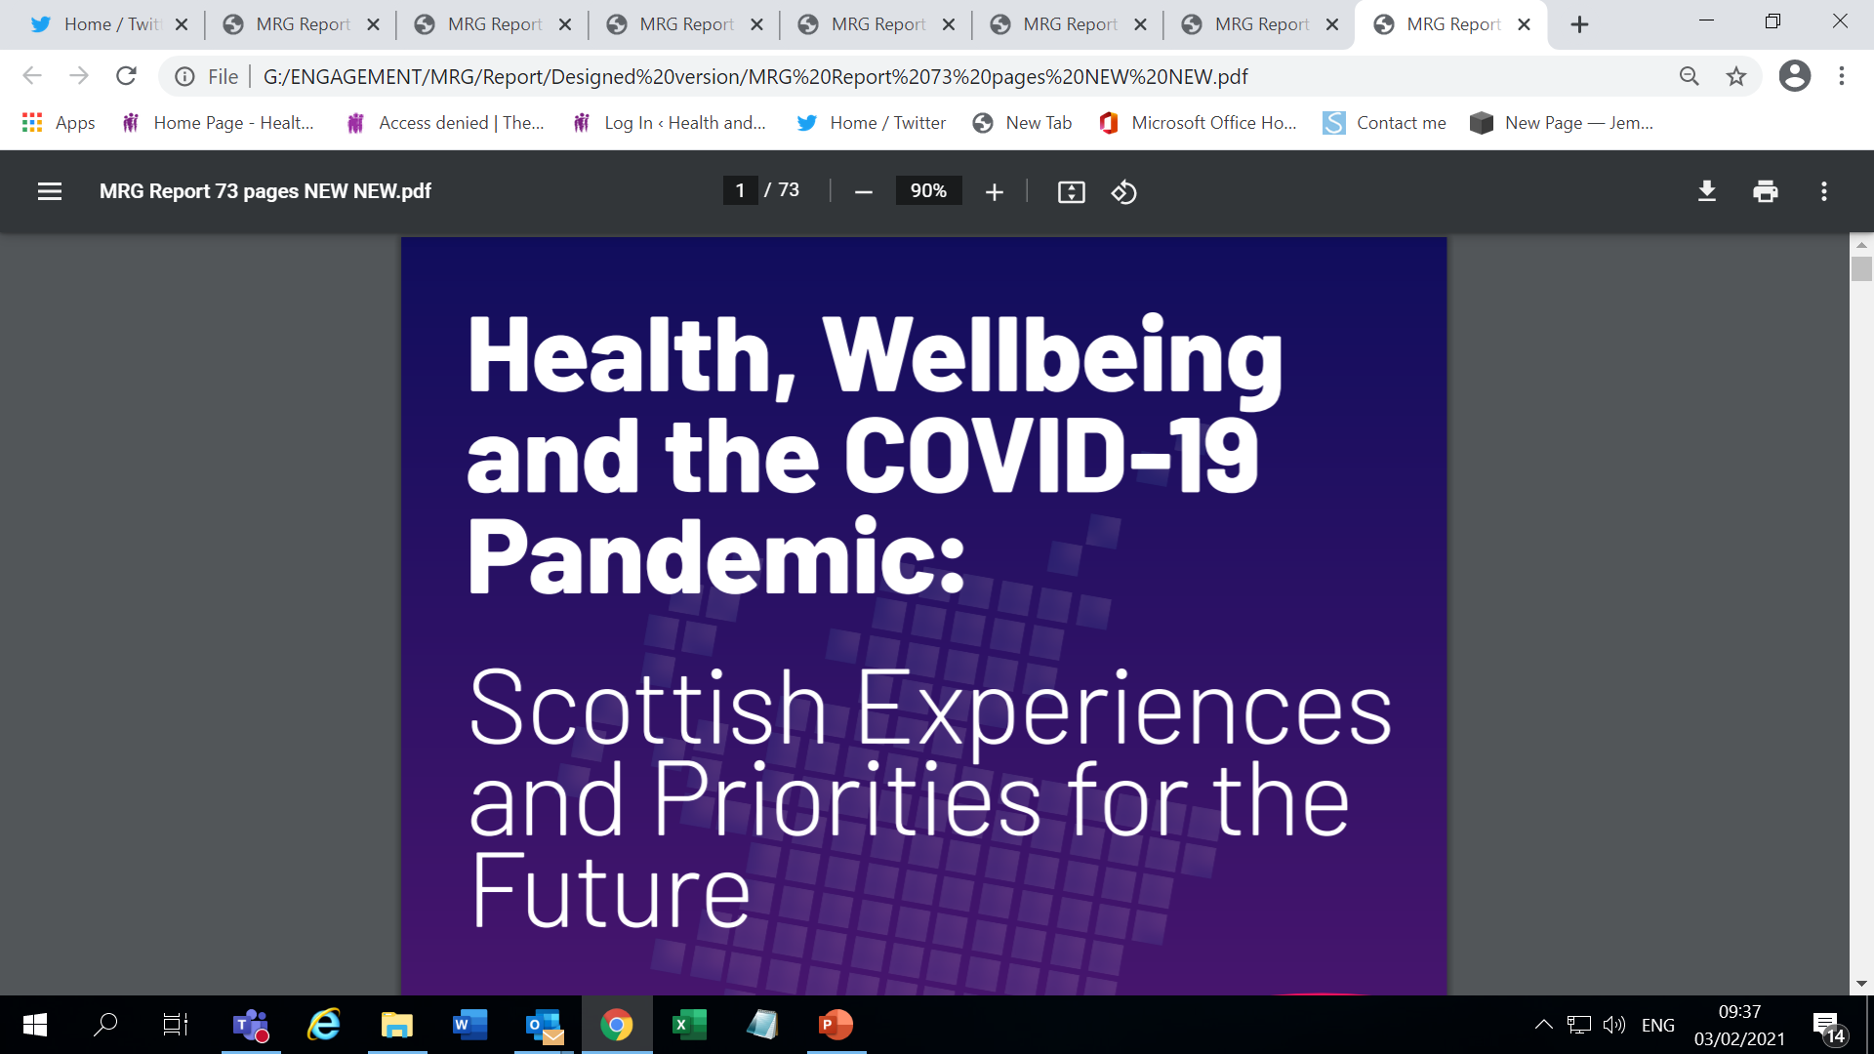
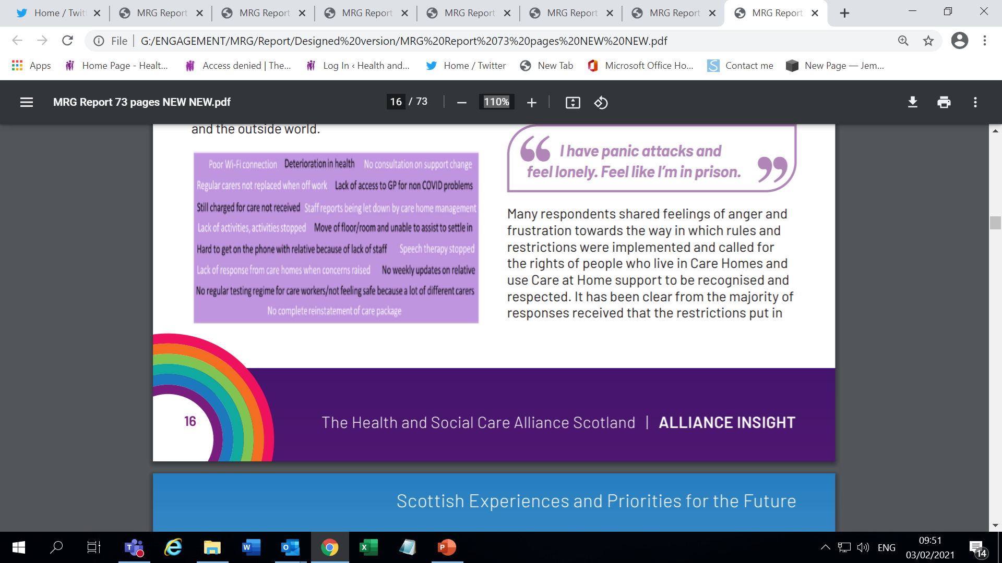
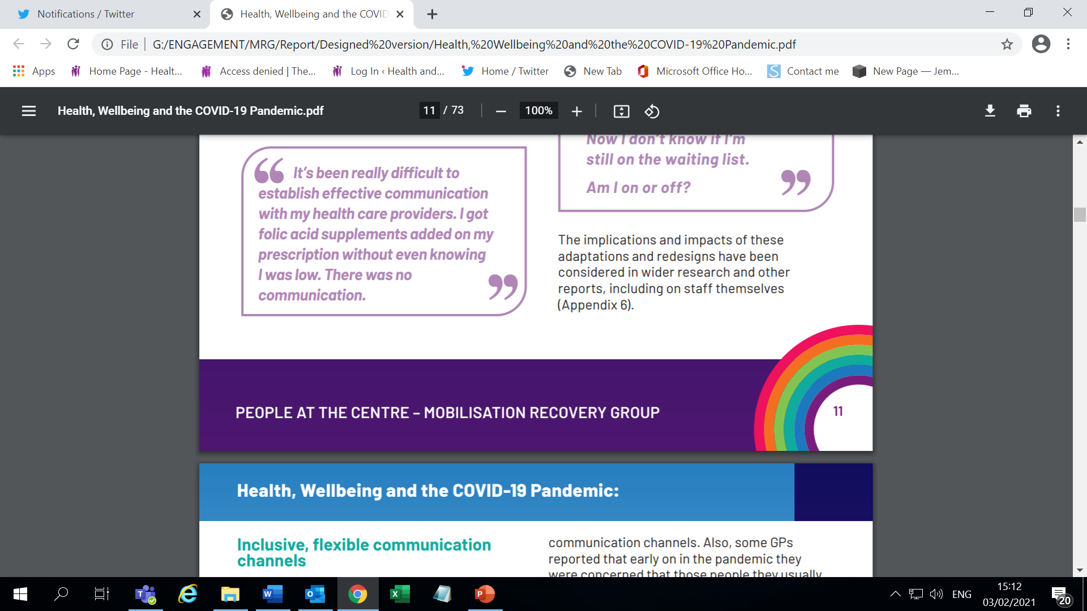
People’s Experiences and Priorities for the Future

Slide 3
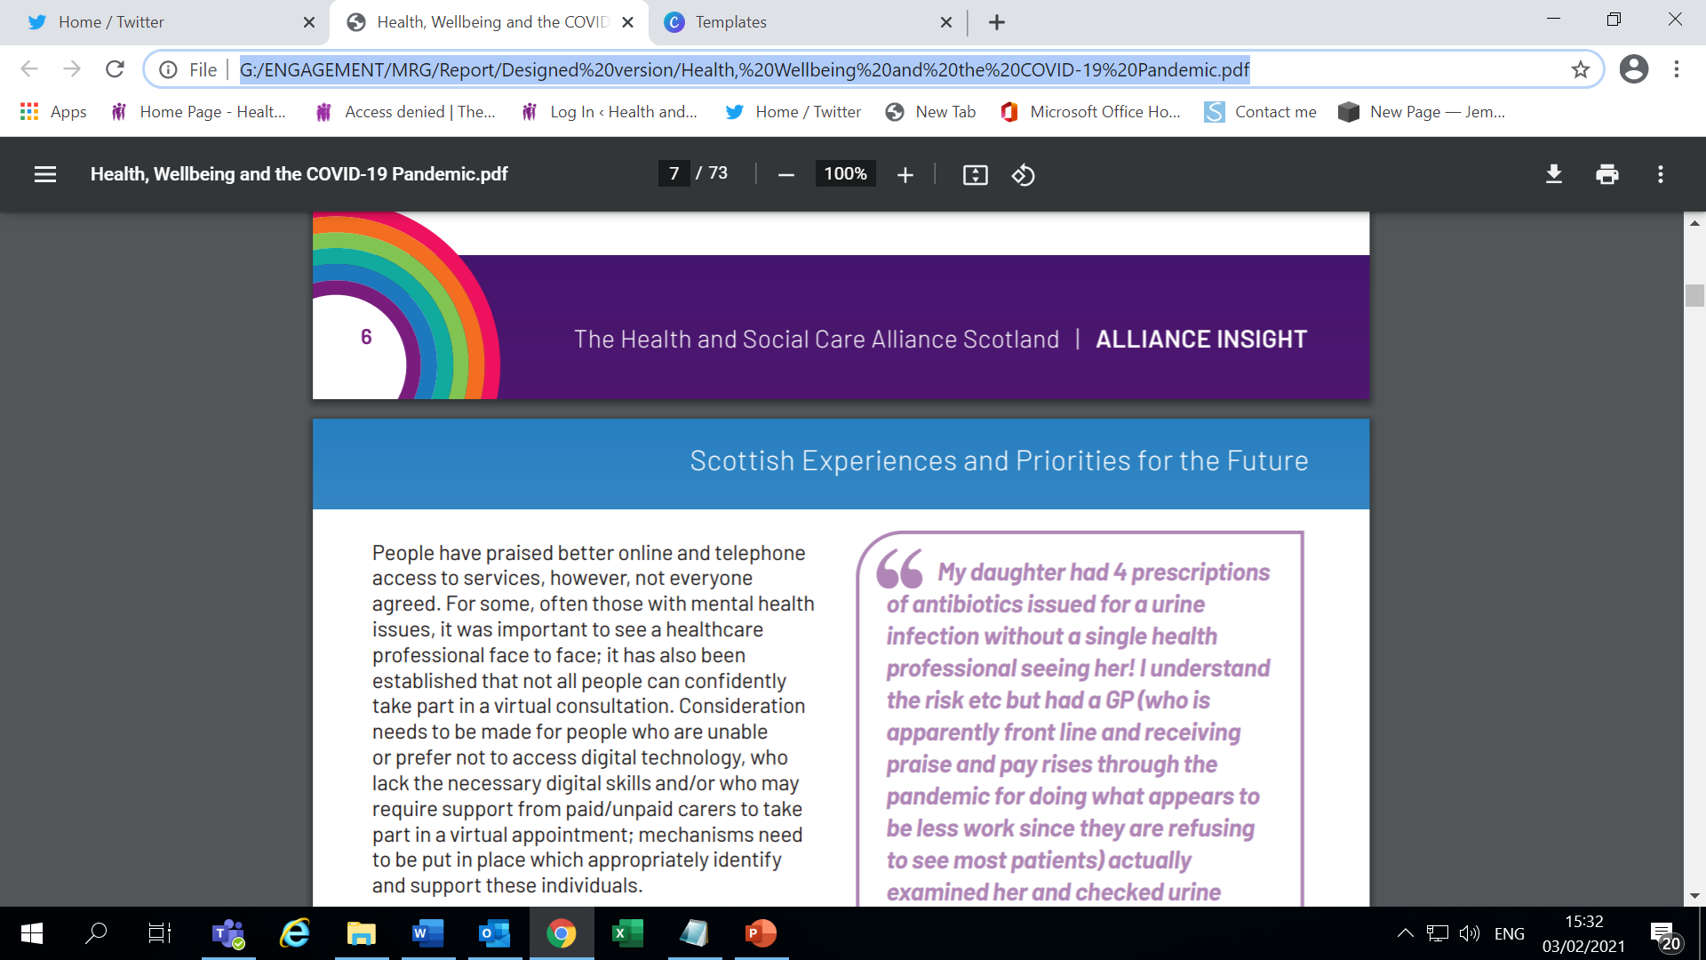
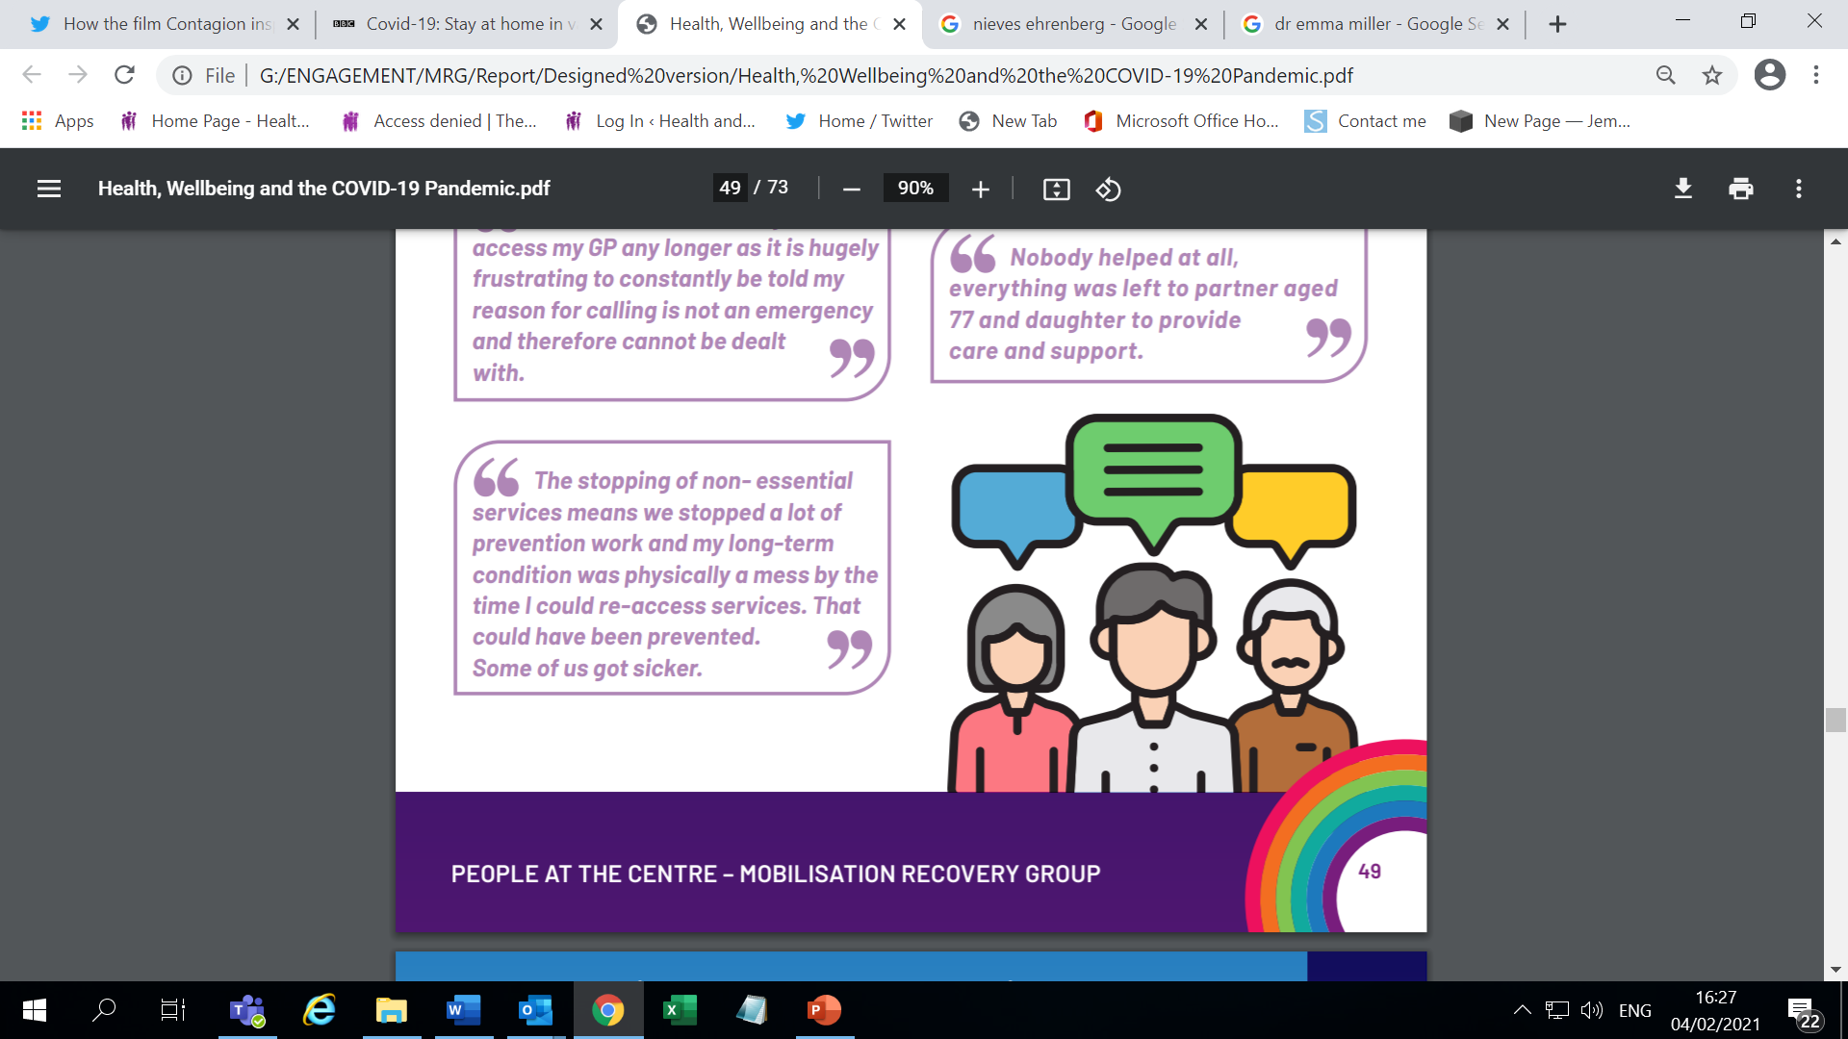

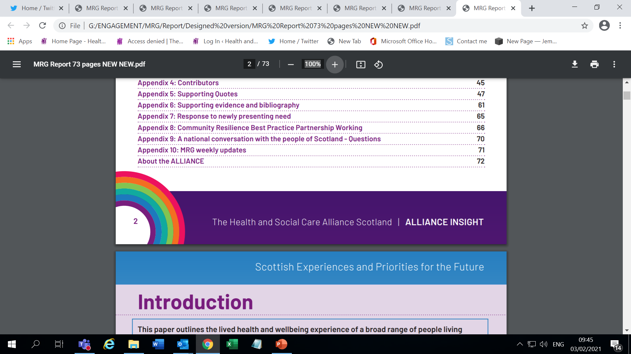
Introduction
The People at the Centre programme of activity was led by the ALLIANCE, in collaboration with delivery partners, to capture insights from people with lived experience to ensure a person-centred focus to remobilisation efforts.
Today:
  Access, communication and person centredness
  Health inequalities
  Good practice and experiences
Georgina Charlton
Georgina.Charlton@alliance-scotland.org.uk
Project Manager – MRG

Slide 4
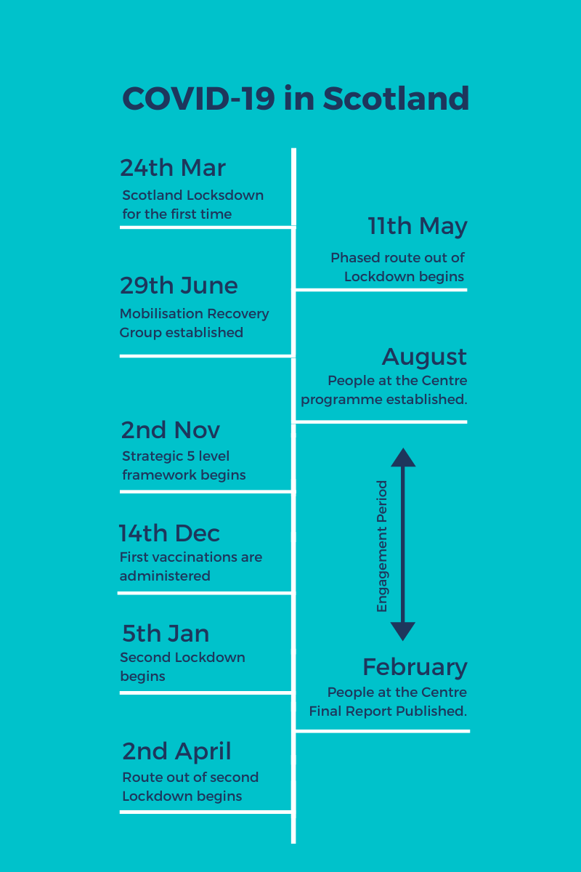
Context
The Mobilisation Recovery Group was established to generate key expert, stakeholder and system-wide input into decisions on resuming and supporting service provision, in the context of the COVID-19 pandemic.
The Cabinet Secretary for Health and Sport invited the ALLIANCE, as a member of MRG, to lead engagement work with people in Scotland and to ensure the voice of live experience was heard.

Slide 5

Approach
To achieve this, the ALLIANCE designed a programme of engagement including:
Facilitating a national conversation on health and care in Scotland
Developing an ALLIANCE member reference group
Creating a living profile of health inequalities challenges and solutions
Capturing community resilience best practice exemplars.
Based on asking:
“What Matters to You?”

Slide 6
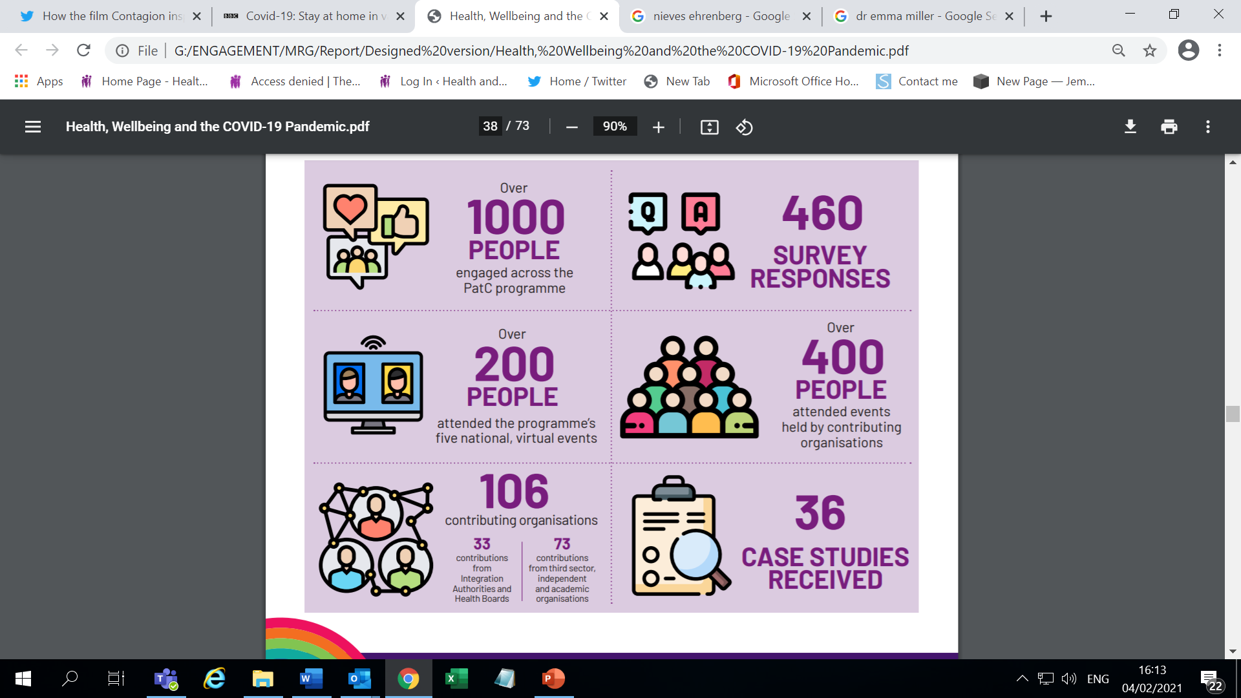
Reach
Qualitative, thematic analysis
Equalities and Human Rights Approach
Engaged virtually, over the telephone, via post and, where in line with guidance, face to face.
Engaged across Scotland’s 32 local authority areas.
Limitations: Time and Physical Distancing

Slide 7
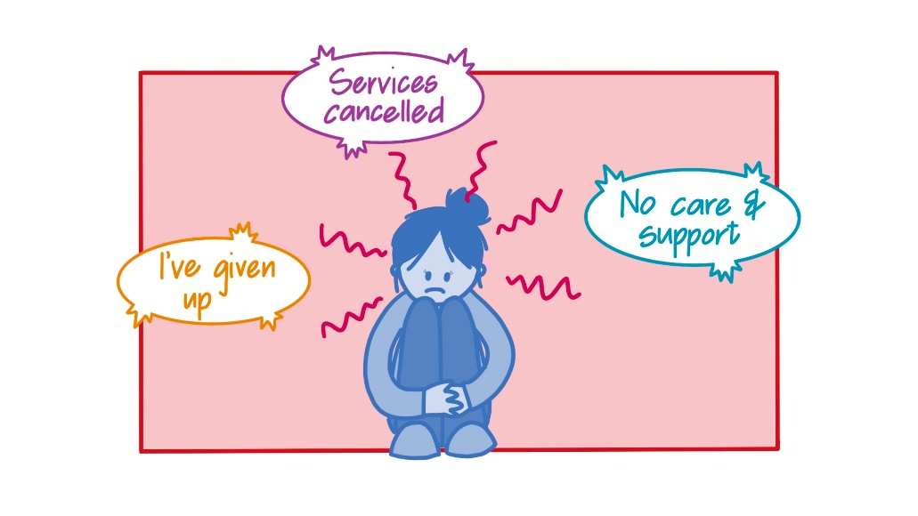
Access
Reduced and disrupted access
The prioritisation of COVID-19 has caused delays and interruptions in care for people with non-COVID needs.
People’s access to services has been varied
Some services, such as pharmacy and urgent care have been commended
Reduced access has resulted in negative implications for people’s health and wellbeing.
This has resulted in a strong emotional response from service users.

Slide 8

Access
The adoption of digital services should continue, but not by default
Enabled people to continue to access health services
The flexibility of these services was welcomed
The ability to see a health professional face to face was still felt to be important
Digital exclusion and digital confidence were highlighted as key concerns for some respondents

Slide 9
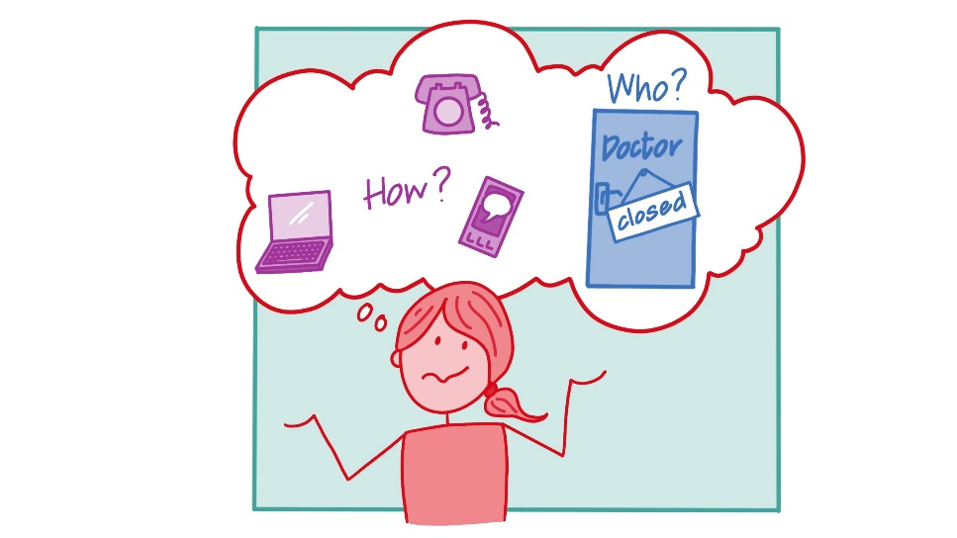
Communication
In some cases, confusing, limited and interrupted communication impeded access to healthcare services.
Information has been perceived as inconsistent, occasionally disjointed
People have been unsure of what is available to them
On-going communication reassures people.
The importance of services adopting flexibility practices
Communication from services must be clear and inclusive

Slide 10
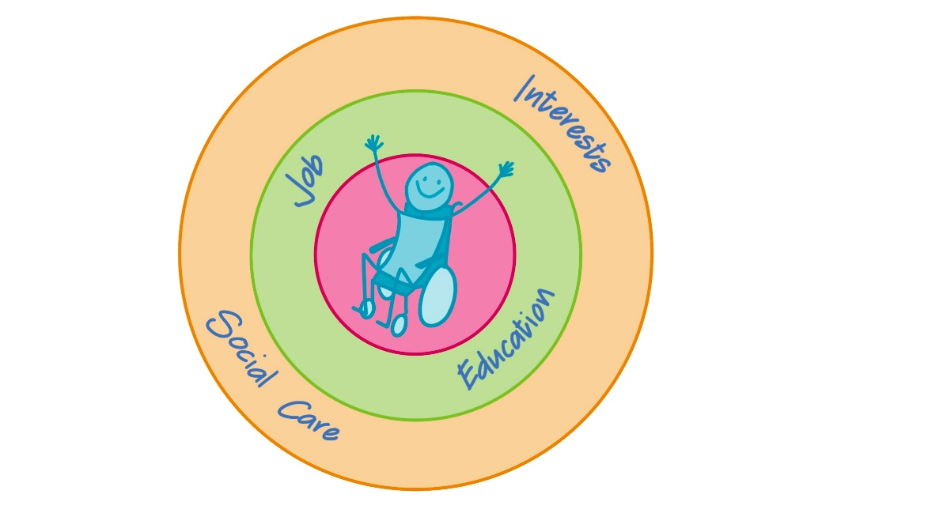
Person Centredness
People value their relationship and connection with healthcare professionals
Importance of continuity of care
The balance of risk during the pandemic
Viewed as a whole person
Flexibility of care provision
The power dynamics of delayed and cancelled care
Holistic, person centred care should be the foundation of healthcare services
People should be empowered partners in decision making

Slide 11
Health, Wellbeing and COVID-19 – People’s Experiences and Priorities for the Future
Janis McDonald, Chief Officer, deafScotland

Slide 12
Deaf Awareness:
Redesign Equality
deafscotland May 2021

Slide 13
What is deafscotland?
Membership based;
Cross sectoral, National and local network reach;
Specific, thematic expertise;
Collaborative approach;
Person Centred, Rights based, Social Model of Disability;
Spectrum of deafness with 4 key pillars;
Impact is on communication
Notes:
How many have hearing loss in Scotland?
1,000,000 plus – 20% of population
Hidden Disability
Culture & attitudinal changes
Inequality, isolation, underestimate the impact

Slide 14
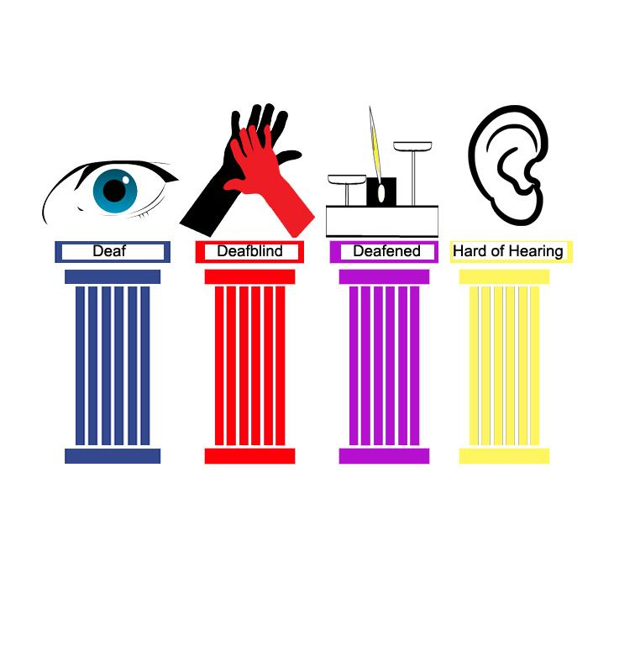
Four Key Pillars-Communication Access
12,500
Language (BSL/other)
4,000
Tactile
355,000
Speech to text
700,000
Hearing Aids, Loops & microphones
Notes:
20% of the population has communication barrier (it’s more than deafness) cannot be ignored. Asked to consider developing services for 20%: 80% will benefit anyway?!
Age related: 40% over forty; 60% over 60 and 90% over 75yrs.
Attainment poor. Children leave school with average reading age 7. Hard of Hearing (mild to moderate deafness) performing less well than those from strong Sign Language background. Indicates mild to moderate bigger problem than currently understood.

Slide 15
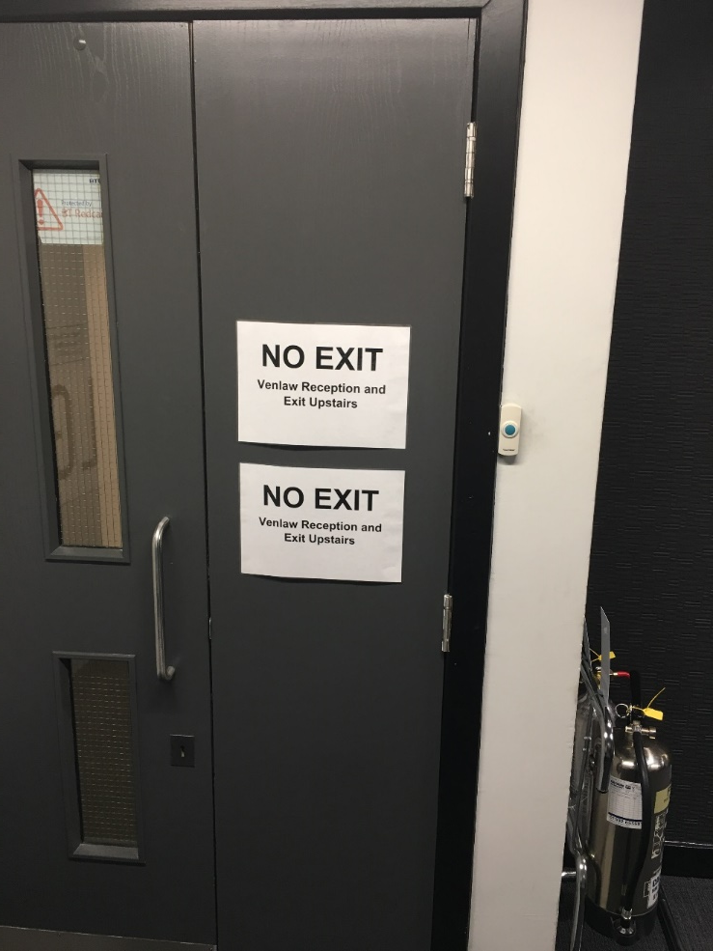
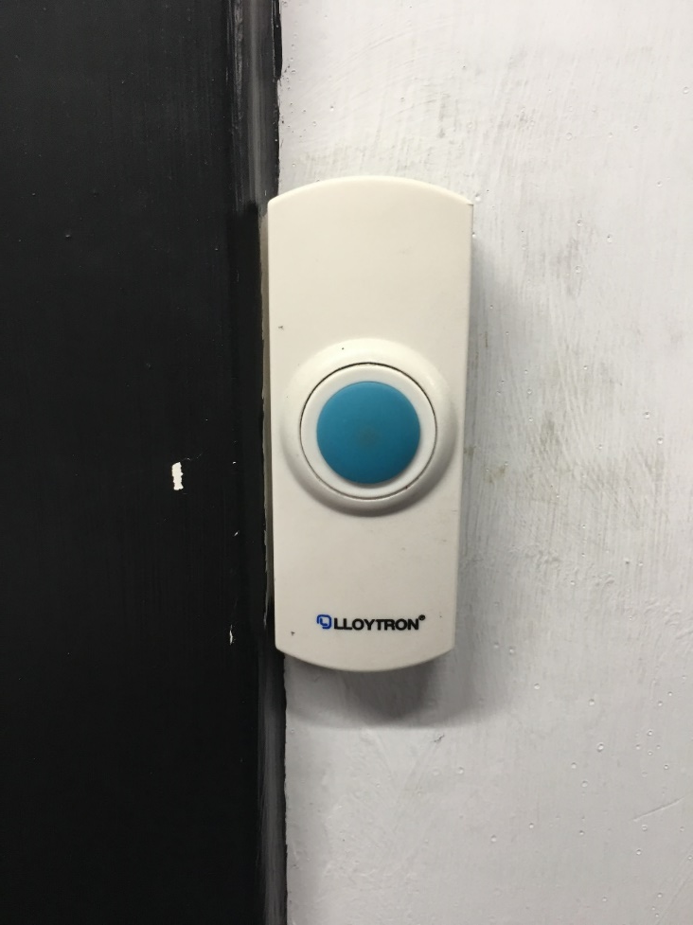
Barriers – Communication Access
Notes:
A little hearing loss is still a big communication barrier!
Daily grind of barriers – needs a range of solutions/dismantling; couple of examples door entry, fire alarms, telephone access (NHS 24!) and white goods in kitchen-beep….. – world is hearing-ist…..discuss!

Slide 16
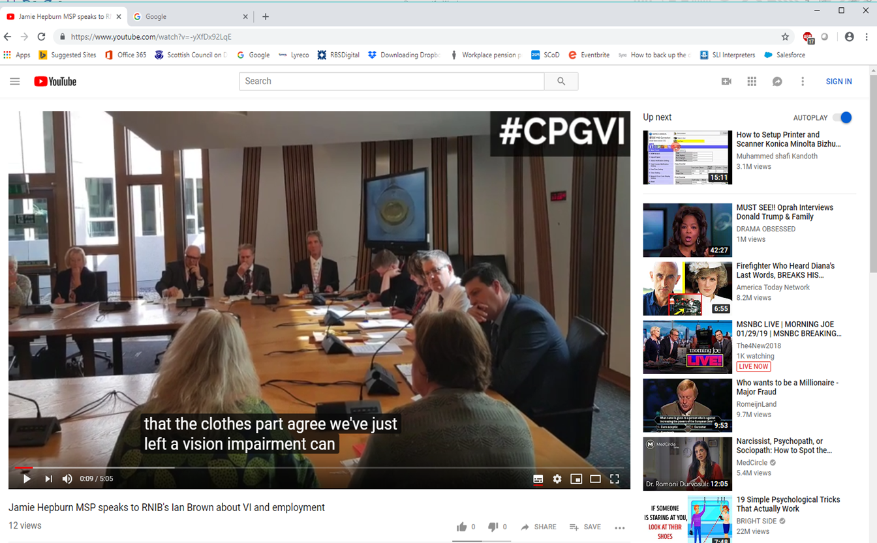
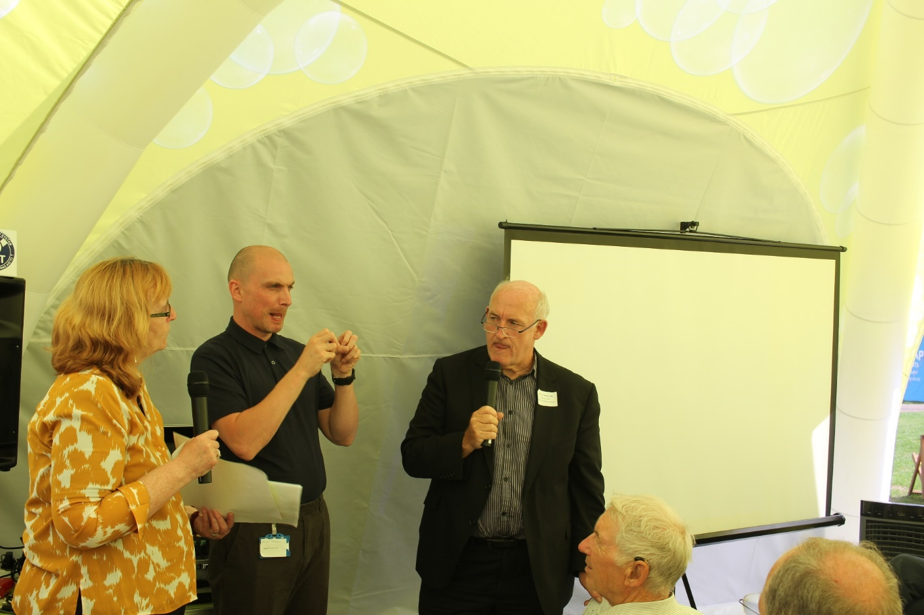
Barriers - Process and Participation
Notes:
Open/closed captions – according to YouTube Minister is talking gobblydaygook!
Technology can make a difference: booking, travelling – apps to phone, purchasing/delivery (theatre tickets & argos examples of access, process and consistency).
Visual example of hearing barrier. Enhancing communication.

Slide 17
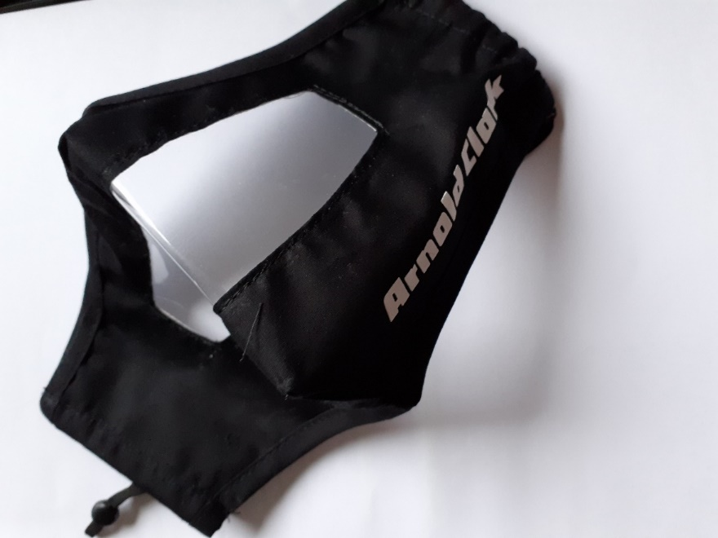
COVID-
Worsens
Existing
Problems
Distancing: hearing aids designed for effectiveness at one metre!
Face Coverings!
Isolation on top of isolation
Communication highlighted
Notes:
Communication Virus
Mitigating actions make it difficult to hear/worsen already challenging problem of significant scale
Range of issues around face coverings
People electing to withdraw as negotiation of exemptions to lower mask almost impossible.
Sensory deprivation is a form of torture yet as a society we really do not take communication solutions seriously

Slide 18
Redesign
Accessible Information - Language & formats:
Inclusive Communication – Dynamic Process that includes people/lived experience;
Investment approach/developing socio-economic benefit
From good intentions to legal requirement
Sharing good practice: digital,
Notes:
So much to do! Need help, champions, consider solutions to help you!!!

Slide 19




You can reach us at...
Telephone: 0141 248 2474
Mobile: 07925 417 338
E-mail: admin@deafscotland.org or chiefofficer@deafscotlsand.org
Address: C/o The ALLIANCE, The Venlaw Building, 349 Bath Street, Glasgow, G2 4AA

Slide 20
Health, Wellbeing and COVID-19 – People’s Experiences and Priorities for the Future
Georgina Charlton, Project Manager, The Health and Social Care Alliance Scotland

Slide 21
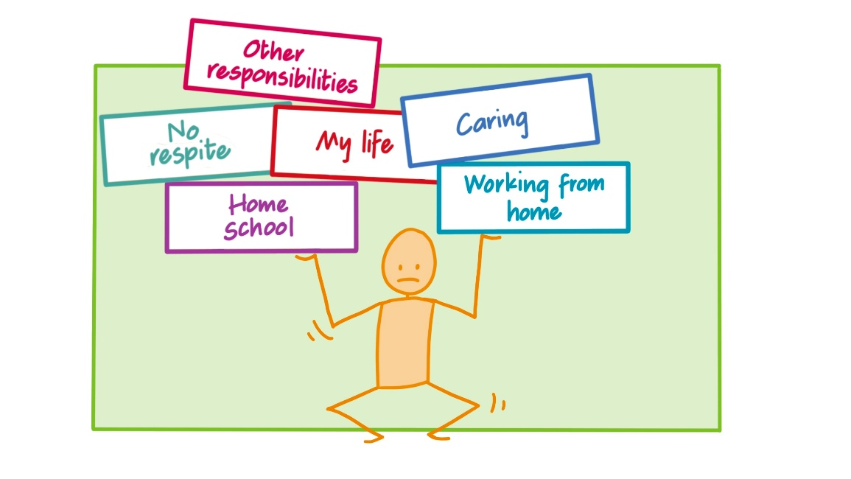
Health Inequalities
Health inequalities have been exacerbated and population groups disproportionately impacted
Access to equitable and consistent care is a priority
People living with long term conditions
Unpaid carers
Maternity and pregnancy
Ethnic minority communities
Care Home residents
Sensory Impaired
Digitally excluded
Wider Impact
Alternative health supports utilised

Slide 22
Links Worker Perspective
HOLD SLIDE – VIDEO 1

Slide 23
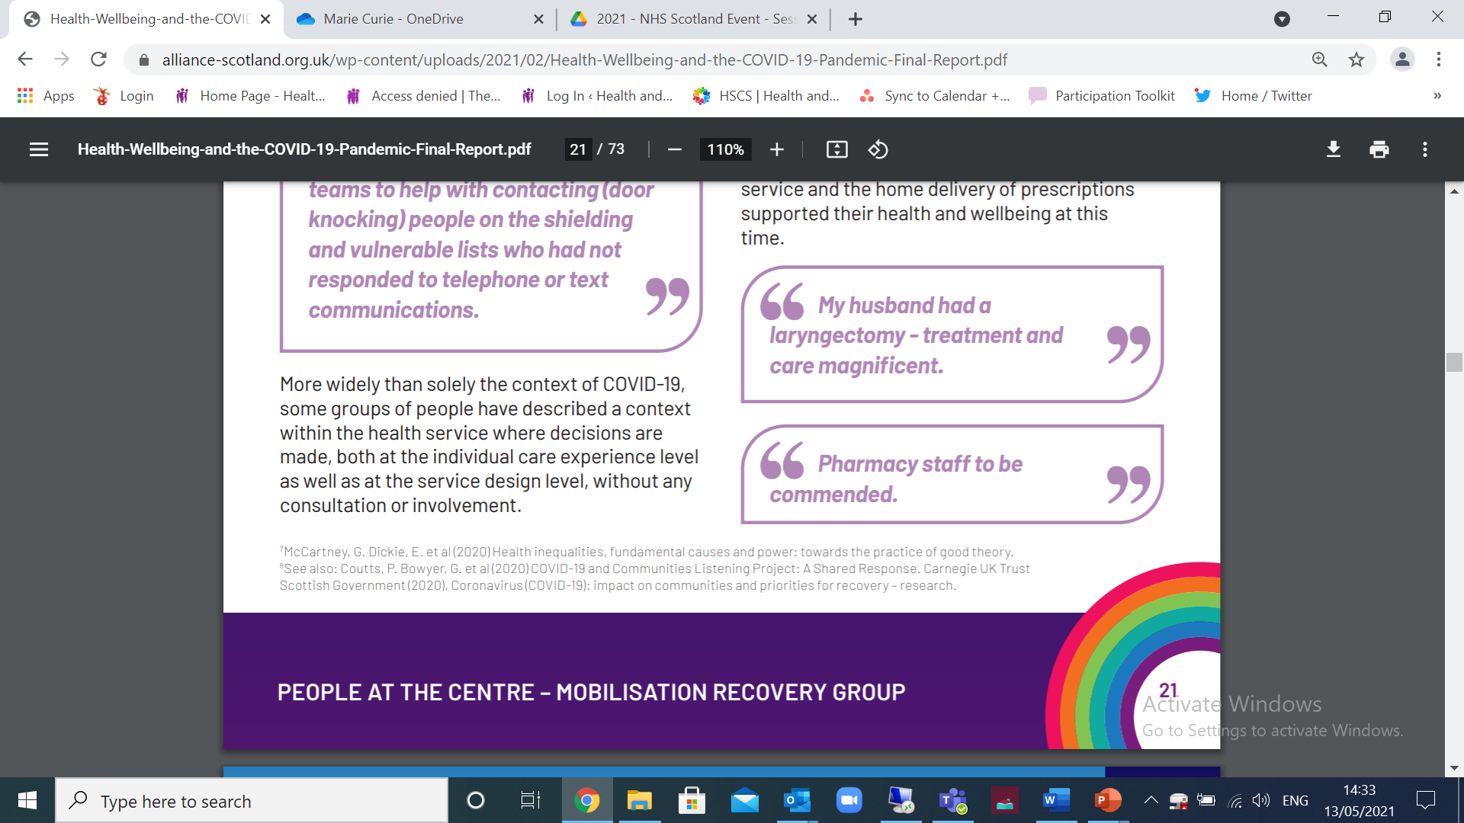
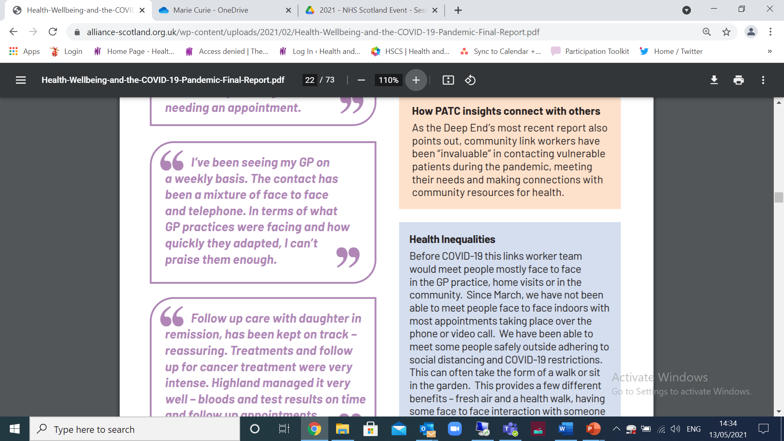
Good Practice & Experiences
“I'd like to pay tribute to our amazing health care workers from the cleaners to the secretaries, to the physios and doctors. They have been incredible.”

Slide 24
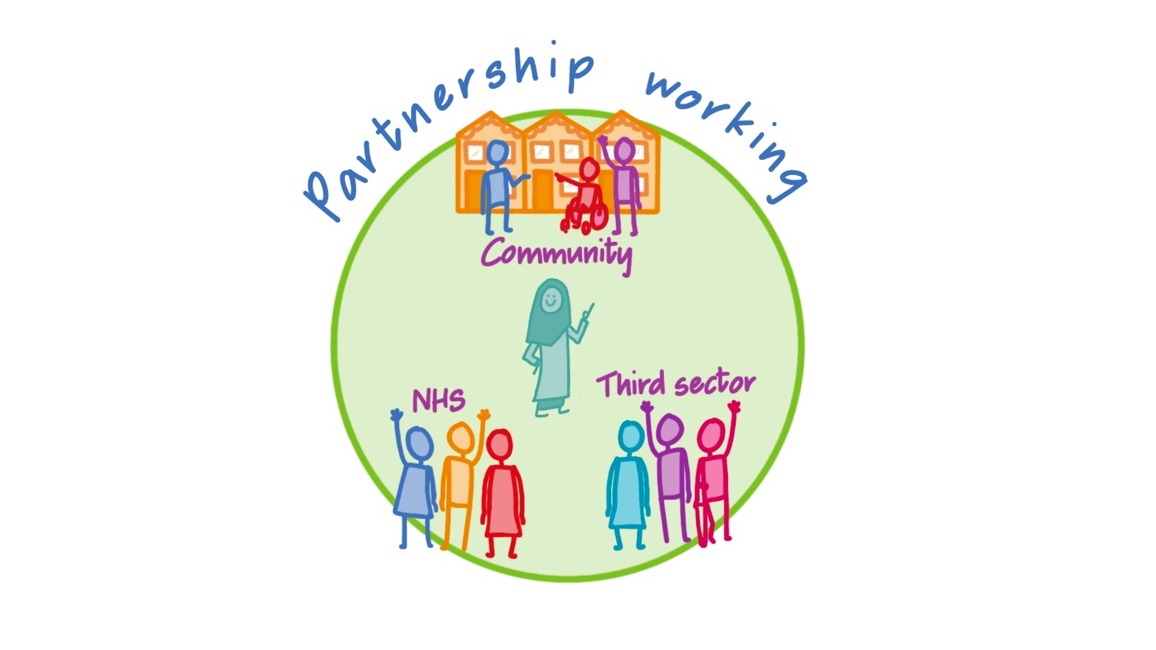
Good Practice & Experiences
Organisations, individuals and communities have worked in partnership to provide innovative, adaptable and effective services
Buffering the impact
Third sector organisations rapidly adapted to the pandemic and bridged the gap
Local communities effectively mobilised to meet local need
Individuals practice self care and supported their own wellbeing
Resource thriving, vibrant, asset based communities

Slide 25
Health, Wellbeing and COVID-19 – People’s Experiences and Priorities for the Future
Dr Libby Ferguson, Medical Director for Scotland, Marie Curie
Libby Milton, Associate Director Strategic Partnerships & Services, Scotland, Marie Curie

Slide 27


“ I feel like I matter ”
Marie Curie Scotland innovations during the pandemic
Libby Ferguson, Marie Curie Medical Director for Scotland
Libby Milton, Associate Director Scotland

Slide 28
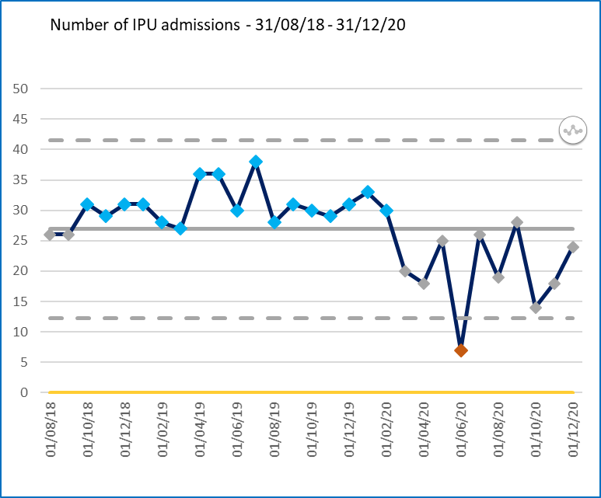
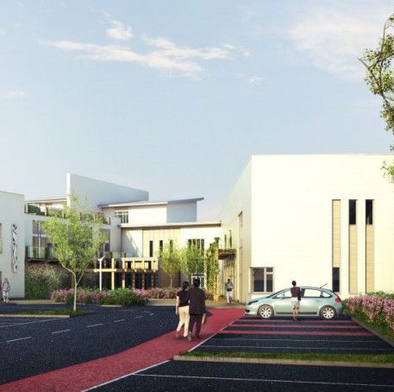
Hospice Virtual Wards/ Hospice at home
  Visiting restrictions meant hospice admission last resort
  Complex unstable patients supported at home
  Daily review doctor/clinical nurse specialist/fast track+/- Marie Curie Nursing service
  7 day service, up to 5 patients
  Close working with district nurses and GP

Slide 29

Increased Community Support
  Rapid response COVID team Lothian : day time and overnight Hospice and Marie Curie nursing service together
  Specialty doctor assigned to support community hospital COVID ward
  Developing and supporting primary care team implementation of COVID guidelines
  Support for care homes including seconding senior nurse to care home team
      Glasgow Outpatients delivered by phone, video or face to face home visit
      Increased medical domiciliary visits (85 first 3 months of lockdown)
      Webinars for HSCP residential homes around end of life care
      COVID symptom control webinars for primary care
  Both hospices issued with prescription pads and medical bags with supply of anticipatory medication

Slide 30
Virtual Support
Day therapy one to one and group/ facebook live streams
Medical outpatients and nurse led clinics
Family meetings
Bereavement support/ Children’s bereavement group

Slide 31
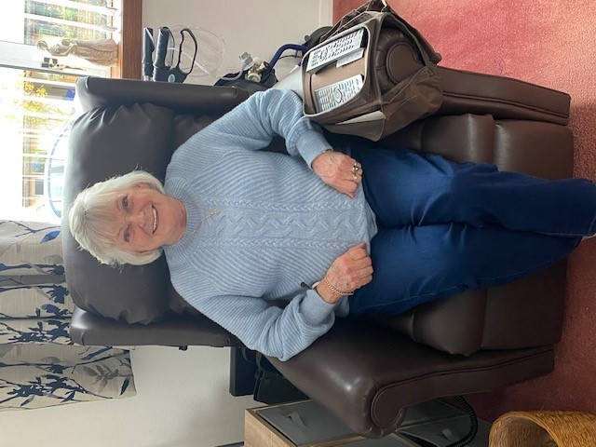
Shirley
“ It’s a lifesaver – keeps me in touch and helps me stay sane”

Slide 32
HOLD SLIDE – VIDEO 2

Slide 33
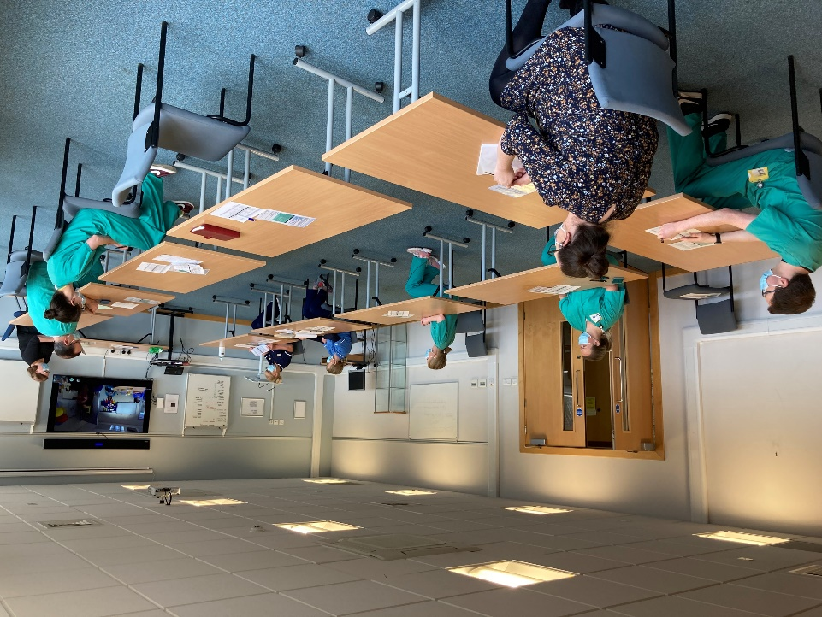
Sustained Innovations
Glasgow Community Hub
Daily morning meeting with hospice, community pall care, HPCT, fast track, DN and care home liaison dialling in
Communication around patients in each setting, admissions and discharges, care home outbreaks also staffing and PPE issues
Edinburgh-ongoing medical support for community palliative care team, virtual day therapy widening access
Strengthened relationships- weekly virtual call HSCP, PPW, ACP lead, Geriatrician and Respiratory physicians now monthly, monthly palliative care meeting in Lothian with all Health and Social care teams
Care Home Team Secondment charge nurse from inpatient unit now a substantive post

Slide 34
Challenging Assumptions
More resource in community supported more deaths at home, is this where we should concentrate our efforts? What was the impact on patients and families?
Virtual technology is very successful in certain circumstances but face to face consultations remain essential for complex problems and those who are unable to access remote consultations
Understanding of COVID symptomatology and outcomes for those with advanced disease

Slide 35

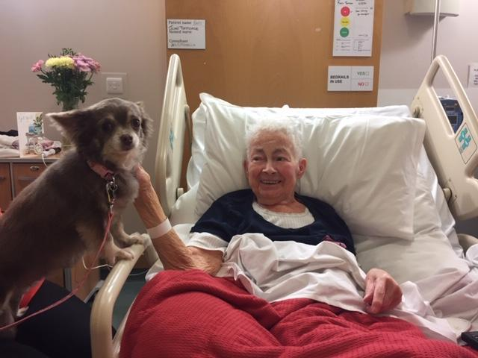
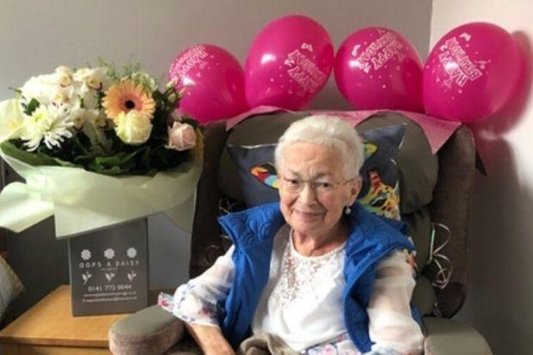
Bishopbriggs great-grandmother with terminal cancer celebrates 81st after beating Covid-19

Slide 36
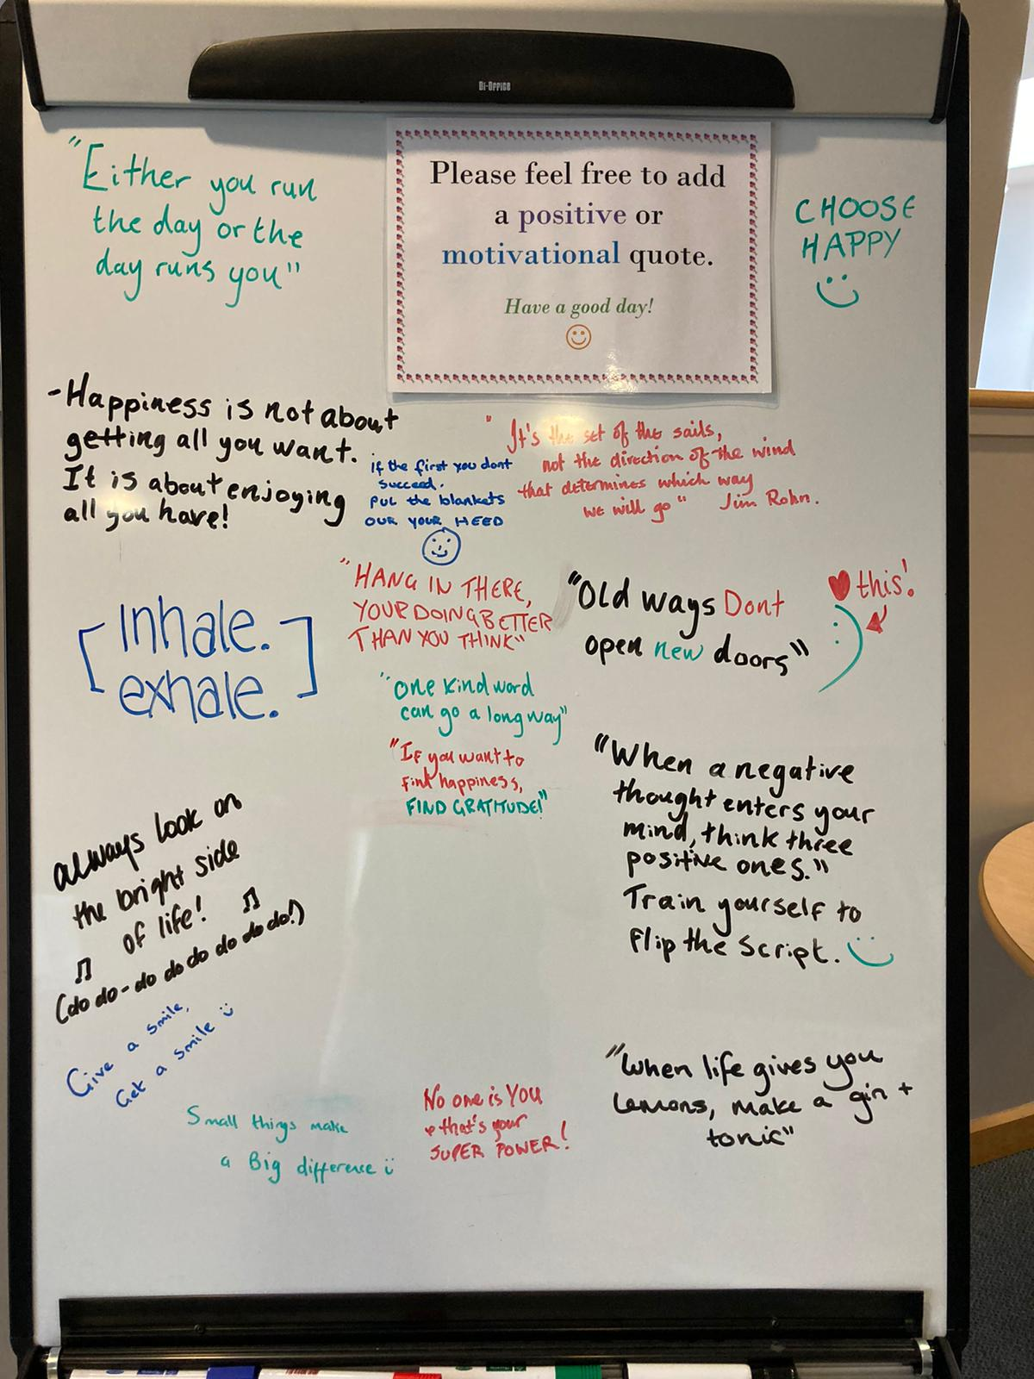

Slide 37
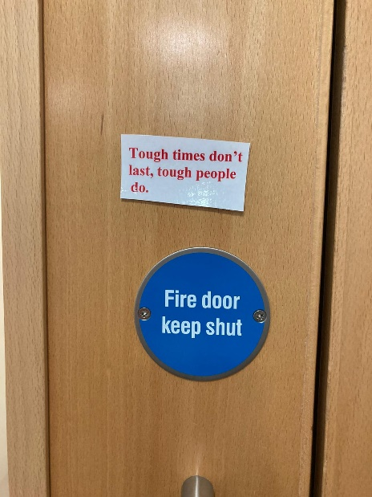
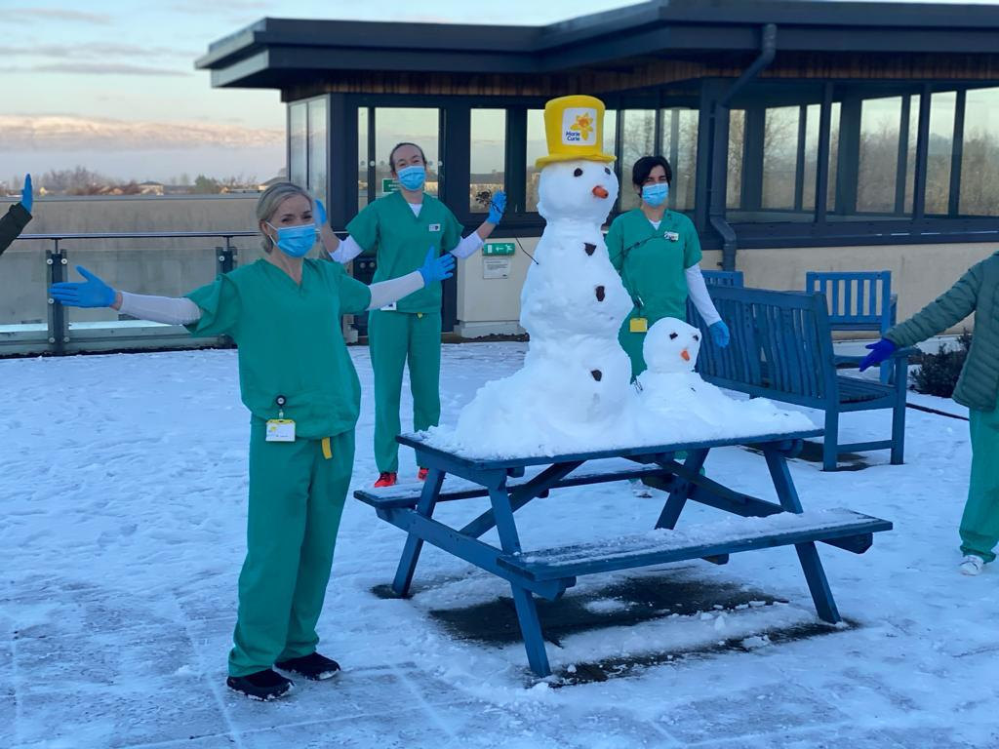
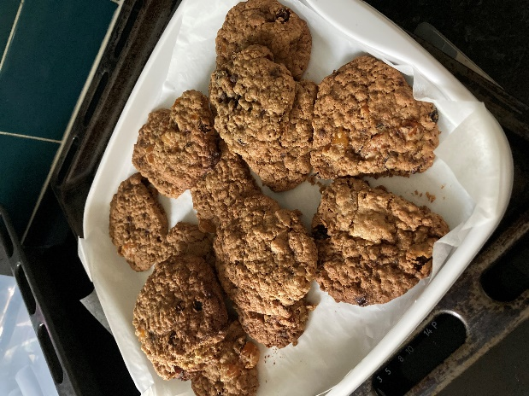

Slide 38
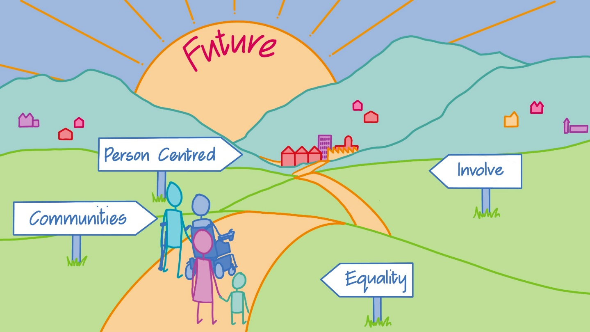
Thank You
The Full Report “Health, Wellbeing and the COVID-19 Pandemic: Scottish Experiences and Priorities for the Future” is available on The Health and Social Care Alliance Scotland’s website.

Slide 39

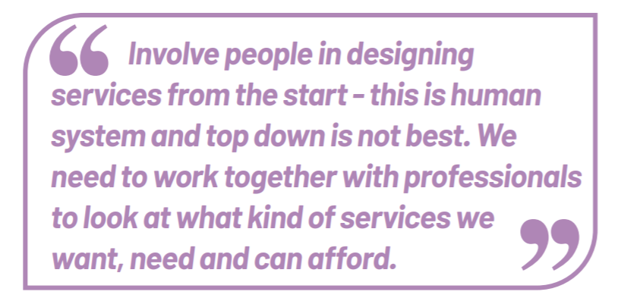
Close

Slide 40
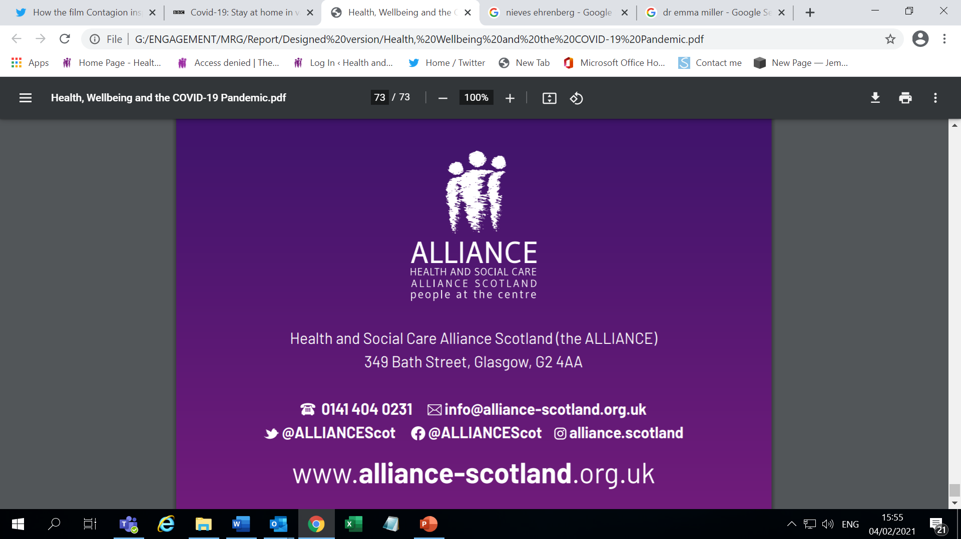

Thank You

