Slide 1
Sustainable Transformation
‘Bringing it Together’
Susan Donaldson, Programme Manager, Scottish Access Collaborative, Centre for Sustainable Delivery, Golden Jubilee National Hospital

Slide 2


Juliette Murray
Clinical Lead, Scottish Access Collaborative
Deputy Medical Director, NHS Forth Valley

Slide 3
What will success look like?
Effective and efficient interfaces between primary and secondary care
Demand and capacity are in balance
Clinical pathways personalised but no unwarranted variation
Funding primarily directed to long term transformation rather than short term activities

Slide 4
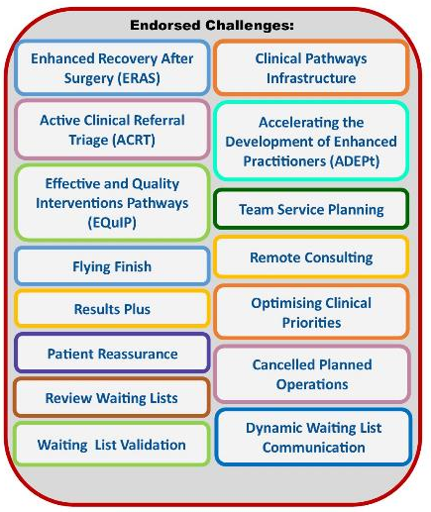
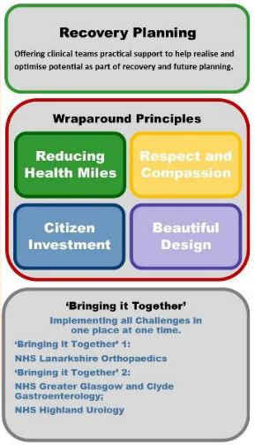
Current programme work plan
Specialty groups
Cardiology
Gynaecology
Urology
Respiratory
ENT
Chronic Pain
Gastroenterology
Neurology
General Surgery
Dermatology
Vascular
Breast Surgery
(Orthopaedics)
(Ophthalmology)

Slide 5

Reducing demand
ACRT Enhanced Vetting
PIR/ PLFU
Clinical Waiting List Validation
Virtual Attendance
EQuIP
Results Plus
Review waiting lists

Slide 6

Increasing capacity
Role extension
ADEPt
Team Service Planning
ERAS
Flying Finish
Cancelled Planned Operations
Optimising clinical priorities

Slide 7
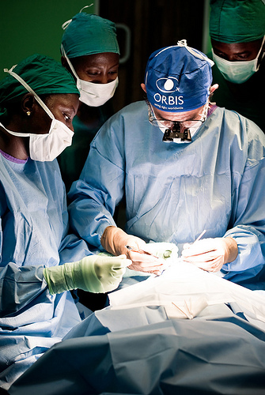
Engagement of whole team in different areas of work
Set new goals throughout project
Work streams run in parallel
Codesign of pathways with primary care
Admin component crucial to success
Break service down into components
Work with access team and understand data

Slide 8

Key Points
Clinical ownership of project
Autonomy in setting goals and measuring progress
Simple clinically driven approach
Incremental gains
Approach can be customised
Service development structure
Share learning with other teams

Slide 9
Mr Alastair Murray
Trauma & Orthopaedics Clinical Director, NHS Lanarkshire
David Murray
Acting Trauma & Orthopaedics Service Manager, NHS Lanarkshire

Slide 10
Bringing it Together in NHS Lanarkshire
The Bringing it Together (BIT) project took all of the Access Collaborative’s endorsed challenges and systematically implemented these into the Orthopaedic department in NHSL aiming to:
    · Balance demand and capacity across the service
    · Shorten waiting times for clinic appointments and surgery
    · Reduce time spent in hospital before and after surgery
    · Deliver more consistent pathways and outcomes for patients
    · Improve recruitment, retention and resilience of clinical workforce
    · Reduce patient visits to hospital that don’t add value
    · Improve team working and morale

Slide 11
Bringing it Together in NHS Lanarkshire
NHSL Monthly Outpatient Position
Number waiting over 84 days

Slide 12
Where to start?
Engage the whole team
Know your baseline
Big wins early – don’t reinvent the wheel
Easier problems first
Build momentum

Slide 13
How to make it Sustainable
Grow the team
Ownership
Collect useful data in a sustainable way
Share the success
Repeat the cycle – learn and review earlier successes

Slide 14
Highlights
No patients waiting more than 12 weeks for OP appt despite pandemic.
Total waiting list reduced from 2608 patients in March 20 to 641.
50% reduction in median length of stay for Hip and 40% for Knee Arthroplasty.
Staff across service working at top of license, improved recruitment/ retention.
Service has adapted to new challenges and triumvirate leadership team engaged in all aspects of service redesign.

Slide 15
Some next steps
Continue to increase theatre productivity with same day arthroplasty & 4 joint lists.
Move LA surgery from theatre environment to OP/ procedure room setting.
Cross Board collaboration to reduce waiting times for surgery/ improve skill mix.
Development of a digitally enabled model for optimising referral management.
Further extension of non-medical roles.
EQuIP pathways : Sub-acromial Decompression (SAD) surgery, arthroscopy in >50yrs
Team Service Planning to optimise flexible use of staff and footprint.

Slide 16
NHS Highland and Bringing it Together
Derick MacRae
Cancer Services Manager, NHS Highland
Elspeth Harrison
Deputy Cancer Services Manager, NHS Highland

Slide 17
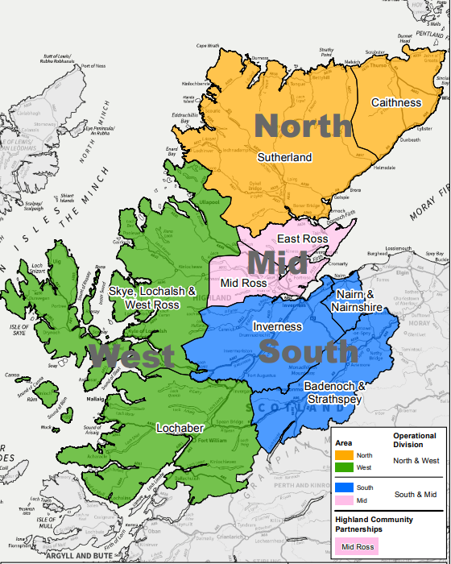
Bringing it Together in NHS Highland
The Six Principles of the Scottish Access Collaborative:
Patients should not be asked to travel unless there is a clear clinical benefit, and that any changes should not increase the workload for primary, secondary or social care in an unplanned/unresourced way.
All referrals should either be vetted by a consultant/senior decision maker or processed via a system wide agreed pathway.
Referral pathways (including self-management) should be clear and published for all to see
Each hospital and referral system should have a joint and clear understanding of demand and capacity
Each local system should have a clear understanding of access to diagnostics as part of pathway management
Improved and published metrics including how we record and measure virtual/ tele-health / tech-enabled care
Notes:
Present on how the principles and challenges developed by the Access Collaborative can be applied successfully within a broad range of health and social care services.
Principles underpin workflows of the SAC.
- Will briefly cover where and why we have implemented it.
Gathering interest from other specialties and at a board level.
How and why SAC can successfully be applied across the Board in various specialties
Principles apply equitably to rural and urban areas for the benefit of all patients.

Slide 18

The beginning: Urology, May 2020
Key specialty
Impact on NHS Highland Cancer Waiting Times
Understaffed consultant cohort
Recruitment struggles
Long waits for new and return patients
Redesign of service needed
Development of staff needed
Need to ensure sustainable service
Notes:
- May 2020, started SAC journey in Urology.
Key Specialty
High impact on Cancer Waiting Times Standards. Pre covid, cancer and benign patients represented a 50/50 cohort split. May 2020 was 80/20, with a greater number of cancer patients moving through the Urology service than ever before due to age profile of Highland population. Other reasons??
Understaffing. Urology, and Highland in particular, historically struggled with recruitment. Not changing. Need to do something different.
Long waits in service: lack of staff and inefficiencies of batching/bagginess
A redesign of the whole service needed, staff development essential.
Need to develop a sustainable service for Highland patients.
- Another motivator was timing right; supportive clinical lead, staff realising a new approach needed, and the SAC support, funding and skills available to add framework and objectivity to the project.

Slide 19

Successes… so far!
CNS role development and capacity impacts (ADEPt)
Demand/capacity gaps and solutions identified
Pathway and physical changes: HUC
Patients contact
NearMe attendance sits at 24% (vs 6% for Surg. Div.)
Waiting List Validation success and embedded
Urology Clinical Forum
Automated patient contact
Clinical dialogue
Notes:
Overview:
ADEPT workflow - develop the CNS role, particularly in terms of their contribution to the prostate pathway. This has had huge impacts on timely delivery, and we have moved from 21 plus days from referral to clinic to seven to ten days. In terms of actual activity and development, the specialist nurse has taken on prostate pathway to DTT and nurse cystoscopoy of new and returns, bladder: work previously domain of consultants
We have reviewed our demand and capacity and the gaps therein in detail and, through the SAC workstreams, have identified various solutions and more efficient/effective ways of running the service.
Some of the solutions revolve around changes to the patient pathway. The major achievement with regards to this is that we have redesigned the urology patient pathway to make it close to a one stop service. Akin to this pathway change is the physical building development of our new HUC, which starts seeing patients this today and will house the Urology service.
The SAC has encouraged us to look at new methods of patient contact and using technology to increase efficiency. NearMe has for example been vital to the running of Urology, particularly over the last year. The use of NearMe is particularly beneficial to patients who live in our more remote regions, and we have had clinics running vitually on oil rigs, campers, WI, etc. We have a high rate of use (24% compared with 6% for rest of surgical division).
Other methods of patient contact being identified to free up nurse time; e.g. Patient portal for PSA results.
WL Validation has been particularly successful: 10% of patients removed – clinical and admin validation. This is now beginning to embed as a work stream regularly within urology, but also across other surgical specialties.
Urology Clinical Forum: Spearheaded implementation of revised pathway. Fully implemented in NHSH.
- Clinical dialogue has reduced email and phonecall traffic for consultants, and they are all now fully engaged and impressed with the system.

Slide 20

Catalyst for change
Tangible outputs
Areas of achievement recognised formally
Promotion: visual and word of mouth
Additional service impact
Notes:
The successes just heard about are foundation for change.
Why? The outputs from each of the SAC work streams are tangible; you can see the HUC and the improvements on waiting times lists.
We can document and present on these improvement in forums like this, but also internally within NHS Highland as a board.
And we do make every effort to discuss SAC work in appropriate settings.
The last point here alludes to the impact that Urology have had on other services by pushing the agenda of the SAC. For example, developing the HUC has displaced a number of other services who we have had to find homes for. We have also had a direct impact on endoscopy and decontamination who are necessary to support Urology scoping services. This is something that we need to be mindful of when implementing the SAC, but it is also an excellent justification for rolling out SAC more widely.

Slide 21
Board-wide service application
Work streams applicable to any and every specialty
Framework for improvements already in progress
Framework and supporting network for new improvements
Encourages measurable/tangible outcomes
Promotes engagement from all stakeholders
Positive stakeholder response
Simultaneous identification and analysis of all areas of service delivery
Notes:
We feel that the SAC workstreams can be applied to any specialty across the Board, and that the SAC principles apply equitably across all boards. For example whether a patient lives in a cottage on the western isles or inner city Glasgow, neither should have to travel more than is necessary for an appointment which may no longer be required.
We have delivered the SAC in Urology presentation to numerous colleagues (clinical and managerial) from a variety of specialties. All have been interested.
For example, we are planning to undertake the SAC process within Haematology. This specialty is incredibly different from Urology, but the SAC tool is applicable, and the service needs a structure and starting point for change.
We have even had our Planning and Performance representative take some SAC workflows back to his team, who do not deal in any way with patient care directly; but the principles still apply.
In some specialties the SAC work streams are already being undertaken; ACRT, Adept, and Team Service Planning. However, these are happening in a disorganised and disparate manner. The framework of the SAC ensures that work streams are prioritised, time and energy is dedicated to them and that they are undertaken in a logical and tangible manner, bringing them together to create complete service review.
The SAC also gives users a network, some in other boards, some clinical, some managerial, some direct from the SAC. All of these groups provide vital advice, collaboration and support. This is invaluable and adds not only insight and knowledge, but also an energy and momentum to the projects/programmes.
A benefit of the SAC and one which should be remembered for board wide application is that it promotes engagement from all stakeholders: Clinicians to nursing teams to senior management to admin staff all have to come together to achieve the SAC workflows. Their interaction towards a common aim has developed their knowledge of their services, department and the teams they work with but may not have direct insight into. For example, our consultants now have a much better understanding of admin processes, and the admin team better understand the pressures on the nursing team.
All stakeholders who have engaged with the SAC in Urology have commented very positively on its approach and successes. It does take time, but it does give results.

Slide 22

Board / Specialty Wide Use
Horizontal implementation
(Specialty by Specialty)
Vertical
(Work stream by Work stream)
Notes:
The SAC ensures that all issues to service delivery are identified and analysed simultaneous. Bringing it together ensures that one development cannot negatively impact on another. Doing this on a board wide remit would assist with the negative service impact previously mentioned, particularly in light of the alterations to service delivery resulting from remobilisation.
So how do we roll it out to the rest of the board?
Practically the tangible results need publicised. E.g. Surgical remobilisation group, Performance Recovery Board, Quality and Patient Safelty meetings, etc.
Roll out:
- Horizontally: Specialty by specialty.
Vertically: Workstream by workstream.
We feel that horazontally has worked well for us in Urology. Many of the workstreams are interlinked and overlap. Working through them as a specialty in our own time has allowed work streams to flow and progress naturally and gave a certain momentum.

Slide 23

Things we have learned
Dedicated time essential (Clinical and Managerial)
Clinical involvement essential
IT, QIT and Planning and Performance support
Other Service impact
Notes:
Things we have learned:
Dedicated time is essential. Ideally the clinical lead needs to dedicate a session a week to the SAC, with equivalent if not much more time from service managers. But everyone within the service will, as workflows progress, need to dedicate time to this.
Clinical involvement and energy is essential for this to work and it serves to pull the management and clinical sides of the service together along with nursing, admin, etc.
Other essential elements are IT support. Without this, the projects and plans and work flows stall and lose momentum.
Quality Improvement Team support is essential as many of the SAC workflows link into work already undertaken or in process by the QIT team who can offer signposting and support.
Planning and Performance are essential from a review point and for quantifying and keeping an audit of new processes and ways of working.
The other thing we have learned is to keep an eye on the impacts SAC having on other services . For the most part, thankfully, these are positive and as we improve systems for one service, other services learn, follow suit, and benefit from the initial work already undertaken.

