Slide 1
Scaling Up, Delivering Together – How NHS 24 is Meeting System and Citizen Needs through COVID-19 and beyond
Dr Laura Ryan, Medical Director NHS 24

Slide 2
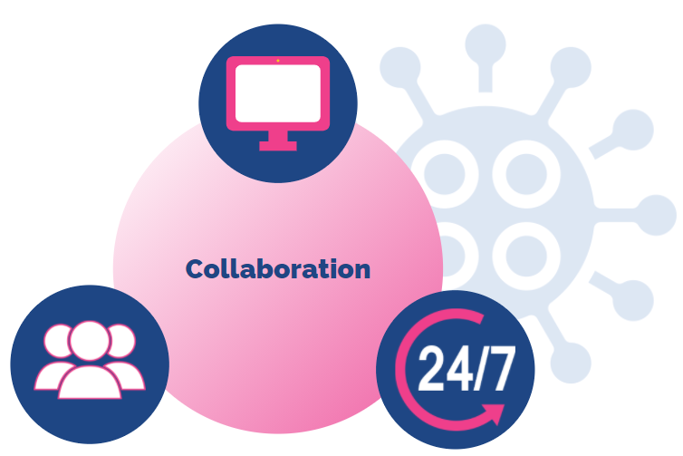
Introduction
Notes:
Hello, and thank-you for joining us for this plenary session where we will look at the way in which NHS 24 responded to needs borne out of the COVID pandemic.
This response was both for the citizens of Scotland, but also for whole system: how could NHS 24, its expertise in delivering telehealth and digital services, its technology infrastructure, be used to respond to the pandemic
As you will learn over the next 50 minutes or so, that response has been a radical transformation of services.
Increased demand across urgent care and mental health support has seen a substantial increase in services, workforce and digital solutions, transforming NHS 24 from primarily providing an out-of-hours response to models of care delivered 24 hours a day, 7 days a week.
This has been achieved collaboratively.
What we also to demonstrate today is what this might mean for the future, as we begin the job of remobilisation, recovery and redesign.

Slide 3

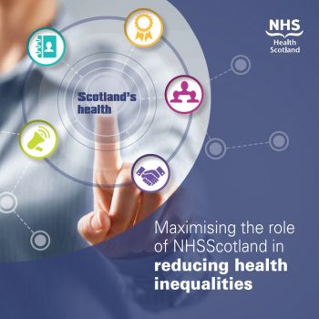
Context of response
Realistic Medicine
Public Health priorities

Slide 4

Format
Whole System Response and Pathways
Kevin MacMahon, Head of Risk Management & Resilience
John Barber, Service Development Manager
NHS 24 COVID-19 Digital Response
Louise Bennie, Head of Digital
Phase II Redesign and COVID-19 Response
Gail McGregor, Head of Clinical Services
Lauren Kennedy, Lead Nurse for Mental Health and Learning Disabilities
Notes:
So we’re going to be hearing from some of the people across NHS 24 who have helped to make this happen.
As you can see we have three short presentations for you starting with an over view of our COVID response, we’ll then look at our digital services and how they scaled up, and we’ll then focus on our mental health services.
We’ll hopefully have about 10/15 minutes at the end for any questions.
So I’ll hand over now to my colleagues Kevin MacMahon and Jon Barber.

Slide 5
Whole System Response and Pathways
Kevin McMahon, Head of Risk Management and Resilience
John Barber, Service Development Manager

Slide 6
Who are NHS 24 and what is our capability to respond?
111 Service inc’ mental health services, dental services (Predominantly out of hours service).
Based across Scotland, call handler to nurse supervision
Clinical system that integrates with all territorial Boards
Digital services, inc’ NHS Inform, national social media footprint
Special helpline capability
Notes:
111 Service
1,500,000 Million Calls
More than 90% were answered within our agreed 30 second target during the first half of 2016/17
5,000 Dental Services calls per month (Scottish Emergency Dental Service)
We helped 36% of our service users with self-care advice
Circa 14,000 calls on peak day
Mental Health Services
Mental Health Hub
Breathing Space and Living Life
Special helpline capability
Digital services
x million visits to NHS 24 managed websites
X million hits per month on NHS Inform
Web-chat demand of around 1,800 chats per month across our health & care information services
National digital footprint for social media

Slide 7
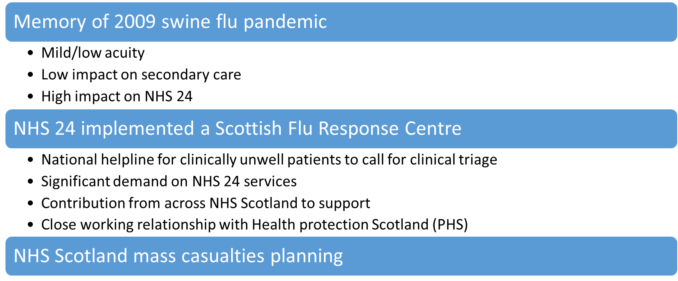
Pre-planning and experience

Slide 8
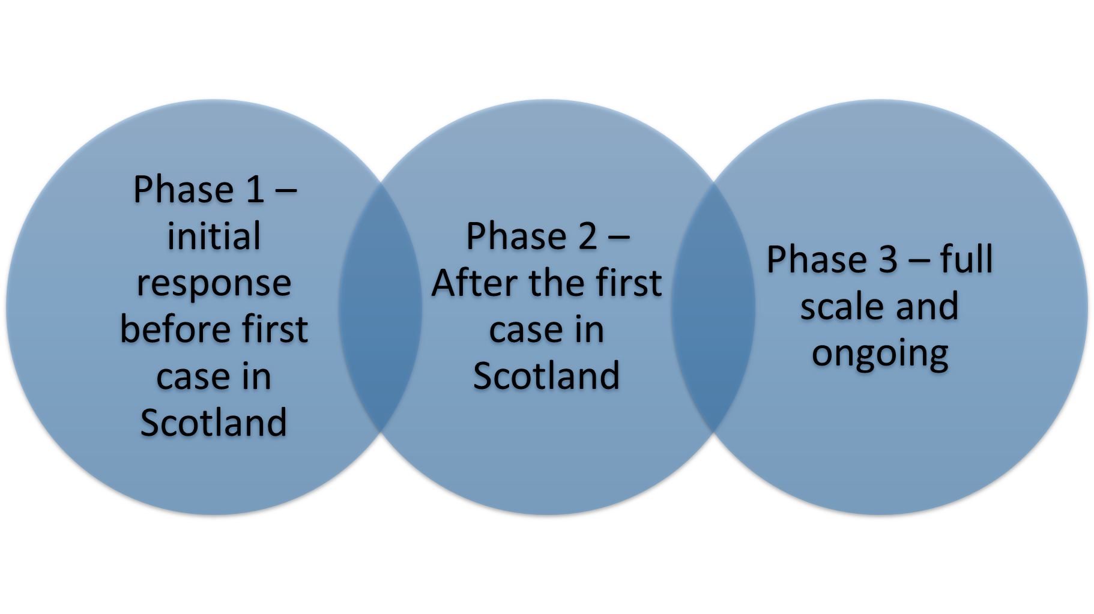
Phases of NHS 24 response
Notes:
Phase 1 – initial response before first case in Scotland
Implement Incident response structure and rhythm in January. Easier to scale down than play catch up.
Close group of people with key skills – Service delivery, clinical systems, Medical, Nursing,digital, comms
Able to adapt our clinical systems.
Adapt 111 service
Changing case definition - Geographic location, data to HPS/PHS, returning travllers,
Manage public anxiety
Internal view
Expediential growth in concern/response.
Lack of data from china re planning assumptions
3 phases but a bit of a blur
Key decisions and challenges:
Establish IMT – Strengths
Outsource helpline
Maintain non-clinical helpline
Clinical systems development
Use of our data
Communicating decisions out
Phase 2 – recognition then that serious and needed to be an NHS Scotland response to manage demand.
Recognition for a mechanism to support more resource to support wider health service.
Key decisions and challenges: Strengths
Phase 3 – Full scale pandemic leading last summer lows, into RUC, winter planning, when to stand down IMT
Key decisions and challenges:
Capturing learning
When to stand down and transition
How to transition
IMT morale
What's our legacy? – empowerment, tactical group, new services, new position in NHS…

Slide 9
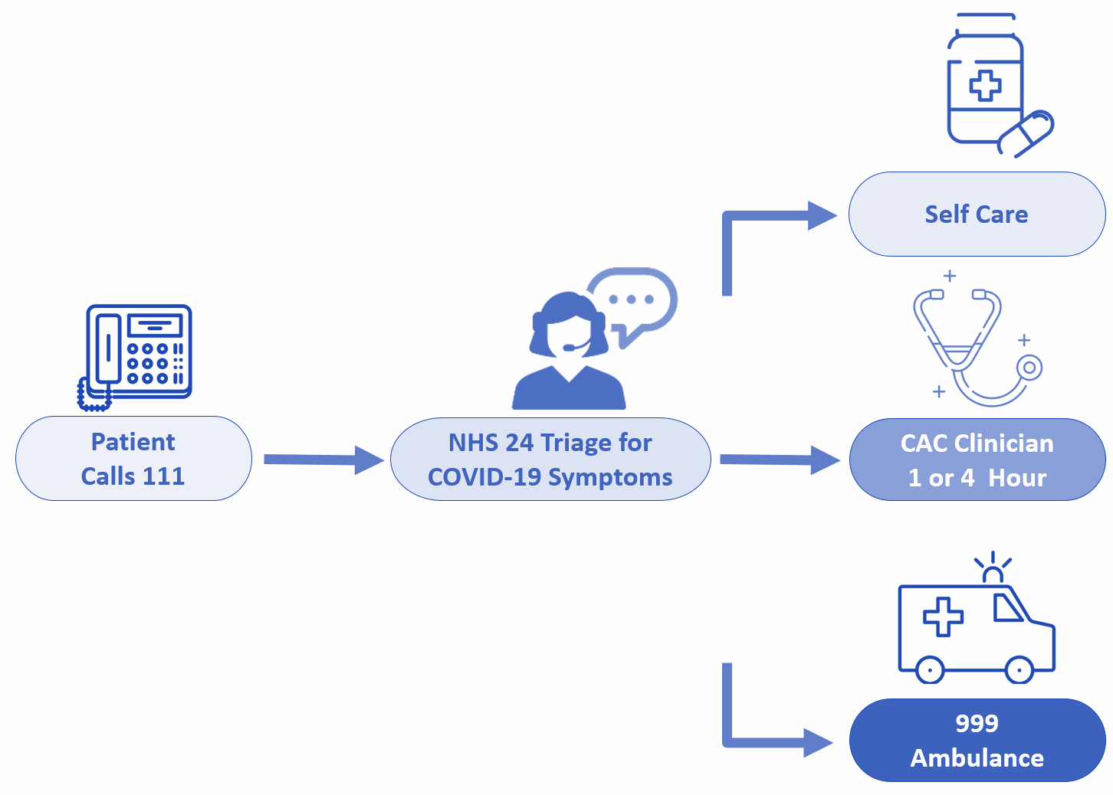
COVID-19 Service & Patient Pathway
National response and collaboration
Establish pathway to benefit patients maximising Infection Prevention Control measures across whole system
24/7 point of access through 111 for triaging potential COVID-19 Infection
A streamlined protocol to manage/ identify symptoms based on case definition
  Delivered alongside and integrated with BAU 111 services
  Developing temporary call operator resource and clinical supervision model
Board Community Assessment Centres
  Support and temp resource via partners
Notes:
The COVID-19 service was setup as part of the national pandemic response and required collaborative whole system working to a shared set of priorities
The main objective was to setup a pathway that would safely and effectively manage and stream demand for COVID-19 care whilst reducing self-presentation at primary and secondary care settings to maximise infection prevention control
NHS 24’s role in this was to provide a national 24/7 access point through 111 for people with suspected coronavirus infection to manage and stream demand for care
This would need to be delivered alongside OOH services – people would still have other unscheduled care needs and the COVID-19 service would need to run alongside this
This required the development of a clinically assured simplified protocol - simplified in terms of would on deal specifically with COVID-19 & actively flag symptoms from case definition anywhere within NHS 24 systems to initiate / increase IPC measures
The simplified protocol could also be delivered by TCO supported by clinical staff – enabled a compressed training programme of 3 days compared to – only deals with COVID-19 symptoms and the associated outcomes for these

Slide 10
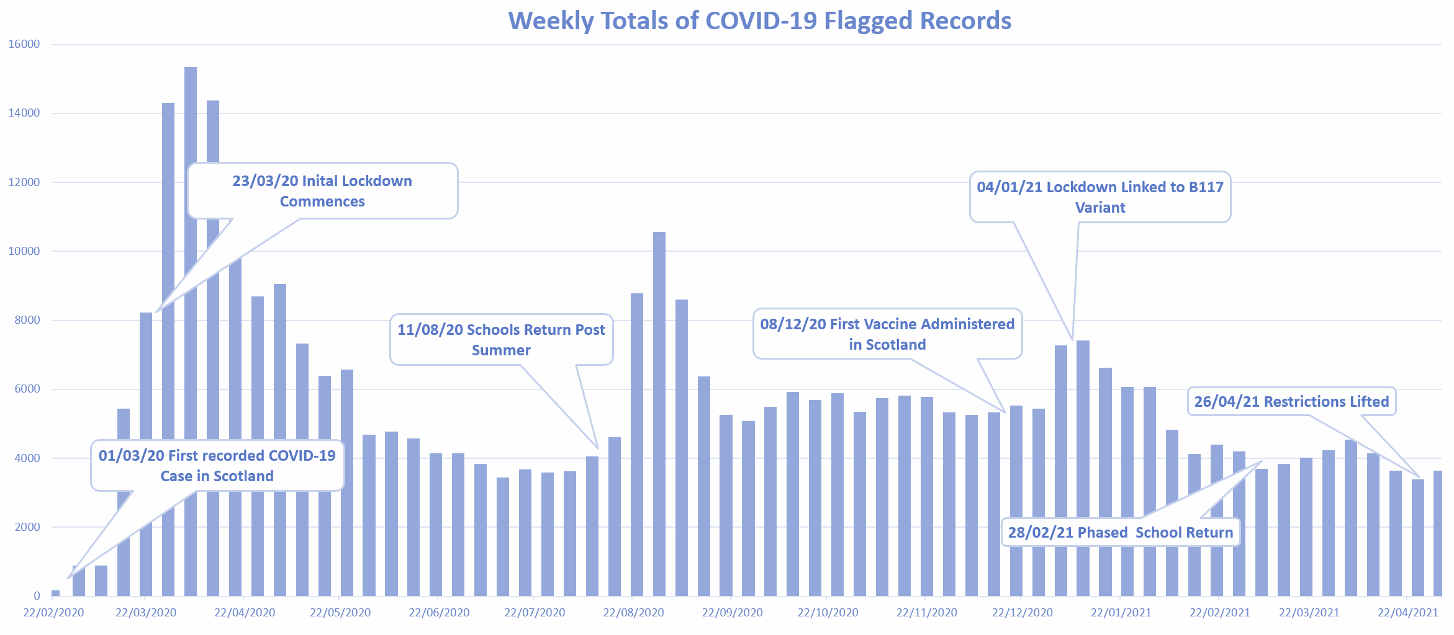
Pattern of Demand, Outcomes and Learning
Notes:
The

Slide 11
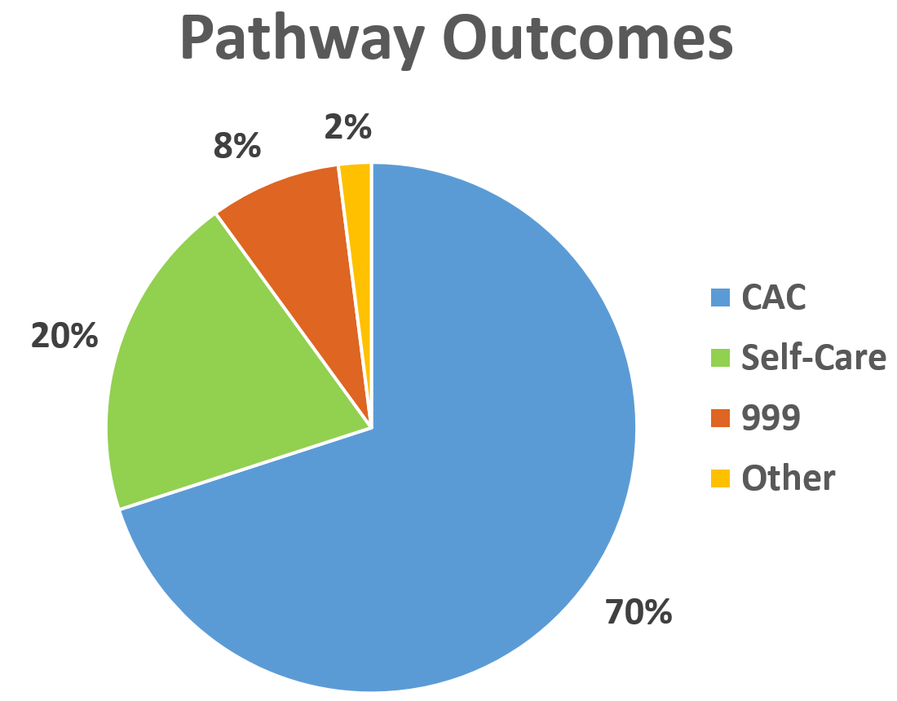
Pattern of Demand, Outcomes and Learning
>350k Flagged
Records
~23% of all the
records created over period
95%
increase across March 2020 culminating in peak of 15,208 records in one week
  Prevalence, seasonal illness & variants
Where are we now with vaccination & easing of restrictions
Effectiveness & longevity of the pathway… considering the alternative
Notes:
The

Slide 12
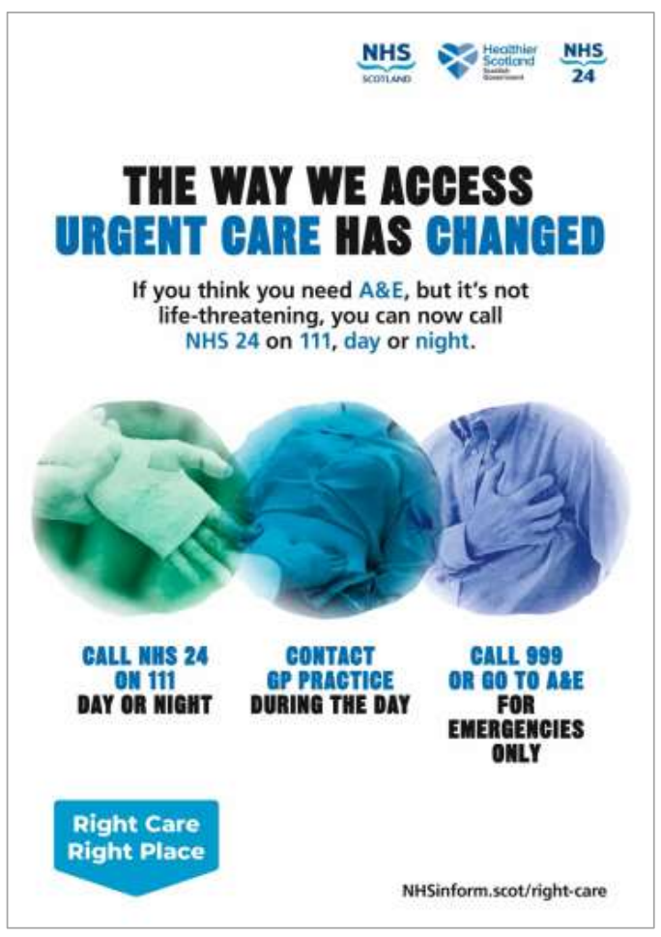
COVID-19: a Catalyst for System Change
The National Redesign of Urgent Care Pathway
  Pandemic impact on behaviours >50% reduction in A&E use
  Infection control and opportunity to manage and stream demand differently longer-term ~20% closer to home
National 24/7 single point of access through 111 supported by Board Flow Navigation Centres
  Potentially 15K additional calls/ week and mostly in-hours
    Not an add-on but impacts whole operational model
    Required significant development and expansion
  ‘Soft launch’ 01 December 2020
    On average 7K contacts/ week
    Developing baselines with COVID-19, restrictions and behaviours

Slide 13

NHS 24 COVID-19 Digital Response
Louise Bennie, Head of Digital

Slide 14
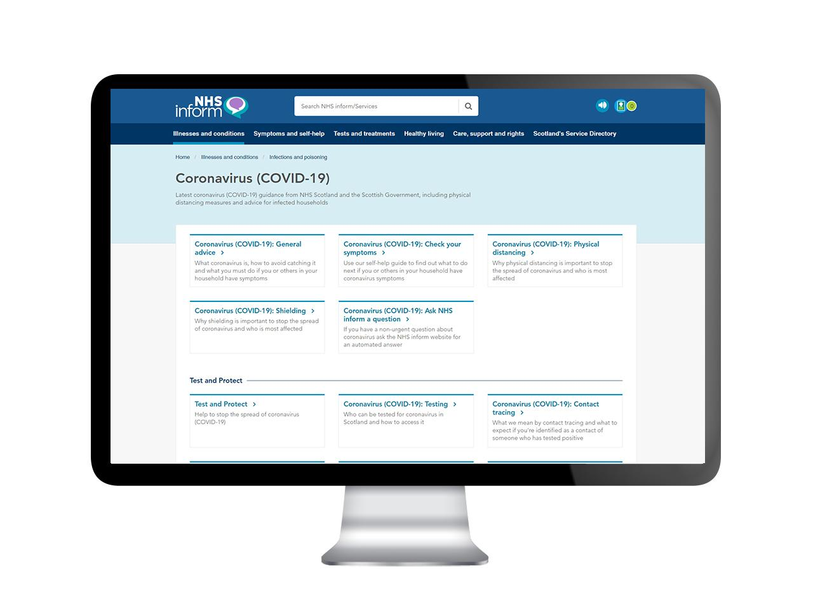
COVID digital content
Growth in scale and scope from campaign to article to content hub
Collaboration with the Scottish Government, Public Health Scotland and internal NHS 24 clinicians
Embracing digital approaches to content collaboration
Single point of access for users to COVID health information

Slide 15
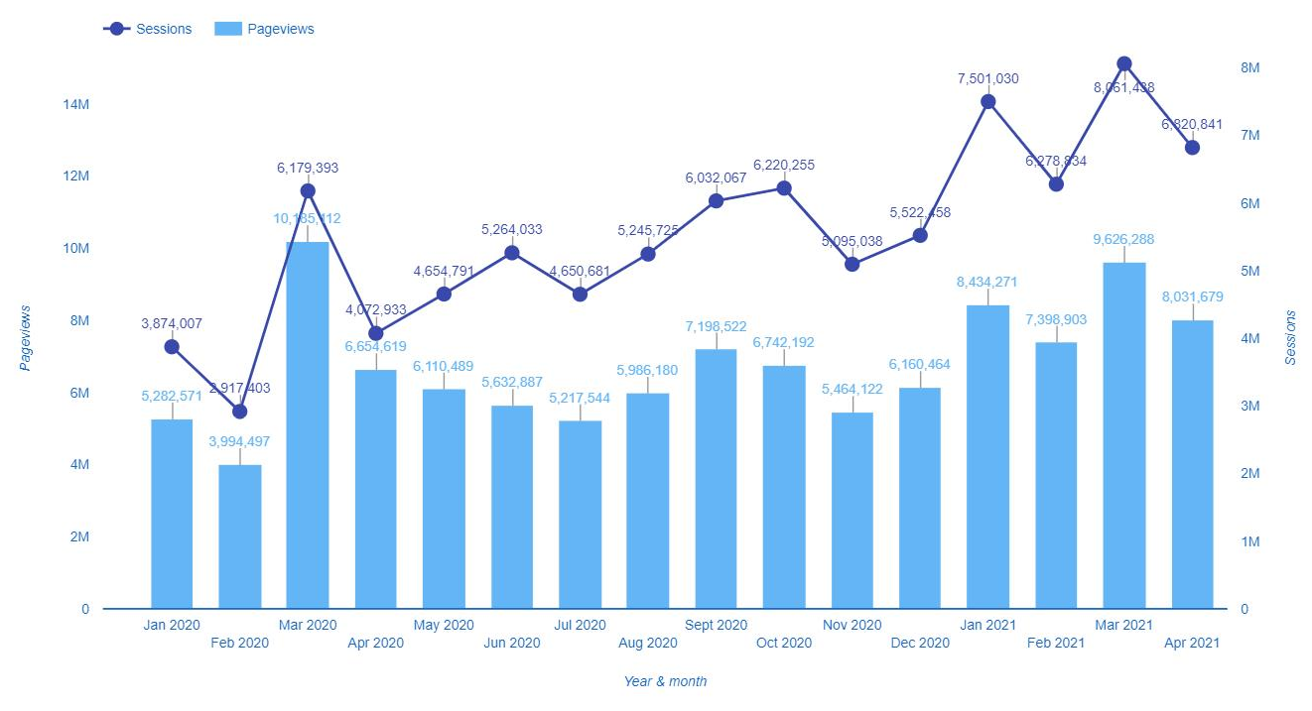
NHS inform demand
Jan 20 - Initial Wuhan Virus article added to NHS Inform
01/03/20 – first case in Scotland
23/03/20 – Initial lockdown commences
08/12/20 - Vaccine programme starts

Slide 16
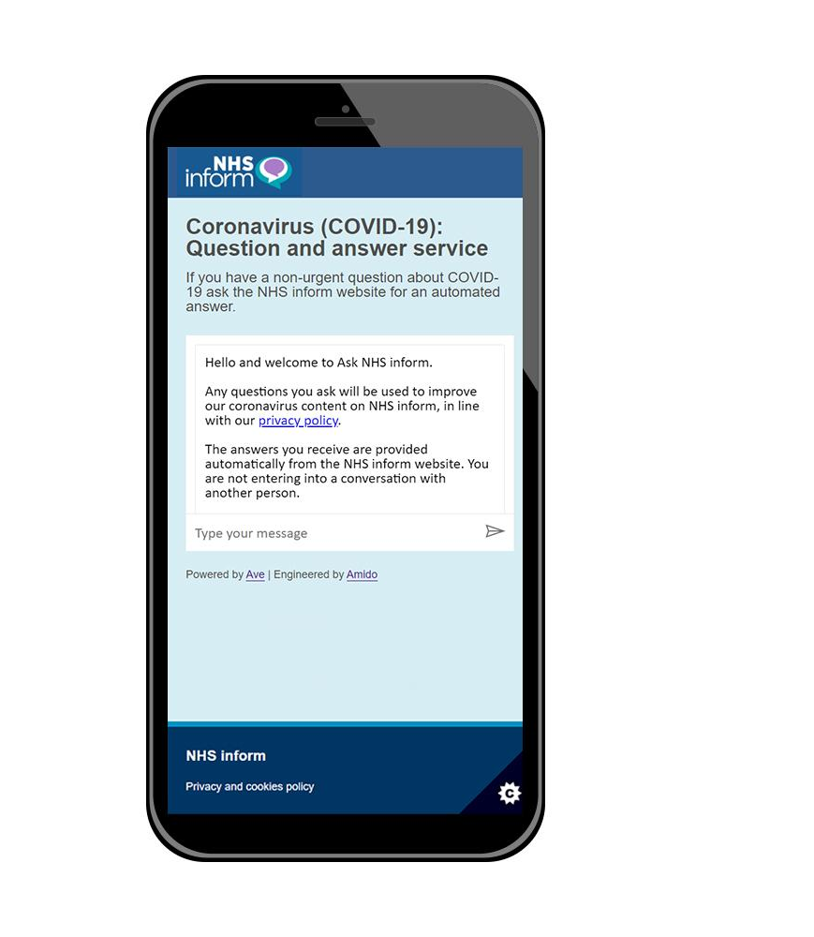
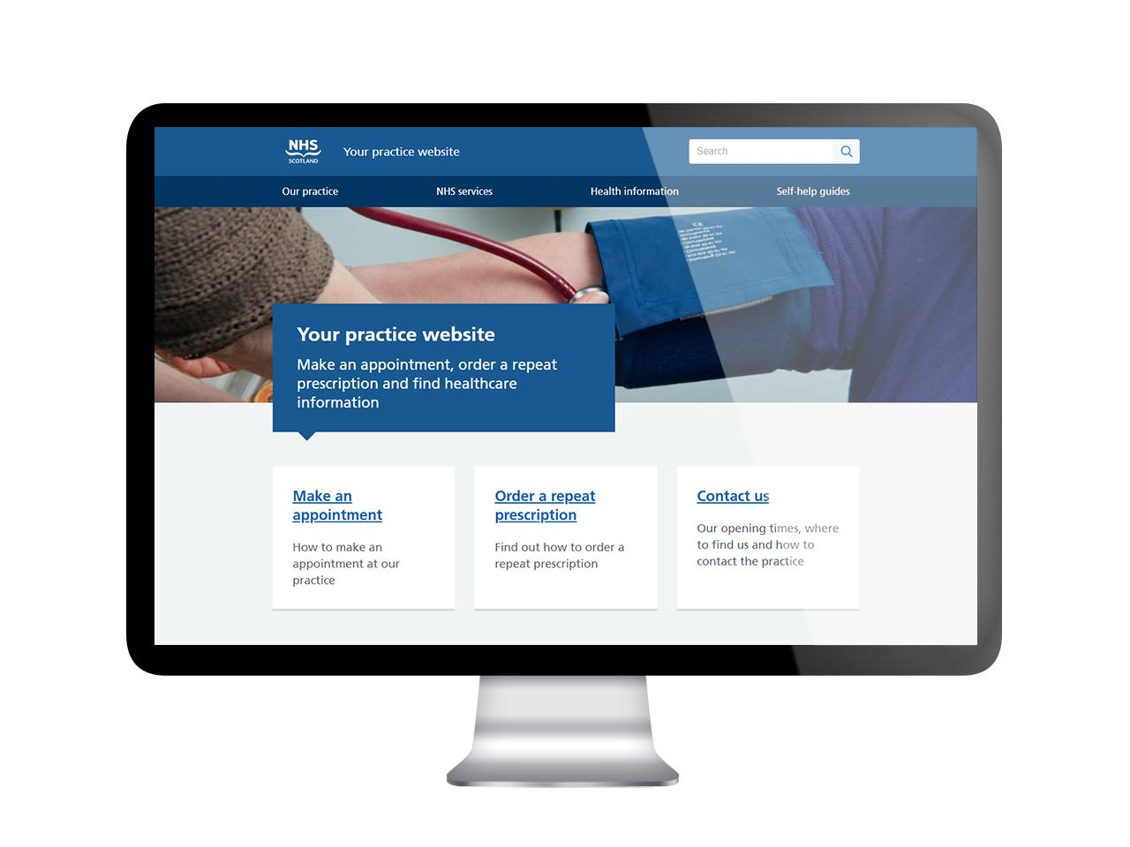
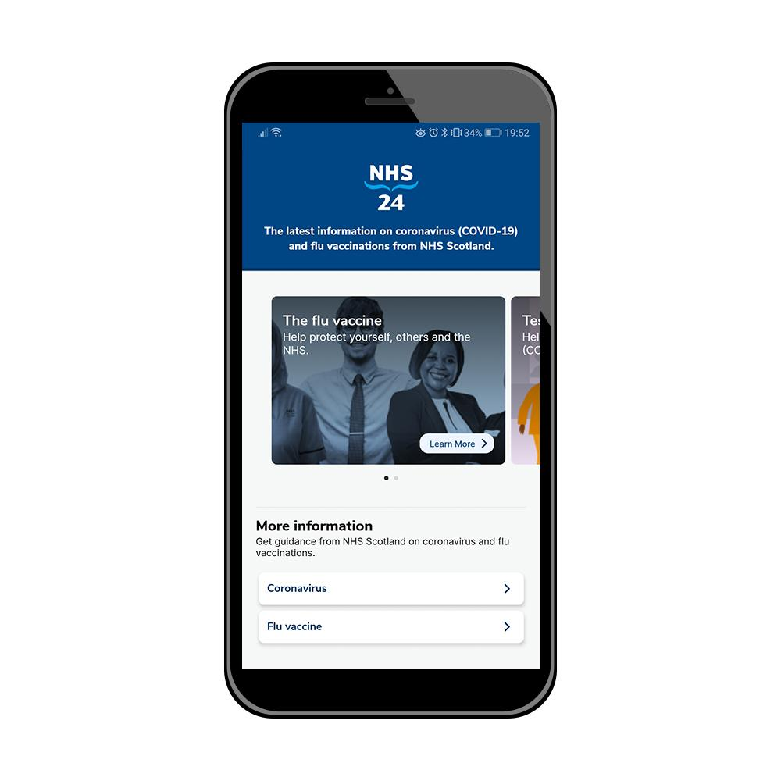
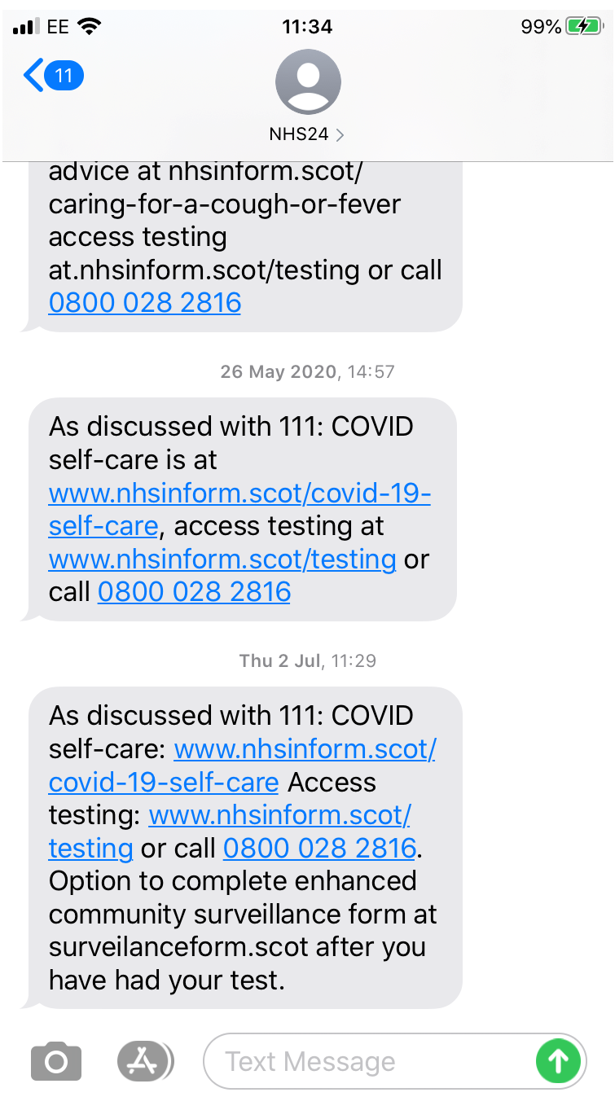
New channels developed
Voice and online
chat bot
COVID App, enhanced for Flu
SMS library –
111 service
Launch of GP.scot

Slide 17
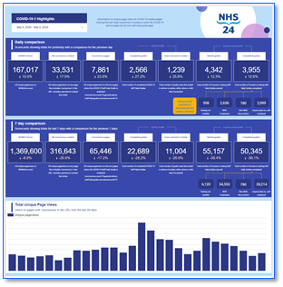
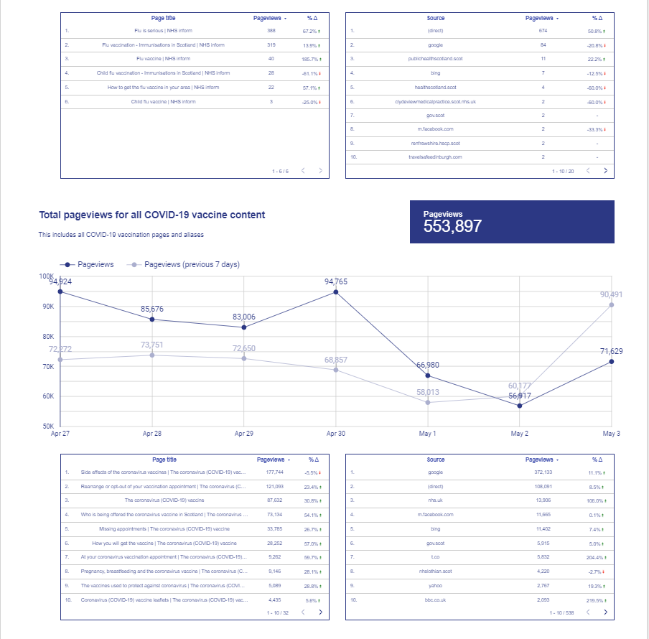
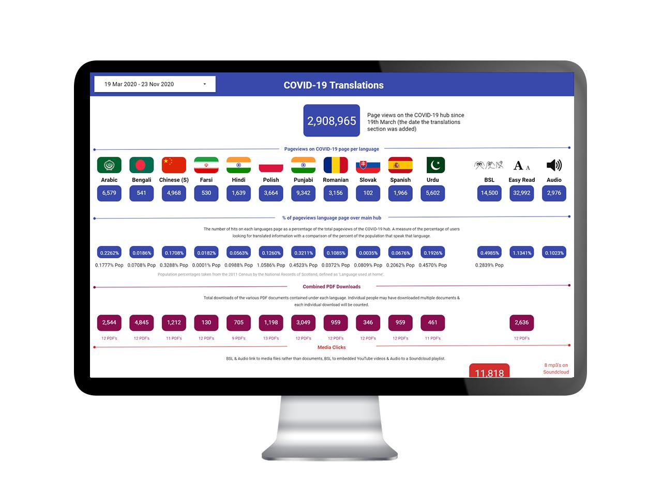
Data and communication

Slide 18

New ways of working
Significant increase of home working within the team
Rapid collaboration, iterate at pace
Reduction in silos
Stronger use of data to inform change

Slide 19
Mental Health COVID-19 Response
Gail MacGregor, Head of Clinical Services
Lauren Kennedy, Lead Nurse for Mental Health and Learning Disabilities
Notes:
I’m going to talk about the Phase 2 redesign of our mental health service provision and NHS 24’s response to the COVID-19 pandemic in the context of our mental health services

Slide 20
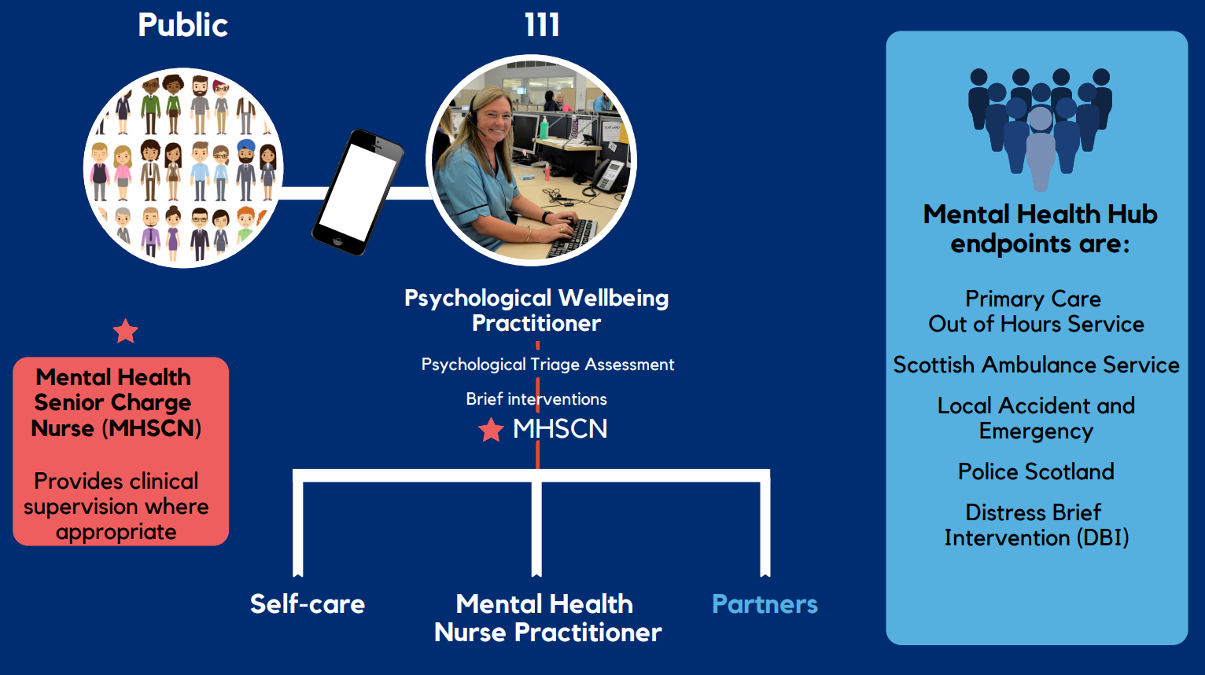
Mental Health Hub
Notes:
Mental Health Hub
In 2018, NHS 24 in collaboration with patients, staff and other key stakeholders embarked on a review and redesign of the way in which we support callers with mental health issues contacting the 111 service.
We listened to service users and their frustrations in having to tell their story multiple times. We recognised that a clinical or acute response is not always the best response and mental wellbeing is more often influenced by wider social factors. And we collectively acknowledged that the outcome for callers could be improved.
Following user research, development of new protocols and processes and the mapping of patient journeys and outcomes, we launched our new Test of Change Mental Health Hub via the 111 service in March 2019.
In developing a Mental Health Hub, NHS 24 worked collaboratively with the Scottish Ambulance Service and Police Scotland to develop an enhanced pathway for those in mental health distress with a key objective of providing people with urgent mental health needs with a compassionate and expert response, delivering the right care, at the right time.

Slide 21





Accelerated expansion of
Mental Health Hub
Hours increased to 24/7
Now available 24 hours a day, 7 days a week by calling 111 and following telephone prompts
Establishment of National Wellbeing Helpline to respond to the needs of Health and Social Care Staff
Recruitment
Required to increase staffing by 200%
New referral pathways
Since May 2020, NHS 24 can refer to Distress Brief Intervention (DBI) an additional pathway for those in distress not requiring a clinical response (circa 350 referrals per month)
Since August 2020, NHS 24 receive low acuity mental health calls from Police Scotland (circa 300 referrals per month)
Notes:
In response to the pandemic:
Hours increased to 24/7
With Scottish Government support, NHS 24 was able to progress the Hub’s expansion rapidly and moved to a 24-hour service over the summer of 2020.
Increased volume of calls from 4k to 9K per month
National Wellbeing Helpline
The capabilities within the Hub enabled a rapid response to the needs of Health and Social Care staff with the launch of the National Wellbeing Helpline in July operated by NHS 24. A compassionate listening service for everyone working in health and social care services open 24 hours a day, 7 days a week, PWPs provide a range of support and may refer to local services.
Recruitment
The mental health hub was rapidly staffed up to help provide the additional support required to respond to the pandemic.
75 Psychological Wellbeing Practitioners, 26 Mental Health Nurse Practitioners, 8 Senior Charge Nurses
Distress Brief Intervention
NHS 24’s Mental Health Hub is now linked into the successful Distress Brief Intervention (DBI) programme, enabling callers in mental health distress to be quickly routed into the most appropriate service local to them.
DBI provides an ‘ask once - get help fast’ early intervention for people over 16 years who do not need urgent medical treatment.
The programme provides support from third sector partners with problem solving, wellness and distress management planning for a period of up to 14 days.
Third sectors partners include Penumbra, Support in Mind Scotland, Lifelink, Scottish Association for Mental Health, Lanarkshire Association for Mental Health and The Richmond fellowship Scotland (https://www.dbi.scot/partners/)
New referral pathways
The Distress Brief Intervention programme was piloted in 4 healthboard areas from the 13th May 2020. Phase 2 of the programme was rolled out nationally in June 2020, to help support people presenting in distress during the COVID-19 pandemic
Another key element of the redesign programme was improving the care pathway for callers presenting to Police Scotland in mental health distress. These callers are now offered access to the 111 Mental Health hub service

Slide 22

Call Outcomes
57%
of calls being resolved without the need for any onward referral
29%
are referred to their local primary care service
7%
are referred to our partners in 999 services or a local Emergency Department
If calls are not Mental Health related they are transferred to the 111 clinical service
Source: NHS 24 SAP System
Notes:
Our team of Psychological Well-being Practitioners and Mental Health Nurses individually assess callers to the Mental Health Hub 111 service. There are a number of possible outcomes, the majority of calls being resolved without the need for any onward referral.
57% of calls being resolved without the need for any onward referral
29% are referred to their local primary care service
7% are referred to our partners in 999 services or a local Emergency Department

Slide 23
Mental Health Hub
Notes:
This graph highlights the growing call demand to the mental health hub, now receiving around 10,000 calls each month

Slide 24
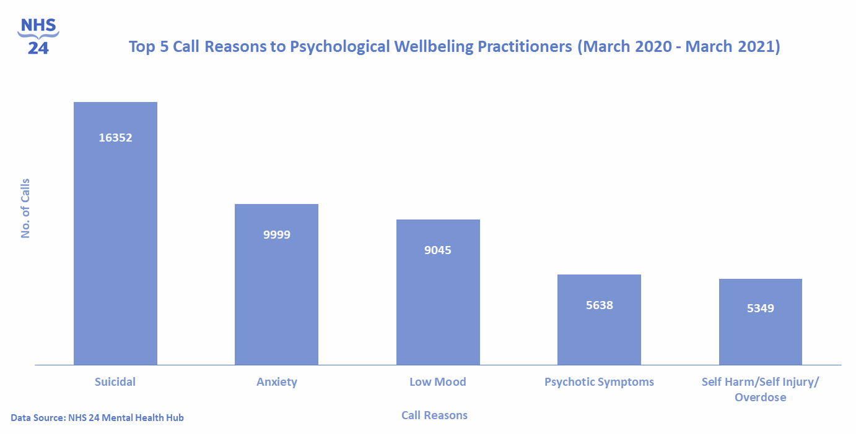
Mental Health Hub
Top 5 Call Reasons to Psychological Wellbeing Practitioners (March 2020 – March 2021)
Notes:
Here are the top call reasons to our psychological wellbeing practitioners, you will see that suicidal ideation is the top call reason.

Slide 25
DBI Referrals
Notes:
Referrals to the DBI service continue to fluctuate at over 250 referrals each month

Slide 26
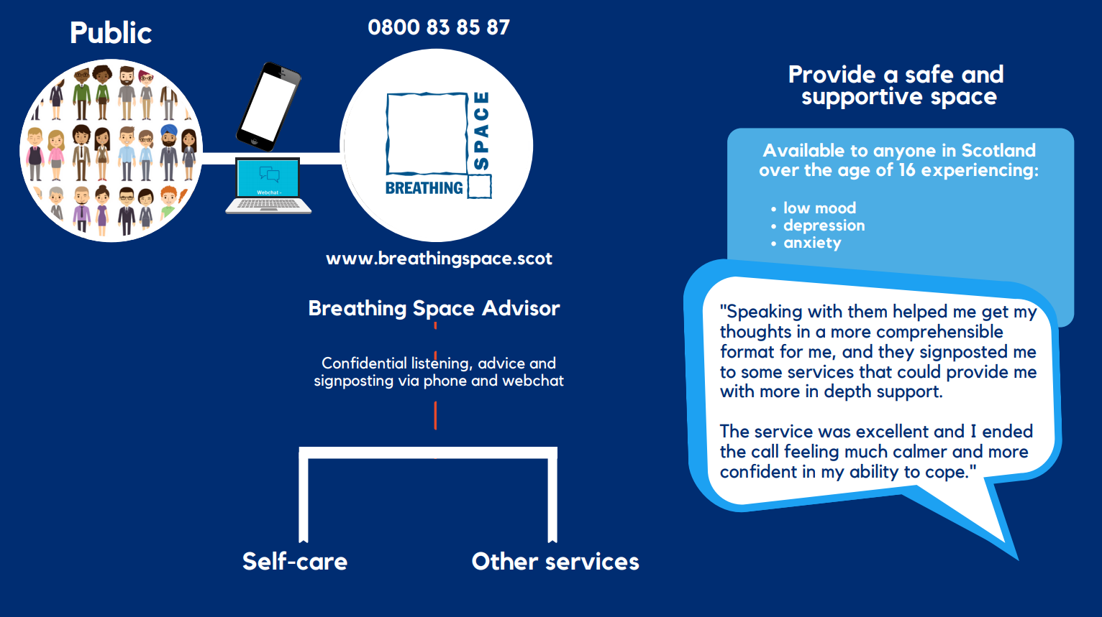
Breathing Space
Notes:
Breathing Space is a free, confidential service available to anyone over the age of 16 in Scotland, experiencing low mood, depression or anxiety
The service is open in the evenings (6pm to 2am) and 24 hours at the weekend (Fri 6pm – Mon 6am) on 0800 83 85 87
Since Breathing Space was launched in 2002 over 1 million calls have been handled by the service

Slide 27


Accelerated expansion of
Breathing Space service offering
Expansion of phone service
Provides listening, advice and signposting to those feeling low or anxious
Recruitment
Additional Breathing Space Advisors and Supervisors recruited
Internal and external training of staff who would be supporting web chat service
Web chat service
Expansion of Test of Change service to a 12 month Pilot
New population who would not otherwise have accessed support
Notes:
In response to the COVID-19 pandemic, and with additional funding from the Scottish Government, NHS 24’s Breathing Space phone service was expanded
Additional Breathing Space Advisors and Supervisors were recruited to offer additional capacity to the phone service, to respond to an anticipated heightened demand from those feeling anxious or distressed due to the pandemic
Further, Breathing Space’s web chat Test of Change service, which had been launched in February 2019, was expanded
Web chat offers an alternative channel for people experiencing mental health issues, allowing users to communicate digitally with advisors in real time rather than over-the-phone.

Slide 28
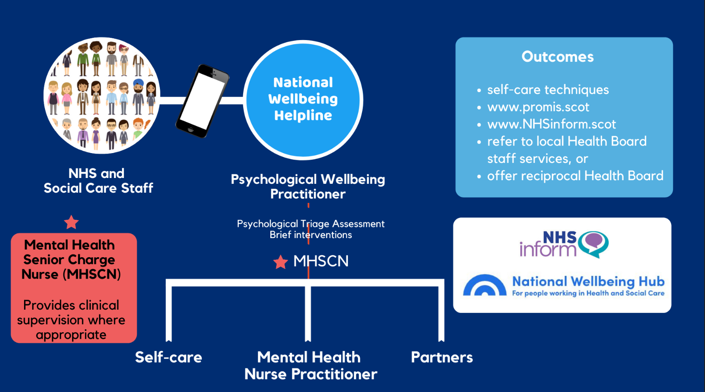
National Wellbeing Helpline
Notes:
National Wellbeing Helpline - Operated by NHS 24 and provides a compassionate listening service for those working in health and social care, which you can access whenever you need it – 24 hours a day, 7 days a week, by calling 0800 111 4191.
Your call will be responded to by a trained Psychological Wellbeing Practitioner (PWP) who will provide you with a range of support including some of the resources available through the National Wellbeing Hub at www.promis.scot/ . If needed, and only with your consent, the PWP can also refer you on to your local staff support service for further support.

Slide 29
National Wellbeing Helpline Calls

Slide 30
Summary
New single national COVID-19 pathway Using a model of initial telephone triage by NHS 24 and subsequent clinical virtual consultation, safely provides advice/care to patients, with the ability to schedule face-to-face assessments where required
Development and rapid roll-out of digital technologies and platforms
Providing a national digital response through NHS inform, new COVID-19 app and GP practice websites - supporting the provision of accessible, quality assured information co-designed with colleagues and communities across Scotland
Rapid expansion of Mental Health services 24/7 Including Distress Brief Intervention roll out to our population and provision for health & social care colleagues in recognition of the significant impact on mental health and wellbeing
Notes:
How the new single national COVID-19 pathway demonstrated that a model of initial telephone triage by NHS 24 and subsequent clinical virtual consultation can safely provide advice/care to patients with the ability to schedule face-to-face assessments where required. This pathway was the catalyst for and is a key component of the 24/7 Redesigned Urgent Care pathway now in place across Scotland.
Development and rapid roll-out of digital technologies and platforms to provide a national digital response through NHS inform, new COVID-19 app and GP practice websites.
This supported the provision of accessible, quality-assured information co-designed with colleagues and communities across Scotland, enabling citizen choice and helping reduce health inequalities.
Rapid expansion of Mental Health services 24/7, including Distress Brief Intervention roll out to our population and provision for health & social care colleagues in recognition of the significant impact the pandemic has had on mental health & wellbeing.

Slide 31

De-escalation: Remobilise, Recover and Renew
Planning for the future
  Significant period of disruptive change and ongoing expansion
  Learning in-flight and maintaining adaptability
  Understanding whole system and citizen needs/ expectations
Long-term impact of COVID-19
  Long COVID and other physical and mental health
  and wellbeing
  Winter planning and pandemic

Slide 32

Q&A

