Slide 1
Dementia – Post-Diagnostic Support App

Slide 2

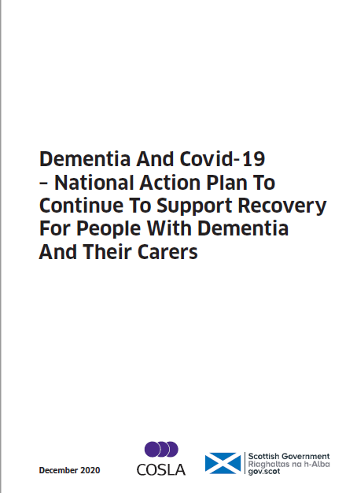
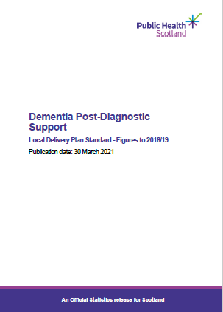

Policy & Drivers

Slide 3
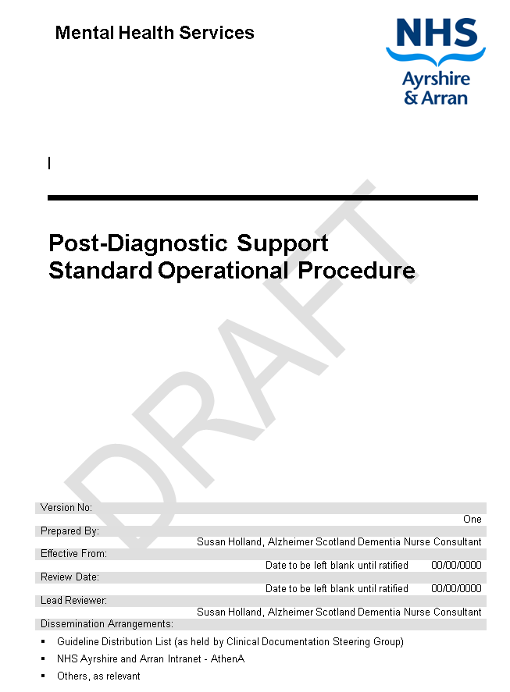
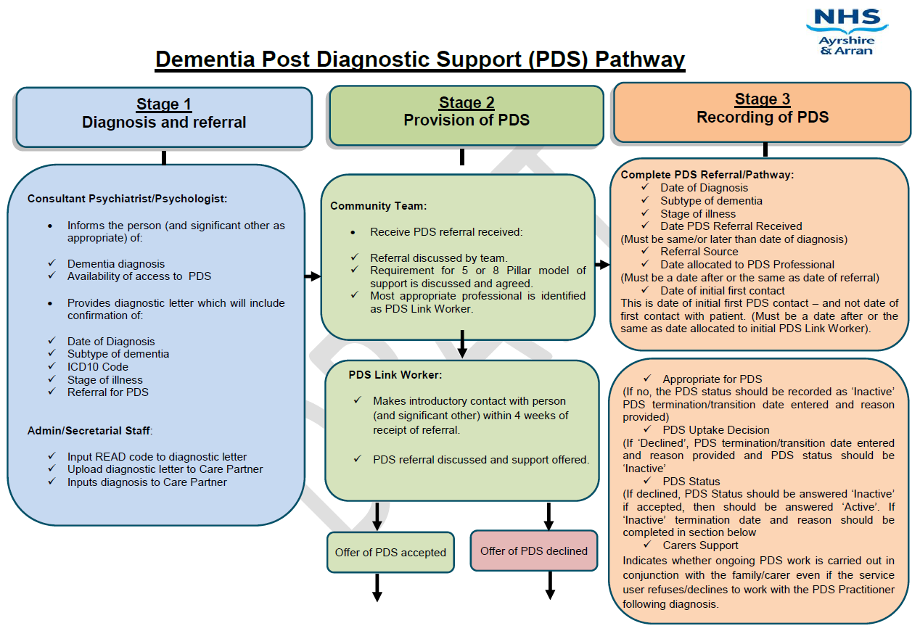
Standard Operational Procedure
& Pathway

Slide 4
PDS App Development Group
Alzheimer Scotland Dementia Nurse Consultant
Family Carers of People with Dementia
Dementia Trainer
PDS Link Worker
Community Nurses (MH & LD)
Allied Health Professionals
Alz Scot and NHS A&A Digitial Services

Slide 5
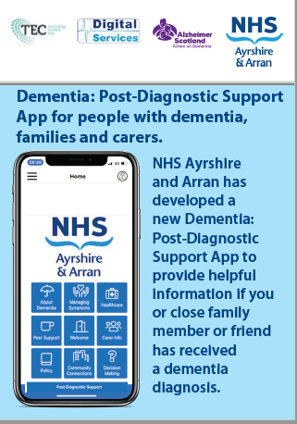
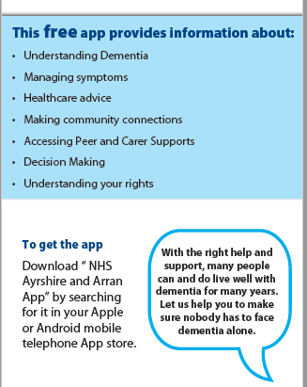
Aim

Slide 6
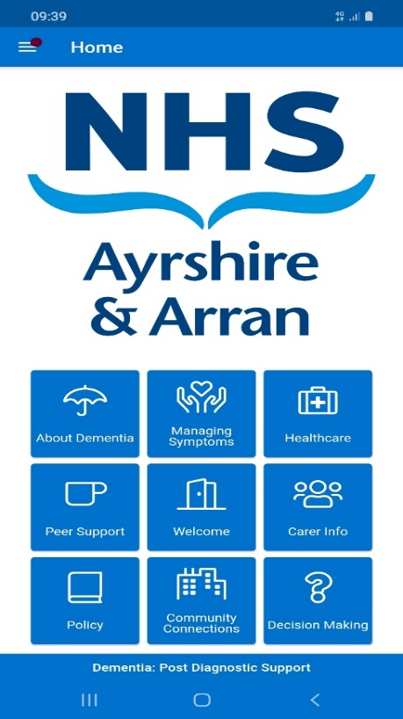
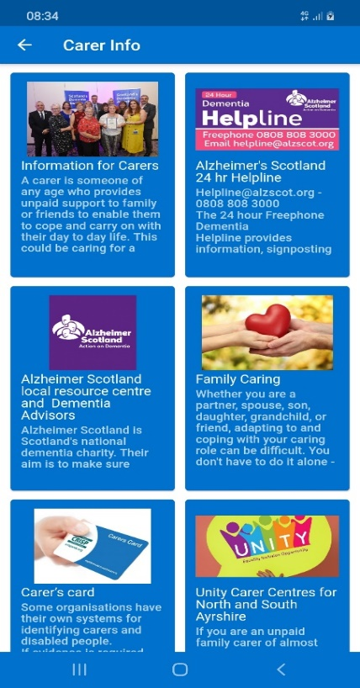
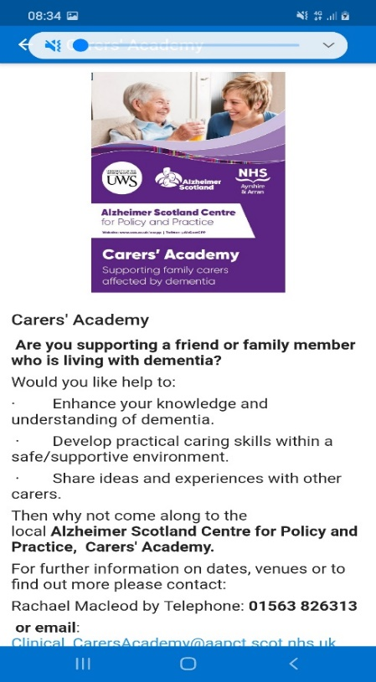
Layout

Slide 7
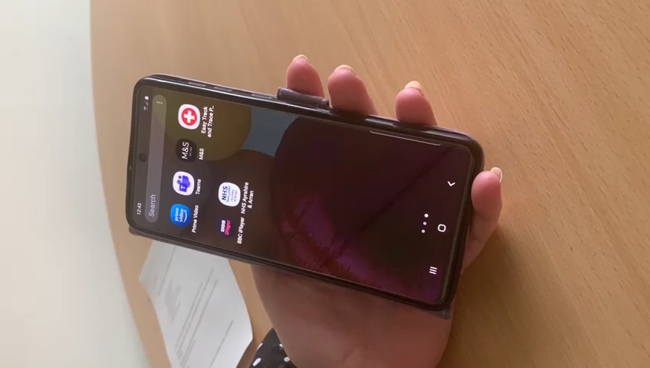
Navigating the App

Slide 8
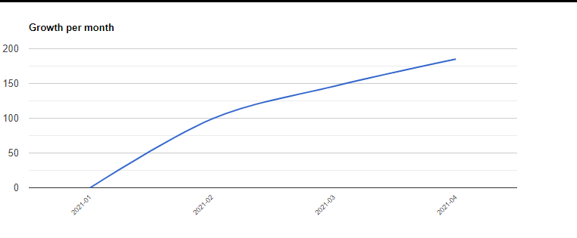
Sign up and Usage
Healthcare 16%
About Dementia 15%
Managing Symptoms 15%
Community Connections 11%
Carer Information 11%
Peer Support 6%
Welcome 3%
Policy 1%
Decision Making 0%

Slide 9
Feedback comments…
“Just wanted to say well done on the app. It’s really fab and so much info but in an easy access, concise way. So helpful that it’s local info. Will definitely be recommending to the people I support.” (dementia advisor)
“Great to have something people can keep referring to as there’s so much information to take in. Really easy to navigate.” (doctor)
“Great app for those at the post diagnostic stage. Very informative and easy to navigate.” (family carer)

Slide 10
Benefits
Adjunct to existing face to face model.
Acts as part of a wider safety net of resources should face to face contact be restricted.
Compliments National Alz Scot App but has an added local focus.
Easy to maintain and up-date information.
Can be easily added to other digital platforms.

Slide 11
Barriers
Functionality of the App is limited.
Cognitive Impairment.
Lack of access/ability to use digital equipment.
Ongoing financial commitment.

Slide 12
Future Plans
Up-date and up-grade
Wider Promotion
Improved Evaluation Processes
Digital Navigators
Alzheimer Scotland Digital Platform

Slide 13
Scottish Ambulance Service – Drug Harm Reduction

Slide 14

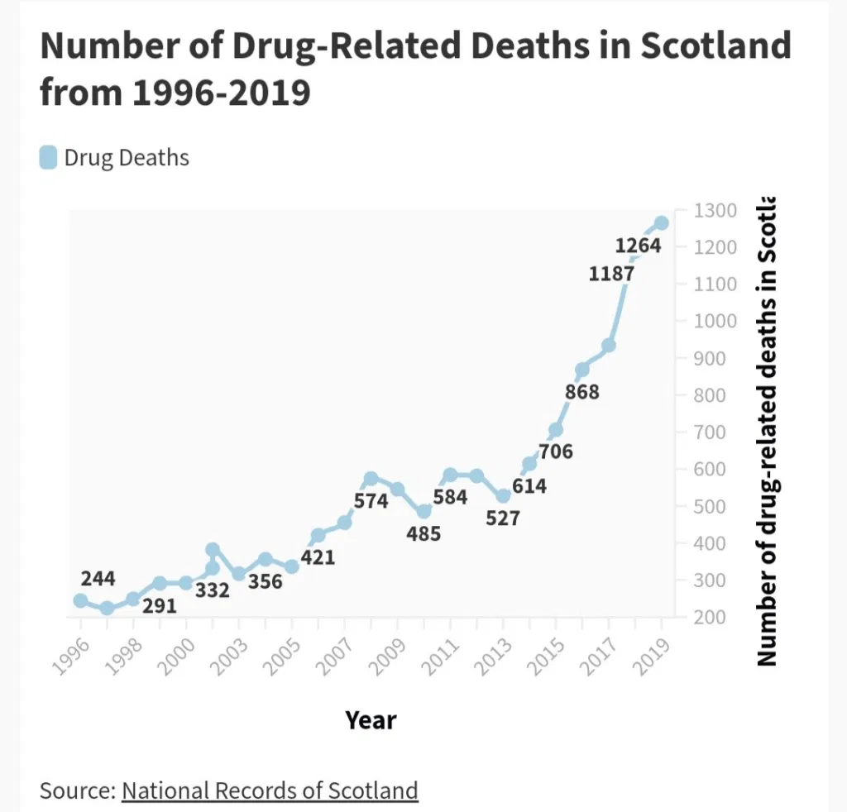
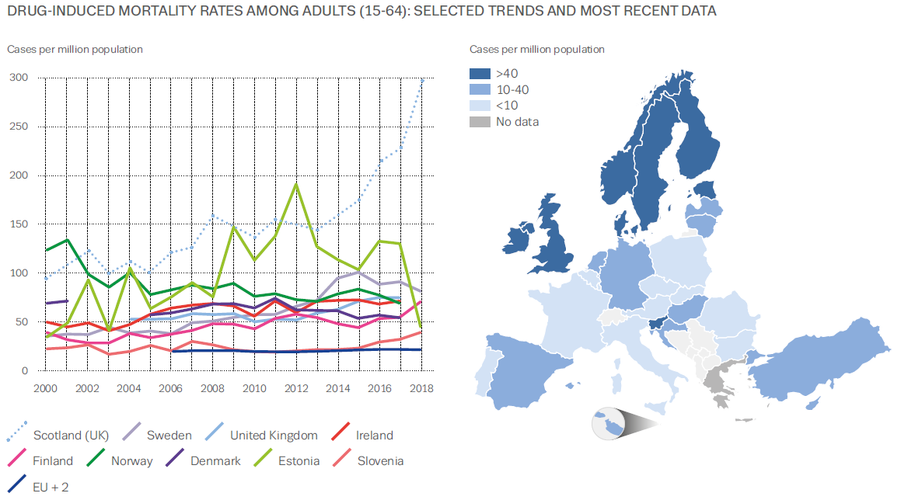
Drug Related Deaths in Scotland

Slide 15
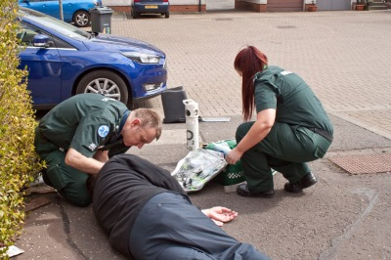
Impact of drug use on SAS
20,000 calls per year relating to overdose and poisoning

Slide 16

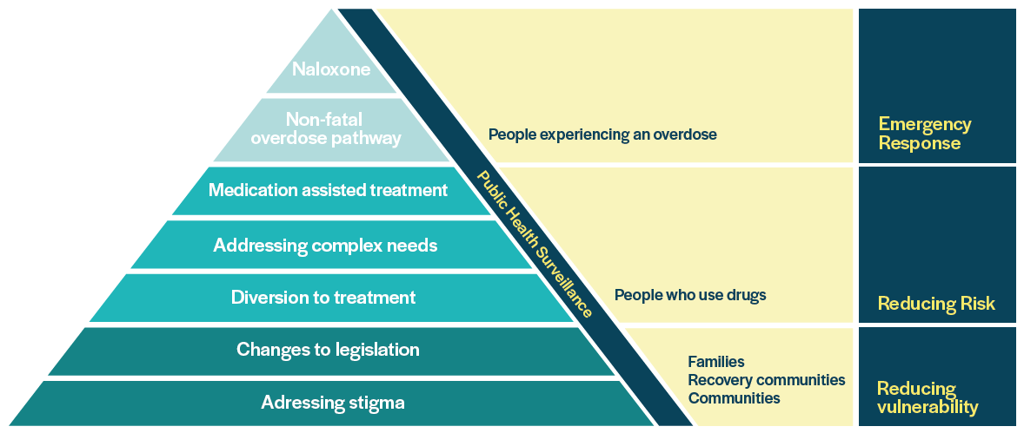
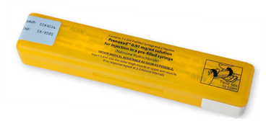
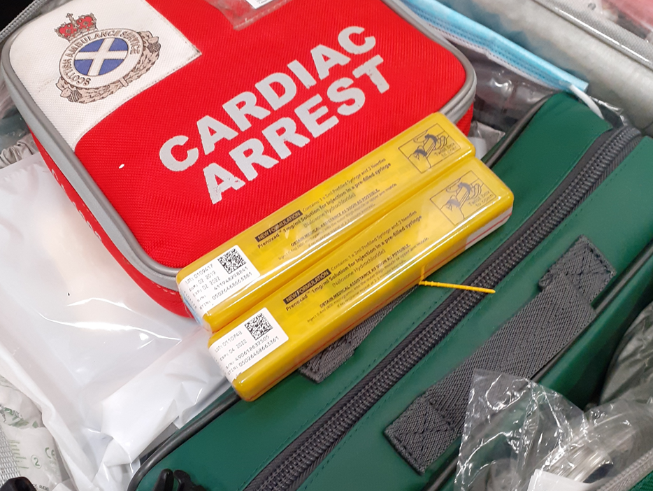
Scottish Drugs Death Taskforce
Areas for Focus & Improvement

Slide 17


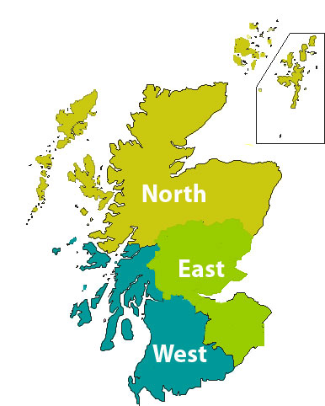

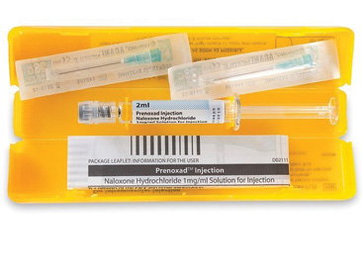
Roll Out National Training Campaign
Workforce Development
Strategy
3500 Paramedics & Technicians – Multiple training options
Targeted Distribution of Naloxone
3 x Clinical Effectiveness Leads
Drug Harm Reduction
Connecting Patients to Services

Slide 18

Working in Partnership
External expertise
Alcohol & Drug Partnerships
Strategic Drug Death Monitoring Groups
Scottish National Naloxone Action Group

Slide 19
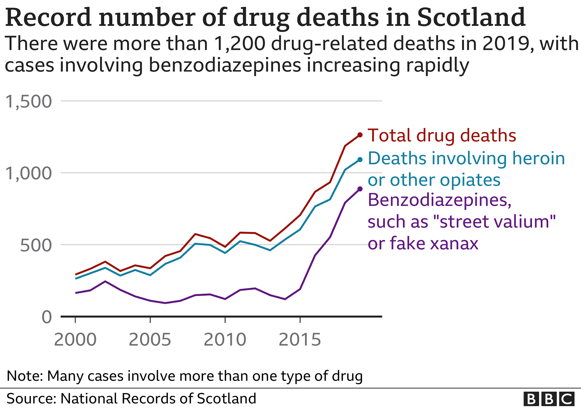

Data Sharing
Optimisation of data sharing
Response to Non Fatal Overdose
Assertive outreach
Continuous care
Resource allocation

Slide 20





Linkage to Care
SAS role in supporting risk-taking behaviour change
Community care pathways
Co-ordinated, continuous care
The right care at the right time
Recovery orientated system of care
SAS Internal Education

Slide 21

Impact of Stigma
Impact on therapeutic and trusting relationships
Self-fulfilling prophecy
Impact on accessing services
Missed opportunities to support
Preventable drug related deaths
d

Slide 22

SAS approach to reducing Stigma
Strategic, regional and individual educational approaches
Involving people with lived and living experience
Use of language and terminology
Providing opportunities to explore perspectives
Trauma Informed Approach (TIA)

Slide 23
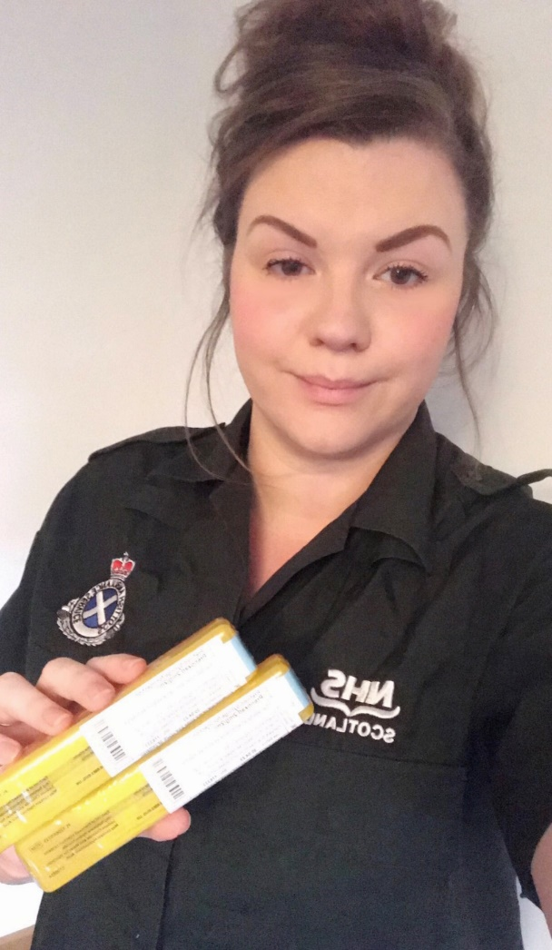
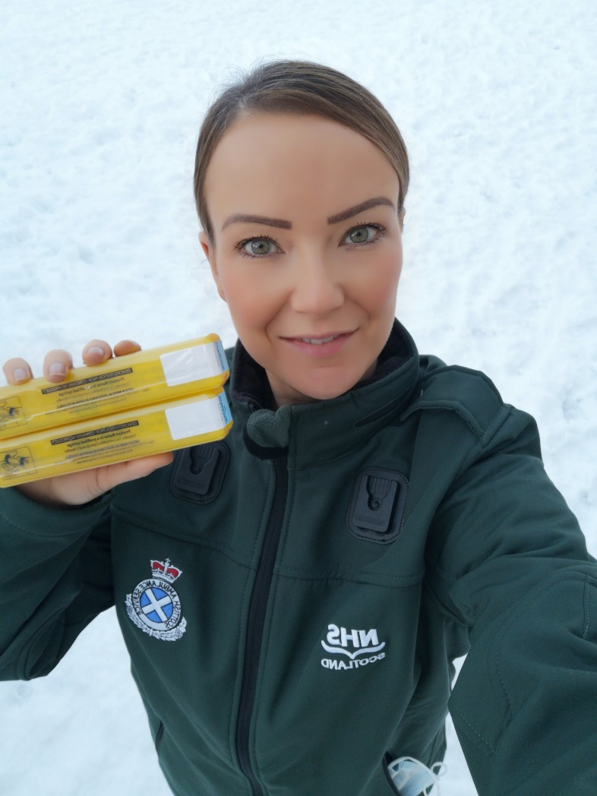
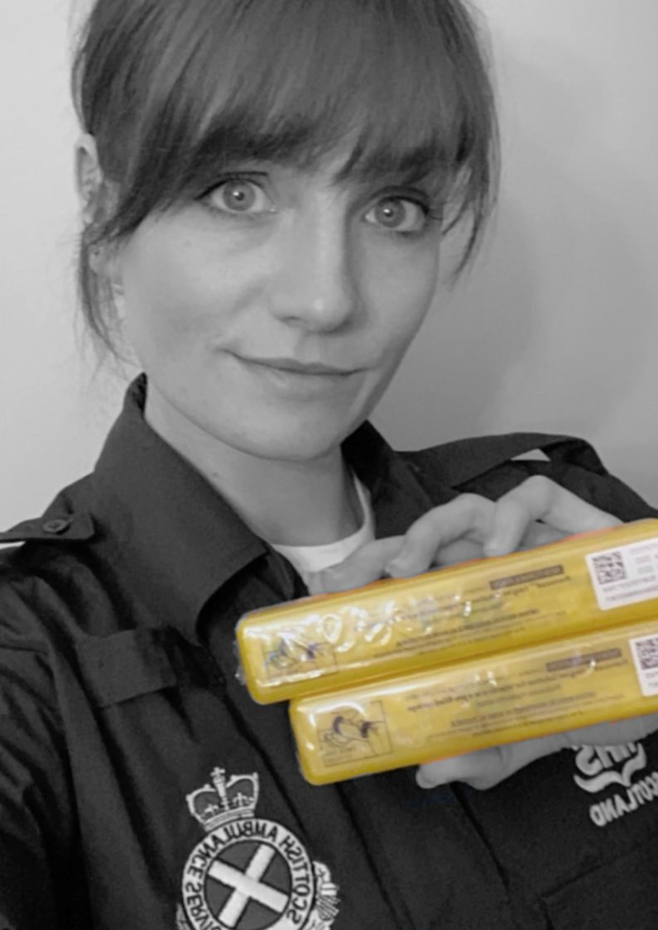

Contact Details
Julie McCartney: East Region
julie.mccartney2@nhs.scot
07385 406061
Lauren Sloey :West Region
lauren.sloey2@nhs.scot
07385 406059
Mary Munro : North Region
mary.munro5@nhs.scot
07385 406060
@Harmleads

Slide 24
Supporting Children and Families – the Development of a Mental Health and Wellbeing Resource Catalogue during COVID-19

Slide 25

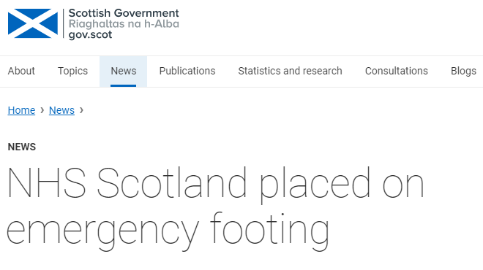

Context
Impact of lockdown on service provision
Rapidly changing situation for families and services
Identified need to collate information on available resources to support clinicians and partner agencies
https://www.gov.scot/news/nhs-scotland-placed-on-emergency-footing/
Credit: Gary Campbell-Hall/Wikimedia Commons/cc-by-2.0.

Slide 26

Aims
Improve and simplify access to quality digital coronavirus mental health and wellbeing resources
Provide up-to-date information about voluntary sector organisations
Audience
Children, young people and their families
CAMHS clinicians

Slide 27
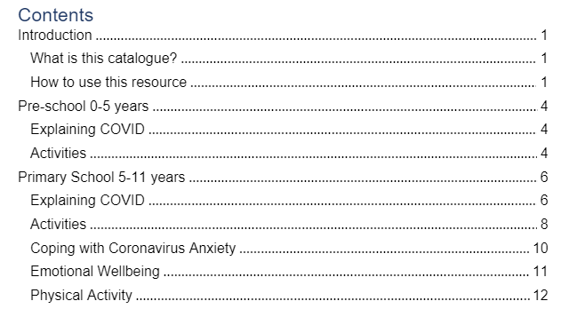
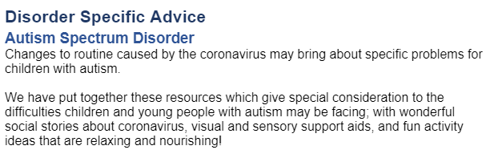
Content
Lay out:
Split between resources and support services
Age and stage
Specific groups with additional needs
Resource topics
Section overviews

Slide 28
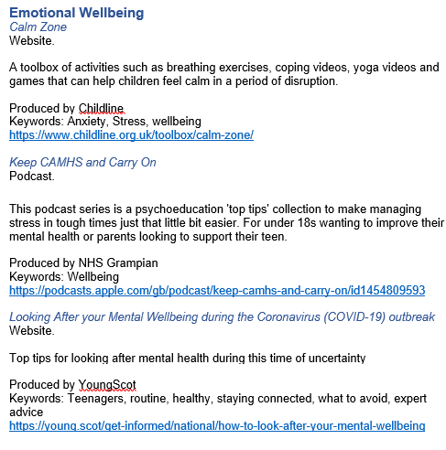
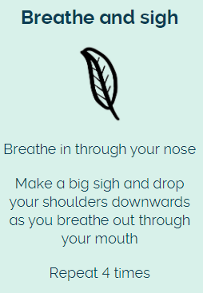
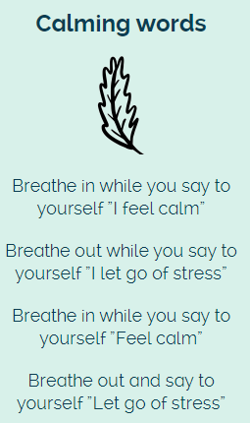
Content - resources
Materials reproduced from: https://www.childline.org.uk/toolbox/calm-zone/

Slide 29
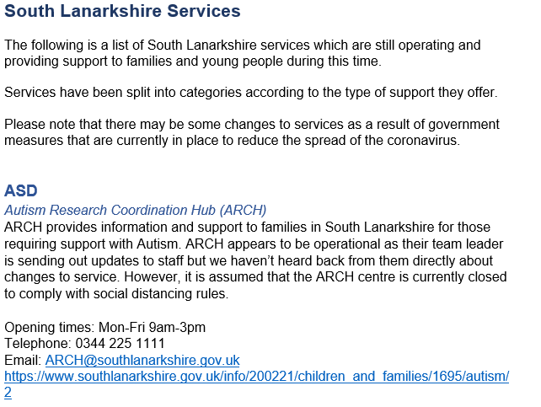
Content – support services
  Wished to create a clear boundary between self-help and additional help services
  Highlighted if services were: National, Lanarkshire-wide or specific to North or South Lanarkshire
  Section for closed services

Slide 30
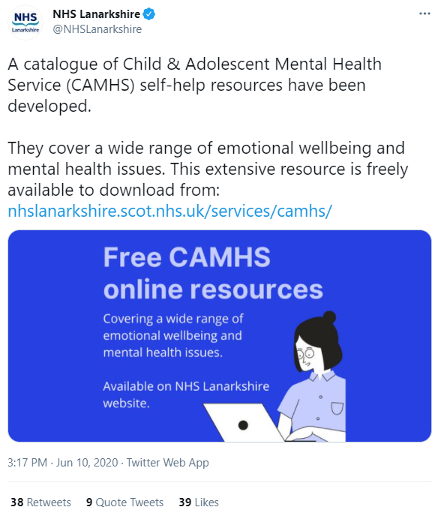
Dissemination
All CAMHS teams
Wider clinical teams
NHS Lanarkshire CAMHS website
External agencies including N/S Lanarkshire Social Work and Educational Psychology
Schools

Slide 31
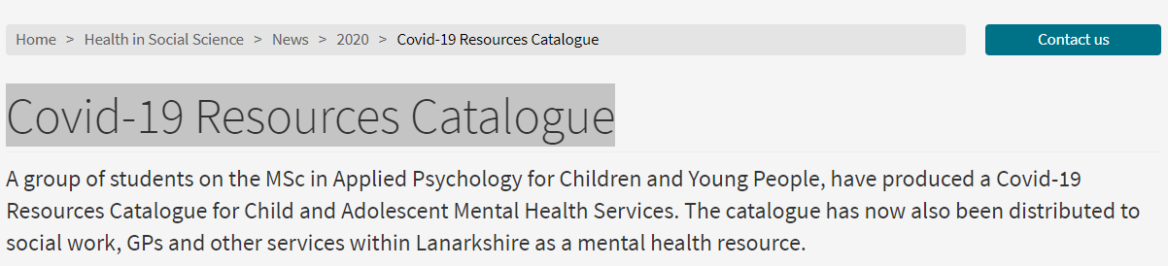
Reception
"your thoughtful and systematic approach really shines through. The catalogue seems to cover the gaps in my Covid-19 resource awareness, and I can see this being a very useful tool for our wider service"
(Clinical Psychologist)
"so much more streamlined to be able to go to one place (for resources)"
(CAMHS clinician)
"a really excellent resource...I have had many conversations with families over the last few weeks about accessing resources and I wish I’d had this!"
(Consultant Psychiatrist)
Notes:
Outcomes
Useful resource in service – advice line, signspoting for families on WL, and for use in direct clinical work esp when not able to see families face to face and when direct clinical work with low risk cases was on hold
Positive reception and demand for this resource from other services within and out with the NHS that included: widely used by partner agencies, requet from two health boards to adapt resource for local use
Unviersity highlighted on website the achievement
Useful resource for CAMHS clinicians to signpost families to, both via advice line and to support direct clinical work
Positive reception and demand for this resource from other services within and out with the NHS

Slide 32
Future Directions
Importance of digitising list of resources
Can use and screen share resources via video appointments with families and partner agencies
Demand for more online access for families will continue
Linking families with the voluntary sector and organising information in an accessible format
Equality of access: all mental health hubs and all patients will have access to the same resources
Requires ring-fenced time for regular review and update

Slide 33
National Drivers
Remobilise, Recover, Re-design framework requires changes to service delivery including embracing digital developments
Children and Young People’s Mental Health and Wellbeing Programme Board
Promotes focus on prevention and early support
Existing community based supports are being enhanced and innovative new approaches for emotional wellbeing are being developed
Catalogue provides a means of collating and signposting to other services within the wider support network

Slide 34
Thank you

