Slide 1
Staff Care and Wellbeing…for a Pandemic and Beyond

Slide 2


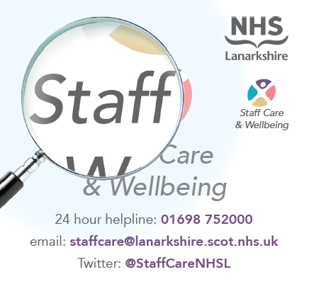
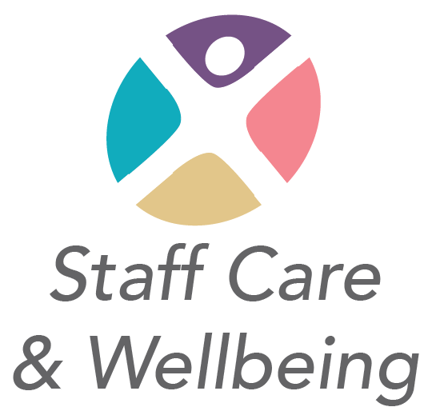

Staff Care and Wellbeing… for a pandemic and beyond!
Supporting health and social care colleagues
across Lanarkshire
Paul Graham, Susan Ross, Lynsey Sutherland

Slide 3

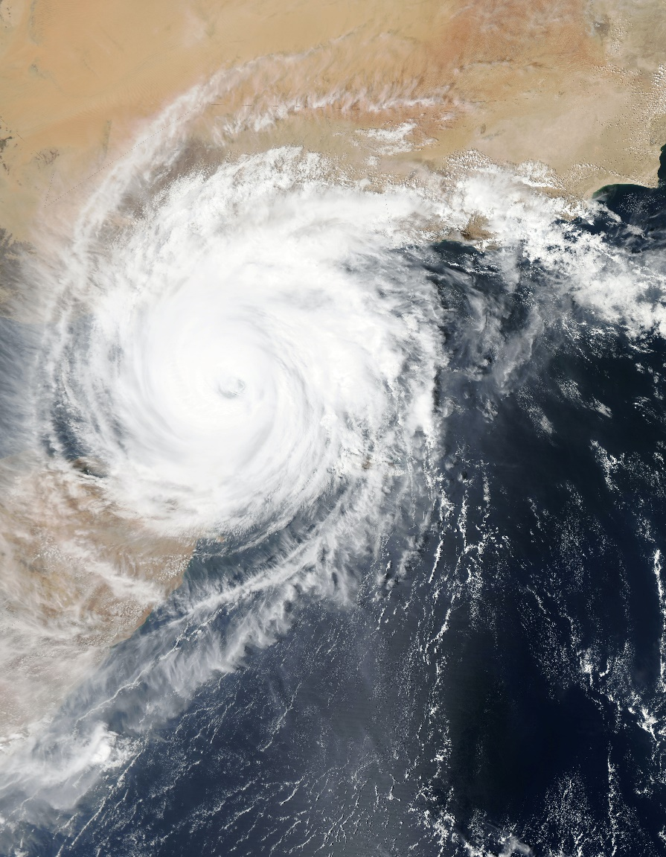
Facing the unknown…
New Collaborations
  Within the NHS
  Across Community and 3rd Sector
  At a National Level
Modified Governance Structures
Resource Flexibility
  Workforce Redeployment
  Reconfiguration of Environments
Photo by NASA on Unsplash

Slide 4
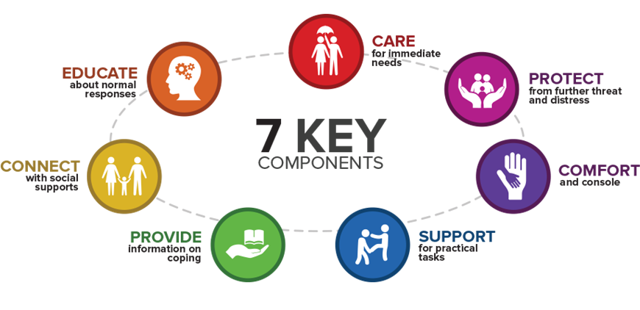
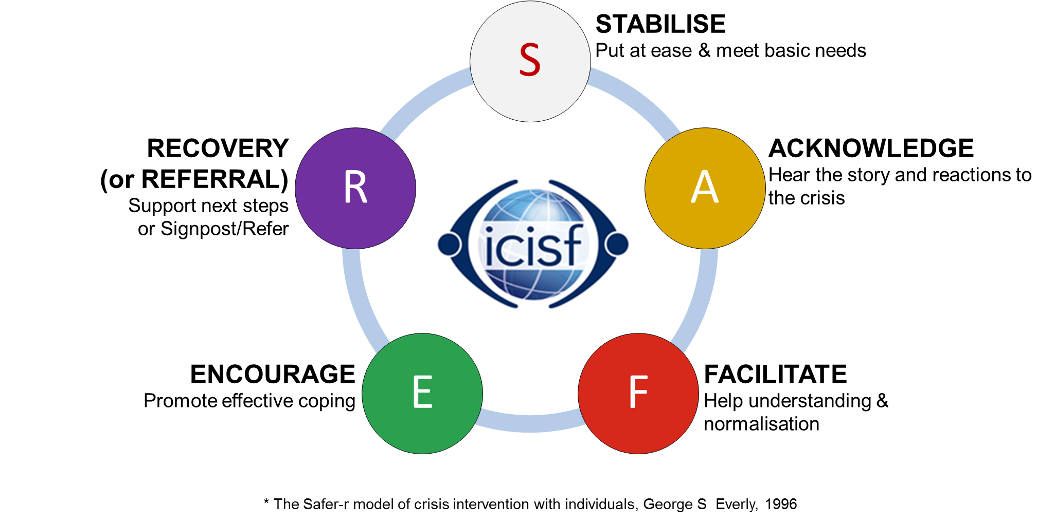
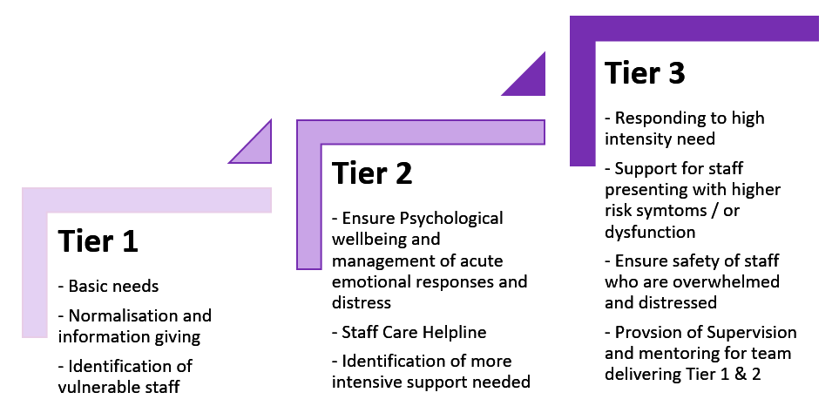
Staff Care & Support Tiered Model

Slide 5
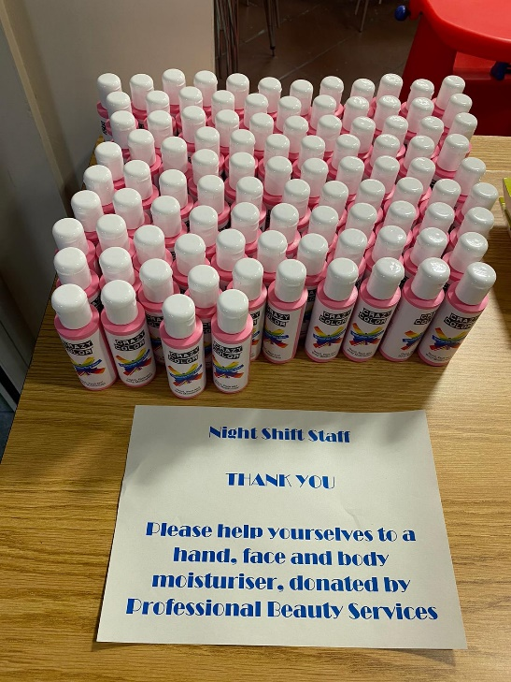
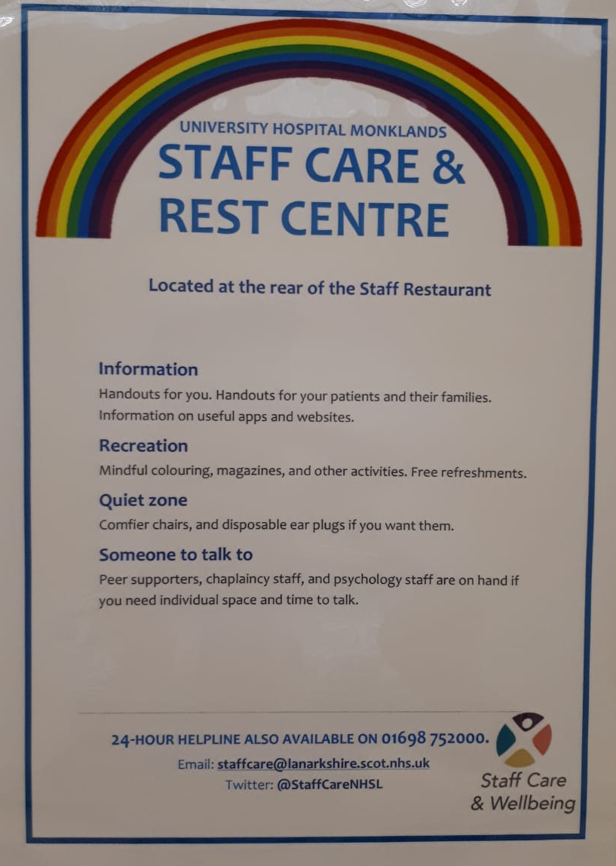
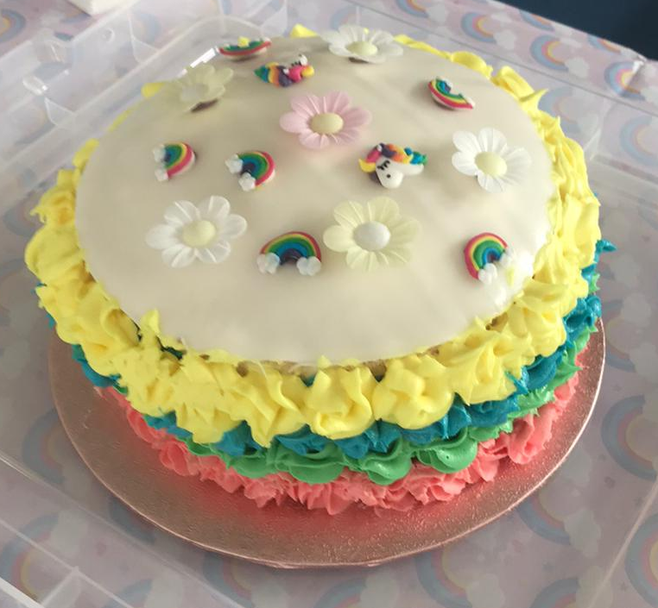
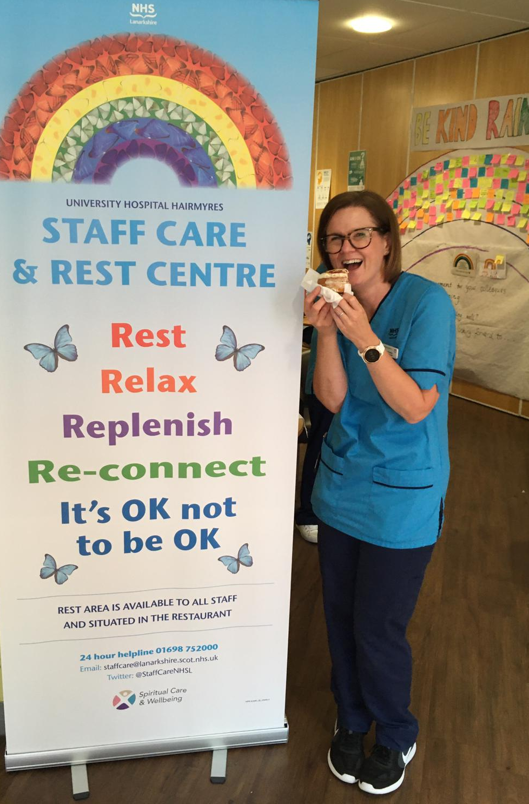
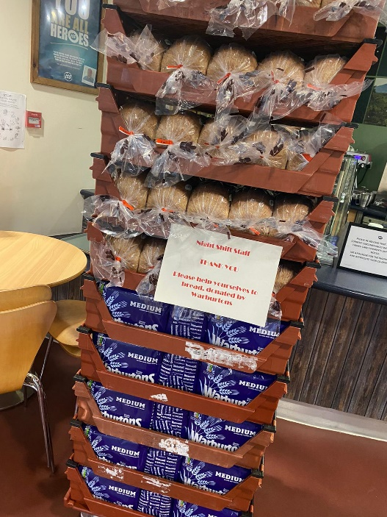

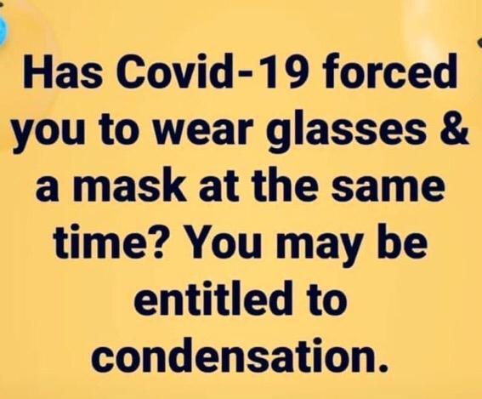
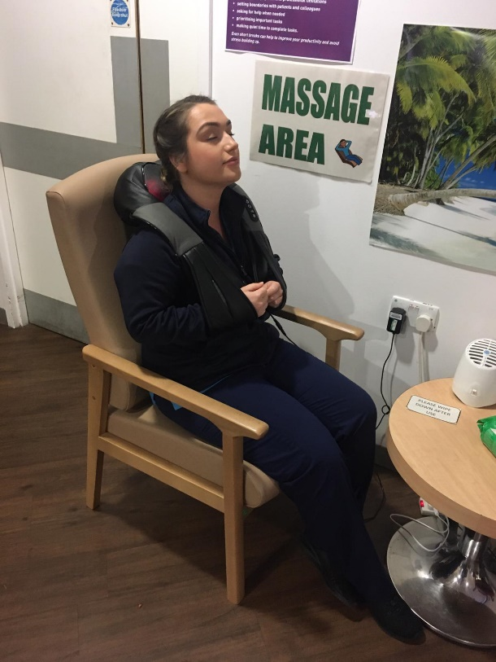
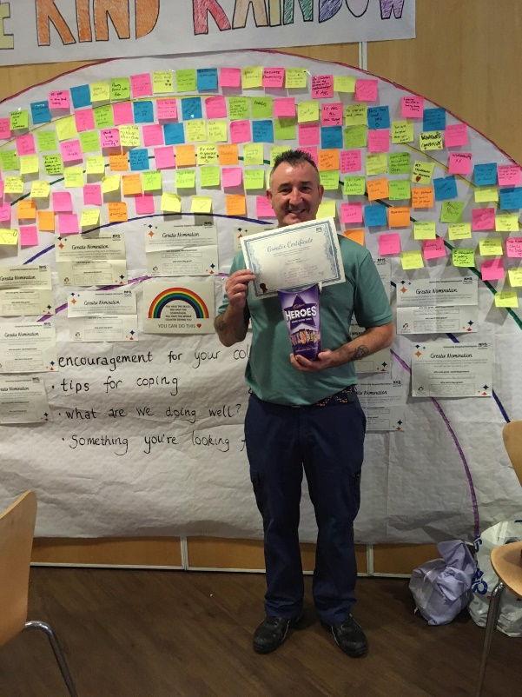
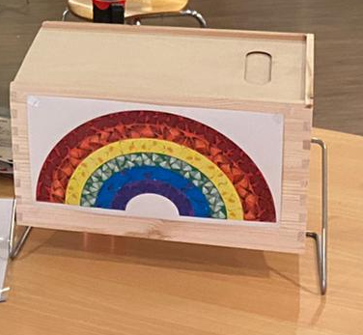
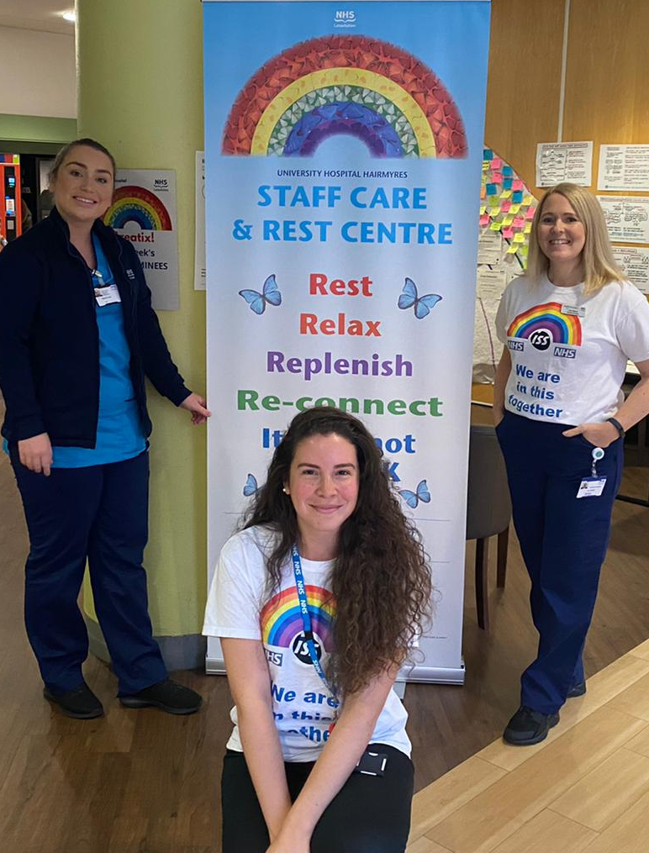
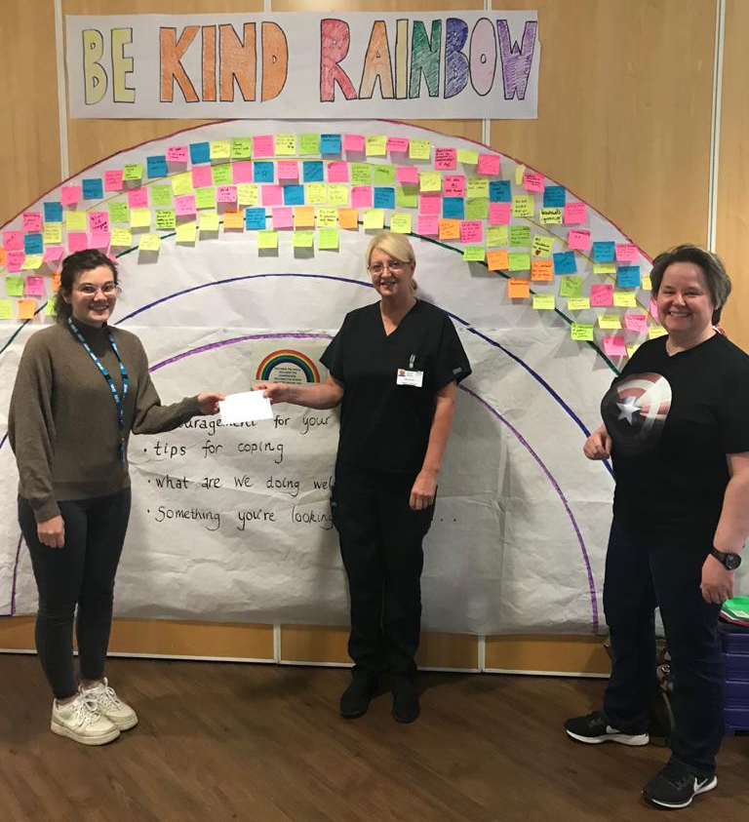
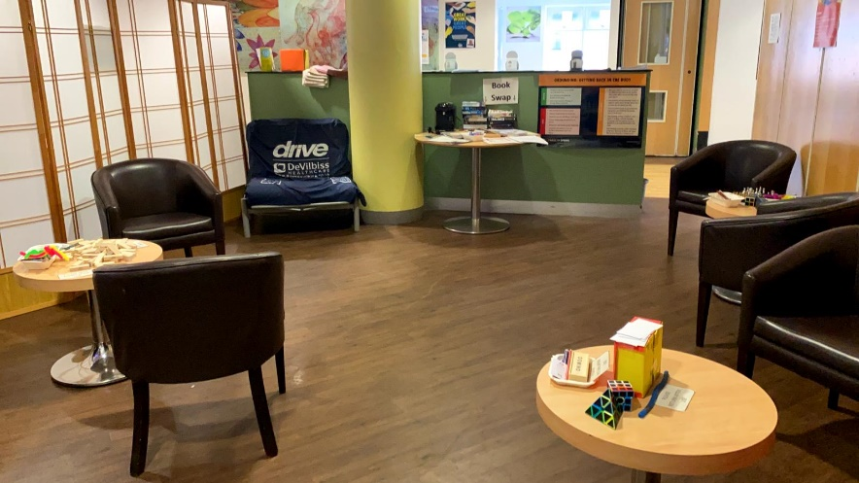
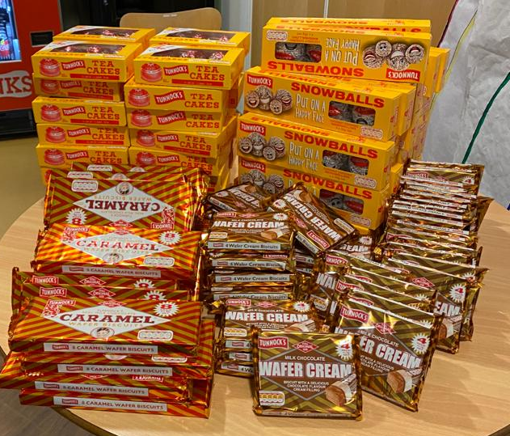

Staff Care & Rest Centres

Slide 6

During Initial Remobilising…
Growing the Model
  Staff Rest Areas
  Care Homes
Increasing Capacity
  MIST
  Peer Support Network
Recovery
  Reflection on Experience
Photo by Chu Tai on Unsplash

Slide 7

Where are we now?
Direction Setting
  Staff Wellbeing Strategy Group
  New Wellbeing Groups
  Staff Engagement & Listening
Resourcing Recovery
  Staff Care Team
  Specialist Psychology Team
  Self Care Training
Photo by Jon Tyson on Unsplash

Slide 8

Looking to the Future…
Strategic Delivery
  QI Approach
  Psychological Safety
Tracking Wellbeing
  Consistent Approach
  Checking with Colleagues
Recovery
  Decompression
  Grief and Healing
  Culture of Kindness
Photo by Victor Garcia on Unsplash

Slide 9
Staff Care and Wellbeing… for a pandemic and beyond!
Supporting health and social care colleagues
across Lanarkshire
Paul Graham, Susan Ross, Lynsey Sutherland

Slide 10
Putting Staff First – Prioritising the Wellbeing and Recovery of Health and Care Teams

Slide 11
Putting Staff First
Order of session:
Opening. Mr Paul Bachoo
“Remobilisation & Recovery: an overview of the organisational context and background”
Mr.Preston Gan
“Response to the challenge: Assessing readiness and recovery (an overview of the questionnaire design and implementation”
Dr Emma Hepburn
“Responding to identified team needs: implementing recovery support and future directions’
Notes:
Grace Milne – speak to her.

Slide 12
Remobilisation & Recovery: an overview of the organisational context and background
Can’t remobilise one bit of the system without the other
The emphasis of working together
Unscheduled flow determine the scheduled flow
Different teams are in different places

Slide 13

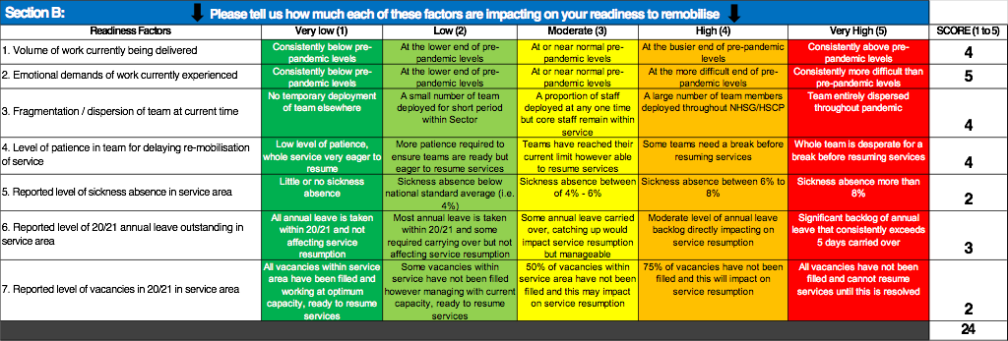

Slide 14
Staff Recovery & Service Remobilisation Readiness: Elective Orthopaedics Surgery (Woodend) & Dependencies – as at 25th Mar’21
Q2 = 4
Q2 = 4
Q3 = 4
No issues
No issues
Q1 = 4
Q2 = 4
Q3 = 4
16
14
22
14
13
11
15
15
15
17
15
15
Q1 = 4
Q5 = 4
Q2 = 4
Q3 = 4
Q5 = 4
Q2 = 4
No issues
No issues
Q3 = 4
Readiness Factors | Very low (1) | Low (2) | Moderate (3) | High (4) | Very High (5)
1. Volume of work currently being delivered | Consistently below pre-pandemic levels | At the lower end of pre-pandemic levels | At or near normal pre-pandemic levels | At the busier end of pre-pandemic levels | Consistently above pre-pandemic levels
2. Emotional demands of work currently experienced | Consistently below pre-pandemic levels | At the lower end of pre-pandemic levels | At or near normal pre-pandemic levels | At the more difficult end of pre-pandemic levels | Consistently more difficult than pre-pandemic levels
3. Fragmentation / dispersion of team at current time | No temporary deployment of team elsewhere | A small number of team deployed for short period within Sector | A proportion of staff deployed at any one time but core staff remain within service | A large number of team members deployed throughout NHSG/HSCP | Team entirely dispersed throughout pandemic
4. Level of patience in team for delaying re-mobilisation of service | Low level of patience, whole service very eager to resume | More patience required to ensure teams are ready but eager to resume services | Teams have reached their current limit however able to resume services | Some teams need a break before resuming services | Whole team is desperate for a break before resuming services
5. Reported level of sickness absence in service area | Little or no sickness absence | Some sickness absence below average | Average level of sickness absence between 3% and 5% | Some sickness absence above average | High sickness absence consistently above average
6. Reported level of 20/21 annual leave outstanding in service area | All annual leave is planned within 20/21 and not affecting service resumption | Some annual leave is planned within 20/21 and some required carrying over but not affecting service resumption | Some annual leave carried over, catching up would impact service resumption but manageable | Moderate level of annual leave backlog directly impacting on service resumption | Significant backlog of annual leave that consistently exceeds 5 days carried over
7. Reported level of vacancies in 20/21 in service area | All vacancies within service area have been filled and working at optimum capacity, ready to resume services | Some vacancies within service have not been filled however managing with current capacity, ready to resume services | 50% of vacancies within service area have not been filled and this may impact on service resumption | 75% of vacancies have not been filled and this will impact on service resumption | All vacancies have not been filled and cannot resume services until this is resolved

Slide 15
Implementing Recovery Support
Team Recovery sits within overall "We Care" Programme for staff wellbeing.
Teams recovery support needs identified via readiness questionnaire & qualitative feedback of support needs.
Follow up information sessions held when readiness/ recovery needs identified.
Mapping and coordinating of existing supports in the system, including capacity and sustainability
Identification of gaps in support needs and additional resource requirements.
Review of evidence base on team support and recovery mechanisms.

Slide 18
Implementing Recovery Support
Matching of recovery needs to support
Medical Secretary team. Stress in relation to changes in role.
Value Based Reflective Practice
Physio & OT Team
High level of demands and team changes
Bespoke recovery session
Further identification of team supports for management
Portering team

Slide 19
Future plans
Development of comprehensive tiered programme of support
Co-ordinated and accessible system to access support
System in place to help match support needs to suitable intervention
Evaluation of effectiveness and application of learning for future planning & delivery
Clear linking in to "We Care" and culture programme

Slide 20
Thank you for listening
For further information please contact
Dr Emma Hepburn
emma.hepburn2@nhs.scot

Slide 21
Staff Wellbeing Throughout the Pandemic from Redeployment to a Flexible New Way of Working

Slide 22
Overview
Background and Wellbeing culture
How we kept in touch about wellbeing during the pandemic
The feedback from staff
The key actions
Their impact
Notes:
Represent the work of teams of people in our service. Focus on new tools we have used in this unusual year.
We are a large MSK out patient Physiotherapy service with 205 staff spread over more than 40 sites & 72 GP practices across great glasgow and clyde health board. And we treat over 80,000 new patients each year helping them to recover from injury, surgery and the effects of being on the planet.
In this short presentation Im just going to focus on some of the highlights and service wide intiatitives reated to wellbeing not go into too much detail so a lots of

Slide 23

New Economics Foundation, Foresight report 2008
Notes:
Wellbeing approach was well established within our service with a wellbeing steering group, representation from all grades and areas of our service (200 staff on 41 sites).
We have used this approach now for several years with a number of specific initiatives. We have 6 qualified mindfulness teachers within our staff and have delivered the evidence based MBSR within working hourse for a number of years.
We have a wellbeing steering group with representation from all areas who meet regularly. Wellbeing is a standing item on team meeting agenda and wherever possible staff anre encoutraged to talk about and take action to support wellbing. So at the start of the pandemic we had a foundation on which to build.
We had offered MBSR dring working hourse over several years, a yearly wellbeing event and had welbe as a standing tems on team agendas. We Had a staff newsletter with an emphasis on all 5 topics above. So we had a foundation on which to build when the pandemic hit

Slide 24
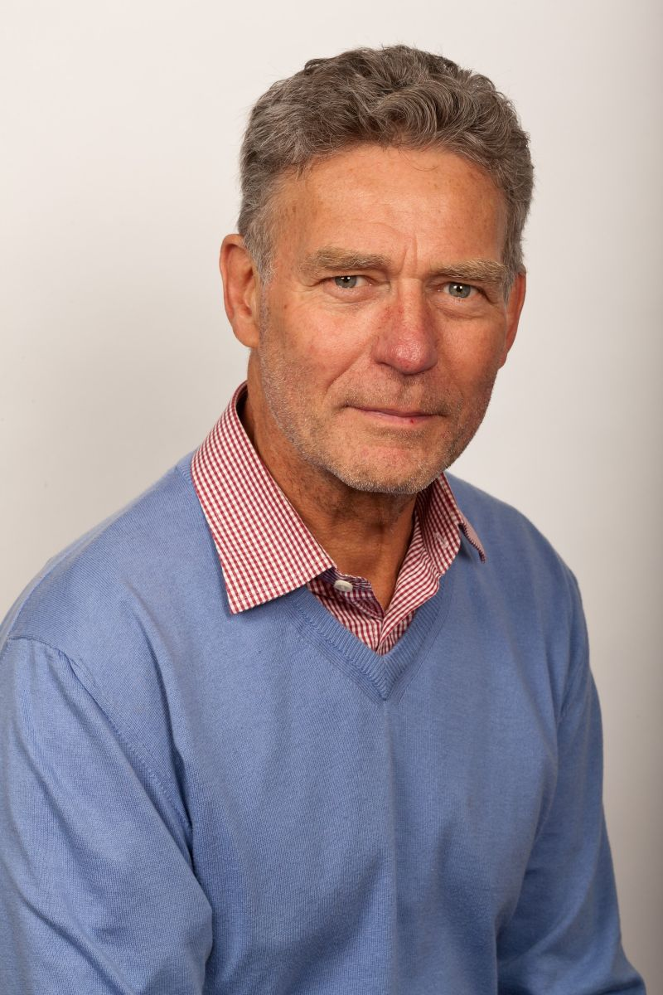
Compassionate Leadership
(particularly during the pandemic)
Be present and ‘Listen with fascination’.
Understand the cause of the pain.
Respond with empathy but without being overwhelmed.
Provide help, or service in some way.
Professor Michael West
Notes:
As the pandemic hit We had 80% of our out-patient MSK physio staff re-deployed to acute wards and departments.
Our injection therapists joined the in patient and care home vaccination programme.
We continued to treat patients with an urgent MSK problem and re-opened to routine care largely on the telephone.
We aspire to be compassionate leaders and were guided by the work of Profesor west in really liste
So lots of new ways of working and adaptation required.

Slide 25

Listen to understand
Notes:
In all the usual ways but I want to mention some tools that we have used more in a virtual environment that may be if interst to others.

Slide 26
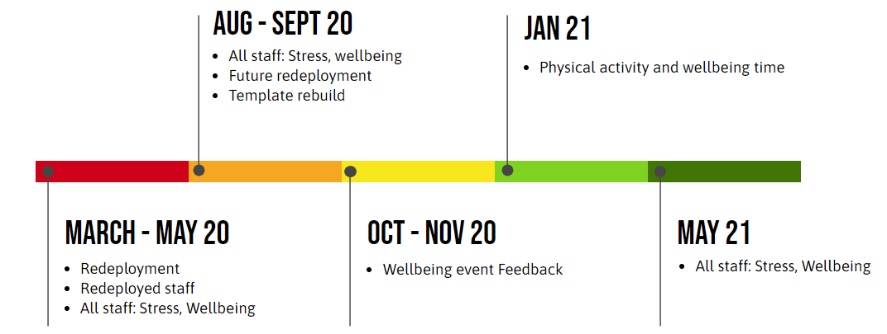
Our Webropol Journey
Notes:
Flurry of activity at the height of the pandemic and during redelopyment, but still being used

Slide 27
The key feedback
Communication challenges
Lack of Time: new ways of working
Lack of Movement: Telephone appointments
Notes:
Particularly in August 2020 our biggest survey for all staff once our service was up and running again, mainly virtual on telephone, staff really starting to feel the effects of months of working differently. Lots of feedback and suggestions for changes but the main points were that it was difficult to communicate well when not meeting as usual, that virtual working, mainly over the phone, for a physical service like MSK Physiotherapy takes longer, to communicate and send patients appropriate exercises and advice via email or post. And finally staff who are used to moving were really feeling the physical and psychological effects of immobility.

Slide 28
Actions
Notes:
Of course there is lots of detail here but Im just going to identify a few highlights again that may be useful to others. Esp in rela to communication 1:1 comms by phone and teams meetings really helped. But Ill mention the more service wide strategic communications

Slide 29
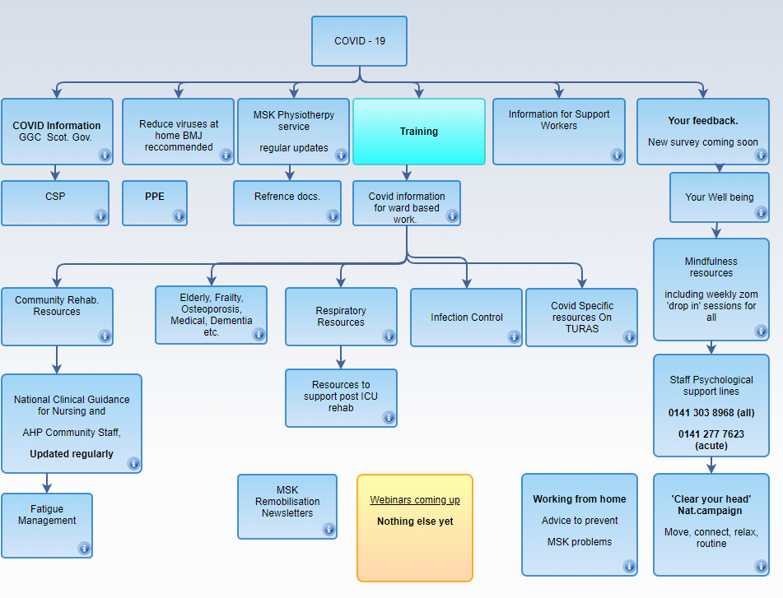
Clinical Knowledge Publisher (NES) Web based
COVID-19 resources in March 2020
Supported self management resources (for patients) in May 2020
CPD in May 2021
Notes:
Very early on we made informationa vailable online using NES platform that all staff were already familiar with for clinical pathways. We quickly created new pthways for COVID related training and information fo staff who were being redeployed. Over 80 of our staff volunteered to be redeployed. We then created another one

Slide 30
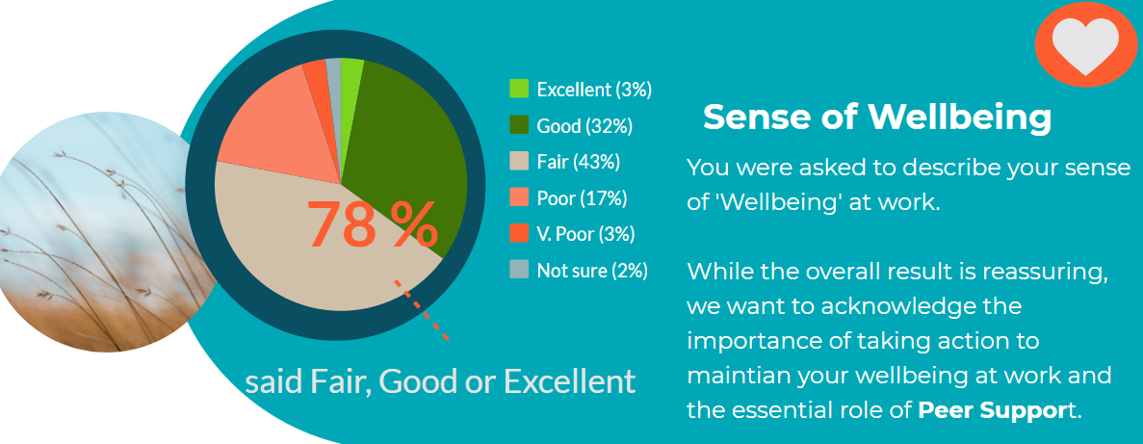
Piktochart for staff September 2020: Wellbeing
Data from Webropol to all staff in August 2020
Notes:
And we communicated back to staff using Piktochart

Slide 31
The key feedback
Communication challenges
Lack of Time: new ways of working
Lack of Movement: Telephone appointments
Notes:
Particularly in August 2020 our biggest survey for all staff once our service was up and running again, mainly virtual on telephone, staff really starting to feel the effects of months of working differently. Lots of feedback and suggestions for changes but the main points were that it was difficult to communicate well when not meeting as usual, that virtual working, mainly over the phone, for a physical service like MSK Physiotherapy takes longer, to communicate and send patients appropriate exercises and advice via email or post. And finally staff who are used to moving were really feeling the physical and psychological effects of immobility.

Slide 32
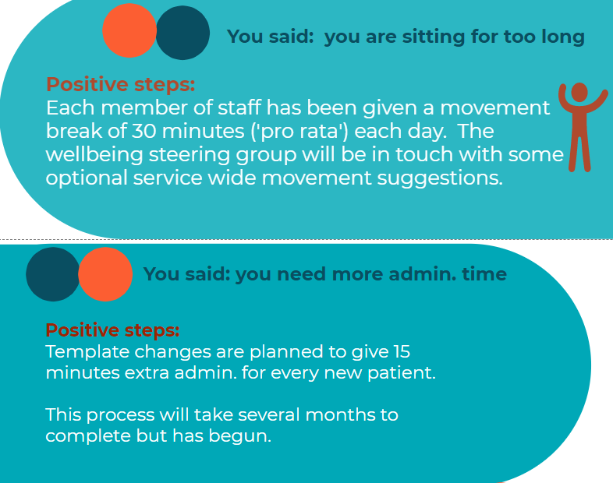
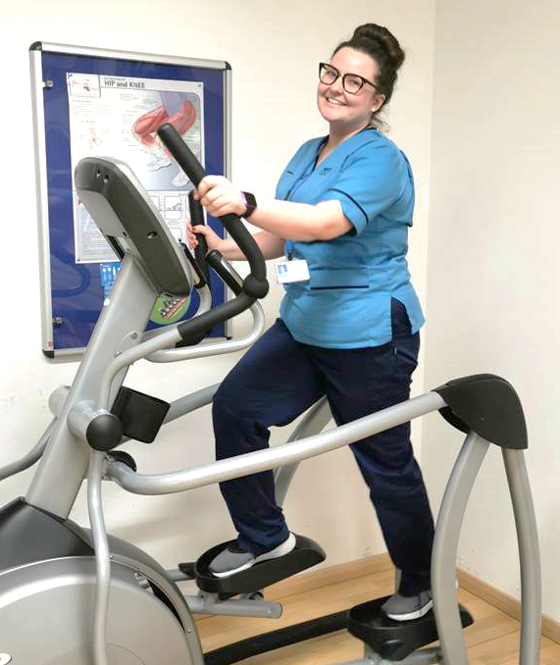

Piktochart for staff September 2020:
Notes:
Two key actions were to add 15 minutes to each new patient time slot to accommodate the nincreaded admin needs and all electronic Trak care templates were changed. That change was complete by fed 2021.
And an even more significant change was to offer all staff 30 minutes each day to be active at work.

Slide 33
Our Physical Activity Video
Notes:
And here are some examples of what staff did in that time.

Slide 34
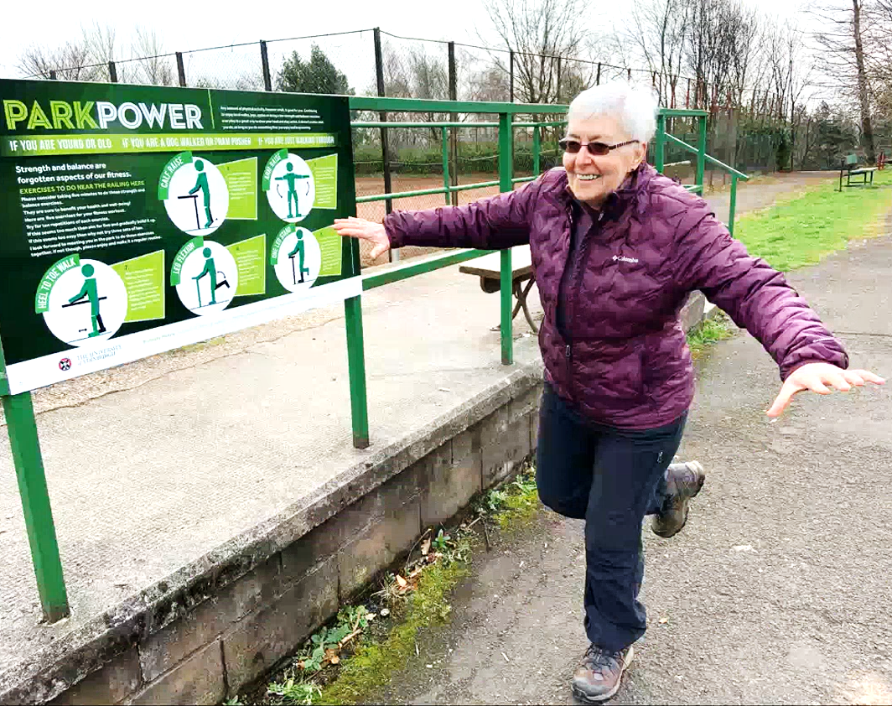
The benefits of Physical Activity
Something is better than nothing
Some movement is good, more is better
Increase at your own pace
Do something that makes you feel good!
Reduce long periods of not moving.
Take regular breaks from the screen
  10 sit to stand
  10 arm raises above your head
Take the dog for a walk, even if you don’t have a dog!
Prof. Nanette Mutrie doing some strength and balance exercises outside with her ‘Park Power’ signs.
Notes:
Right now, Physical activity Improves sleep, makes you feel better mentally and physically, helps to manage your weight. Prof N M chair of PA for health at uni of Edin and chair of CMO expert group on PA messaging. She also emphasises that we know that PA enhances immunity..

Slide 35

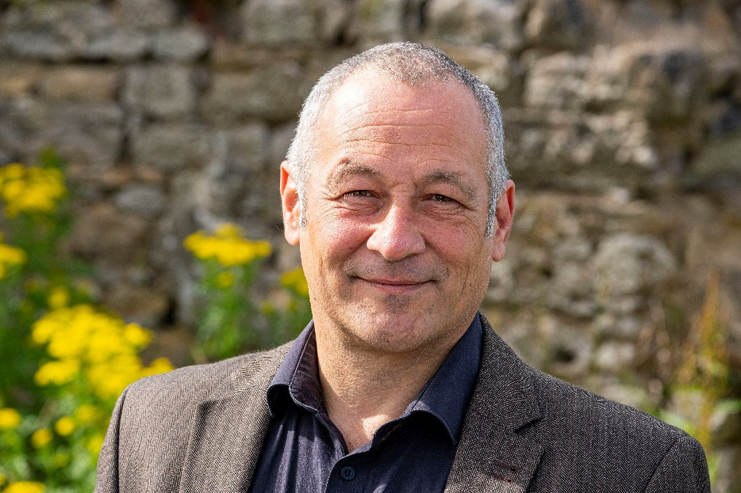
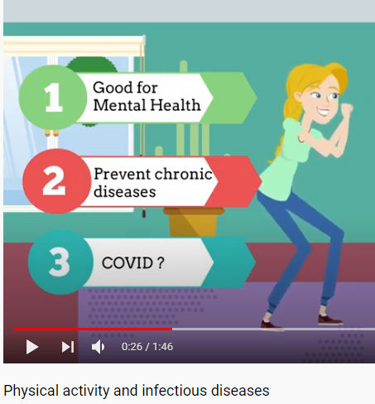
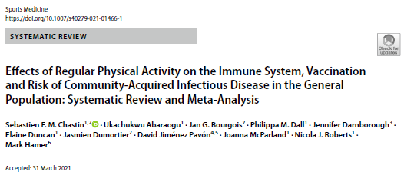
Increased Immune response and Physical Activity
Professor Sebastian Chastin
‘World’s largest study of its kind finds that exercise reduces the chance of contracting infectious diseases (such as COVID-19) by 31 per cent and increases the effectiveness of vaccination by up to 40 per cent’.
U tube animation:
Physical Activity and
Infections disease
Notes:
Lead author Professor of Health Behaviour Dynamics Sebastien Chastin . Regular physical activity cuts the risk of dying from infectious diseases such as COVID-19 by 37 per cent and reduces the chance of catching the virus by 31 per cent, according to new global research.
The research carried out by an international team of researchers, led by Glasgow Caledonian University’s Professor of Health Behaviour Dynamics Sebastien Chastin, also found that physical activity can boost the effectiveness of vaccines by up to 40 per cent.

Slide 36
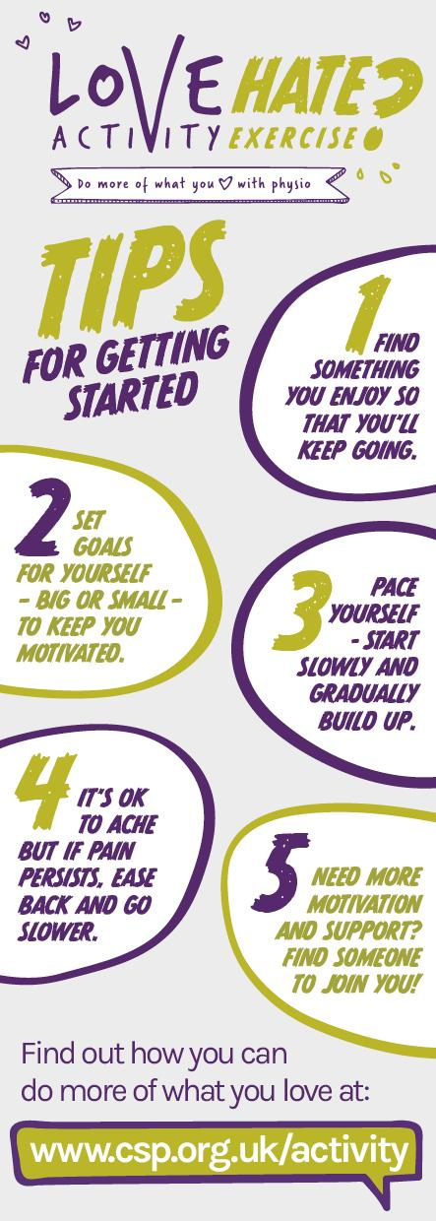
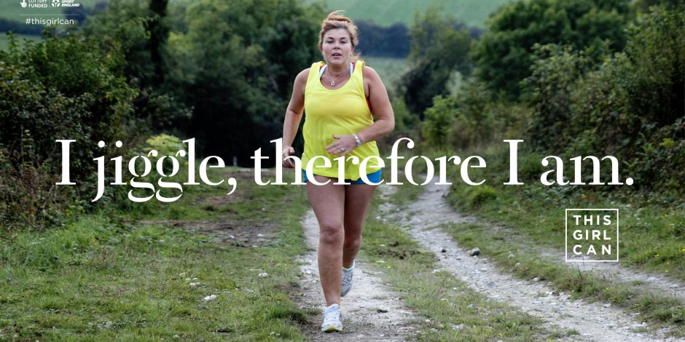
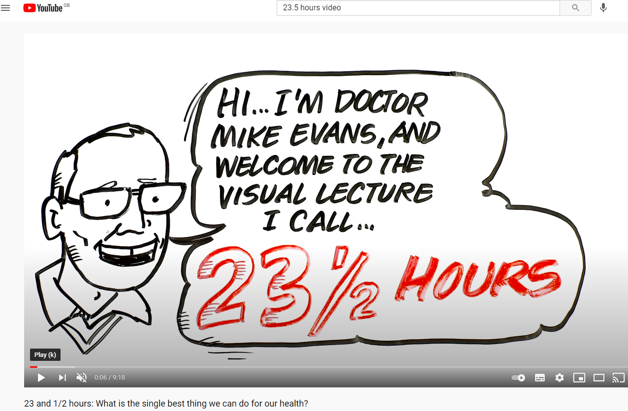

Slide 37
Impact

Slide 38
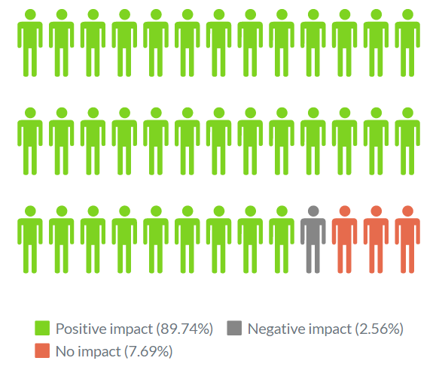
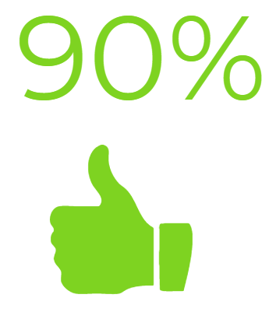
What impact has having 30 minutes of
Physical Activity each day had on your wellbeing?
Notes:
Quant feedback Jan 2021

Slide 39
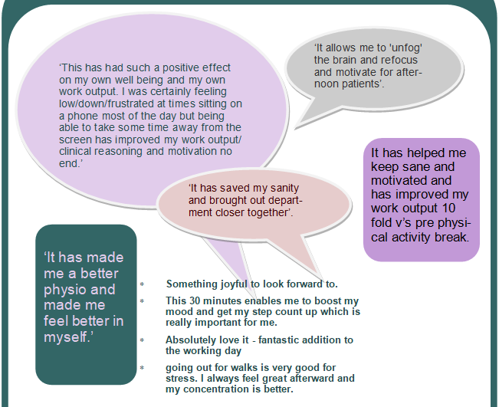
Staff feedback: newsletter extract
Joyful
Unfog
Focus
Motivate
Mood boost
Increased output
Notes:
We can see for the qualitative feedback that improved mood, helped concentration, clinical reasoning.

Slide 40
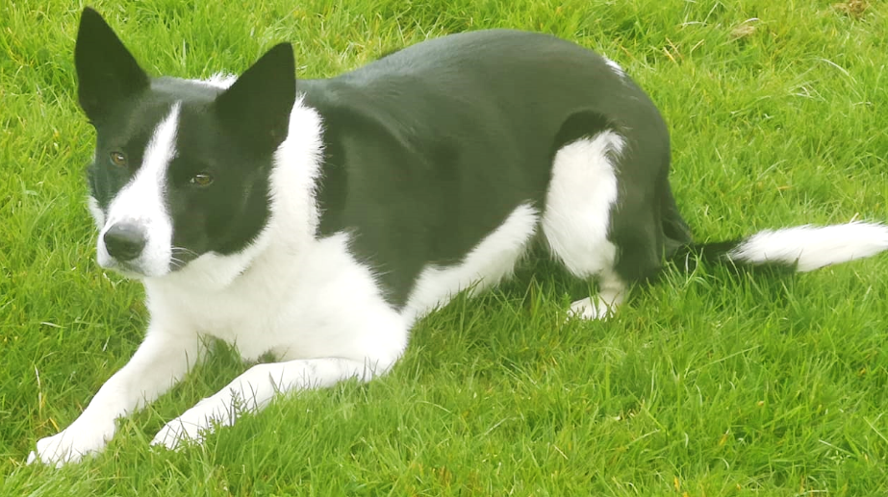
Managers
As a leader for my team I felt it was important to lead by example.
I try to get out for a short walk in the middle of the day, alone or with my dog.
Skye
I have really benefited from the physical activity time as it helps me clear my mind and refocus.
I believe the time invested improves my productivity and also helps me feel valued as an employee of NHSGGC.
Fiona Rough, GP APP leader

Slide 41
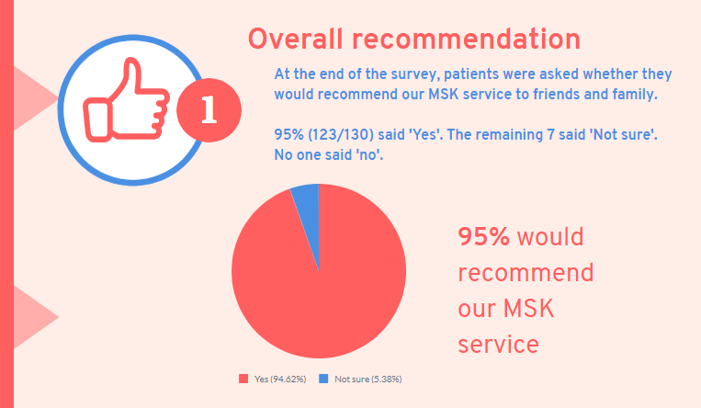
Patient feedback

Slide 42

Dr Helen Little
Head of service for MSK Physiotherapy GG&C
Wellbeing really matters for quality
Listen and hear what staff say
Needs support at the highest level
Absence rates below 2 %
Notes:
And finally a few words form Dr Helen Little, our Head of service about how to make this work

Slide 43
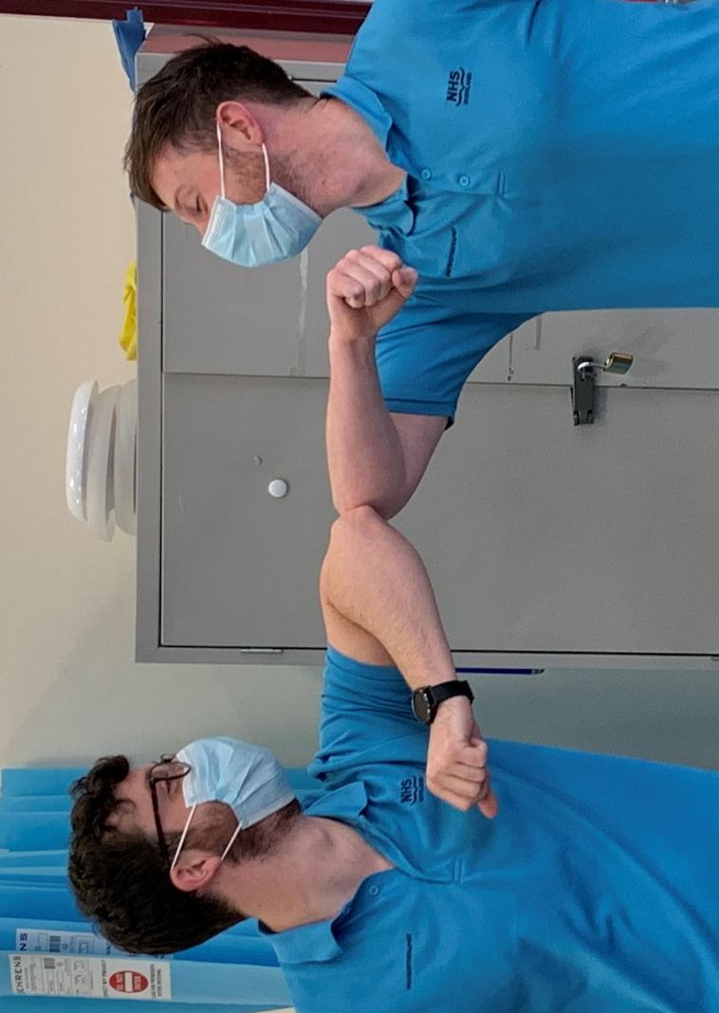
Notes:
So to come full circle, we have seen how embracing new technology and tools such as webropol, CKP and pictochart have allowed us to listen with factination to really understand and then to communicate in new ways across our large workforce on over 100 sites.
We have seen that two of the key things driving stress were time pressure and immobility and both have led to practical actions to reduce their harmful imapct.
But I want to just finish on this final point. When asked, staff said that one of the main things that made a good day at work was Peer Support.
And what we mean by that is simple, everyday Kindness. We don’t need to go on a course or watch a video. We know how to give it, we know what if feels like to receive it and we certainly notice when its absent.
The kindness that we show towards our patients, towards each other and last but not least towards ourselves is perhaps the most important element to wellbeing at work.
Thank you

Slide 44
Thank You

