Slide 1
Edinburgh’s Story – the Three Conversations Approach
Nikki Conway, Locality Manager, Edinburgh Health and Social Care Partnership (City of Edinburgh Council)
Jan Stuart, South East Innovation Team Lead / 3Cs Practice Lead, Edinburgh Health and Social Care Partnership (City of Edinburgh Council)

Slide 2

The Story So Far… Why 3 Conversations?
3 Conversations provides an effective approach in supporting culture change
We need to support more people as efficiently, effectively, and as early as possible in their journey
Focus on prevention, early intervention and person centred approaches
Having open and interested conversations with people who need support – focussing on the person not bureaucracy
The power of collaboration with colleagues and partners and using connections to make things happen to help people get on with their lives
Building a sustainable, high quality health and social care system for Edinburgh

Slide 3
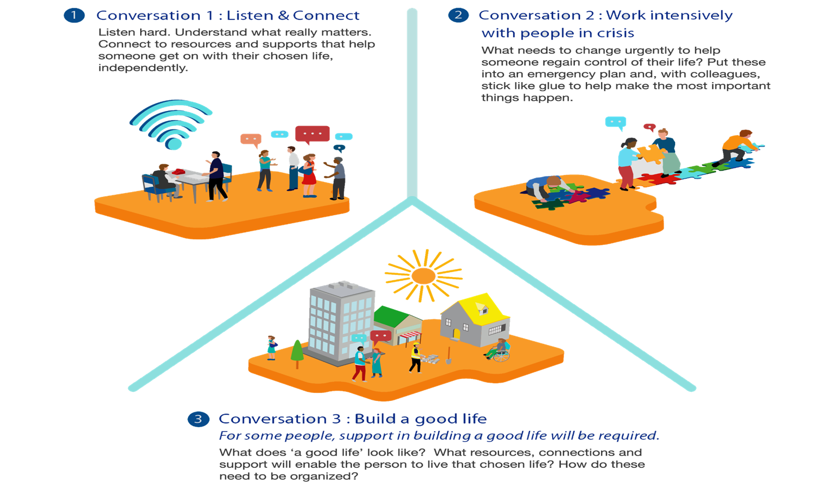
The Three Conversations Approach
A new way of working
Having open and interested conversations with people and families who need support
Collaborating with colleagues and partners to make things happen – not referring on to others or ‘handing off’
People and families are the experts in their own lives

Slide 4
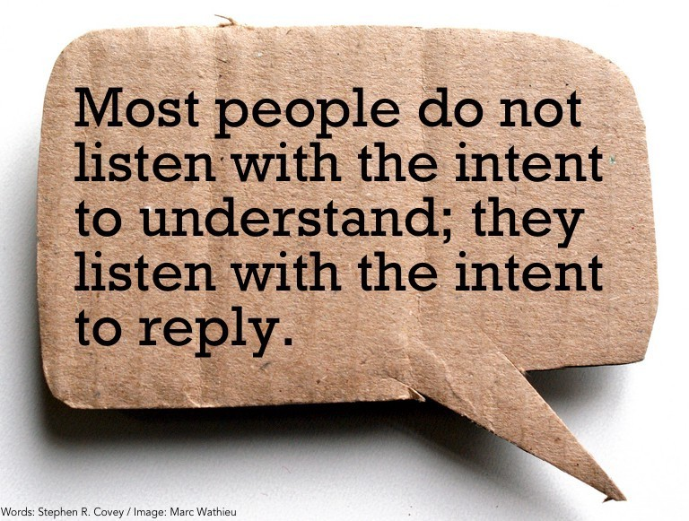
Conversation One
      Not just for people we’ve not met before!
      Developing a rapport/relationship – quickly
      Understanding what really matters
      Connecting people to local resources and opportunities - not the same as an ‘information and advice’
      Helping people’s life work better
      Can be in any setting

Slide 5

Conversation Two
We use it immediately we detect instability, crisis, risk of people losing control of their life, their quality of life, becoming dependent on formal care
or…
Where people need more of our time to support their situation and help move them on towards independence

Slide 6


Conversation Three
Open, honest conversations about the informal and formal support options available
Work with the person and anyone else they’d like to be involved to develop their Care and Support
Plan, and organise the support.
Agree with the person when you’ll contact them to check how things are going.
If everything is working with their plan, and they are getting on with their lives, that’s great.
Be prepared to have further conversations to either tweak the plan or make more significant changes to help them get on better with their lives

Slide 7
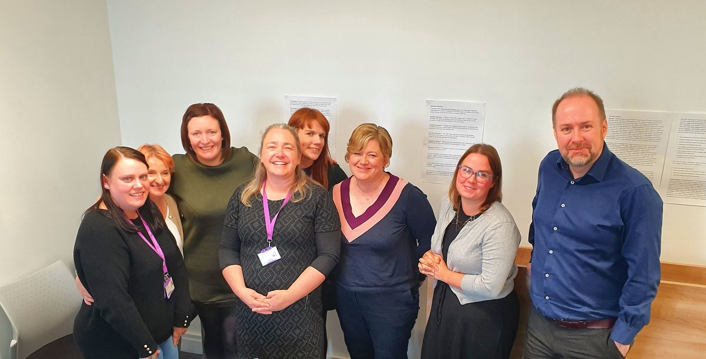
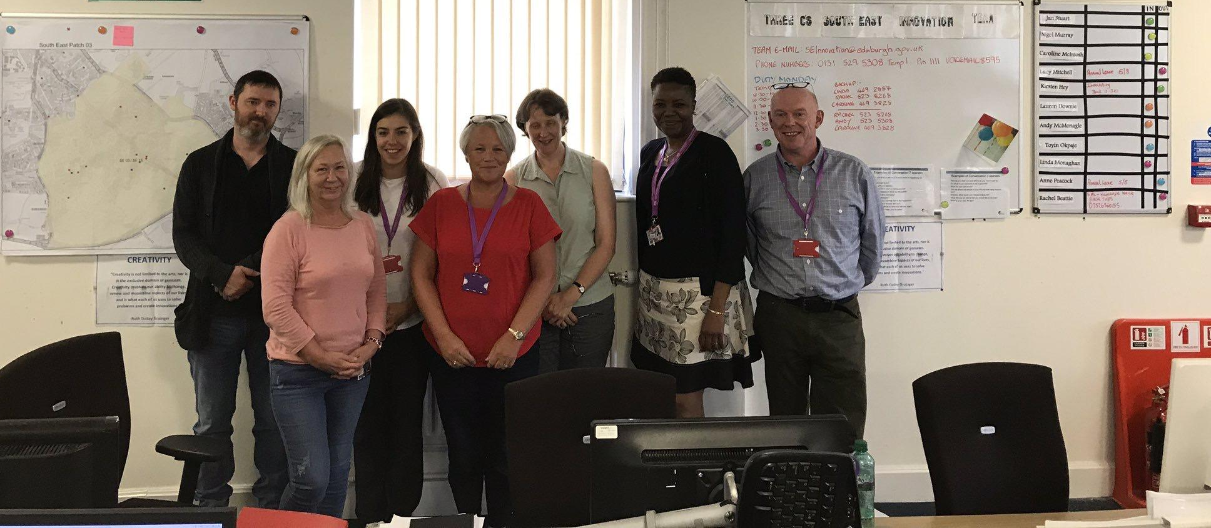
Our innovation sites
North East start date 7/10/19 All new contacts received on Mondays and Tuesdays
South East
SE 05 from 29/7/19 SE 03 from 30/9/19
Community Rehab service
Expanded to cover whole service 08/07/20
South East
Expanded team
08/12/21
Young Adult Disability service start date 7/10/19 All 2020 school leavers
Due soon
South East team 2
South East Review Team
South West Team 2
MH Supported Living
Community Rehab service start date 7/10/19
People in South West area
Residential Review team
All new contacts from 30/9/19
North West start date 11/11/19
All social work waiting list
North West start date 08/12/21
Expanded to the Tower & Bridge Teams
South West start date 7/10/19
Canal Cluster waiting list

Slide 8

A challenging year

Slide 9
What can it help achieve for people?
Improves the experience of people and families who need support
Significantly improves workers’ job satisfaction and productivity – by liberating them to do the role they aspired to
Supports independence and connectedness with community
Reduces the bureaucracy that threatens to drown us all
Has been successfully implemented and evaluated across the UK

Slide 10

KPI - Responsiveness
Are we more responsive?
Sites are responding to people very quickly, the average wait to see a worker now at 2.5 days for new people and those with existing support plans contacting the Partnership
Most teams operate without a waiting list throughout period under evaluation

Slide 11
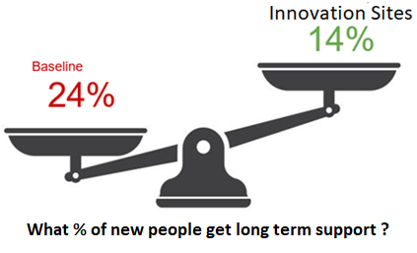
KPI - Effectiveness
Are we more effective?
Most people (56%) are supported at Conversation 1 by listening and connecting them with informal or community resources
A further 20% were helped through Conversation 2 with short term low cost or no cost support
76% of people did not require Conversation 3, in otherwise did not required paid for formal support
Of the people who have gone on to require long-term paid for support only 14% of new people required this compared to the pre-innovation average of 24%.

Slide 12



What people say
“The staff have been admirable. They really make a point of getting to know you”
“It got me out and about again, I have been missing going out”
“Right from the beginning they have been very interested in me, right from when they came to see me straight after I came out of the hospital, a week after I think it was”
(Before three conversations approach, this lady would have been waiting for 4-6 weeks)
“She has a great relationship with her granny and I’d love that to be nurtured further through this way of working”

Slide 13


Slide 14
The Role of Social Work in Recovery Re-mobilisation and Re-design Across Health and Social Care
Alison Bavidge, National Director, Scottish Association of Social Work

Slide 15
Why am I here?

Slide 16

About us
In Scotland: over 10,000 registered social workers; mainly in LA fieldwork
Specialisms (adults, children, justice) and sub-specialisms (child and adult protection, learning difficulties, mental health, older people)
Complex environment
Impact of the pandemic
Independent Review of Adult Social Care/National Care Service

Slide 17
Social services
Social care
Social work
Personal care
Social support
Practical help
Holistic assessment
Statutory interventions
Therapeutic relationships

Slide 18
What’s special about social work
Video 1

Slide 19
How do we work?
Series of conversations; often with many people, sometimes difficult
Relationship-based; takes time
Holistic; individual, family, work, education, leisure, desires, legal positions (social/systems models)
Recognises the issues are often not sited within the person themselves (disability model)
Notes:
.

Slide 20
What makes social work assessment unique?
Video 2

Slide 21

Social work - transitions
From James Cox, SASW member and SG CP Adviser

Slide 22
The potential and the challenges
Increase in inequalities
Mental health
Substance use
Domestic abuse
Bereavement
Loss of independence
Social change
Eligibility
Resource
Structures
"Statutory" duties

Slide 23
Hopes for pandemic recovery
Video 3

Slide 24
Reconnect – Community Health through Digital Stealth
Kimberley Alshaikly, Learn Digital coordinator, People Know How Claudia Baldacchino, Graphic Designer and Communications & IT Officer, People Know How

Slide 25



Slide 26
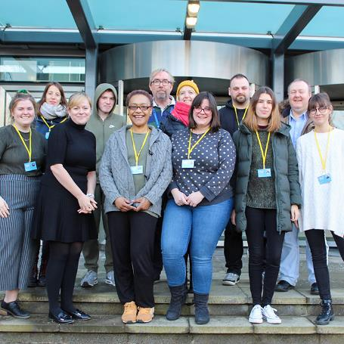
Who are we?
A social innovation charity​
Working with people and communities to develop
innovative strategies and services to address
social issues
Edinburgh and East Lothian​
Staff and 200 VIPs (volunteers, interns and placement students)
Core services:​
  Reconnect, supporting adults and families to improve
  wellbeing through digital and social inclusion. ​
  Positive Transitions, supporting children, young people and families;​
We are also passionate about cross-sectoral ​
collaboration and regularly hold events and initiate research​

Slide 27

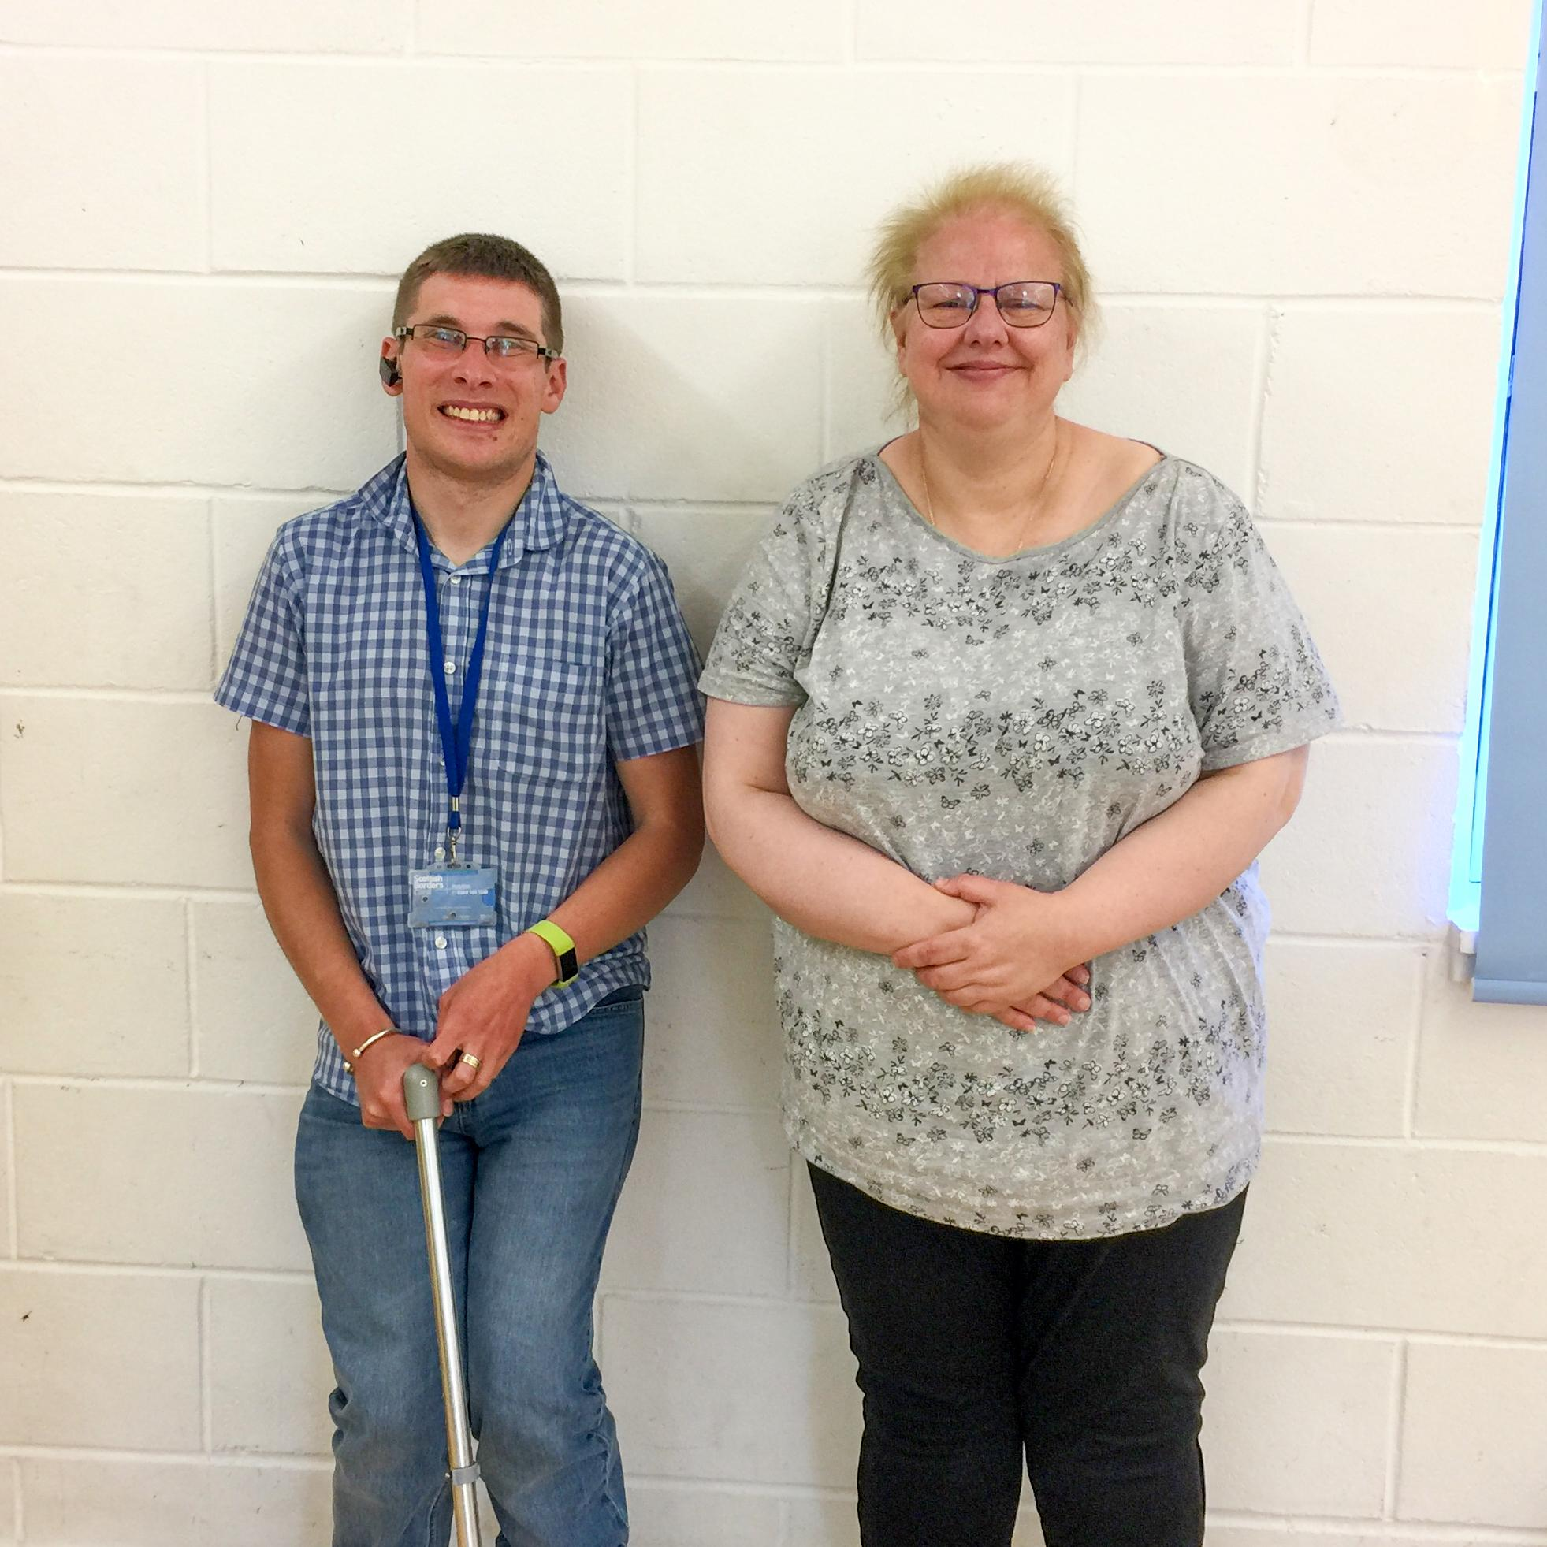
Supporting adults and families to improve
wellbeing by increasing digital and social inclusion
Digital inclusion + social inclusion
  Getting the device
  Getting the support
  Getting connectivity
Building digital skills, maintaining connections
  Improve financial health, increase employability, access resources, and more
One-to-one tailored approach

Slide 28
Adapting in lockdown
We had to ask ourselves:
  Who do we communicate with (audience)?
    Other staff members
    Service users
    Other organisations, partners
    Funders
  How do communicate?
    Emails
    Face to face sessions
    “Corridor conversations” or quick desk catch-ups
We had to make sure all staff understood the technology - accessibility
We had to make sure service users understood the technology
We had to make sure that, in bringing everything online, our service users would be protected
Notes:
I think its important to mention that in organisation no staff member is left behind. We focus on strengths and come together to support staff members where needed.

Slide 29
Finding the tools
Using the tools we already had to their full potential
  Office 365 non-profit subscription:
    OneDrive – individual cloud storage
    SharePoint – group cloud storage and group collaboration
    Planner – efficient project management
    Forms – simple form building, sharing and data analysis
    Microsoft Teams – communication and integration of all of the above
    Stream – video sharing service
    Powerful admin back-end
  Social media following and website knowledge
Notes:
This is great – it would be cool to mention that these should not be temporary changes but a new way of working. Everyone can work on the same document at the same time. Meetings across organisations can be organised quickly. Establishing trust and good relationships with work force by not micro managing. More flexibility for cares = more diversity and equality.

Slide 30
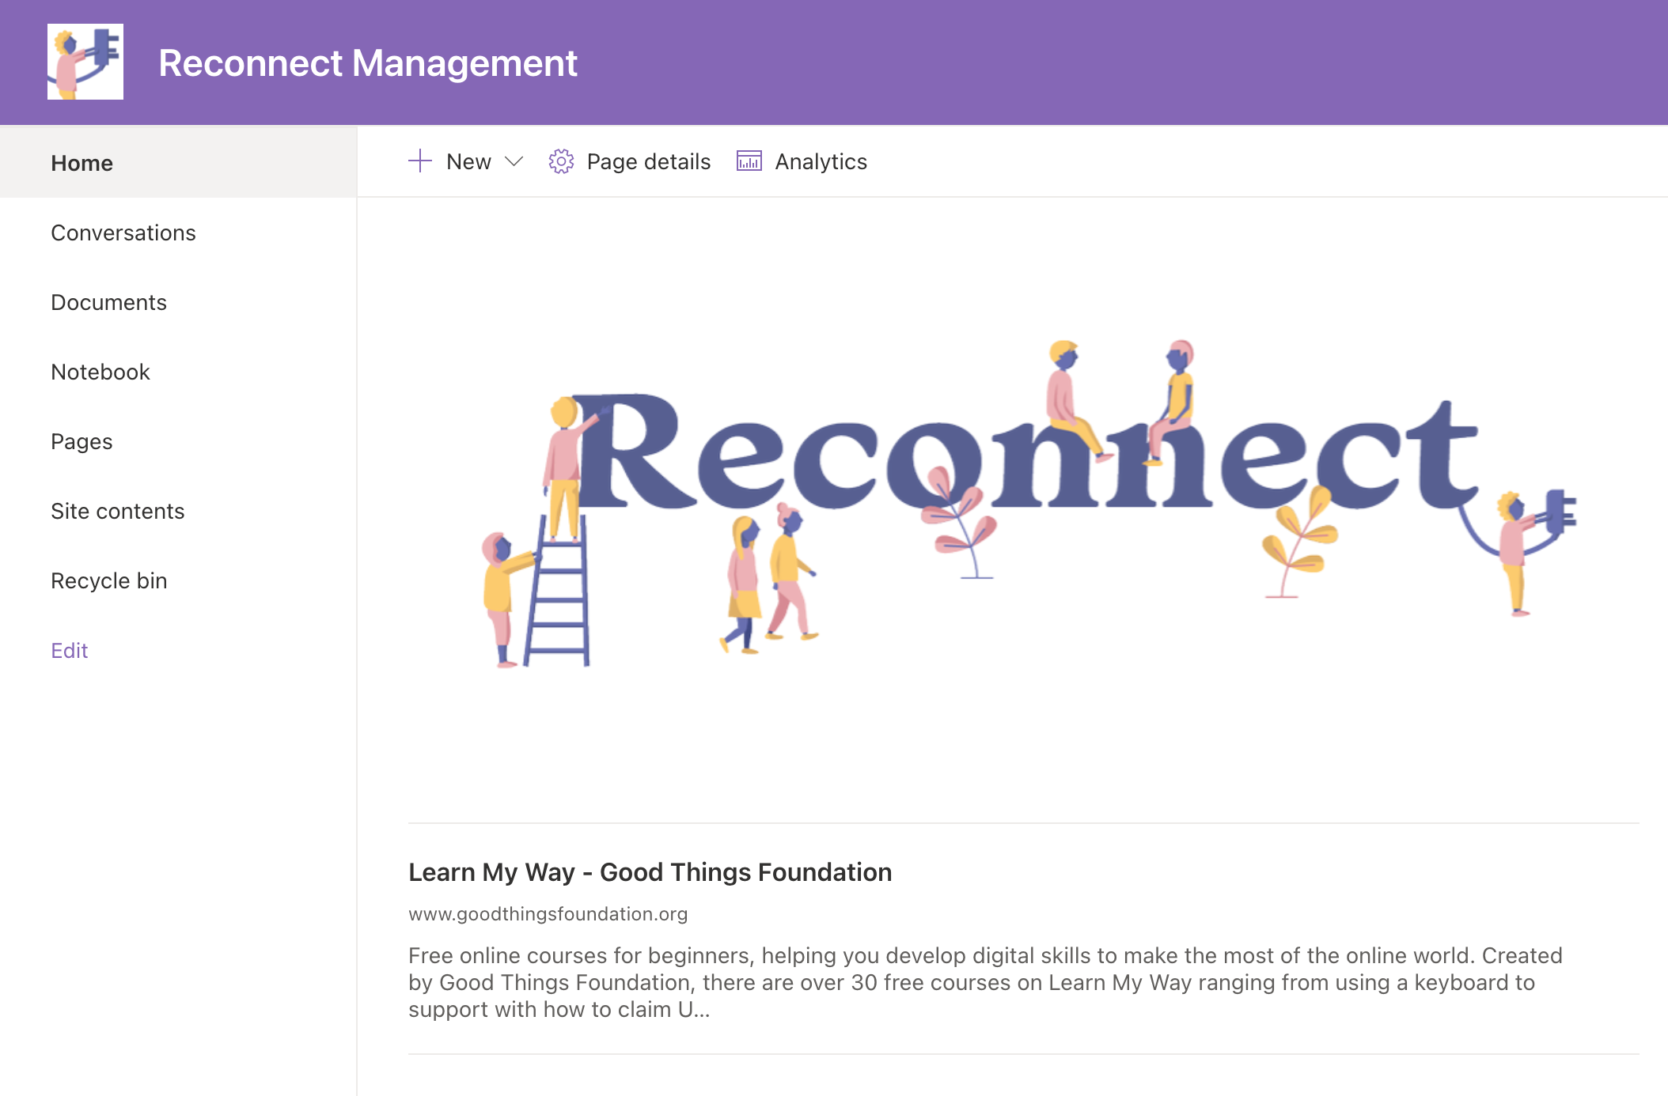
Building collaborative online spaces
The first step was to organise our internal communications to collaborate with staff and VIPs
Reconnect Management / Computer Delivery / Connecting Scotland
  An Office 365 Group =
  SharePoint intranet +
  Group document folders +
  Dynamic distribution list +
  Microsoft Teams team

Slide 31
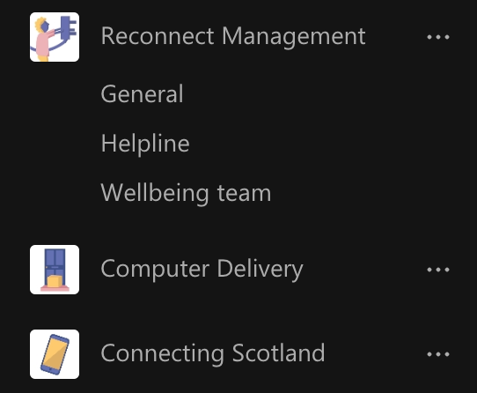
Within the team, we created channels for each project
  With each channel, a linked folder is created, allowing documents to be stored in one place
Channels are used for team updates, sharing resources and staying up to date with projects
We also do team building online – coffee times, quizzes, games
Notes:
We could also mention coffee afternoons and staff events like the quiz we had online etc. When talking about tech its important to keep the human element in mind for those who are sceptical.

Slide 32

Promotion and induction
With all these systems in place it was time to promote our services online through social media and the website
We also began inducting and training VIPs online, adapting our existing induction materials and creating interactive online presentations

Slide 33
Where are we now?
Digital can be used to improve wellbeing
One-to-one holistic support - finding the hook
Profile and matching process
High standard of volunteers
  Training and rigorous interview process – everyone can help with digital
Helpline for technical support
1,500 devices provided around Edinburgh and East Lothian
Over 300 people supported to improve their digital skills
Notes:
Wb and LD were separate.
We quickly realised that Wellbeing and Digital were intertwined. Digital enables people to be independent and to have access to services family and entertainment to lift mood.
121 support via weekly calls. Phone/Zoom/Teams/text/whatsapp support initially from LDC. In that time we get to know the SU, complte Profile form this covers:
Availbility
Interests/hobbies
Physical/Mental Health
Relationship with family
History
Needs
Goals/ecxpections

Slide 34
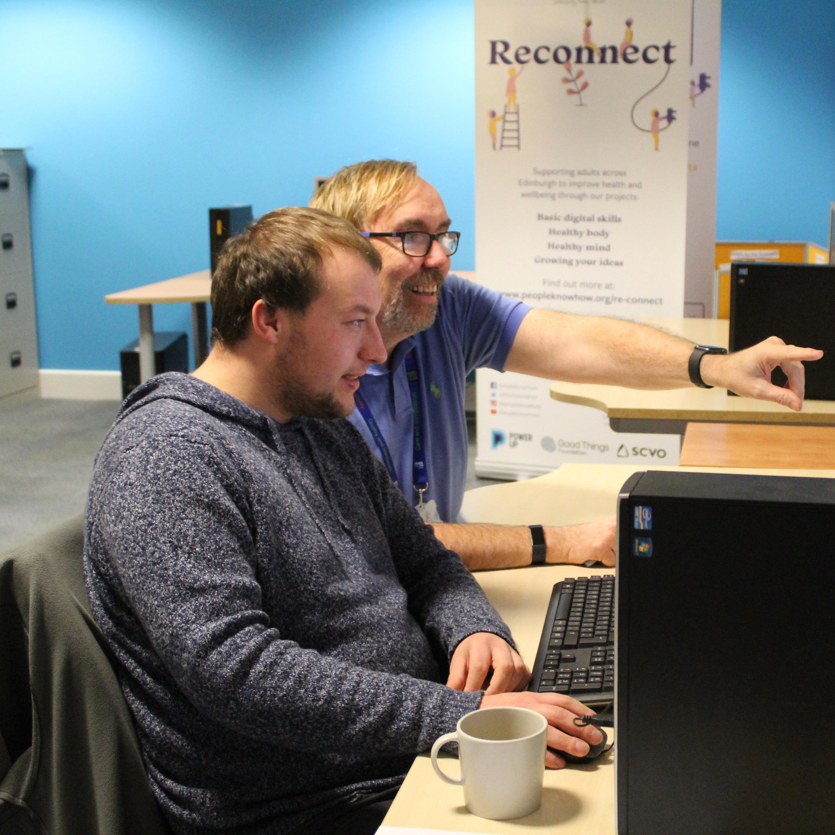
Who do we help?
Service user criteria
  18+
  Isolated or excluded
  People needing digital support
  People with various learning disabilities and accessibility needs
  People who have fallen through the gaps

Slide 35
What do we help with?
Managing information
Using search engines to look for information
Finding websites visited before - history, bookmarks
Downloading or saving photos found online
Communicating
Sending personal messages via email or online messaging
Connecting via video calls to the doctor, family or friends
Transacting
Buying items or services from websites
Buying or installing apps on a device
Problem solving
Verifying sources of information online
Solving a problem with a device or digital service using online help
Creating
Completing online application forms
Using Microsoft Office applications or similar

Slide 36

Distance befriending
Benefits
Drawbacks
Less time consuming
Can easily befriend more than 1 service user
Very flexible to suit both parties (no travel)
The most isolated can easily get support
Easy for projects to ramp up support
Befriending more inclusive for those who are disabled/ill
Can use resources available in the organisation to guide the conversation
Connection/technology problems
No body language/facial expressions
Background noise and distractions
Internet safety and security
Can be difficult if the service user is hard of hearing
Access:
  Cost of calls/data, equipment, internet
  Age and lack of knowledge/low confidence

Slide 37
Case study
59-year-old Tam has gone from struggling to recognise letters on the keyboard to sending emails, listening to podcasts and office programmes on Learn My Way.

Slide 38

Coronavirus has highlighted the need for connectivity now.
Connect Four: Digital Inclusion identified lack of connectivity as the biggest obstacle to digital inclusion
  Key voices in digital from academic, business, public, third sectors
Digital Inclusion
  Devices: Computer Delivery – ex. laptop for schoolwork
  Digital skills: Learn Digital – ex. using the device
  Connectivity: temporary solutions such as Connecting Scotland

Slide 39



Connectivity Now Manifesto
Calling for an end to data poverty
Regulate
connectivity
Link connectivity to
shared spaces
Zero-rate essential
service websites
Let's address the poverty premium and regulate connectivity by:
Viewing connectivity as a basic utility
Regulating the telecoms market to simplify internet package tariffs
Increasing accessibility of packages aimed at low income households
Let's share connectivity and link it to shared and public spaces by:
Developing ways to gift, share or subsidise data
Offering secure connectivity in community hubs
Rolling out shared connectivity across all social housing
Let's help everyone get access to essential services online by:
Recognising that digital and social isolation are linked
Zero-rating essential service websites
Increasing accessibility to the essential services all are entitled to

Slide 40

Pledge your support
Organisations, community groups and individuals from the third, public, business and academic sectors are invited to pledge
Let’s unite our voices – share your experience about digital exclusion and data poverty with us
We encourage you to record a short video clip explaining why you support the campaign
Lobbying the government to implement policy change
Pledge your support for #ConnectivityNow:
www.peopleknowhow.org/connectivity-now

