Slide 1
Parkinson’s Active – Getting People with Parkinson’s moving

Slide 2
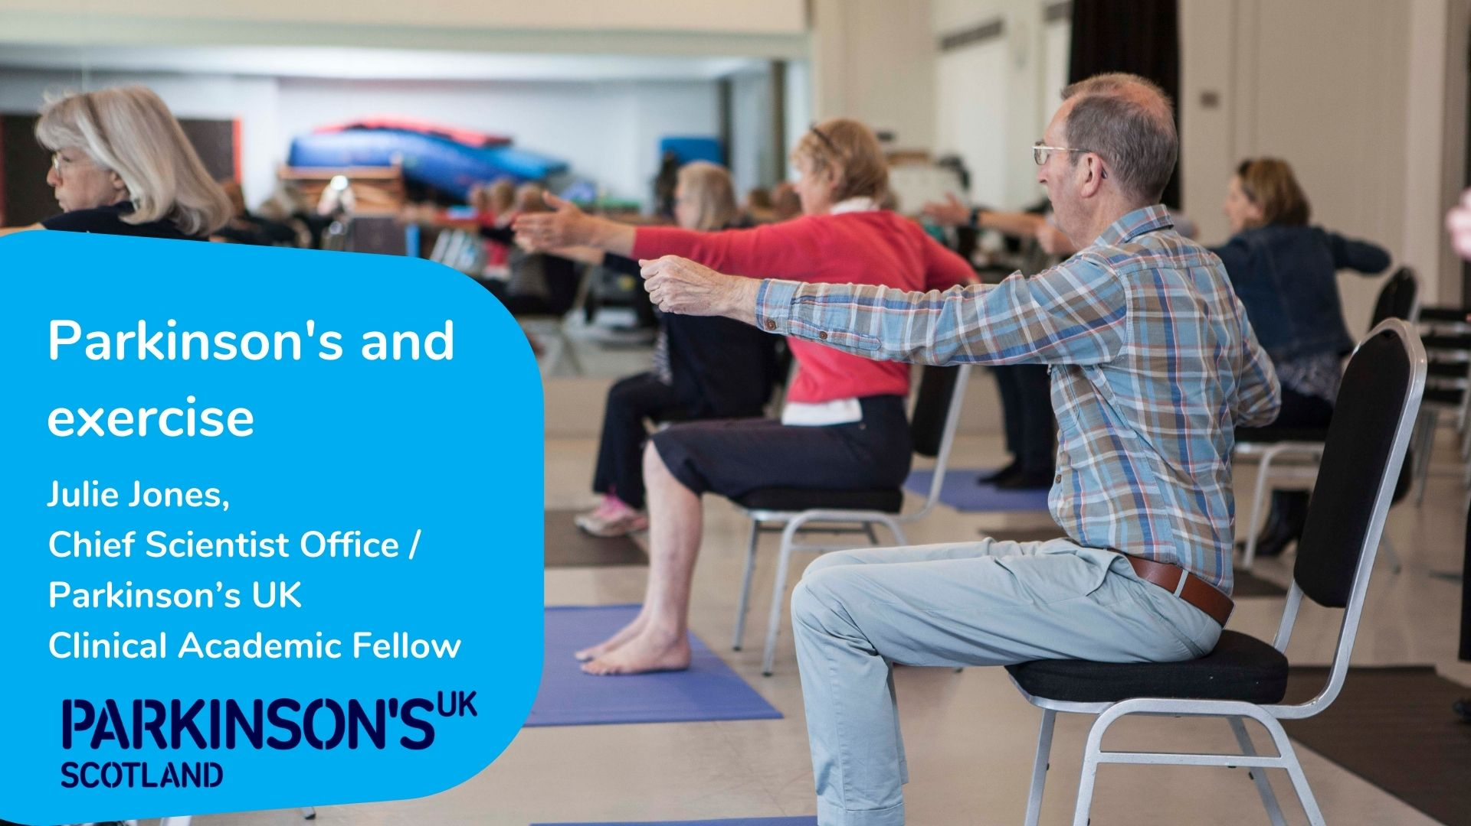

Slide 3
Benefits of physical activity for Parkinson’s
Fastest growing neurodegenerative condition - prevalence predicted to rise by 50% by 2030¹
Effectiveness of current medical management is time limited²
Exercise reduces the risk of developing Parkinson's,³ and has potential to limit the rate of decline⁴
Regular exercise is associated with improved health outcomes and Quality of Life⁵
^{References at end of slideset}

Slide 4



Benefits of exercise
Physical benefits
↑strength, flexibility, aerobic capacity, balance, walking
↓bradykinesia, ↓ rigidity, ↑amplitude of movement
Psychosocial Benefits
↓depression, fatigue, apathy.
↑sleep, cognition, socialisation, independence
Physiological benefits
↑Medication efficiency
↑Neurogenesis, and Synaptogenesis, Dopamine turnover
Improved health and well-being and sense of community, taking control of own health

Slide 5
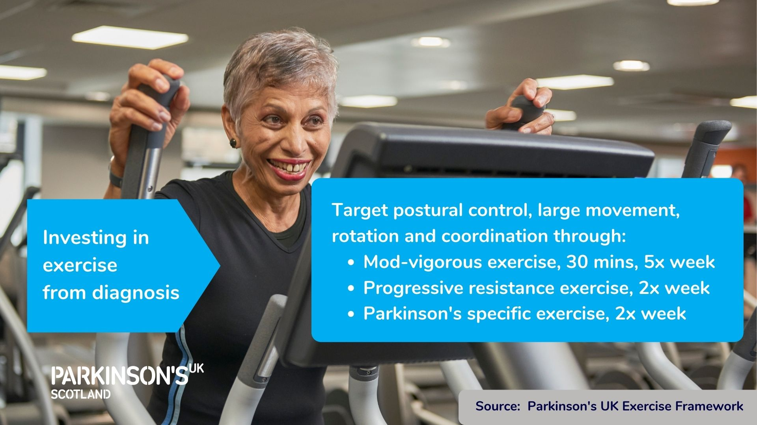

Slide 6
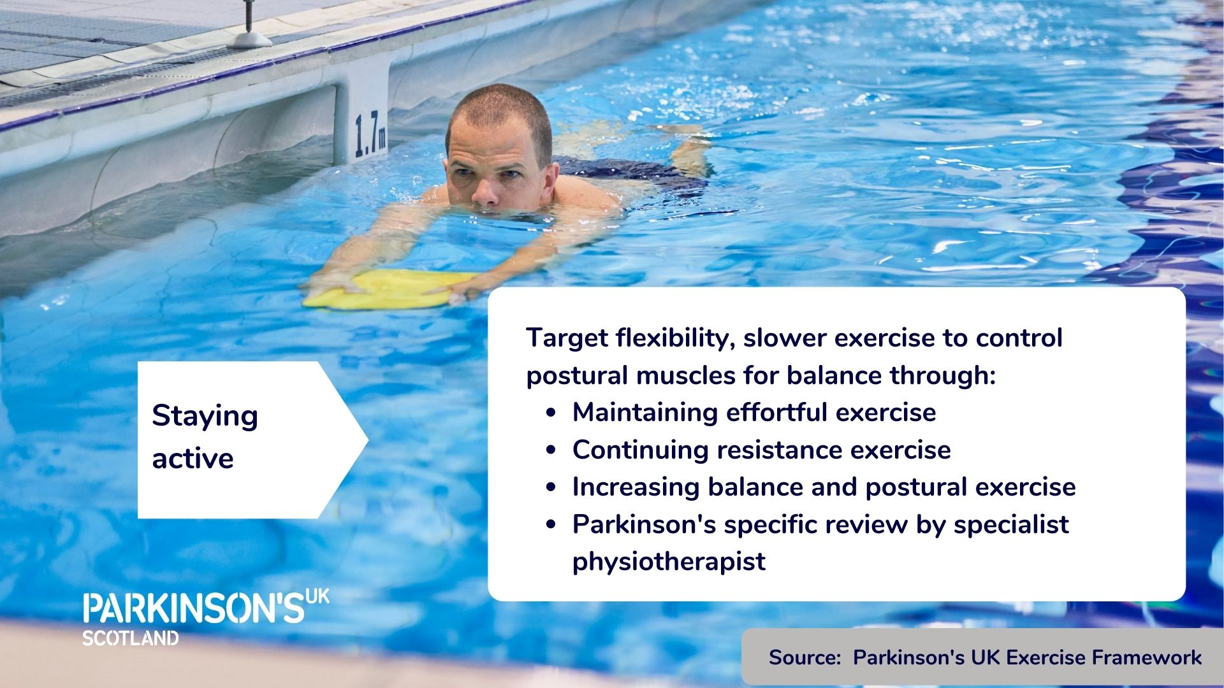

Slide 7
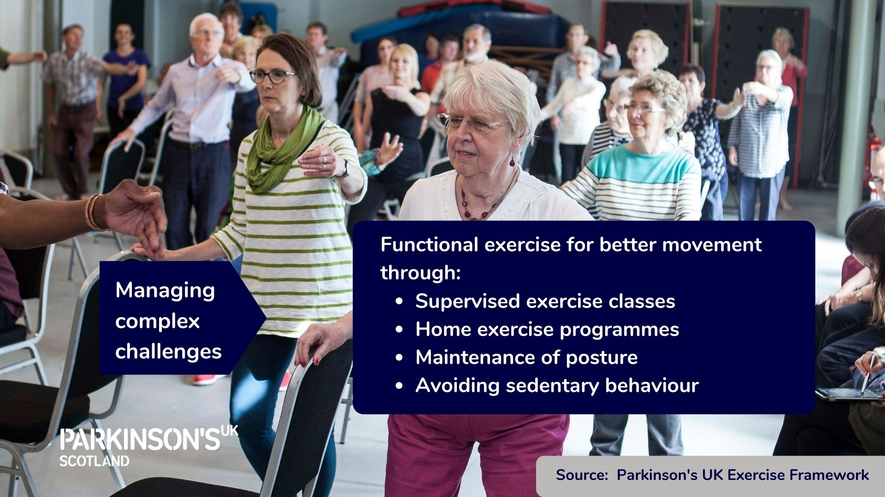

Slide 8
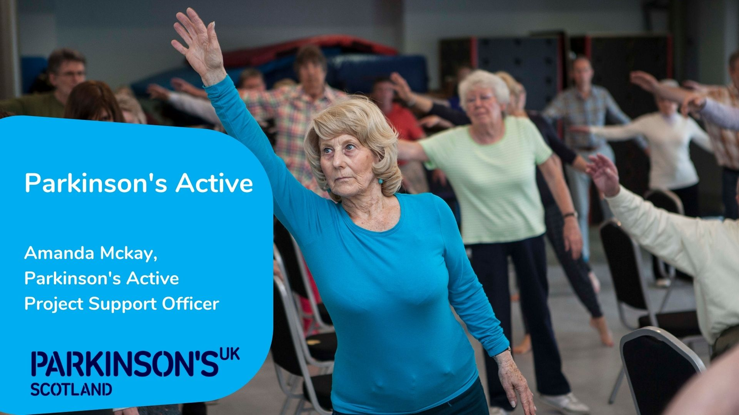

Slide 9

Parkinson’s Active
AIM: Increase opportunities for people with Parkinson's to be active in their local community
Collaboration involving the Parkinson’s community alongside health professionals and leisure providers
Supported by the National Lottery Community Fund
Notes:
The project was funded by the Lottery in early in 2020 and its aim is to increase the number of opportunities for people with Parkinson’s to be active.
Our insights tell us that people with Parkinson’s feel it was important
To be able exercise with their peers
That having instructors with some knowledge of Parkinson’s is important.
We know that many people with Parkinson’s have experienced an increase in physical and mental health symptoms as a result of COVID 19.. The recent Lancaster Survey of 2000 people with Parkinson’s reported an increase in symptoms such as slowness, stiffness, fatigue, anxiety, tremor, depression, problems with thinking and hallucinations during lockdown as a result of isolation and reduced access to health and exercise services.
So we know exercise is more important than ever and exercise opportunities have had to adapt to COVID
Involving the wider Parkinson's community has been key to the project and Physiotherapists and Parkinson’s nurses have been central to developing the project through pilot work but also now delivering the project by
Providing training and ongoing support to exercise instructors and
Referring or signposting people with Parkinson’s to ex’programmes,
ensuring that those who can benefit most are aware of the opportunity and more importantly are given the confidence to join in.
The project is driven by a Steering Group made up a a multidisciplinary team including, Parkinson’s Nurse, Physio, People with Parkinson’s, NHS Health Scotland and Leisure providers. This enables the project to meet the needs of all stakeholders

Slide 10

Partnership Working
“Thank you it was a great workshop, I like the delivery as zoom can be hard but it’s very interactive”
“The course was brilliant, very informative and all tutors did a fantastic job to keep the content interesting and very informative!”
10 Leisure Trusts
Parkinson’s Awareness Training
“The workshop was excellent, I learnt so much”
“Great to have pre-course learning to get my brain fired up”
“The workshop flowed really well and everything we covered I felt had a reason for it”
Notes:
We are targeting 10 new local authority areas in Scotland over the 3yr project.
Due to COVID, the delivery areas have focused on leisure providers who have been able to deliver online exercise classes and so far this includes:
Aberdeen city
Aberdeenshire
Perth & Kinross
North Ayrshire
Highland which was a pre project pilot area - we have supported them to deliver 4 online classes and they are about to re-launching their face to face program 5 classes per week (delivered pre COVID)
With the support of Physios Julie Jones & Aimi McGeough we developed and delivered a training module to 13 exercise referral instructors from the area's mentioned. The training was well received and has allowed us to pilot 2 online exercise classes per week in each area .
We hope to be able to support local physio teams to deliver this training more locally in the future.

Slide 11
Pilot Work- Interim anecdotal findings
55 participants online each week
Benefits in balance and strength reported
Being with peer group valued, even if online
Engagement in other exercise opportunities
Notes:
Initial findings tell us
Online classes have been well received
Physical and social benefits
Provided motivation for other activties

Slide 12
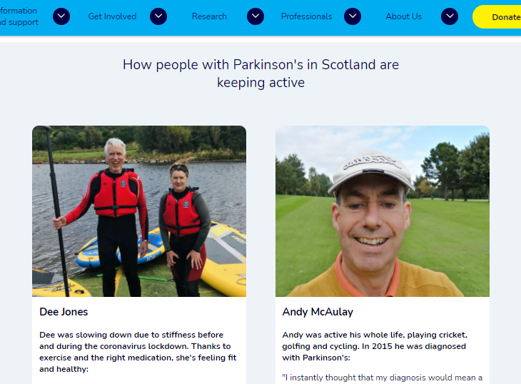
Spreading the message
Volunteer Ambassador Programme
Raising Awareness of importance & benefits of activity
Notes:
Raising awareness off the benefits of exercise for Parkinson’s is key in this project
Not only amongst leisure providers, NHS colleagues and other professionals who support people with Parkinson’s how we hope to share good practice with but also amongst people with Parkinson’s.
Our Volunteer Ambassadors are people living with Parkinson’s who value the importance of exercise in managing their condition and tell their story of how exercise benefits them to empower others to get or stay active
.

Slide 13
Parkinson’s Active VIDEO
https://youtu.be/1UaZ4XWFxK0
Notes:
Here are some people to tell you more about the exercise programme offered in Perth & Kinross.

Slide 14
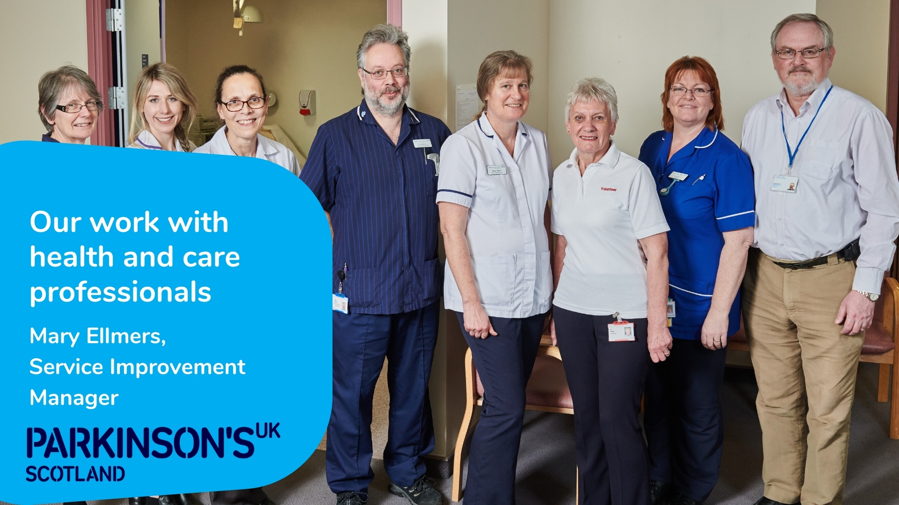

Slide 15

The Excellence Network - the driving force for service improvement in Parkinson’s care
Collaboration: a UK-wide network of many different professionals with regional and special interest groups addressing service challenges
Resources: Audit, clinical tools, guidelines, case studies and business case support
Learning: free resources for all levels of staff – nurse, therapy and generalist pathways mapped to career stage and experience level
parkinsons.org.uk/excellencenetwork

Slide 16
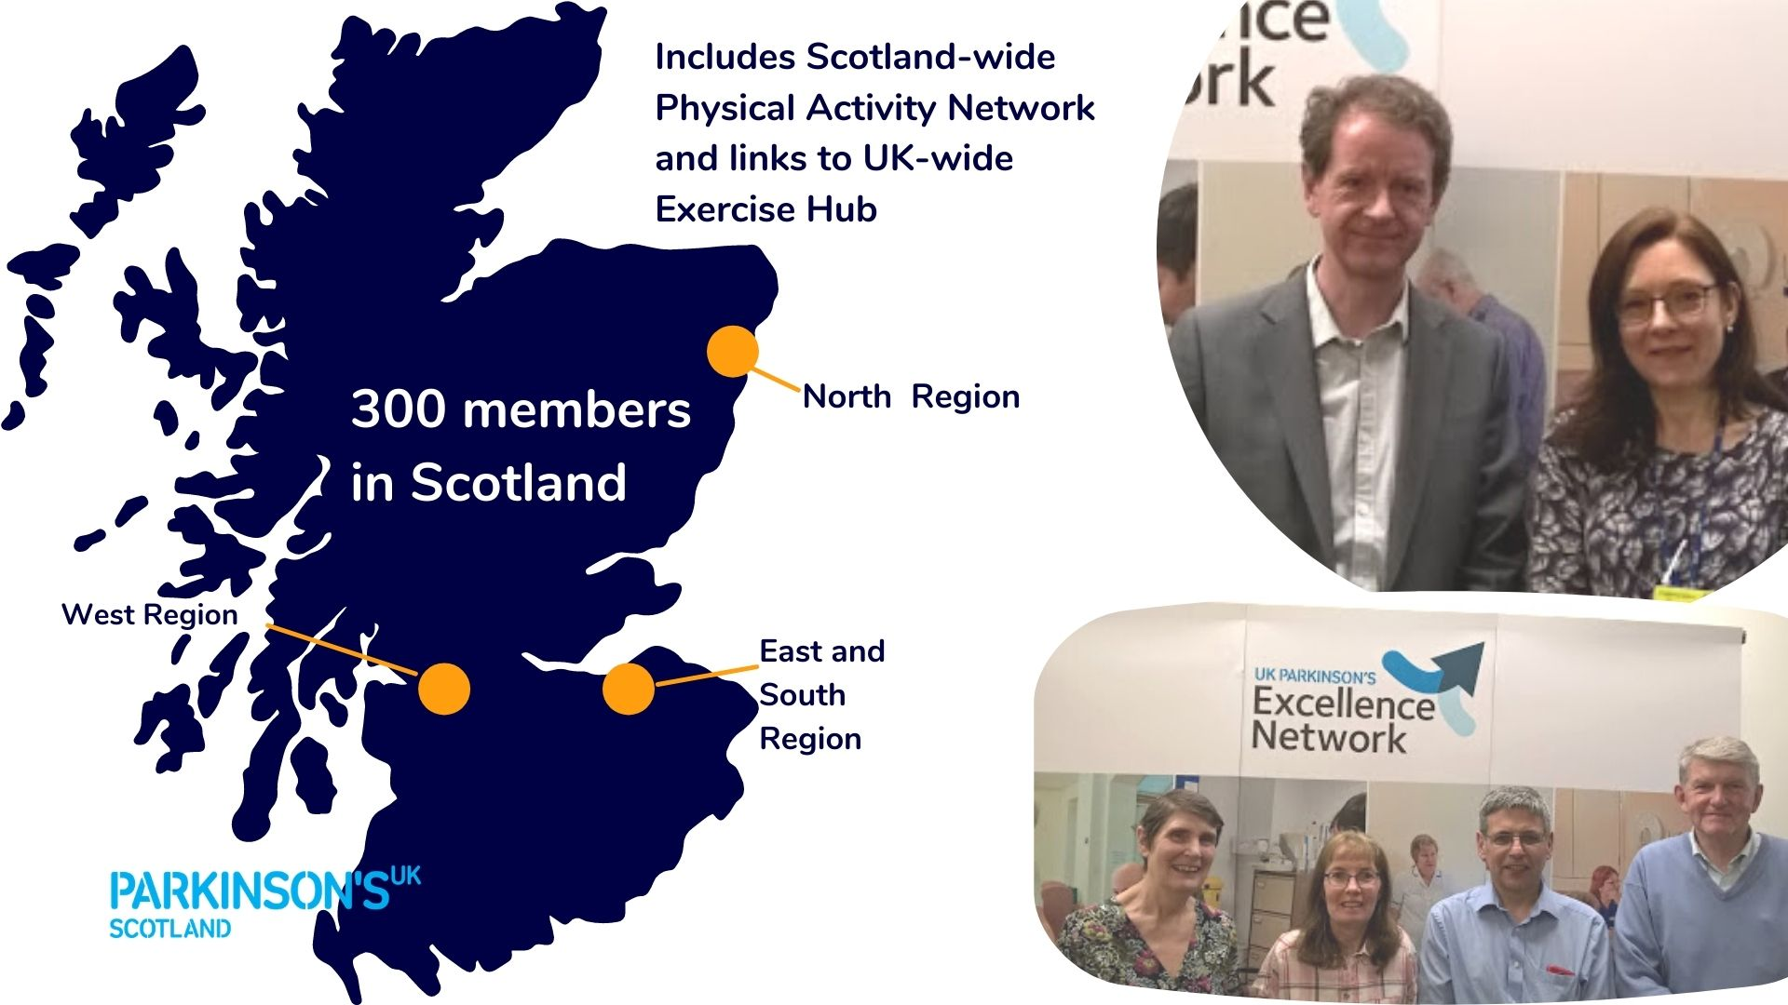

Slide 17

2019 UK Parkinson’s Audit Findings
Some areas identified for improvement
Multidisciplinary working
Bone health
Communications and info sharing
Medicines management
parkinsons.org.uk/audit
Next Audit 2022
Notes:
Can you mention Access to physio as part of MDT working.

Slide 18
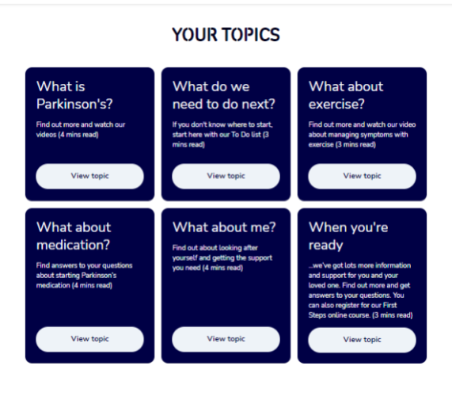
Parkinson’s Connect
Integrated pathway - tailored information for people with Parkinson’s and unpaid carers
Direct referral from healthcare professionals reaches more people
Digital and offline options
Notes:
Note that EXERCISE info is part of the offer (top right hand side of slide)

Slide 19
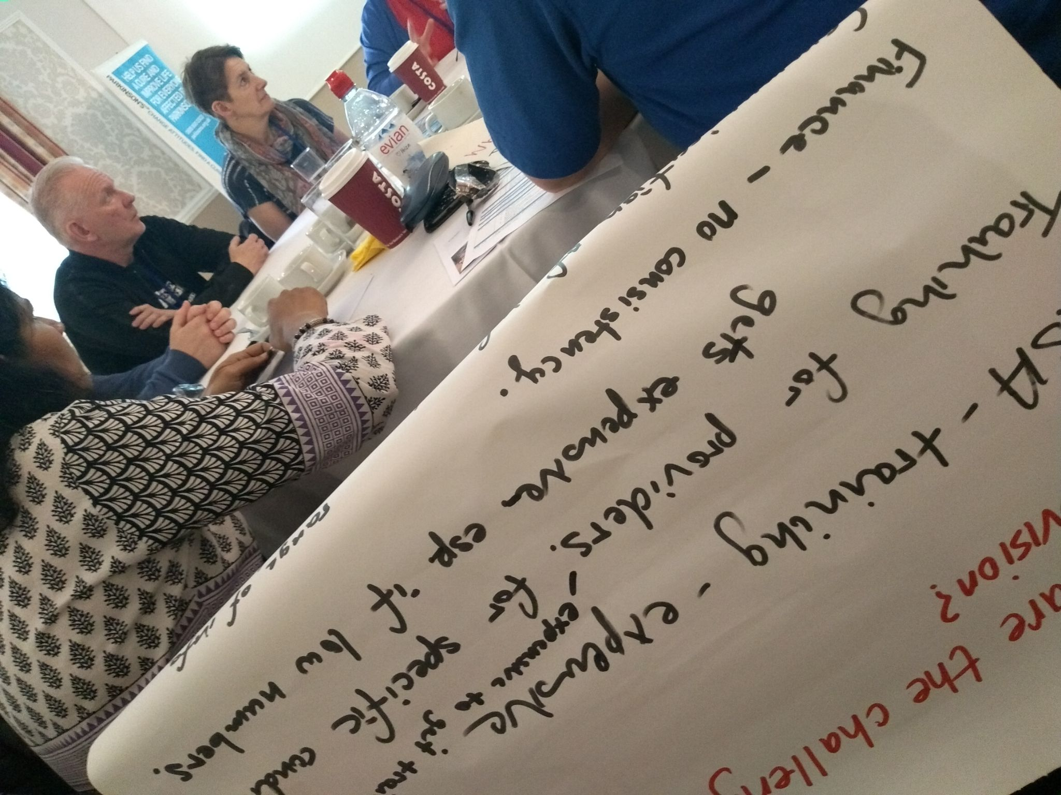
Virtual network events including updates on exercise
UK Excellence Network Conference 4 Nov 2021
parkinsons.org.uk/professionals/2021-uk-parkinsons-excellence-network-awards
Scotland Excellence Network event
  Contact Mary Ellmers
0344 225 3723
mellmers@parkinsons.org.uk

Slide 20

Notes:
Refer people to references and resource slides (to follow)

Slide 21
Helpful links
Email the team scotland@parkinsons.org.uk
Parkinson’s Active parkinsons.org.uk/parkinsons-active
Exercise Hub parkinsons.org.uk/professionals/exercise-hub
Parkinson’s Exercise Framework parkinsons.org.uk/information-and-support/parkinsons-exercise-framework
Parkinson’s Excellence Network parkinsons.org.uk/professionals/your-network
UK Parkinson’s Audit parkinsons.org.uk/professionals/uk-parkinsons-audit-transforming-care
Rosemary Maguire Educational Bursary and other funding opportunities
For professional Parkinson’s related education eg PD Warrior, Lee Silverman Voice Treatment training and others - parkinsons.org.uk/professionals/funding-opportunities
Funding for research
We fund clinicians to undertake Parkinson’s research, including clinical trials, non-drug approaches and applied health and social care research and welcome applications - parkinsons.org.uk/research/types-grant

Slide 22
References
From slide #3
1. Dorsey, R., Sherer, T., Okun, M., and Bloem, B. (2018). The emerging evidence of the Parkinson pandemic. Journal of Parkinson’s Disease. 8 (Suppl 1): S1-3. Doi: 10.3233/JPD-181474
2. Bloem, B., Okun, M., and Klein C. (2021). Parkinson’s disease. The Lancet.
Doi: 10.1016/S0140-6736(21)00218-X
3. LaHue, S. C., Comella C. L., Tanner C. M. (2016). The best medicine? The influence of physical activity and inactivity on Parkinson’s disease. Mov. Disord. 31 1444–1454. Doi: 10.1002/mds.26728
4. Rafferty, M. R., Schmidt P. N., Luo S. T., Li K., Marras C., Davis T. L., et al. (2017). Regular exercise, quality of life, and mobility in Parkinson’s disease: a longitudinal analysis of national Parkinson foundation quality improvement initiative data. J. Parkinsons Dis. 7 193–202. Doi: 10.3233/JPD-160912
5. Radder, D. L. M., Lígia Silva de Lima A., Domingos J., et al. Physiotherapy in Parkinson’s Disease: A Meta-Analysis of Present Treatment Modalities. Neurorehabilitation and Neural Repair. 2020;34(10):871-880. Doi: 10.1177/1545968320952799

Slide 23

The Community Solutions programme - Improving health and wellbeing through community-led support and partnerships
Gina Alexander, Community Solutions Programme Manager, Voluntary Action North Lanarkshire

Slide 24
What is Community Solutions?
A pioneering, community led, health and social care investment and improvement programme for North Lanarkshire committed to building community capacity and individual capabilities to help people live healthier and richer lives.
The programme, which was established in 2012, is a partnership between:-
Health and Social Care North Lanarkshire (HSCNL)
Voluntary Action North Lanarkshire (VANL)
the vibrant community and voluntary sector of North Lanarkshire.

Slide 25

https://www.youtube.com/watch?v=JOPHU7Z_gcQ

Slide 26
The Community Solutions ambition and approach
To improve people’s quality of life and wellbeing by taking action which:
strengthens social connections and support, helping to reduce isolation and loneliness
supports healthier living and recovery
promotes human rights and equality – helping to reduce inequalities
Through services and activities informed by need, agreed in partnership and delivered mostly through the community and voluntary sector

Slide 27

Community Solutions
An approach
A programme

Slide 28
Community Solutions structure
Community led
Locality hosts/anchors
Multi agency partnership
Commissioners
Locality consortia
Governance Sub Group
HSCNL Senior Leadership Team
Integrated Health and Social Care Joint Board (IJB)
Thematic projects
Networks

Slide 29
Summary of outcomes – 2019 -2020
Outcomes | No of people
Reduction in isolation and loneliness | 10685
Enhanced use of information, advice and education | 12674
Improved independence and well-being | 10778
People feel included, connected and safe | 12405
Citizens have greater access to health and wellbeing supports and services | 10116
Outcomes for Carers Carers:- | No of people
Have accessed a short break from caring | 1690
Have increased ability to manage or cope with their caring role | 1934
health and wellbeing are optimized | 2168
Have been referred to direct carer support services | 1032
Have been signposted to direct carer support services | 1585
Outcomes for children and young people | No of people
Sense of wellbeing is increased | 2295
Mental health is optimised | 2203
Parental/carer attachment is improved | 2218
Physical activity is increased | 2344
Resilience is improved | 2231

Slide 30
C19 support from CS funded projects and wider community and voluntary sector: 18th March to 31 July 2020
Support | Activities
Befriending & wellbeing calls | 67,591
Shopping | 52,843
Meals delivered | 17,046
Medication drop offs | 1,426
Other support | 26,804
Volunteers engaged | 3,877
Volunteer hours | 16,107
Staff involved | 1,553
Flexible
Local
Immediate
Creative

Slide 31
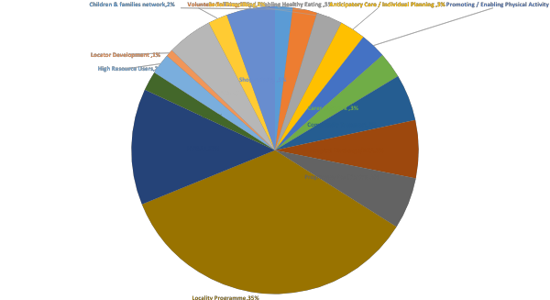
Summary of investment 2019 -2020

Slide 32

Additional investment generated 2019- 2020

Slide 33
Community Transport Volunteer Driver scheme – 2019-2020
Cost Avoidance example
Volunteer Drivers supported 1674 passengers
Completing 3348 journeys
It is reasonable to assume that due to the age and mobility difficulties that most passengers would not be able to attend their appointment without the assistance and level of service offered by their volunteer driver, ie picked up at home address, correctly assisted to vehicle, escorted to and from Hospital department, correctly assisted to vehicle and taken home then assisted to their front door if required.
On the basis that 50% did not attend appointments 837 people
DNA (did not appear) cost (NHS Lanarkshire figure) x £135
Cost avoidance for NHS Lanarkshire (837 x £135) = £112,995
Cost of funding Community Transport project minus £72,000
Total cost avoidance £50,995

Slide 34

Positive Growing with VIP
J is a young boy in kinship care, who has witnessed and experienced domestic violence from two parents who are drug dependant. On attending VIP at beginning he was very disruptive, screaming, hitting other young people and being very aggressive. J is now attending over two evenings and has calmed down, he is willing to take part in group activities and has made new friends within the group.
On discussion with his social worker, they have commented that J is now listening and able to communicate better at sessions with them and that his teachers and head teachers have said his concentration has increased and his ability to share and willingness to take part in activities has improved and this is down to VIP.

Slide 35

People and partnerships in action
https://www.youtube.com/watch?v=oKFweLWbge0

Slide 36
For further information:
Gina Alexander, Programme Manager
gina.alexander@vanl.co.uk
www.voluntaryactionnorthlanarkshire.org
01236 748011

Slide 37
Planned Date of Discharge – an Exemplar of Partnership Working
Euan Duguid, Communication Manager, South Lanarkshire Health and Social Care Partnership
Marianne Hayward, Head of Health and Social Care, South Lanarkshire Health and Social Care Partnership

Slide 38
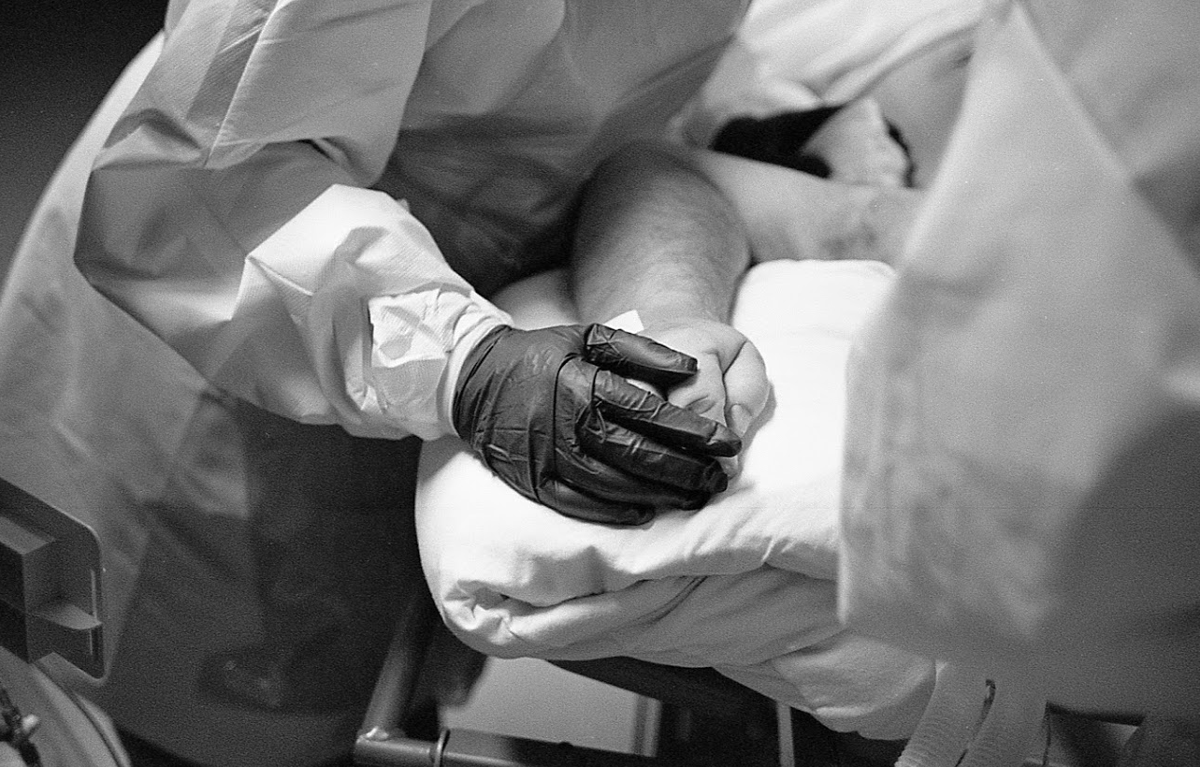
“When am I going home”
“Going into hospital journey can elicit a maelstrom of mixed emotions . . .
From those who are apart from a loved one for the first time, to others - who feel utterly alone in their lives – who are suddenly the recipients centre of kindness and compassion.
The majority are simply very anxious of the unfamiliar and the unknown . . .” Bev MacLean, Discharge Facilitator, University Hospital Hairmyres

Slide 39




A glance back – what happened before the
PDD pilot?
An opportunity in adversity – how COVID-19 provided a chance to do things differently.
The foundations set in place: The key principles of PDD

Slide 40

The mechanics of PDD explained

Slide 41
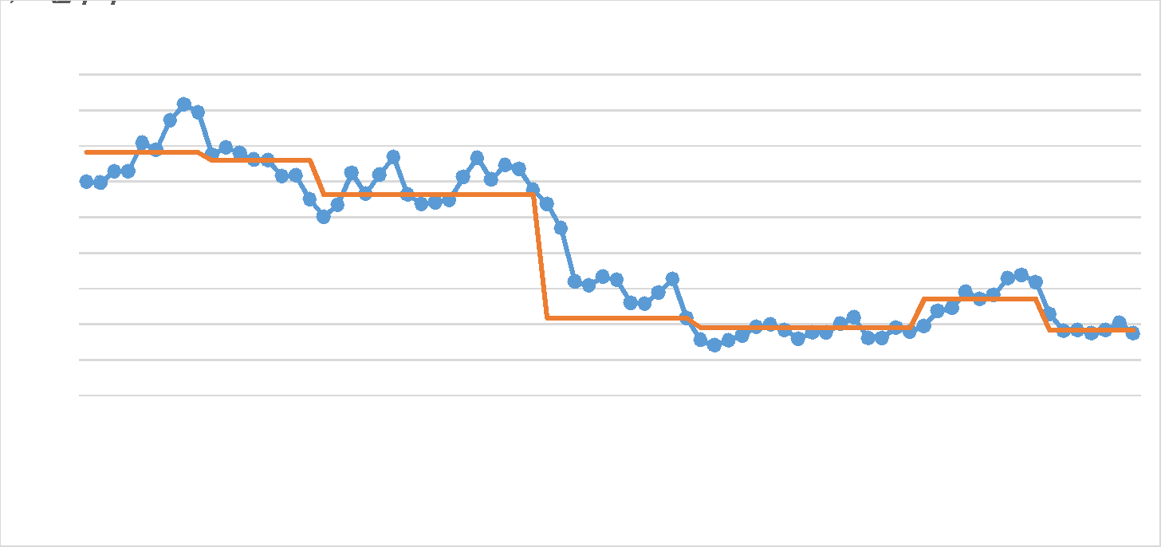
Impact on Delays

Slide 42
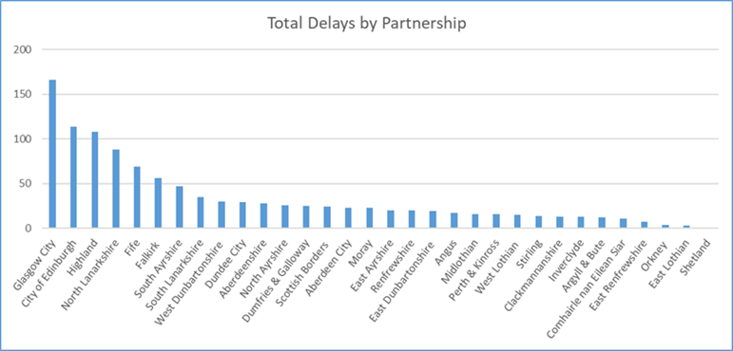
Impact of PDD

Slide 43
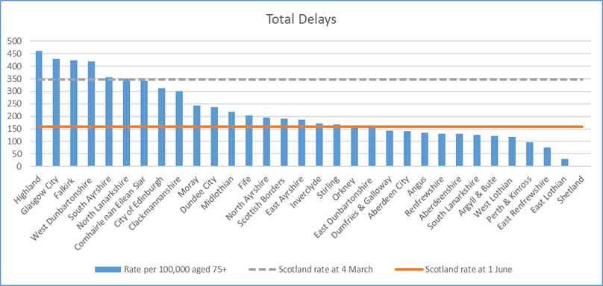
The Impact

Slide 44
“It just works” – a view from the frontline

Slide 45

Spreading the word and supporting change
Adapting communications in a changing environment
Harnessing multi-media platforms
First things first – empowering our staff and partners for PDD

Slide 46

The road ahead
For further information contact:
marianne.hayward@lanarkshire.scot.nhs.uk

