Slide 1
Virtual Pulmonary Rehabilitation
Emma Dignan, Team Lead Physiotherapist – Pulmonary Rehabilitation, NHS Lothian
Susan McNarry, Team Lead Physiotherapist – Pulmonary Rehabilitation, NHS Lothian

Slide 2


Pulmonary Rehabilitation (PR)
PR is an effective and low cost intervention
for people with chronic lung disease
Exercise and Education sessions
Barriers and challenges to tradition PR

Slide 3
Impact of Covid 19
Temporary suspension of PR across Lothian
Unable to run our service in its traditional format
“How do we re-mobilise PR?”

Slide 4
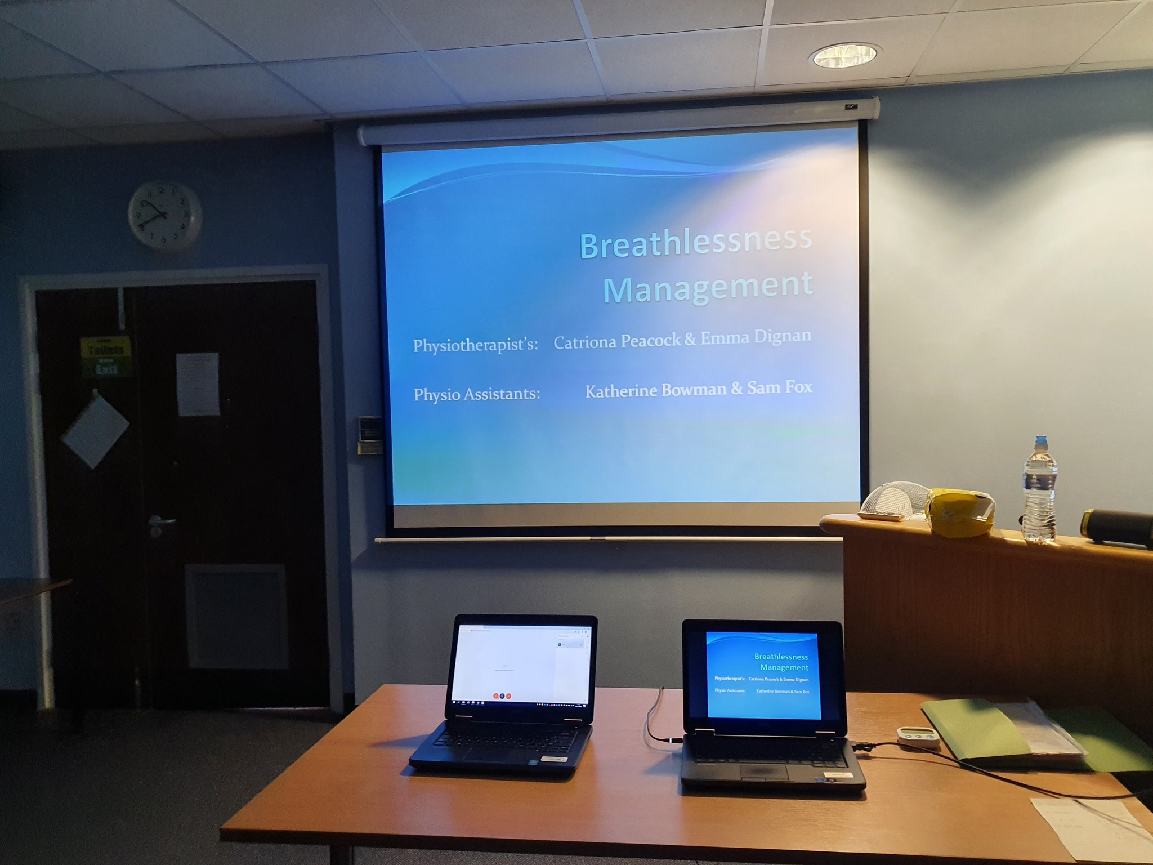
Virtual PR Re-Design
Platform - cisco
Safety - main priority
Whole team involvement
Robust risk assessment and SOP

Slide 5
Participant Assessments
Face to face
Adaptation of outcome measures
Supplied with “virtual class pack” including pulse oximeter

Slide 6
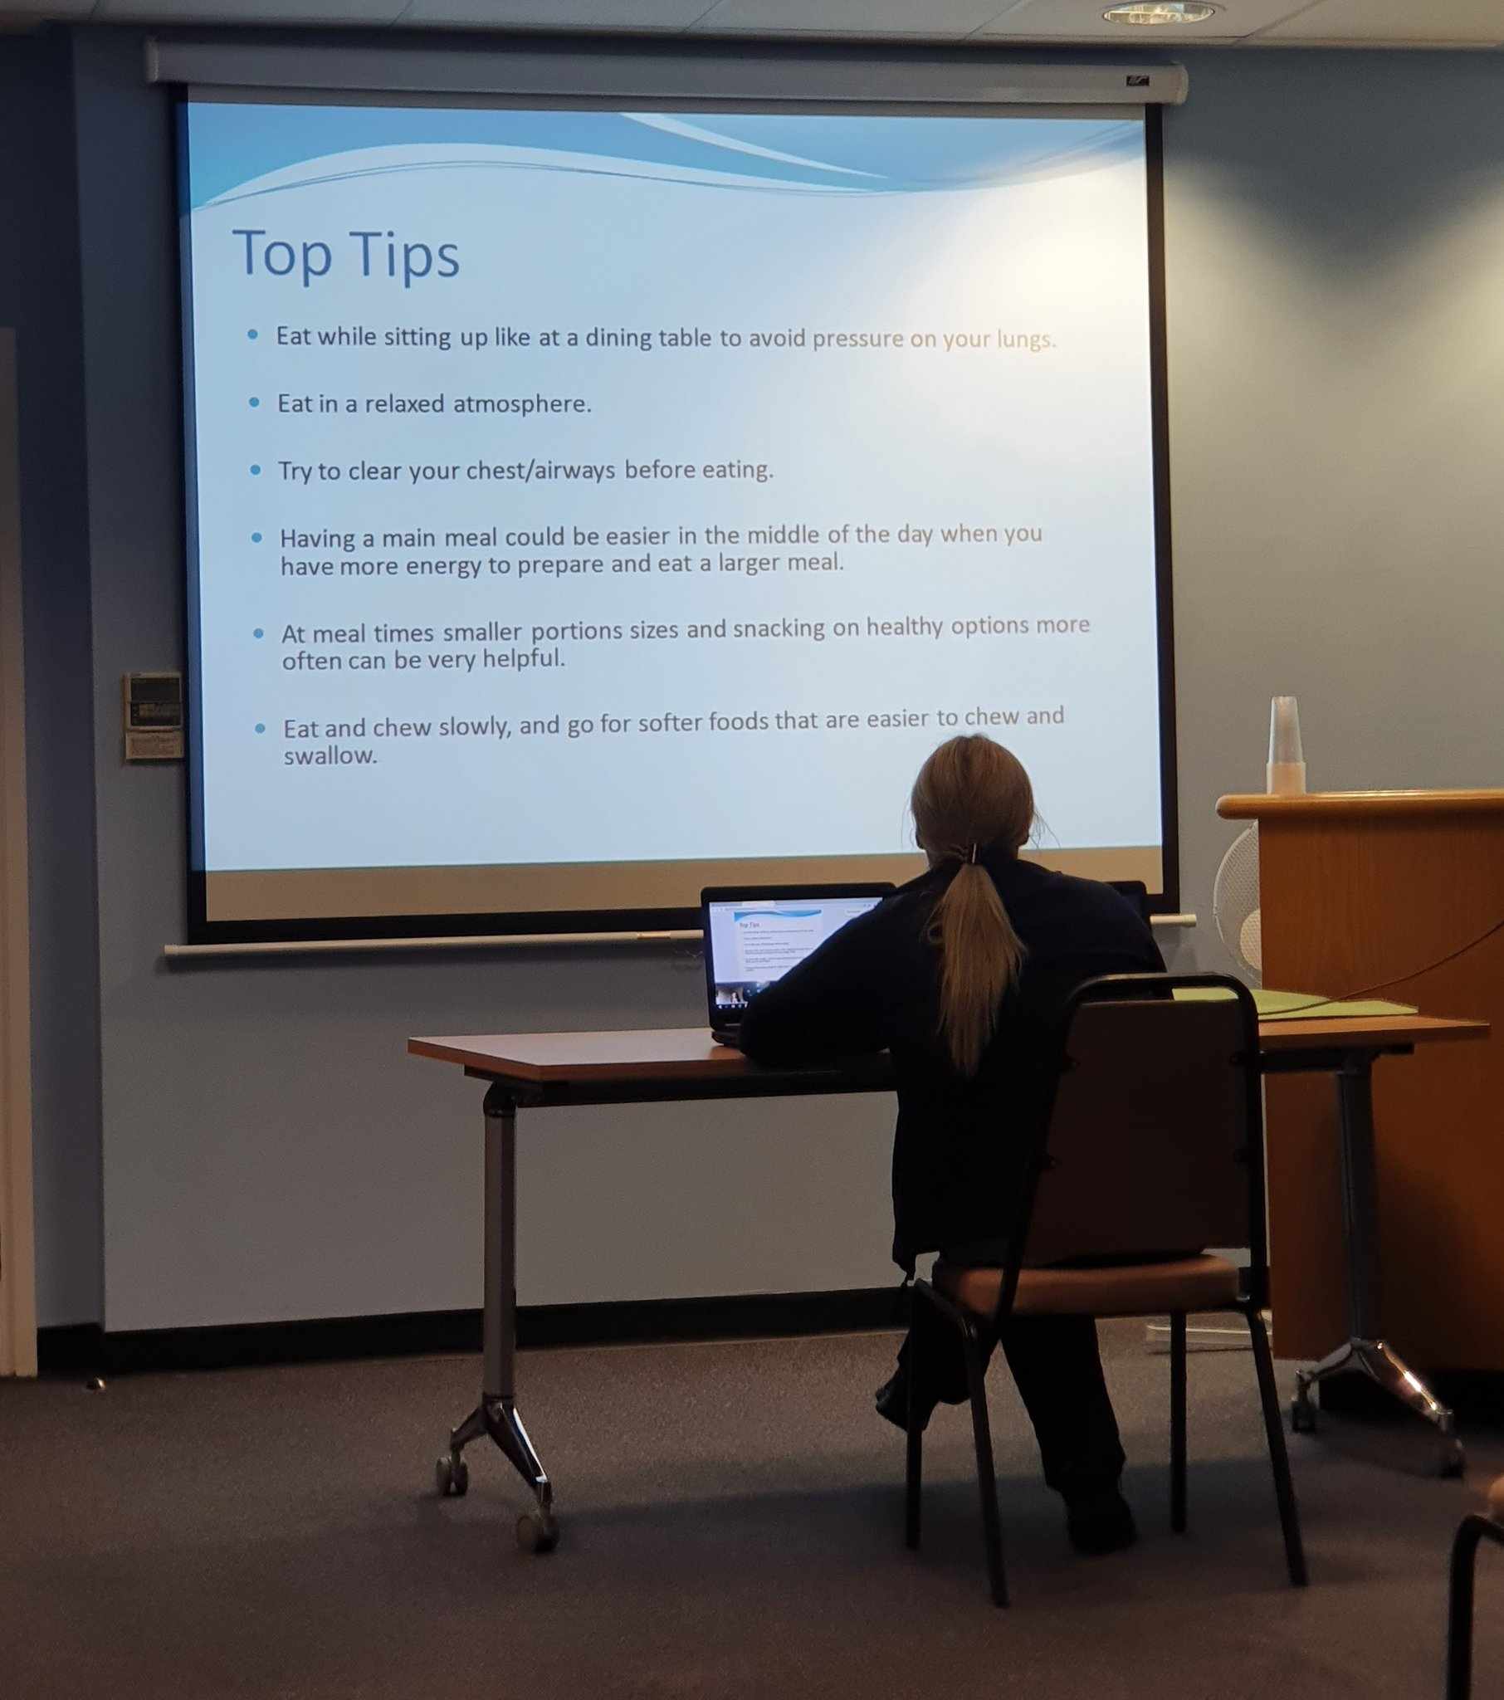
Exercise and Education
Exercise component based on existing class format
Reducing risk as far as reasonably possible
Education - share screen facility and discussion

Slide 7
Outcomes
6 participants joined the first block of virtual classes

Slide 8
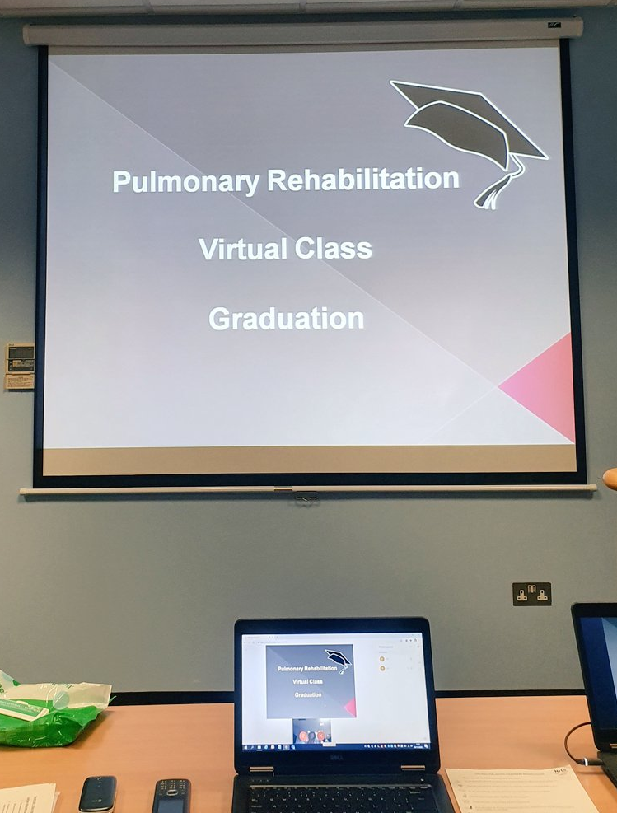
Feedback
Participants
Overwhelmingly positive- routines established,
belonging in a group, improved wellbeing
enthusiastic
improved confidence with technology
Staff

Slide 9
Pros and Cons of Virtual PR
Pros
Patient feedback positive, Establish group class, reducing barriers
connection issues, Safety, Keen for normal service to resume
Cons

Slide 10
Moving Forward
More options to increase accessibility
Always room for improvement and development (PDSA cycles)
During March – April 3 virtual classes have run – 10 patients completed

Slide 11
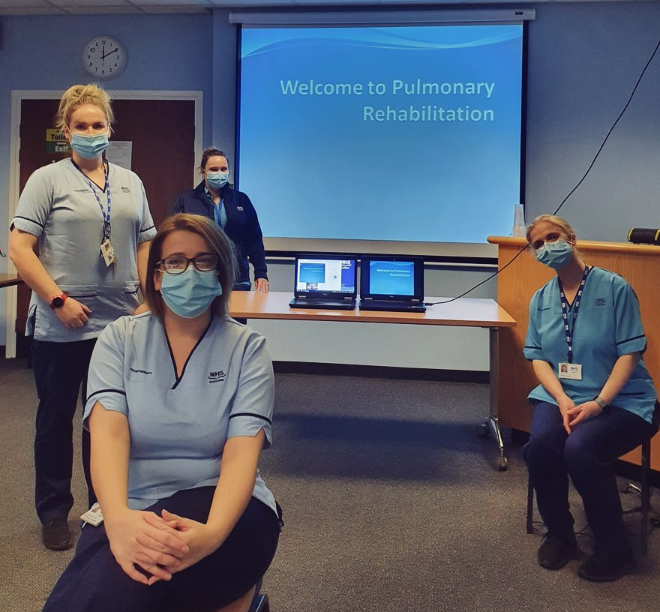
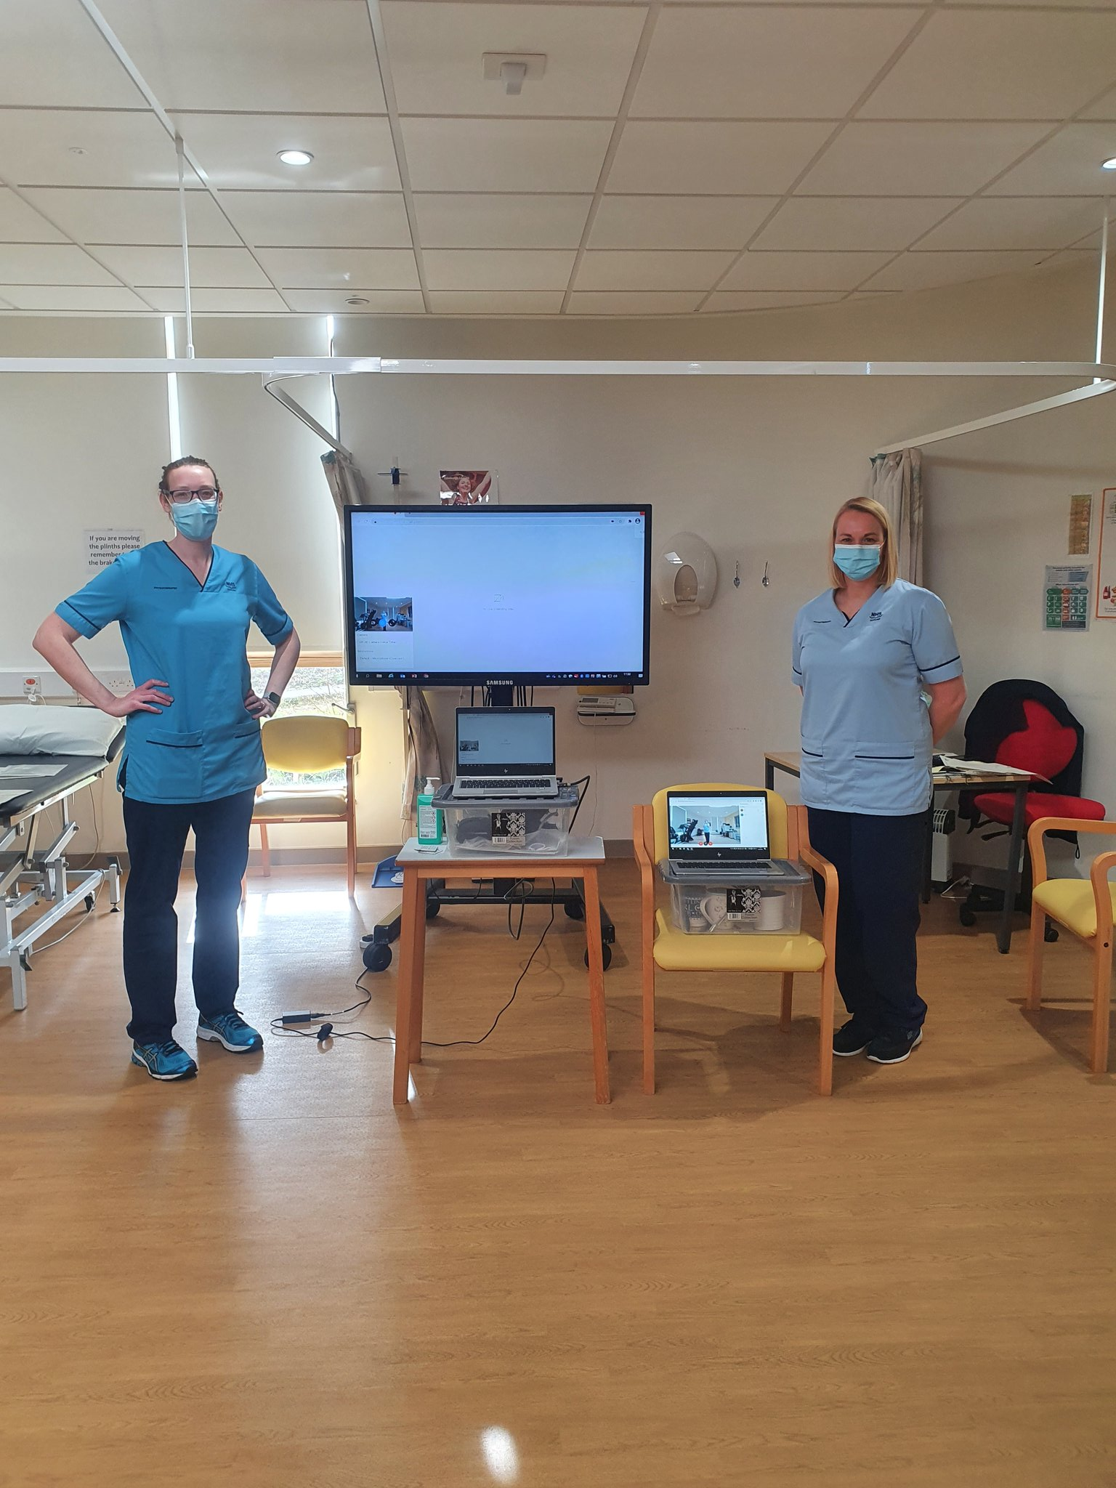
Virtual PR - Here to stay in Lothian!

Slide 12
Saving and Improving Lives – Clinical Research in our NHS
Fiona Fleming, Head of Communications and Engagement
Dr Charles Weller, General Manager, NHS Research Scotland

Slide 13

Clinical research is the single most important way healthcare is improved – by identifying new means to detect, diagnose, treat and prevent disease.

Slide 14

A research ready nation
Unified health service
Stable population of c.5 million
Nationwide research infrastructure
Internationally leading clinicians
World-class academics
Exceptional health data and informatics
Focus
“Scotland is home to a vibrant and innovative research environment…world-leading research is led, supported and delivered across our NHS and universities. This has already transformed the lives of patients in Scotland, UK and around the world.”
Jeane Freeman (former Cabinet Secretary for Health), March 2021

Slide 15


Research infrastructure
Focus
NHS Research Scotland is a partnership of Scottish NHS Boards and the Chief Scientist Office (CSO) of Scottish Government.
Simplifying access to Scotland’s world-class research infrastructure; and supporting the placement, setup and delivery of clinical research studies, and innovative research collaborations, from all sectors and therapy areas.
We work to ensure NHS Scotland provides the best environment to support research, and contributes towards a thriving life sciences sector.

Slide 16

Diverse portfolio
Holyrood, Health of the Nation (August 2019)

Slide 17

COVID-19 research response
The first case of coronavirus in Scotland emerged in of March 2020. Research played a vital part of the response.
Focus
“We have a strong history of medical research in Scotland; and part of our COVID-19 response has been to rally our excellent research resource to advance understanding of COVID-19, to gather evidence about effective interventions and to understand the impact of COVID-19 on our population.”
Dr Gregor Smith, Chief Medical Officer Scotland
“The world faces an unprecedented challenge in our efforts to tackle the spread of COVID-19 and it is vital we harness our research capabilities to the fullest extent to limit the outbreak, and protect life.”
Professor Chris Whitty, Chief Medical Officer England

Slide 18
Session Outcomes
Recognise the vital importance of research within the NHS
Outline Scotland’s contribution to COVID-19 research
Reflect on what more can be done to harness capabilities across the country and translate research and innovation into improved outcomes for patients.
“Research has been a crucial part of the pandemic response – advancing scientific understanding, researching new ways to understand and treat the disease, and guiding the treatment and care of patients, both now and in the future.”
Dr Gregor Smith, Chief Medical Officer

Slide 19

COVID-19 research
Challenge
Response
As a new virus with no specific vaccines or treatments; advancing scientific knowledge and researching new ways to understand and treat the disease is critical.
Extraordinary pressures faced by the health and care system across the country - only a certain amount of specialist resource and capacity in the NHS to do research.
Scotland formed part of a single national UK prioritisation process, drawing on expert advice to prioritise the COVID-19 studies which hold the most potential. Extended to studies funded by the public sector, industry or charities
By being embedded in the NHS, we have been able to respond quickly and prioritise research based on science, relevance and feasibility
Commitment, energy and resilience of the research community

Slide 20

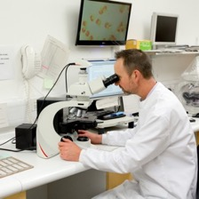

COVID-19 research
Collaboration
Progress has been made possible by members of the public, NHS and university researchers, health and social care professionals, regulators, life science companies and policy makers across the UK and internationally working together.

Slide 21


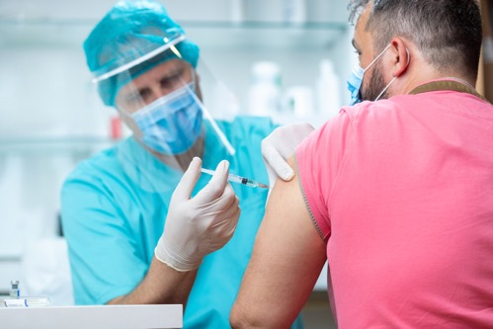


COVID-19 Research
Focus
120+
COVID-19 studies
Surveillance
how the disease transmits across groups
Understanding
how and why it affects people in particular ways
Treating
Identifying and testing therapeutics to treat people with COVID-19
Preventing
Vaccine development to prevent the disease spreading further
Long term impact
Tackling wider impacts on health, social care and society

Slide 22


COVID-19 Research – Examples
World’s largest randomised controlled trial for COVID-19
Identified the first proven treatment for the virus
Vital evidence about which treatments work and which don’t
  steroid dexamethasone can cut deaths by up to a third in patients on ventilators
  tocilizumab reduces the need for a mechanical ventilator and shortens the time COVID-19 patients spend in hospital
  no benefit from antibiotic azithromycin
  no benefit from convalescent plasma

Slide 23

COVID-19 Research – Examples
Studied DNA of 2700 patients in 208 ICUs
Identified 5 genes associated with severe COVID-19
Ability to predict the effect of drug treatments on patients, because some genetic variants respond in a similar way to particular drugs
“Our results immediately highlight which drugs should be at the top of the list for clinical testing. We can only test a few drugs at a time, so making the right choices will save thousands of lives.”
Kenneth Baillie, the project’s chief investigator and Academic Consultant in Critical Care Medicine and Senior Research Fellow at University of Edinburgh’s Roslin Institute

Slide 24

COVID-19 Research – Examples
Vaccine Trials
NHS Greater Glasgow & Clyde and NHS Lothian trialled the Oxford/AstraZeneca vaccine
NHS Grampian delivered Phase 3 trials of Novavax COVID-19 vaccine
NHS Tayside delivered Phase 3 trials of Janssen COVID-19 vaccine and recruited the first global patient
NHS Grampian opens the first trial with Medicago and GlaxoSmithKline (GSK) to test a plant-derived COVID-19 vaccine candidate
NHS Greater Glasgow and Clyde and NHS Lothian opens trial of Valneva COVID-19 vaccine - the only inactivated, adjuvanted (an ingredient to create a stronger immune response) vaccine in clinical development in Europe
NHS Lothian open first Pfizer - BioNTech COVID-19 vaccine study for pregnant women
NHS Greater Glasgow and Clyde opens Cov-Boost study - the first in the world to provide vital data on the impact of a third dose on patients’ immune responses.
Over 33,000 people in Scotland signed up to the NHS COVID-19 Vaccines Research Registry; and thousands have come forward to participate in trials

Slide 25









INTERNATIONAL CLINICAL TRIALS DAY (20 MAY)
YouGov Survey Results #BePartofResearch

Slide 26

#BePartofResearch
YouGov survey asked respondents a range of questions on their understanding of coronavirus research - especially research in the UK - and the role it has played in tackling the pandemic.
The survey was commissioned by the National Institute for Health Research (NIHR), NHS Research Scotland (NRS), Health and Care Research Wales, and Health and Social Care R&D Division Northern Ireland.
All figures, unless otherwise stated, are from YouGov Plc. Total sample size was 1009 adults. Fieldwork was undertaken between 13th - 17th May 2021. The survey was carried out online. The figures have been weighted and are representative of all Scotland adults (aged 18+).

Slide 27
The vast majority of Scottish adults think health research has played a very (66%) or fairly (23%) important role in the coronavirus pandemic
A significant disconnect exists between people’s perceptions of the importance of coronavirus research, and their understanding of where it happened and who took part
The vast majority of Scottish adults strongly agree (33%) or tend to agree (45%) that it is important the NHS offers participation in health research to everyone as part of routine care

Slide 28
In general, how important, if at all, do you think health research in the UK has been during the Coronavirus (COVID-19) pandemic?

Slide 29

Public Perception
23% said they trust health research more now than before the pandemic began
28% said they were now more likely to take part in health research

Slide 30

80% agree that the UK has played a leading role in the scientific response to coronavirus, with more than two-thirds (67%) saying they would be confident (scoring 7+ on a scale of 0 to 10) taking part in NHS-funded or public sector research
83% expressed pride in those UK researchers and NHS staff who identified coronavirus treatments and vaccines, and 90% think we should be grateful to people participating in coronavirus research

Slide 31

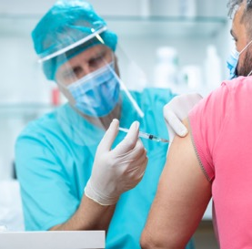
Despite these very positive views, the survey suggests that people’s perceptions of how that success was achieved did not reflect the scale of effort that has been put in by healthcare professionals and participants alike.

Slide 32

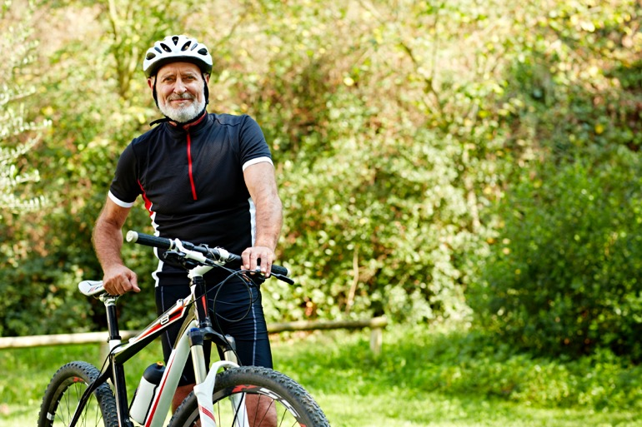
When asked about awareness and understanding of coronavirus research the survey showed…
#BePartofResearch

Slide 33
Approximately, how many participants in total do you think have taken part in health research into Coronavirus (COVID-19) in the UK?

Slide 34

#BePartofResearch
#ResearchVsCovid (March 2021)
Across the UK, a total of 1,075,000 participants have taken part in COVID-19 research
In Scotland, over 66,000 participants have taken part in 123 COVID-19 research studies

Slide 35
To the best of your knowledge, has your local NHS hospital offered opportunities to take part in health research into Coronavirus (COVID-19)?

Slide 36
To the best of your knowledge, has your local NHS hospital offered opportunities to take part in health research unrelated to Coronavirus (COVID-19)?

Slide 37
It is important that the NHS offers participation in health research to everyone as part of routine care

Slide 38
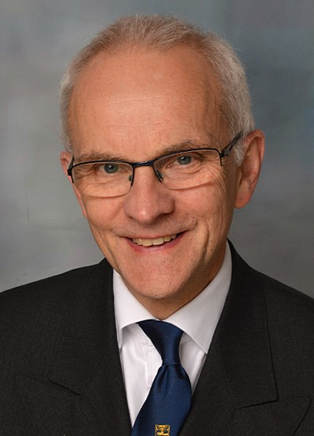
#BePartofResearch
“The COVID-19 pandemic has brought into sharp focus the importance of research. We must build on this momentum, the exceptional collaboration of all partners and strong public support for research to extend these efforts into all areas of heath.
Ensuring patients and the public are aware of research that is taking place around them, and the opportunities to take part is vital to help improve future health care and treatment.”
Professor Crossman, Chief Scientist (Health)
Scottish Government

Slide 39

Future of UK Clinical Research Delivery
Launched 23 March 2021
Presents a bold and ambitious vision for the future of clinical research delivery across the UK
Scotland has worked alongside the UK nations to develop the vision, with input from NHS, regulators, medical research charities and life sciences industry.

Slide 40
Future of UK Clinical Research Delivery
Throughout the COVID-19 pandemic, clinical research has provided a beacon of hope and shone a light on the vital role research plays in improving healthcare for us all.
The spirit of collaboration shown by all those involved in this phenomenal research effort has been fundamental…we must carry this spirit of collaboration with us into the future, placing clinical research front and centre of our plans to build back better.
It has showcased the clear link between research and better outcomes – for individuals and the NHS.
Despite our successes in COVID-19 research over the last year, the pandemic has had a significant impact on our ability to deliver other important clinical research – we need to restore and enhance diverse research portfolio offered before the pandemic – across all phases, treatment types and conditions.

Slide 41
Future of UK Clinical Research Delivery
Sets out the ambition to create a patient-centred, pro-innovation and data-enabled clinical research environment.
It empowers everyone across the health service to participate in delivering research; and enables people across the country to take part in research that is of relevance to them.

Slide 42
Five key themes
Clinical research embedded in the NHS – to create a research-positive culture in which all health and care staff feel empowered to support and participate in clinical research as part of their job
Patient-centred research – to make access and participation in research as easy as possible for everyone across the UK, including rural, diverse and under-served populations
Streamlined, efficient and innovative research – so the UK is seen as the best place in the world to conduct fast, efficient and cutting-edge clinical research
Research enabled by data and digital tools – to ensure the UK has the most advanced and data-enabled clinical research environment in the world, building on our unique data assets to improve health and care
A sustainable and supported research workforce – which offers rewarding opportunities and exciting careers for all healthcare and research staff of all professional backgrounds - across both commercial and non-commercial research

Slide 43


Future of UK Clinical Research Delivery
Together we can create a research delivery environment that improves patients’ lives, levels up economic opportunity across the UK and bolsters our health resilience, all while addressing health inequalities.

Slide 44
Future of UK Clinical Research Delivery
Next steps
Wider policy alignment - vision is a vital part of the wider strategy to improve the health of people right across the UK, and to ensure we continue to lead the world in the development and delivery of cutting-edge treatments and technologies
Part of a coordinated and coherent programme of work - to ensure the recovery, resilience and growth of UK clinical research delivery
Implementation plans published in each nation end of June

Slide 45





Stay in touch
www.nrs.org.uk
@NHSResearchScot
NHS Research Scotland
communications@nrs.org.uk
Visit NHS Research Scotland in the virtual exhibition

Slide 46
Finding Lung Cancer Early
Diane Primrose, Senior Programme Manager – Cancer Performance & Early Diagnosis, Centre for Sustainable Delivery

Slide 47
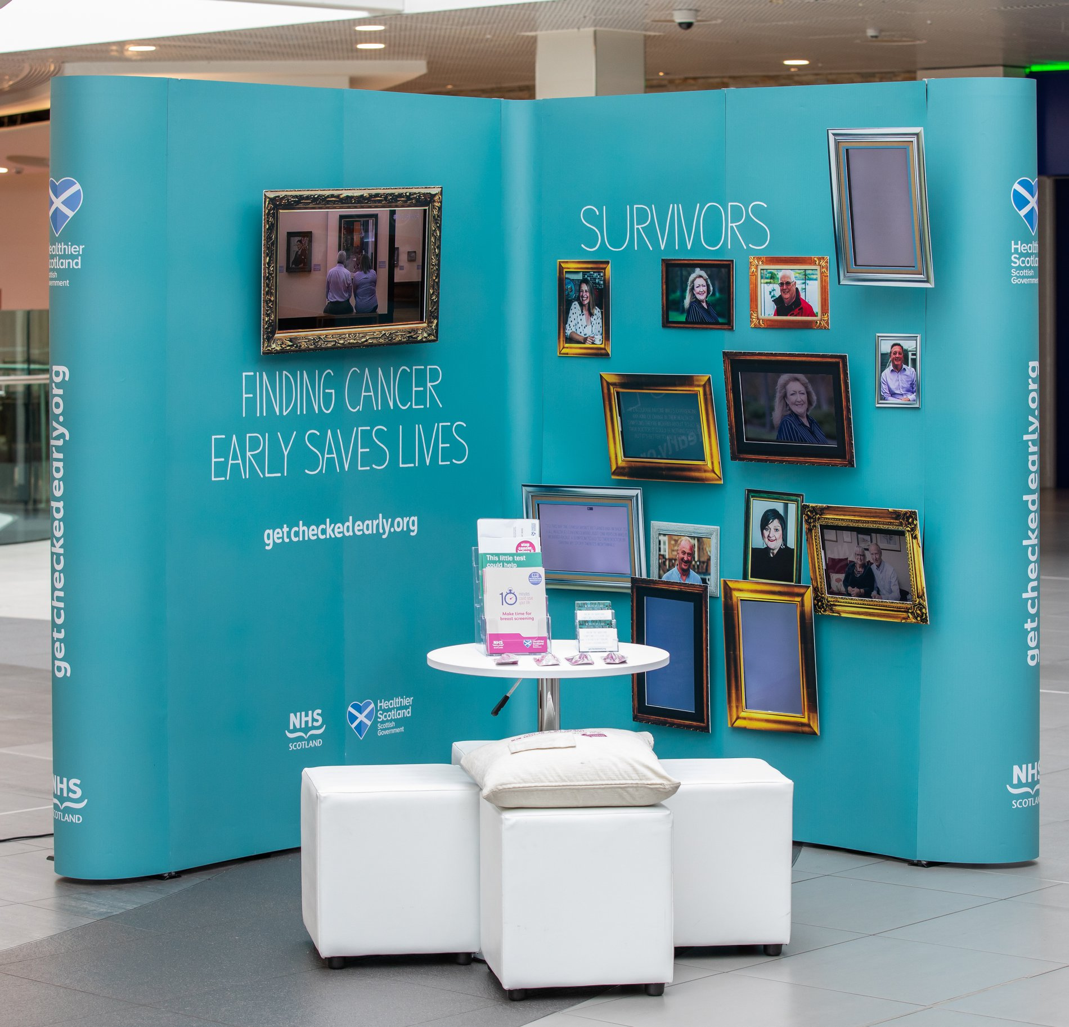
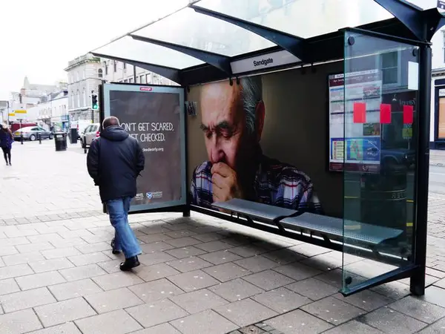


Detect Cancer Early (DCE)
Flagship £43 million DCE Programme launched in 2012
Ambitious target to increase the proportion of stage one bowel, breast and lung cancers by 25%
Whole-systems approach adopted (public awareness, primary care, screening, diagnostics and data), with a focus on reducing inequalities

Slide 48
Latest Lung Staging
Latest DCE staging data (published November 2020) shows that for 2018 & 2019 combined there has been a 43% increase in the proportion of stage 1 lung cancers diagnosed, compared to the baseline (2010 and 2011).
If we look stage one and two combined, there has been around a 29% increase since the beginning of the Programme.
The biggest increase in stage one lung cancer diagnoses has been in the most deprived areas of the country – 57% increase from baseline.
It’s essential that this progress isn’t now reversed as a result of the Covid-19 pandemic, of which the true impact on patient outcomes, including staging and survival, won’t be realised for some time.

Slide 49
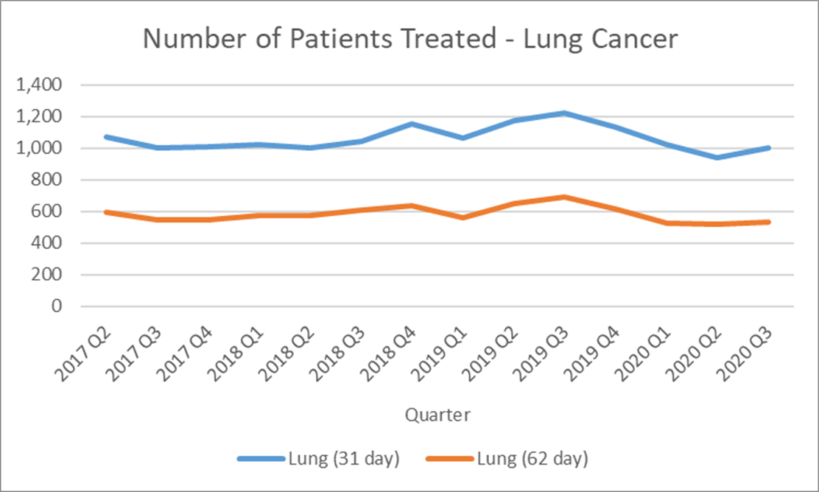
Covid-19
Advice to stay at home to protect people from Covid-19, people’s anxiety around possible infection at NHS sites and the cross-over of symptoms – such as a cough – is believed to have contributed to people delaying seeking help, and thereafter being referred for further tests
USC lung referrals remain below pre-Covid levels*
We’re diagnosing around 25% fewer lung cancers now compared to pre-Covid
Anecdotally, Health Boards are reporting people presenting with more advanced morbidity
*as of week ending 25 April 2021

Slide 50
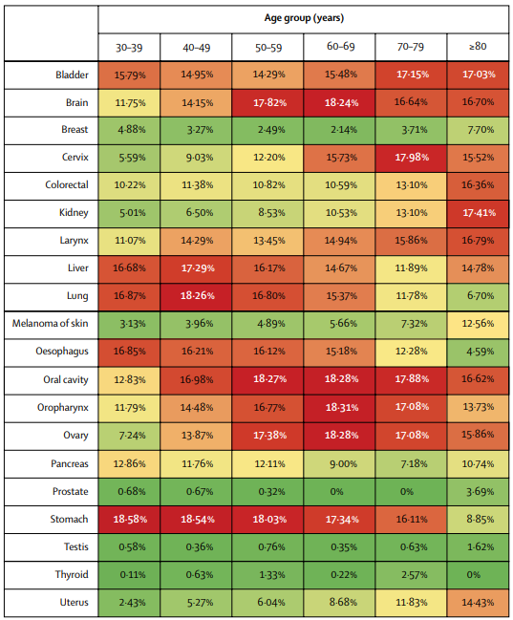
The Importance of Early Diagnosis
Sud et al undertook a piece of modelling, published in The Lancet, July 2020
The diagram opposite shows the reduction in 10-year net survival incurred from a 3-month delay for the 20 most common tumour types, by age group
Around 1% worse survival for every 1 week delay
Modelling has also been undertaken in Scotland to explore the long-term effects of the disruption of cancer services on patient outcomes, focusing on DCE’s three core tumour groups (breast, bowel and lung)
https://www.thelancet.com/action/showPdf?pii=S1470-2045%2820%2930392-2

Slide 51


Latest attitudinal tracking
65% said they would delay contacting their GP practice unless it was an emergency
37% are worried about going to their GP practice due to the risk of catching Covid-19
1/5 agree that they might delay contacting their GP about possible signs of lung cancer at the moment, because “cancer screening and referrals are not operating as normal”
50% agree that cancer is still a death sentence for the majority of people
More than a quarter of people might put off contacting their GP practice about possible signs of lung cancer – for fear of what they might be told
There appears to be some confusion around symptoms of Covid-19 and lung cancer, which may impact on presentation:
  Being short of breath that is unusual for you: 62% think this is a sign of Covid while 52% think it is a sign of lung cancer
  New or change in cough for 3 weeks or more: 47% think this is Covid v’s 59% lung cancer

Slide 52
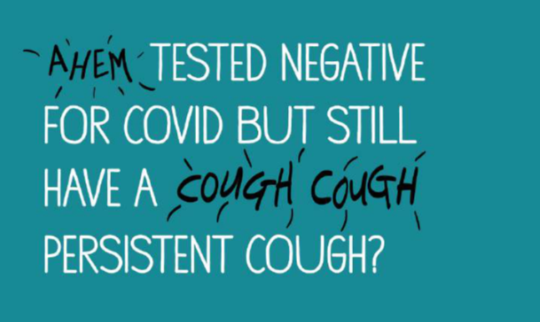
The Response
Recovery & Redesign: An Action Plan for Cancer Services includes a standalone section on lung cancer
First Minister’s daily briefings helped reinforce cancer as a priority
A door-drop to every household in Scotland, guiding people on how to access NHS services, included a specific message around potential lung cancer symptoms
An interim Detect Cancer Early campaign, aimed at those aged 40+, ran throughout February 2021 with a new mass-awareness campaign currently live across Scotland

Slide 53

The Response
Urgent Suspicion of Lung Cancer Guidance published
Cancer Research UK’s Clinical Engagement Team in Scotland funded for 18 months to support the recovery of the lung pathway
Supporting remaining few Health Boards to establish direct access to CT pathway for primary care
Optimal pathways being explored
Funding pilot for pharmacy referral of patients with possible lung cancer symptoms
The University of Edinburgh is undertaking a feasibility study in relation to high risk screening in Scotland
University of Aberdeen undertaking analysis of upcoming NCDA data to better understand referral patterns and avoidable delays in relation to lung cancer and non-specific symptomatic cohort
Scotland’s first Early Cancer Diagnostic Centres live

Slide 54
Thank you
Diane Primrose, Senior Programme Manager – Early Diagnosis & Cancer Performance
Diane.Primrose@gov.scot

