Slide 1
Choosing Where I Die: Paediatric Palliative Care and Realistic Choice

Slide 2




The Clinical Advisory Service (CAS)
The context, the service, a clinical case, and what comes next
01 CONTEXT
02 THE SERVICE
03 CLINICAL CASE
04 NEXT STEPS
Clinical picture, Scottish Government strategy and service mapping
What the Clinical Advisory Service offers and how it works
A case showing the service in practice
CAS evaluation findings and priorities ahead
Context, service, clinical case, and next steps

Slide 3
Slido Questions
Question 1:
If a child with a life-shortening condition deteriorated tonight, how confident would you feel accessing specialist paediatric palliative care advice? (1-10 scale)
Question 2:
Have you previously sought specialist paediatric palliative care advice for a child? (Multiple Choice)
Yes, through CAS
Yes, through another service
No, but I know how to access advice
No, and I would be unsure where to start

Slide 4
Do not edit
How to change the design
If a child with a life-shortening condition deteriorated tonight, how confident would you feel accessing specialist paediatric palliative care advice?
The Slido app must be installed on every computer you’re presenting from

Slide 5
Do not edit
How to change the design
Have you previously sought specialist paediatric palliative care advice for a child?
The Slido app must be installed on every computer you’re presenting from

Slide 6

National Context
Strategy, networks and the case for equitable access
Paediatric Subgroup
  Paediatric End of Life Care Network (PELiCaN)
  SACMO
  Scottish Children and Young People's Palliative Care Network (SCYPPN)
  Transition
  NHS and Third Sector membership
Focus on understanding current environment – Healthcare Improvement Scotland survey and data
Develop recommendations for equitable access to Paediatric Palliative Care for all children
National strategy sets the direction for equitable access

Slide 7

Survey Response
Responses to the national mapping exercise and the Gathering Views report on paediatric palliative care
11 of 14 Territorial Boards
12 different service types
All major specialist service centres represented
Children and families
A broad national picture: 11 of 14 boards, 12 service types

Slide 8
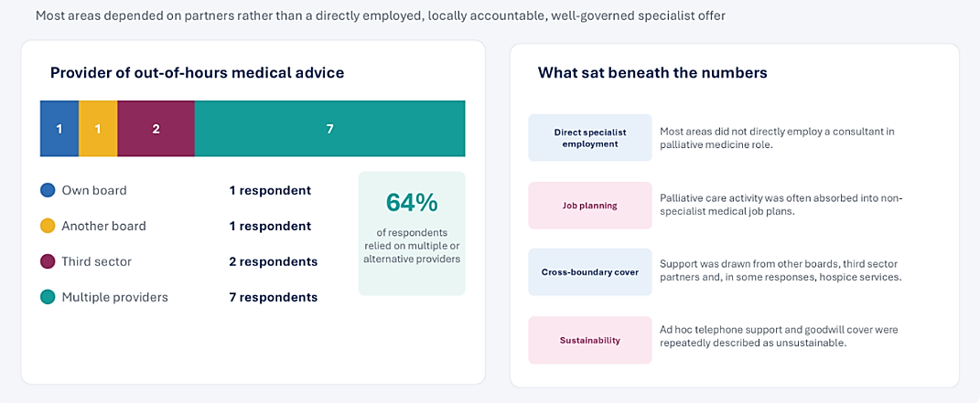
Specialist Medical Support
What sat beneath the numbers on out-of-hours medical advice
Access existed but governance and capacity were fragmented

Slide 9
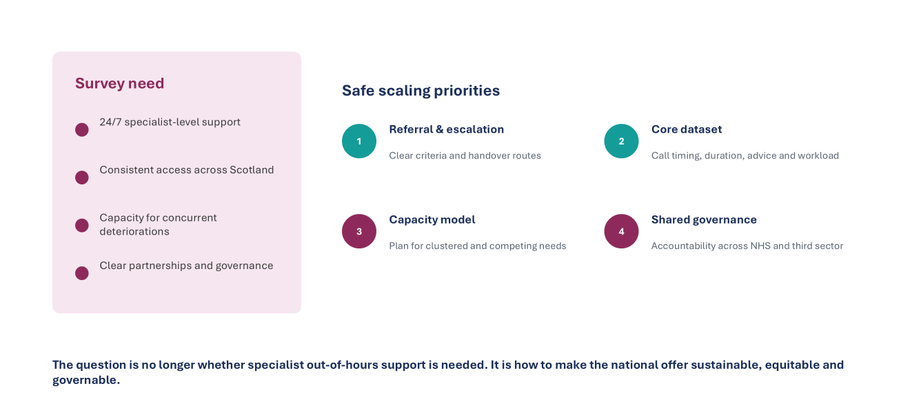
Survey Need and Response
From what the survey identified to how the service was scaled
Survey needs mapped directly to safe scaling priorities

Slide 10
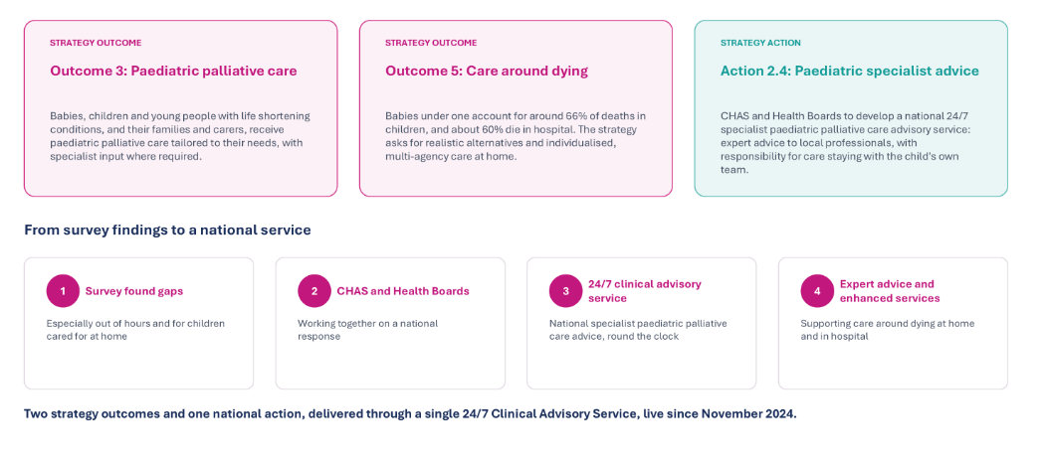
From Strategy to National Service
From survey findings to a single national advisory service
Two strategy outcomes - delivered through one 24/7 service

Slide 11





A national partnership
Four organisations combine specialist expertise for professionals across Scotland
Clinical Advisory Service
Hosted by CHAS - Delivered by all four partners

Slide 12
What CAS set out to achieve
Five connected aims — from national access to safe, locally delivered care
01
02
03
04
05
ACCESS
24/7
WHOLE FAMILY
SAFETY
GOVERNANCE
Specialist advice
across Scotland
Empower local teams
to deliver care
Holistic care and
wider family support
Partnership, standards
and clear procedures
Accountability, peer
support and review
Specialist expertise supports — but does not replace — the team already caring for the child.
National expertise Local delivery Whole-family care

Slide 13

The clinical model
Specialist advice strengthens the team already caring for the child
Weekly national MDT
Consultant-led discussion with the local team
Out-of-hours advice
Specialist paediatric palliative medicine support
In-hours advice and follow-up
Urgent advice, planning and support after MDT
Clinical responsibility stays with the local team

Slide 14

What CAS offers
For serious illness with instability, deterioration or a need for specialist palliative care advice
Medical and nursing expertise with pharmacy, family support and spiritual care
Symptom management
Future care planning
Complex decisions
Care around dying
Pain, seizures and other distressing symptoms
Anticipatory plans and treatment escalation
Specialist discussion and multidisciplinary review
Support for the child’s preferred place of care
Defined question Shared recommendations Local delivery

Slide 15

Governance across the partnership
Shared standards, clear responsibilities and a route for learning
Local team
Assessment, prescribing and delivery of care
CAS clinicians
Specialist advice, documentation and handover
Partner oversight
Steering group, risk review and quality reporting
One framework links CAS to every partner’s governance

Slide 16

How the Service works
Referring clinicians experience, what the service offered, how the service worked in partnership locally
A clinician’s perspective

Slide 17


Challenges and enablers
What hinders and helps a national service
Delivering a national service

Slide 18
Slido Questions
Question 3:
What could make it difficult for a local team to use a national clinical advisory service effectively? (Free Text)
Question 4:
What would most help a national advisory service work well with your local team? (Free Text)

Slide 19
Do not edit
How to change the design
What could make it difficult for a local team to use a national clinical advisory service effectively?
The Slido app must be installed on every computer you’re presenting from

Slide 20
Do not edit
How to change the design
What would most help a national advisory service work well with your local team?
The Slido app must be installed on every computer you’re presenting from

Slide 21
How the service responds
Facing challenges, building on enablers
Delivering a national service

Slide 22
The first year of CAS
November 2024 to October 2025
56
162
261
children supported
MDT case presentations
estimated out-of-hours calls
Service records and professional feedback
10 of 17 referring clinicians responded
5 CAS MDT members contributed feedback
A descriptive evaluation of a developing service

Slide 23
Support across 10 health boards
Children supported by health board area in year one
10
of 14 health boards
Access expanded
incrementally
throughout the year
56 children, from before birth to 19 years

Slide 24

Clinical complexity
Children were seriously ill, technology-dependent and experiencing rapid change
73%
55%
enteral or
parenteral feeding
respiratory
support
61%
28%
epilepsy or
seizures
recent PICU
admission
13
unique prescriptions on average
High complexity demanded specialist, responsive advice

Slide 25

Family background shaped care
Clinical recommendations had to work within each family’s circumstances
46%
33%
lived in SIMD
quintiles 1 and 2
reported financial
hardship
33%
25%
had diverse family
structures
from ethnic minority
backgrounds
Trauma · safeguarding · language · culture · religion · time-critical practices
Whole-family context is part of safe care planning

Slide 26
Beyond the call
An MDT discussion or telephone call often began a much longer episode of work
01
02
03
THE ADVICE EVENT
THE WORK IT GENERATED
THE DAYTIME IMPACT
≈20%
29
21
Future care and symptom plans
Medicines and syringe-driver review
Rapid discharge and coordination
Education, staff and parent training
+
→
→
min call
min admin
of CAS clinicians’ time
additional daytime advice,
education, training and support
Demand could cluster: 31 calls in 3 days · 4 children · 4 health boards
The call was only the beginning
Notes:
TIMING: 70 seconds.
The call or MDT discussion was often only the beginning of the clinical work. The visible contact generated plans, medicines review, rapid-discharge support, coordination and education for the professionals or parents delivering care.
The evaluation found that this additional work accounted for almost 20 per cent of CAS clinicians’ time. Crucially, the report describes it as daytime activity. It therefore affected the capacity of the specialist teams’ existing daytime services, not only the out-of-hours rota. The work was shared with NHS specialist teams, local teams, CHAS and other services, but it still required specialist CAS clinician input.
The left-hand figures show the work directly attached to a recorded out-of-hours contact: an average 29-minute call and a further 21 minutes of administration. Demand could also cluster, with 31 calls over three days for four children in four health boards.
Recording was incomplete, especially for work outside the formal model, so the true impact is likely to have been greater.
SOURCES
The Clinical Advisory Service Year One Evaluation V1.5, August 2026, pp. 10–11 and 20. The report describes additional advice arising from MDT recommendations as almost 20% of CAS clinicians’ time and explicitly identifies it as daytime activity. Call and administration means are based on incomplete records.

Slide 27
Supporting the family’s preferred place
Preferred place of death was achieved in 39 of 43 deaths
Where children died
Home
17
91%
Hospital
13
Hospice
11
39 of 43
Respite centre
2
43 children died during the evaluation
Mean time from referral to death: 36 days
Success means care aligned with each family’s preference

Slide 28
What clinicians valued
Professional feedback was strongest about out-of-hours support
“Having a paediatric palliative care
consultant available to support and
advise is invaluable when working remotely.”
Referring clinician
Swift responses
Trusted expertise
Permission to call back
10 respondents across five health boards

Slide 29
Progress against our aims
Year one established national reach and value — with important gaps still to close
AIM
EVIDENCE FROM YEAR ONE
01
Wider access
10 boards · 56 children · 162 MDT presentations
02
24/7 and local care
261 estimated OOH calls · preferred place achieved in 91%
03
Whole-family support
High need identified · support not always accessed through CAS
04
Safe, consistent practice
Standardisation welcomed · forms, IT and recording still developing
05
Governance and peer support
Peer learning reported · consistent implementation still required
Strong progress — with consistency still to build

Slide 30
What we learned and what changed
The first year prompted operational changes and a clearer description of the service
Learning from year one
Changes and ongoing priorities
The offer was not always clear
Framework explicitly describes in-hours advice
Forms and IT made participation harder
Repeated revisions to forms, recording and IT
Safe advice needs current information
Framework specifies updates and SBAR handover
Needs did not always become actions
Family support and action tracking remain priorities
Clear practice needs consistent implementation

Slide 31
Priorities for the next phase
Service development informed by the first-year evaluation
01
Clearer access
Shared referral criteria and explanation of the full offer
02
A more useful MDT
Agreed purpose, respectful challenge and better documentation
03
Whole-family support
Named actions and links to the agency best placed to help
04
A stronger dataset
Activity, workload, care planning, outcomes and equity
National ambition: consultant-supported advice, 24/7

Slide 32

Accessing CAS
Specialist advice for the professionals caring for the child
Referral guidance and forms
chas.org.uk/for-professionals/
clinical-advisory-service
clinicaladvisoryservice@chas.org.uk
Scan for the CAS webpage
Share the CAS referral page with your clinical teams

Slide 33

Questions and Answers
What do you want to know about the Clinical Advisory Service?
Thank you

Slide 34
Slido Questions
Question 5:
If a child with a life-shortening condition deteriorated tonight, how confident would you feel accessing specialist paediatric palliative care advice? (1-10 scale)
Question 6:
What transferable learning can you take from this session? (Free Text)

Slide 35
Do not edit
How to change the design
If a child with a life-shortening condition deteriorated tonight, how confident would you feel accessing specialist paediatric palliative care advice?
The Slido app must be installed on every computer you’re presenting from

Slide 36
Do not edit
How to change the design
What transferable learning can you take from this session?
The Slido app must be installed on every computer you’re presenting from

