Slide 1
Prevention First: Tackling Winter Respiratory Illness Together in Scotland

Slide 2
Overview
The session will focus on how Public Health Scotland (PHS), with partners, led a coordinated, prevention focused winter preparedness and operational response for 2025/26.
We will cover:
National and local planning to maximise vaccination uptake
Building confidence using evidence on vaccine effectiveness and safety
Delivering integrated surveillance to detect risk early
Embedding pandemic learning into routine winter planning

Slide 3
Winter preparedness and operational response
Vaccine preventable diseases with winter seasonal peaks include:
Influenza
COVID-19
respiratory syncytial virus (RSV)
pneumococcal disease.
Flu and covid vaccines are offered seasonally
Achieving high uptake has been challenging in recent years
Post-pandemic declines seen globally across most programmes
Notes:
PHS has key national leadership roles, including for the Scottish Vaccination and Immunisation Programme (SVIP), respiratory pathogen surveillance and healthcare public health

Slide 4
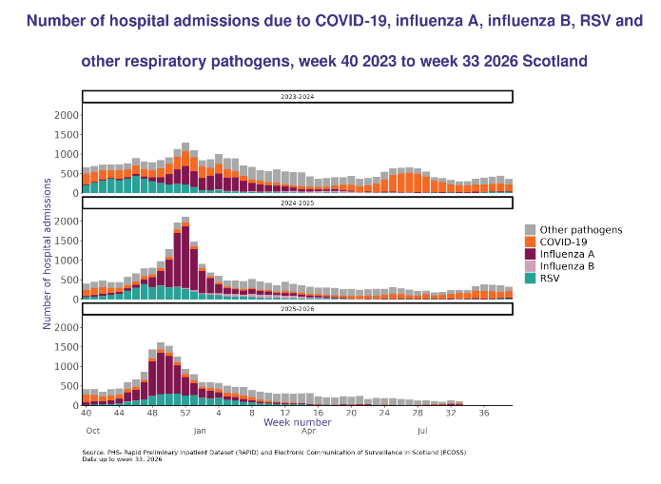
Respiratory winter viruses cause serious illness in Scotland
Around 5,000 adults were admitted to hospital with flu in Scotland between Oct 25 - Mar 26. More than half were aged 65 and over.
COVID-19 infections and hospital admissions remain much lower than during the pandemic.
RSV mainly affects young children, with babies under 1 year most likely to be admitted to hospital.
Source: Weekly Viral respiratory diseases in Scotland surveillance report

Slide 5
Influenza uptake increased in most groups in Winter 2025/26
More than 1.8 million flu vaccines given in Scotland
Notable increases for:
Healthcare
workers
+ 6.1%
35.9% to 42.0%
18-64
at-risk
+ 4.3%
34.6% to 38.9%
Weakened immune system
+ 3.5%
61.0% to 64.5%
Small increases for:
Social care workers
17.2% to 18.5% (+1.3%)
65 years and over
74.1% to 74.6% (+0.5%)
75 years and over
80.6% to 81.0% (+0.4%)
Pre-school children
50.3% to 50.8% (+0.5%)
Flu vaccine uptake remained very high in care home residents (83%), although slightly lower than the previous season
Areas for improvement:
Primary school pupils
68.1% to 67.0% (-1.1%)
Secondary school pupils
53.1% to 52.1% (-1.0%)
At-risk children aged 6m-2yrs
40.7% to 40.1% (-0.6%)

Slide 6
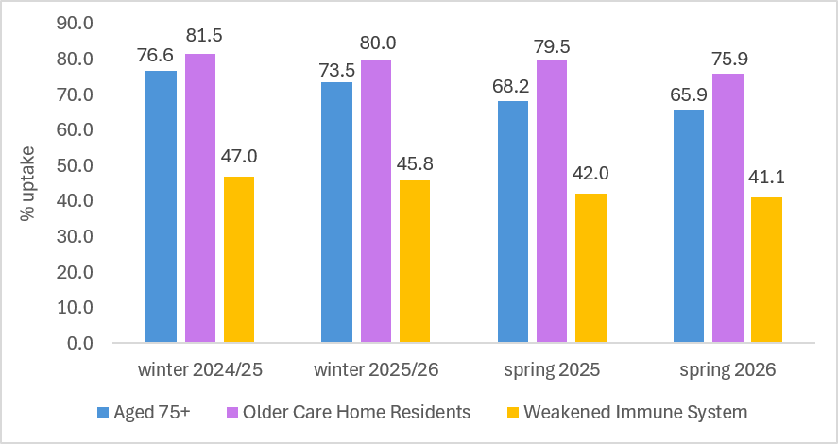
COVID-19 uptake remained high in care home residents
Around 489,000 COVID-19 vaccine doses given
in winter 2025/26 and 425,000 in spring 2026 in Scotland
More people were vaccinated in winter than in spring.
Care home residents had the highest uptake.
People with weakened immune systems had the lowest uptake.
Uptake was slightly lower than the previous year across all groups.
COVID-19 vaccine uptake (%)
by JCVI priority group, 2024-2026
Comparing winter 2024/25 to 2025/26:
Aged 75+
-3.1%
Older care
home residents
-1.5%
Weakened
immune system
-1.2%
Comparing spring 2025 and spring 2026:
Older care
home residents
-3.6%
Weakened
immune system
-0.9%
Aged 75+
-2.3%

Slide 7
Respiratory syncytial virus: programme in 3rd year, with expanded offer to older adults
Older adult programme
47,416 RSV vaccinations delivered in 2025/26.
Most vaccinations were given in August and September.
Uptake in newly eligible 75-year-olds was 68.8% (70.0% in 2024/25) and 15.9% among those aged 75-79
Future reports will include newly eligible groups aged 65-74 at risk and 80+.
Maternal vaccination
In 2025, there were around 25,000 doses given.
Highest monthly uptake was 63.9% in Dec 2025.
RSV vaccine uptake (%)
Among pregnant women, 2025-2026

Slide 8
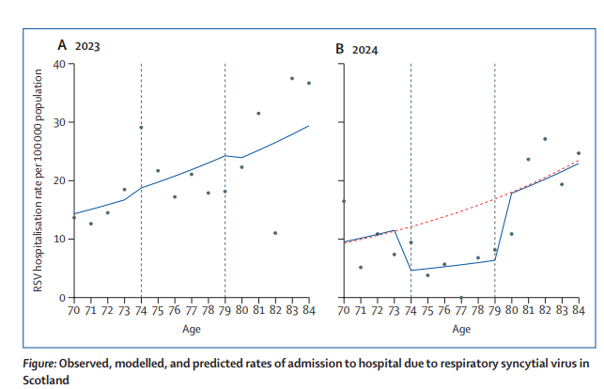

Winter vaccines help prevent hospital admissions
Flu: Vaccination reduces hospital admissions by about 30-50%.
COVID-19: Around 40% fewer COVID-19 hospital admissions among those eligible
Scotland’s newest vaccine programme for RSV:
  62% reduction in RSV admissions among older adults.
  Around 80% fewer RSV admissions in babies whose mothers were vaccinated during pregnancy - around 219 fewer admissions in the first three months of life in the first season.
  Modelled reductions in admissions
  to hospital for RSV among 75-79 year olds following vaccination in Scotland, 2024
  219 RSV-related hospitalisations averted
  in Scotland, 2024/25

Slide 9
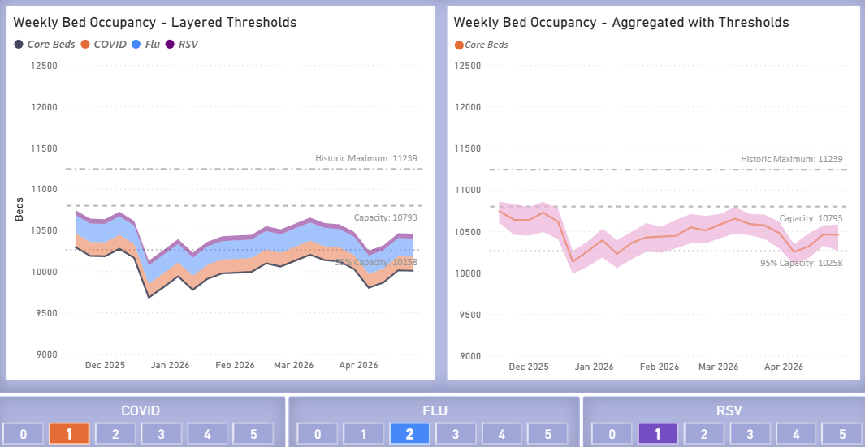
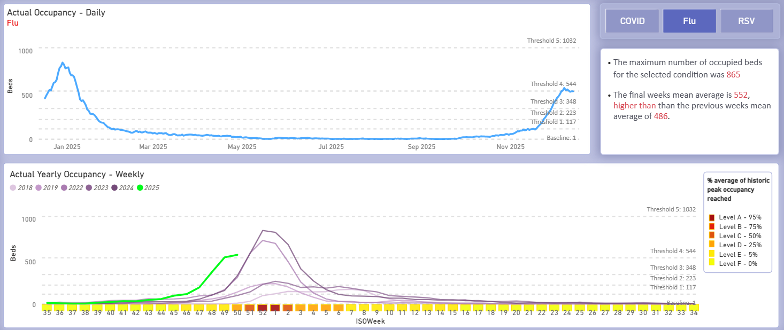
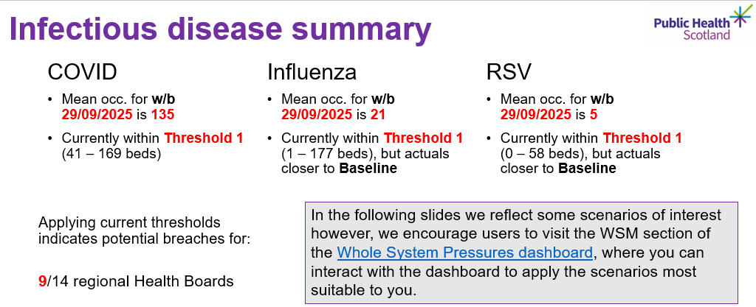
Data & Intelligence can support winter preparedness and responsiveness
1
UNDERSTAND
2
ANTICIPATE
3
MONITOR & ADAPT
Historic demand and flow
Model plausible winter scenarios
Monitor emerging pressures
Historic patterns
Scenario range
Near-time position
Use historic demand, activity and flow to understand underlying patterns and seasonal pressures.
Supports identification of likely pressure points and provides a baseline for winter planning
Use scenario modelling to explore plausible levels of winter pressure and test plans against them
Supports capacity, workforce and resilience/surge planning
Use real-time or near-time intelligence to track emerging pressures and assess whether plans need to change
Supports decisions on when to scale responses up – and when additional capacity can be stepped down
PHS supports Boards to move from:
Understanding previous winters -> Anticipating plausible pressures -> Adapting plans as winter unfolds
Notes:
Speaker notes:
Winter respiratory illness creates additional pressure across the health and care system, particularly on acute services and hospital flow.
PHS provides Boards with data, intelligence and modelling to support winter planning at three stages. This includes tools such as Discovery and whole system pressure dashboards.
First, we use historic demand, activity and flow to understand underlying trends and the additional pressures typically associated with winter.
Second, scenario modelling allows Boards to explore a plausible range of winter pressures and test whether capacity, workforce and resilience plans are sufficient. A particular focus has been general medical beds.
Third, as winter unfolds, real-time and near-time intelligence can help Boards understand emerging pressures and assess whether plans need to be adapted - including when additional capacity may need to be brought on and when it can safely be stepped down.
The aim is to provide Boards with intelligence that supports decisions before and during winter, rather than simply describing pressures after they have occurred.

Slide 10
We engaged with our target audiences through trusted intermediaries and networks
Notes:
Ministerial roundtables (April and May 2025)
Weekly task and finish group with all health boards represented
Stakeholder engagement sessions in partnership with the Health and Social Care Alliance Scotland (July and November 2025)
Social Care short-life working group

Slide 11
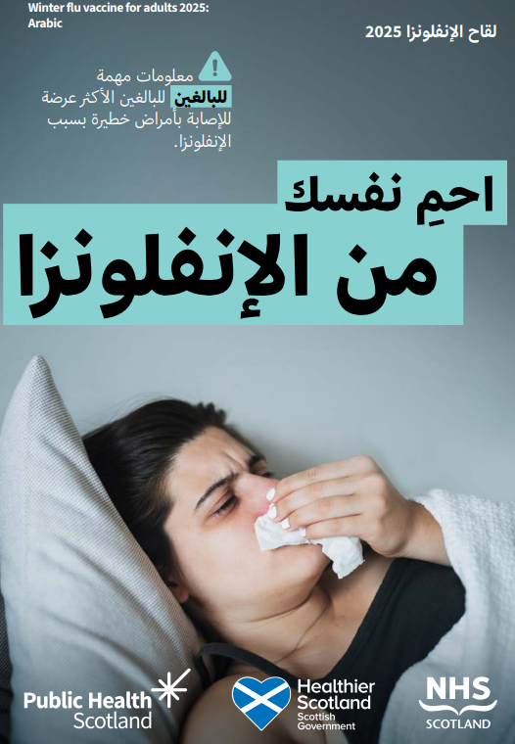
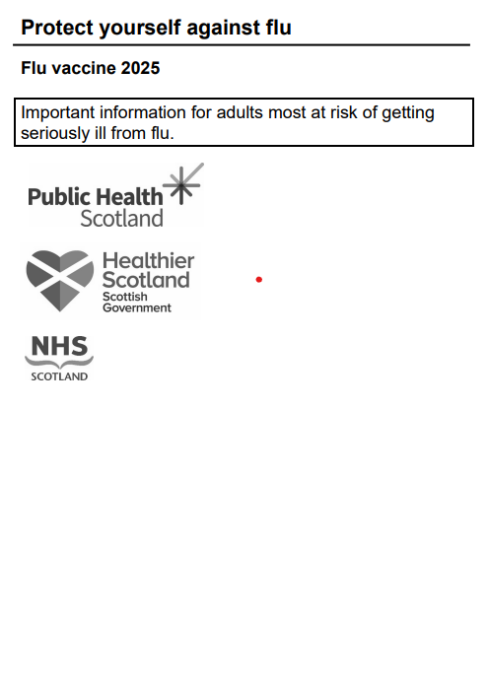
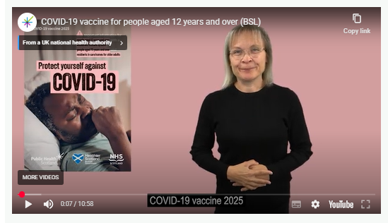
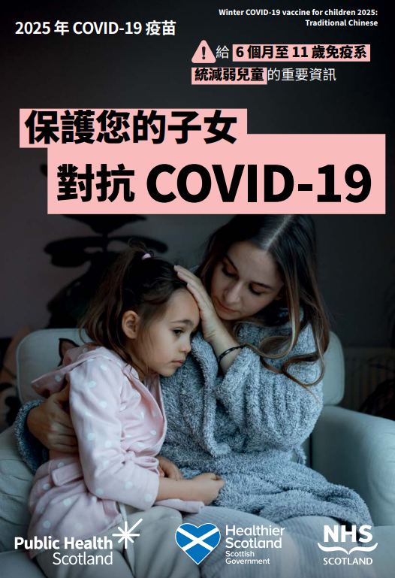
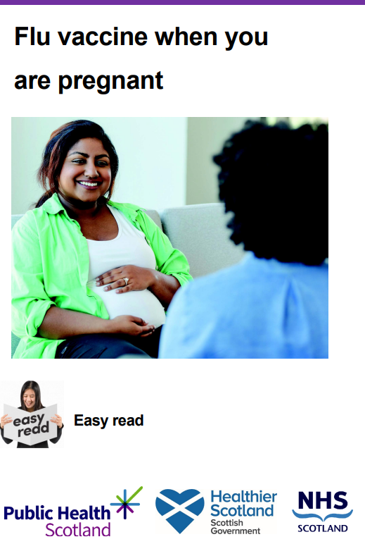
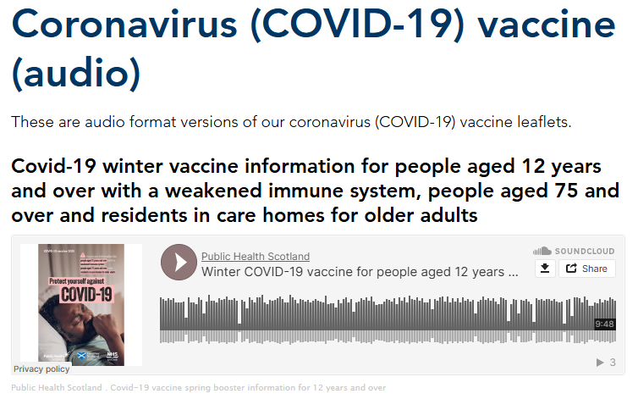
Informed consent materials - other languages/ formats examples
Large print
BSL
Translated leaflets: Arabic, Chinese Traditional (Cantonese), Chinese Simplified (Mandarin) & Polish
Easy read
Audio
Notes:
Resources were sent to over 30k locations including: Schools, Nurseries, GPs, Pharmacies, Libraries, Hospitals/ maternity settings, Dentists, Vaccination Centres, Mosques, Synagogues, Hospices, Opticians, Community Centres, Leisure Centres, Bingo Halls, Colleges/Universities, Care Homes

Slide 12
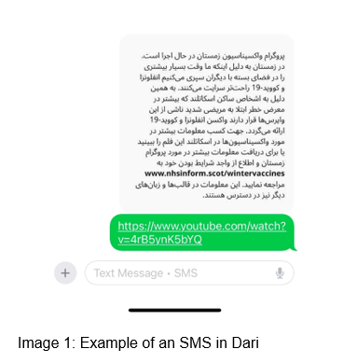

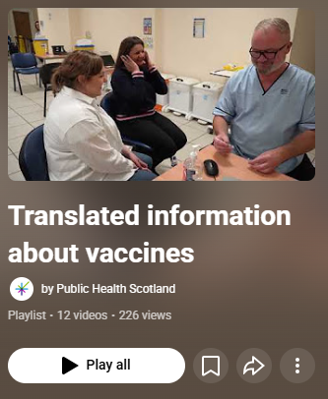
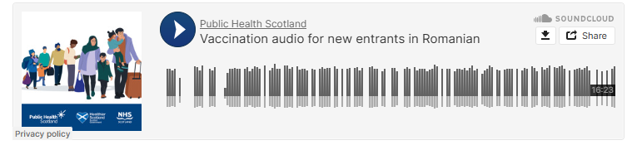
Collaboration with Scottish Refugee Council
-
Notes:
A link to the video which includes key information about the NHS in Scotland, why vaccines are offered, free access, interpreter support, safe equipment, and ingredients
- Winter Vaccines message (text image/word document) to accompany the video when sharing it with communities and other stakeholders

Slide 13
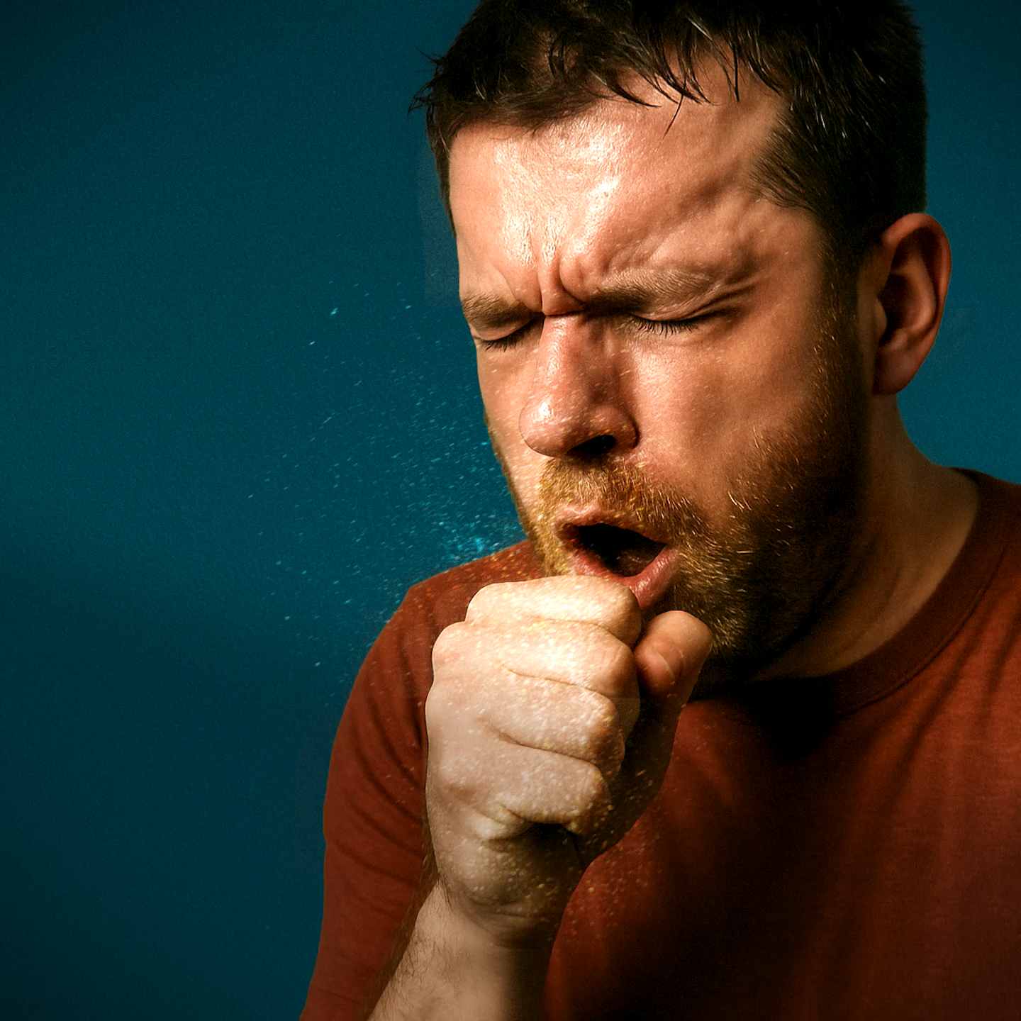

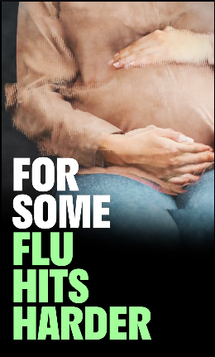
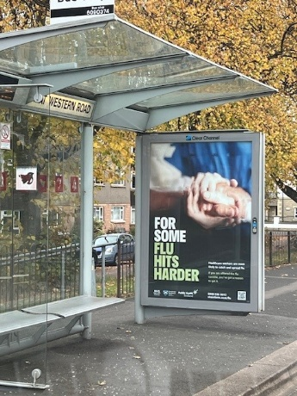
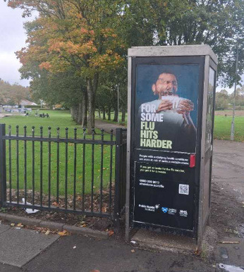
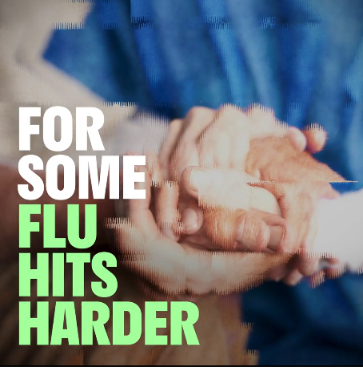
Flu vaccine campaign 2025/26
Radio
Social media advert
Out of home advertising
Notes:
In September 2025 - Public Health Scotland (PHS) launched a brand-new campaign to raise awareness of the eligibility of the flu vaccine and the seriousness of the virus. The campaign focused on the chaos and disruption that having flu can have. It is highly targeted, focusing on those most at risk.
Radio activity: Radio reached more than 2.5 million listeners. The ad was heard by 60% of the 18–64 population in Scotland and on average listeners heard the advert 14 times
Social media ad: T
Out of home advertising - bus panels,
6 sheets and phone kiosks in 20% most deprived areas and proximity to some hospitals
argeted people at risk, ethnic minorities, lower 20% SIMD postcodes, health and social care workers and pregnant women

Slide 14
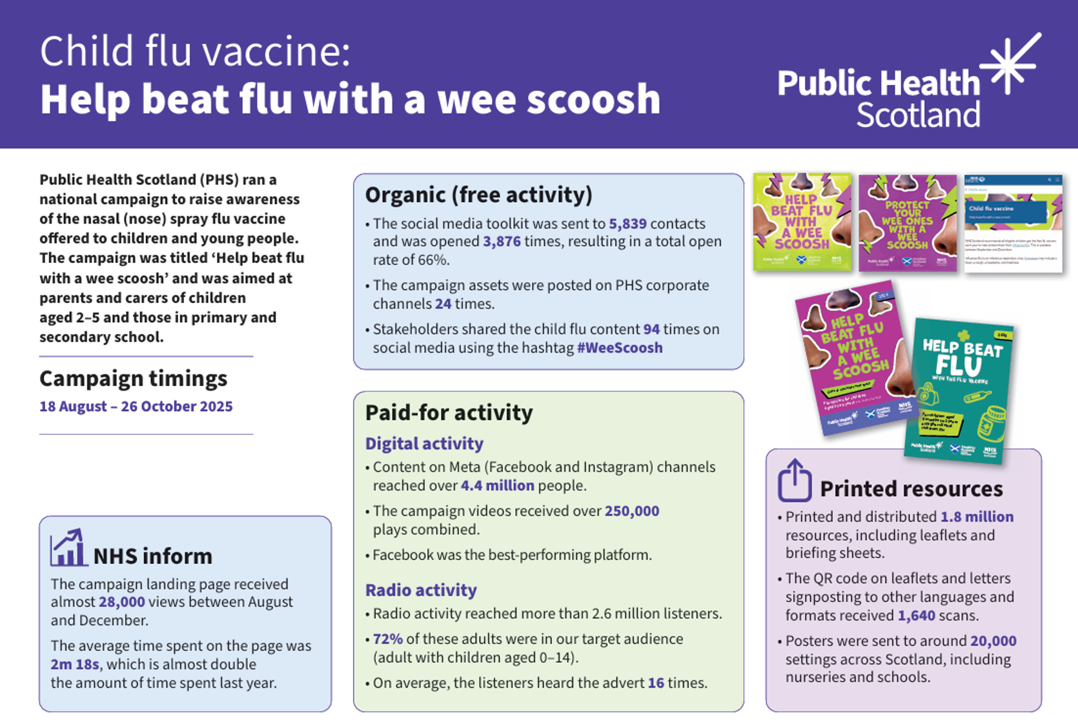

Slide 15
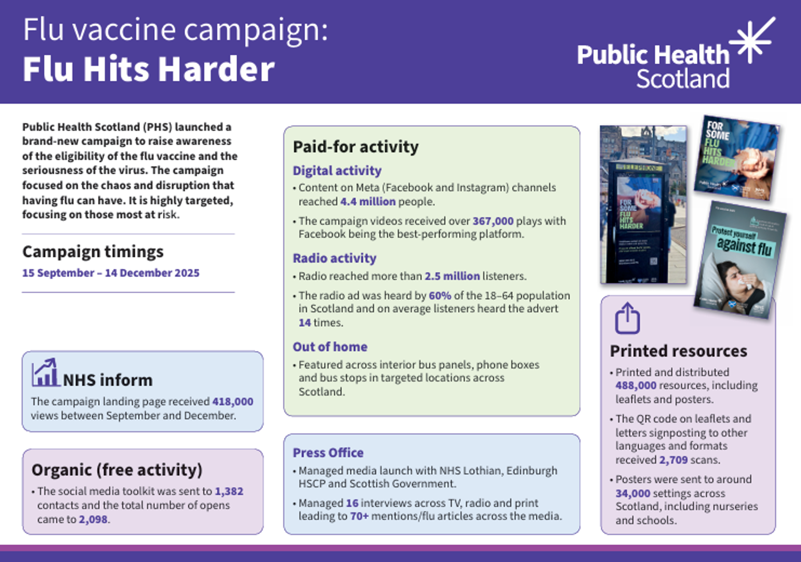

Slide 16
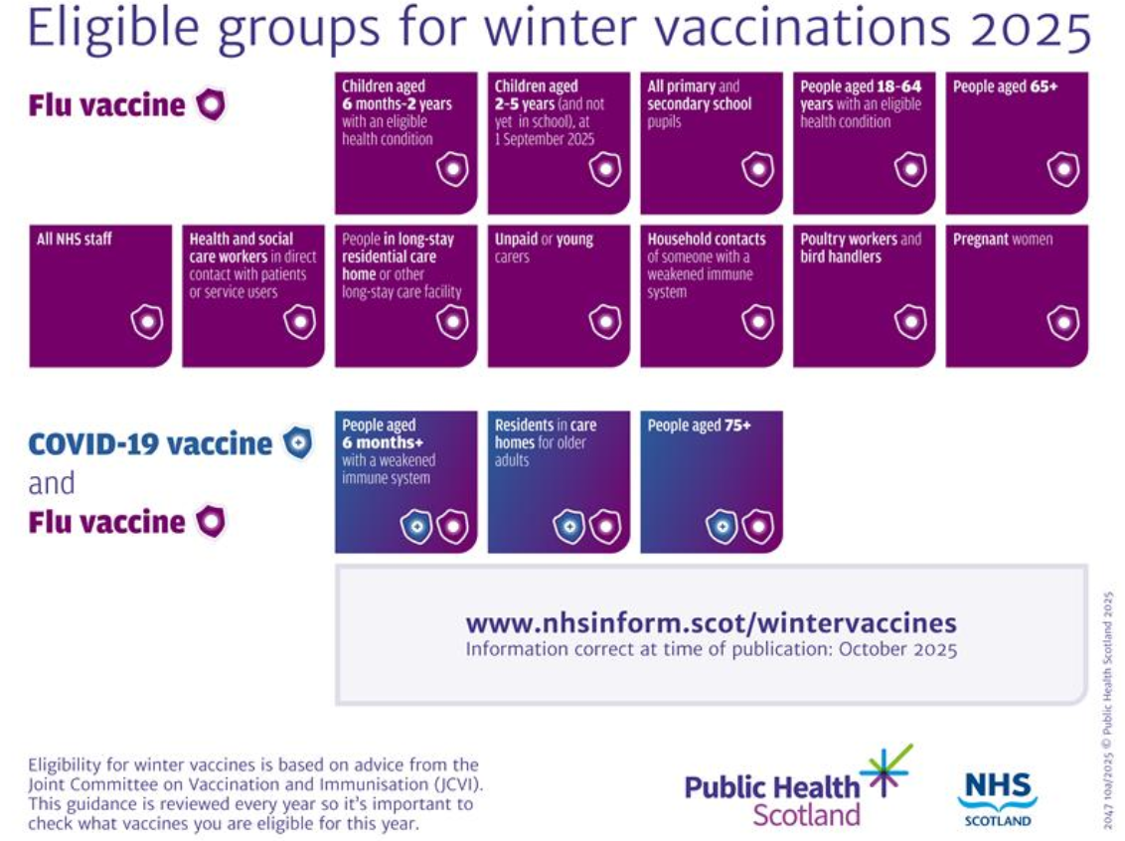
Communicating changes to eligibility

Slide 17
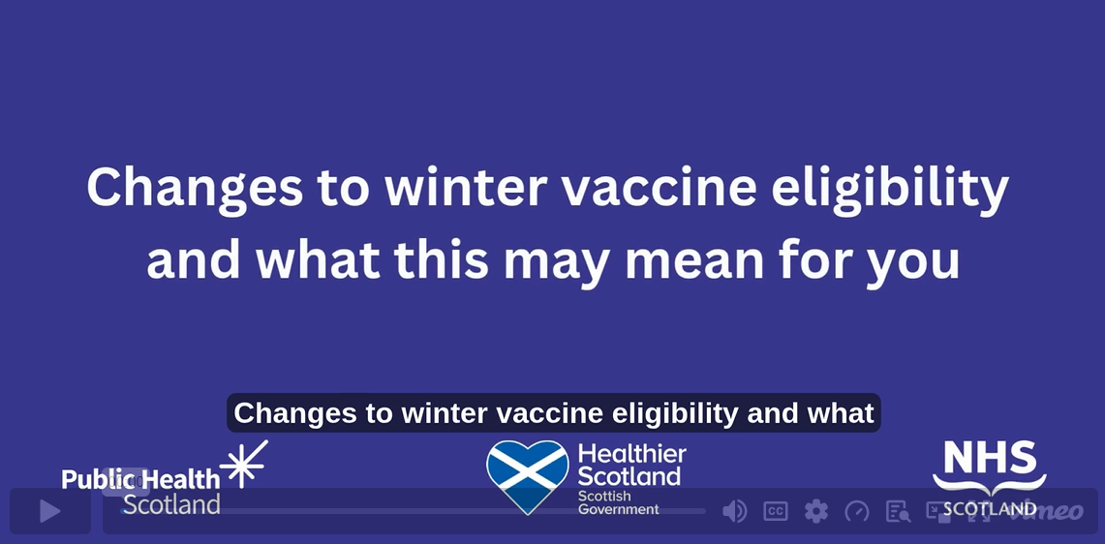
Communicating changes to eligibility
Public Health Scotland blog

Slide 18
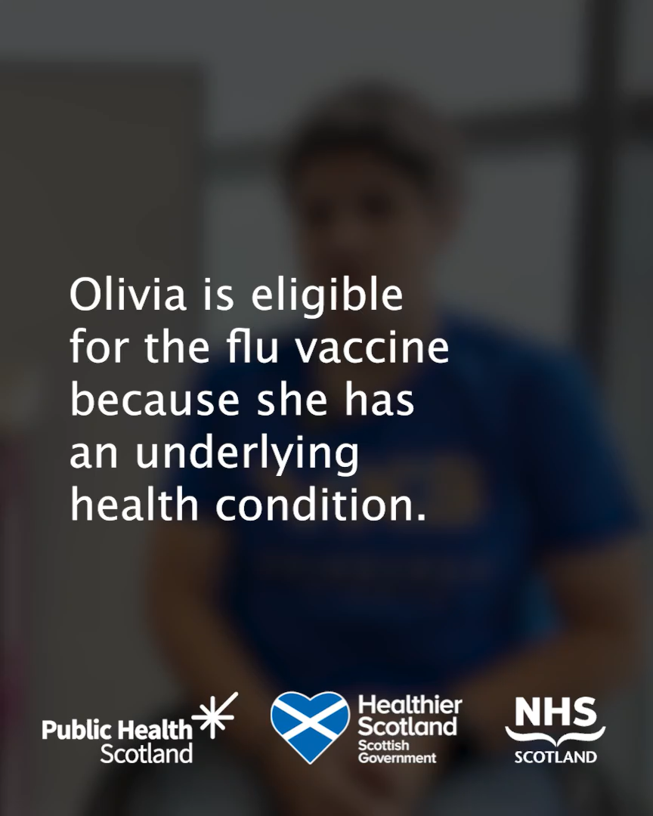
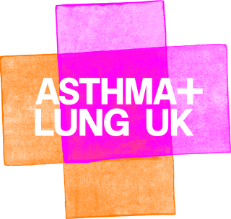
Video case study
Olivia Fulton
Notes:
Olivia Fulton, Asthma and Lung UK representative
Olivia attended the clinic visit launch event and shared her experience of living with asthma and how having flu resulted in her spending time in intensive care.
Olivia wanted to raise awareness and encourage others with an underlying health condition to come forward for their flu vaccine.
Source: https://www.facebook.com/watch/?v=1490838461992032

Slide 19

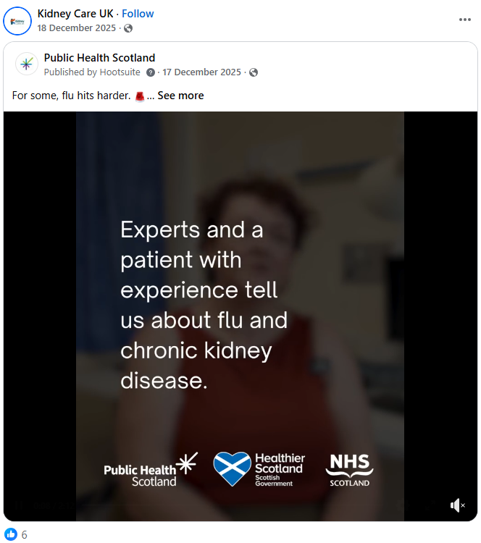
Case studies
Dr Zoe Cousland, Renal Consultant talked about the importance of kidney patients getting their flu vaccine.
One of Dr Cousland’s patients who had already had his vaccine, highlighted why for him as a renal patient it was vital and encouraged people in similar circumstances to come forward for theirs.
Dr Cousland also received her flu vaccine as a healthcare worker.
This video was developed in collaboration with Kidney Care UK and NHS Lanarkshire with both organisations sharing the content on their channels.
.

Slide 20
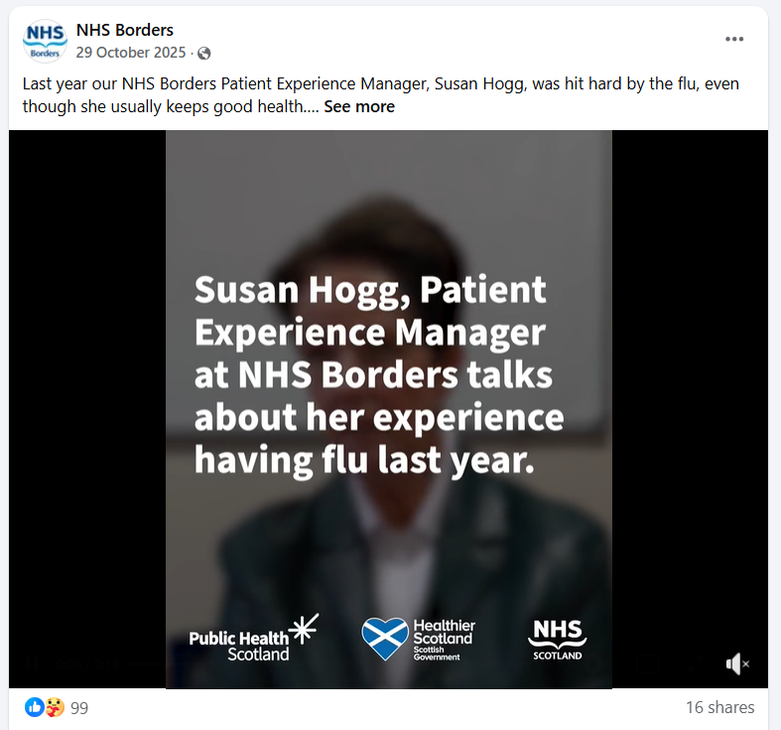
Other case studies
Susan Hogg, Patient Experience Manager
is a healthcare worker from NHS Borders shared her experience of having flu and how severe it was.
She spoke about how she previously didn’t get the flu vaccine due to being needle-phobic but now understands how important it is.
She encouraged fellow healthcare workers to do the same.
This video was developed in partnership with NHS Borders who shared the video on their channels, resulting in it being one of the most interacted with posts of the campaign.

Slide 21

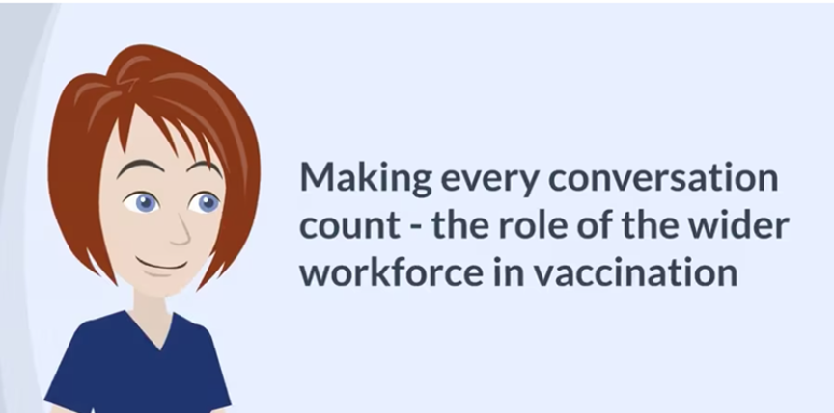
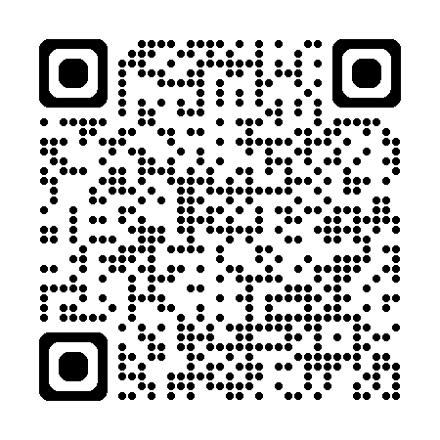
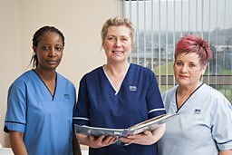
Workforce education resources
Vaccination Conversations
Combatting False Vaccine Information
Inclusive Vaccination Practice
Scan Me
Notes:
Public Services Delivery (PSD) Scotland (previously known as NHS Education for Scotland) in collaboration with Public Health Scotland (PHS) have developed a range of learning resources which are designed to help support vaccinators and other healthcare practitioners who have an opportunity to discuss vaccination with the public
These are all available on Turas Learn (the PSD Scotland learning platform) which is freely available to all health and social care staff

Slide 22
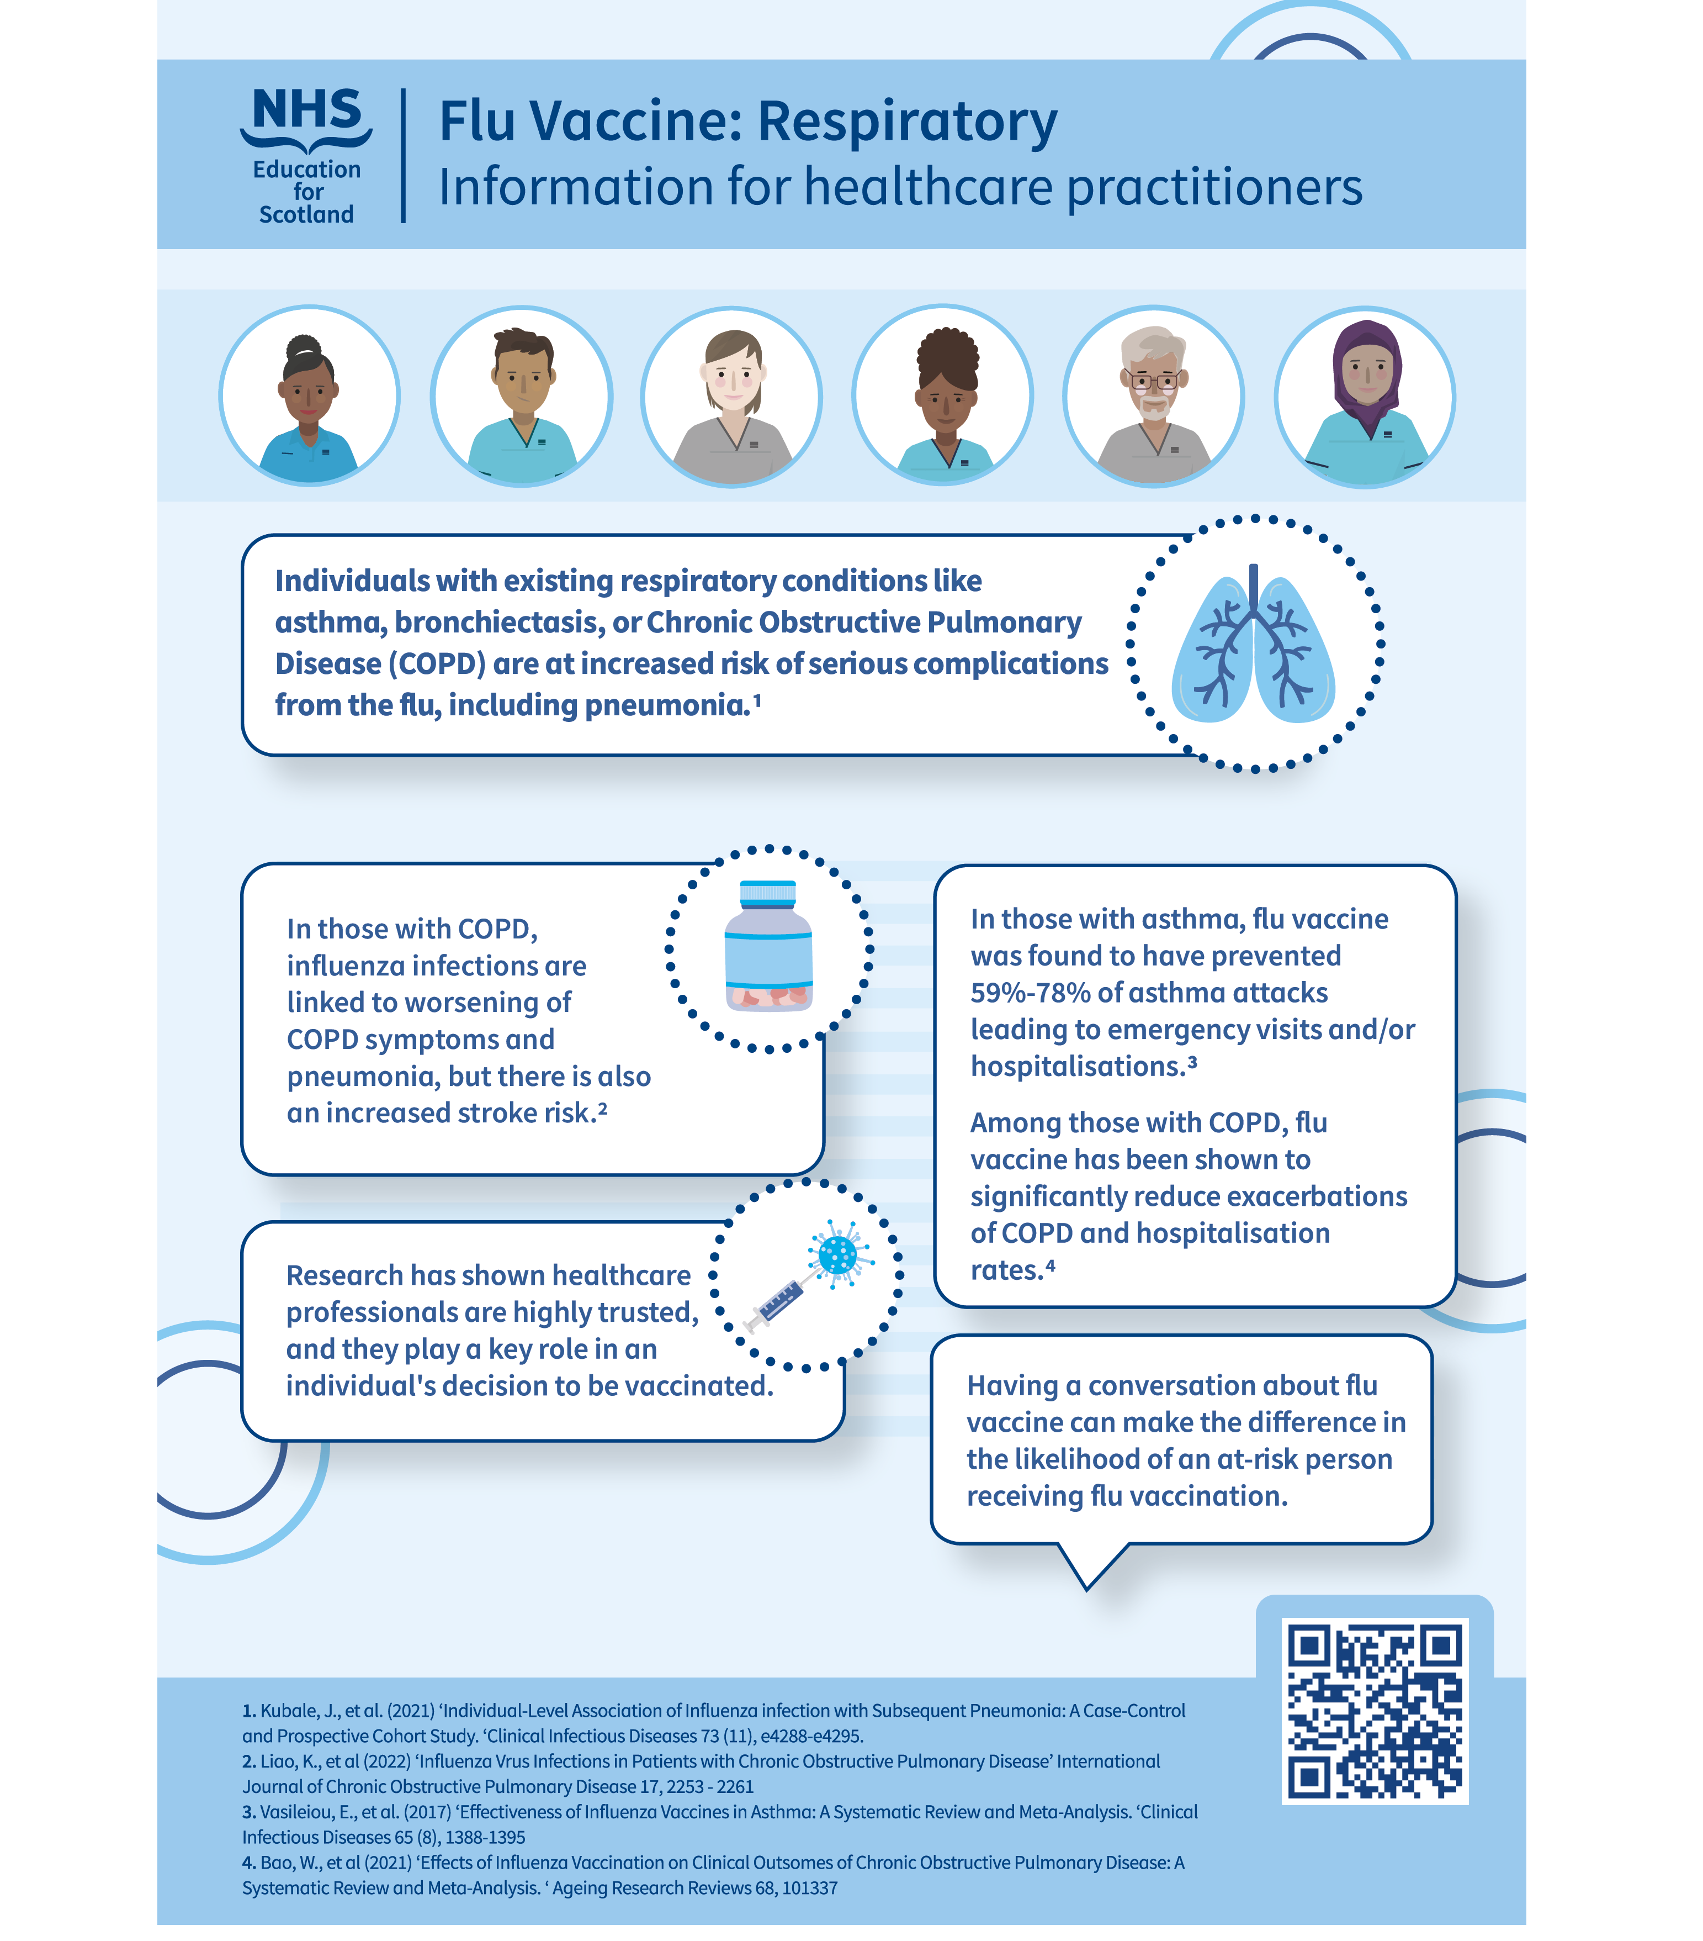
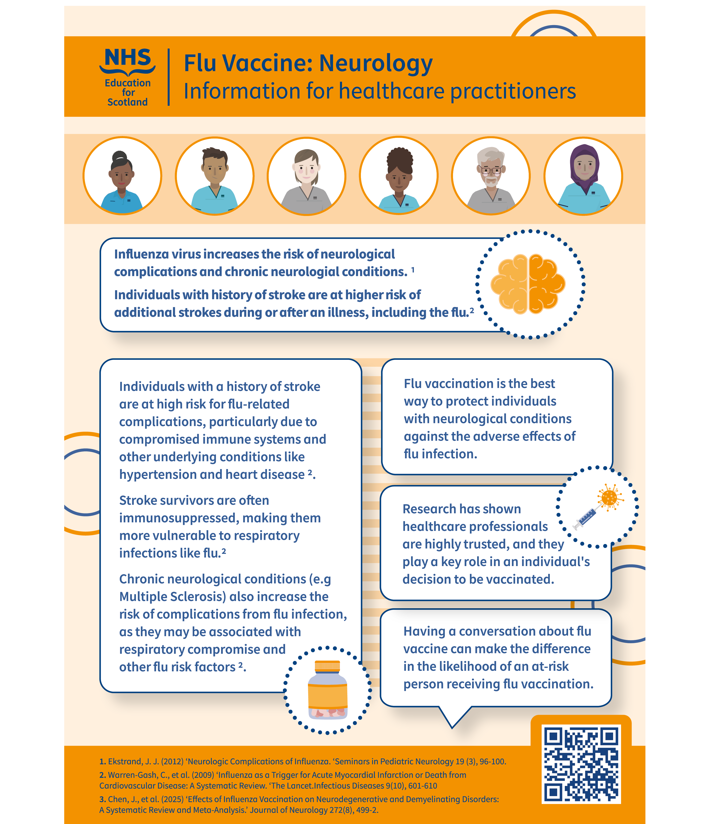
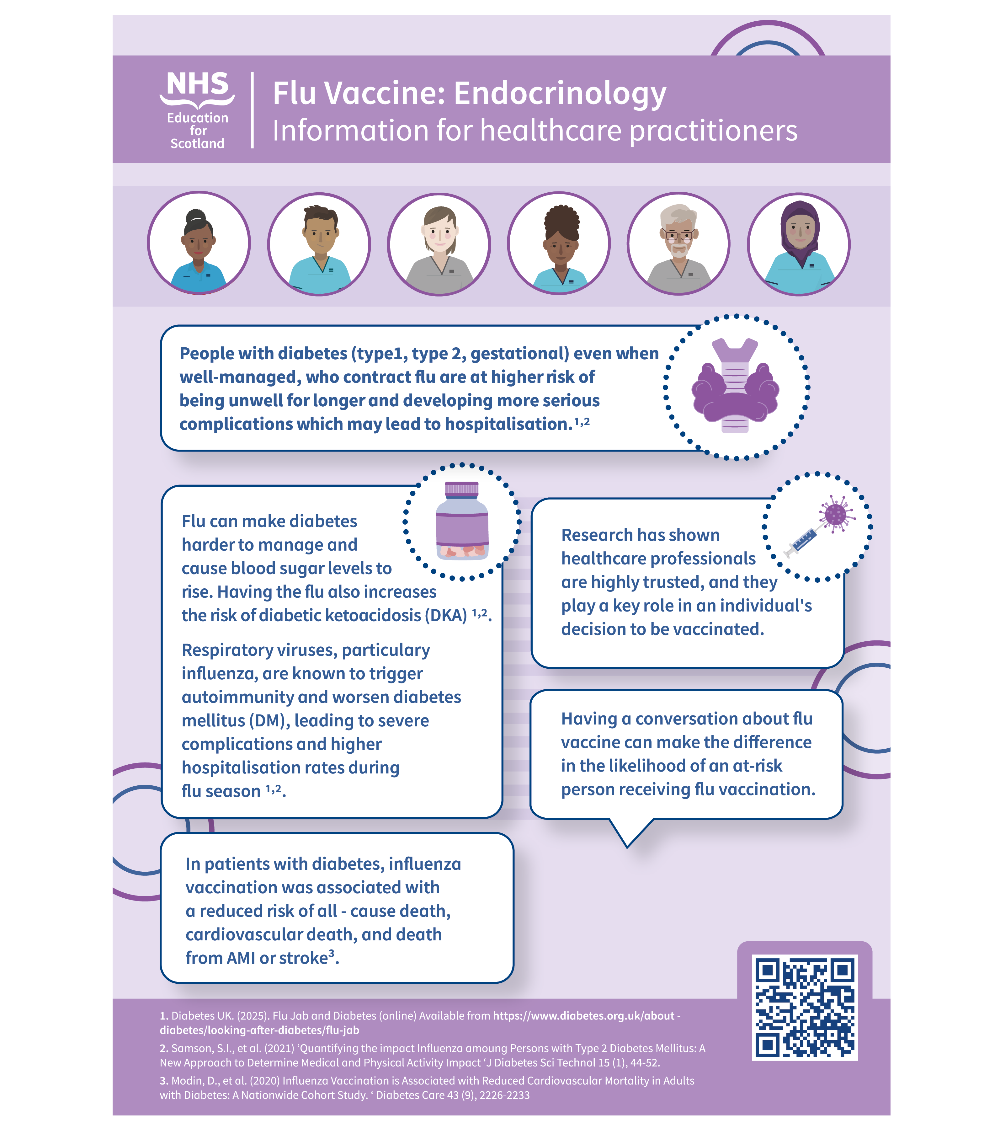
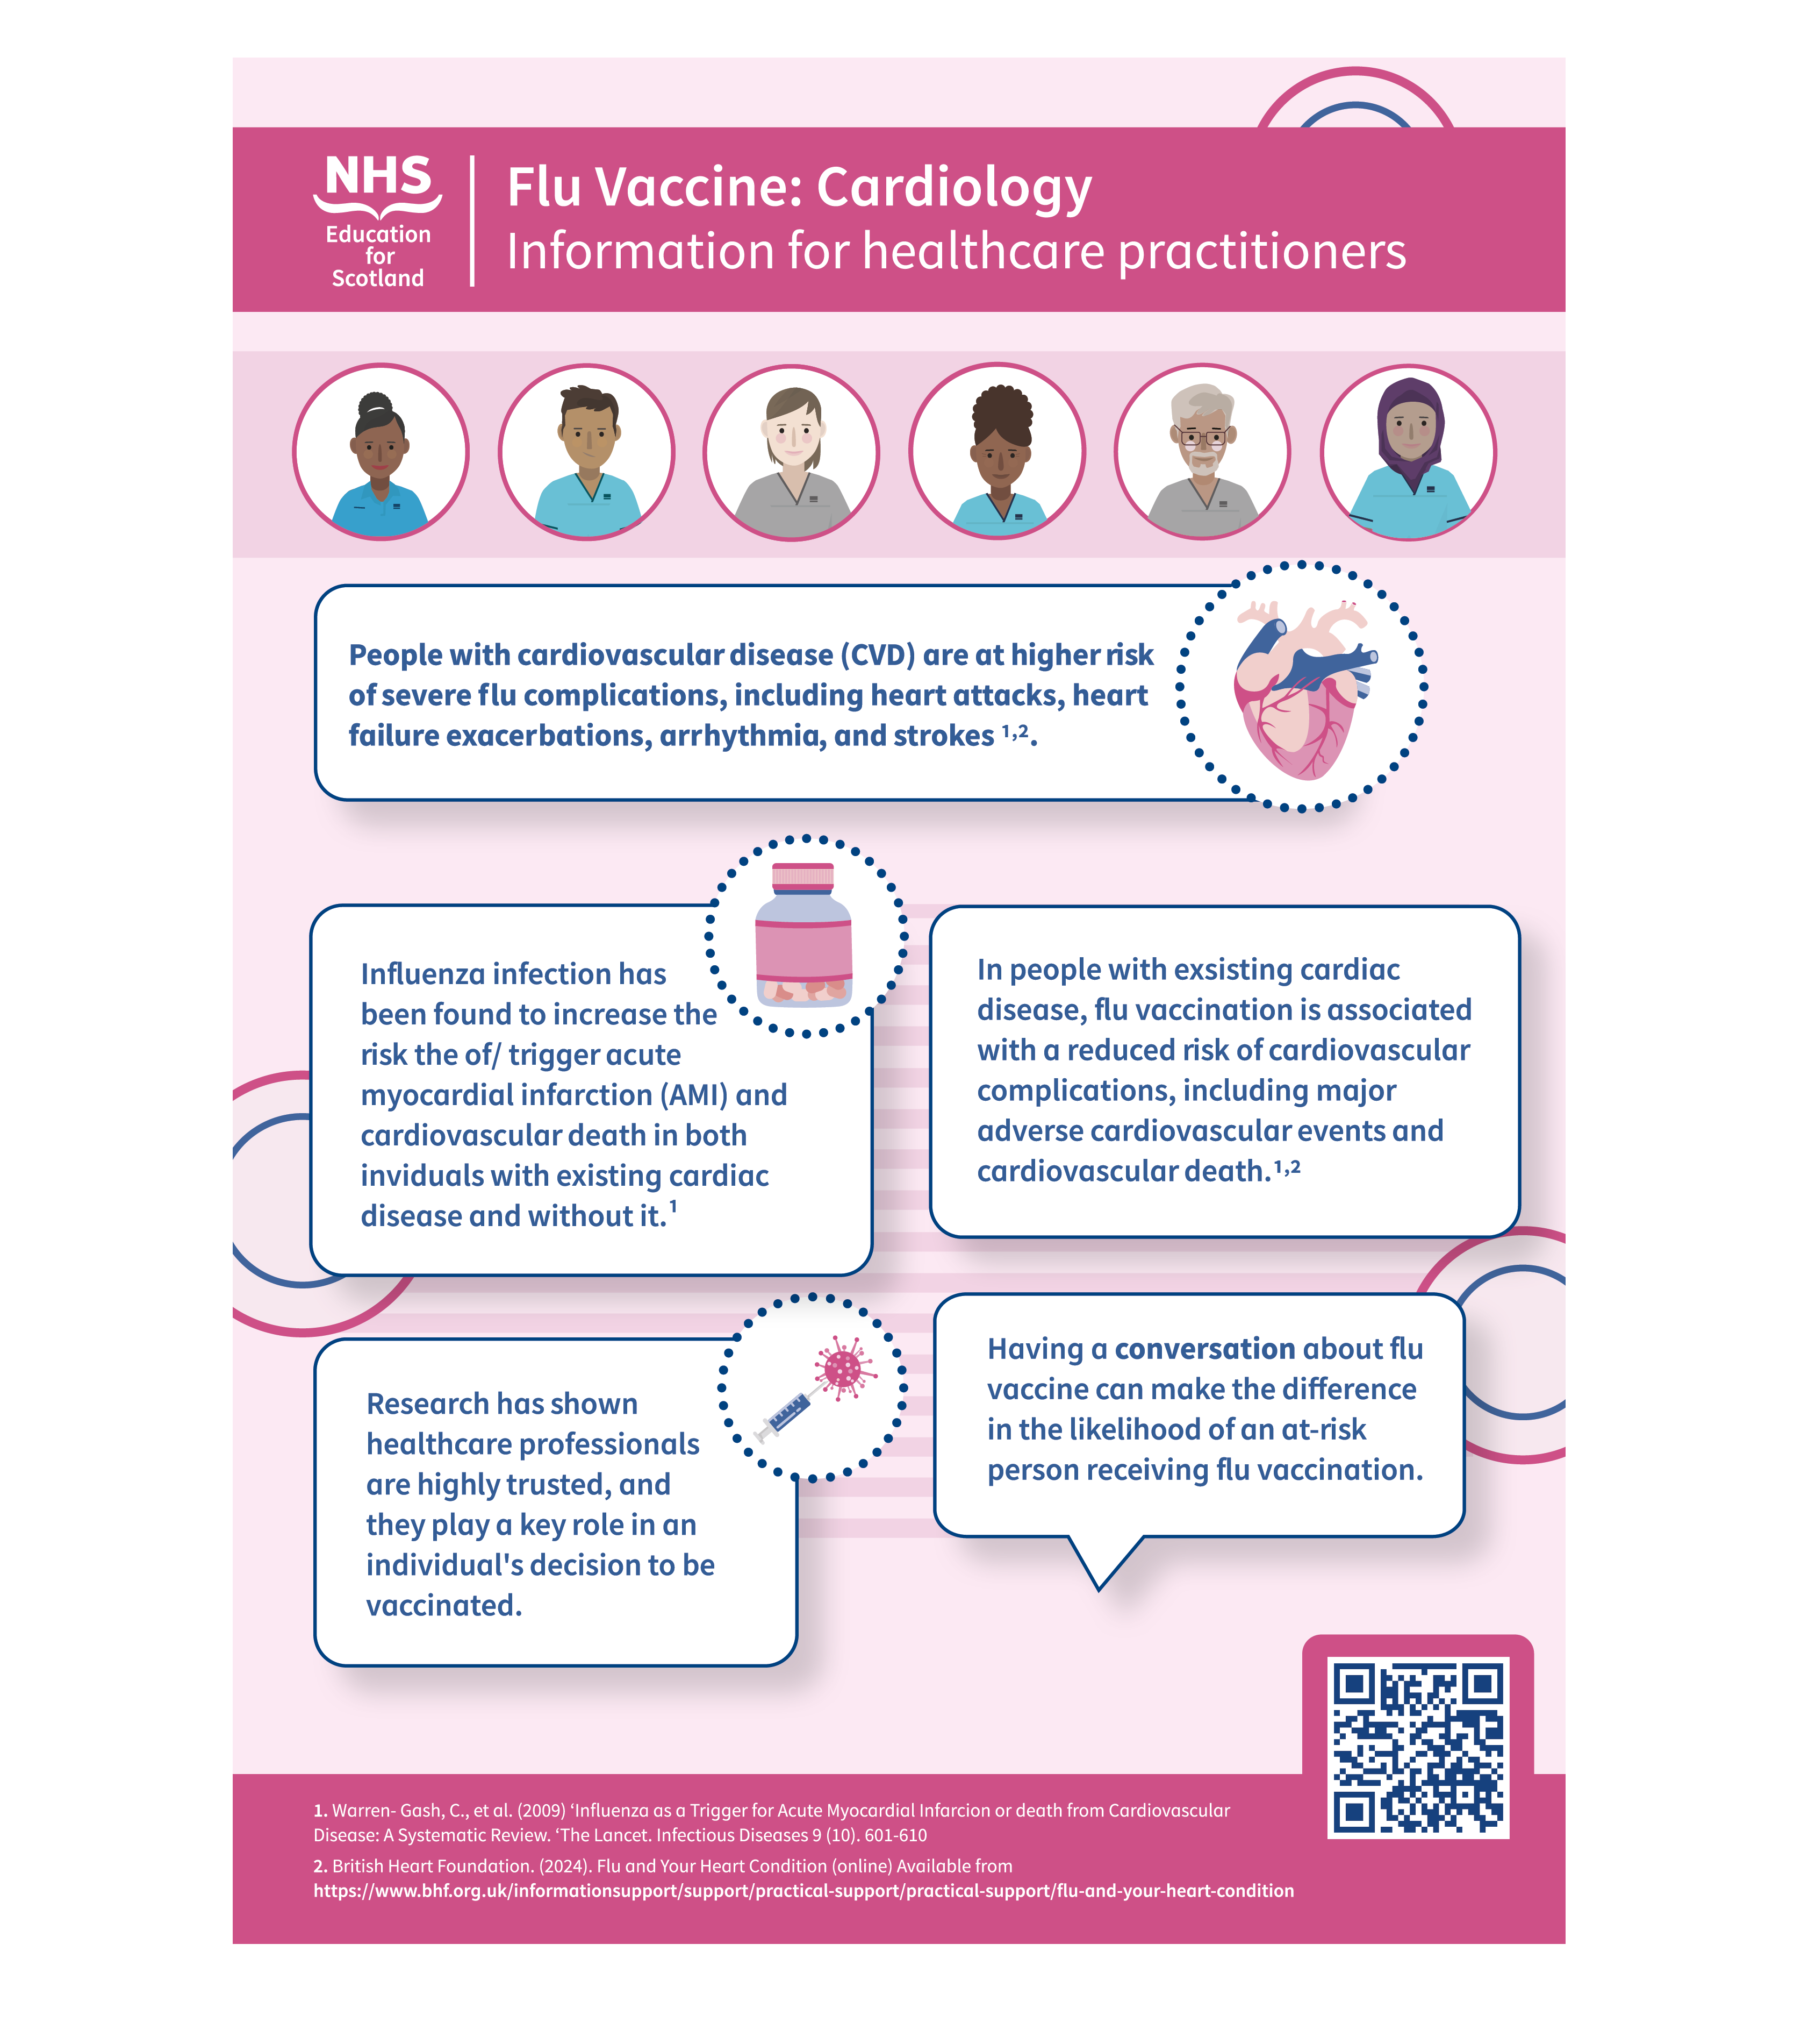
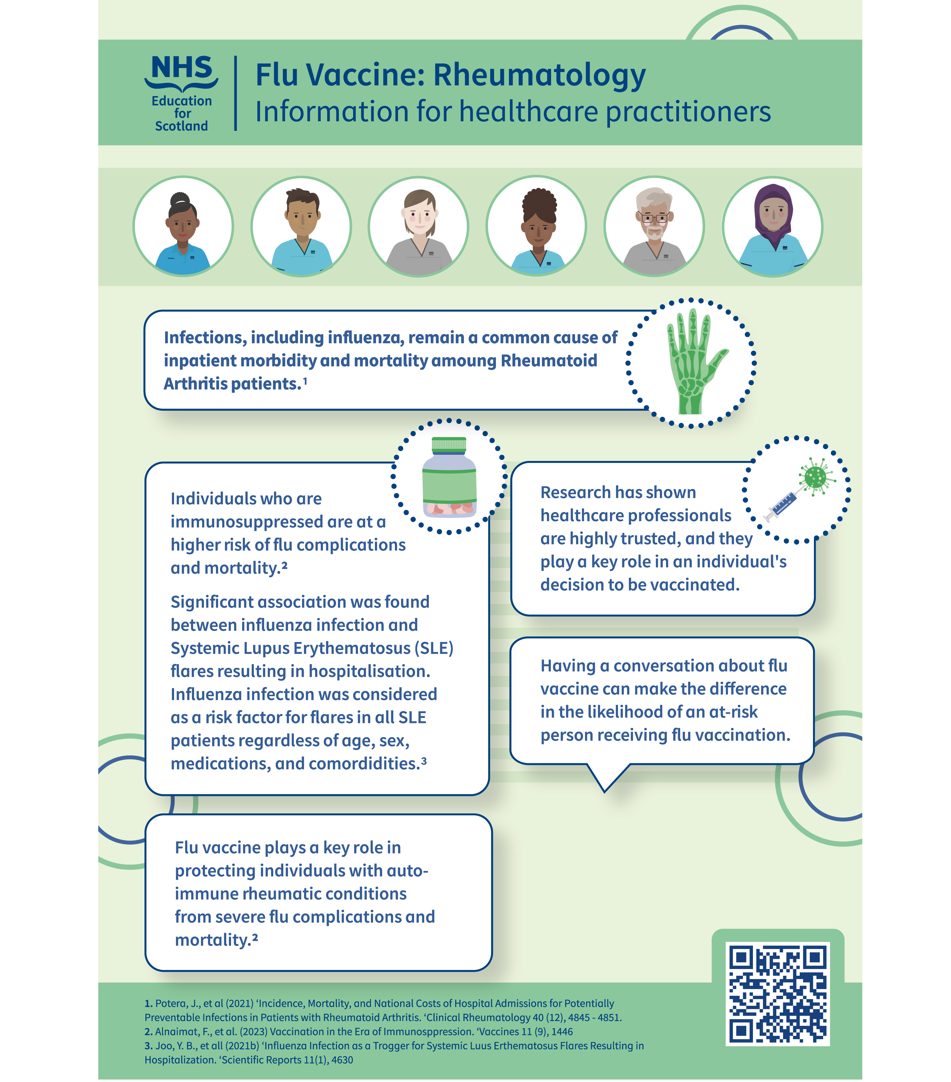
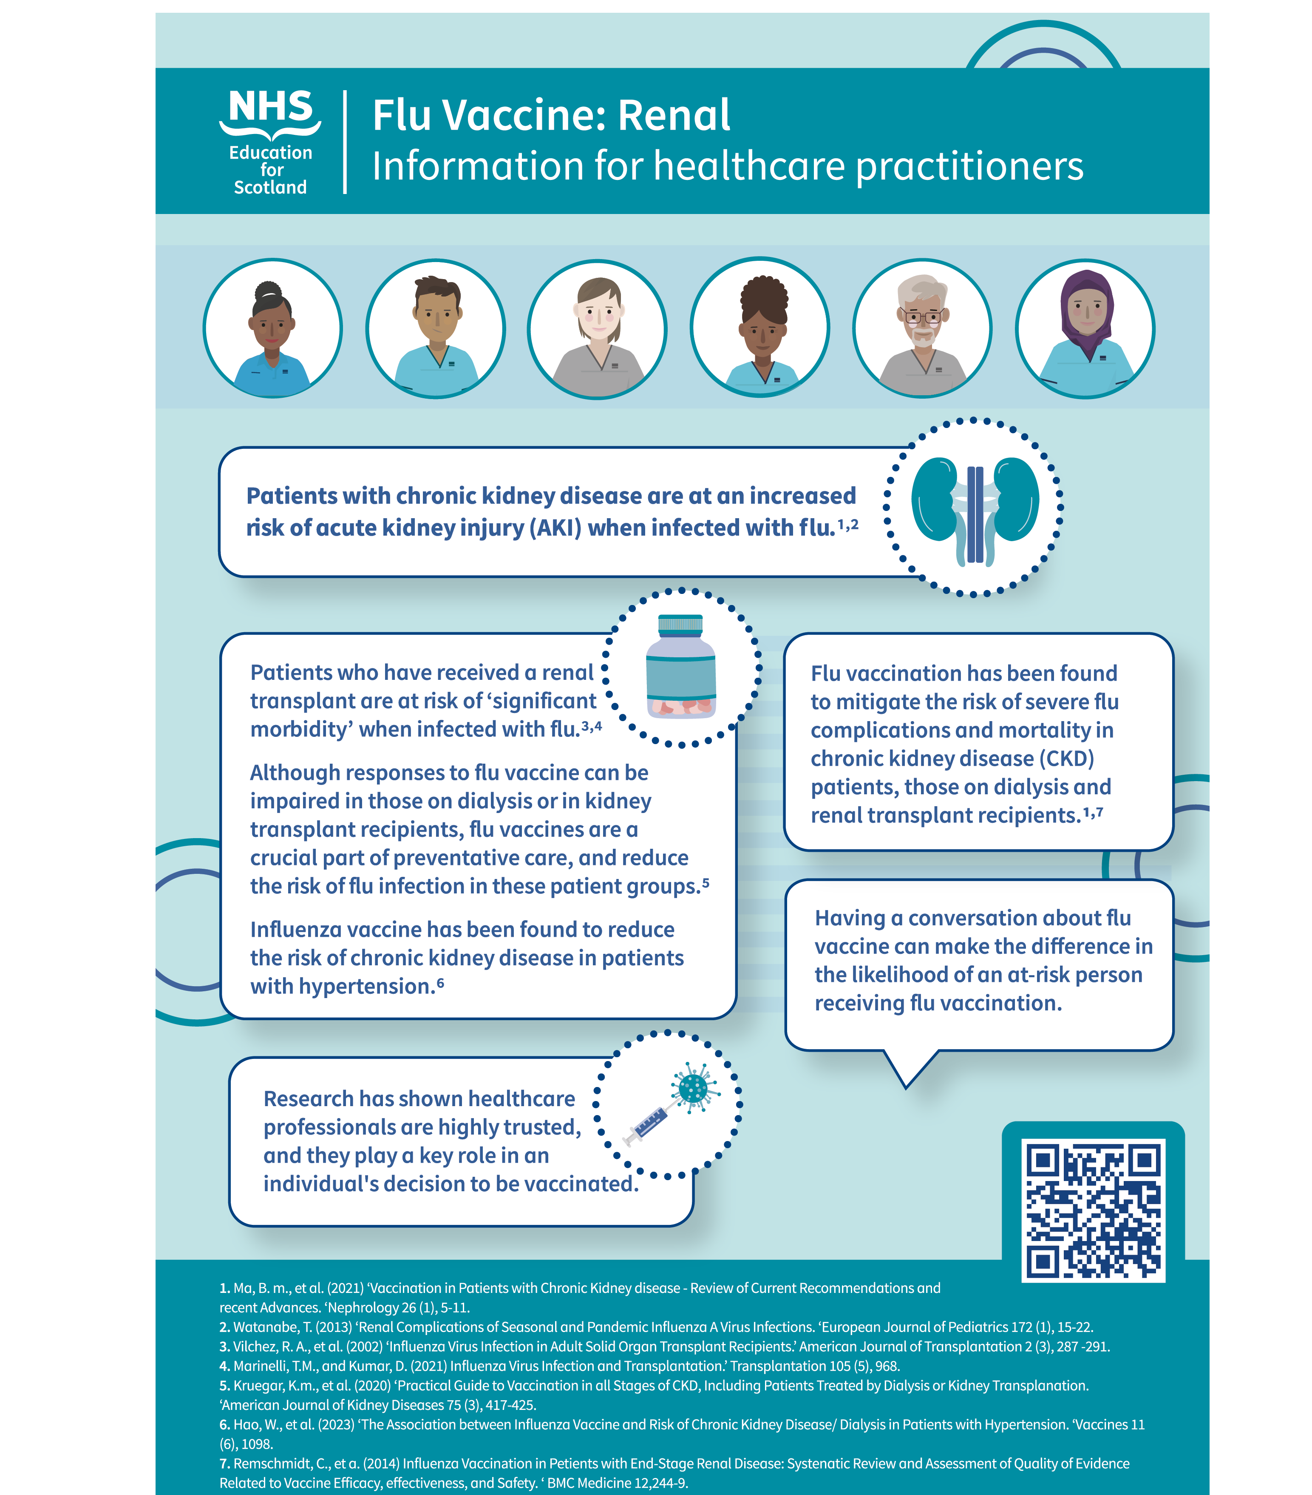
Poster for healthcare professionals. Source: Clinical risk groups and Vaccination | Turas | Learn

Slide 23
Winter Flu Vaccination Programme 2025/26
NHS Lothian Health Board Implementation and Experience
NHS Lothian Public Health Immunisations

Slide 24
Overview – Winter Flu Programme
NHS Lothian Population of approx. 800,000
Second largest residential population in Scotland
Last Winter 25/26 NHS Lothian administered flu vaccination to:
214,664 Over 18s - 59.6%
&
89,408 Under 18s - 60.4%
NHS Lothian Public Health Immunisations

Slide 25
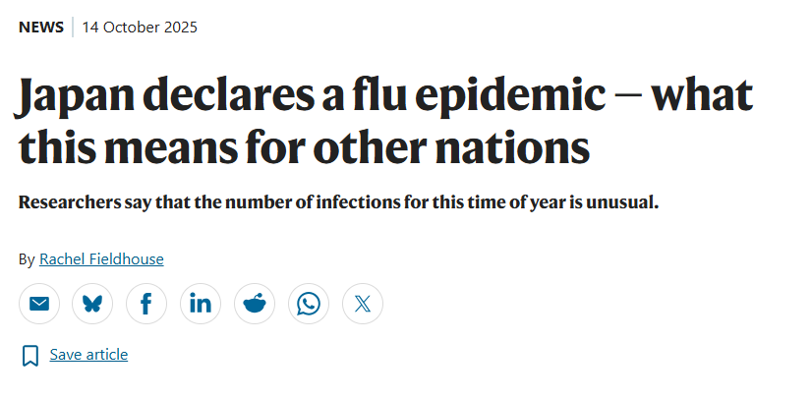
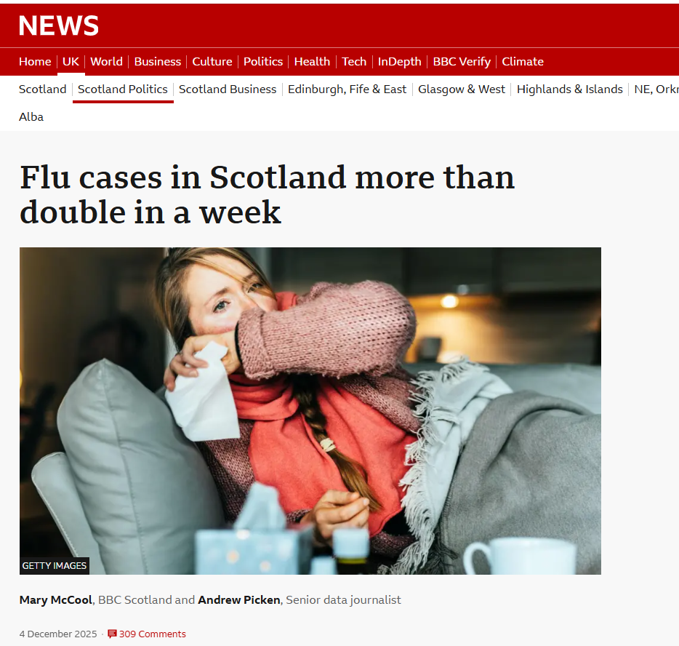
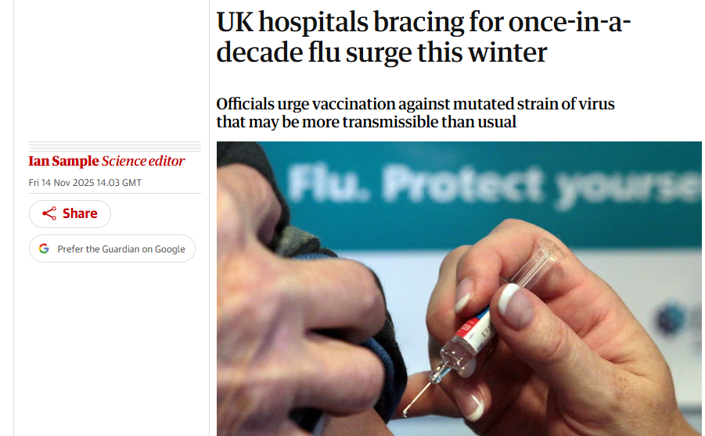
A Challenging Start
NHS Lothian Public Health Immunisations

Slide 26
Mobilising the Programme
We work as part of the Scottish Vaccination and Immunisation Programme (SVIP)
National guidance and collaboration informed local collaboration and action
Rapid mobilization in response to early flu activity involved
Vaccination Teams
Pharmacy
Transport
Service Management
Public Health
Communications and Media
NHS Lothian Public Health Immunisations

Slide 27
Mobilising the Programme
The challenge? Increase activity whilst maintaining large scale planned delivery
Clinically and strategically prioritised groups:
Children and Young People
Health and Social Care Staff
Low Income Communities
Ethnic Minority Groups
Care Home Residents
NHS Lothian Public Health Immunisations

Slide 28
Mobilising the Programme
Examples:
All clinics drop-in for Primary Pupils
Letters to parents/carers of unvaccinated children
Additional drop-in clinics for Secondary School Pupils
Increased efforts to raise awareness amongst NHS Staff
All clinics made drop in for Health and Social Care Staff
Pop up clinic at primary care nursing conference
NHS Lothian Public Health Immunisations

Slide 29
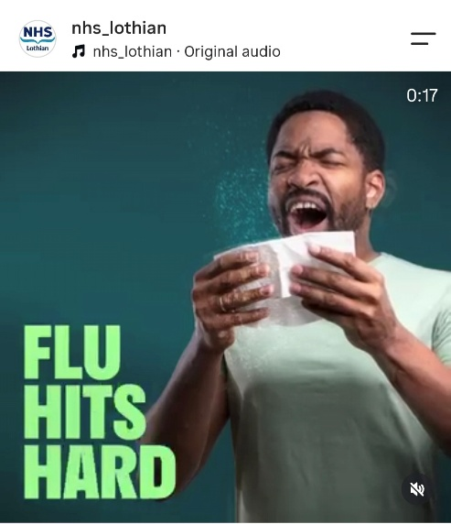
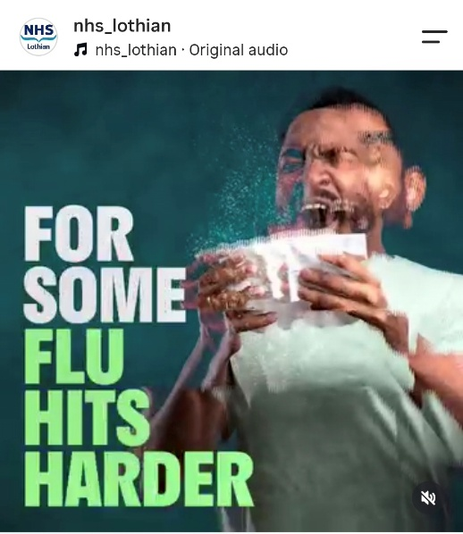
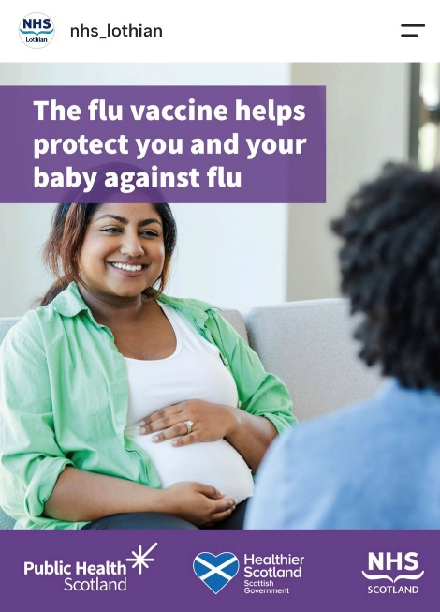
Communications and Messaging
Communication toolkit created by PHS complemented local communications
Wide engagement with stakeholders across health and social care, including third sector to target priority groups.
NHS Lothian Public Health Immunisations
Notes:
Emails, intranet, social media, team briefing
Flu eligibility extends to a wide range of patient groups plus staff in Health and Social Care

Slide 30
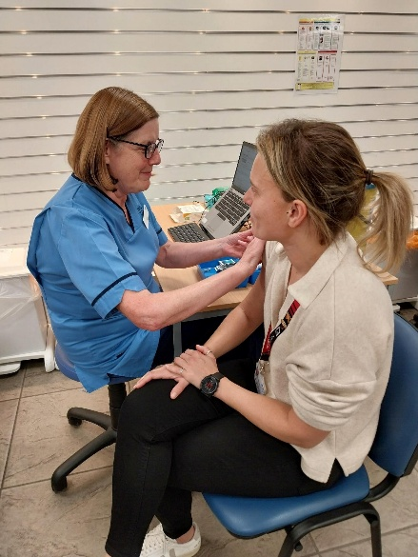
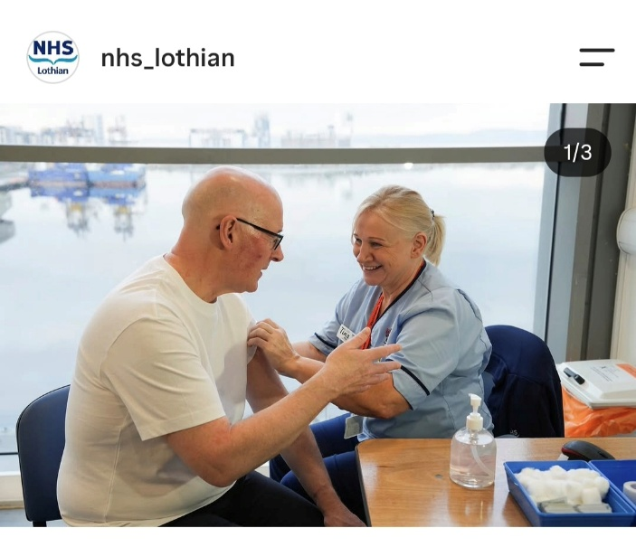
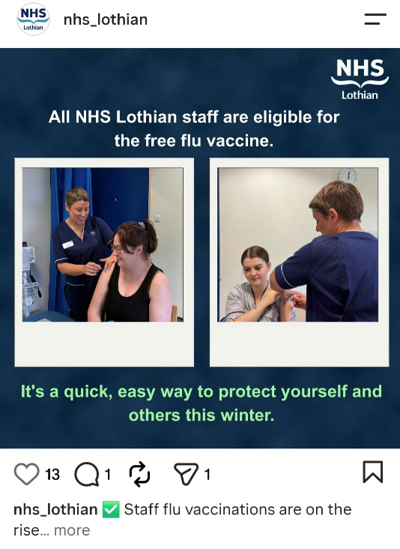
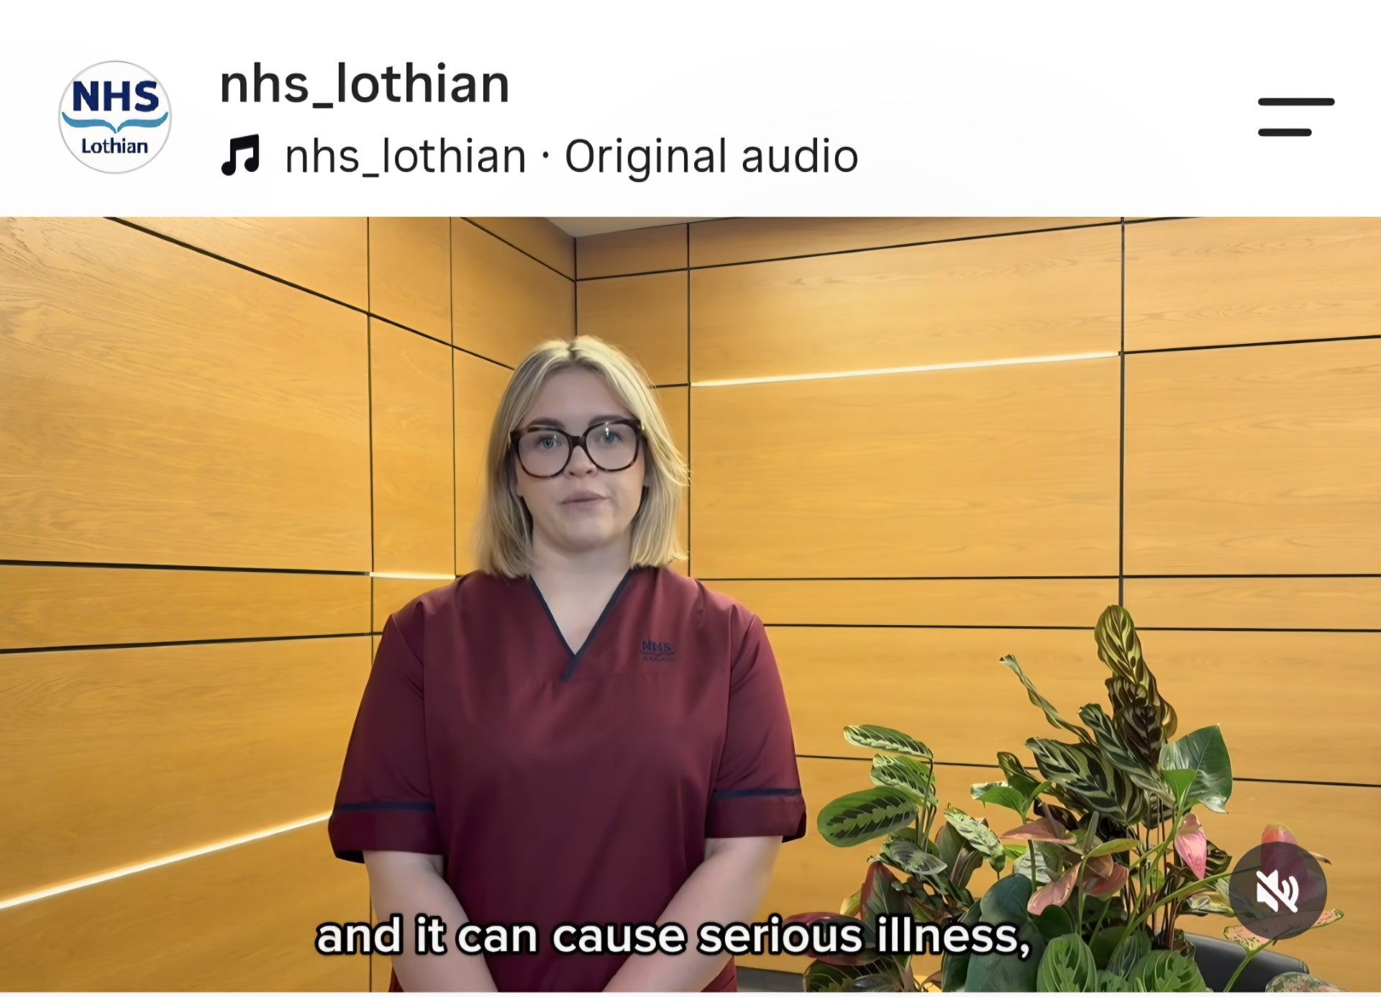
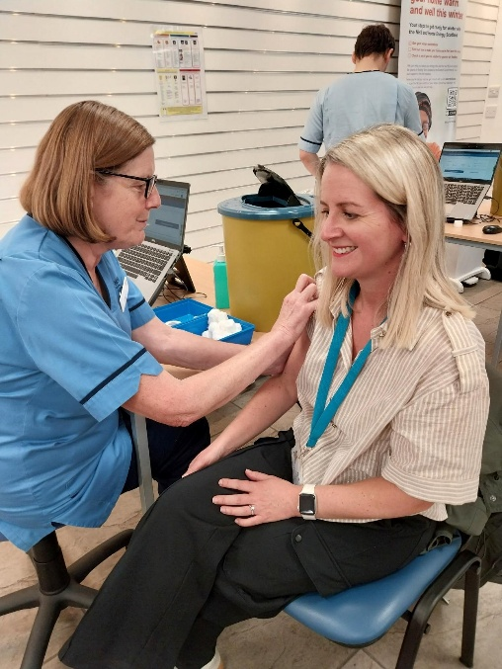
Priority Group- Staff
Working Board-wide to vaccinate staff
Email banners
HSCP and social care leadership
Social media
Staff intranet
NHS Lothian Website
Posters in Clinical areas
Staff pop-ups
NHS Lothian Public Health Immunisations
Notes:
Emails, intranet, social media, team briefing
Staff pop ups e.g. primary care nursing conference

Slide 31
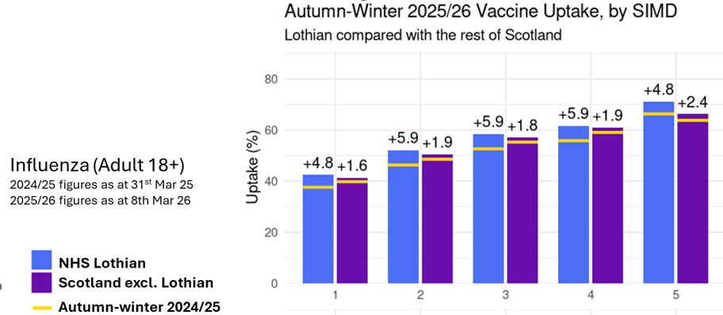
Priority Group – Low Income
NHS Lothian Public Health Immunisations
Notes:
Low income

Slide 32
Priority Group – Ethnicity
Flu uptake lowest across Scotland (13.6%) and in NHS Lothian (15.2%) for Polish community.
Highest uptake for white British (65.5%), Scottish (64%) and Irish (62.6%) in NHS Lothian
Second lowest uptake amongst African (25.4%), Caribbean or Black (27.3%) ethnic groups.
NHS Lothian Public Health Immunisations

Slide 33
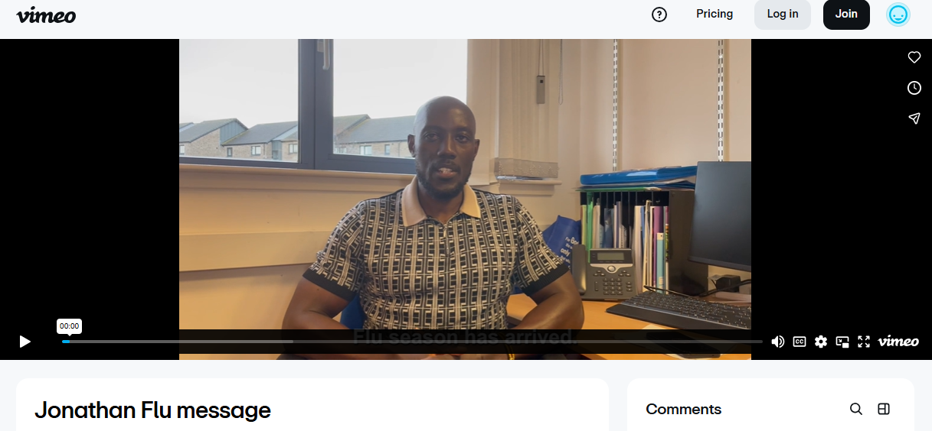


Targeted Work - Ethnic Minority Groups and Lower Income Communities
Partnership working with communities and voluntary sector
Scottish Ambulance Service support
Targeted outreach clinics e.g. homeless units
Flu Videos with community champions
NHS Lothian Public Health Immunisations

Slide 34

Priority Group – Preschool Children
Winter 2025/26
SIMD1 uptake 39.4% and SIMD5 uptake 70.5%
Gap between SIMD1 and SIMD5 31.1%, compared to 31.9% in 2024
Overall gaps in uptake for 2024/25 and 2025/26 flu improved slightly. Except for the gap between SIMD1 and 2 which increased by 1.4%
NHS Lothian Public Health Immunisations
Notes:
Within time limited programmes, inequalities become more apparent.

Slide 35

Targeted Work – Preschool Flu
Play Talk Read bus used to improve accessibility and host pop-up events. Targeting lower income areas.
NHS Lothian Public Health Immunisations

Slide 36
Key Messages
Collaboration between national partners and territorial Health Boards is essential for a coordinated response. This translates into collaboration at local level.
Partnership working is the only way to improve uptake. NHS Lothian performed well against national averages.
Widespread and targeted communication and marketing complement operational efforts.
Health inequalities present a challenge every year we must continue to work with others to remove barriers.
NHS Lothian Public Health Immunisations

Slide 37

“Alone we can do a little, together we can do a lot”
NHS Lothian Public Health Immunisations

Slide 38
Over to you………..
Protect yourselves and others
Visit Winter vaccines | NHS inform to book your own vaccine appointment
Find out about local arrangements (including drop-in clinics) at: Getting your vaccinations | NHS inform
Be a trusted voice for friends, family, colleagues, staff, patients, service users and the public.
Educate yourself at Immunisation | Turas | Learn
Read the information sheets on the PHS website
Signpost to reliable vaccine information on NHS inform
Use the social media toolkit

Slide 39
Slido Poll question 1
Who are the trusted voices in your communities and workplaces that we should be partnering with more? (word cloud)

Slide 40
Do not edit
How to change the design
Who are the trusted voices in your communities and workplaces that we should be partnering with more?
The Slido app must be installed on every computer you’re presenting from

Slide 41
Slido Poll question 2
What is currently the biggest barrier to vaccine uptake in your area? (word cloud)

Slide 42
Do not edit
How to change the design
What is currently the biggest barrier to vaccine uptake in your area?
The Slido app must be installed on every computer you’re presenting from

Slide 43
Slido Poll question 3
What is one thing we could do differently this winter that would make the biggest difference to increasing vaccination uptake in health and social care workers? (word cloud)

Slide 44
Do not edit
How to change the design
What is one thing we could do differently this winter that would make the biggest difference to increasing vaccination uptake in health and social care workers?
The Slido app must be installed on every computer you’re presenting from

