Slide 1
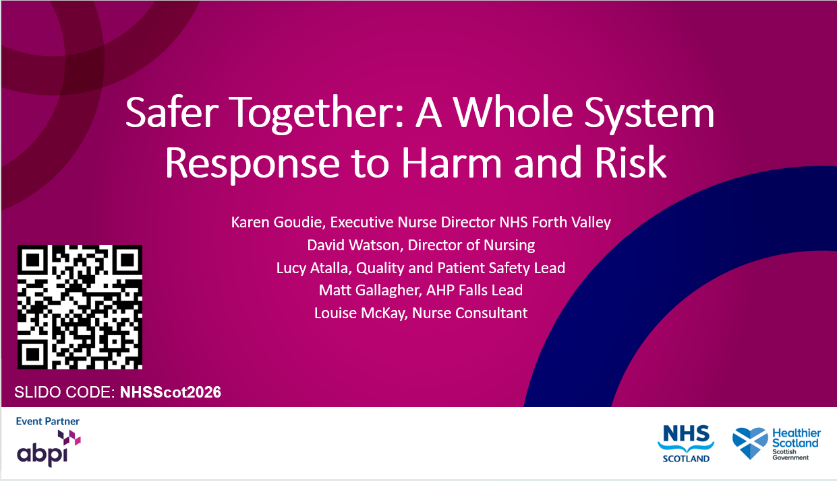

Slide 2





Forth Valley
Safer Together
Karen Goudie, Executive Nurse Director
David Watson, Director of Nursing
Lucy Atalla, Quality and Patient Safety Lead
Matt Gallagher, AHP Falls Lead
Louise McKay, Nurse Consultant
Notes:
Karen – 15 minutes

Slide 3

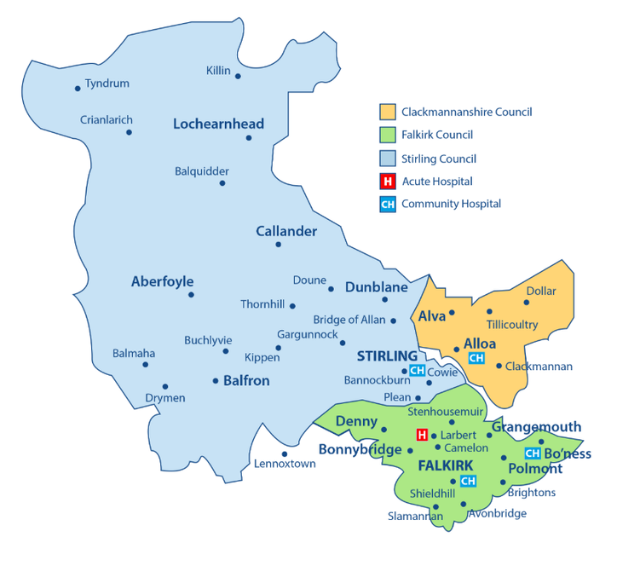
-The challenge
  NHS Forth Valley in Stage 4 escalation – Leadership, Governance, Culture
  Workforce Constraints
  Quality, Safety and Experience Governance & Culture
  The voice of people using and working in the service
  The Learning System
Karen Goudie, Executive Nurse Director

Slide 4
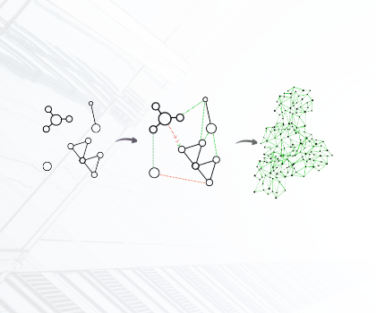

Reality before the collaborative
  Improvement efforts fragmented, data triangulation and quality. Safety Reporting.
  Staff committed – Implementation approach required.
  Improvement expertise existed in pockets, underutilised
Karen Goudie, Executive Nurse Director

Slide 5

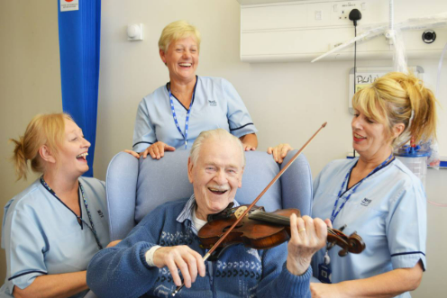
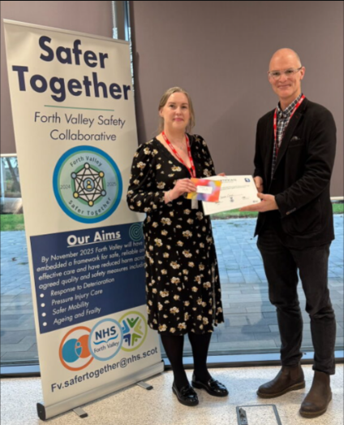
The catalyst
One Story
Data and Measurement
Triangulation with other aspects of delivery, Workforce Improvements, Policy Alignment, Listening organisation
Karen Goudie, Executive Nurse Director

Slide 6
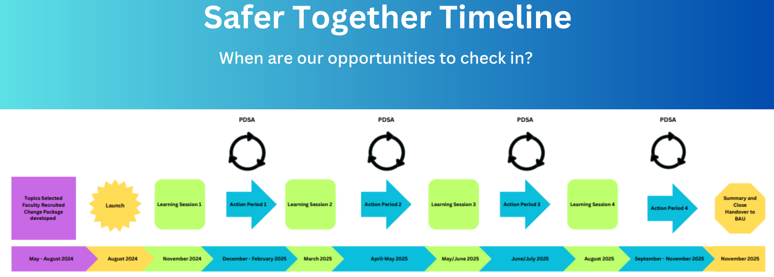
Breakthrough Series Collaborative
Karen Goudie, Executive Nurse Director

Slide 7
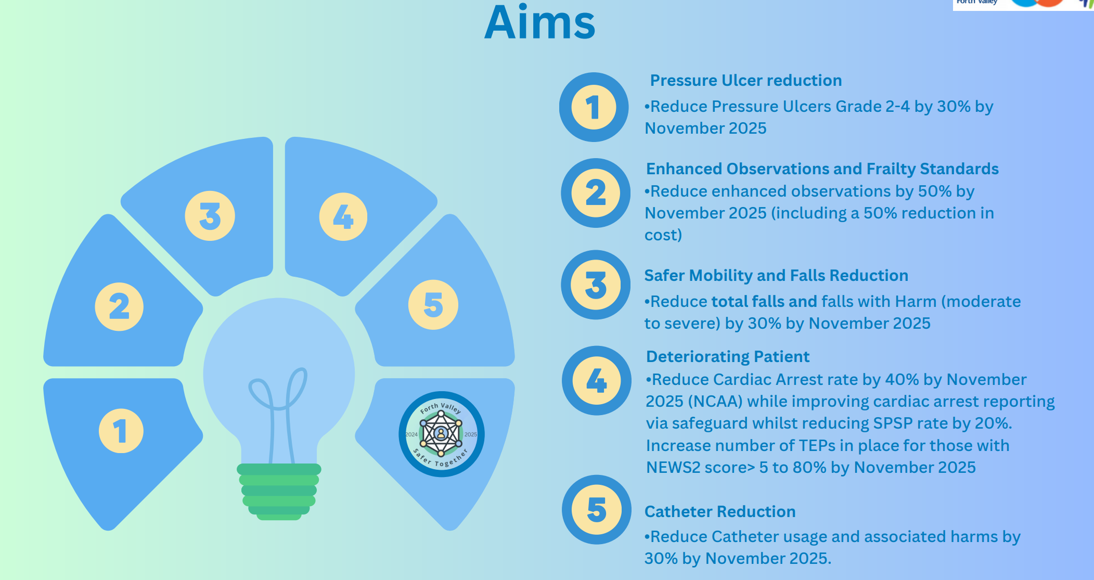
Establishing AIMs

Slide 8
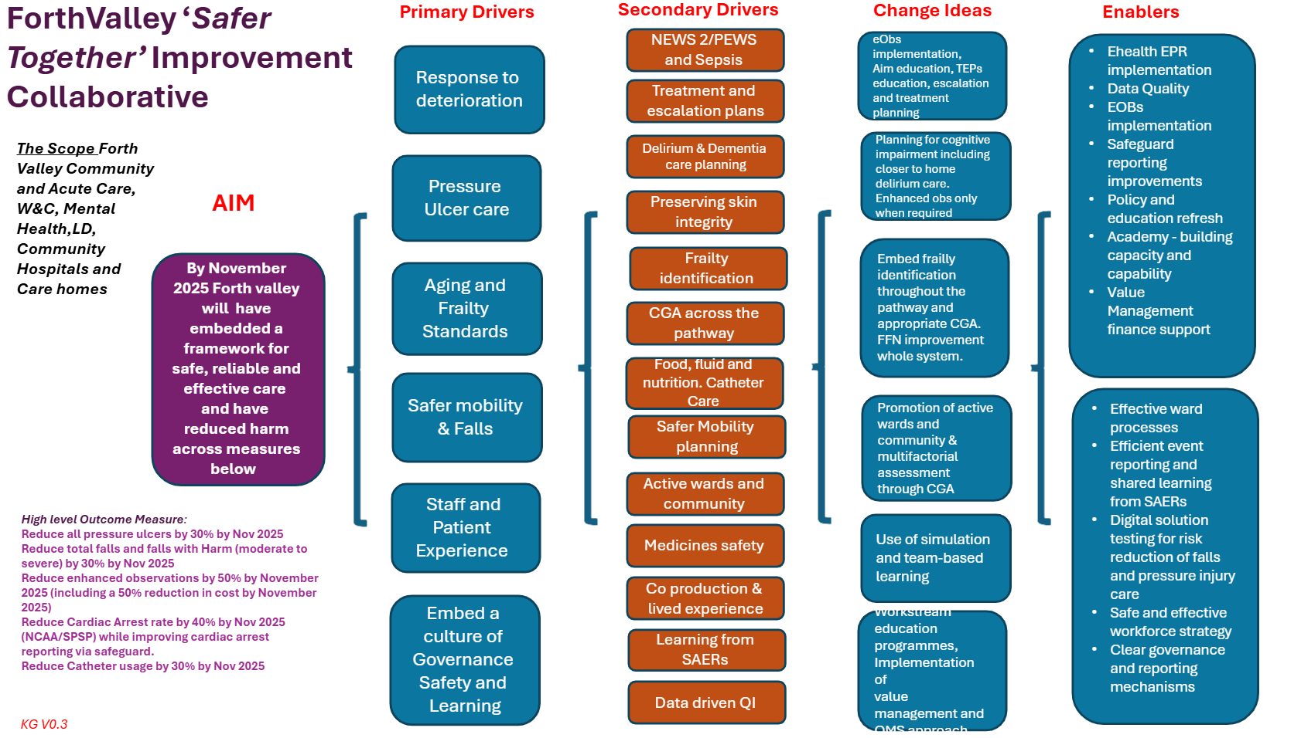
Karen Goudie, Executive Nurse Director

Slide 9

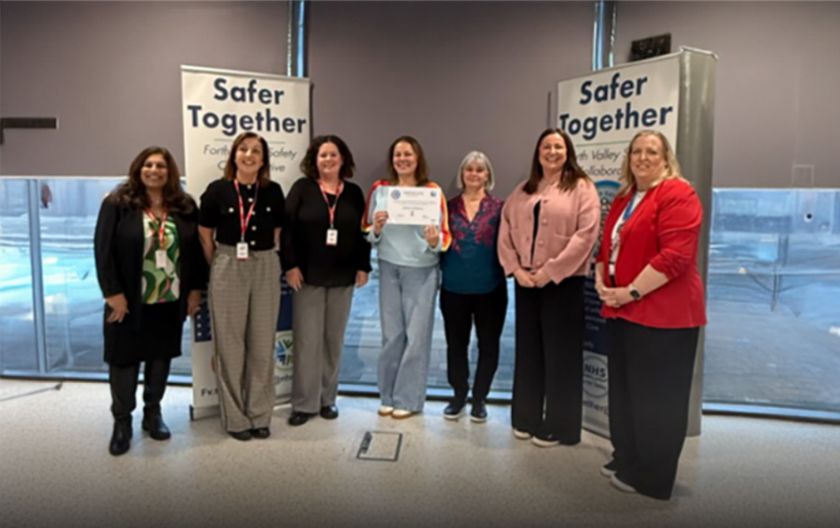
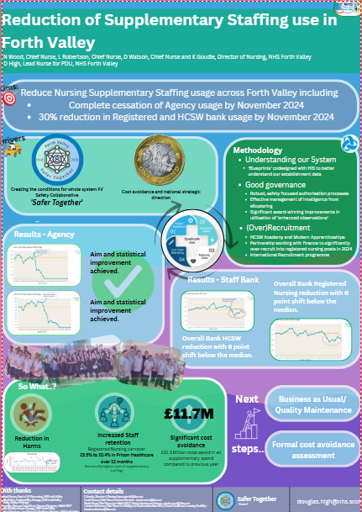
Safer Together - Project Team, Planning and Creating the Conditions
Pressure Ulcer
Deteriorating Patient
Safer Mobility
  IA prep
  Identification of test teams
  Change Package
  Reduction in Supplementary Staffing
Lucy Atalla, Quality and Patient Safety Lead NHS FV
Notes:
Lucy Atalla - 5

Slide 10

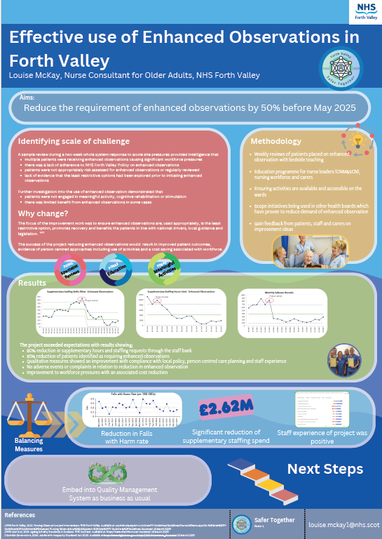
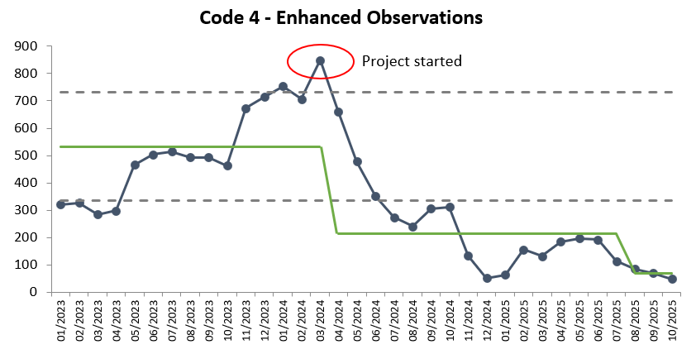
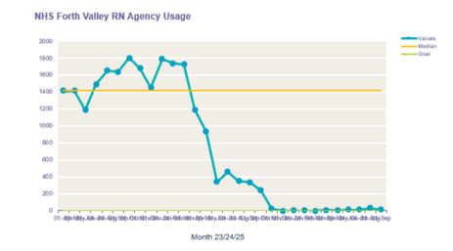
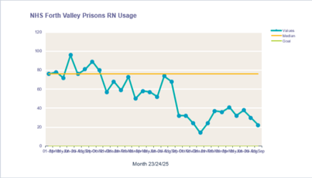
Enhanced Obs reduction work
  Engaging with staff, patients and carers for feedback​
  Weekly reviews with bedside teaching​
  Education programme for nurse leaders (CNM&SCN), nursing workforce and carers​
  Scope initiatives being used in other health boards which have proven to reduce demand of enhanced observation​
Louise McKay, Nurse Consultant for Older Adults
Notes:
Louise McKay - 4

Slide 11
Enhanced Obs reduction work
  Sustaining an 90% reduction in supplementary hours and staffing requests through the staff bank ​
  65% reduction of patients identified as requiring enhanced observations through safecare​
  Qualitative measures showed an improvement with compliance with local policy, person centred care planning and staff experience ​
  No adverse events or complaints in relation to reduction in enhanced observation ​
  Improvement to workforce pressures with an associated cost reduction​
  Awarded at BGS as best clinical poster 2025 Spring Meet​
  Contemporary local policy and transferable the learning
£3.6M
Louise McKay, Nurse Consultant for Older Adults
Notes:
Louise McKay - 4

Slide 12
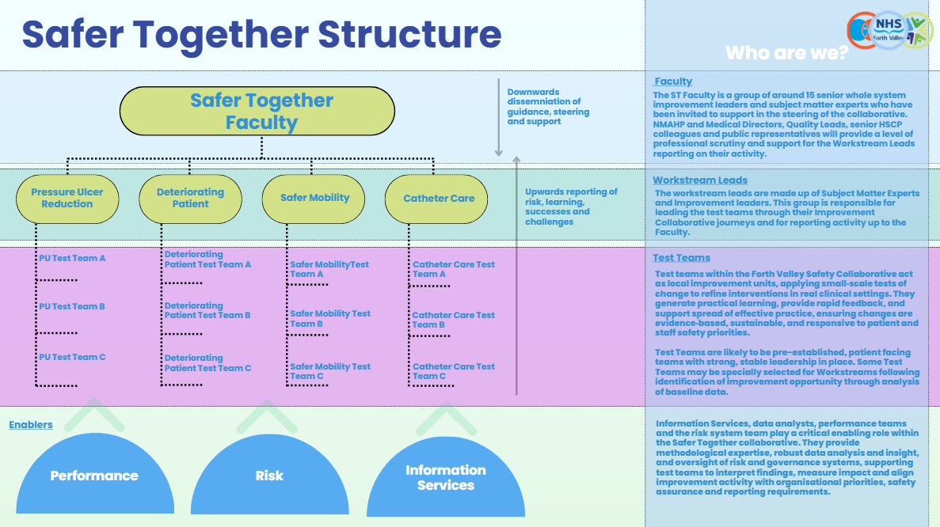
Lucy Atalla, Quality and Patient Safety Lead NHS FV
Notes:
Lucy Atalla – 10 mins

Slide 13

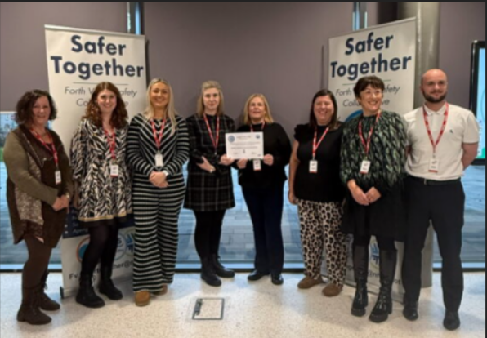
Collaboration breeds collaboration
Structure allowed teams to share successes and challenges openly
Learning spread quickly and crossed historical boundaries
Improvement increasingly viewed as collective responsibility - culture shift
Lucy Atalla, Quality and Patient Safety Lead NHS FV
Notes:
3

Slide 14


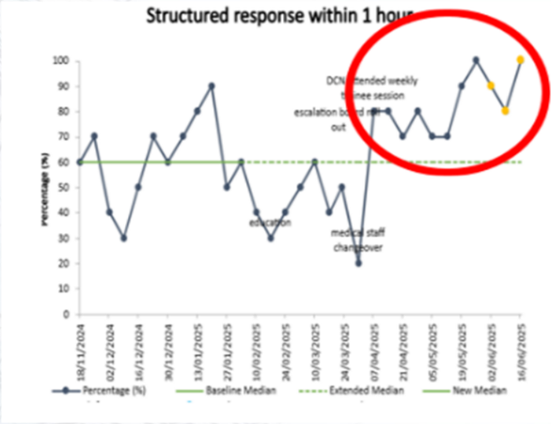
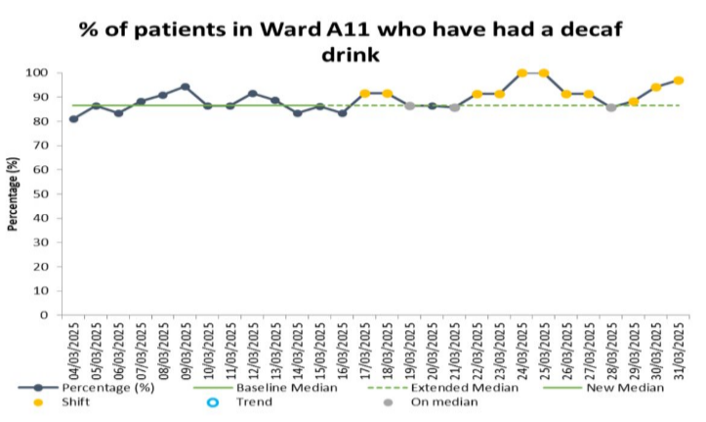
(Process)Results started to appear
Early improvements in pockets against agreed quality and safety metrics
Early process data under Deteriorating Patient workstream
Early process data under Safer Mobility Workstream
Lucy Atalla, Quality and Patient Safety Lead NHS FV
Notes:
3

Slide 15
What is Safer Mobility?
Safer Mobility is a proactive, prevention-focused approach that supports people living in care settings to remain active while reducing the risk of falls and fall-related harm.
Falls are a major issue in care homes, representing the most common reason for unplanned attendances to Acute Hospital, highlighting the need for effective falls prevention strategies.
Promoting regular movement and activity is essential, alongside addressing modifiable risk factors such as environmental hazards, medication-related risks, and other contributors to falls.
A sole focus on reducing the number of falls can unintentionally restrict activity, leading to deconditioning, reduced resilience, and an increased risk of future falls.
Recognising that not all falls are preventable allows a shift towards safer mobility, where well-organised, multidisciplinary teams deliver person-centred, evidence-based care to identify and manage risks while helping residents remain active, independent, and less likely to experience serious injury.
Matt Gallagher, AHP Falls Lead
Notes:
Matt Gallagher – 10 mins

Slide 16
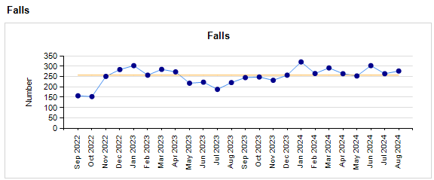
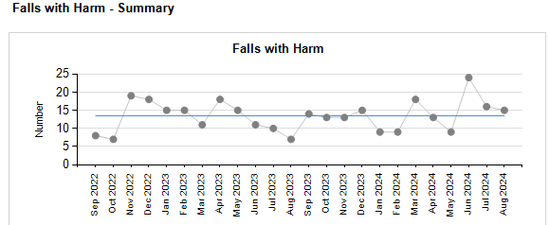
Safer Mobility
Increased Shift in falls Jan 24 – August 24
Random Variation Jan 24-August 24
Matt Gallagher, AHP Falls Lead

Slide 17
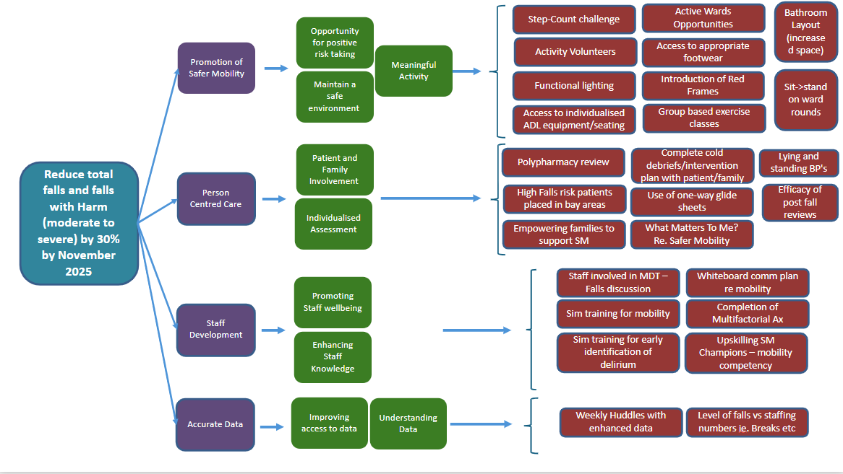
Safer Mobility
Matt Gallagher, AHP Falls Lead

Slide 18
Workstreams
Safer Mobility
Decaf
Active Visiting
Clacks Cafe
Red Zimmers
Postural Drop Ax
SBARD Tool – soft signs
Sit-to-Stand Summit
Matt Gallagher, AHP Falls Lead

Slide 19

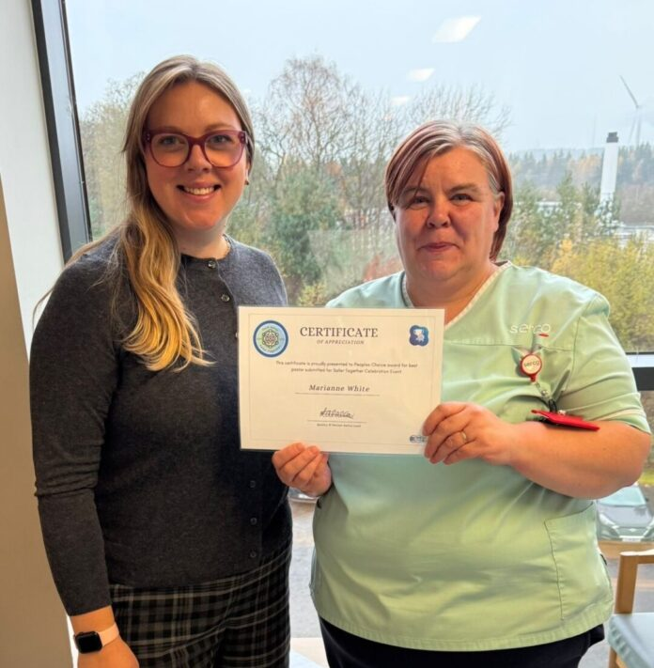
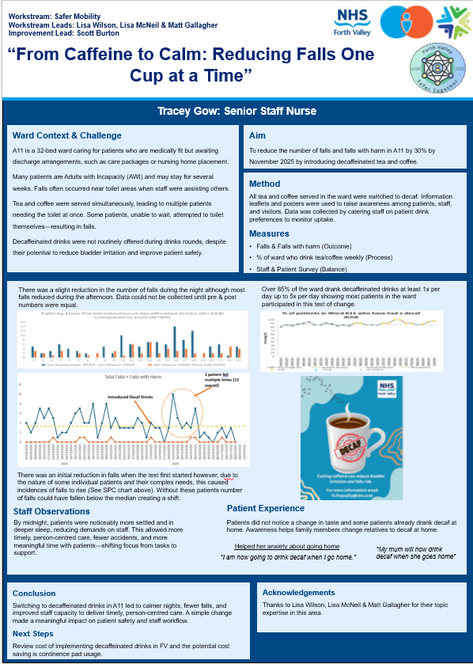
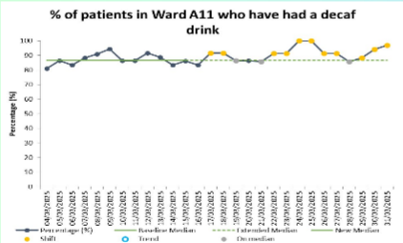
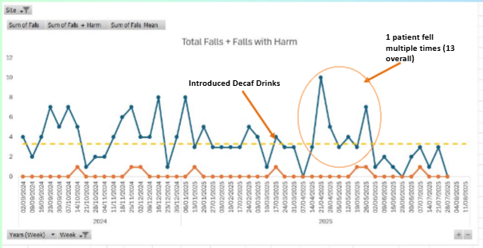
Going Decaf!
Introduced a "Decaf by Default" initiative to reduce falls risk through improved sleep, hydration and continence management.
Replaced caffeinated drinks with decaffeinated alternatives across Ward A11 using a whole-team approach.
Achieved uptake from over 80% of patients, supported by staff, patient and family engagement.
Demonstrated early reductions in falls and no falls with harm during a five-week measurement period. Showed how a simple, evidence-based change can improve patient safety and support wider safer mobility work
Policy / categorisation of events
the legacy
Matt Gallagher, AHP Falls Lead

Slide 20
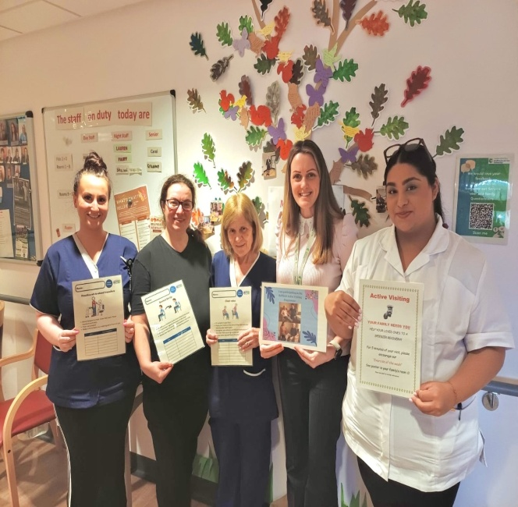
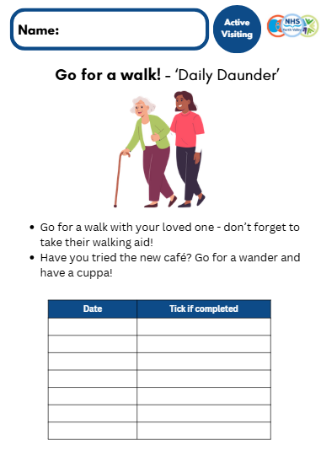
Active Visiting
Introduced an Active Visiting programme to increase patient activity and reduce deconditioning through family involvement.
Empowered visitors to support rehabilitation and mobility through structured weekly activities. Engaged 62 service users over five months, with participants achieving greater functional improvements.
Demonstrated a downward trend in falls despite increasing levels of physical activity.
Strengthened partnerships between families, therapy services and social care, creating a sustainable model for safer mobility
Policy / categorisation of events
the legacy
Matt Gallagher, AHP Falls Lead

Slide 21
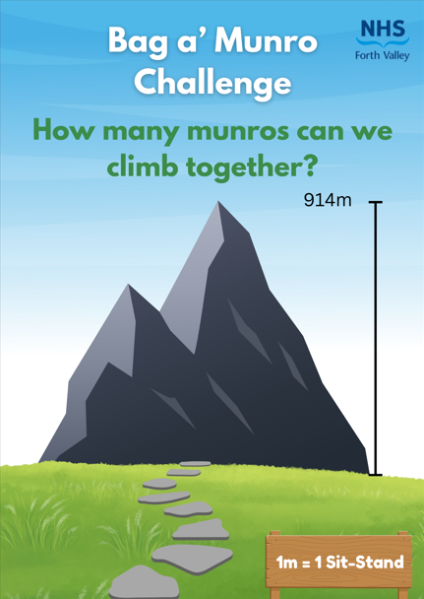
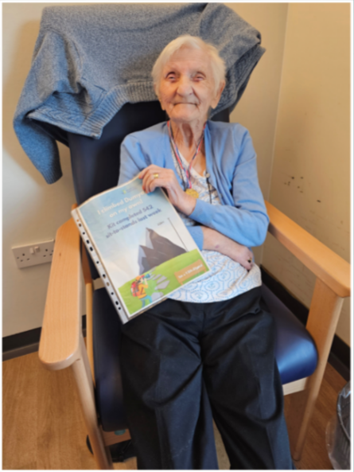
Sit-Stand to the Summit
Introduced a ward-wide Sit-to-Stand challenge to reduce deconditioning and support safer mobility.
Empowered nursing and care staff to lead patient physical activity as part of everyday care.
Achieved 5,943 sit-to-stands in one month, equivalent to climbing Mount Kilimanjaro.
Generated high levels of staff and patient engagement through a team-based challenge approach.
Demonstrated a positive downward trend in falls and established a foundation for future safer mobility initiatives
the legacy
Matt Gallagher, AHP Falls Lead

Slide 22
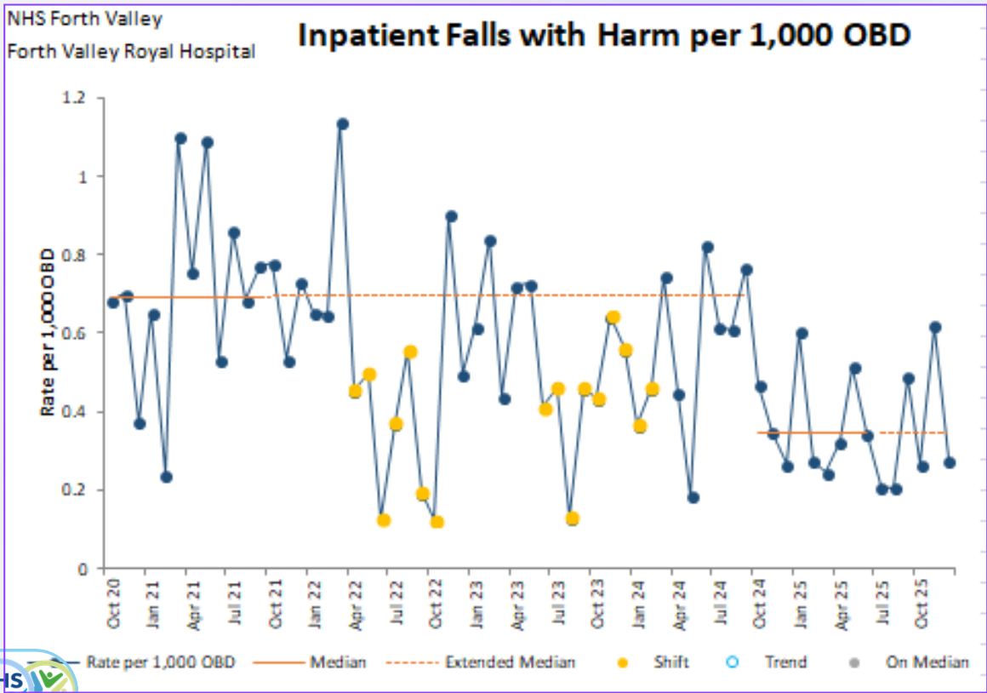
Safer Mobility – Implementation & Spread
Whole System Safer Mobility Steering Group:
    Acute
    Community
    Care Homes
Share Learning
Identify Areas for Improvement
Decisions based on data/evidence base
Matt Gallagher, AHP Falls Lead

Slide 23
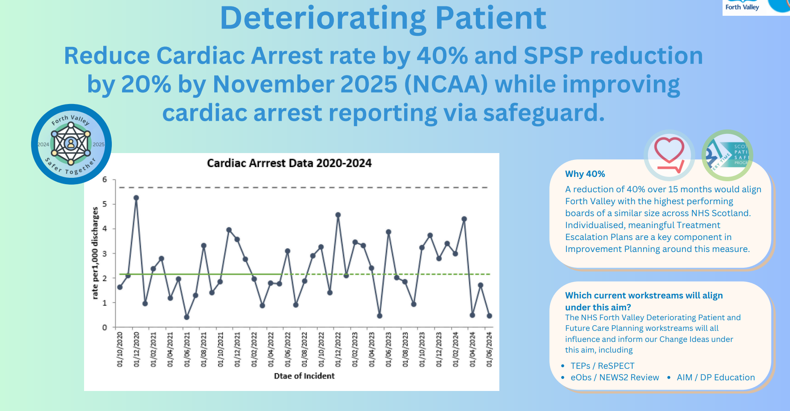
Deteriorating Patient Workstream
Dr David Watson, Director of Nursing
Notes:
David Watson – 17 minutes

Slide 24
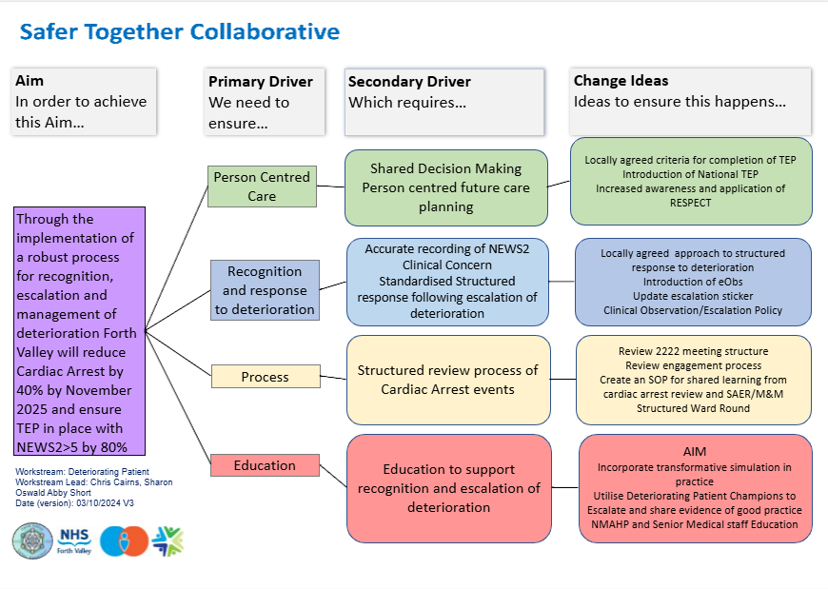
Deteriorating Patient
Dr David Watson, Director of Nursing

Slide 25



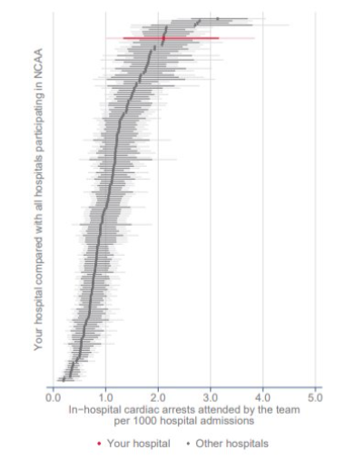
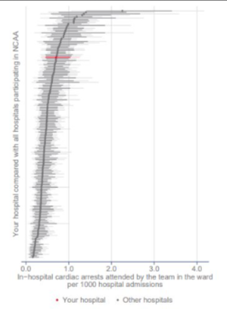
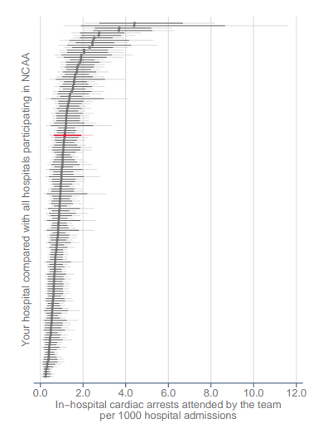

  Cardiac arrest rate reduced approximately 53%, from 1.83 to 0.86 over the collaborative period. ​
​
  National Cardiac Arrest Audit performance moved from around the 90th centile into the 25th-75th centile range.​
FV NCAA Cardiac Arrest Caterpillar charts
FVRH
FVRH
FVRH
April - Dec 2022
April - Dec 2024
April - June 2025
Safer Together
Celebration Event, Nov 2025

Slide 26
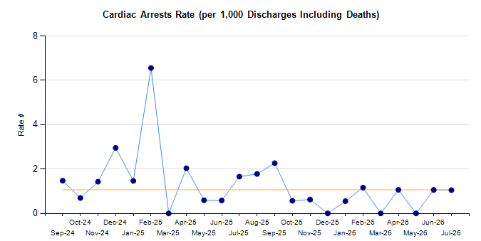
Deteriorating Patient Outcome Measure
  Cardiac arrest rate reduced approximately 53%, from 1.83 to 0.86 over the collaborative period.
  National Cardiac Arrest Audit performance moved from around the 90th centile into the 25th-75th centile range.
Dr David Watson, Director of Nursing

Slide 27

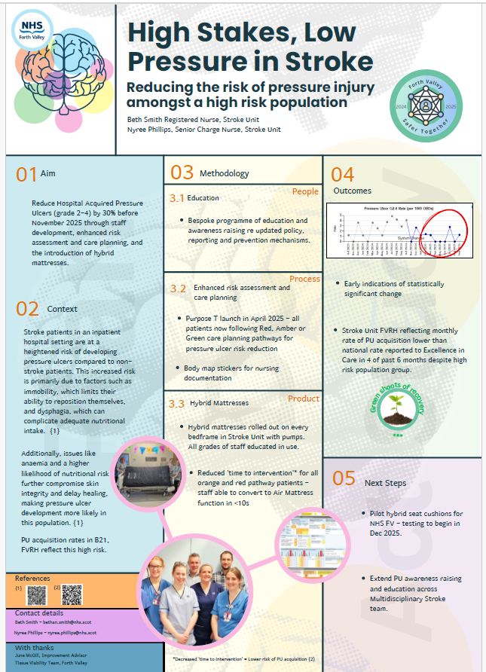
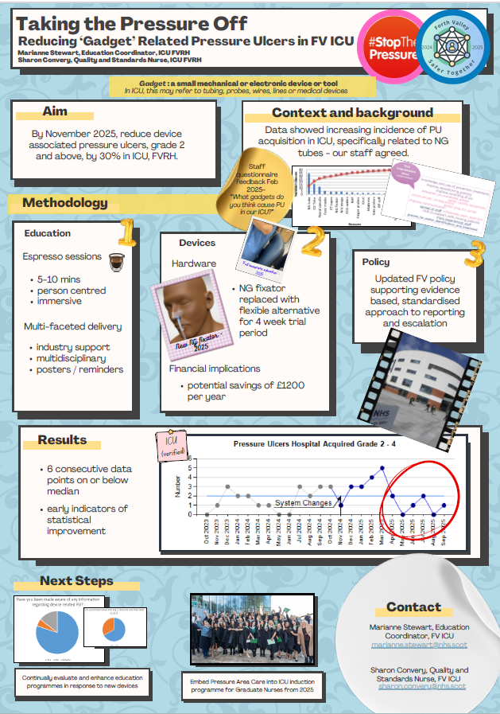
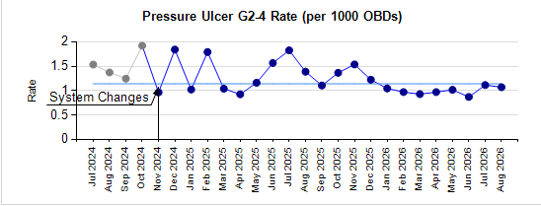
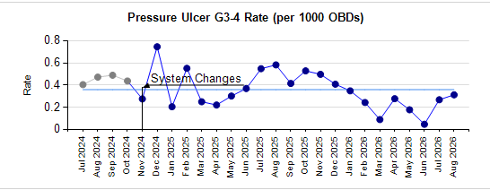
The legacy
Whole system Pressure Ulcer rates
8 point shift in grade 2-4 PU rate (per 1000 bed days)
5 point downwards trend into a 7 point shift in grade 3-4 PU rate (per 1000 bed days)
Dr David Watson, Director of Nursing

Slide 28

The legacy
  The collaborative demonstrated that large-scale improvement was possible across NHS Forth Valley.
  It created capability, confidence and relationships that extended beyond the programme itself.
  It established a foundation for a more ambitious whole-system approach.
Dr David Watson, Director of Nursing

Slide 29
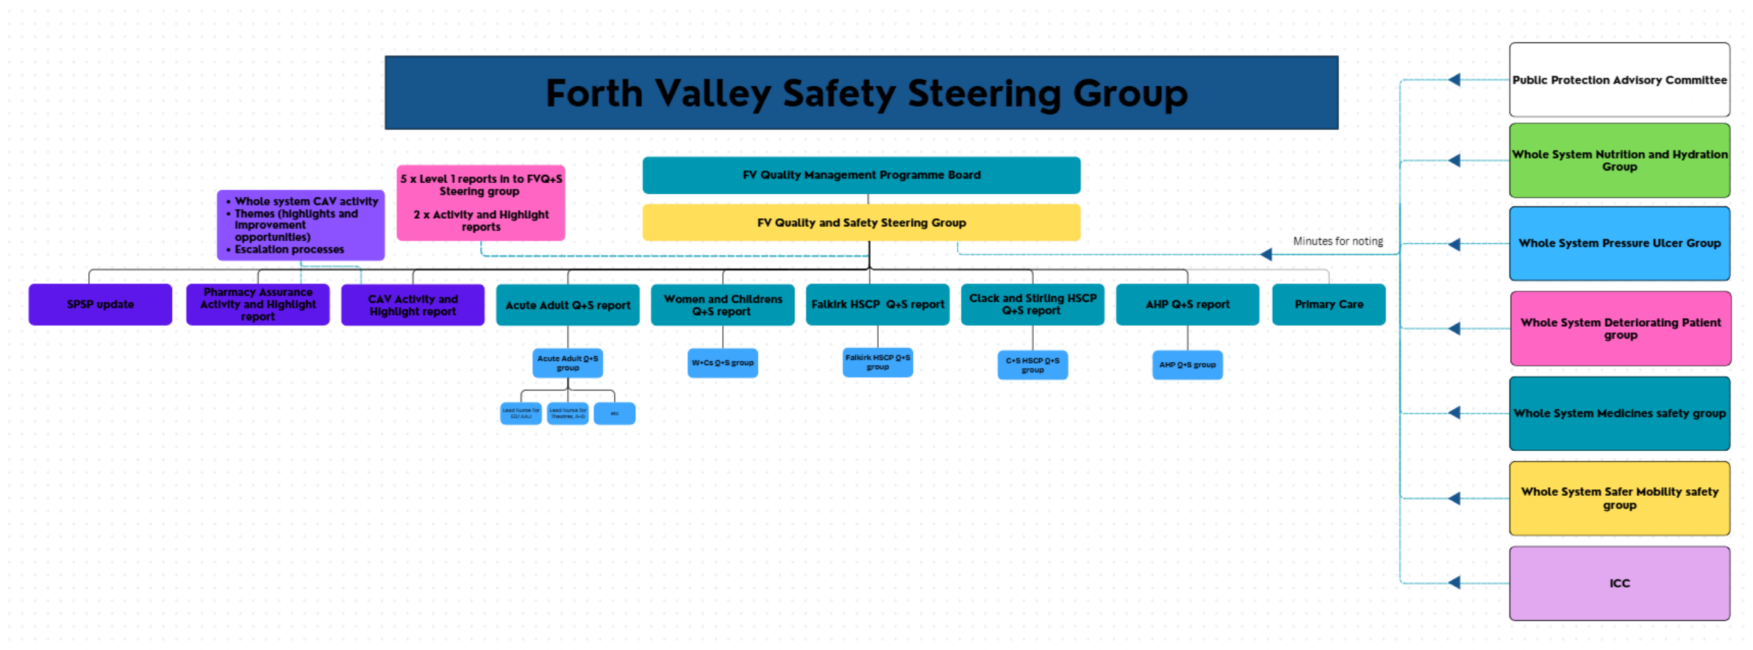
The legacy
Safety Steering Group
Dr David Watson, Director of Nursing

Slide 30

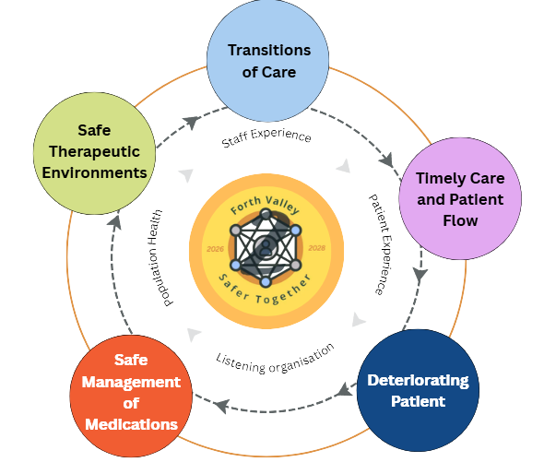

The next chapter
Dr David Watson, Director of Nursing

Slide 31

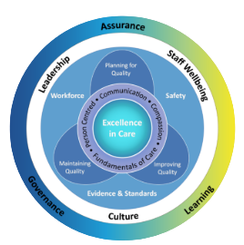

The next chapter
Enabling functions for the future in Forth Valley.
Quality, Safety and Experience ambition
Dr David Watson, Director of Nursing

Slide 32


Thank
You
We would welcome any questions...
Notes:
Q+A for 10 minutes

