Slide 1
The Dietetic Review - Leading collaborative change to improve access and outcomes

Slide 2
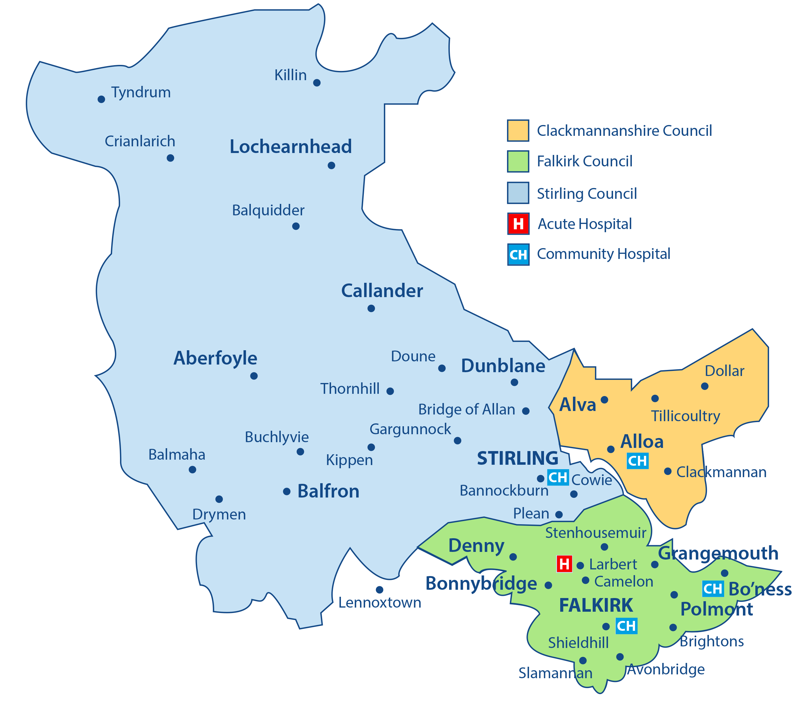
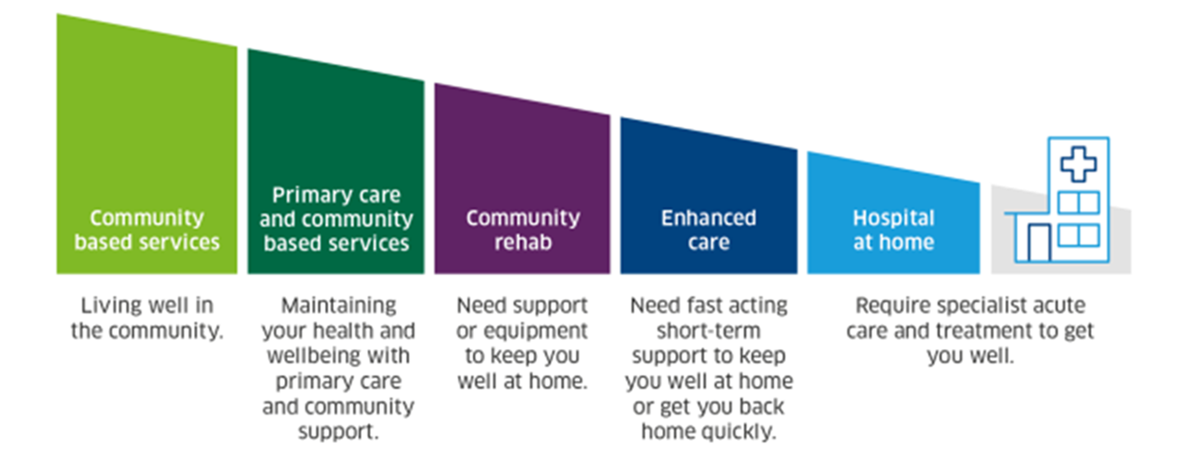

NHS Forth Valley Nutrition and Dietetics
Clinical pCommunity Dietetics
Acute Dietetics
Healthier Future Team
Learning Disability Dietetics
1 Health Board
2 HSCP
3 Council areas
4 Dietetic Teams
13 clinical sub teams
Cradle to Grave

Slide 3
Why the Dietetic Review?
THE CHALLENGE
THE OPPORTUNITY
THE AMBITION
- Rising demand
- Increasing complexity
- Variation in access
- Workforce pressures
- A desire from staff to continually improve
- Build on existing good practice
- Develop new and innovative ways of working
- Ensure services are fit for purpose and the future (where do we add value?)
- Ensure service can meet challenges and demands
- Develop a sustainable service
- Deliver the right care, in the right place, at the right time, through a skilled workforce and sustainable services
WHY
BETTER OUTCOMES
for people
BETTER EXPERIENCE
for staff
BETTER VALUE
from our resources
Notes:
The Dietetic Review
This was a longstanding ambition…….
The project was initiated in January 2022, to ensure that the FV Nutrition and Dietetic service meets the needs of our service users and staff, and services are aligned to local and national strategies
The review offered the opportunity to recognise and celebrate what is done well, but also identify any improvements or developments required and where the service added value.
The project objectives were outlined at the beginning of the project;
• To build on existing good practice
• To develop new and innovative ways of working
• To ensure services are fit for purpose and the future (where do we add value?)
• To ensure service can meet challenges and demands
• To develop a sustainable service

Slide 4
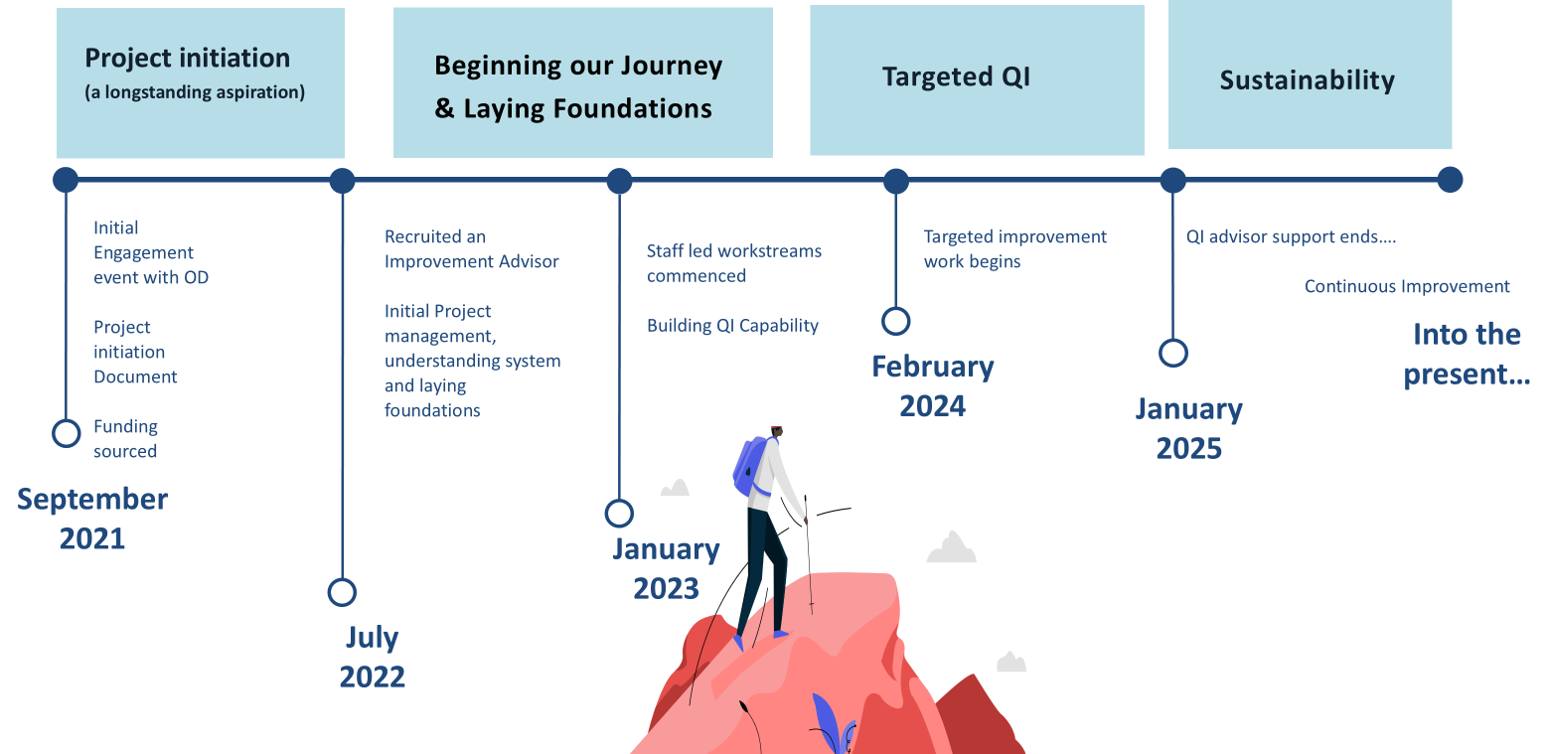
Timeline
Notes:
The Review was sponsored by an AHP Manager and supported by Senior Leaders in the Organisation with key stakeholders being involved throughout.
Crucially, some dietetic resource was temporarily diverted to support a fixed term improvement advisor to lead this and upskill staff in improvement work.
All staff across all bands in all N&D teams including admin were involved. This was an inclusive project .
3 staff engagement events were held which resulted in the development of 7 staff directed workstreams. These created improvement projects that were shared and celebrated within whole profession events.
Service Delivery
Workforce Development
Governance and Compliance
Communications and Social Media
Administration
Accommodation
Data

Slide 5
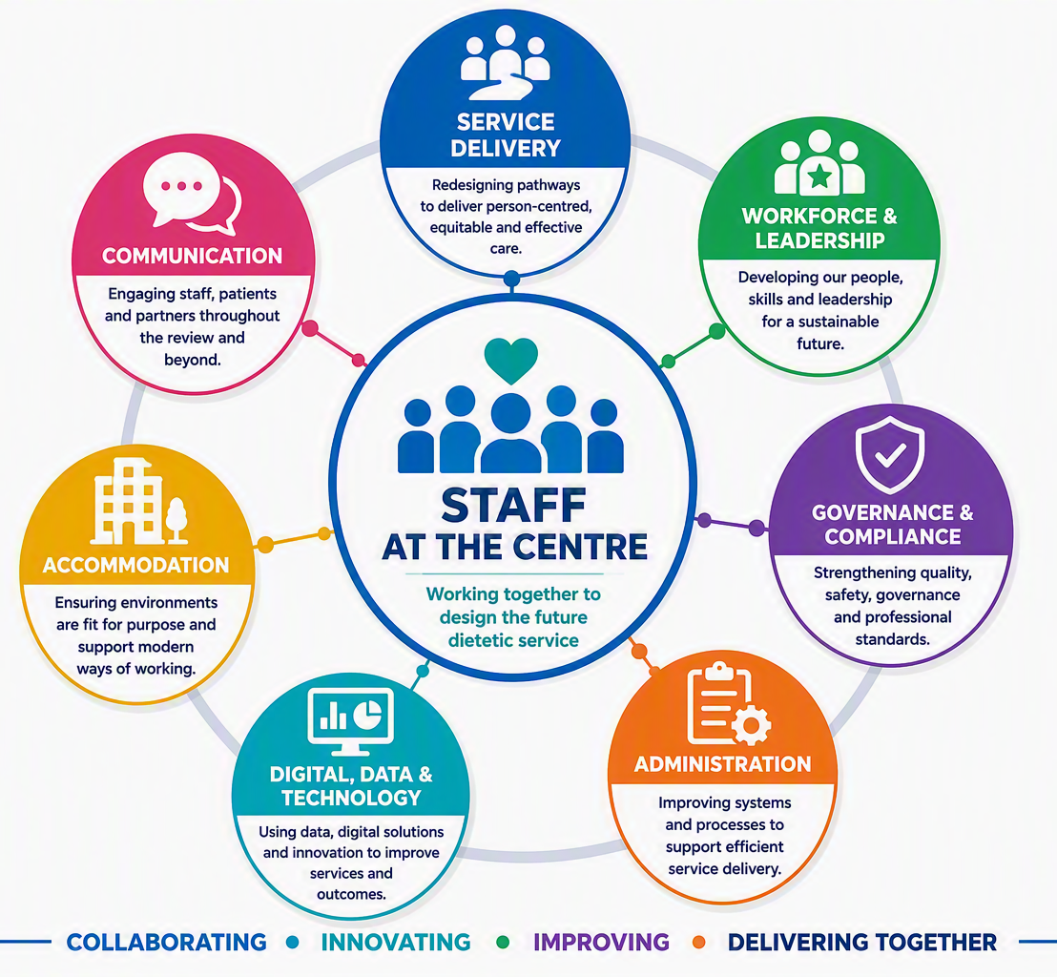
Staff Led Workstreams
Notes:
Staff self selected which workstreams they wanted to be involved in which best suited their interests and specialities
Staff led workstreams allowed leadership development, autonomy, teams were ready to begin targeted improvement work
Brief highlights from a few workstreams –
Accommodation review and identification of physical improvements that could be supported and use of available space
Communication –
Focussed improvement work to further develop the N&D Website with engagement across the service
Creation of a staff directory and welcome pack for new starts
Administration – shared working across teams to support the administration staff with processes and systems
Service Delivery – focussed on pathways rather than teams ….

Slide 6
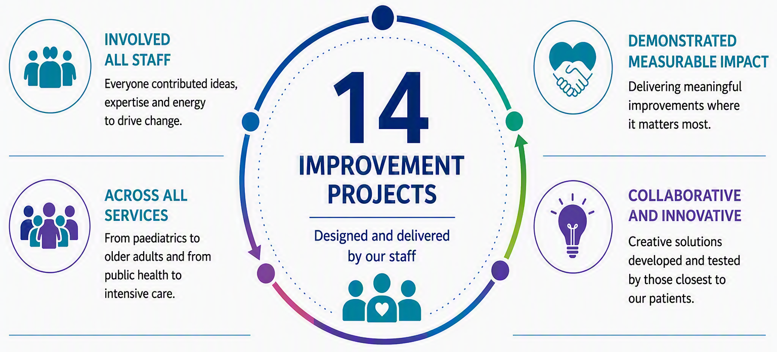
Targeted Improvement Projects
Notes:
Investment of time to organically come together to create pathways and allow understanding of data and methodology and have motivation and enthusiasm and trust in each other to change
By empowering staff and creating a culture of collaboration, ownership, curiosity and improvement, the Dietetic Review enabled staff across all grades and teams to lead and sustain meaningful quality improvement projects.

Slide 7
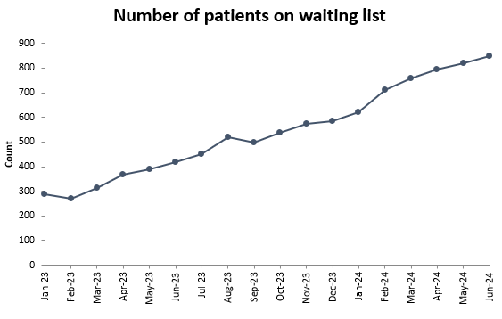
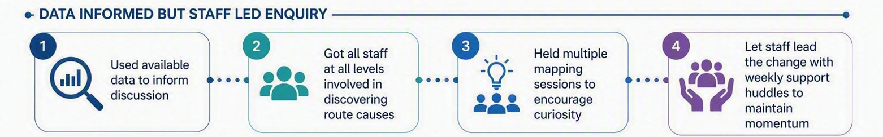
An Example:
The Adult Weight Management Service
850
WHAT PATIENTS TOLD US
PEOPLE WAITING
Low satisfaction
67% over 18 weeks
Difficult to access
140 over one year
Waiting affected motivation
Wanted choice
Longest wait: 75 weeks
Wanted the best chance of success
Notes:
One example, which sat within the Service Delivery Workstream was the Adult Weight Management Service.
In line with many other Boards in Scotland, the service had long exponentially increasing waiting times with patients waiting over 1 year for any input and it was only getting worse. Our model focused on seeing the next patient in the queue on a one-to-one basis and treatment pathway was criteria led and what was considered most appropriate by the clinician. Patients reported difficulty accessing the service, long waits impacting motivation and they wanted more choice.
The staff feeling empowered, curious if there could be a better way and having listened to patients felt the option to do nothing was not an option at all!
We used our data to inform all our work, and the staff were given the time and permission to reflect on the service, the evidence and be curious about what could be possible. Mapping sessions where held, time invested in understanding need ands weekly huddles were introduced to support momentum. This led to a project plan specific to this service and a number of change ideas.

Slide 8
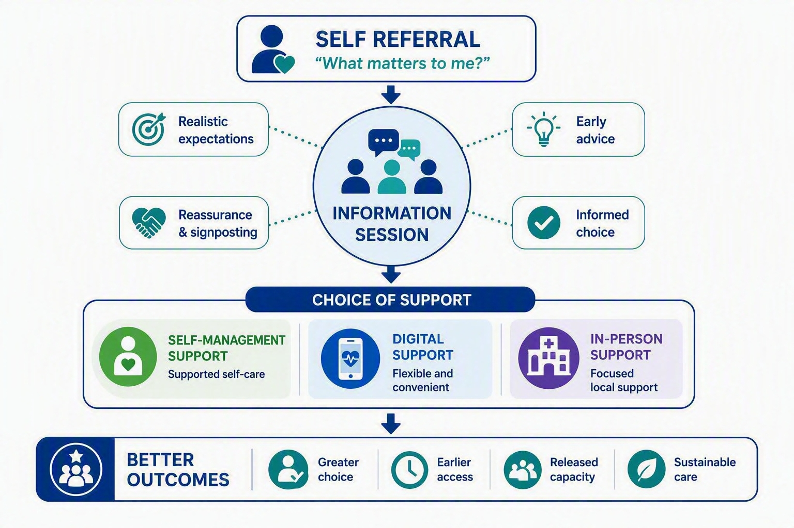
An Example: The Adult Weight Management Service
Notes:
The service has been transformed
Access to AWM was changed to self referral. This was welcomed by GP colleagues, reduced unnecessary appointments for patients and allowed the patient to tell us what mattered to them.
2. The introduction of group Information Sessions allowed patients to engage with the AWM team within a month of self referral, to receive initial advice, an understanding of wider factors beyond individual behaviour change that may be impacting their weight, local and national signposting on a number of topics and for those who still had an outstanding need an overview of available programmes delivered by the service.
3. The digital offers were expanded to support early intervention to patients ready to engage. This allowed a flexible, remote delivery of weight management programmes which evaluated well and produced equal outcomes in care for those that were comfortable with this approach. This released some capacity for the team to to focus local, in-person resources on those with the greatest need and gave the service more resilience in times of reduced staffing.

Slide 9
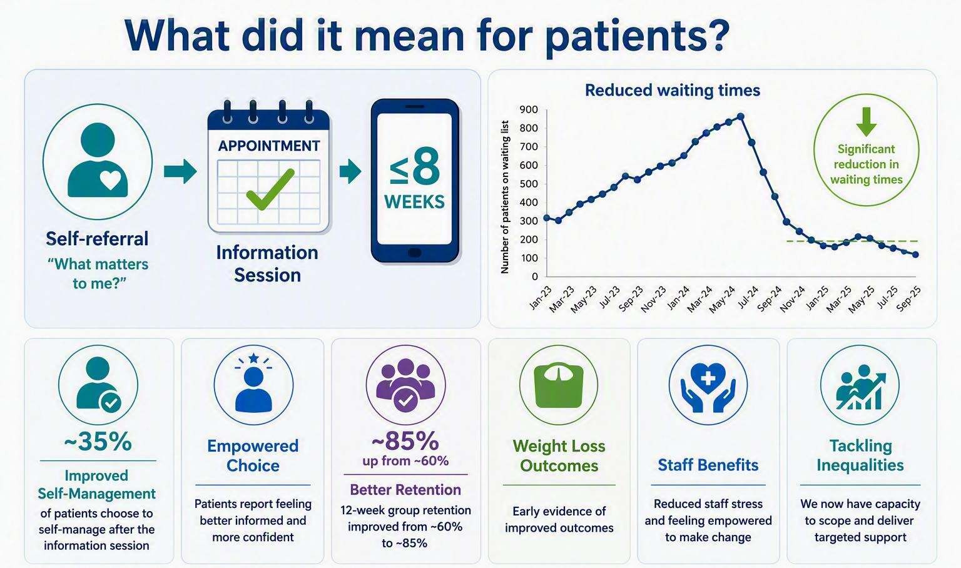
An Example:
The Adult Weight Management Service
This improvement has been sustained
Notes:
Waiting times dramatically improved and has been sustained. We now offer a range of options and patients report positive experience.
Outcome data from the Information Session shows that 35% of patients go onto self manage following the information session with the confidence that they can re access service for direct support within a timely manner if needed. These patients would have historically remained on a waiting list waiting that next 1:1 appointment building reliance rather than resilience.
For those who do choose to access programmes we have seen improved retention for example within groups increasing from around 60% to 85% and 85% within digital options too – perhaps reflecting informed decision making by patients.
We are finding those seeking digital support are of a range of changes but there is a higher proportion of younger working age accessing this and those seeking local support generally have more comorbidities. Patients accessing digital options have commented on the benefits of reduced appointment burden.
We are gathering information on weight loss outcomes, and this is looking positive:
The digital options are evaluating well with positive weight loss outcomes at 3months (average 6.3%) and Local Active Groups – 3-4% at 3 months and 4-5% at 6months
We have reviewed our data and know that we haven’t widened the inequality gap but by releasing some capacity we plan to explore this and deliver targeted work in our communities on inequalities. Further increase resource used for digital options allow local resource to be utilised for those who need us most i.e. those in our most deprived communities and those at highest risk of obesity related health conditions such as T2DM
Staff are feeling positive and valued having been involved in delivering this change

Slide 10
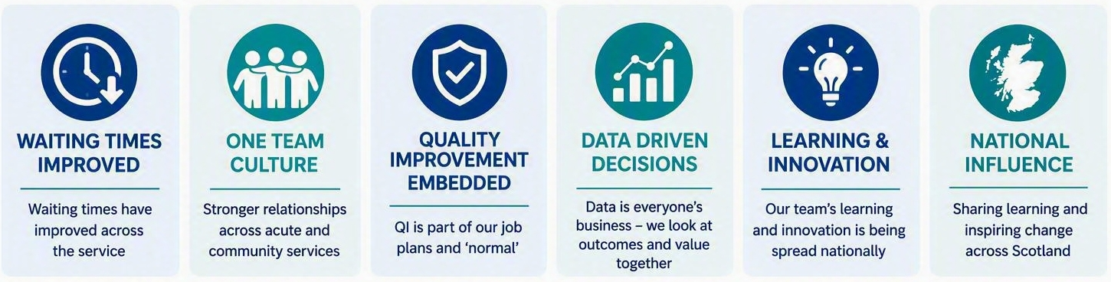
As a whole service, where are we now?
Clinical pCommunity Dietetics
Acute Dietetics
Healthier Future Team
Learning Disability Dietetics
Notes:
This was just one example of the type of work we are doing and the learning has been shared across the whole service. The team’s commitment to collaboration and overcoming obstacles led to significant achievements, including reductions in waiting times (61% for Clinical Community Dietetics, 77% for the Healthier Future Team AWM) , and 71% for Paediatric Dietetics). These outcomes, without restricting access, and actually by removing restrictive referral criteria, demonstrate an ability to deliver high-quality, patient-centred care even under pressure.
As always and crucially, it’s all about relationships and Staff feedback reflects the positive impact of working closer together, with reports of improved teamwork, communication, and job satisfaction.
Importantly QI has been firmly embedded as core business. More than 60% of the staff have completed training and we now ensure that our dietetic students have a QI elemtnt o theirt project supporting their future capacity and capability for service change but also supporting us locally while with us.
The whole culture and language has changed, with more focus on data, outcomes and value,

Slide 11
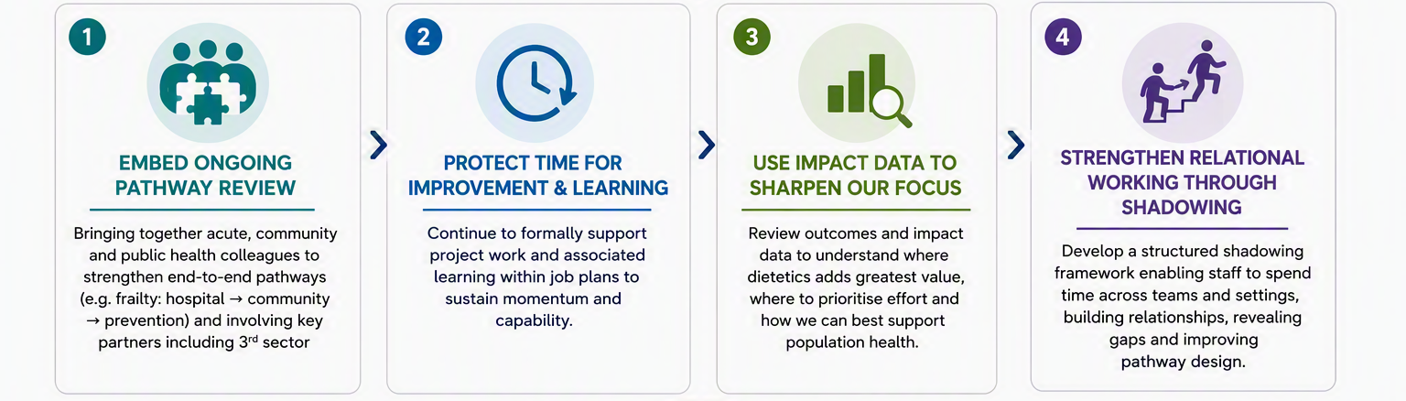
What next for Forth Valley Dietetics?
Notes:
so, what’s next? We carry on with this good work in the form of :
Whole System work - ongoing end to end pathway work – for example in frailty – prevention, supported self management, early intervention, and supported discharges involving all teams and collaboration with all sectors.
Protected time for learning and improving – support project and improvement work, recognise its value and create a movement that is sustainable and include in Job Plans
Data informed staff enquiry to show where Nutrition & Dietetics add value (and where we don’t)
Up Next: Throughout this year we will build on the relational work in the review via a structured, supported shadowing framework for all staff

Slide 12
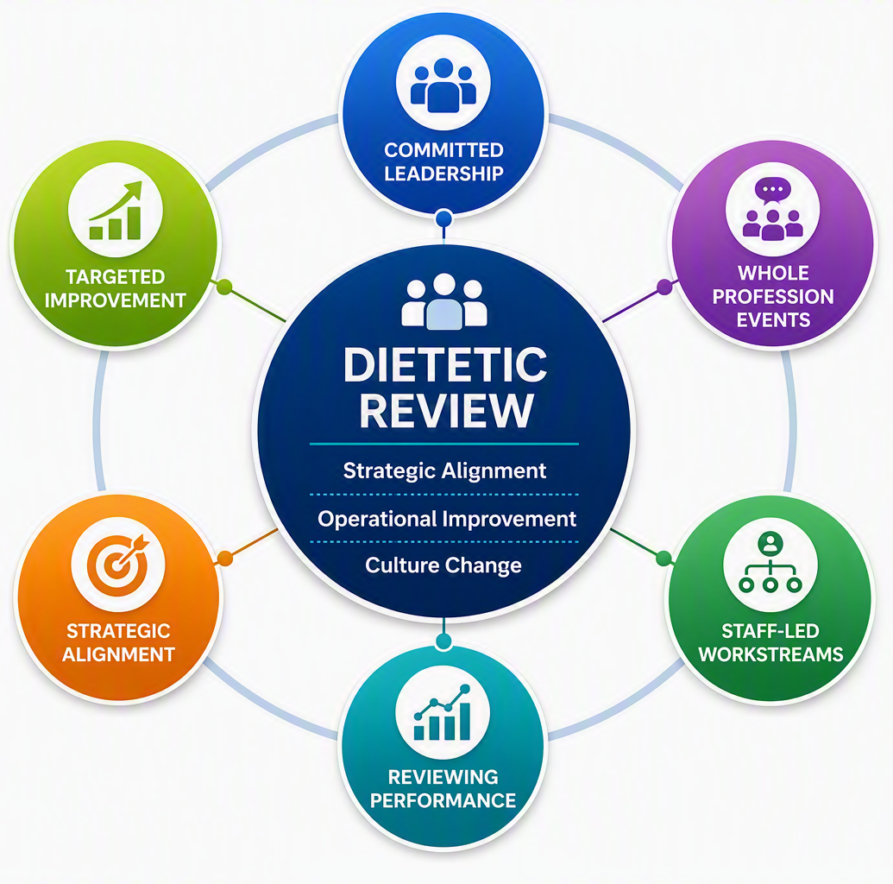
Thank you for listening
Notes:
So, what did we do and how was this different to any previous work?
The Review was sponsored by an AHP Manager and supported by Senior Leaders in the Organisation with key stakeholders being involved throughout.
Crucially, some dietetic resource was temporarily diverted to support a fixed term improvement advisor to lead this and upskill staff in improvement work.
All staff across all bands in all N&D teams including admin were involved. This was an inclusive project .
3 staff engagement events were held which resulted in the development of 7 staff directed workstreams. These created improvement projects that were shared and celebrated within whole profession events.
Service Delivery
Workforce Development
Governance and Compliance
Communications and Social Media
Administration
Accommodation
Data

Slide 13
Turning Waiting into Action: Innovative approach to managing Podiatry services

Slide 14


Aims of our session
Prevention and Early Intervention approach – to managing podiatry demand, supporting sustainable and equitable access to care.
“What Matters to You” conversations – to strengthening person-centred approaches and informed more responsive, needs-led access models.
Community Appointment Days - to improving patient knowledge, experience, and flow across waiting times pathways.
Service transformation and redesign – identifying opportunities to share learning, support quality improvement, and ensure better outcomes for people and communities.
Notes:
Hello, my name is Kirsty Symons and this is my colleagues Wendy Lawson.
We are delighted to have the opportunity to briefly share our journey to date with you on Aberdeen City Podiatry Service redesign and transformation. In particular, we will focus on how Community Appointment Days has been one of the key developments in helping us achieving our goal.
Before I begin, I would like to highlight, although references throughout this presentation are to Podiatry, most if not all, processes and learning can be adopted across any service/profession, system wide.
Our sessions aims to:
1. How CADs enabled us to adopt and embed a prevention and early intervention approach to supporting both public and patients.
2. How ‘What Matters To You’ approach ensure a person centred approach was taken.
3 and 4. How CAD help support patient/public knowledge and help manage service demand, outcomes and become a part of ongoing service model to support for people and communities.

Slide 15
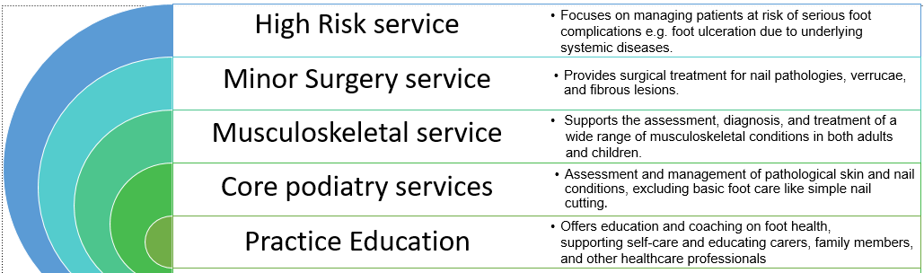
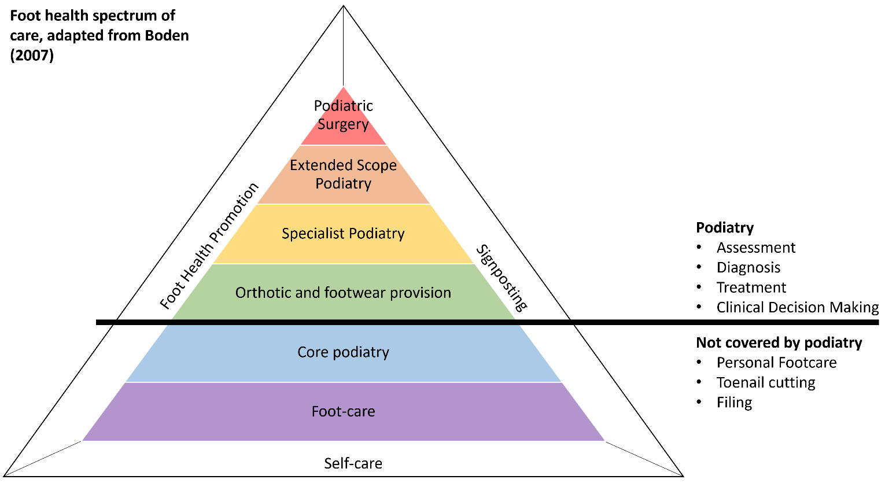

Aberdeen City HSCP Podiatry Service
Notes:
Aberdeen City Podiatry Service is part of NHS Grampian and provides specialist assessment, diagnosis, treatment, education, and prevention services for foot and lower limb conditions. Its overall aim is to improve mobility, independence, foot health, and quality of life. Receiving approx. 250 NP referrals per month, equating to approx 3000 per year supporting patients within both community and hospital sectors.
The Podiatry service is subdivided into 4 key areas which are supported and underpinned by Practice Education.
This is reflected in the diagram (right hand side) which is part of Scottish Personal Foot Care Guidance, 2025. Highlighting what requires support from a Podiatrist and what doesn’t e.g. personal foot care.

Slide 16
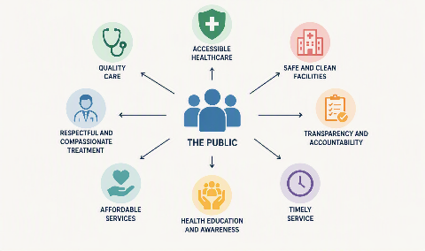
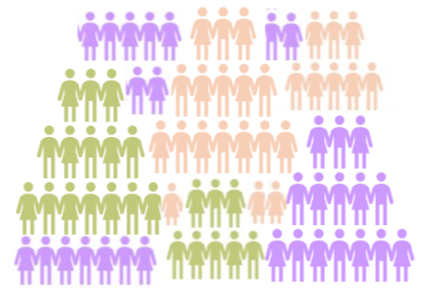







Drivers for Change
Workforce
Recovery from the COVID pandemic
Service Demand
Staff Health and Wellbeing
Financial Sustainability
Patient disease profile
and complexity
Public Expectation
Notes:
Our service redesign and transformation has been driven by a number of drivers, examples of which can be seen here..
Suggest that you select a few to briefly mention.

Slide 17
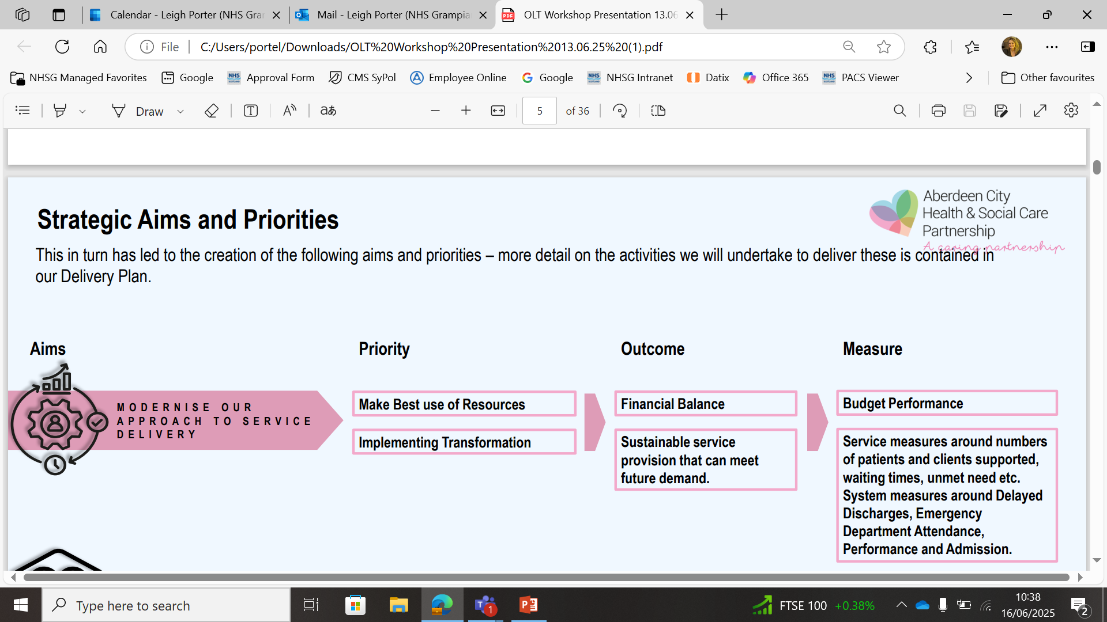

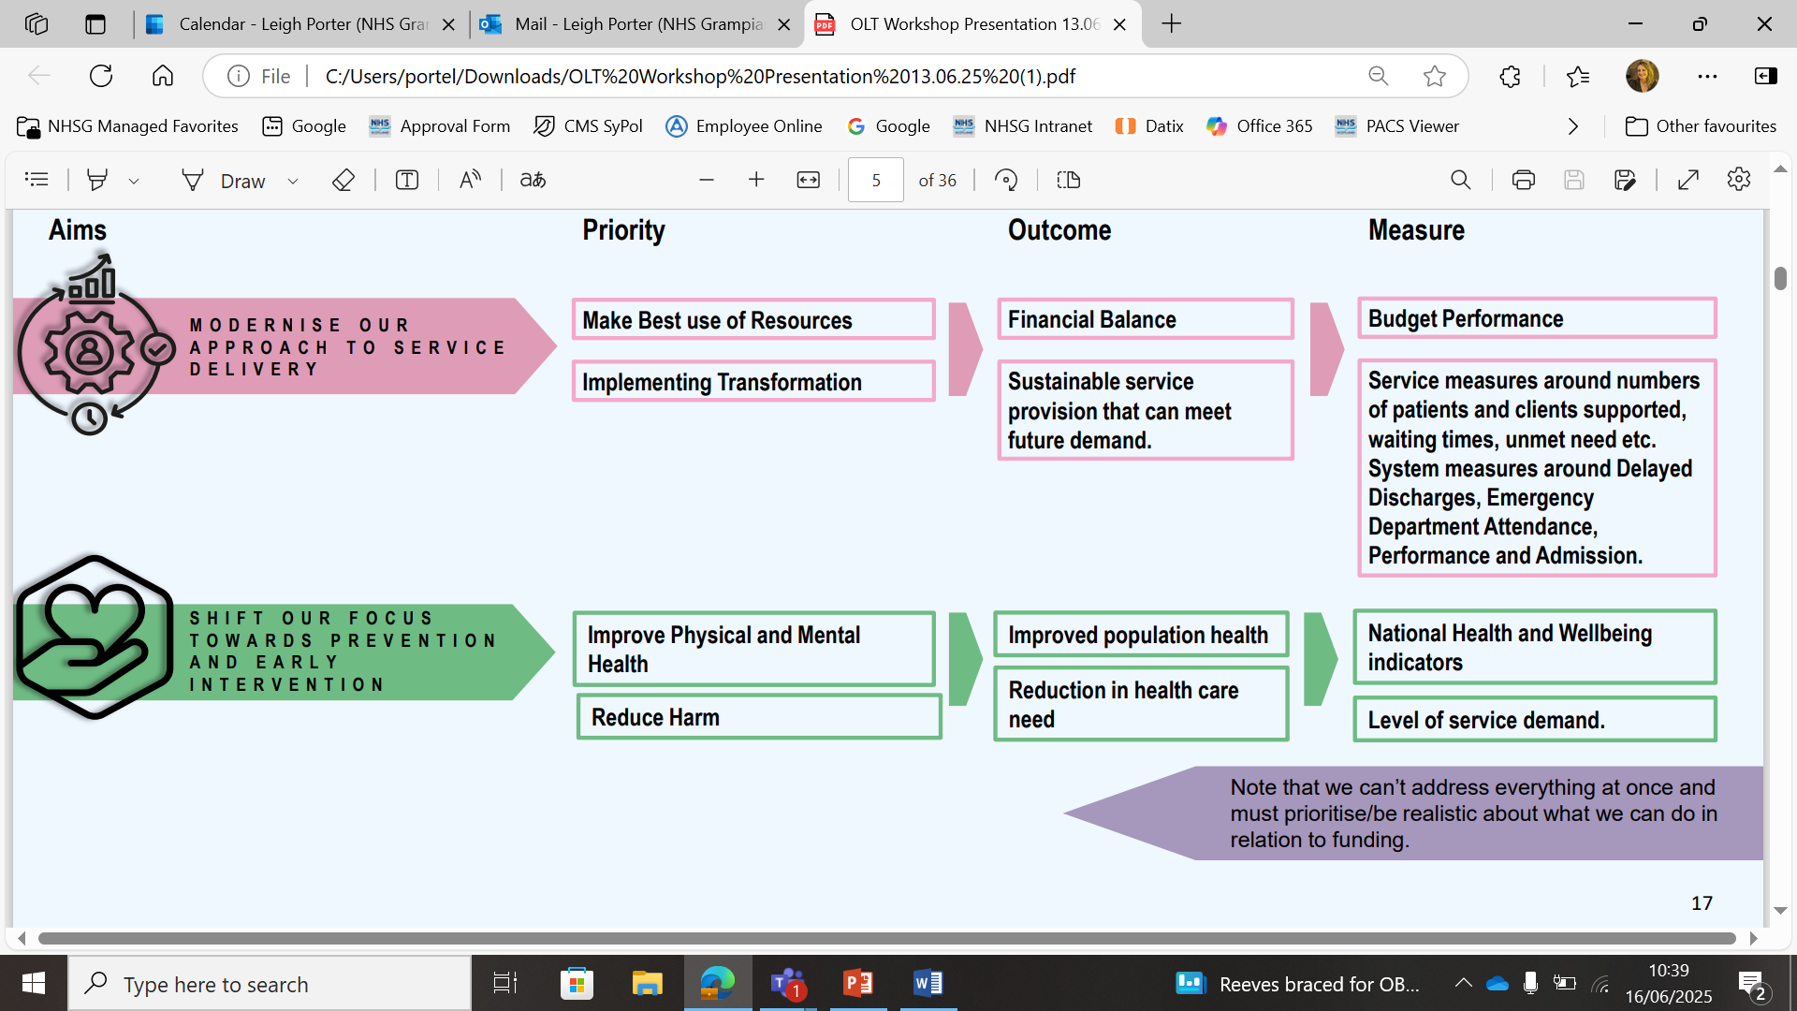




Our journey to redesigning and transforming Aberdeen City HSCP Podiatry Service
Implementation of an e-clinic model to support hospital based services (e.g. Digital Solutions).
Review and redesign of shared care wound care pathway with nursing teams, patients, carers. (e.g. Integrated NHSG Diabetic Foot Pathway).
Improving public knowledge and understanding of the importance of good foot health, and when necessary to seek advice from a Podiatrist (e.g. Scottish Index Multiple Deprivation, Targeted Education).
Change of referral criteria into the service, with a view to prioritizing those with the greatest need (e.g. Community Appointment Day, Waiting Well Team, Active Clinical Referral Triage).
Notes:
Our service redesign focuses on 4 key areas, underpinned by the HSCP strategic aims (on left hand side) and principles of Realistic Medicine and GIRFE.
HIS has also been a key partner and supporting during our transformational journey.
For the purpose of todays presentation, we will focus on change of referral criteria into the service, with a view to prioritising those with the greatest need, and in particular how CADs have helped us to achieve this ambition.

Slide 18

What is a Community Appointment Day?
Holistic health and wellbeing support - bringing together health services, social care, and community partners in one accessible location.
Personalised Care - Empower attendees through co-designed events that focus on “What Matters to You” conversations, enabling individuals to voice priorities and make informed choices.
De-medicalised setting - Holding appointments in a community setting like a leisure centre, the atmosphere is less clinical and more relaxed, potentially reducing anxiety and encouraging engagement.
Improved Access and Reduced Waiting Times - offering same-day access to clinical assessments where that is appropriate.
Community Empowerment – Empowering patients to take a more active role in their own care by providing them with the knowledge, resources, and support to manage their conditions effectively.
Notes:
Chat through the slide, providing an overview of the benefit of CADs.

Slide 19
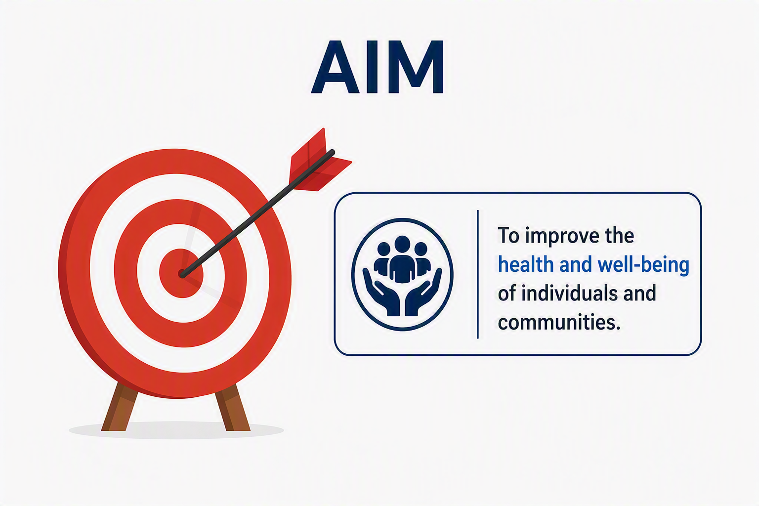
Aims of the Podiatry CADs
Educate, promote and empower foot health within the community.
Early identification and prevention of individuals ‘at risk’ of developing complications.
Management of patients aligned to Core General Waiting List.
Notes:
3 key primary aims ere identified for our CADs:
Educate, promote and empower foot health within the community. Not just patients, but opening education and sharing of information to the wider public.
Early identification and prevention of individuals at risk. Taking that upstream approach. This may be via a general chat at the podiatry stand, during that brief 1 to 1 consultation.
Management of patients aligned to the Core General Waiting List. Due to Covid legacy combined with severe staff shortages, the waiting list consisted of approximately 2500 patients, with the majority waiting over 1 year.

Slide 20
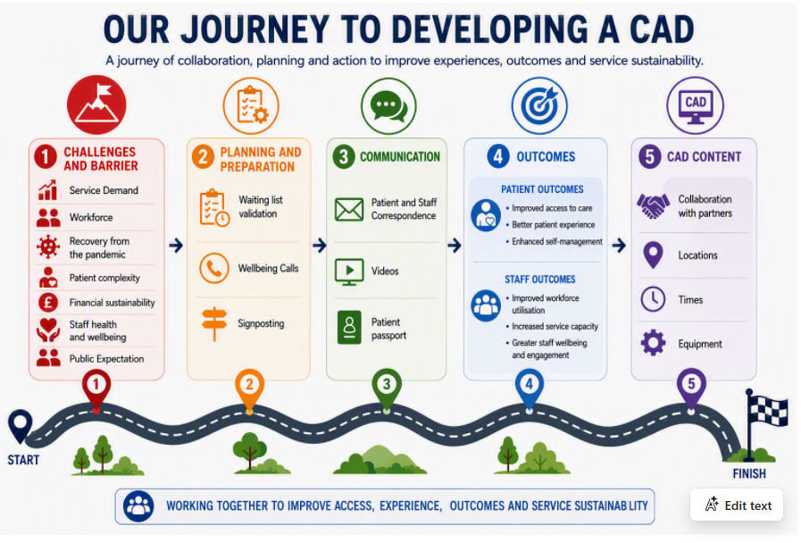
Notes:
This slide provides a high-level overview of our journey to developing a CAD.
As mentioned previously, several challenges and barriers were identified.
Planning and preparation involved validation of the waiting list to ensure that all patients remaining on the WL required support from the Podiatry service or whether signposting to another service was more appropriate. This was undertaken by NHSG Waiting Well Team.
One of the most important areas of progressing the CAD was Communication (MOVE TO NEXT SLIDE).

Slide 21
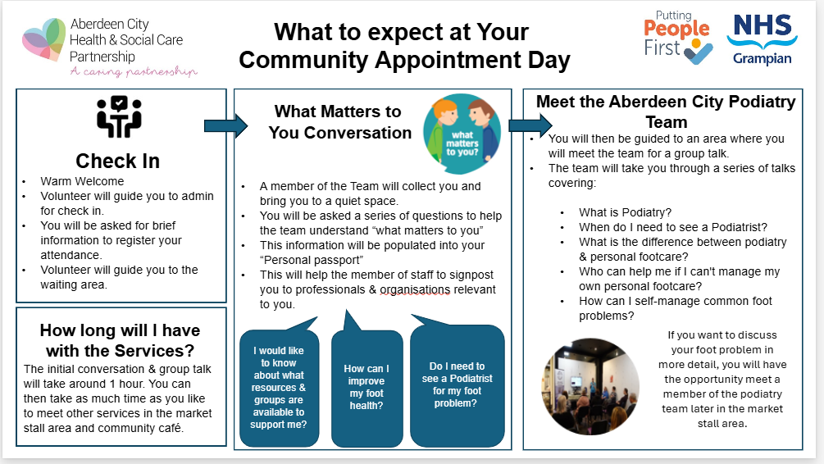
Notes:
We have learned throughout this journey how important communication has been to ensuring success.
Based on ongoing feedback from patients, and by adopting a PDSA approach, we have continually adapted information such as patients letters and information as you can see here. Ensuring information is person centred, prepares the patient for what to expect at a CAD from start to finish.

Slide 22
Notes:
To evaluate the effectiveness of CADs and impact on patients, staff and service, several outcomes were collected, both qualitative and quantitative.
This included measures such as, but not limited to the impact on the waiting list, demographics of the patients attending, direct feedback from patients and staff on the value and experience of the CAD and understanding, longer ter, the impact of learning from the CAD to help self manage and prevent deterioration of the individuals foot condition.
Results of the outcomes will be covered I another slide.
And the final stage was the actual content of the CAD (MOVE TO NEXT SLIDE).

Slide 23
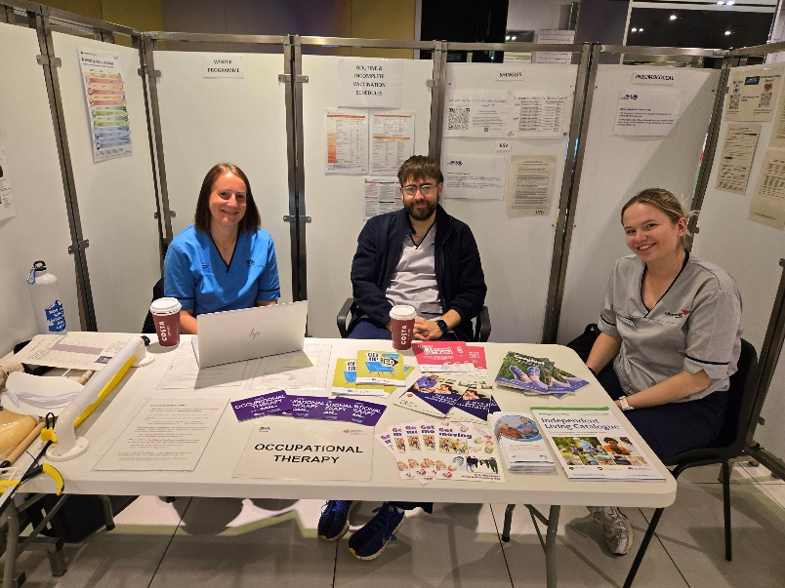
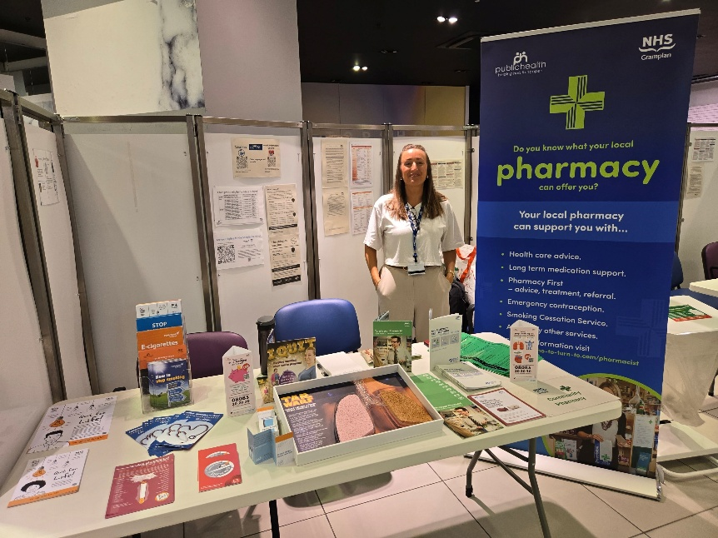
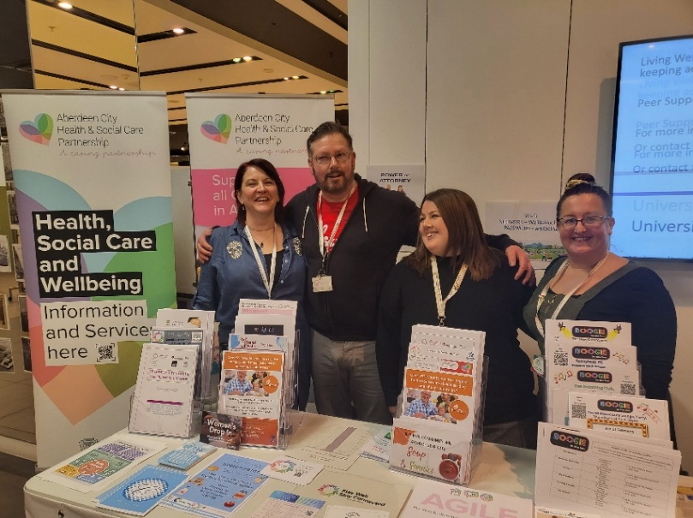
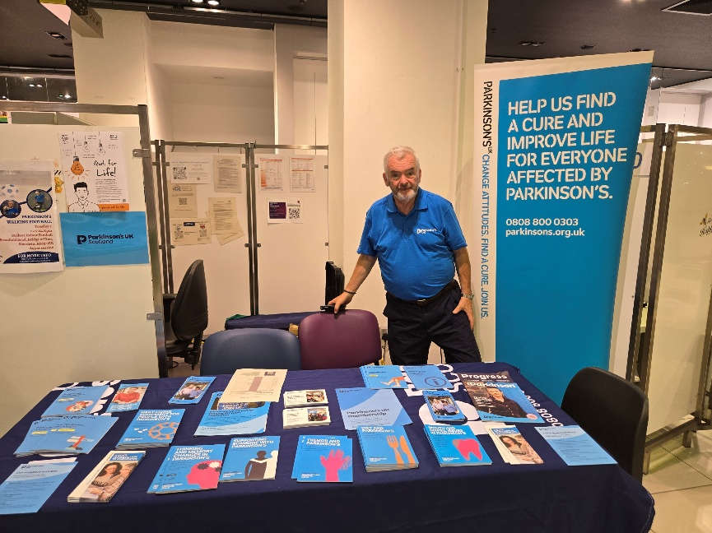
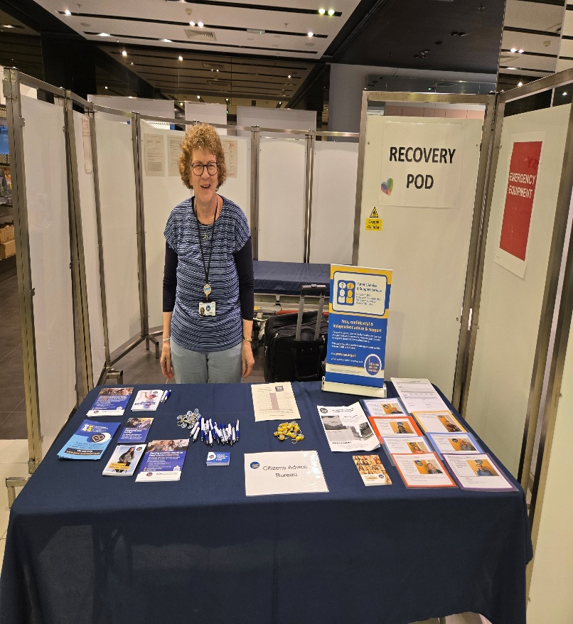
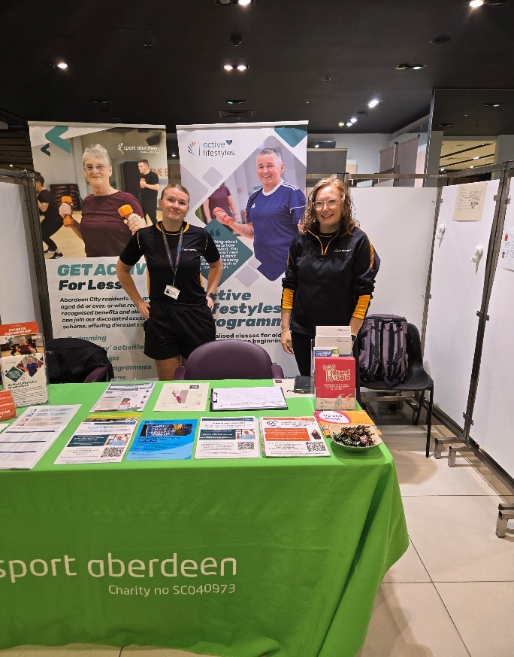
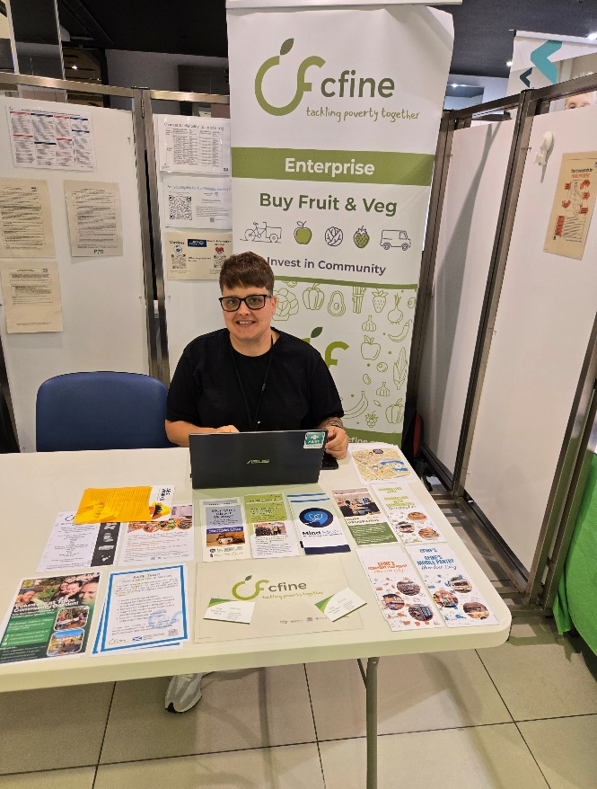
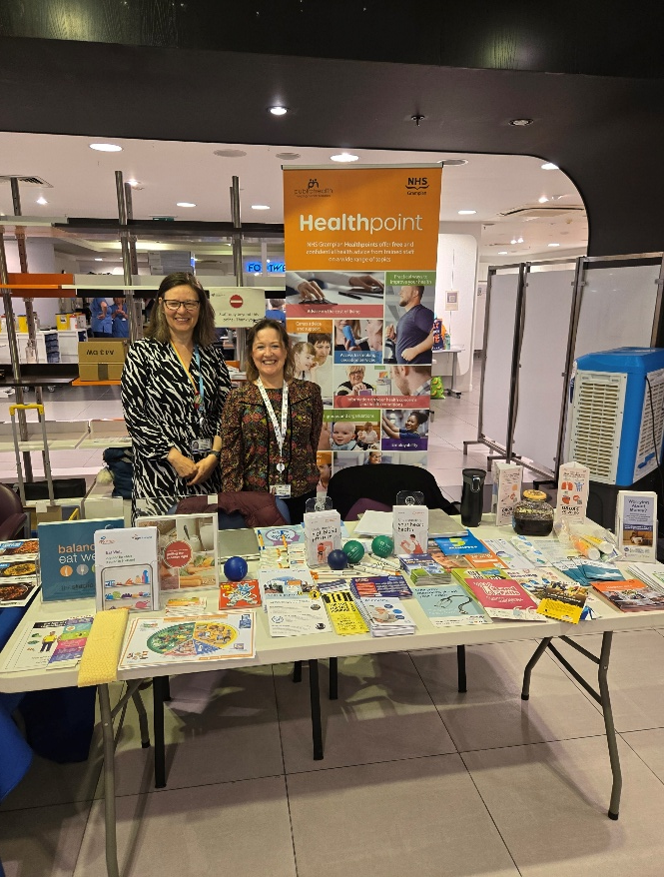
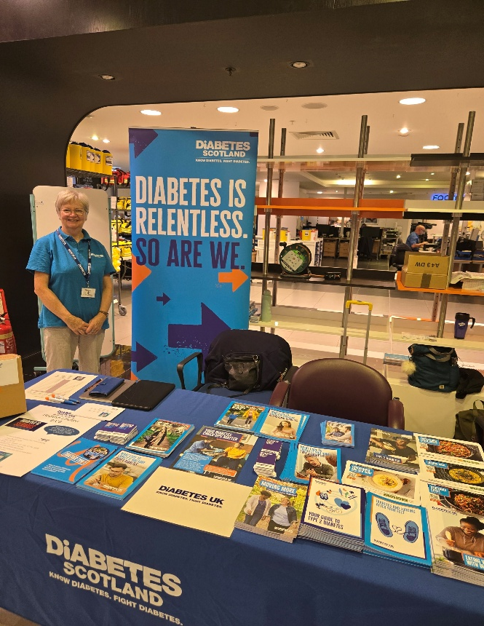
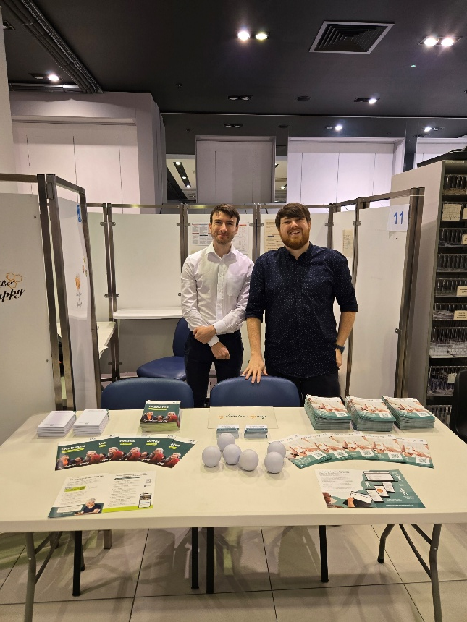
Services & Community Partners
Our Community Partners
Health
Occupational Therapy (CAARS)
Podiatry
Physiotherapy (CAARS)
Aberdeen City Vaccination Team
Public Health – Healthpoint
Community Pharmacy
Condition Specific
My Diabetes my Way
Parkinsons UK
Diabetes UK
Vernacare Instruments
Stay Well / Stay Connected
Sport Aberdeen – Stay Active Programme
ACHSCP Wellbeing Co-ordinators
Carers Support – ACHSCP Team
Benefits & General Support
CFINE Safe Team
Department of Work & Pensions
Citizens Advice Bureau
Notes:
A key benefit in undertaking CADs is the community spirit and support from our partners. This includes, but again, not limited to financial support e.g. Citizens Advice, advice on long term conditions e.g. Diabetes UK, Advice from other health care professional such as AHPs, Pharmacists, etc.

Slide 24

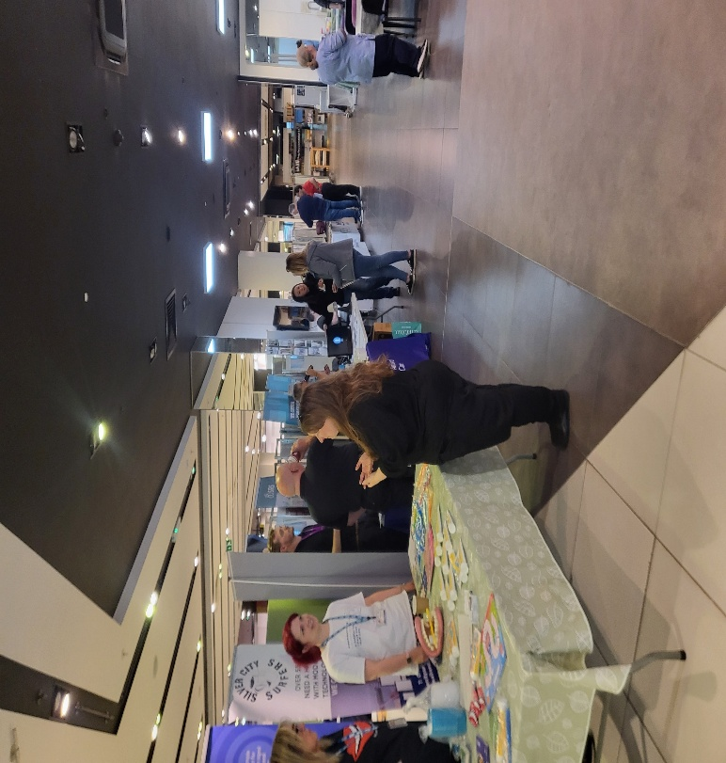
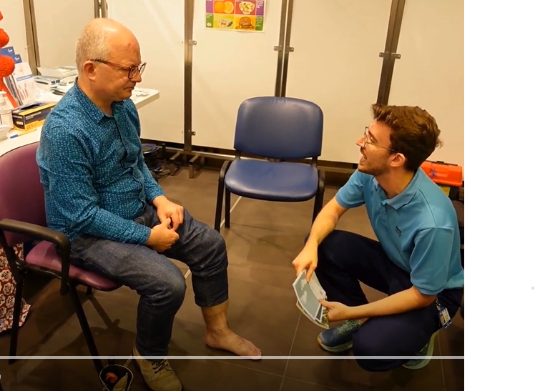

On the Day……
Zone 1
“What matters to you”
Conversation
Zone 2
Market Stalls – Health, Community Partners & Voluntary Organisations
Zone 3
1 to 1 brief discussion with a Podiatrist
Zone 4
Pain Café /
Peer Support
Notes:
The initial part of the day seen patients supported to participate in What Matters to you’ conversations. A conversation which is a structured, open dialogue focused on understanding what truly matters to a person — their needs, values, worries, and what makes a good day — using active listening, curiosity, and follow‑up reflection.
Next stage was visiting the stalls, which also included a Podiatry staff. 3rd stop was an opportunity to meet with a Podiatrist for a brief discussion, no treatment, unless urgent. We learned a 1 to 1 brief discussion with Podiatrist was important for patients, opposed to a general discussion as part of a wider audience.
And finally, possibly one of the most important stops was at the café for a cuppa, biscuit and chat.

Slide 25
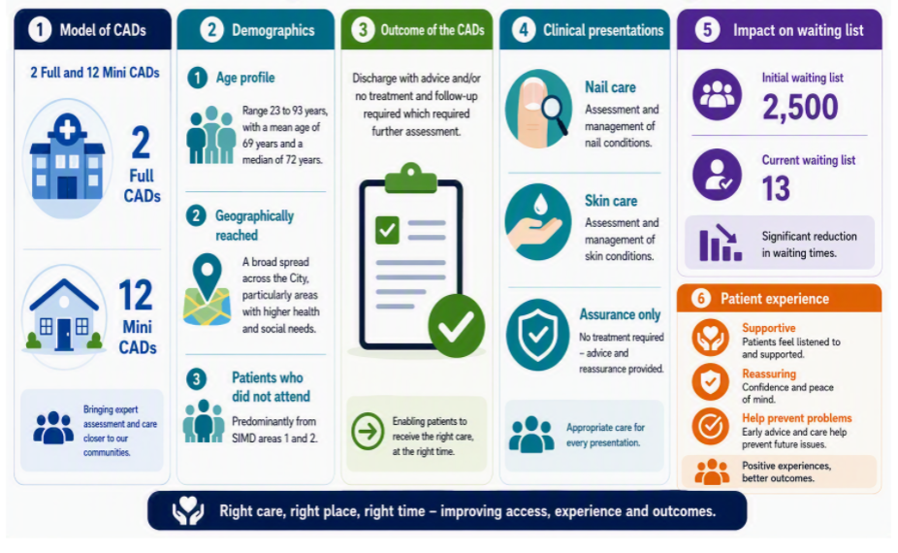
Notes:
Model of CAD – 2 Full CADs specifically dedicated to Podiatry, transitioning to 12 Mini CADS. Driven by patient feedback e.g. smaller groups of patients invited which run in tandem with vaccination programmes.
Demographics – a wide age range of patients attended the CAD city wide. Equally important is those patients who did not attend. It was important to understand data around this cohort of patients, such as the SIIMS. In on attenders this was identified as being 1 and 2. For assurance, patients who did not opt in to attend the CAD were followed up individually.
Outcome of CADs – Approx 68% of patients attending the CAD were discharged with advice, empowered to self manage and/or had treatment completed. The remaining 32% had treatment commenced, follow-up required or referred onwards.
Clinical presentation – Majority (70%) presented with a nail and/or skin condition, this was followed by MSK conditions, and a small percentage with foot ulceration (5%). Interesting, several patients attended to seek assurance they were managing their foot condition appropriately, which suggested further education and support should be available for the public.
Waiting List - One key are of success can be seen in the reduction of the Core General WL. In collaboration with other initiatives such as waiting well calls, and waiting list validation, face to face appts, we seen a significant reduction from approx. 2500 patients (August 2025), to 13 by May 2026.
Patient and Staff Experience - MOVE TO NEXT SLIDE

Slide 26

75% stated their understanding of who can help me if “I can’t manage my personal foot care” is a bit or much better than before.
Really enjoyed the day, a different way of delivering services to patients and supporting the wider community
“ I didn’t realise how much support was available in the community. I’ve come away with a load of information”
“It was reassuring to hear other people’s experiences and know I wasn’t the only one with these concerns”
It is well organised, there’s a good atmosphere. It is useful to meet up with other organisations.
83% would recommend a CAD to a friend of Family member in future
Spoke to a reasonable number of people. There was some quiet spells – Supporting staff were excellent
I learned things I can do at home to look after my feet and help prevent problems in the future”
Large group of colleagues to network with. Plenty of time was given per patient, so was able to resolve some issues on the day
Notes:
Chat through patient and staff feedback. Yellow patients Blue staff.

Slide 27



Successes, Outcomes and Next Steps
Service Improvement and Delivery - Continue to build on the success of CADs and further develop the service. Consider implementing a more locality-based model and extending it to other patient cohorts, such as people with diabetes.
Teamwork and Workforce – Feedback from staff has been overwhelmingly positive. The initiative has created opportunities for closer collaboration, fostered multi-disciplinary team working, and supported workforce development across the service.
Partnership and collaboration – Collaborate and co-produce with public, patients, and wider health and social care teams to deliver a high- quality podiatry service that is sustainable, person centred and responsive to local needs.
Integrated Care Pathways – Collaborate, co-produce and co-create with the public, patients, wider health and social care teams and third sector to develop integrated care and clinical pathways that prioritise prevention and early intervention, while ensuring those with the greatest need receive timely and appropriate care.
Notes:
Chat through the above.

Slide 28


Slide 29
Improving Access to Contraception: Lessons from a LARC Drop-In Pilot

Slide 30
Session Overview
Defining the Challenge
Listening before acting
Collaborative Service Design
What we did
Using real time feedback
Staff Co-designers
What next?
Practical lessons for service transformation

Slide 31
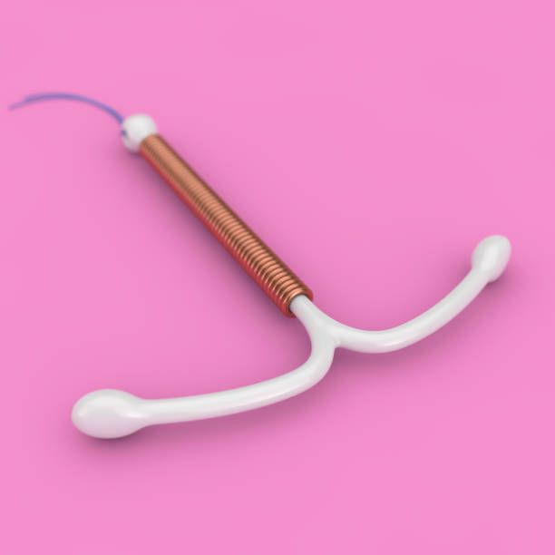



LARC= Long Acting Reversible Contraception
Intrauterine Device (IUD) or 'Coil'
Injection 'Jag'
Implant 'Rod'
Notes:
Long Acting Reversible Contraception (LARC) remains the most effective form of contraception, with the lowest rate of unplanned pregnancy and highest financial impact, with an estimated £1 spent on LARC expected to generate £48 ROI (return on investment)

Slide 32
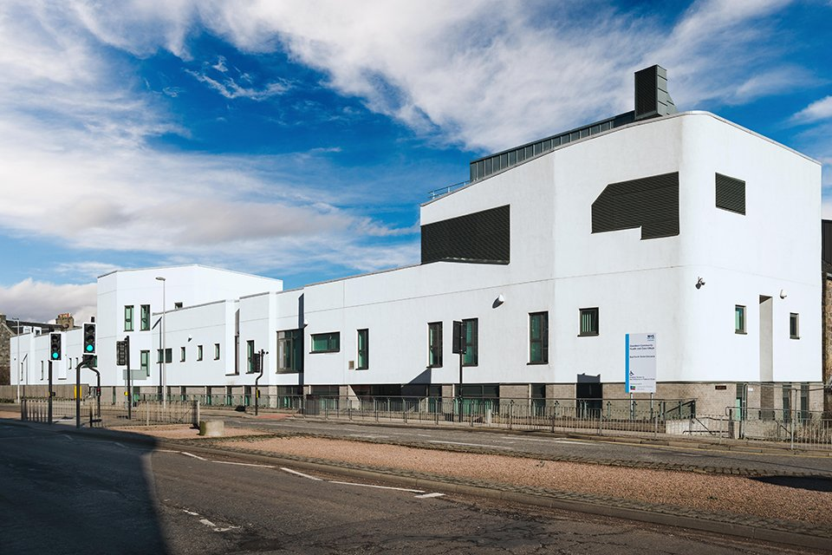
Aberdeen Sexual Health Service
Combined Genitourinary Medicine and Sexual and Reproductive Health Service
Services
Community Gynaecology
HIV Care
GUM
Contraception
Abortion Care
Psychosexual Medicine
Young people
Notes:
Shared referral pathway with Gynaecology
Combined Genitourinary Medicine and Sexual and Reproductive Health Service
NHS Grampian (Shetland and Orkney)

Slide 33
Defining the Challenge
Declining LARC fitting rates across NHS Grampian
Rising abortion rates
Traditional appointment-based clinics - DNA rates of up to 26%
Notes:
Long Acting Reversible Contraception (LARC) remains the most effective form of contraception, with the lowest rate of unplanned pregnancy and highest financial impact, with an estimated £1 spent on LARC expected to generate £48 ROI (return on investment)
LARC insertion rates have not recovered since Covid, especially in primary care in Aberdeen City, and at the same time abortion care demand has increased by >20% in the same time period, with significant impact on service resource. Early data from a rapid access LARC pilot in NHS Lothian has shown this has increased LARC access and uptake. A pilot in NHS Grampian is proposed to trial this process locally to assess impact, especially for those who experience deprivation. If people cannot access contraception when they need it, even high-quality services fail to deliver their intended impact.
Concerns that existing service models were not meeting patient needs

Slide 34

Listening before acting
Pre-pilot questionnaire completed by 126 patients attending routine IUD or implant appointments
  63% would definitely attend a drop-in service
  Evening appointments preferred
Notes:
63% definitely
28% maybe and only 9% responded 'no'
3 key barriers:
Daytime work commitments
Study commitments
Difficulty accessing appointments quickly
Patients helped design the service before it existed.

Slide 35
Collaborative Service Design
Patients identified service acceptability
Clinical team designed model
Staff contributed operational expertise
Continuous feedback informed delivery

Slide 36
What we did
A 4 week pilot
Weekly evening drop-in clinic (5pm to 8pm)
Coil and implant insertion, removal and replacement
Appointment capacity based on available staff skill mix
Evening access
No booking barrier
Walk-in attendance
Notes:
Designing the solution collaboratively
Decribe how:
- Patients identified the need
- Clinical teams designed the model
- Staff contributed operational expertise
- Continuous feedback informed delivery

Slide 37
Results
IUD= 50 appointments
Implants= 25
80 appointments offered over 4 weeks
Demand exceeded capacity every week
Notes:
80 appointments offered
72 procedures completed
Every available appointment used
Demand exceeded capacity every week
Demand far exceeded expectations There was higher demand for IUD appointments, accounting for 72% (n=51) of consultations
Patients consistently arrived before registration opened at 4:45pm.

Slide 38
Results
Notes:
Good uptake across all ages
25% of attendees came from SIMD 1 and 2 areas
These groups experience higher abortion rates
in Grampian
Flexible access models can support equity as well as efficiency.

Slide 39

Use of real time feedback
All patients asked to complete feedback
52 survey responses
96% found the service easy to access
94% would definitely use it again
94% would recommend it to friends and family
89% reported being satisfied or very satisfied
Notes:
Reasons for choosing drop in
Evenign more convenient
Work study childcare commitments

Slide 40
I think everything was perfect. Everyone was so kind and respectful and the lady who did my procedure was brilliant! So so happy that these clinics exist :)
I'm extremely happy about my experience during the drop-in. Staffs were really friendly and professional
No, it was such a smooth process and all professionals were kind and made everything so easy

Slide 41

Use of real time feedback
Improvements made during the pilot
Concerns regarding order of arrival
Managing queues before registration opening

Slide 42
Staff as co-designers
Staff Experience
11 staff responses
82% felt the clinic should continue (with improvements)
73% would definitely work future drop-ins
What Staff Identified
Registration process needed refinement
Communication with patients could be streamlined
Notes:
Successful transformation requires staff feedback to be valued equally with patient feedback.

Slide 43
What next?
A longer pilot of evening clinics (3 months)
But.. with modifications
IUDs only
Move away from drop-in model
On the day bookable appointments
Notes:
What went well and what didn’t

Slide 44
Transformation Toolkit
Start with patient need
01
Test changes on a small scale
02
Measure continuously
03
Use rapid feedback loops
04
Expect to adapt as you learn
05

Slide 45
Key learning points
Flexible service models can improve access
Patients and staff powerful partners in service design
Real-time feedback enables rapid improvement
Small pilots can generate major system learning
Notes:
What happens when we remove barriers rather than asking patients to overcome them?

