Slide 1
The Scottish Approach to Change: Making Change Work in Reality
Notes:
Running order
1330-1335: Welcome and introduction to speakers - Clare Morrison
1335-1345: Context and overview of Scottish Approach to Change - Clare Morrison
1345-1405: Examples from CfSD- Juliette Murray
1405-1415: Examples from HIS- Diana Hekerem
1415-1435: Q&A/What does this mean for delivering sustainable transformation at scale across Scotland? – all (Draw out learning against enablers/elements of Scottish Approach to Change to pull it all together)
1435-1445: Closing - all

Slide 2

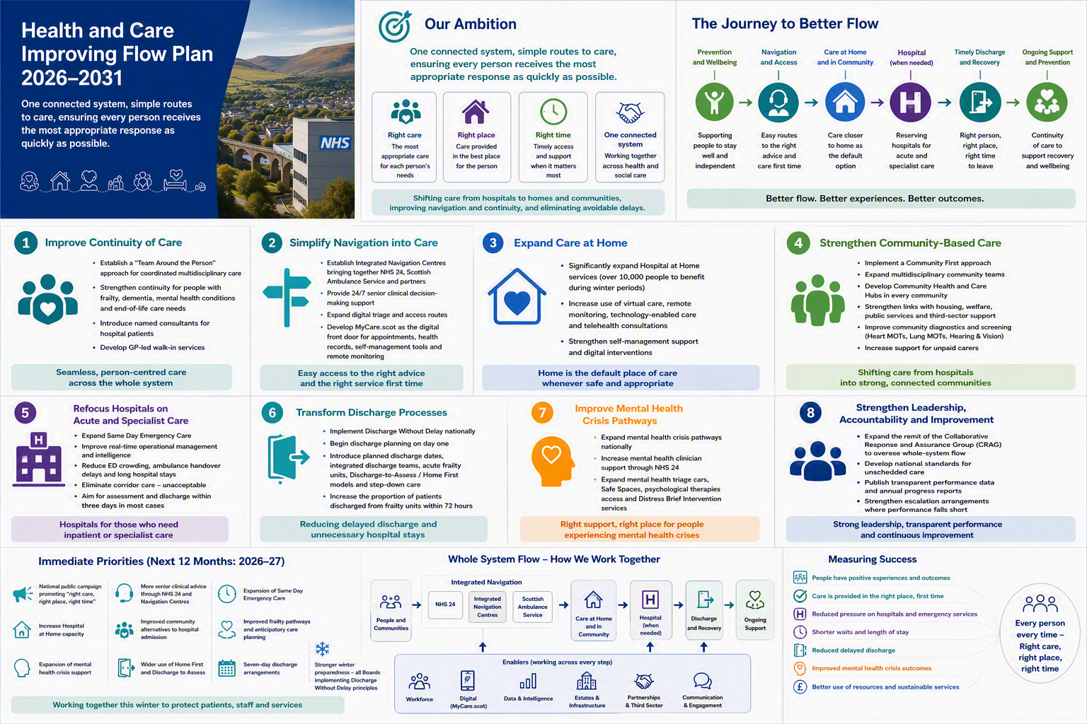
What drives our need for change?
The Scottish Approach to Change is recognised as an integral part of delivering the renewal agenda by providing a clear and coherent method for change.
Notes:
Health and social care organisations are facing an unprecedented volume and pace of change arising from NHS renewal, service challenges, and wider reform. There is a need to respond to three key drivers of change:
Policy direction – the Scottish Government has a clear vision for the future of health and social care in Scotland. This vision prioritises prevention, care designed around people, community delivery, population planning, and digital and technological innovation. This vision is set out in the following documents:
Health and Social Care Renewal Framework
Scotland's Population Health Framework
Scotland’s Public Service Reform Strategy
Resource pressures – health and social care in Scotland is facing ongoing financial constraints and workforce shortages.
Rising demand and need – increasing complexity of care and multi-morbidity means there is an additional pressure to move away from single condition care.
The Scottish Approach to Change is recognised as an integral part of delivering the renewal agenda by providing a clear and coherent method for change.

Slide 3
Building the Scottish Approach to Change: principles
Aims
Maximise the benefits of different change methods
Provide continuity of approach:
  Applicable to any scale and type of change
  Applicable to different settings
  Framework for managing quality and change
Be accessible and understandable by everyone
Be able to drive meaningful change
Notes:
The Scottish Approach to Change has been designed to create a clear pathway to support everyone to do change well. It aims to:
Bring together siloed change methods into a single approach, showing how they can be used together. These include quality improvement, service design, engagement practice, strategic planning and human learning systems.
Be practical – it translate theory into a practical, coherent approach.
Be applicable to any scale of change (from small tests of change to system level transformation) and type of change (e.g. patient safety, digital innovation, etc.).
Be applicable to different health and social care settings (e.g. acute hospitals, community care organisations, etc.).
Be accessible and understandable by everyone working in health and social care, whether or not they have expertise in change methodologies.
Create a universal language and a common approach to foster shared understanding of what is needed to achieve high quality change.

Slide 4
Building the Scottish Approach to Change: evidence base
Diverse improvement priorities
Adaptability, spread and sustainability
Capacity, capability and culture
Notes:
We know from our evidence base that how you do change matters.
Diverse improvement priorities
The evidence is clear that when people don't have rigour and structure to how they do change this results in multiple improvement priorities. This means that nothing really gets get changed. People can get lost and change fatigue becomes incredibly high.
Adaptability, spread and sustainability
The common challenge we see in lots of improvement work is that people see a good thing that's happening over there and want to copy it.
The idea that you can just see a good thing and have it everywhere presents us with real challenges. There is a need to adapt to local needs and to understand what it is you're trying to spread and why. There is a need to build change in within the local system to create sustainability, so that the service will work and be able to be funded as it goes forward.
Capacity, capability and culture
There is a need for institutional capacity, capability and culture for change. We need to support people to do change well and have access to the right skills and tools.
We need to support a culture that is person-centred, thoughtful, and that embodies collaborative leadership while taking a rigorous approach.

Slide 5
Building the Scottish Approach to Change: approach
We have built the Scottish Approach to Change through:
Being curious
Learning and adapting as we go
Involving and engaging a wide range of stakeholders
Drawing on real world experience (including from our pathfinder sites)
Collaboration with partners
This has been built with the same ethos we hope people will use for doing change

Slide 6
Scottish Approach to Change
Notes:
What and why
Health and social care organisations are facing an unprecedented volume and pace of change arising from NHS renewal, service challenges, and wider reform: many people feel overwhelmed. The number of methods and tools used for change is huge, and there is significant variation in the adoption of different change methods between health and social care organisations.
The Scottish Approach to Change helps make sense of this chaos by:
- creating a clear pathway to support everyone to do change well
- bringing together siloed change methods into a single approach, showing how they can be used together – these include quality improvement, service design, engagement practice, strategic planning, and human learning systems
- translating theory into a practical, coherent, decision-support tool
creating a universal language and a common approach to foster shared understanding of what is needed to achieve high quality change across professions and organisations.
The Scottish Approach to Change can be used as:
- a practical approach to manage discreet change projects at any level
- a framework for managing quality and change at an organisational level based on aligning a vision, whole-system thinking, empowering staff, and delivering high-quality equitable services.
The Scottish Approach to Change is made up of three parts - steps, enablers and quality management system. It is crucial they all work together and are applied consistently.
The five enablers of quality and change create the conditions that support successful and sustainable improvement. They do this by aligning people, processes, and leadership around a shared purpose.
The eight steps of change provide a practical, structured approach to achieving successful change.
Background
Scottish Government commissioned Healthcare Improvement Scotland (HIS) to develop the Scottish Approach to Change in 2024 to develop a clear and coherent methodology to underpin NHS Renewal.
It is aligned with the Scottish Government’s Health and Social Care Service Renewal Framework, published in June 2025. The Scottish Approach to Change was approved as the delivery mechanism for change by NHS board chief executives and Health and Social Care Partnership (HSCP) chief officers in October 2025.
This work contributes to HIS’s strategic function of providing improvement and redesign support for health and care, and the strategic priority of delivering support to accelerate the delivery of sustainable improvements in healthcare.
Phase 1 defined a high-level framework for change, consolidating what is known already. Phase 2 formally launched the framework and established a more detail approach to change. Phase 3 is focussing on embedding it across Scotland and its continual development through practical tools and resources to support its use.
Introducing the Scottish Approach to Change
There is often an implementation gap between policy ambitions and reality. Evidence shows that a significant contributing factor to this is that change is not always done well in health and social care. The Scottish Government commissioned HIS to develop a Scottish Approach to change to underpin delivery of health and social care renewal and reform.
The Scottish Approach to Change aims to:
Create a clear pathway to support everyone to do change well
It does this by:
Bringing together siloed change methods into a single approach, showing how they can be used together
Translating theory into a practical, coherent tool
Creating a universal language for change
The Scottish Approach to Change can be used to:
Manage discreet change projects
Provide an organisational framework for managing quality and change
The Scottish Approach to Change includes an approach to quality management, five enablers, and eight steps. Together, they create strong support for successful and lasting change.

Slide 7
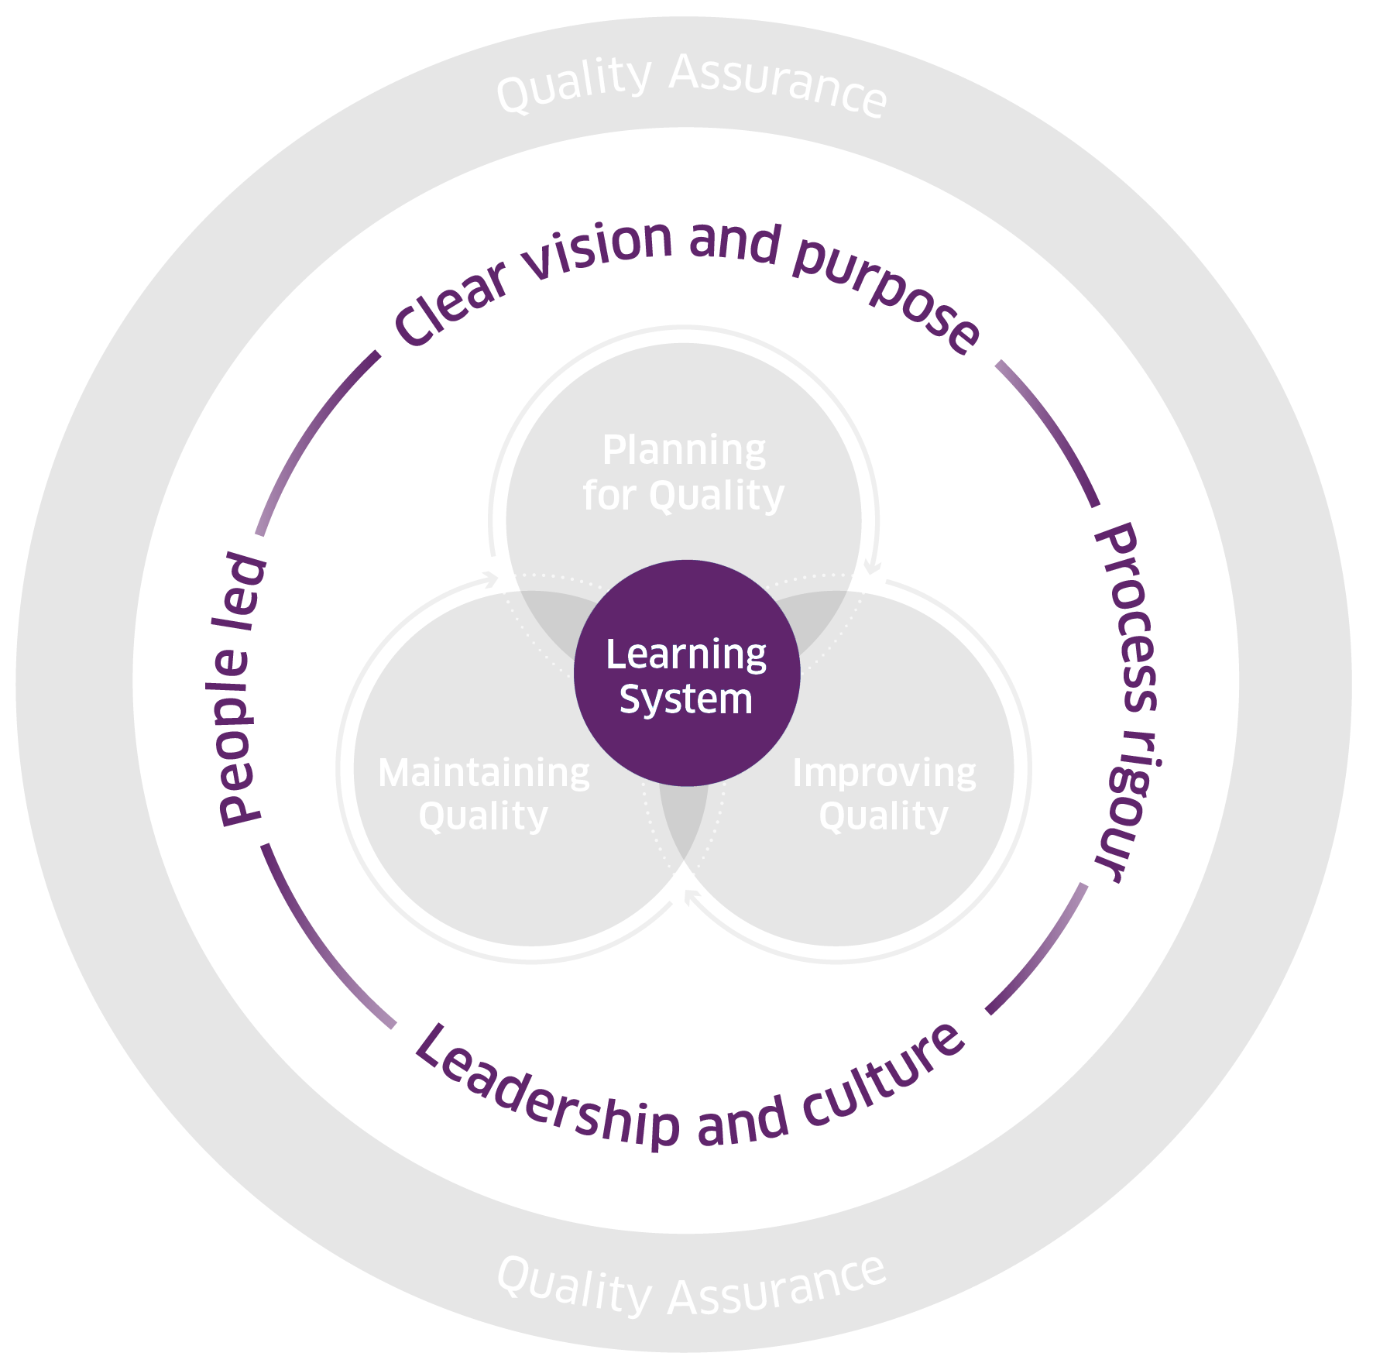
Scottish Approach to Change: enablers
Clear vision and purpose – providing direction, motivation, and alignment
Leadership and culture – setting a vision, and inspiring and empowering others
People led – meaningfully engaging and involving people to help meet their needs
Process rigour – going through a structured process to ensure high-quality outcomes
Learning system – sharing learning and knowledge to support improvement and better outcomes
© Healthcare Improvement Scotland. Published: 2025
Notes:
The five enablers of quality and change create the conditions that support successful and sustainable improvement. They do this by aligning people, processes, and leadership around a shared purpose. These must all be in place for successful change.
The enablers are:
Define a clear vision and purpose that drives your change. It unites us and builds momentum behind a single direction, and is tangible and actionable, it doesn’t shy away from hard choices.
Outline a rigorous approach to how you understand change. It adds clarity to we are doing, when and why - it brings calm to the noise of change, and helps increase our confidence in decision making, supporting momentum in uncertainty and complexity.
Create the conditions for change to thrive through setting the right culture and leadership. It sets the vision, empowers others and unblocks barriers to change, and sees leaders stepping into change, playing an active role.
Take a people-led approach by inviting people to design and deliver change together. It values meaningful engagement as vital, not an additional ‘thing to do’, people articulating their own needs and supports them to do so meaningfully, and the needs of people over the needs of the system - services belong to people.
Embed a learning culture to support your change programme sustainably. It is a superpower – it unlocks knowledge, solutions, energy, momentum and brilliance, and requires commitment, it challenges our engrained values and behaviours, and needs continued practice.
Evidence shows that without these enablers, change can:
Face more systemic challenges and organisational barriers
Struggle to gain support and make progress
Be more challenging to sustain over time
Successful change relies on having all five enablers in place.

Slide 8
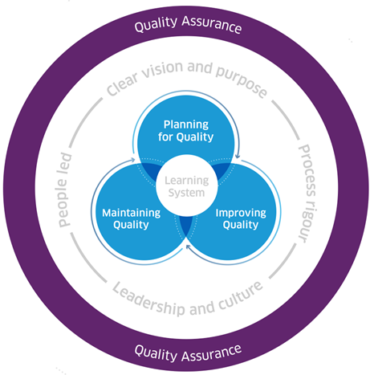
Scottish Approach to Change: Quality Management
Notes:
Quality management supports delivery of high-quality care in health and social care organisations.
It is essential to both day-to-day operations and the delivery of effective change.
Quality management is a coordinated and interconnected approach to:
Planning for quality – proactive planning and prioritisation of services and processes
Improving quality – a systematic and coordinated approach to making services or processes better
Maintaining quality – routine monitoring to assess and maintain performance
Quality assurance – internal and external processes to ensure services are operating effectively and providing quality care

Slide 9
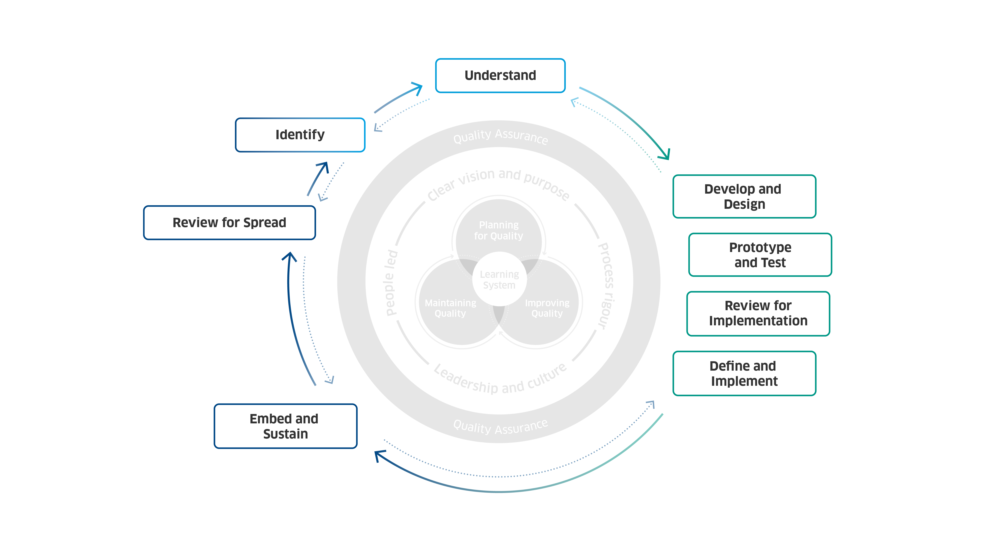
Scottish Approach to Change: steps
Notes:
The eight steps of change provide a practical, structured approach to achieving successful change. These are:
Identify: Identifying the need for change can come from many sources. You can learn from staff, service users, new technologies, or updates in policy and strategy.
Understand: Understanding the challenge or opportunity you have found is key. It helps you choose the best option for change and guides your approach to making it happen.
Develop and design: Developing and designing your options and collaborating with others to develop better solutions.
Prototype and test: Prototyping and testing what works and what does not work, allowing you to continue improving and refining your change.
Review for implementation: Reviewing for implementation to reflect on where you are and deciding how you want to continue.
Define and implement: Defining and implementing how you will support teams in enabling that change as part of business as usual.
Embed and sustain: Embedding and sustaining as part of routine and culture.

Slide 10

Ongoing development

Slide 11

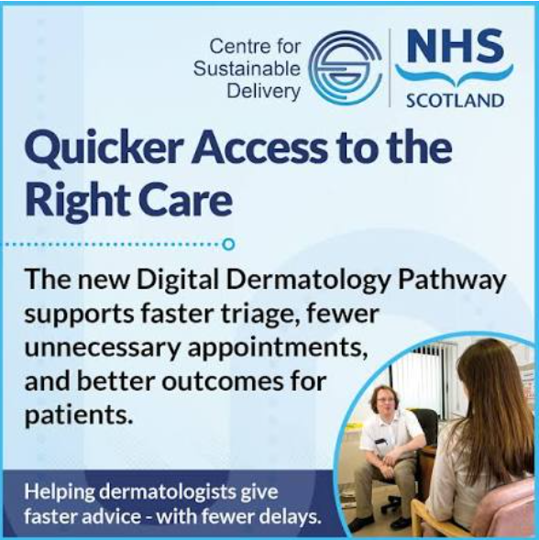
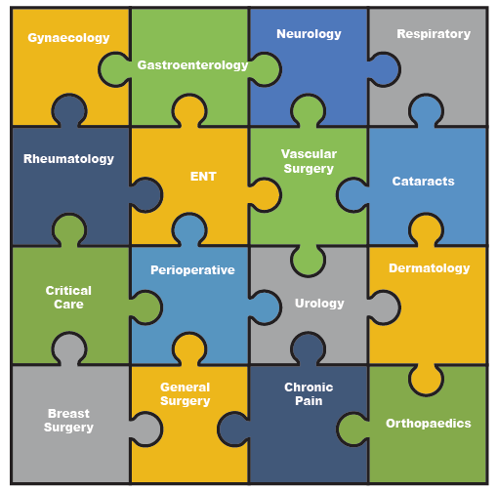


Specialty Delivery Group Model
Shared purpose/vision
Adequate leadership time
Spread of innovation
Programme delivery
Meaningful measurement
Stakeholder engagement
Sharing learning and
improvements
between teams
Endoscopy

Slide 12
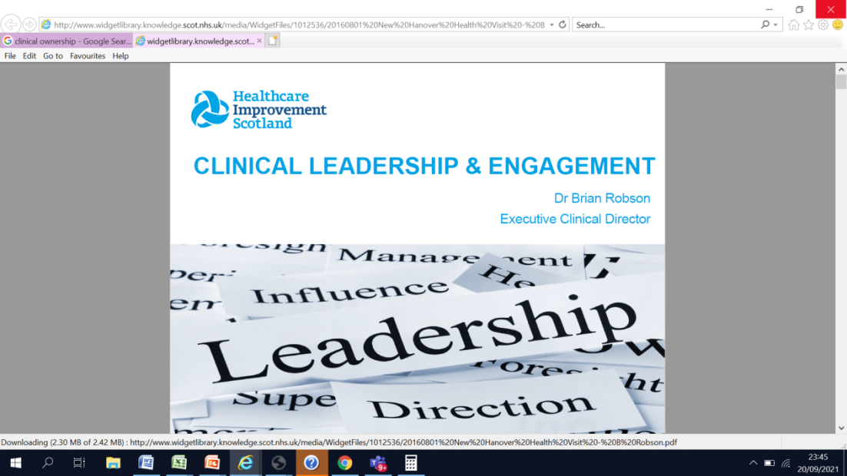
Leadership and Clinical Ownership
Monthly service development groups by specialty
Multidisciplinary – all team members of the service
Involve finance team, manage own budget
Use data to drive improvements
Share learning between teams
Promote new ways of working
Develop role extension
Ensure clinical leads have enough time to do
their role properly especially job planning
Monthly service development groups by specialty
Multidisciplinary – all team members of the service
Involve finance team, manage own budget
Use data to drive improvements
Share learning between teams
Promote new ways of working
Develop role extension
Ensure clinical leads have enough time to
do their role properly especially job planning

Slide 13
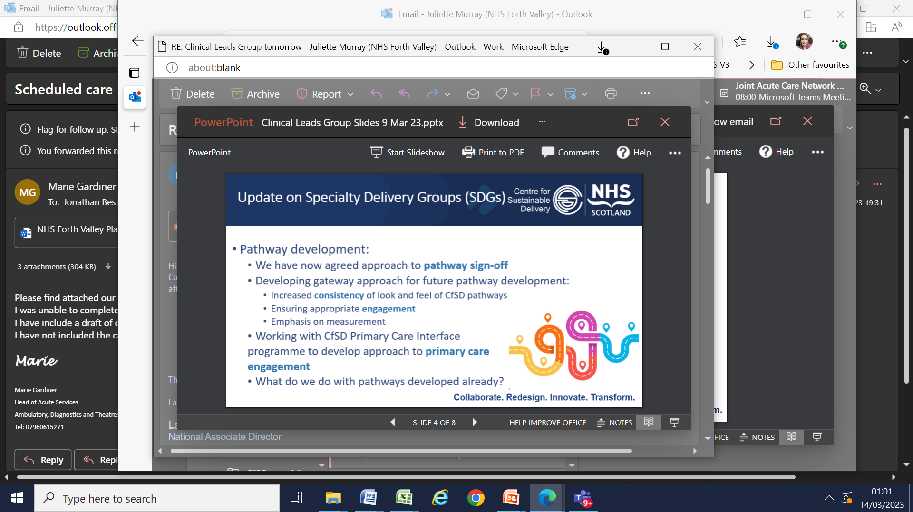
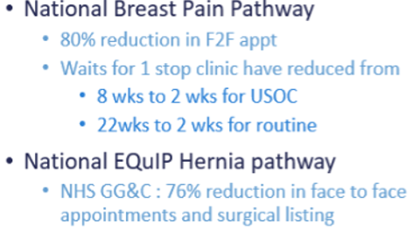
Leadership and Clinical Ownership
Monthly service development groups by specialty
Multidisciplinary – all team members of the service
Involve finance team, manage own budget
Use data to drive improvements
Share learning between teams
Promote new ways of working
Develop role extension
Ensure clinical leads have enough time to do
their role properly especially job planning
Develop pathways nationally
Locally customise if needed
Co-design with primary care colleagues
Utilise ref help resource
Embed realistic medicine principles
Ensure pathways easy to see and use
Develop resources to give advice to patients
Use opt in where possible

Slide 14
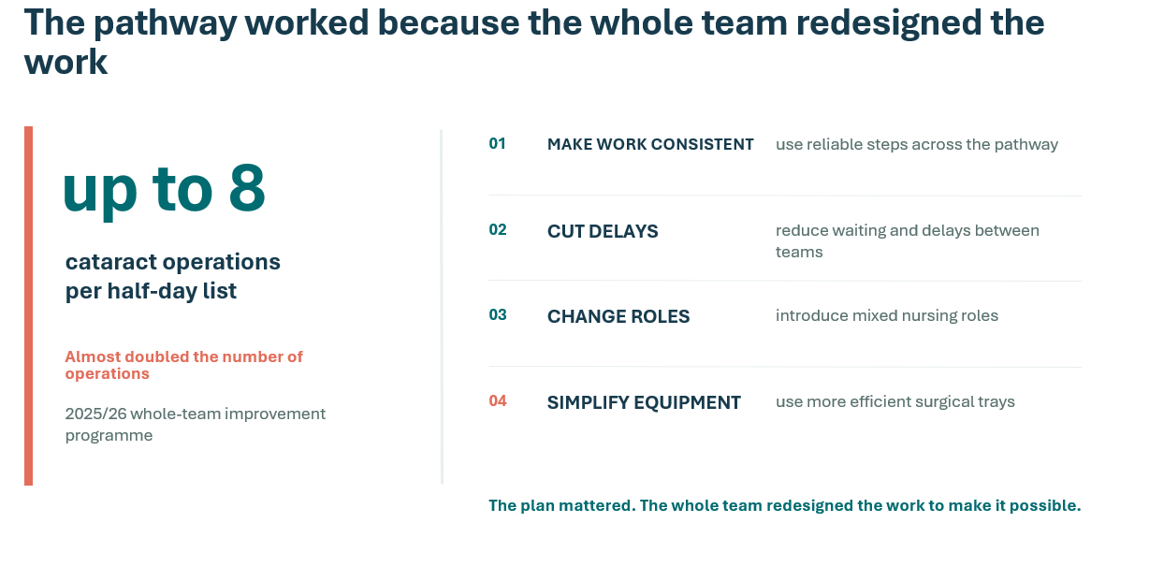

Cataract Improvement Project - Clinical Ownership

Slide 15
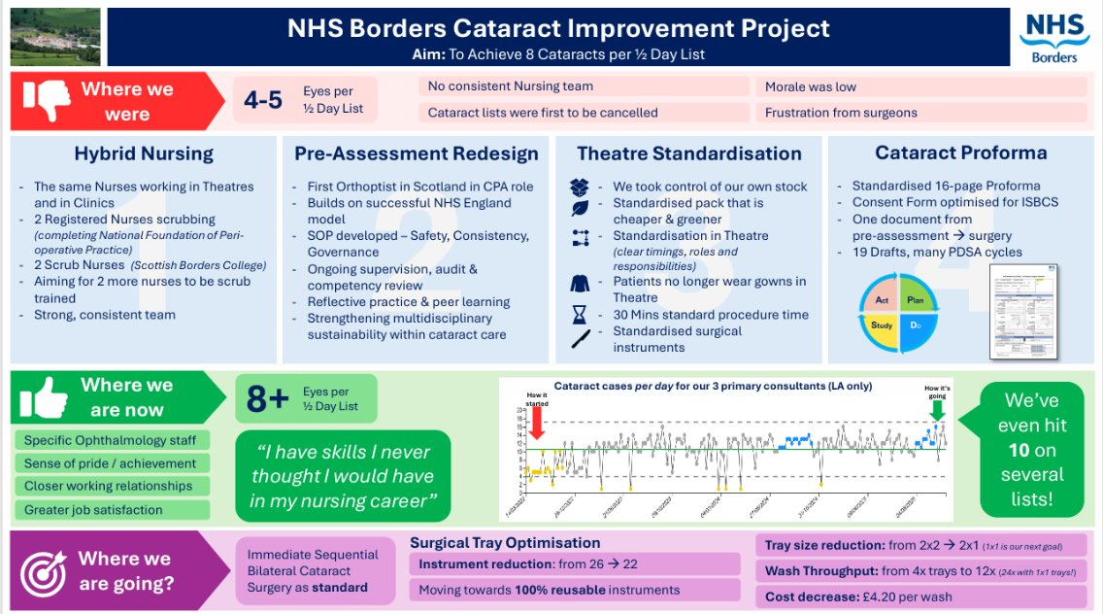
Cataract Capacity Doubled

Slide 16
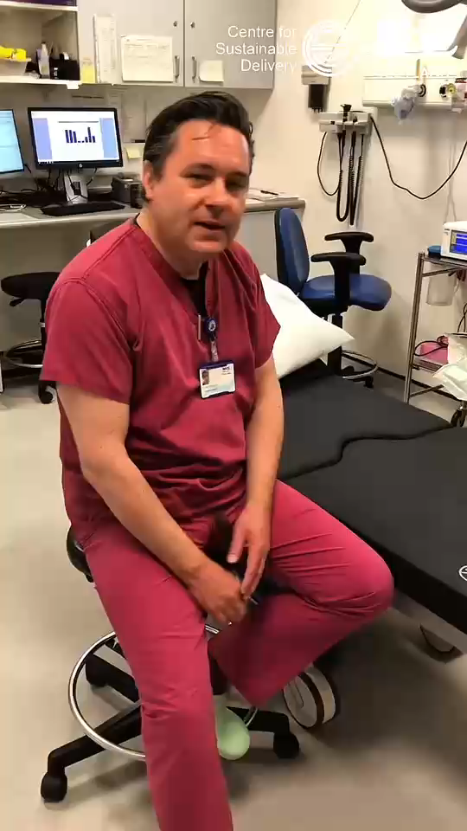

Surgical Care Practitioners
long waits for high volume low
complexity surgery and clinic apps
workforce shortages
trial of new model of workforce

Slide 17
REALITY
Across different services, the same four needs return:
01
CLINICAL TRUST
Do the right people believe this is the right change?
is where change becomes real
02
LOCAL OWNERSHIP
Can teams shape how it works in their service?
These lessons come from CfSD's work with clinical teams
and Boards across Scotland.
03
TIME + SUPPORT
Do people have time, skills and the right tools?
04
VISIBLE LEARNING
Can teams see what helps—and what creates extra work?
Source: CfSD delivery learning across NHS Scotland programmes
Notes:
TIMING: 1:30 (total 2:00)
WHAT TO SAY: Across CfSD's work, four needs return again and again. First, clinical trust: the people affected must believe the change is right. Second, local ownership: Boards and teams need room to make it work in their setting. Third, time and support: change cannot simply be added to already full jobs. Fourth, visible learning: teams need quick feedback on results, use and extra work.
KEY LINE: Different services need different solutions, but these four needs are remarkably consistent.
NEXT: Leadership and culture decide whether those needs are met.

Slide 18
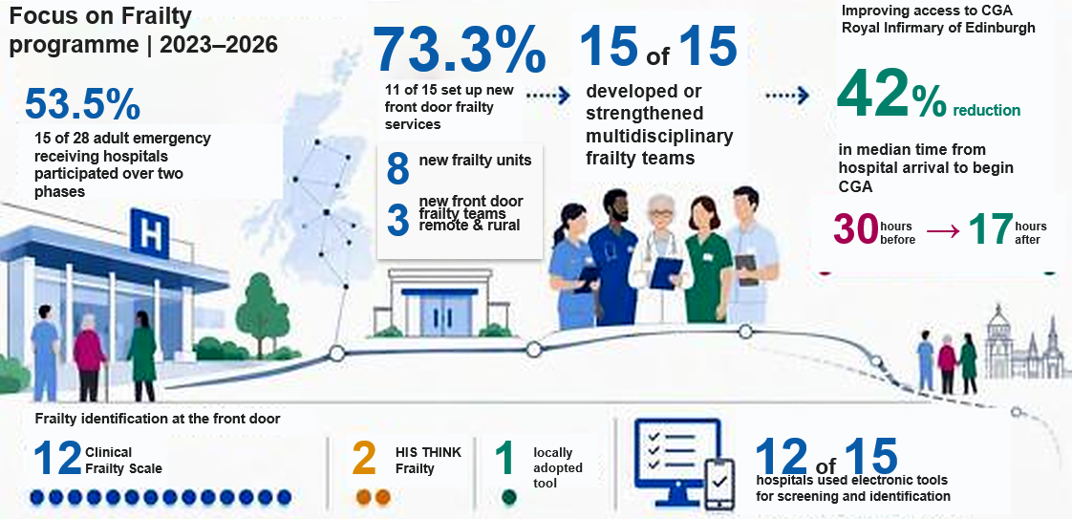
Focus on Frailty
Notes:
This is the high level impact for acute
Between 2023 and 2026, more than half of Scotland’s adult emergency receiving hospitals (53.5%, 15/28) participated in the Focus on Frailty programme over two phases. Of the 15 participating hospitals, 73.3% (11/15) set up new front door frailty services including eight new frailty units. The remaining four participating hospitals built on existing front door frailty services, enhancing these and strengthening integration across local care pathways.
All 15 sites developed or strengthened their multidisciplinary frailty teams at the front door within unscheduled care, improving access to CGA. One example of xxx [insert RIE time to CGA data]included the development of a dedicated Emergency Department Frailty team at the Royal Infirmary of Edinburgh, which contributed to a 42% reduction in the median time taken from hospital arrival, for an older patient living with frailty to begin CGA (30 hours before to 17 hours after intervention).
Frailty identification
All acute sites had or developed a process for identification of frailty at the front door. In 12 hospitals, the tool used was Clinical Frailty Scale, two used HIS THINK Frailty and one used a locally adapted tool. In 12 of 15 hospitals, electronic tools supported screening and identification.

Slide 19
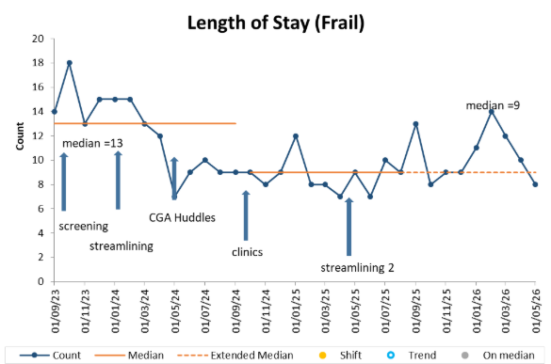
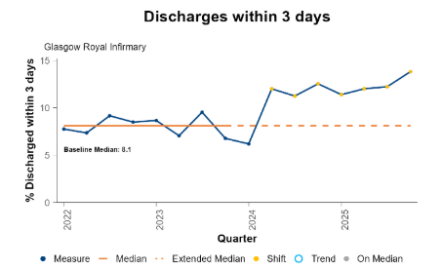
Focus on Frailty
Improved identification of frailty
Dedicated frailty unit
Multidisciplinary CGA
Integration with community
Improved of frailty
OUTCOME
OUTCOME
13 → 9
72h
days
Increase in discharges to a homely setting
median length
of stay
✓
No change in readmissions
Notes:
Glasgow Royal Infirmary

Slide 20
Focus on Frailty
Holistic assessment and person-centred support
81%
73%
77%
78%
11%
of people (130/160)
with moderate to severe frailty had holistic assessment
Falkirk
of people (244/355)
OT wellbeing reviews
of people
of medicines
referred to district nursing living with severe frailty had a holistic assessment
of people who had a wellbeing review reported improved wellbeing
who had a wellbeing review reduced their GP appointments
deprescribed after review
South Ayrshire
South Ayrshire
South Ayrshire
Dumfries and Galloway

Slide 21



Mental Health Transformation - Early Intervention in Psychosis
Quickly and easily access
services
Experience evidence
based person-centred
care and treatment
Have an increased
likelihood of getting
well and staying well
96% of people identified within these areas were treated within 14 days
Over 50% of people in treatment in these services for more than 6 months are in employment, education and training
Substantially lower readmissions for the Early Intervention in Psychosis services compared to their NHS board mental health readmission rates
“Both me and my mum have accessed mental health services in the past. [The Early Intervention in Psychosis Service] has given me more clarification of my illness, more understanding of what to do and why. [It] has been more nurturing and supportive” Early Intervention in Psychosis Service User
Notes:
The Early Intervention in Psychosis programme has supported the set up of new mental health services in three areas of Scotland so that people experiencing first episode psychosis can… see detail on slide

Slide 22



Mental Health Transformation - Delayed Discharge
Strengthening
communication across
multidisciplinary teams
Starting discharge
planning earlier
Improving escalation
processes for complex cases
Sustained reductions in delayed discharges at both sites with reductions between 35% and 46%
“[it's helping] us to challenge what we think is fact in an environment that creates space to reflect, challenge thinking and find solutions. It’s been a collaborative learning journey with fantastic outcomes." Senior Charge Nurse User
Notes:
As part of Scotland’s national mission to reduce delayed discharges, the responsive support team worked with two hospitals to improve patient flow and support timely transitions from mental health inpatient care.
Teams embedded three key improvements:
strengthening communication across multidisciplinary teams,
starting discharge planning earlier, and
improving escalation processes for complex cases.
The work resulted in sustained reductions in delayed discharges at both sites with reductions between 35% and 46%.

Slide 23
Questions and answers

Slide 24




Available support from Scottish Approach to Change team
Digital resource provides detailed guidance, tools, resources, and case studies to help you use the Scottish Approach to Change.
Scottish Approach to Change learning community to access our learning events (including webinars, reflective practice, and project surgery sessions) and to receive information, advice, and peer support on using the Scottish Approach to Change.
Provision of direct tailored support for NHS boards and HSCPs who are looking to embed the Scottish Approach to Change – local areas can express an interest in receiving support by contacting his.satc@nhs.scot.
Education and training offers are being considered to support the Scottish Approach to Change - until then support can be found on the various methods included in the Scottish Approach to Change on the education and training page.

Slide 25
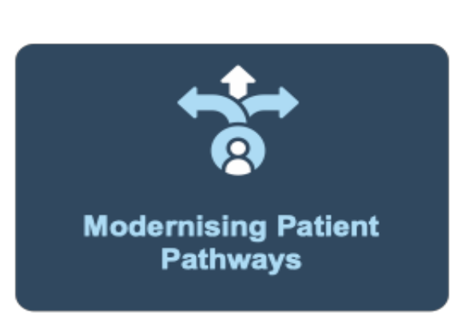
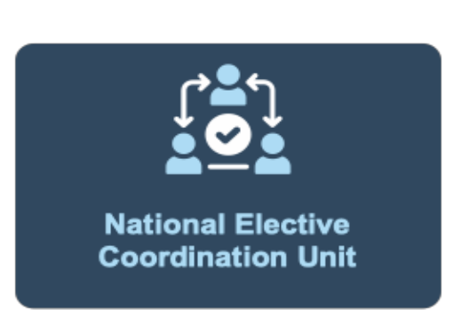






Available support from Centre for Sustainable Delivery team
Our programmes
Modernising Patient Pathways
National Elective Coordination Unit
Innovation
Cancer Improvement and Earlier Diagnosis
Green Healthcare Scotland Programme
National Unscheduled Care Programme
National Planned Care Programme
National Endoscopy Programme
Centre for Sustainable Delivery website - www.nhscfsd.co.uk
Right Decision Service - www.rightdecisions.scot.nhs.uk
Contact us on - www.nhscfsd.co.uk/contact-us

