Slide 1
Beyond technology:
Digital transformation in action

Slide 2
Beyond Technology:
Digital transformation in action
Chal Chute, Digital Health & Care Innovation Centre (Chair)
Greg Thomson, Public Services Delivery Scotland (MyCare.scot)
Rowen Paton and Carol Ruth, NHS Greater Glasgow and Clyde
(Digital Clinical Notes)

Slide 3


Beyond the technology
Connecting people, services and information

Slide 4



MyCare
Digital Front Door
Digital Front Door (DFD) is a national transformation programme to make health and social care easier to access, easier to navigate and easier to manage for people across Scotland.
This will mainly be achieved via MyCare.scot, which is building a secure, consistent and person-centred digital route for people to access information, services and their personal data.
Transforming how we experience health and care. MyCare, in my hands.
02
Notes:
Digital Front Door (DFD) is a national transformation programme to make health and social care easier to access, easier to navigate and easier to manage for people across Scotland
This will mainly be achieved via MyCare.scot, where a secure, consistent and person-centred digital route will exist for people to access information, services and their personal data. Non-digital routes will also be retained or if necessary, created for those who need them,
[Mention Programme for Government, Service Renewal Framework, SG and COSLA strategies, in particular DHAC]
It supports Scotland’s key Health and Social Care strategies and ambitions by improving access, reducing complexity, enabling more proactive care and creating a platform for future service transformation.
Transforming how we experience health and care. MyCare, in my hands.

Slide 5

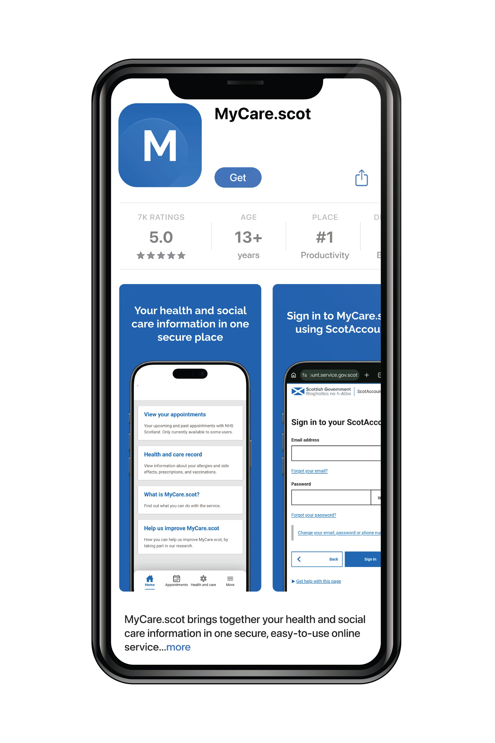
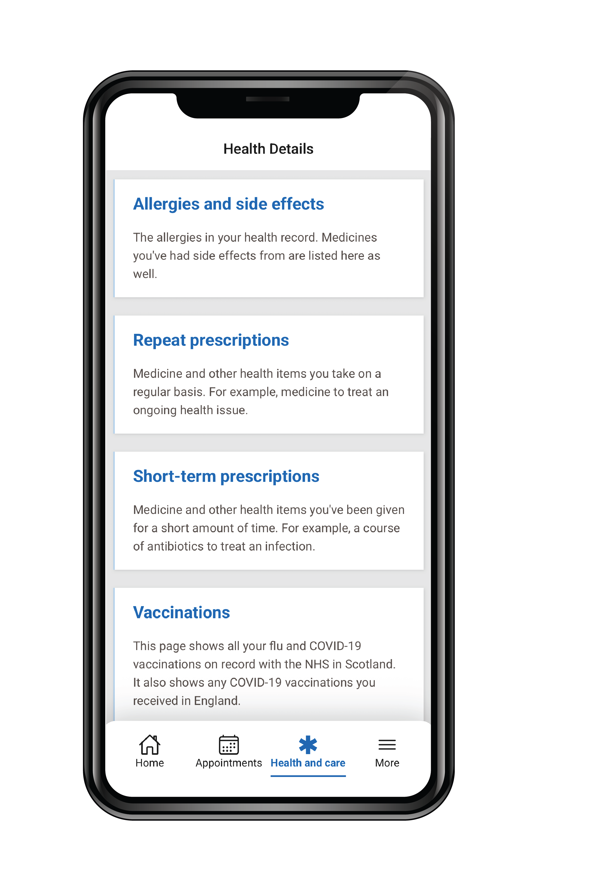
MyCare
What is MyCare.scot?
MyCare.scot is a secure online service where people can access their health and social care information.
It’s the first step toward giving people more choice in how, when and where they find the information they need.
03
Notes:
So what actually is MyCare.scot?
It's a secure online service where people can access their own health and social care information, in one place.
People aged 18 and over can use MyCare.scot on the web or download the mobile app to view a selection of their health and social care information.
It’s designed to offer an additional way to see key information, rather than replace existing routes, to make sure access to information is inclusive and flexible.
MyCare.scot gives people more choice and access to their information, so they can actively manage their health and care when, where and how they want.
[ANY OTHER MENTION OF BENEFITS – FOR PEOPLE AND SERVICES]
[MyCare.scot is being built and released in stages – functionality will continue to develop over time. As more people use the service and provide feedback, more information will be added. ]

Slide 6
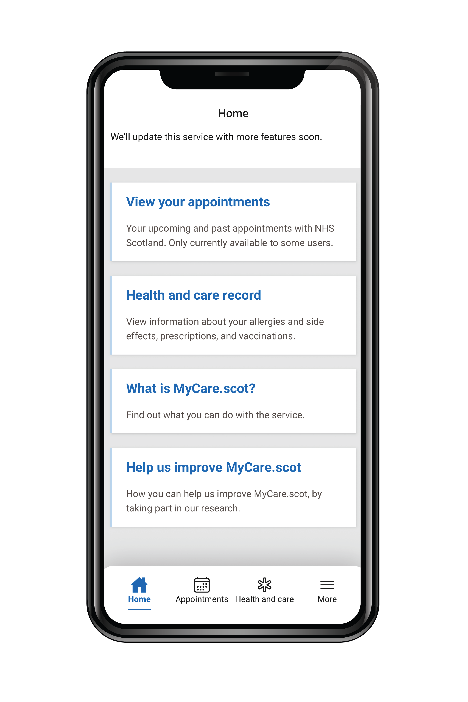
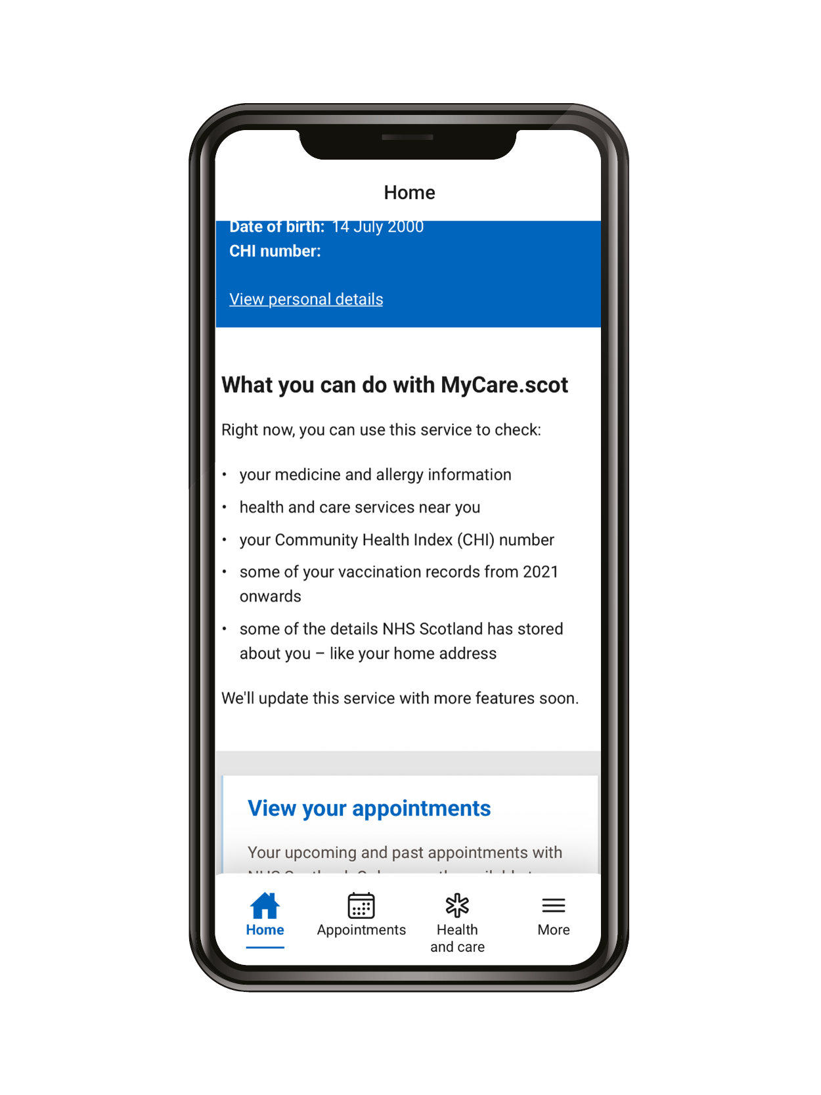
MyCare
Using MyCare.scot today
Identity
Secure login using ScotAccount
Health & care record
View Flu and Covid-19 vaccinations, medicines and allergies
Demographics
View personal information, including CHI number
Service finder
Links to useful information
Appointments
View upcoming new routine appointments
Digital communications
Receive letters, notifications & messages
04
Notes:
[CURRENT FEATURES] So what can people do right now using MyCare.scot right now?
From earlier this year, people 18 and over in Scotland can use MyCare.scot to see key information, including their Community Health Index (CHI) number, some personal details, medication and allergy information, some vaccination records, and local health and wellbeing services.
Access is protected through ScotAccount identity verification, using the same safeguards already applied to health and social care information.
Current features
Invitation to onboard and login using ScotAccount
Users can view their medication, allergies and certain vaccinations
Also utilise service finder
[EXPLAIN SCCA CLEARLY, IN ACCESSIBLE LANGUAGE – AND HOW IT WILL BENEFIT PUBLIC] Access to appointments and the digital mailbox is only available in Dermatology in NHS Lanarkshire, but will scale up later this FY, once Boards\Regions implement this through specialties
Meds and Allergies info from ECS, Vaccination info from NCDS, demographics from CHI, Service Finder via API from NHS24, ScotAccount and Digital Comms Mailbox provided by SG Digital, Appts from Trak

Slide 7

MyCare
Current priorities
Secondary care appointments and communications
Social work / social care
Maintenance and improvements of the live service
'Discovery' work for new or enhanced features
05
Notes:
Current priorities:
Maintenance of live service – priority updates to maintain and improve the existing live service
National solution for secondary care appointments and communications [explain what we mean by this – inc timescales etc]
Exploring possible services and features in relation to social work and social care – e.g. signposting, AboutMe,ALISS integration [explain what we mean by this]
[This is for H&SC, so different to NHS App in England]
Discovery work that will lead to delivery of new or enhanced features at a later date [ such as – could be good to highlight long term ambition here]
[Discovery work across many areas and aligning to learning from NHSE and NHS Wales (where relevant)
3.
4.

Slide 8
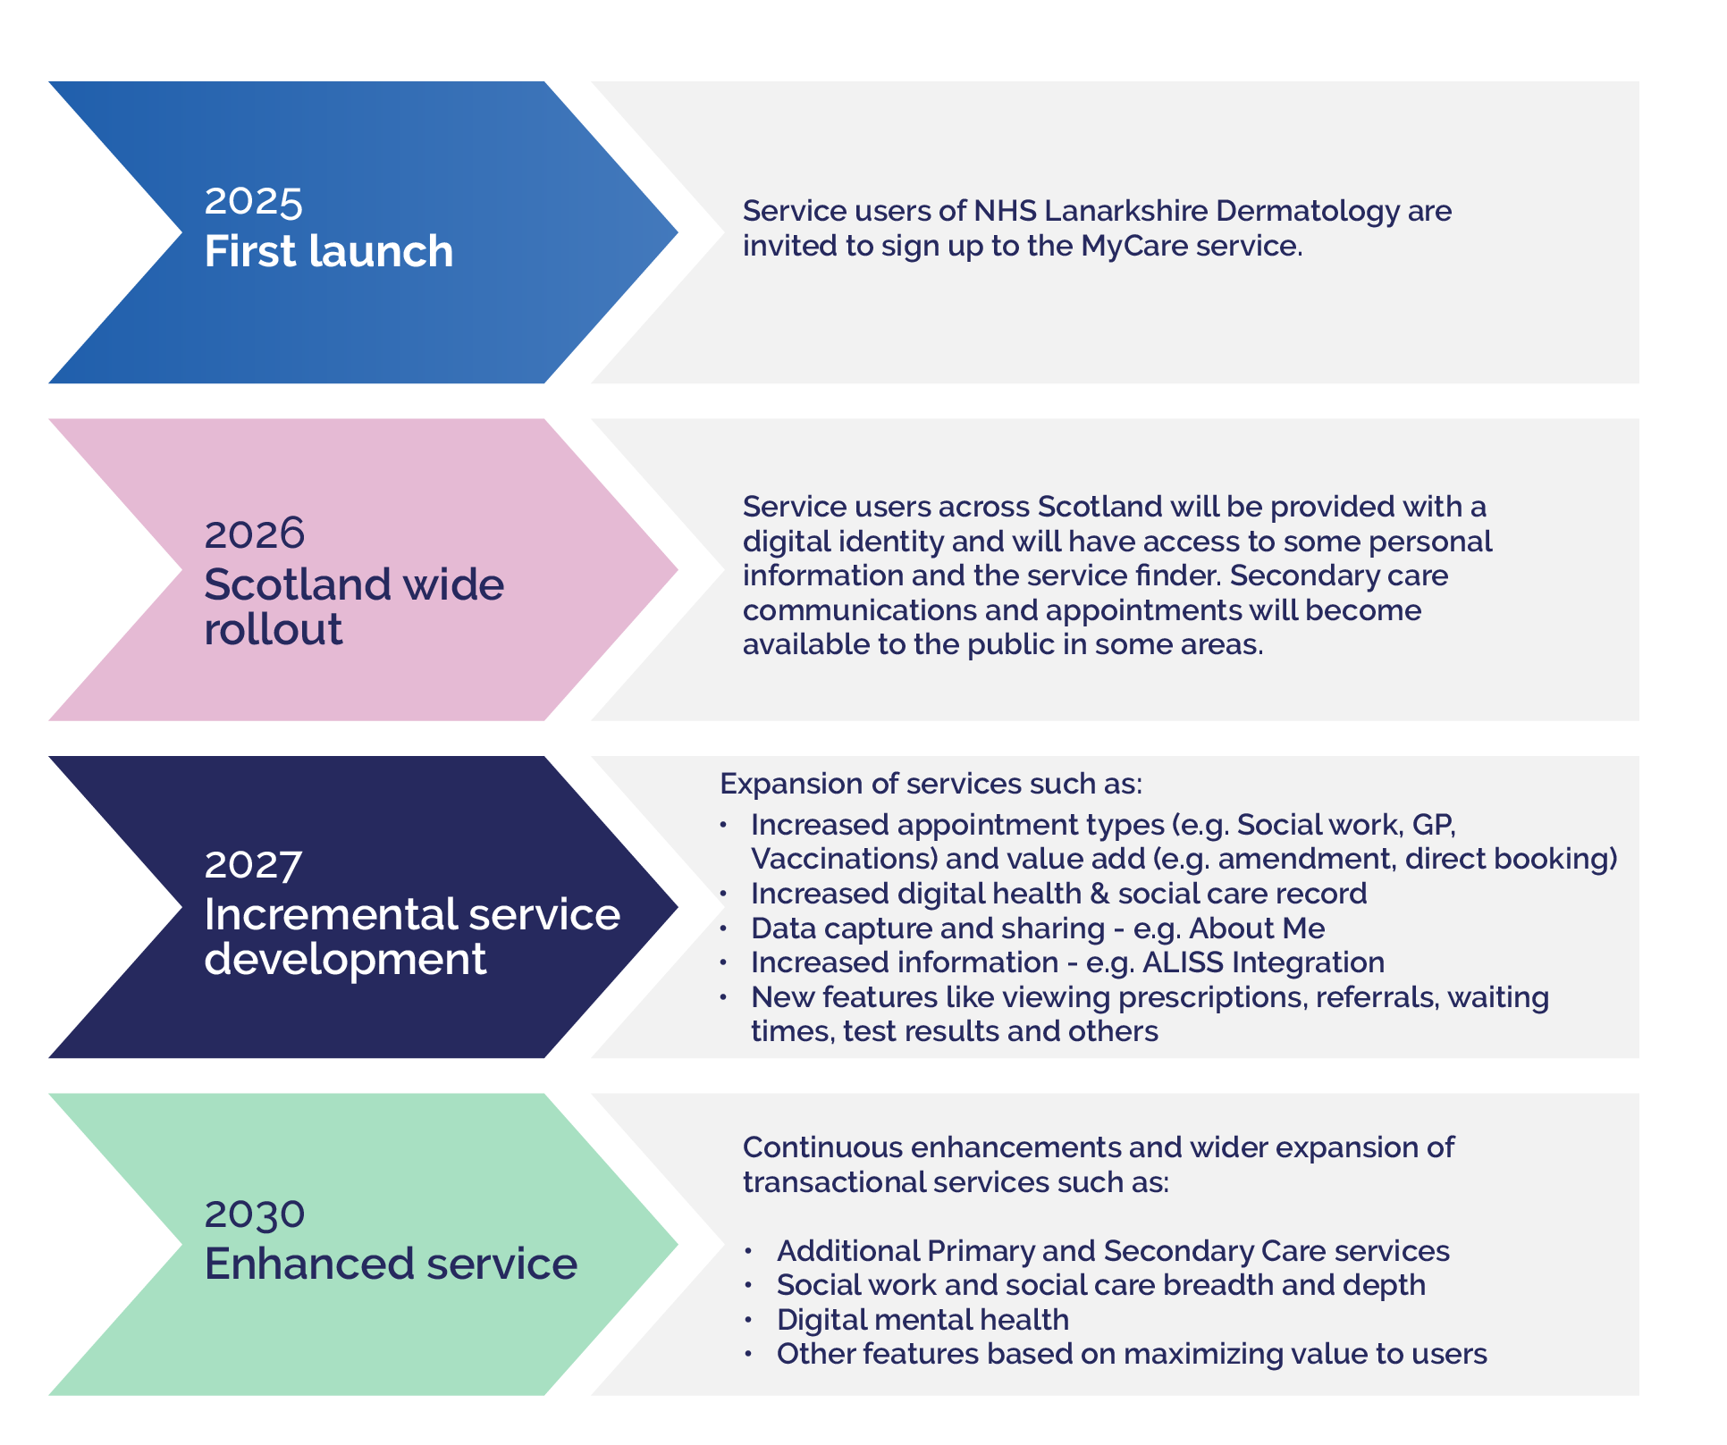
MyCare
Our roadmap
06
Notes:
This isn’t a build-it-once-and-then-it’s-done task. Over the years ahead there’s lots of potential, and lots to do.
A continually maintained DFD product roadmap shows the timeline of ongoing enhancements of DFD capabilities and features, as well as new service areas
We will identify and prioritise additional service areas and features collaboratively
Endless opportunities exist to utilise MyCare.scot to support service users, so prioritisation of greatest impacts will inform the ongoing evolution

Slide 9

MyCare
Key challenges
Change in culture
Trust
Adding value quickly
Implementation
This isn’t a digital programme.
It’s a complex transformation programme with digital at the core.
07
Notes:
Key challenges
Change in culture – public and workforce
Trust – ensuring data is secure and the public are confident to use MyCare.scot
Adding value quickly – to increase engagement
Implementation – change to existing processes and at times policy to enable transformation, realisation of benefits and most importantly, a user experience that truly makes a difference
In summary – this isn’t a digital programme, is a complex transformation programme

Slide 10

MyCare
Moving forward, together
Whole system ownership
Collaborative working
Massive potential, finite resource
Once for Scotland
This will take all of us, together.
08
Notes:
What will make this transformation possible?
DFD and MyCare.scot need to be seen as national assets and have whole system ownership
DFD will only succeed if there is genuine collaborative working between national, regional and local teams
This includes considering how best to use MyCare.scot to meet public needs, and contribution to prioritisation to enable focus on highest value features
Accepting that there are is a lot of potential and finite resource to progress key areas
Collaborative working
The DFD Programme continues to build collaboration between national, regional and local levels
Sub-national structures and Local Government Digital Office will play key roles in driving standardisation, transformation, readiness and implementation to maximize the benefits that can be gained from MyCare.scot
Ongoing learning from current work, including how to apply ‘Once for Scotland’ across variable starting points, clinical input\leadership, data standardisation, resourcing and many other factors

Slide 11
MyCare
What can you do?
Download MyCare.scot
Encourage others to use it
Share your thoughts with us
Share your thoughts with us
Share your thoughts with us
Share your thoughts with us
mycare@nhs.scot
099
Notes:
Download and use MyCare.scot, have a play with it and see what it can do
Familiarise yourself with future plans via summary versions of the roadmap which will be made widely available
Promote MyCare.scot when dealing with service users and encourage people to download – and remind them that features will be added and expand
Promote the use of MyCare.scot internally as a key way of delivering public facing services
Provide thoughts, feedback and ideas to us – come see us at the exhibition stand

Slide 12

Transforming how we experience health and care.
MyCare, in my hands.
Sign up at: MyCare.scot

Slide 13

Beyond technology:
Digital transformation in action
SLIDO CODE: NHSScot2026

Slide 14
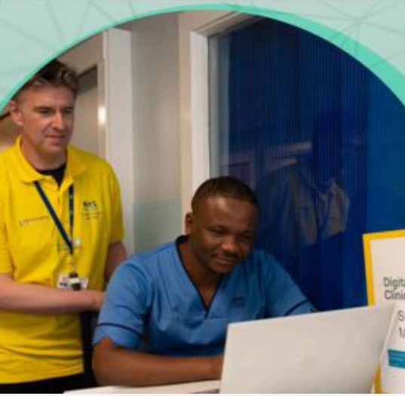


NHS SCOTLAND EVENT 2026 • DIGITAL
People make
transformation real
Digital Clinical Notes (DCN)
A practical story of clinical practice, collaboration and change at scale
People • Process • Partnership • Technology
Notes:
Welcome delegates and frame this as a practical story of change, not a technology showcase.
DCN shows how clinical practice changes at scale when trust, ownership and partnership are built into delivery. Digital Clinical Notes is not purely a digital transformation, but a cultural transformation and in order to make this a success, we need to apply four pillars of practice these being People. Process. Partnership and Technology

Slide 15

FOUR-PILLAR FRAMEWORK
Four pillars make transformation real
PEOPLE
PROCESS
Confidence, roles and support
A safe, repeatable way of working
PARTNERSHIP
TECHNOLOGY
Clinical, digital and organisational ownership
A usable, reliable digital service
Each pillar has a distinct job; together they sustain adoption.
Notes:
The theme of this presentation is going to be the four pillars that make any transformation real or a success. These are People. Process. Partnership and Technology, before we go into each one in a bit more detail
Successful digital transformation is not simply a technology deployment. It depends on four connected pillars.
People need confidence, clear roles and ongoing support. Process provides a safe, repeatable way of working. Partnership creates shared clinical, digital and organisational ownership. Technology must be usable and reliable in daily practice.
Invite a quick show of hands: which of the four elements is hardest to sustain in practice? Ask the audience to think of a technically sound transformation that struggled because one of the other elements was weak.
If one pillar is weak, adoption becomes difficult to sustain—even when the technical solution is sound. Together, these pillars provide the framework for our Digital Clinical Notes journey
We are going to start with an extremely important pillar - PEOPLE

Slide 16

PEOPLE
People
Build confidence to lead
The change works when clinical teams have the skills, support and authority to lead.
01
Clinical teams
Define safe and meaningful practice
02
Practice development
Turn practice into role-specific learning
03
External stakeholders
Configure, test and deliver with users
04
Educators and facilitators
Build confidence in real care settings
05
Governance
Stakeholders Group, build change process
Notes:
Pillar: PEOPLE
From the very early days of development of an electronic patient record, the project team recognised that in order to develop and launch a successful and effective nursing documentation, assessment and care planning digital system, we had to involve our many stakeholders. It was imperative that before we even developed a form, we had full collaboration with subject matter experts, practice development, clinical teams, staff side representatives and members of the public.
Development: subject matter experts, practice development, clinical leaders and frontline users
Testing: clinical areas, staff nurses, hcsws, staff side, carers, members of the public
Early adopters: clinical teams, clinical educators, subject matter experts
Implementation: facilitators, proactive team, clinical teams, local educators, senior nursing management, GM CSMs, Medics, AHPs, PEFs, student nurses
Different groups held distinct responsibilities, and none could substitute for another.
The important governance principle is that changes to clinical documentation require professional as well as digital decision-making.

Slide 17

PROCESS
Process
Pilot. Learn. Adapt. Spread.
1
Start with a real pathway
Test with early users
2
Support intensively
Make learning role-specific
3
Measure and listen
Combine data with lived experience
4
Improve the model
Change build, guidance and workflow
5
Spread consistently
Reuse learning without ignoring context
Notes:
Standing strong alongside our People pillar – we then move onto the next pillar – PROCESS
Early discussions – what (admission documentation, risk assessments, care plan, clinical note) who (SME) where (adult inpatient) how (testing and implementation model)
Development – person centred care plan, supplier review and adopted solutions where possible, recognise local fit, risk assessment build (continuation within same form, cumulative view, calculations within MUST 4AT, learning resources
Testing – user acceptance testing, clinical areas, pathways patient flow
Update/changes from testing
Early adopters - 3 months 24/7 cover - lessons learned that resulted in solution changes, specifically re the Care Plan - informed support model for wider implementation.
Feedback and Issues
Spread – develop implementation plan – new pathways – clinical areas local pathways - timings – clinical leaders – support model facilitators
Running alongside is Governance – risks and issues, action logs, change requests process, regular contact with users, quality - internal audit – programme board assurance
Stress that stabilisation is part of DCN implementation. Support cannot disappear at go-live.
The model is transferable across the programme: begin with real users, measure, adapt and then spread with a controlled common core.

Slide 18
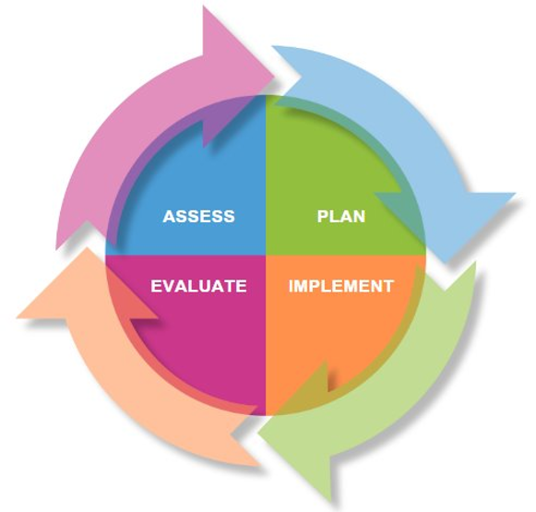
PROCESS
Process
One model from assessment to review
Assess–Plan–Implement–Evaluate creates a consistent, person-centred workflow.
Not simply paper on a screen
1
ASSESS
Capture needs and risks
2
PLAN
Agree person-centred goals
3
IMPLEMENT
Record care and actions
4
EVALUATE
Review change and outcomes
The model is the standard; local teams apply it in context.
5
Notes:
Another PROCESS is the nursing model process that we embedded into our digital Person Centred Care plan.
The APIE nursing process evolved from the nursing process developed in the 1950s and 1960s, when nursing theorists promoted a systematic approach to patient care. The four-step Assessment, Planning, Implementation, and Evaluation (APIE) model became widely adopted as a practical framework for clinical decision-making, care planning, and professional accountability.
APIE is a structured nursing process used to deliver person-centred care:
Assessment: Gather information about the patient.
Planning: Set goals and identify interventions.
Implementation: Deliver the planned care.
Evaluation: Review outcomes and adjust care as needed.
It supports safe, effective, and evidence-based nursing practice.
Standardisation is not about removing professional judgement. It provides a dependable structure through which judgement and person-centred care can be seen. Daily care plan to reflect 24 hours of care
Overview of Care Plan break down and how model is applied - 12 dimensions - created new every day and updated at least once.
Embedding culture change – more complex than technology change

Slide 19

PARTNERSHIP
Partnership.
Once for Scotland, locally adapted
A shared clinical core succeeds when national development and local practice shape it together.
Common clinical core
One assess–plan–implement–evaluate model and shared standards
Local flexibility
Adapt to specialties, roles and operational realities
Shared ownership
InterSystems, clinical and digital teams shape delivery together
Learning loop
Feedback, audit and governance guide continuous improvement
Notes:
Thaks Carol – I want to move the conversation on to look at the wider context in relation to people and partnership
When we talk about partnership, it's important to recognise the wider NHS Scotland landscape that we operate within.
Across Scotland, the majority of us use the same core Electronic Patient Record platform, TrakCare, provided by InterSystems.
However, whilst we may share the same supplier, we don't share a single system. Each Board has developed its own instance over many years, configured to support local clinical practice, local priorities and local operating models. Some environments are hosted, some remain on-premise, and Boards are currently at different stages in their journey towards the next generation of the platform.
Alongside this sits a well-established national governance structure that brings together strategic leadership, operational deployment groups and clinical input to help shape the future direction of these systems. That governance is critical because it provides the forum where local experience can influence national thinking.
For me, one of the key lessons from programmes such as Digital Clinical Notes is the importance of capturing and sharing learning. As we move forward together with the strategic Boards, we need to think carefully about how we take the experience from DCN and similar programmes across Scotland and use that evidence to inform future development. That becomes increasingly important as we start looking towards the current contract horizon in 2029 and what comes next.
Strong partnerships with suppliers are also essential. Success comes from more than technology delivery. It requires professional influence, robust clinical evidence, and constructive challenge, ensuring that future developments meet national objectives while still allowing flexibility for local needs.
I think we're in a particularly exciting place right now. We have a genuine opportunity to use the learning we've generated across Scotland to help inform Scottish Government policy, shape future investment decisions, and contribute to a shared national direction for digital healthcare.
Partnership, in that sense, becomes much more than collaboration. It becomes a mechanism for shaping the future together.

Slide 20

TECHNOLOGY
Technology
Make care visible and reusable
The value is better access, quality and assurance—not digitisation alone.
Paper retrieval and filing
→
Simultaneous, real-time access
Variable forms and recording
→
Standardised person-centred structure
Gaps identified retrospectively
→
Completion visibility and audit trails
Limited reusable information
→
Structured data for reporting and improvement
At scale: 160+ wards, 75,000+ admission records and 1 million+ care plans by August 2026.
Notes:
When we talk about technology, it's easy to assume that digital transformation is about systems, software or technical delivery. In reality, the most important role of digital is often not to lead change, but to enable it.
One of the lessons I've learned throughout my career is that sustainable transformation happens when the service owns the change.
In the case of Digital Clinical Notes, this is fundamentally a nursing transformation programme. The nursing profession defines the standards, the workflows and the outcomes. Digital provides the tools that make that vision possible.
Historically, the NHS has relied heavily on people to move information.
Staff have physically transported paper records across hospitals, between departments, and increasingly between organisations.
That approach has served us for many years, but it introduces delay, duplication and risk. Information is only available where the paper happens to be at that moment in time.
The real transformation offered by programmes such as DCN is not that information has been digitised. It is that information becomes accessible simultaneously, in real time, to those who need it.
Instead of moving paper, we move knowledge. Instead of waiting for records to arrive, we enable clinicians to access the information they require to support patient care when and where it is needed.
It's also important to recognise that paper-based systems are not risk free.
They can vary in quality, be difficult to audit, and can make it challenging to identify omissions or trends.
Digital solutions give us opportunities to standardise core processes, improve visibility, strengthen auditability and create greater consistency in practice. When designed well, they can also reduce administrative burden, allowing staff to spend more time focusing on care rather than documentation.
This becomes increasingly important as health and care services evolve. We are seeing more care delivered in community settings, greater collaboration across organisational boundaries, and increasing expectations around integrated care at a sub-national and national level.
The ability to access and share information safely and effectively is becoming a fundamental enabler of modern healthcare.
At present, Scotland does not yet have a single national solution for sharing the digital healthcare record across all care settings.
However, through the work being led by Public Sector Digital Services and partners across the system, we should expect significant progress in this area over the coming years.
That is why the work of Digital Clinical Notes is so important. Before information can be shared, it must first be captured consistently, structured appropriately and recorded to a high standard.
DCN lays that foundation. It can improve the quality of the information we hold, creates data that can be reused for assurance and service improvement, and positions us to take advantage of future national solutions as they emerge.
Ultimately, technology is not the transformation. Technology is the platform that allows people, professions and services to transform the way care is delivered.“

Slide 21

CLOSING THOUGHT • QUESTIONS VIA SLIDO
Four pillars.
One transformation.
People, process and partnership turn technology into safer, scalable care.
1
People — build confidence and ownership
2
Process — make safe practice repeatable
3
Partnership — share decisions and adapt locally
4
Technology — make care visible, usable and reliable
5
Together — make transformation real
Reliable digital recording is foundational to the Digital Front Door and wider transformation.
Notes:
As I bring this to a close, I'd like to return to the four pillars we started with: People, Process, Partnership and Technology.
What we've learned through Digital Clinical Notes is that none of these pillars are sufficient on their own.
Technology without ownership becomes a system implementation.
Process without engagement becomes bureaucracy.
Partnership without a shared purpose becomes discussion.
And people, no matter how committed they are, need the right structures and tools around them to succeed.
The success of DCN has come from bringing all four together.
We empowered clinical teams to lead the change.
We developed repeatable processes that could be tested, improved and scaled.
We built partnerships across clinical, digital, organisational and supplier boundaries.
And we deployed technology that supports practice rather than dictates it.
Importantly, the outcome is much bigger than replacing paper with digital forms. What we've really created is a foundation. A foundation of standardised information, improved quality, stronger governance, greater visibility and more reliable data.
That foundation is critical as NHS Scotland continues its wider digital transformation journey.
Whether we think about integrated health and social care, regional collaboration, improving access to information across organisational boundaries, or the ambitions of programmes such as the Digital Front Door, all of these depend on having trusted, high-quality information available in digital form.
We often focus on the visible parts of transformation, the apps, the portals and the technology that patients and staff interact with.
But those capabilities are only possible when the foundations beneath them are strong.
Digital Clinical Notes is one example of the work required to build those foundations.
Looking ahead, I believe the opportunity for NHS Scotland is significant. We now have the chance to take the learning from programmes like DCN, combine it with emerging national capabilities, and create a more connected, more accessible and more person-centred digital healthcare system.
So my final reflection is this: technology may open the door, but it is people, process and partnership that allow us to walk through it.
Together, these four pillars provide the foundation on which we can deliver the transformational vision of programmes such as Digital Front Door and the future of digital health and care in Scotland.

Slide 22
Beyond technology:
Digital transformation in action
SLIDO CODE: NHSScot2026

