Slide 1
Day Zero and Beyond (Thoracic Surgery)

Slide 2
Dr Mark Steven
Consultant Cardiothoracic Anaesthetist

Slide 3
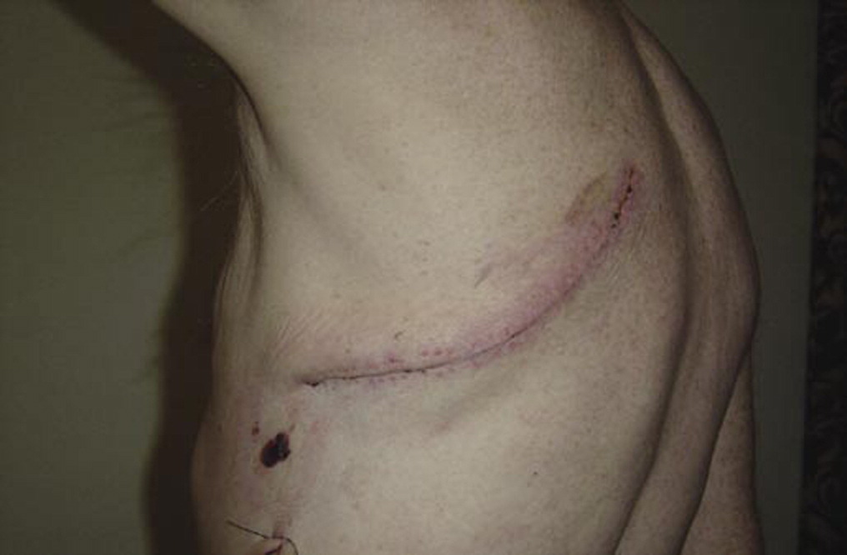

Background
High dose opiate
Pain
Intensive nursing
Epidural
Thoracotomy
Hypotension
Inotropic support
Duration of surgery
Leg weakness/ instability
Blood loss
Air leak
Constipation
Multiple chest drains
Urinary retention
Invasive monitoring
Immobility
Arterial line
Deconditioning/ weakness
Central line
DVT risk
Urinary catheter
Chest infection
HDU essential

Slide 4

VATs and RATs
VATs and RATS
Minimal access surgery
Smaller wounds, smaller scars
Better tissue handling
Less air leaks and bleeding
Single drain
Shorter procedures
Less pain
Less haemodynamic swings
Unilateral regional techniques
Oral analgesia
Standard nursing requirement
ERAS

Slide 5
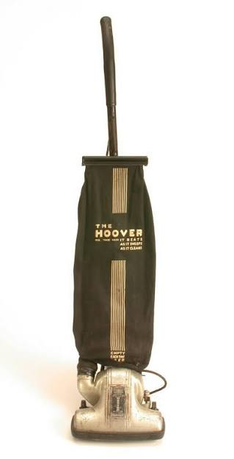
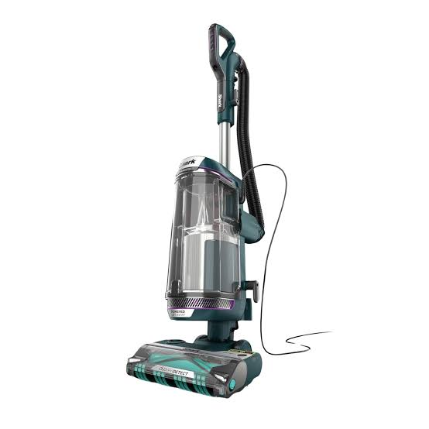
Original pathway
Original pathway
All major lung resections for HDU
Patients admitted pre-op day to Thoracic ward
HDU bed booked the day before
Surgery
24 hours plus in HDU
Transfer to ward when meet nursing requirements
Thoracic ward until ready for home
Bed availability – multiple demands
Same day cancellations
Cost of HDU care

Slide 6
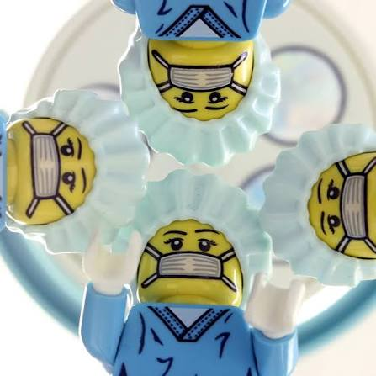
Perioperative team
Perioperative team
Patient
Surgeon
Anaesthetist
Reception/ Recovery nurse
Anaesthetic nurse and theatre assistants
Theatre nurse
Ward nurse / Advanced Nurse Practitioners
HDU/ ICU nurse
Physiotherapist
Pharmacist
Pain nurse
Hospital @ Night

Slide 7
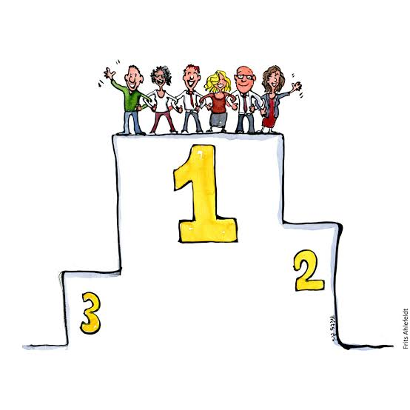
Day Zero proposal
Day Zero proposal
Patients no longer need a default admission to HDU
Ward care is adequate for the majority
Major lung resection independent of level 2 care availability
Improve level 2 bed availability for other specialities
Patients relatively untethered
Easier to facilitate ERAS
Earlier discharge
Cost saving from reduced level 2 care
Cost saving from reduced IP bed days
Reduced cancellations
Better patient satisfaction

Slide 8

Established practice
Established practice

Slide 9

Key principles
Patient safety
Fitness criteria for Day 0 ward management
Identify patients with co-morbidity requiring planned HDU
Immediate post-op criteria for ward transfer
Monitoring protocols
Escalation pathways
Staff safety
Nursing safe staffing levels - number, skillset and experience
Medical and surgical support
New processes
Physio
Acute Pain Service

Slide 10


Writing the policy
Writing the policy
Anaesthetist
Surgeon
Recovery charge nurse
Thoracic ward charge nurse
HDU charge nurse
Advanced Nurse Practitioner lead
Service manager
Acute Pain Service lead
Physiotherapy lead
Clinical Nurse educators
CardioThoracic ERAS team
Governance team

Slide 11

Project Management obstacles
Project management obstacles
Belief
Meeting space
Time management
Size of group
Scope of Work
Chair
Value
Deadline
Diary matching
Actions

Slide 12

Our process
Our process
First meeting – agree principle and outline
Second meeting – listen and note
Write draft proposal
Circulate shared document and collate feedback
Update proposal
Circulate shared document and collate feedback
Repeat until agreement
Final washout meeting to approve policy
Submit to Governance

Slide 13

Day Zero – The Pilot
Policy is the framework – 10 page booklet
Period of education for all staff groups
Audit application approval
Limited introduction
2 patients per week
First patient on list only
3 months
Target 15-20 patients

Slide 14
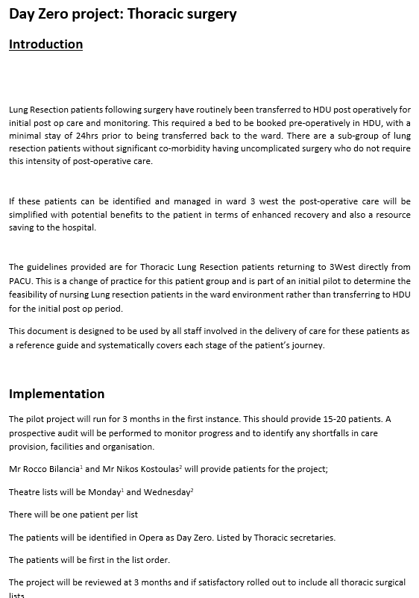
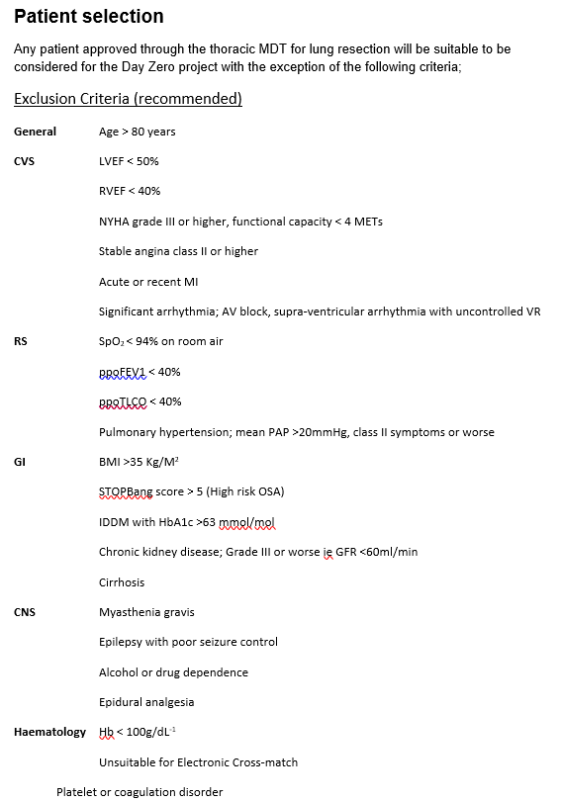
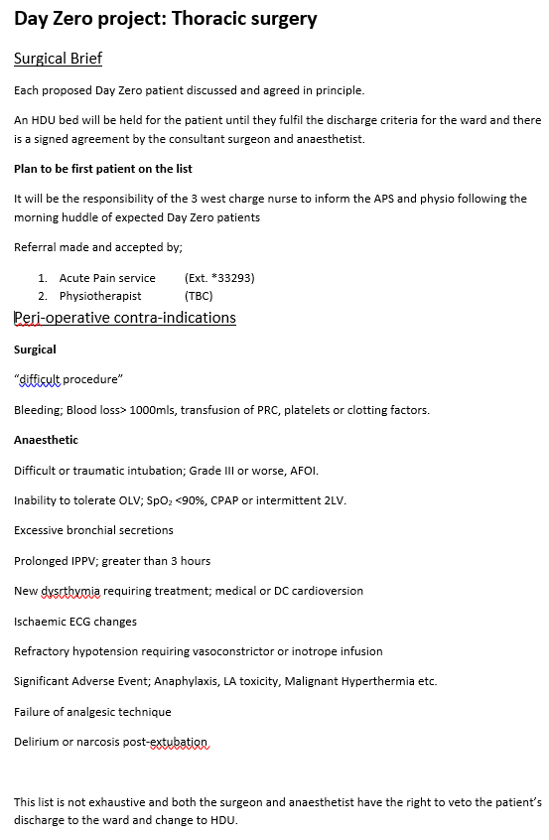

Slide 15
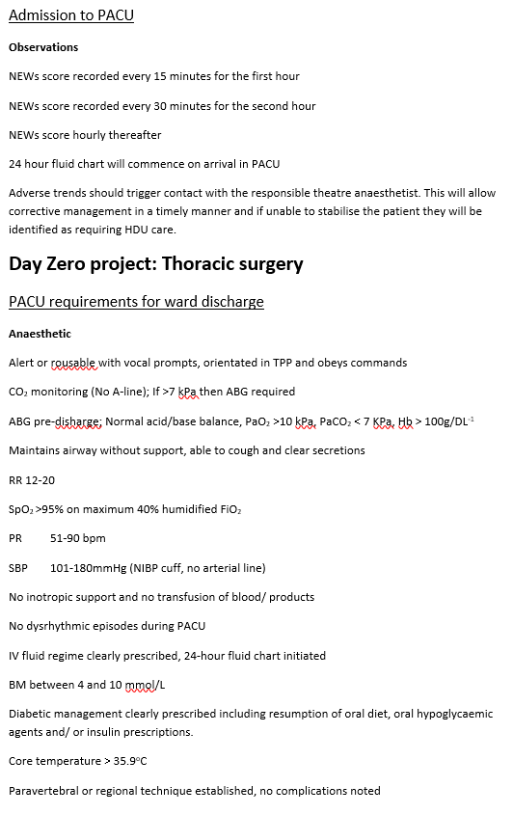
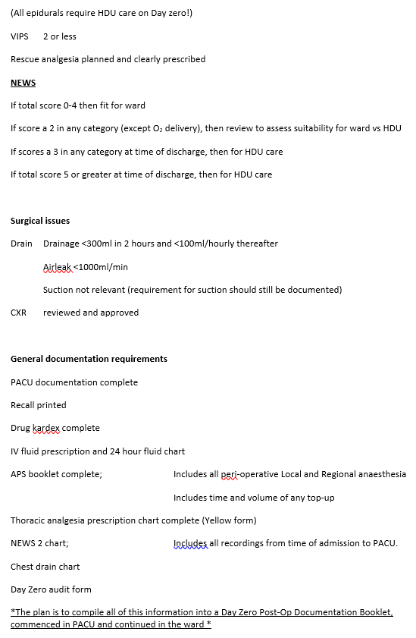
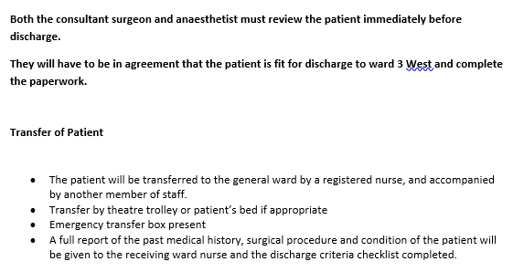

Slide 16
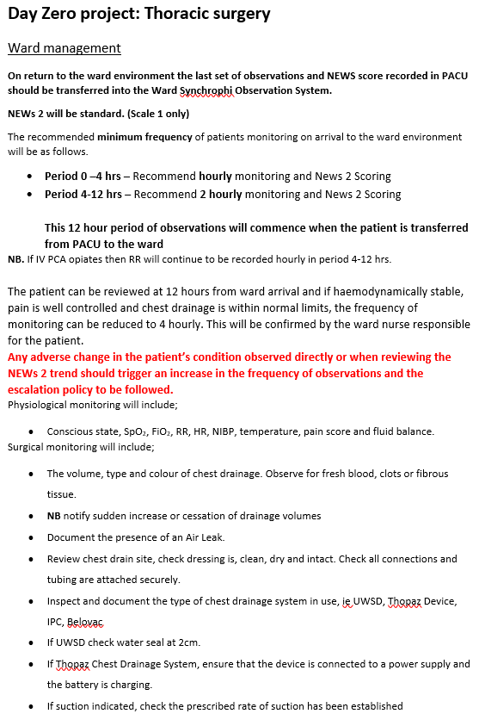
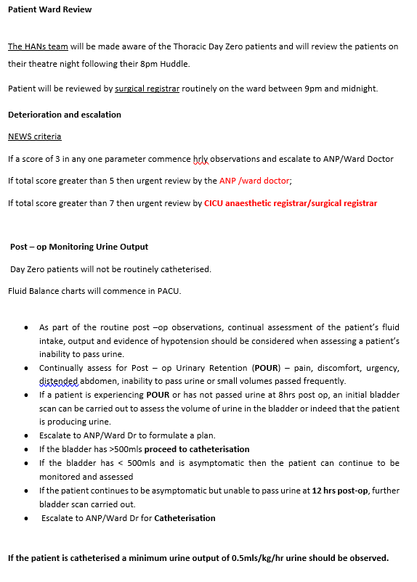
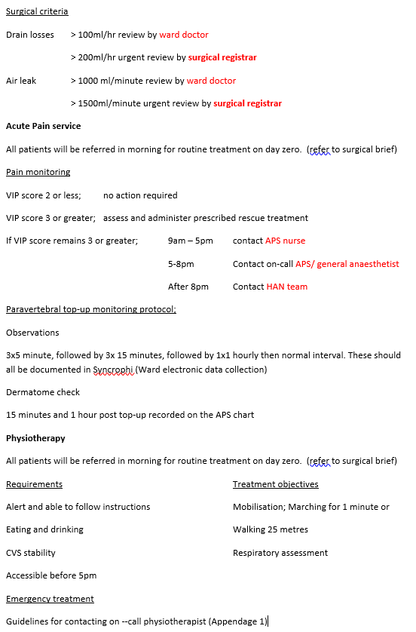

Slide 17

Audit
Audit
Patient satisfaction survey
Patient number successfully transferred to the ward
Patient number planned for HDU
Patient number planned for ward but required HDU from recovery
Reasons
Patient number escalated to HDU from ward
Reasons
HDU bed days saved
Bed availability on 3 West
Average length of stay compared to baseline

Slide 18
Results
11 (85%)
Successfully completed
13 (77%)
Successfully transferred to 3 West
2 (15%)
Required later admission to HDU
17 patients
22/7 - 30/11
8 RB, 6 NK, 3 AK
Minimally invasive lobectomy or complex segmentectomy
4 (23%)
Admitted to HDU

Slide 19
Results
11 (85%)
Successfully completed
Median LOS 3 days (2-20)
13 (77%)
Successfully transferred to 3 West
2 (15%)
Required later admission to HDU
17 patients
22/7 - 30/11
8 RB, 6 NK, 3 AK
Minimally invasive lobectomy or complex segmentectomy
4 (23%)
Admitted to HDU

Slide 20
Results
Results
11 (85%)
Successfully completed
Median LOS 3 days (2-20)
13 (77%)
Successfully transferred to 3 West
17 patients
2 (15%)
Required later admission to HDU
22/7 - 30/11
8 RB, 6 NK, 3 AK
Minimally invasive lobectomy or complex segmentectomy
4 (23%)
Admitted to HDU
Median LOS 4 days (3-8)

Slide 21
Day Zero but needed HDU
11 (85%)
Successfully completed
Median LOS 3 days (2-20)
13 (77%)
Successfully transferred to 3 West
17 patients
11 RATS/ 6 VATS
RATS LOS 3 (2-8)
  4 on POD 2, 8 by POD 3, 9 by POD 4
VATS LOS 4.5 (3-20)
  2 outliers (17 and 20 days) out of 6 cases
2 (15%)
Required later admission to HDU
4 (23%)
Admitted to HDU
Median LOS 4 days (3-8)

Slide 22

Day Zero but needed HDU
4 patients identified in PACU for HDU
Persistent sedation
Difficult surgery, hypotensive with Air leak > 1,000mls
Reopened for bleeding
(1 data incomplete; reason not documented)
Discharge criteria not met.
Agreed process followed
Patients ongoing care organised in HDU. No issues.

Slide 23

Needed escalation to HDU
2 patients
Day Zero x1:
Patient desaturated requiring NIV options
Day 1 x1:
Patient bleeding requiring reopening
Issues unrelated to area or intensity of monitoring
MEWs scoring and escalation protocols successful

Slide 24

Outcome
77% of patients transferred to Thoracic ward on Day Zero
85% of Day Zero patients followed pathway
65% of HDU bed occupancy saved compared to predicted
15% of patients required unexpected HDU admission
100% of patients managed safely
1 Inpatient bed day saved per patient (LoS 3 vs 4cdays)

Slide 25

Success

Slide 26

Day Zero 2.0

Slide 27
Issues
All major lung resections
All surgeons
2 lists per day
Potentially 2 cases per list – up to 5x increase
Ward capacity
Safe staffing levels
Daytime vs Nighttime
Higher throughput vs complications
Investment???

Slide 28

Current position
Day Zero established practice
Safer surgery
Simplified anaesthesia
Robust ward processes
Familiarity
Patients happy
Still looking for investment!

Slide 29
Ms Jennifer Whiteley
Consultant Thoracic Surgeon

Slide 30
Surgical evolution that made day zero ward admission possible
Thoracotomy → VATS → RATS →
Enhanced Recovery
Day Zero Ward Admission

Slide 31
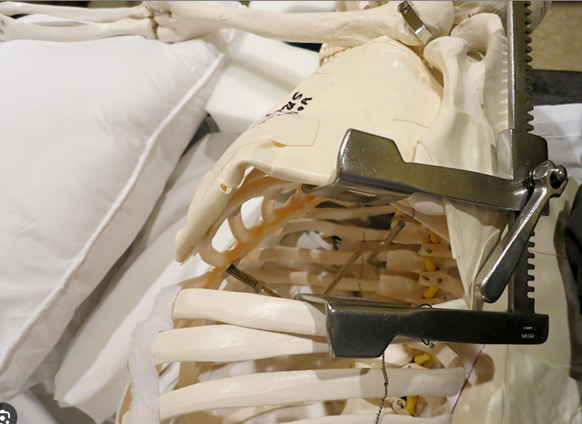
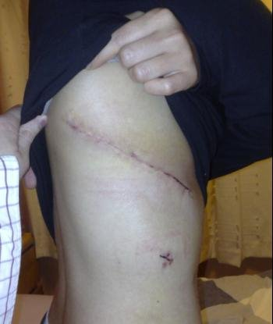
15 years ago
Thoracotomy → HDU→ Ward → Home
• Large incision and rib spreading
• Significant pain – Epidurals
• Longer recovery and LOS
Good access to the hilum
Remains incision of choice for many complex surgeries

Slide 32
The surgical revolution
2000s
Thoracotomy dominant
2010
VATS introduced
2018
Robotic expansion
Today @ GJUNH
91% Minimally invasive

Slide 33
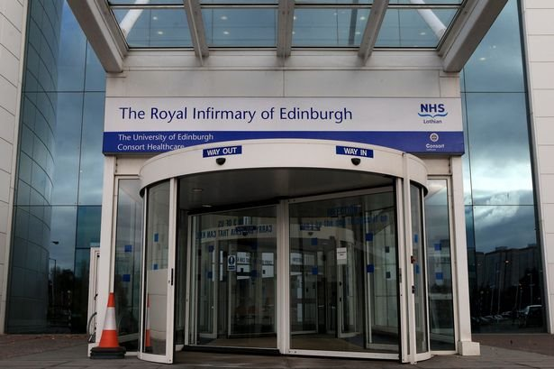

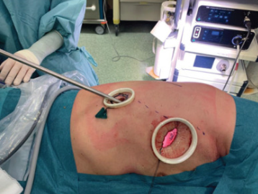
Video Assisted Thoracic Surgery (VATS)
First VATS lobe (in the world!) - Bill Walker RIE 2010
Total endoscopic approach
No rib spreading
Shift towards paravertebral catheters over epidurals
Less pain/ surgical insult

Slide 34
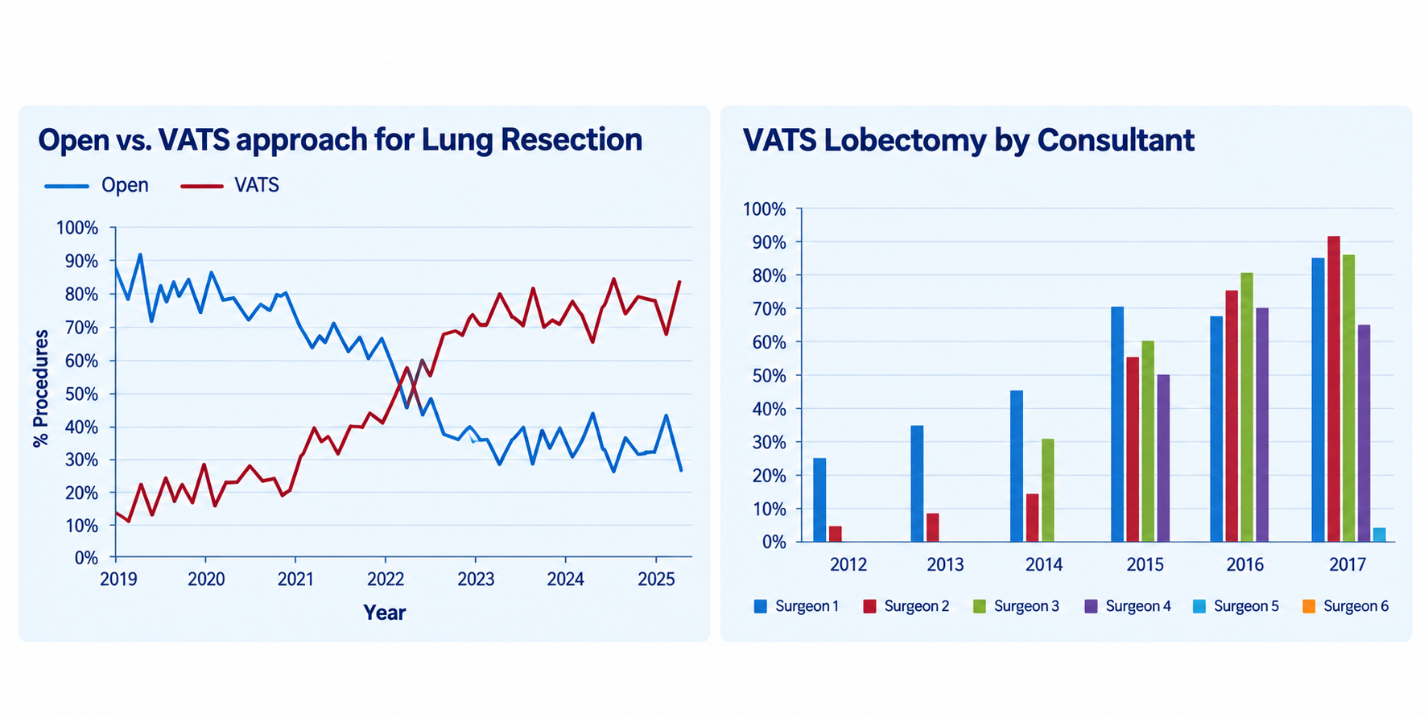
VATS revolution at GJUNH

Slide 35
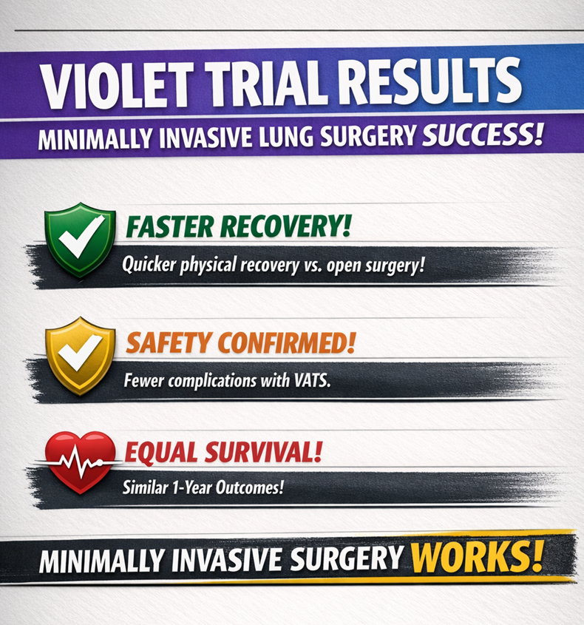

Slide 36
Robotic Assisted Thoracic Surgery (RATS)
Robotic Surgery introduced at GJNH in 2018
No rib spreading, less pain etc..
As with VATs- one surgeon at a time
Now one of the largest centres in the UK for thoracic Robotic Surgery
What's different ?
  Dexterity of the robot
  Increasing the complexity of surgeries that can be done minimally invasively

Slide 37
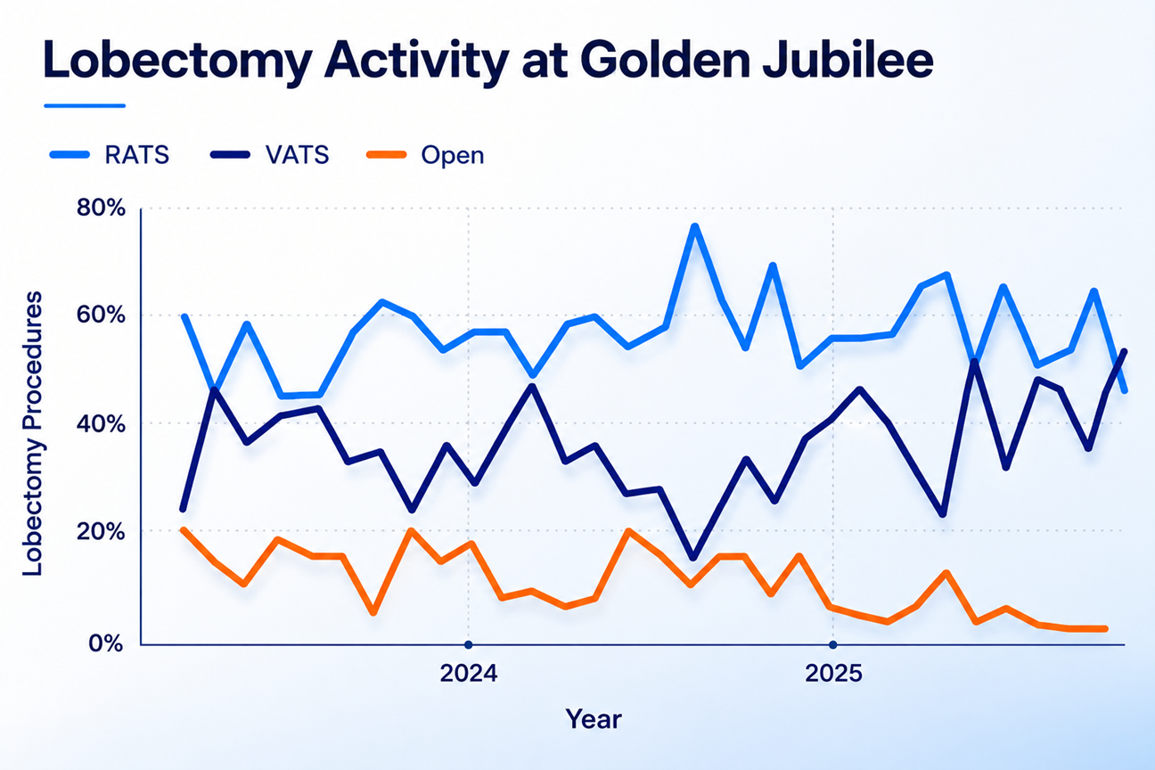
Robotic revolution at GJUNH

Slide 38
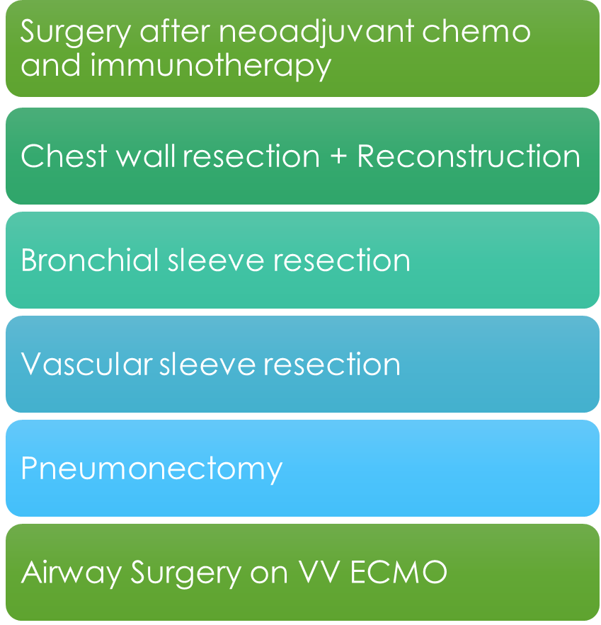
Robotic revolution at GJNUNH

Slide 39
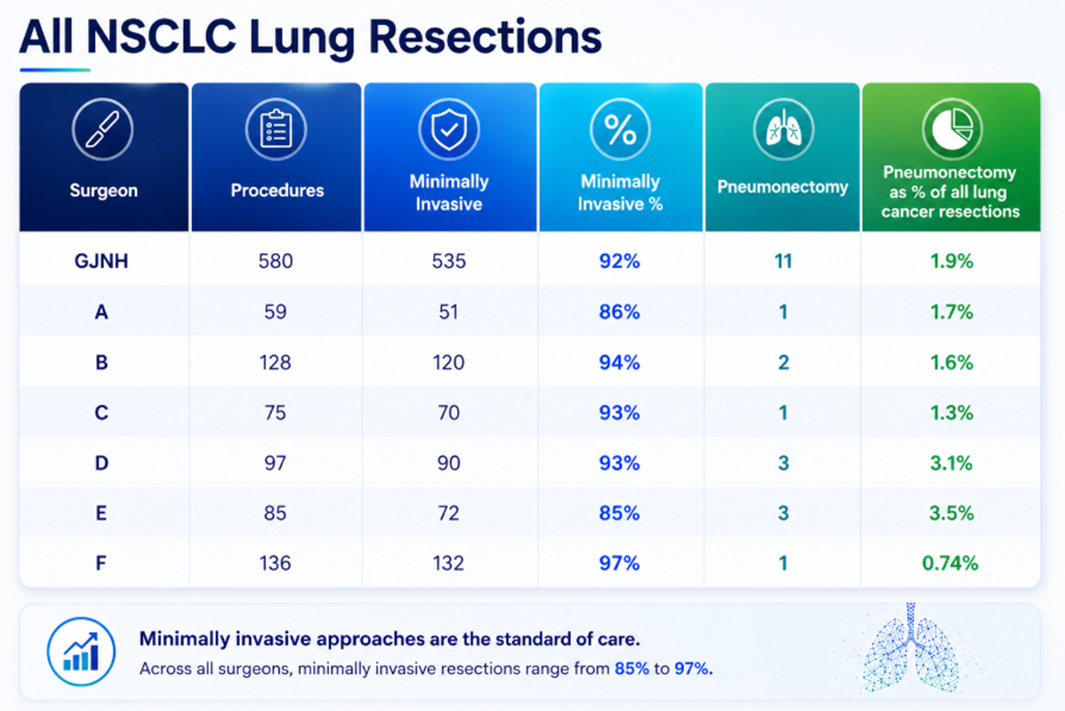
Robotic revolution at GJNUNH

Slide 40
Where do patients recover best?
ERAS Principles:
Patients recover by walking, eating, sleeping normally and regaining independence.
Why Challenge Routine HDU?
Not every patient requires HDU-level care. Recover on ward when safe.
Massive shift to minimally invasive surgery – less pain, less epidurals, less monitoring
Post-operative Complications
AF, pneumonia, AKI and respiratory deterioration usually occur Day 2+.
HDU on Day 0 does not prevent these.
Robust escalation policies.

Slide 41
The new/ future pathway
RATS/VATS → PACU → Ward → Home Day 2
Virtual review Day 4
Selected patients home with drains

Slide 42
Key message
Day Zero is the result of better surgery, anaesthesia, nursing and ERAS principles.

Slide 43
Emma McColl
Clinical Nurse Manager

Slide 44
Why Day Zero​
A modern pathway enabled by minimally invasive surgery and robust ward processes​
Original patient Pathway
Day Zero Patient Pathway
Default HDU admission after major lung resection​
Multiple invasive lines and intensive monitoring​
Immobility, pain and deconditioning risks​
HDU capacity could drive cancellation​
Ward care is suitable for the majority of patients
Less attachments
ERAS is easier to deliver
Fewer HDU bed days, cancellations and inpatient days

Slide 45
The Nursing Contribution
      Ward Nursing Team
      Acute Pain Service Nurse Specialists
      Thoracic Nurse Specialist
      ERAS Thoracic Nurse

Slide 46

ERAS nursing principles for lung surgery
Patient Partnership
Education, expectation setting and shared goals
Opioid Sparing Comfort
Regular pain assessment and multimodal analgesia
Pulmonary Function
Upright posture, supported cough and breathing exercises
Move early and often
Early mobilisation with lines and drains managed safely
Restore Normality
Oral fluids, nutrition, sleep and personal care
Standardise and Review
Shared milestones, multidisciplinary review

Slide 47
Day Zero Ward Priorities
Observe
Complete observations NEWS2, pain assessment, drain function and fluid balance.
Optimsise
Upright position, nausea control, oral intake as tolerated, timely analgesia.
Mobilise
Sit out and begin supported mobilisation.
Manage drains and oxygen to preserve confidence and function.
Communicate
Explain progress and goals to patient and family.

Slide 48
Safe delivery
What nurses need as Day Zero becomes established practice
Competence
Education, supervised practice, drain, analgesia and respiratory care and escalation
Capacity
Safe staffing numbers, skill mix and experience. Ward bed capacity*/-
Clinical Support
Reliable access to ANPs, surgeons, anaesthetic, physiotherapy, OT, dietitian, pain team
Standard Work
Clear policy, transfer criteria, monitoring, handover tools and escalation routes
Learning System
Audit, outcomes, patient experience and staff experience
Patient Voice
Use feedback to improve education, confidence, ward experience and discharge support

Slide 49
Key messages for nursing practice
Day zero is not lower acuity care. It is enhanced recovery delivered within the ward with clear boundaries
ERAS is delivered through reliable everyday nursing and ANP actions that protect patient function and independence
Early recognition and escalation are markers of pathway safety not pathway failure
Education, nurse staffing and MDT access must develop together to ensure success.

Slide 50
Panel Q&A

