Slide 1
Edinburgh’s Integrated Whole System Approach to Falls Prevention

Slide 2


Slide 3
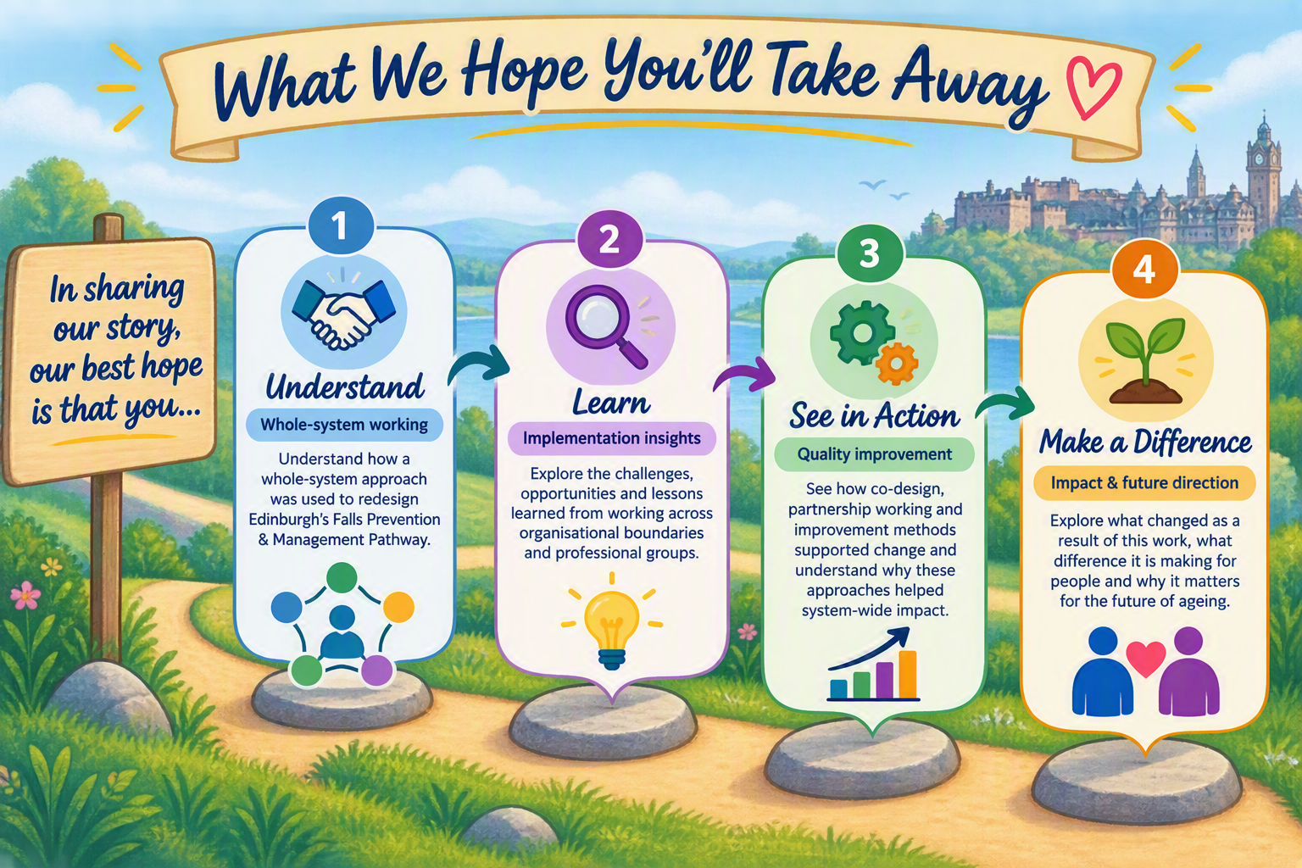

Slide 4
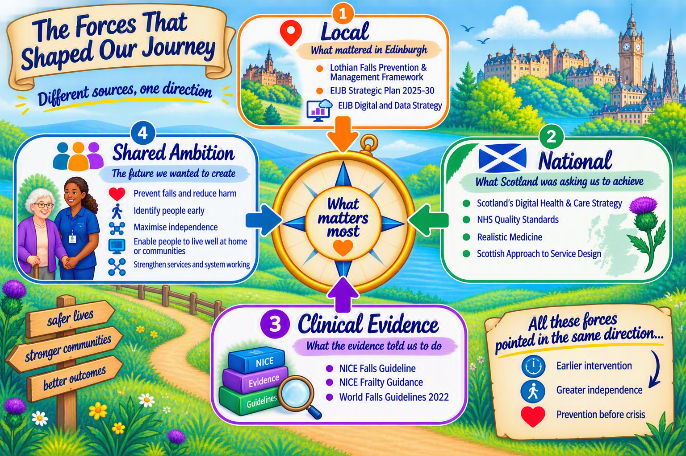

Slide 5
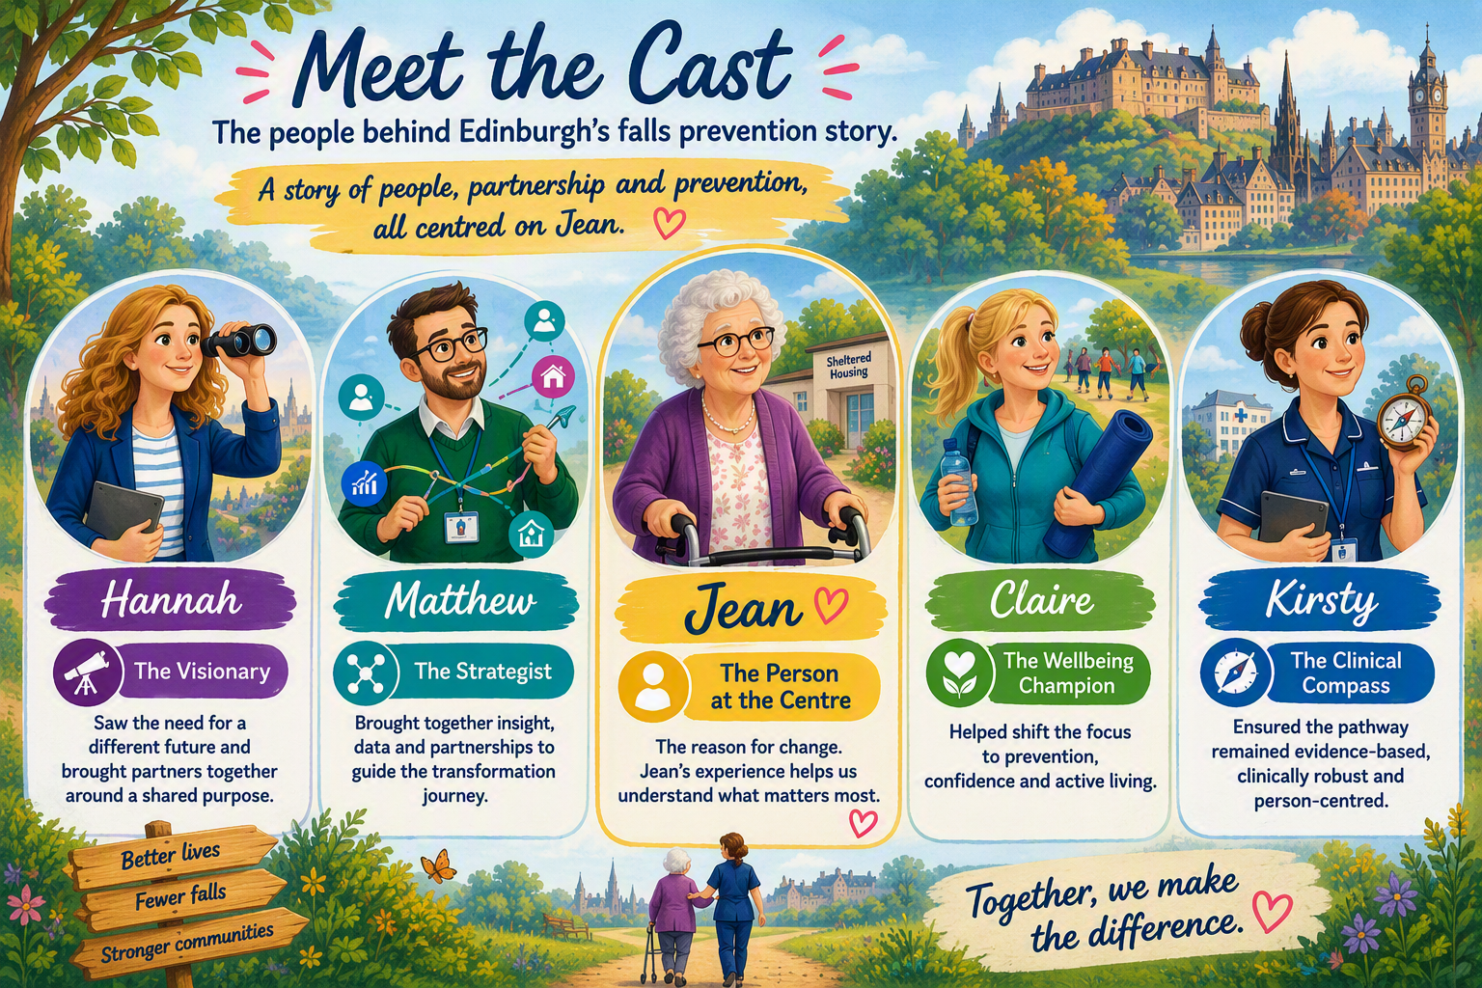

Slide 6


Slide 7

Whole-Systems Approach
Many partners.
🤝 Health • Social Care • Leisure • Communities • People
One shared purpose.
🧭 Prevent falls and maximise independence.
One connected journey.
🏡 Coordinated support centred around people like Jean.

Slide 8
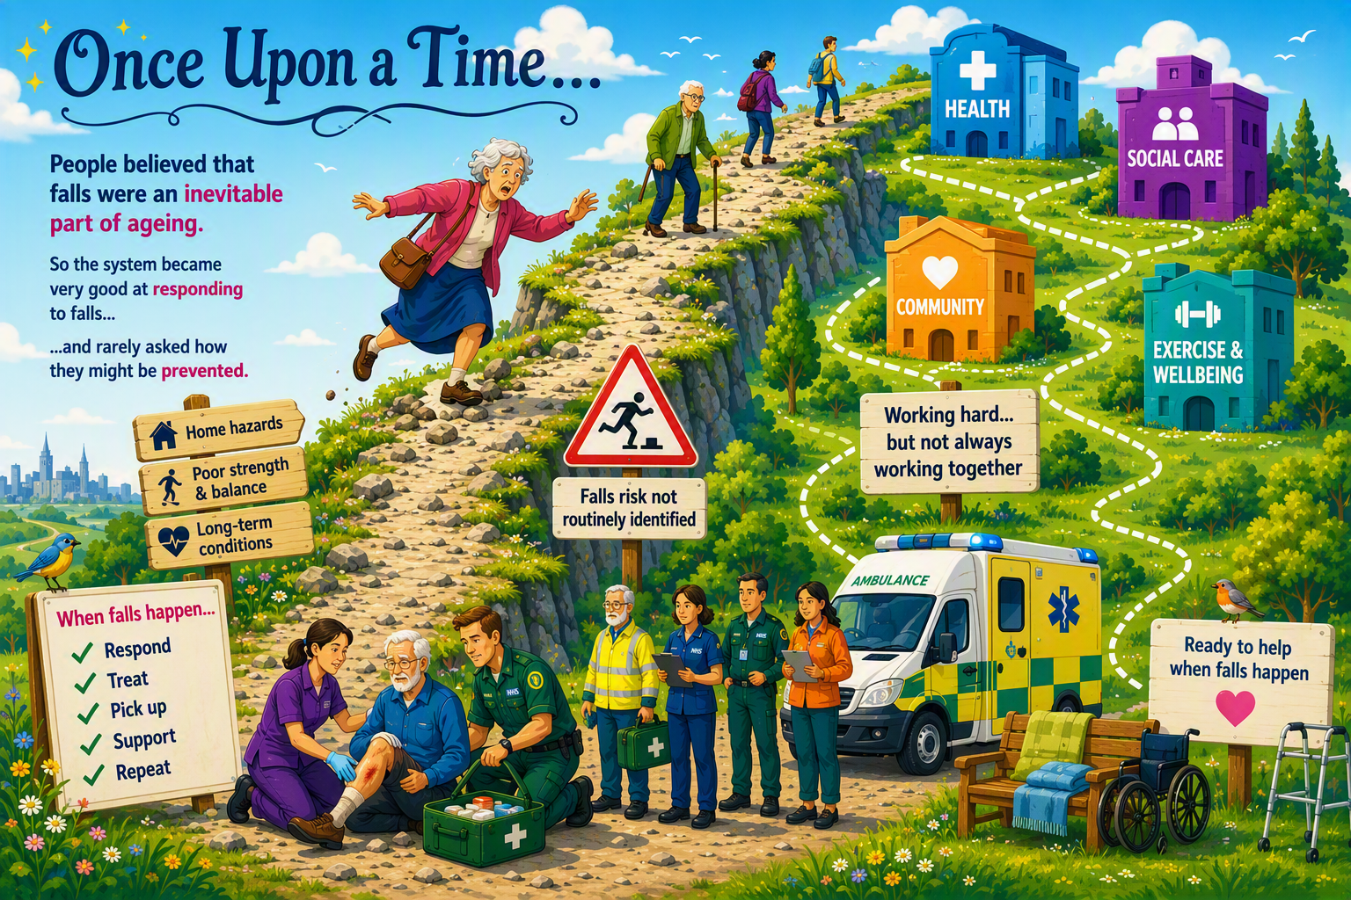

Slide 9
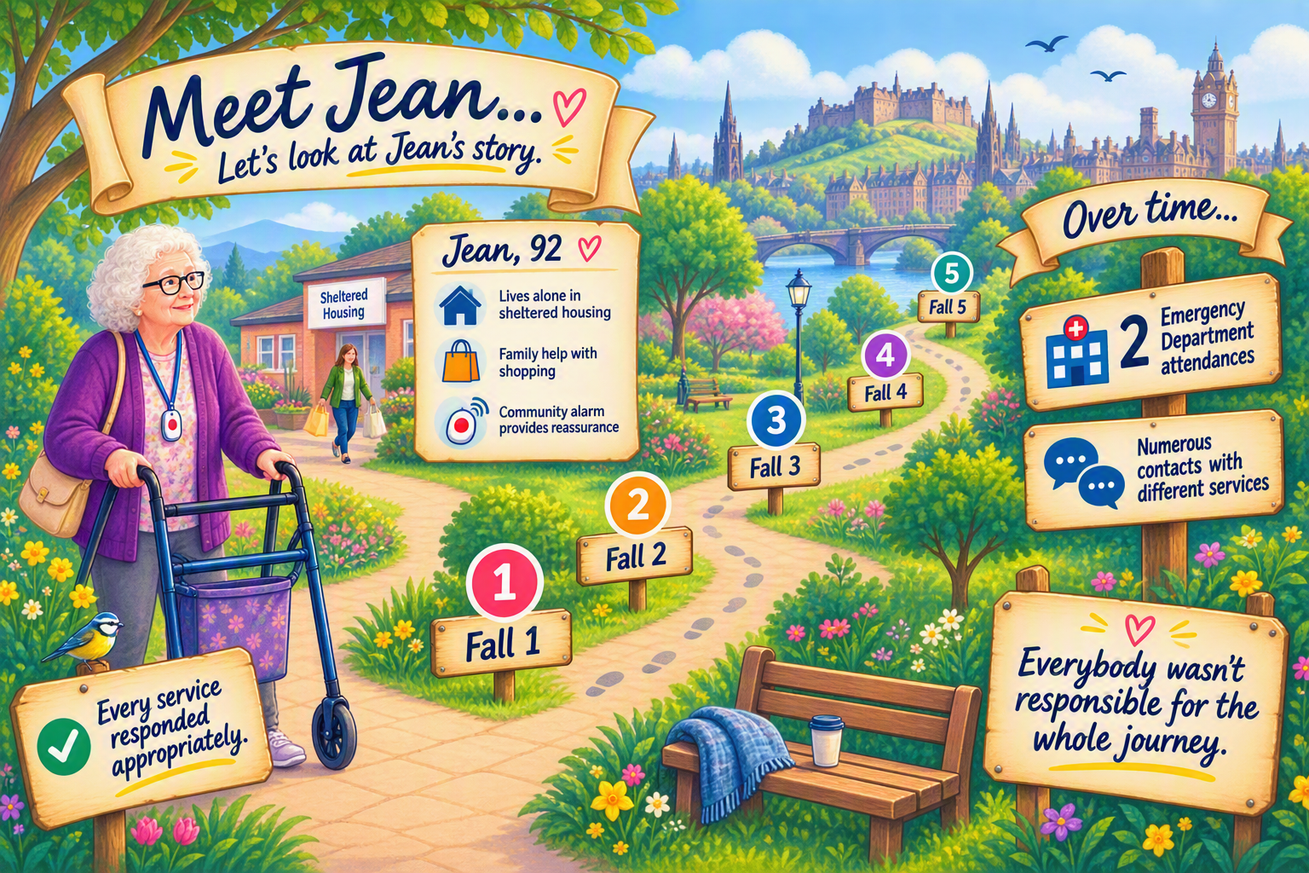

Slide 10
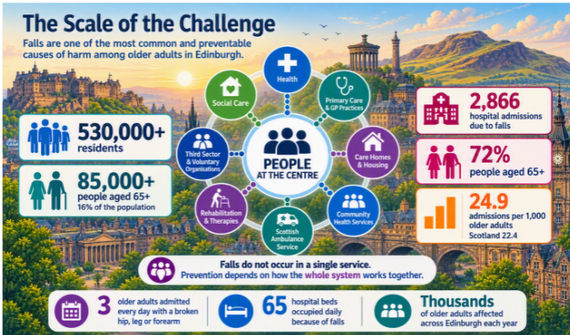

Slide 11


Slide 12
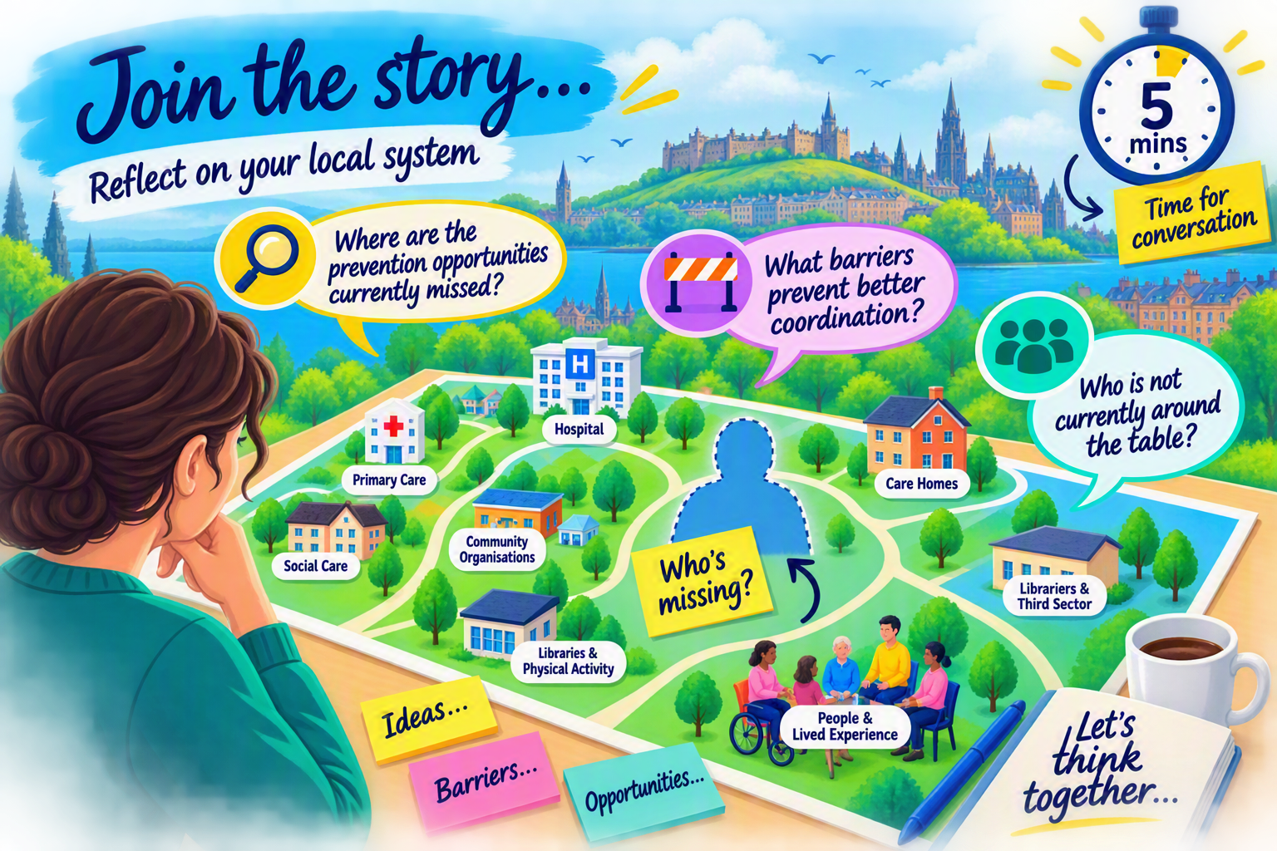

Slide 13
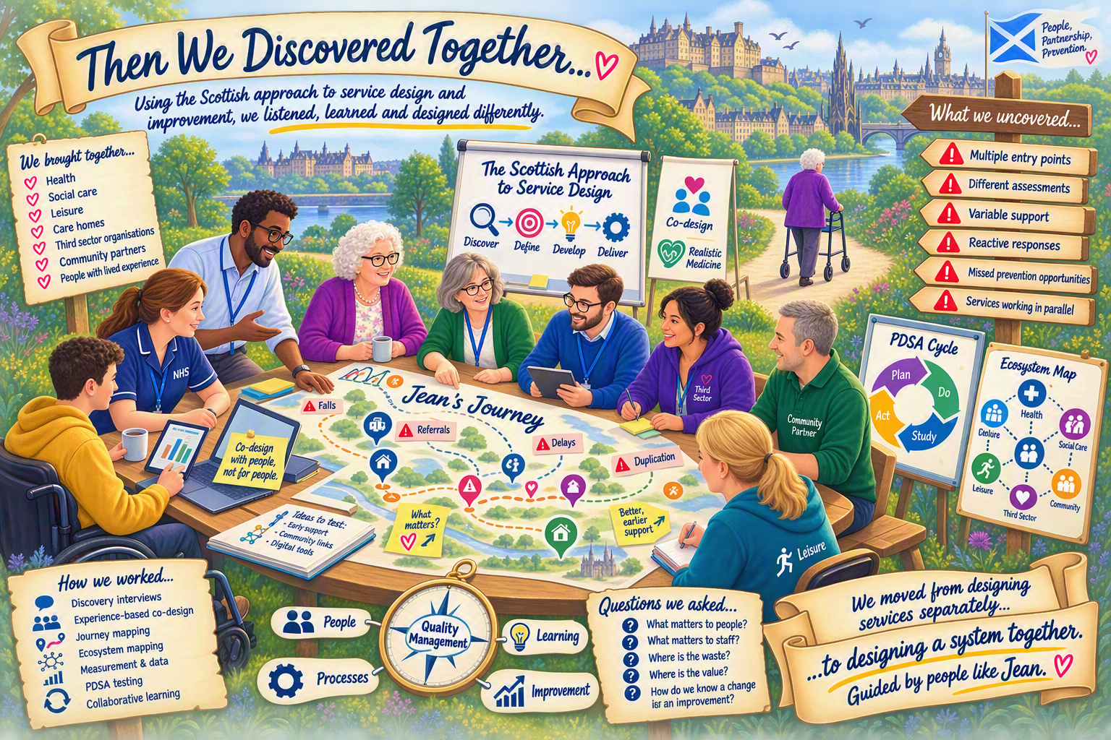

Slide 14
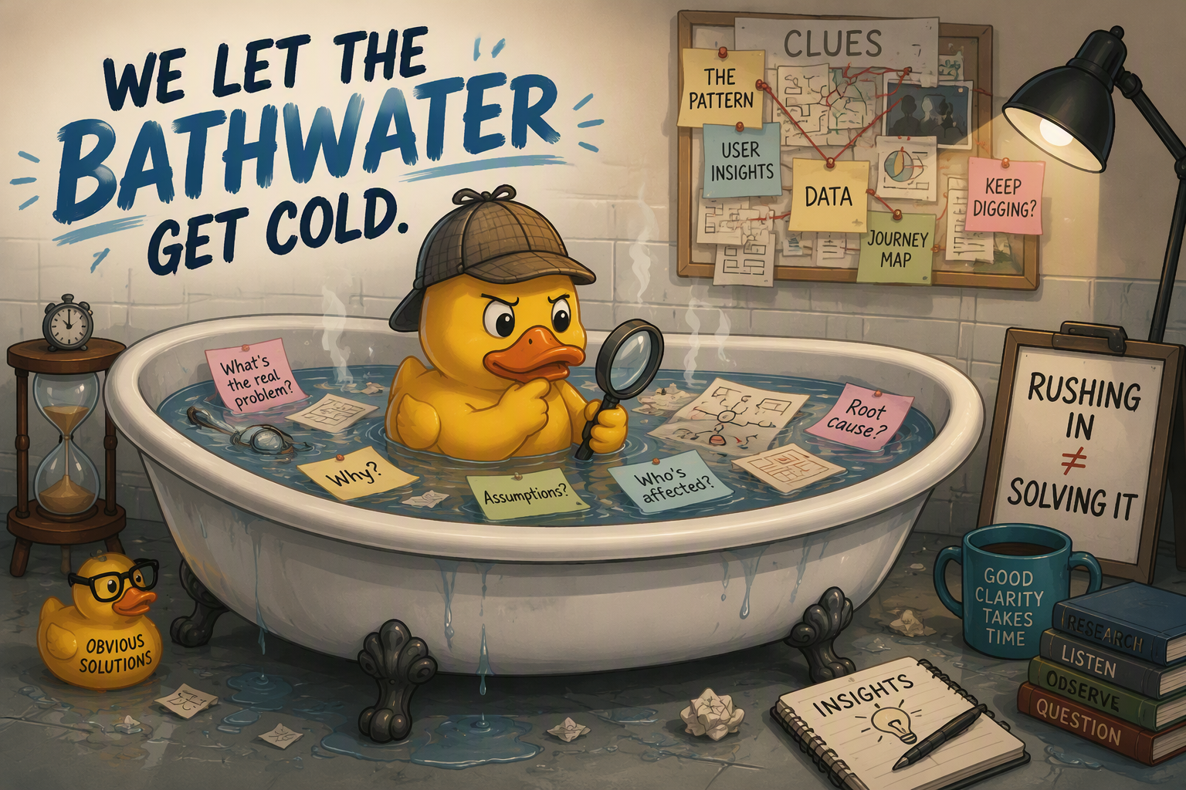

Slide 15
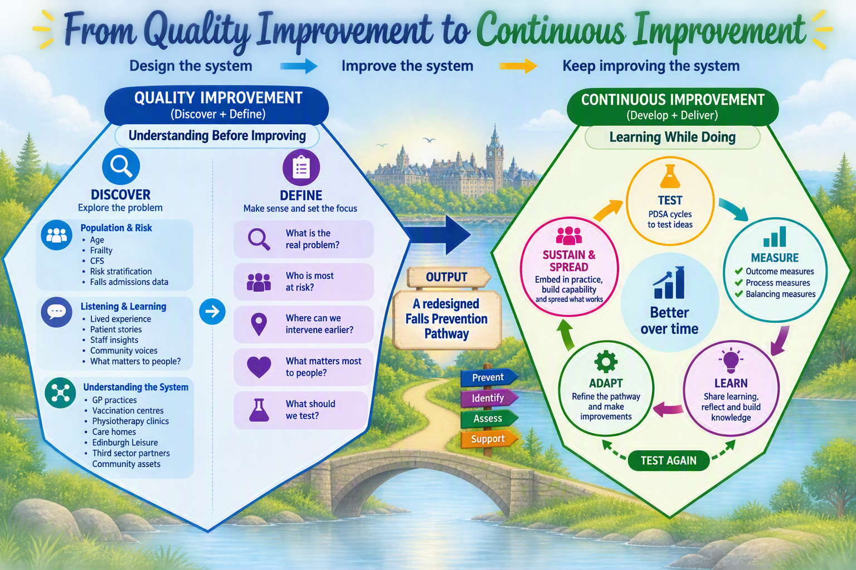

Slide 16
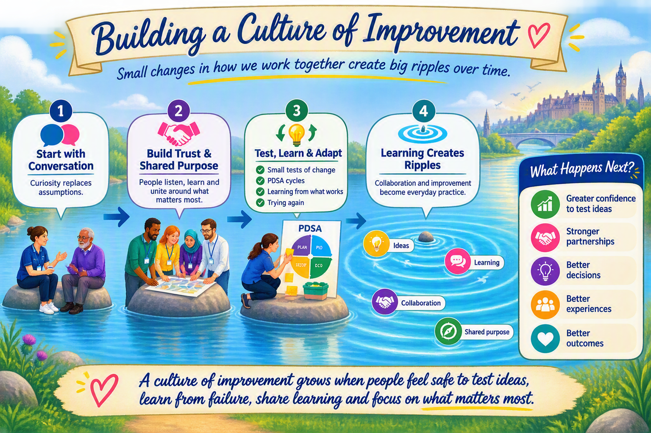

Slide 17
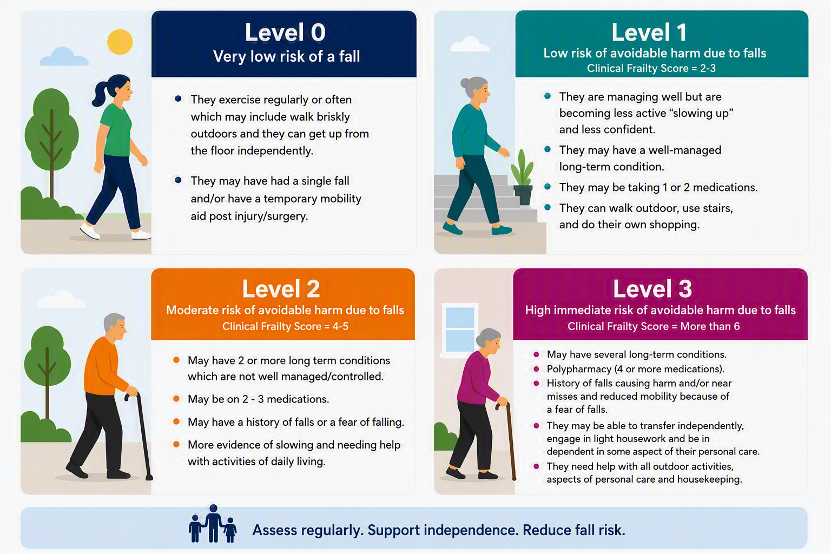
🔍 Risk Stratification Framework
Using frailty, falls risk and clinical judgement to match people to the most appropriate level of support.

Slide 18
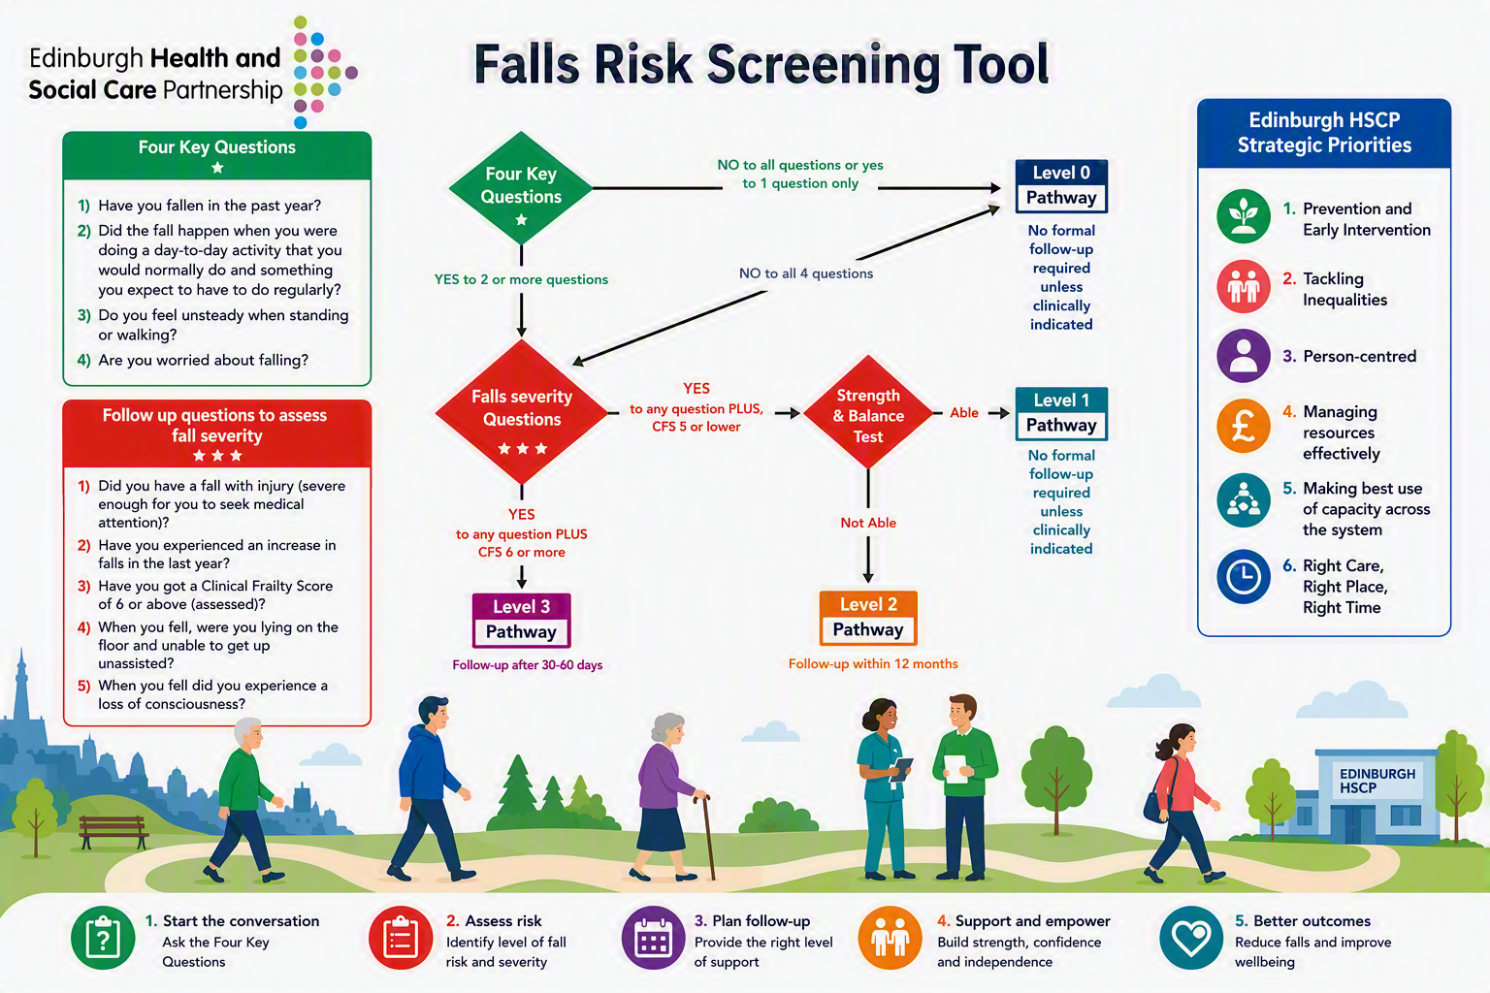

Slide 19
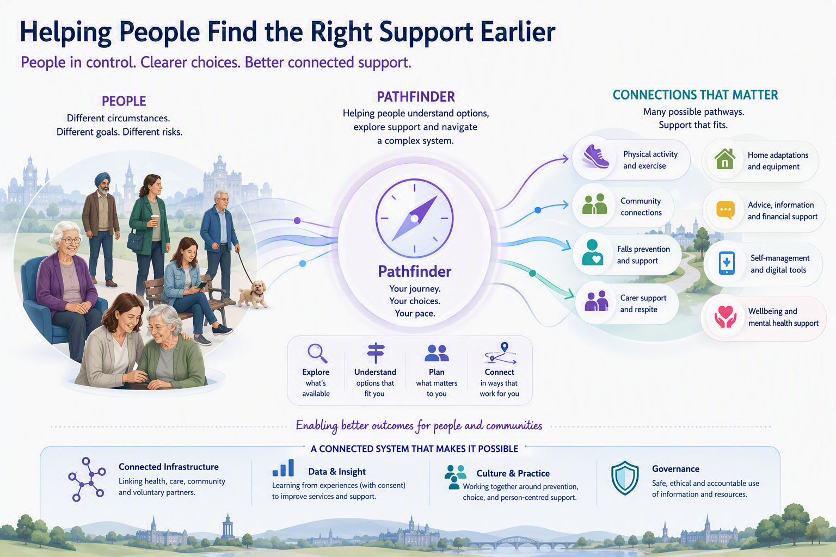

Slide 20
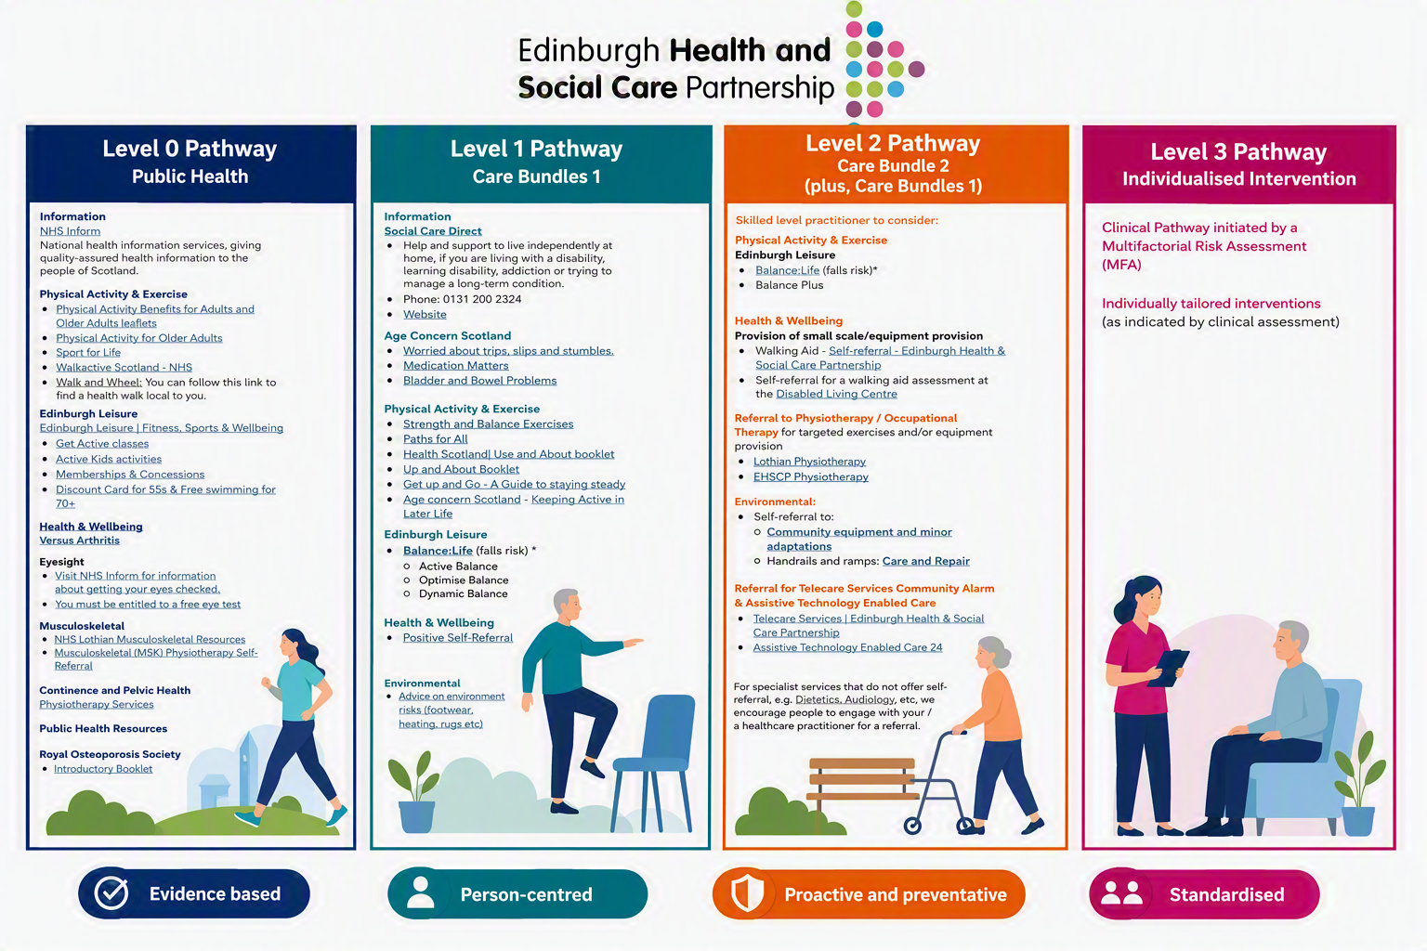
🔍 Risk Stratified Care Bundles
Using risk level, frailty, clinical assessment and personal goals to match people to the interventions most likely to reduce falls-related harm and support independence.

Slide 21
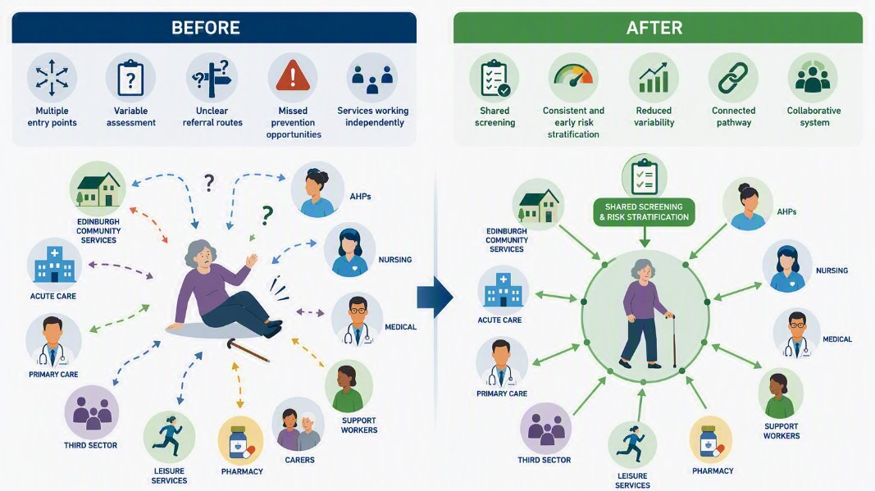
❤️ The Difference We Hope to Make
Helping people stay independent, confident and connected to the things that matter most

Slide 22
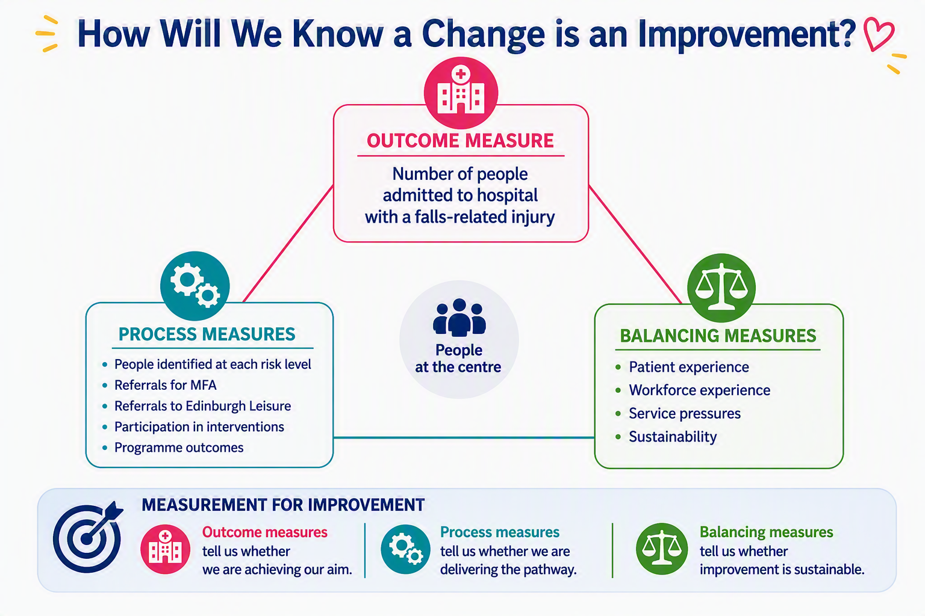

Slide 23
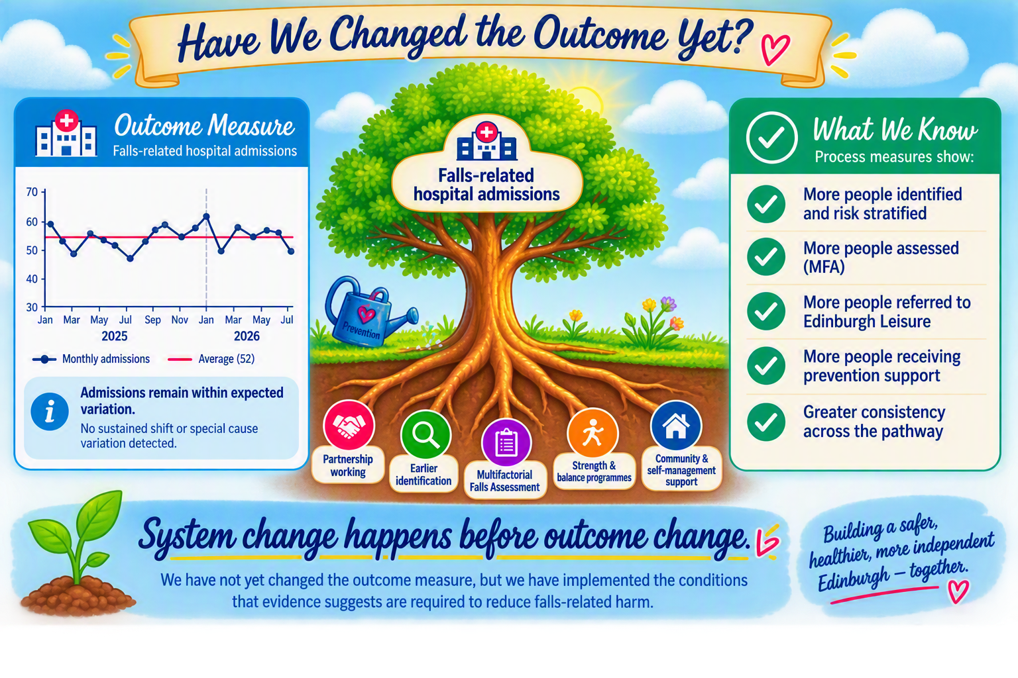

Slide 24
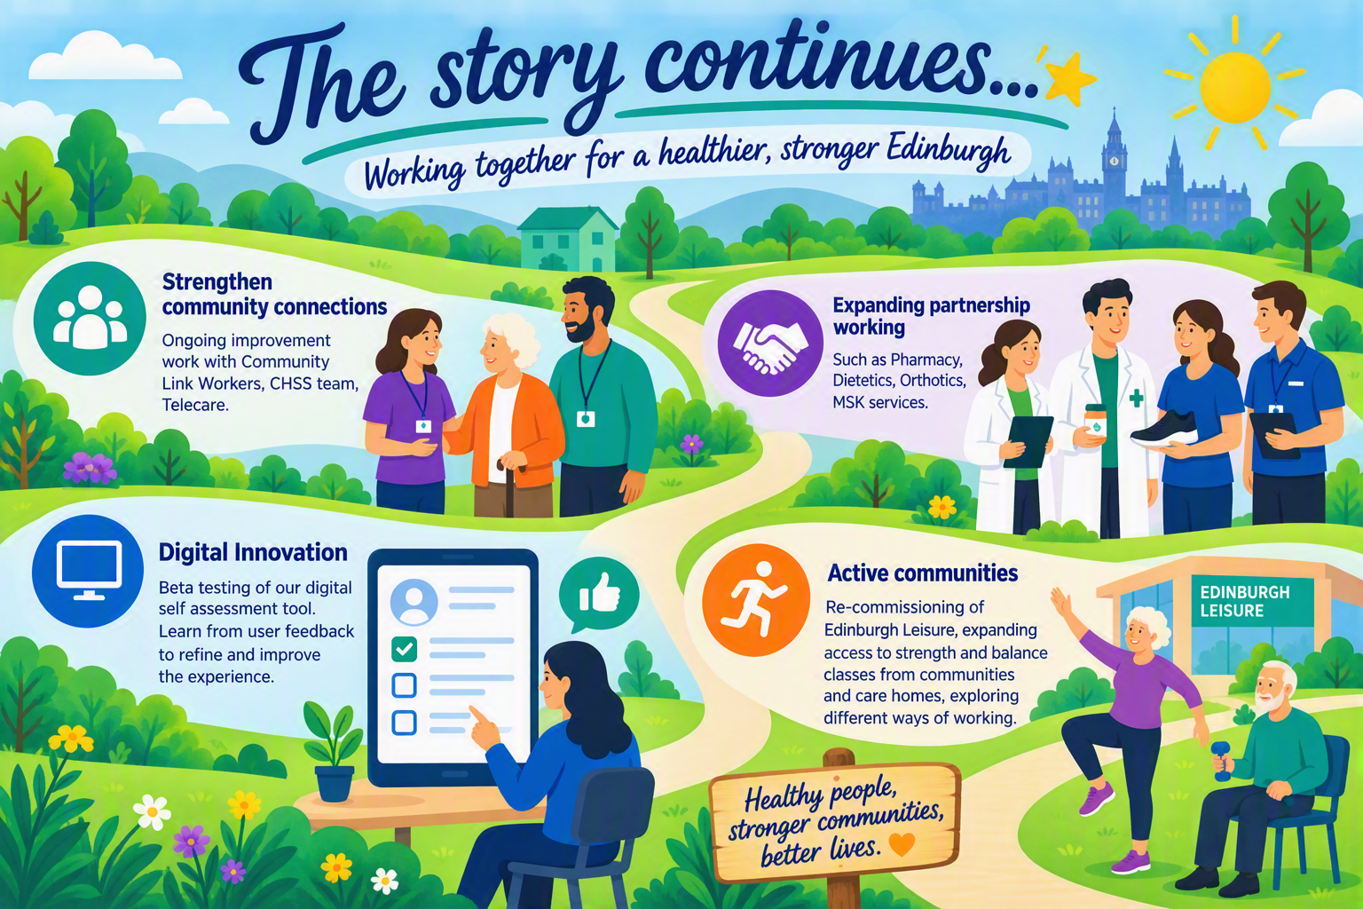

Slide 25
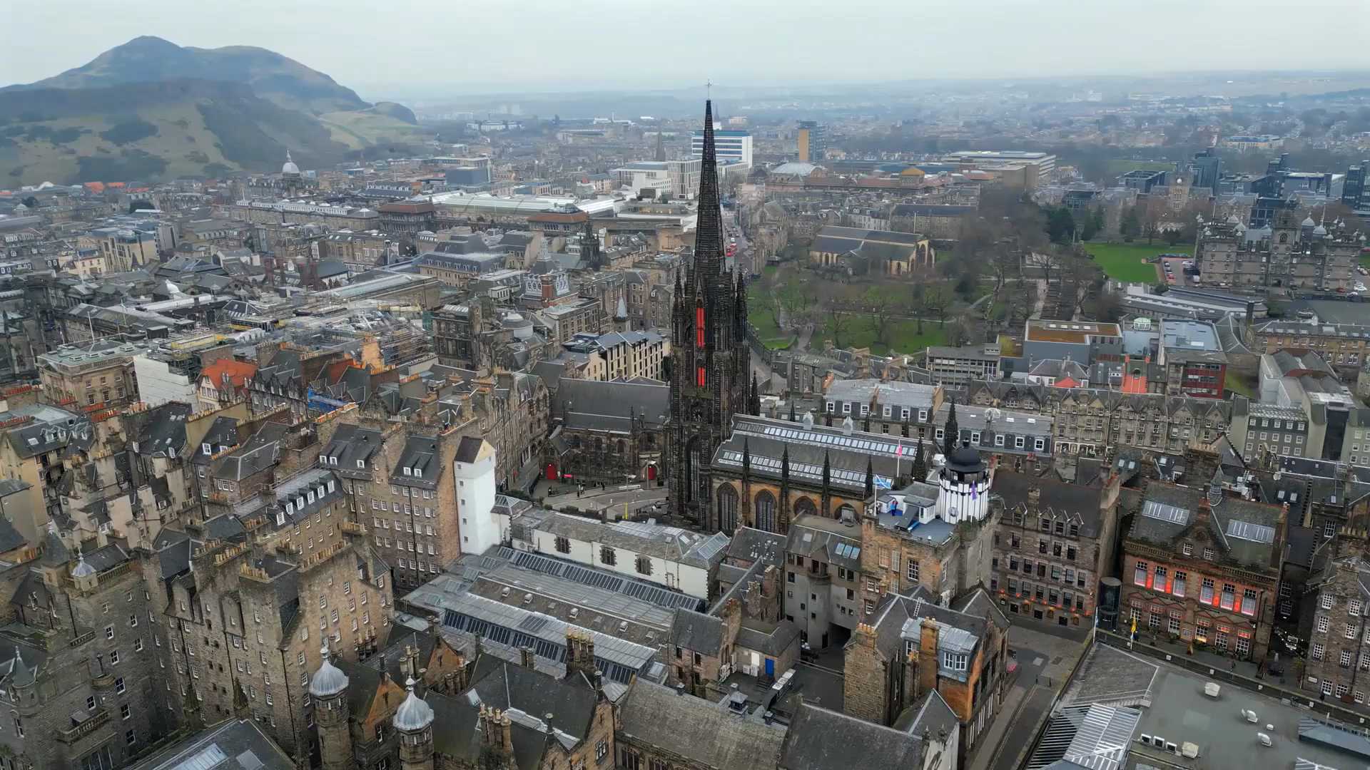
Regaining Independence

Slide 26
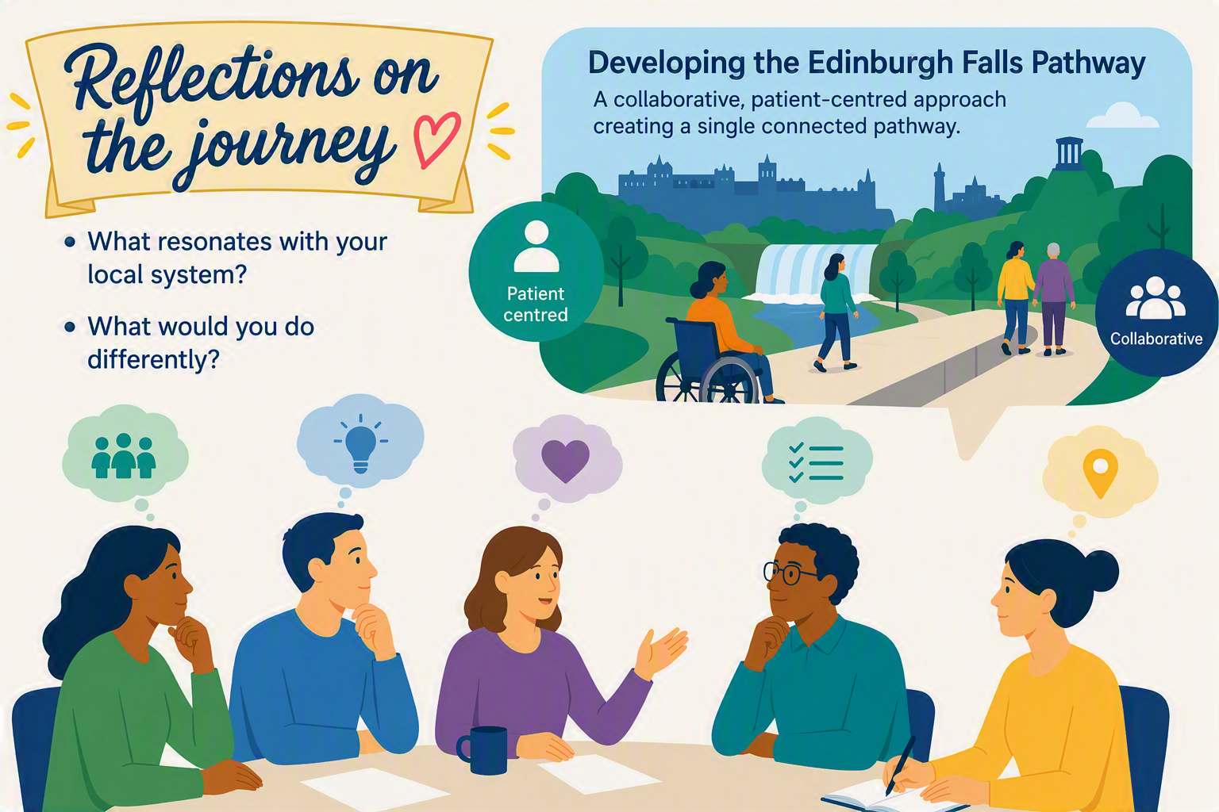

Slide 27


