Slide 1
From Foot to Heart: A Podiatry Led Approach to Atrial Fibrillation Detection and Stroke Prevention

Slide 2
Introduction
The session will describe a preventative approach developed by NHS Fife podiatry service
  What led us to this project
  The process
  Challenges
  Outcomes
  Learning
Notes:
sharon

Slide 3
Interactive session ! – socks and shoes off, slido, work in groups
Notes:
sharon

Slide 4

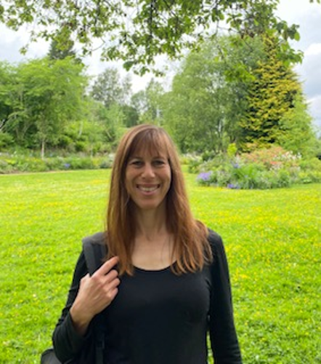
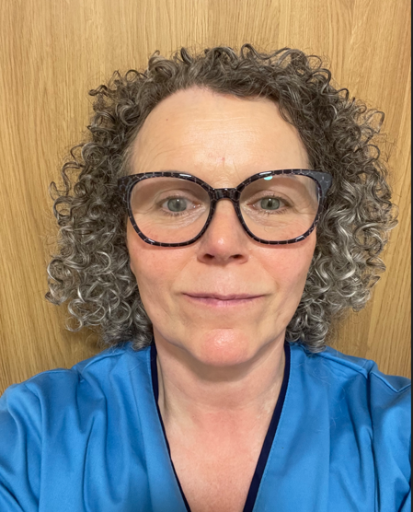
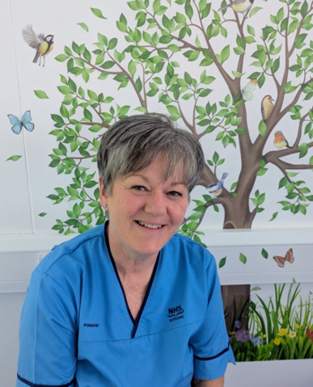
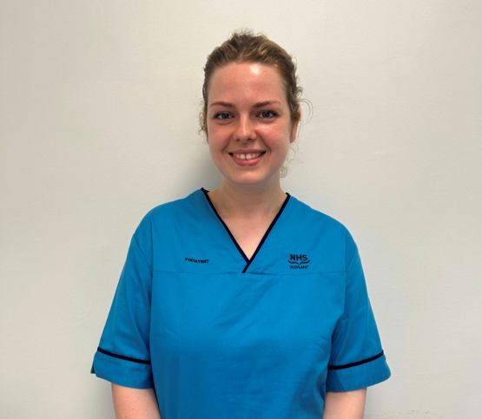
A little bit about us…
Ellie Wyatt
Sharon Wiener-Ogilvie
Toni Symon
Angela Martin
Notes:
All
My name is sharon Wiener- Ogilvie, I am the professional head of service of Podiatry in Fife ( and also currently manging the rheumatology service) . I had a portfolio career that spanned across clinical , managerial academic and education . As well as working in a number of health boards as a podiatrist and in operational roles, I worked at NES , HIS and with Scottish School of Primary care and Edinburgh university centre for population health.

Slide 5

What type of preventative services, treatments , advice and support do you think NHS podiatrists provide?
Notes:
Sharon
What’s the firs thing that comes to mind?

Slide 6
Do not edit
How to change the design
What type of preventative services, treatments , advice and support do you think NHS podiatrists provide?
The Slido app must be installed on every computer you’re presenting from

Slide 7
Slido results
Notes:
Sharon

Slide 8
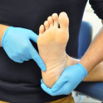
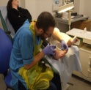
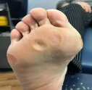

NHS Fife Podiatry
Ulceration and foot infection
Treatment of ulcers and non healing wounds
Provision of foot pressure reduction devices to support healing
MSK
Hallux Rigidus
Community events
Painful lesion
Assessment of painful lesions that restrict mobility in patients at risk of ulceration.
Nail surgery
Vascular assessment and diabetic foot surveillance
Prescribing medicines
Hallux Abducto Valgus
Lesser toe deformaties
Heel pad fat atrophy
Tibialis Posterior Tendinopathy Link
Peroneal Tendinopathy
Plantar fasciitis
Morton’s Neuroma
Cuboid syndrome
Footwear advice
Skin lesions/corns
Midfoot pain
Undiagnosed foot pain/ Metartarsalgia
Posterior heel pain
Achilles Tendinopathy
Pes Cavus (Flexible)- symptomatic.
Pes Planus-symptomatic
Surgical removal of ingrown toenails
Treatment of ingrown toenails
Prescribing of antibiotics
Diabetic foot surveillance for high risk patients
Circulation and vascular assessment
Notes:
sharon
NHS Podiatry services provide a range of treatment advice and support and our activity can classified under the following areas :
Treatment of ulcers and non healing wounds; provision of foot pressure reduction intervention; prescribing
MSK- we manage a range of foot and ankle MSK conditions including bunion, neuromas, tendonitis
We undertake nail surgery/ treat IGTn , aim to reduce antibiotic prescriptions for those conditions
We assess and treat painful lesions especially of people who are at a risk of foot ulceration
Undertake Db surveillance and vascular assessment
But we deliver more than that
Care co-ordination of patients with wounds and patients in care home with complex foot presentations – liaison with vascular, OPAT plastics, direct referrals to imaging , ECG , prescribing
Education- patient nursing staff , medial staff like FY s -In many areas podiatrist lead on CPR for feet
WE work as part of multidisciplinary team and sometimes lead Multiprofessional working – e.g in fife we have VMDFC which brings together vascular, microbiology. Endocrinology , pod and orthotists and other disciplines , who come together to agree care planning of complex patients

Slide 9
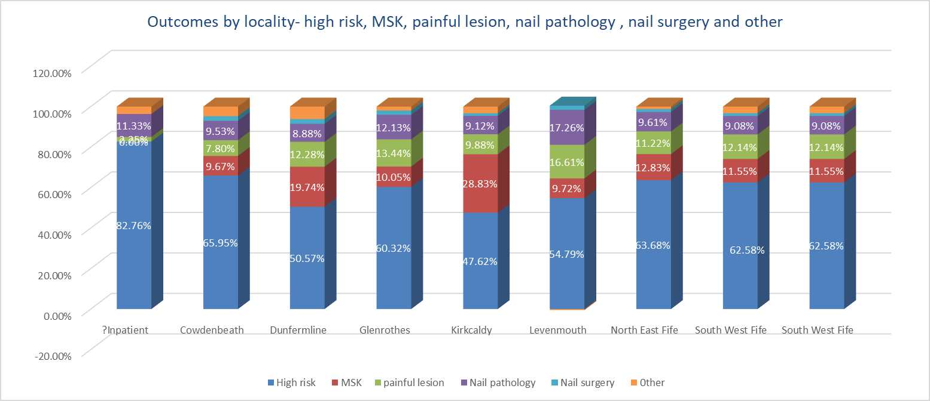
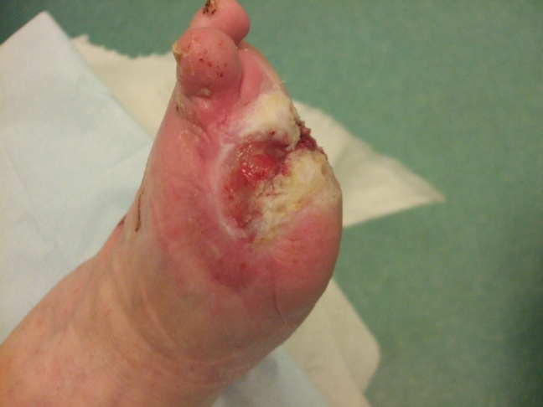
In Fife more than 60% of Podiatry patients have a high risk foot
Notes:
Sharon
When we say high risk, we mean patients that either ulcerated already indicating sig disease complexity and risk of limb loss
or at the risk of ulcerating due to PVD, poor glycaemic control, loss of sensation
On average in Fife this account to 60% of the patients we see although you will see that there is some variation across our 7 localities

Slide 10
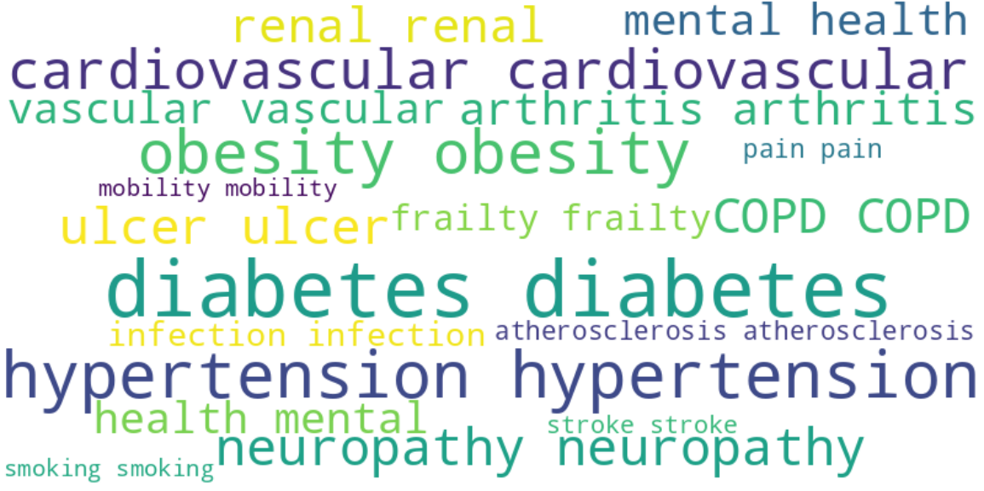
Notes:
sharon
these patients are more likely to have co-morbidites conditions that predispose them to have higher cardiovascular risk

Slide 11
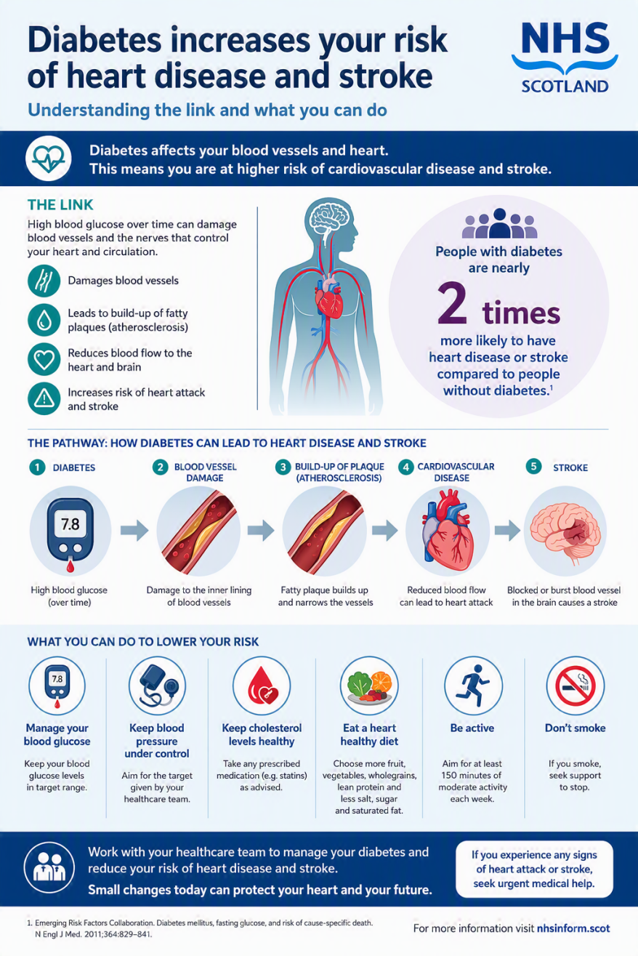
.
For example, adults with diabetes are nearly twice as likely to have heart disease or stroke as adults without diabetes. High blood glucose can damage blood vessels and nerves controlling the heart and circulation
Notes:
Sharon
Mention not all our patient are Db

Slide 12
Background

Slide 13
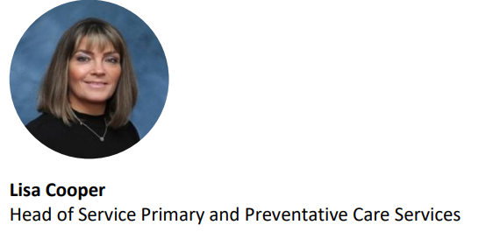

Prevention and early intervention FIFE HSCP strategy -2024
Notes:
sharon
A bit of background:
Fife HSCP hosts 3 main portfolios- complex critical care, community care and Primary and preventative care. We- podiatry were fortunate to be hosted under P&PC portfolio, headed by Lisa cooper
Gave us anchor and strategic direction to focus on preventative work
WE embarked on this work Prior to the publication of SG renewal framework and population health framework . However there was already a drive for AHPs to play a significant public health role and this was also reflected in the revised Healthcare professional Council , our regulator , standards of proficiency – promote health and prevent ill health

Slide 14
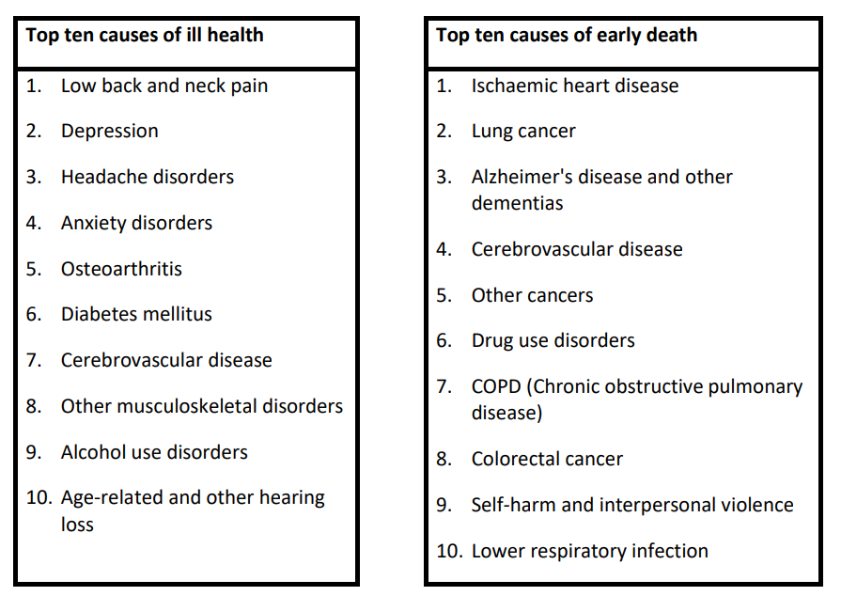

Notes:
Sharon
The fife Prevention and early intervention strategy that was approved by the IJB, identified some key areas of priority . These mirror priorities in the rest of Scotland where
the top causes of ill health include DB and CVD with IHD and CVS being the to 10 causes of early death

Slide 15

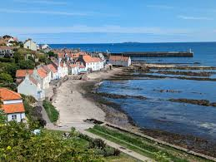


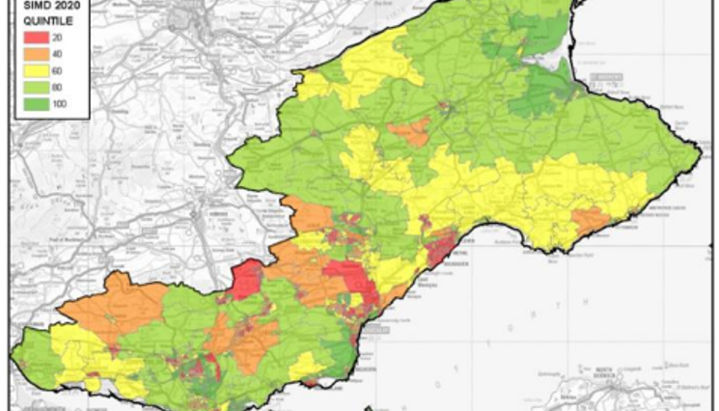
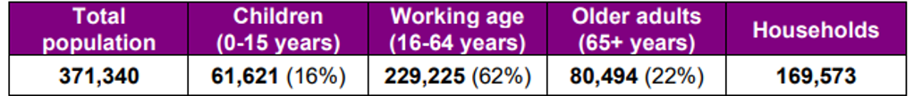
Notes:
Sharon
In Fife , we are Blessed with beautiful coastline, and I am sure many of you visited Fife as tourists but we also have significant areas of deprivation, Glenrothes, Levenmouth-
We also have a significantly high elderly population in NE Fife which lives longer and eventually develops chronic disease

Slide 16
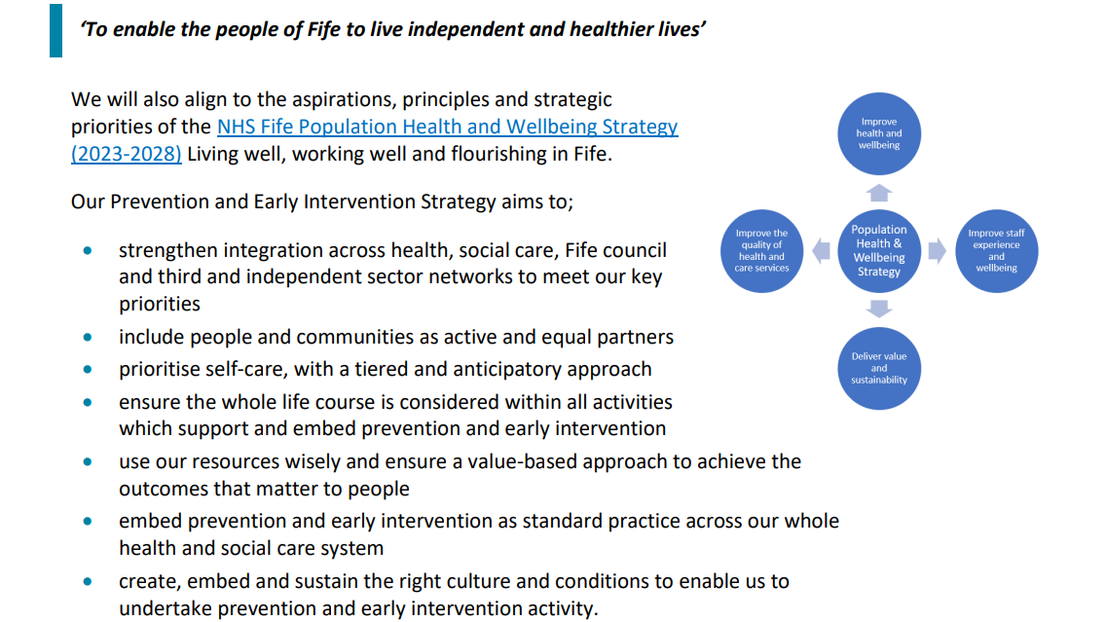
Notes:
The Fife population health strategy had a number of objectives
6th bullet point focused on embedding preventative services

Slide 17
Atrial fibrillation (AF)
Stroke remains a leading cause of death in Scotland
Atrial Fibrillation (AF) is thought to be present in around 9% of people over 65 years.
With a population of 374,700 and approx 80,000 of those over 65 years old, Fife have the potential to have approximately 7,200 people with AF.
It is estimated that one in five strokes can be attributed to undiagnosed AF
Notes:
Angela
So far this is the background for the work. Now we talk about Atrial fibrillation :

Slide 18
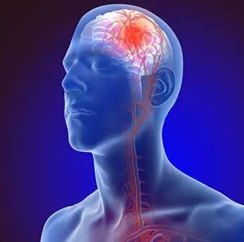
AF related strokes are associated with greater disability and mortality than non-AF related strokes thereby resulting in significant personal, societal and NHS costs.
Heart Disease Action Plan (2021) & Stroke Improvement Plan (2023), aim to prevent as many strokes as possible by early detection of key risk factors such as AF.
As part of the action plan, a national arterial fibrillation steering group came together to drive improvements in detection and management of AF in Scotland
The development of models to establish ways to reach people who are less likely to engage with healthcare is a recognised priority for both the heart and stroke action groups.
Notes:
Angela

Slide 19
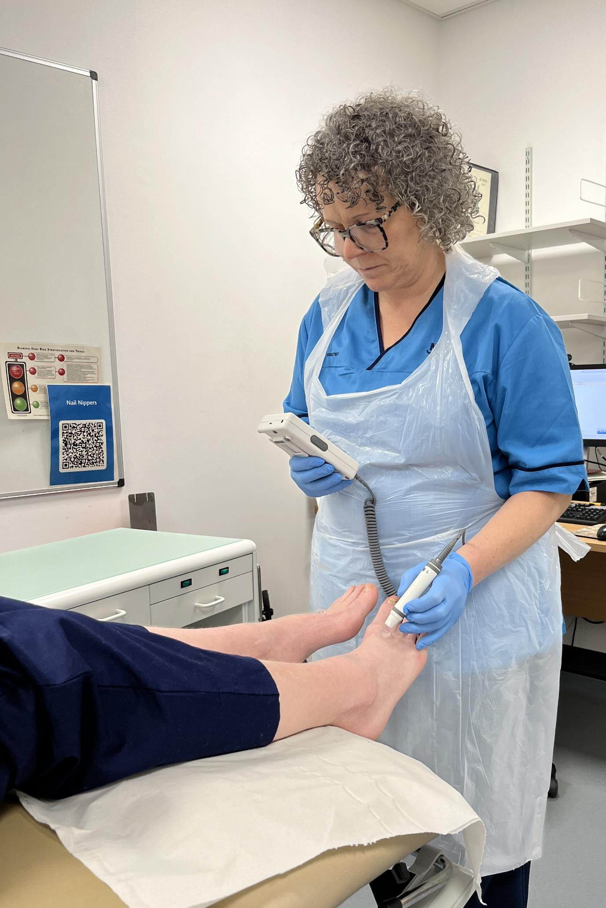
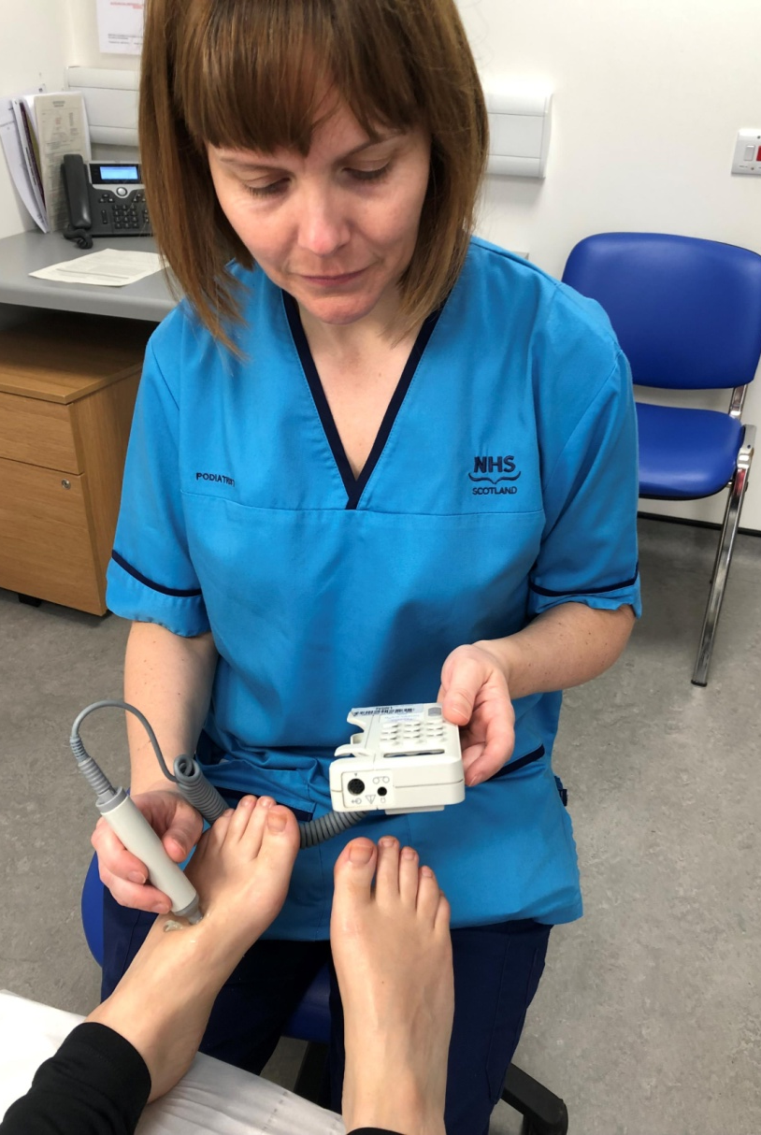
Podiatry practitioners are ideally placed to undertake pedal pulse surveillance
Notes:
Angela
Podiatrists are trained to identify foot pulses and therefore ideally placed to undertake pedal pulse surveillance.
Podiatrists can assess pedal pulses using hand-held dopplers, the sound waves generated, can help identify abnormalities in cardiac rhythm.
As a result, our teams are well placed to detect arrhythmia as part of routine vascular assessment which informs individualised preventative care planning. Podiatry clinics, where diabetic foot surveillance, preventative foot health care and wound management is provided, allows a premium opportunity to identify anyone with an undiagnosed cardiac arrhythmia and arrange for an ECG to be undertaken to address and minimise their risk of stroke and/or cardiac failure.
Management of arrhythmia requires precise diagnosis of the type of arrhythmia and electrocardiography is essential. Identification of AF is typically detected by a 12-lead ECG carried out in either secondary care or General Practice.

Slide 20
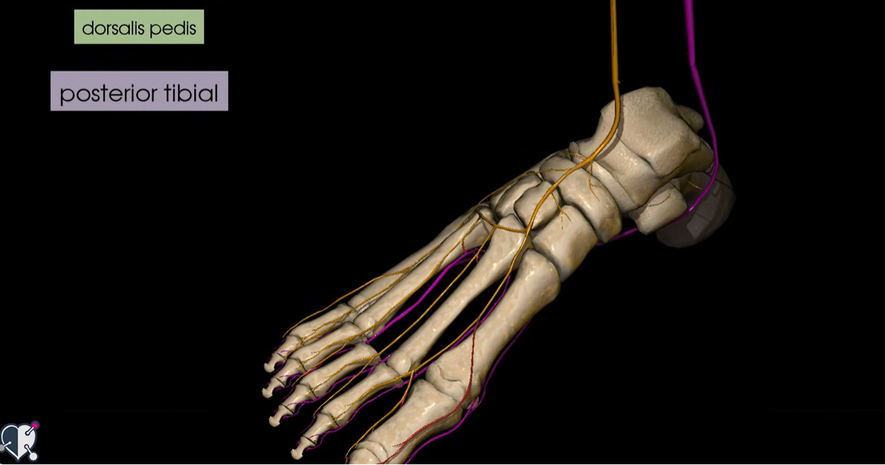
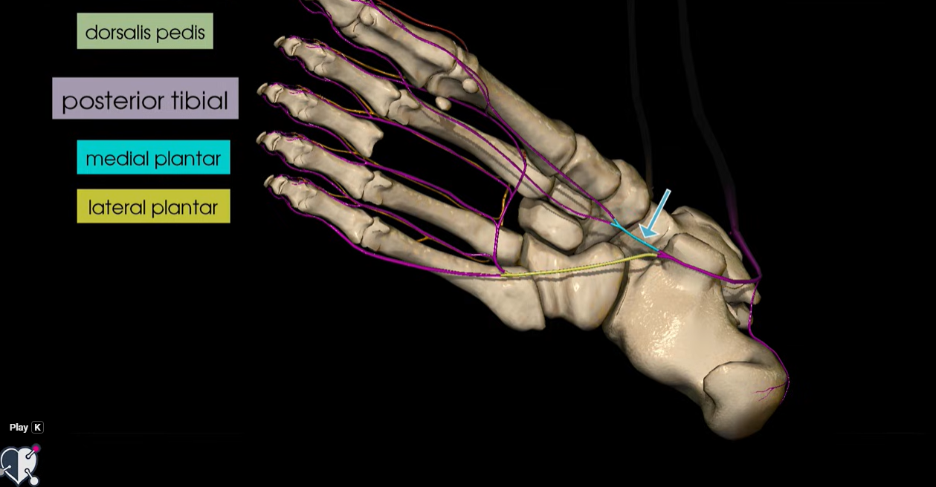
Notes:
Angela
So lets talk about the arteries of the foot:
There are 2 main arteries that supply the foot: DP and PT both split to supply the whole of the foot as you can see from this picture

Slide 21
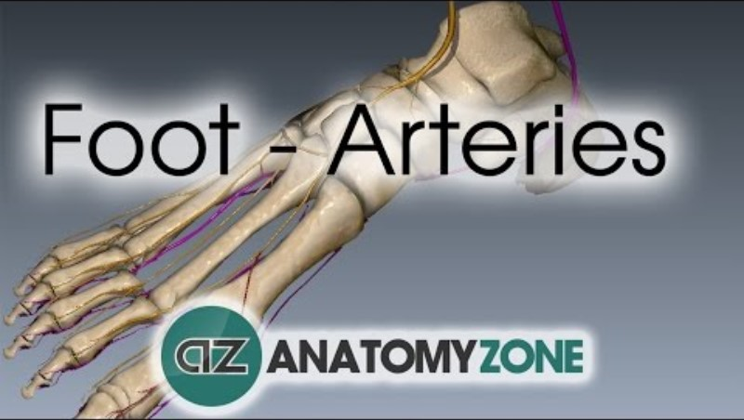
Notes:
Angela
Start at 17 seconds

Slide 22
Activity – demonstration and then try in groups
Find your Dorsalis pedis or and Posterior tibial arteries
Notes:
All work in groups

Slide 23
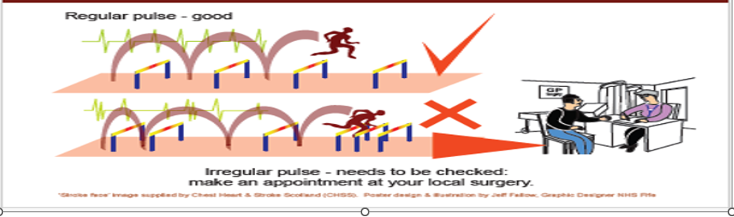
Regular and irregular Rhythm
Notes:
Angela
WE thought the following image is good to illustrate a regular and irregular pulse.
You can see that regular pulse is running at regular intervals which are the same length
With irregular pulse the interval vary in length

Slide 24

Activity- regular or irregular sound?
Notes:
Toni/angela
We will first let them hear all, they will mark on a paper if regular or not and then Toni will go over describe some of the issues with each pulse
1.Regular
2.Iregualar
3. Regular
4. Irregular?
5. Regular
6. Regular ( monophasic)
7. Irregular
8. Irregular
9. Irregular
10. Regular.

Slide 25
Aim..
We wanted
To establish whether early AF identification by Podiatry Services, with direct referral to ECG enhances patient care and saves GP resources within the Fife Health and Social Care Partnership.
To improve upon existing pathways of care for adults with unidentified cardiac arrhythmia
Notes:
Toni
NHS Western Isles had piloted this ' proof of concept' successful using cardia

Slide 26
Process

Slide 27
Test of change 1 – Feasibility (PDSA1) in one locality
PLAN - Hand held Doppler sounds for every patient attending for Podiatry care over a 4 week period within a single locality ( Glenrothes)
DO - If an arrhythmia was identified, we followed the existing pathway for referral for ECG (via GP)
Data was gathered on a spreadsheet so that the prevalence was established.
STUDY - Within the study period, 10 people were identified, only 1 person’s arrhythmia was undiagnosed.
ACT – We established there were no inappropriate referrals. We sought to develop a more simplified pathway of care ( next slide)
Notes:
Toni
To start with we held discussion with the ECG service.
We discussed kardia – a simple hand held devise that was used in the Western Isles pilot , with our ECG department who suggested direct referral to them would be better as it will be more sensitive than Kardian however ECG colleagues were worried about the impact- will they receive too many referrals? Will the referrals be appropriate?
We knew that we had :
a TV lead in Glenrothes , who came up with idea and was keen to test it
We already had dopplers available in the clinic in Glenrothes , in addition Glenrothes- high deprivation area so we though there will be scope for detecting undiagnosed AF
Read the Plan, do study act slide

Slide 28
Pathway under PDSA1
Proposed pathway (PDSA2)
Patient identified in podiatry as having an arrhythmia using doppler
Podiatrist refer for ECG/ inform GP
ECG undertaken and report available on portal
Podiatrist check portal and write to GP to inform report is available
GP checks report on portal
GP -medical management/social prescribing
GP actioned medical management
Patient identified in podiatry as having an arrhythmia using doppler ( opportunistically)
ECG report sent to GP
Letter to inform GP
Or GP refers to Acute for ECG
GP may carry out ECG in practice
The above often necessitate appointment with GP
Notes:
Toni
In the previous PDSA 1 - podiatrist informed the GP that there is suspected AF and that an ECG is merited. GP then either carried out ECG in their practice or referred to ECG. Following referral to ECG GP received the report and initiate medical management as require
The new process PDSA2 saved GP appointment – podiatrist refer directly to ECG notifying GP that they have done so by letter . Podiatrist awaits ECG results on portal – 2 weeks later and once available send a letter to GP notifying them that the results are available . GP instigate medical management/ social prescribing .
Important to emphasise that p[prior to moving to PDSA 2, we sought support from ECG and from GP LMC

Slide 29
PDSA 2- spread/ scaling
Plan – agreement with ECG, GPs and pathway and letters to support podiatrists with the process , training delivered.
Do - rolled out new pathway Fife wide, every adult new to Podiatry received AF screening using hand held doppler.
Existing patients received screening opportunistically
Study: At 3 month we audited referrals : 13 ECGs were requested with 1 new case of AF being identified. Of the other 12 cases, various cardiac irregularities were identified for GP input as required.
Notes:
Toni
Plan- we agreed with ECG department and GPs LMC that we will refer directly to ECG. We also developed letter on Morse to support podiatrist to make the referrals ; these letters made the process simple as information was pulled automatically.
Do – rolled out new pathways fife wide, with every adult new to podiatry receiving AF screening using hand held doppler
Existing patients received screening opportunistically
Study –At 3 month we audited referrals : 13 ECGs were requested with 1 new case of AF being identified. Of the other 12 cases, various cardiac irregularities were identified for GP input as required.

Slide 30
The second test of change identified some concerns
Not all staff engaged in the screening process
Equipment- insufficient number of dopplers
majority of podiatrists were sending the letter for ECG and the follow-up letter to the GP at the same time, causing confusion
LMC -GPs raised concerns that they do not check portal and having to obtain the report from portal, rather than having the report sent by ECG was a hindrance
Notes:
Toni

Slide 31
PDSA 3- simplified pathway
Patient identified in podiatry as having an arrhythmia using doppler
Podiatrist refer for ECG
ECG undertaken and report sent to GP
GP action medical management/social prescribing
Every adult new to the NHS Fife Podiatry service received opportunistic screening using hand held doppler ultrasound. Existing patients screened as part of their lower limb vascular updates.
Notes:
Ellie
Rolled out simplified pathway Fife wide.
New process:
Pod uses Doppler to identify arrhythmia ( reduced the need for the patient to see the GP)
Podiatrist refers to Acute for ECG – via a letter – and also inform GP
ECG department undertake ECG and report sent to GPs via docman
GP sees patient for medical management as appropriate – reduce the need for second letter
For a 3 month period

Slide 32
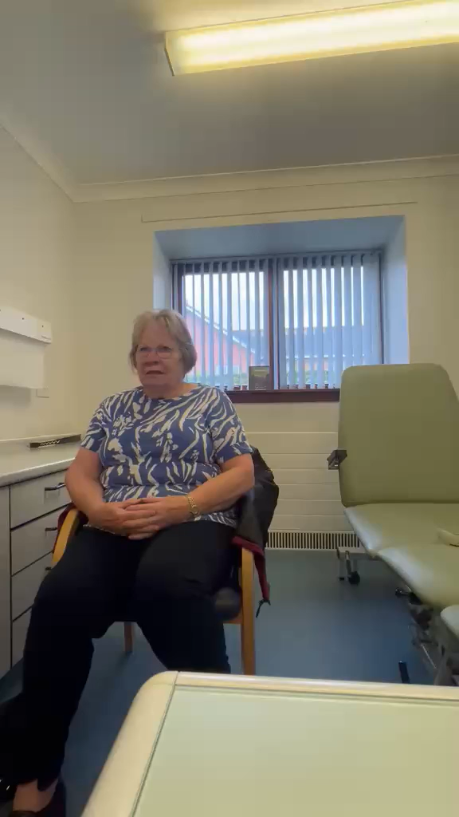
Patient perspective
Notes:
Ellie

Slide 33
Outcomes-

Slide 34
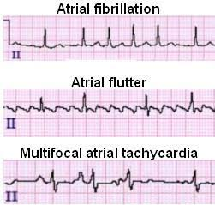
Further evaluation- 6 months
33 patients referred for ECG
10 cases of AF were identified
16 other cardiac conditions which require additional monitoring or medical input in order to minimise future cardiac conditions
Notes:
Ellie

Slide 35
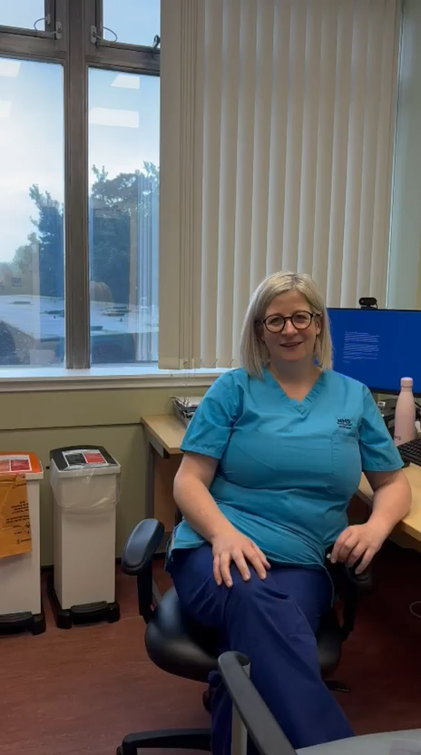
Preceptive of ECG
Notes:
Ellie

Slide 36
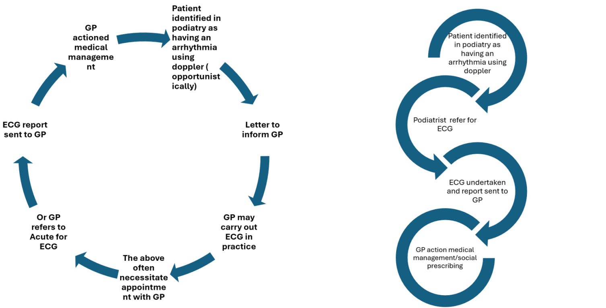
The difference it made
Early identification and timely intervention to reduce stroke risk and avoidable deterioration
Reduced number of GP appointments , shorten patient journey
Notes:
Ellie

Slide 37
What was required to support spread?
Governance
Staff skills and competence
Process in place to support staff and communicate with ECG and GPs
Engagement with GPs, Diabetes and Vascular Managed Clinical Networks.
Notes:
Sharon
We needed good governance – we couldn’t be in a situation that ECG results were missed ,
We needed clear process for staff 0 standardised approach in terms of letter
We needed to ensure that staff are trained – our workforce is mix some new graduate some long standing staff some of which working in specialists roles and we wanted to ensure they were all trained
WE needed the support of GP colleagues , ECG and MCN

Slide 38

Issue
Solution
Process of referral
Agree a process with ECG for the whole service
Proposal to LMC
Agreement with GPs, including how we would communicate
Clear written SOP to podiatrists
Clear written pathway to podiatrists and template letters
Training to all staff- AF identification but also on the SOP, ensuring all have dopplers
Notes:
Sharon
Discussion with ECG and agree how podiatrist will refer to the service
Proposal to LMC and feedback from GPs
Clear SOP to podiatrists
Training delivered to all staff in their localities, regarding process of onwards referral
Reaudit Podiatrist are trained but we re-delivered training sessions and ensured

Slide 39
Challenges

Slide 40
Adherence- audit
Was the process of screening new patients for AF being carried out?
A single reviewer randomly selected one new patient from every general clinic, the record card was checked for the recording of Doppler/AF findings.
Of the 47 records checked, 1 did not have a record card completed, of the remaining 46 records, 25 (54%) had recorded Doppler findings the remaining 21 (46%) did not.
Notes:
Angela

Slide 41

Main challenges
Embedding the new process as business as usual for all NP podiatry appointments and all existing patients annually - reminders to staff through weekly updates , re-enforce in departmental training
Funding for additional equipment at time of financial pressures
New staff
Notes:
Angela

Slide 42
Learning

Slide 43
Key learning
Importance of getting GPs on board and that our process are aligned to GP practice procedures.
Staff upskilling
Importance of governance – process and procurers written down
Asset register t of dopplers to align to staff ( identified that we have more dopplers per staff)
Joint working with ECG - we developed relationship with the service
The importance of using the model for improvement as it allowed us to identify changes required and continuedly refined the approach
The need to continue to re-enforce screening with staff
Notes:
Angela

Slide 44
Discussion in groups
What can make this happen in your health board?
What other collaborative approaches would you consider, between services in your board area, to support preventative care? of AF or reducing CHD risk
Notes:
Angela

Slide 45
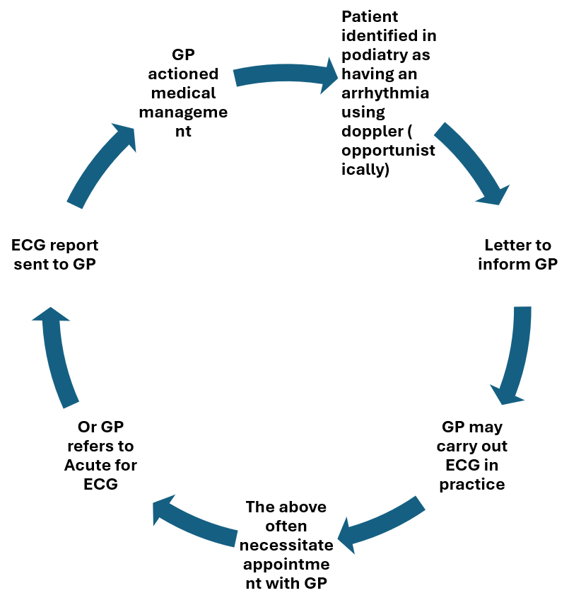
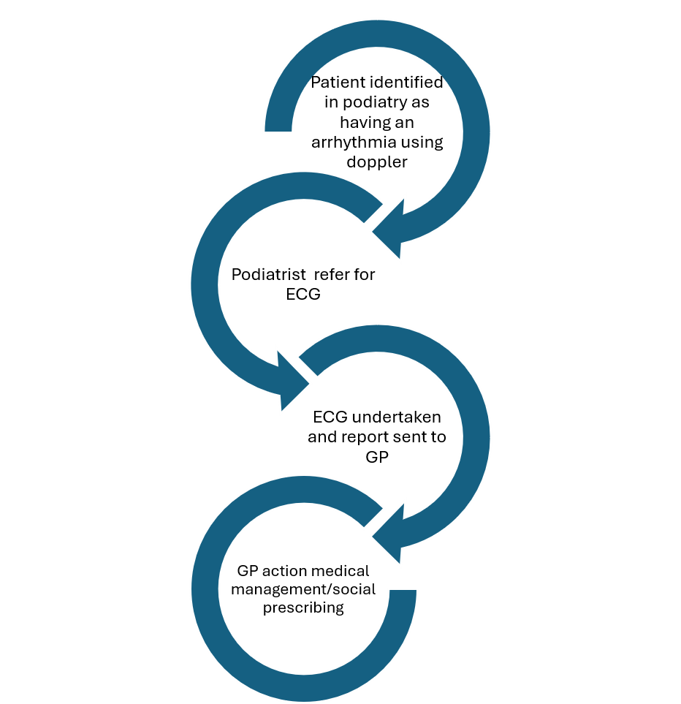
Notes:
make a

