Slide 1
Addressing Health Inequalities:
An Inclusive and Integrated Approach
Transforming screening data analytics and local intelligence

Slide 2

Using your web browser go to: sli.do
Enter the participant code:
9960900
QUIZ
HSCP Screening Inequalities Programme

Slide 3

The Challenge
1.6 million invitations are sent annually
About 30% do not attend
There is a high correlation between deprivation and non-attendance.
By understanding the barriers to attending we can focus resources and personalise services to facilitate participation
HSCP Screening Inequalities Programme

Slide 4





Focus of our collaboration with HSCPs
Data Intelligence
Cervical Screening
Identify factors
How might we use personalised communications to help improve cervical screening uptake in West Lothian?
Service Design
Predictive Analytics
Co-design solutions
Bowel Screening
Focus resources
How might we leverage health and social care touchpoints to increase bowel screening uptake in North Lanarkshire?

Slide 5
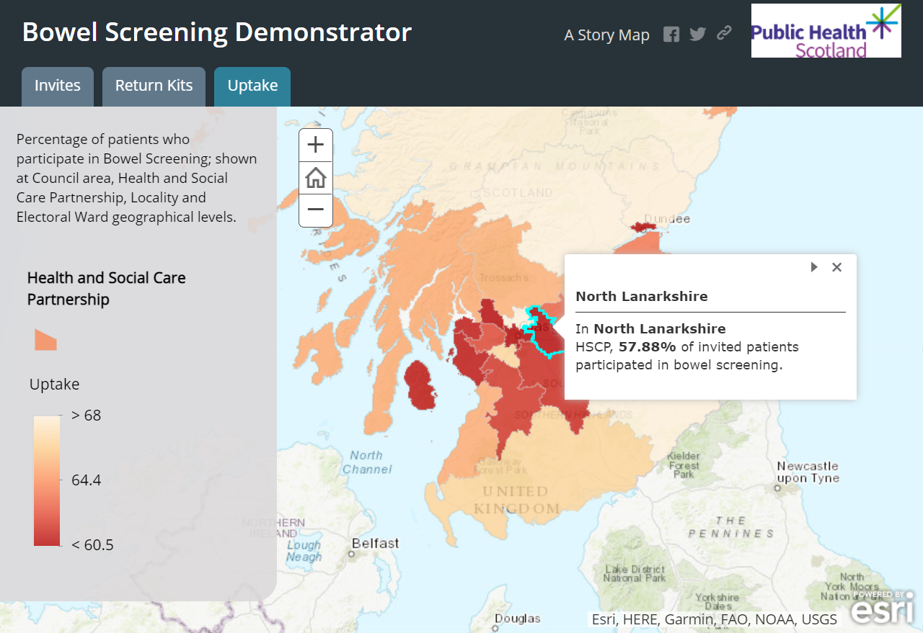
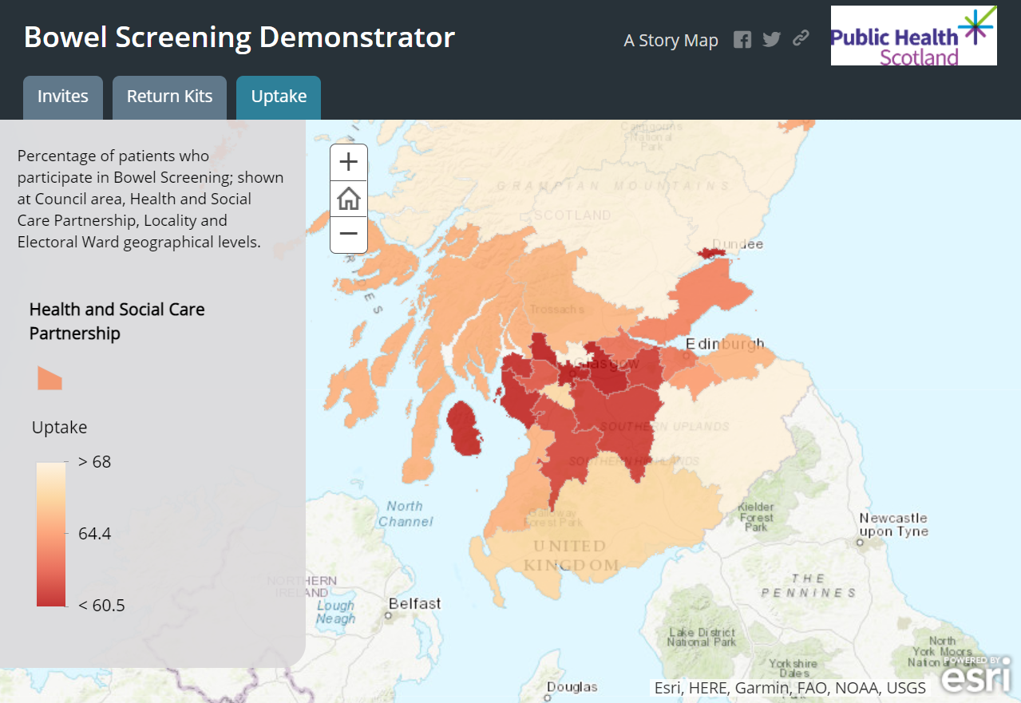
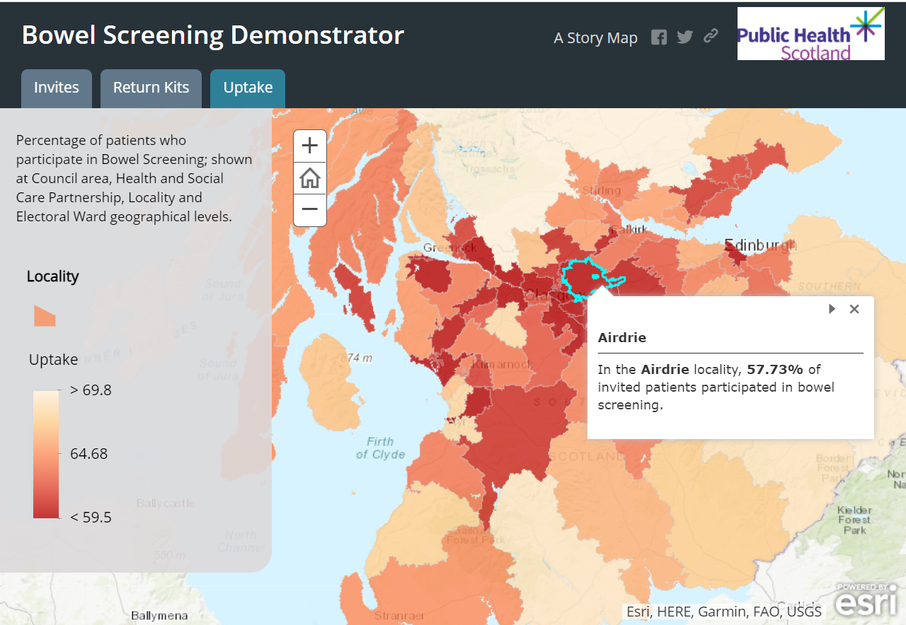
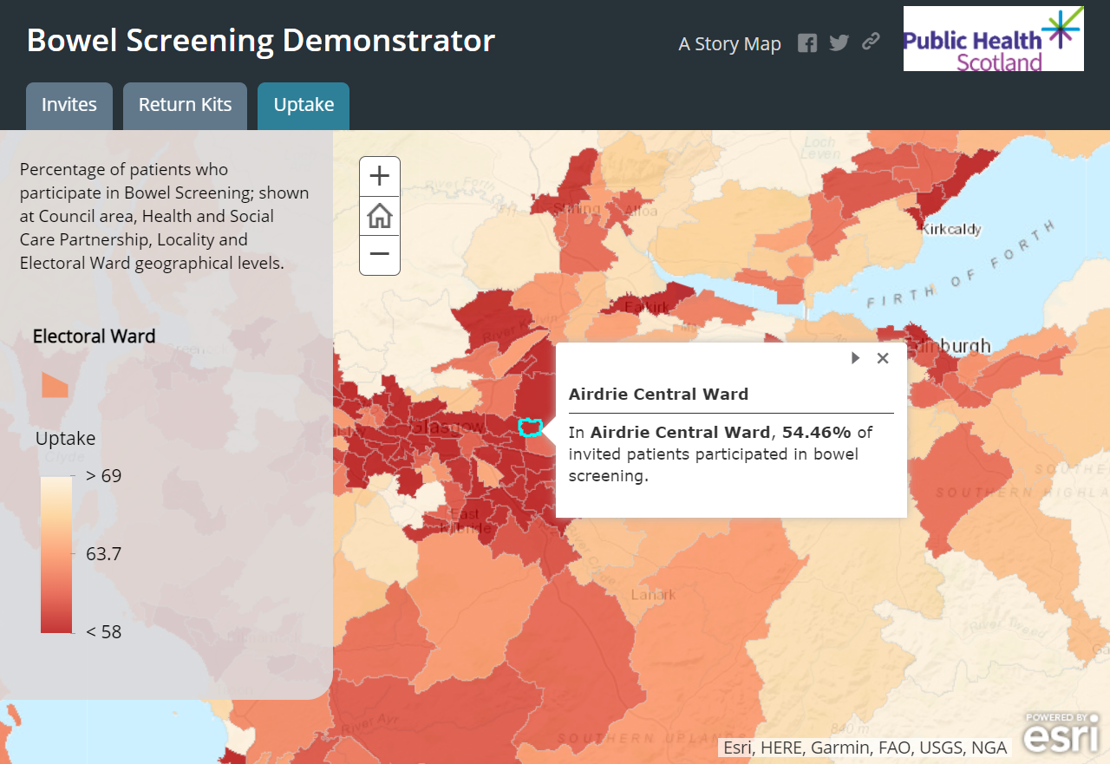
Geographic presentation of data
HSCP
Locality
Ward
HSCP Screening Inequalities Programme

Slide 6

Contextual information to help understand the impact of screening
Source: ONS
The earlier cancer is detected the better.
HSCP Screening Inequalities Programme

Slide 7









Our service design journey
Interviews with those with lived experience
Focus groups on ideation
Scoping / prototyping workshop
Kick off workshop
Workshop to refine areas for exploration
Synthesis and insight write up
Prioritisation of ideas
Blueprint / roadmap of service implementation
TIMELINES
August to November 2021
December to June 2022
HSCP Screening Inequalities Programme

Slide 8




4 Carers
Who we listened to
25 citizens
Nurses, GPs
33 Semi-structured interviews
North Lanarkshire
HSCP
4 GPs
West Lothian HSCP
169 Participants
engaged across the 8 workshops
Health Improvement and Public Health Scotland
Scottish Government
Deafblind Scotland
Networking Key Services
Service Managers
5 Focus Groups
Visibility
Scotland

Slide 9
Behaviours in screening
“Our current approaches are failing to engage the most vulnerable.”
Professor Katie Robb, University of Glasgow
Participant influences
Unaware
Unengaged
Undecided
Decided not to act
"I think the understanding of what a cervical smear actually is across our patient group is not great, actually." ​
"Homeless populations or those who are unregistered aren’t picked up by the screening service and it relies on organisations to find them"
​
"I don’t know whether it’s the information side of it or having the freedom and independence to go as and when it’s right for you, as and when it’s your business, it’s not to do with anyone else."
"Losing your vision does kind of take away the same kind of access and privacy, confidentiality that other women have. You lose a bit of that. You feel like public property."
Environment influences
SOURCE: Kathryn A. Robb, The integrated screening action model (I-SAM): A theory-based approach to inform intervention development, Preventive Medicine Reports, Volume 23,2021,
HSCP Screening Inequalities Programme

Slide 10
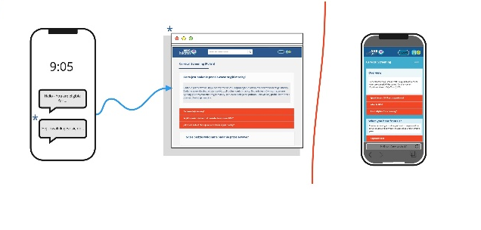
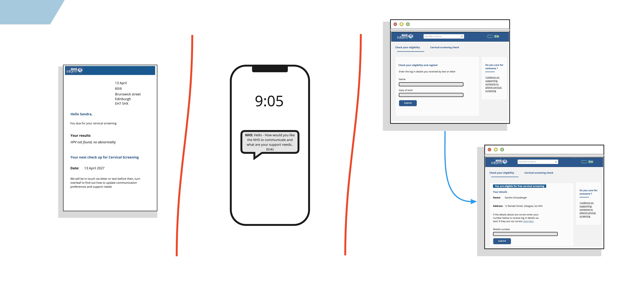
Proposed ideas for pilot – cervical screening
Text messaging service
Screening record
Pre-appointment
Easy read & Signposting

Slide 11
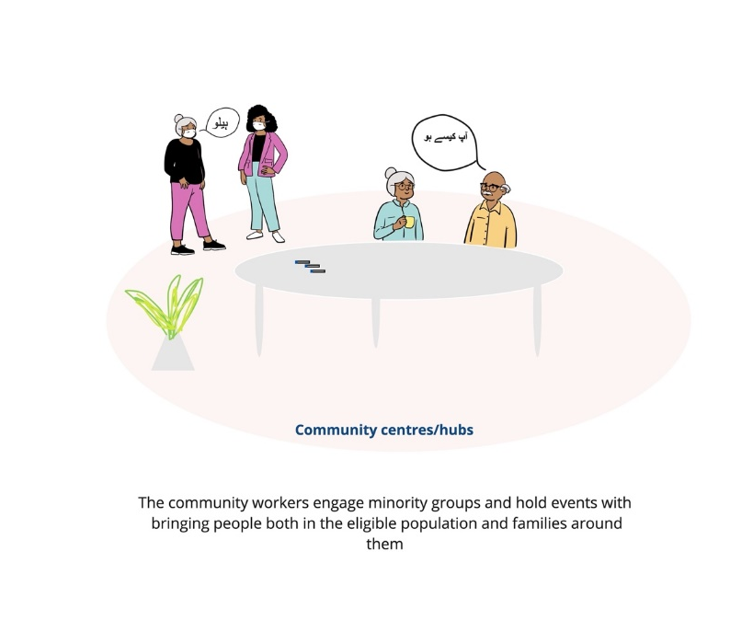
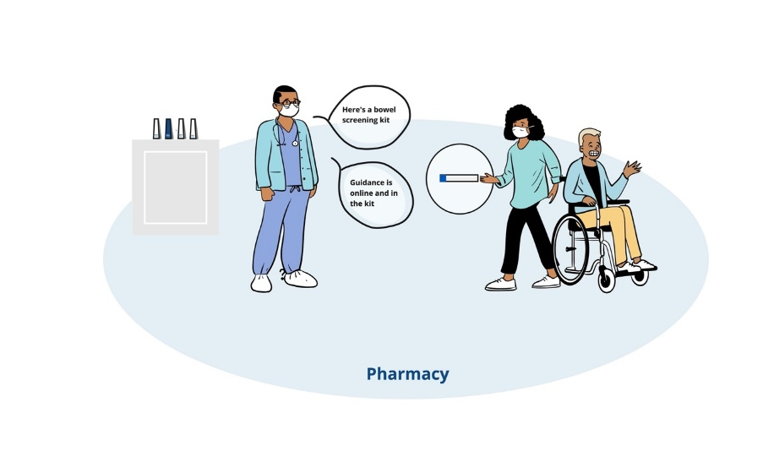
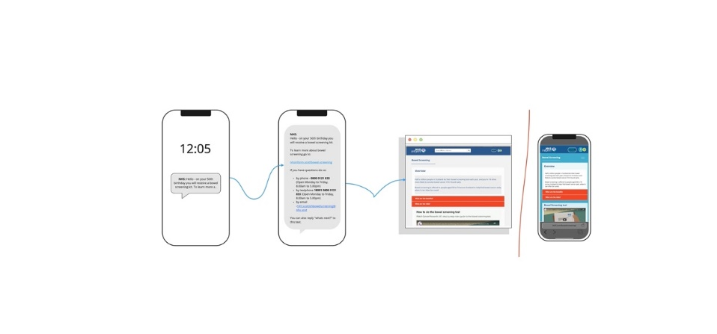
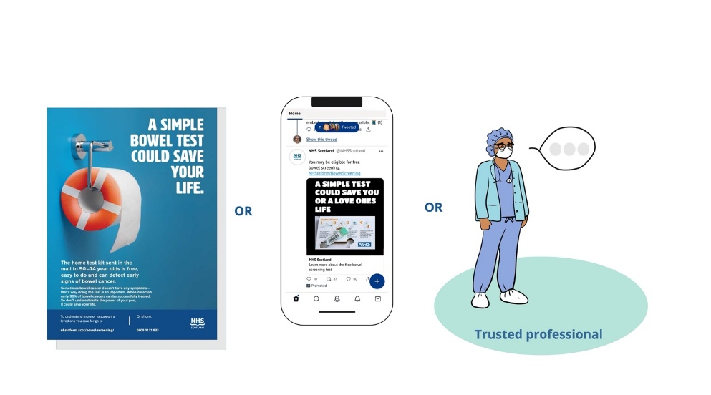
Proposed ideas for pilot – bowel screening
Focused community workshops
Local pharmacy prompt and pick up
Texts to prime and track kit
Guidance to activate community touch points
HSCP Screening Inequalities Programme

Slide 12



Key principles of the HSCP screening inequalities programme
Data informed problem framing
National digital capabilities enabling local solutions
Designing for and with diverse end users
HSCP Screening Inequalities Programme

Slide 13
Questions?
For further information please feel free to contact us:
David Proud
David.Proud@nhs.scot
Associate Director, Digital & Security
NHS National Services Scotland
07919 392112
Katharine Ross
Katharine.Ross2@nhs.scot
Health and Social Care Senior Integration Advisor
NHS National Services Scotland
07427 615880
Sarah Adams
Sarah.Adams2@nhs.scot
Project Manager, PgMS
NHS National Services Scotland
07817 122159
HSCP Screening Inequalities Programme

