Slide 1
Climate Change and Clinical Practice
Chair: Gregor Smith

Slide 2
Healthcare with Harm Video
(https://www.youtube.com/watch?v=sU8ipo8CUOo&t=26s

Slide 3
Scott Brady
Climate Programme Manager
Health Care Without Harm

Slide 4
Healthcare & climate change:
A global perspective

Slide 6

120 members
in 20 countries
5,712
GGHH members in Europe

Slide 7
FIRST, DO NO HARM
Healthcare is the frontline service tasked with addressing the health impacts of the climate crisis
Healthcare is a significant contributor to the climate crisis

Slide 8
CLIMATE IMPACT ON HEALTHCARE
Climate change is the greatest public health threat of the 21st century.
Between 2030 and 2050, it is estimated to cause 250k additional deaths per year.
Direct damage costs to health is estimated between $ 2-4 billion/year by 2030.
Value of health gains from reducing CO2 would be approx. double the global cost of implementing mitigation measures.

Slide 9
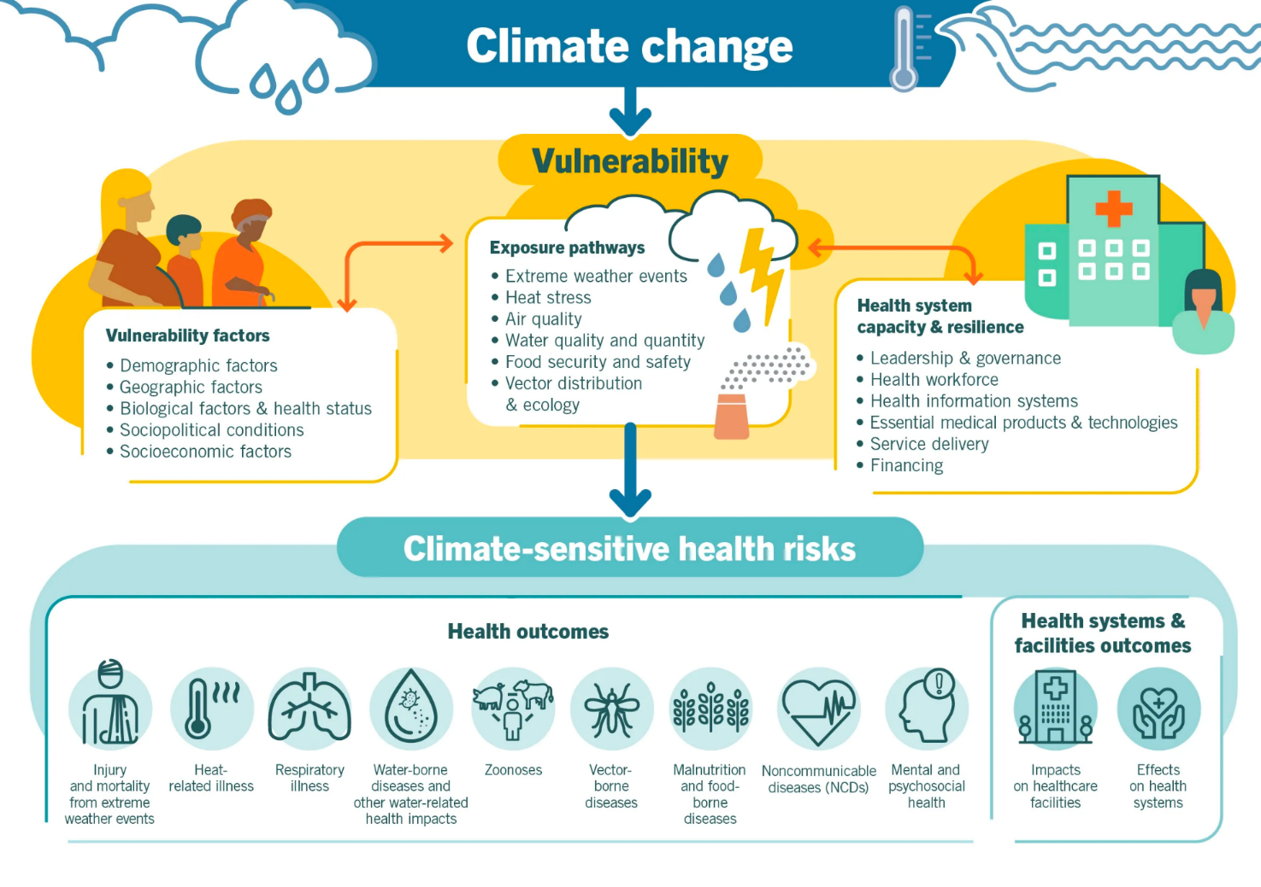

Slide 10
HEALTHCARE’S CLIMATE FOOTPRINT
Healthcare’s climate footprint is equivalent to 4.4% of global net emissions
If the healthcare sector were a country, it would be the 5th largest emitter in the world

Slide 11
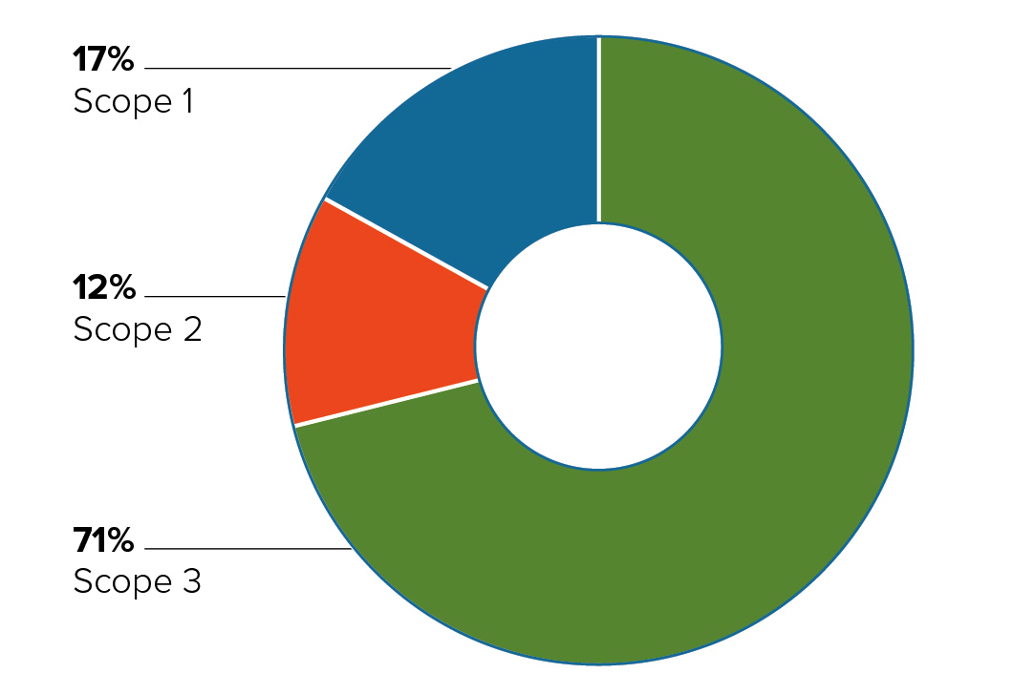
Pharmaceuticals = 12.0%
Business services = 10.7%
Food, catering etc = 7.2%

Slide 12
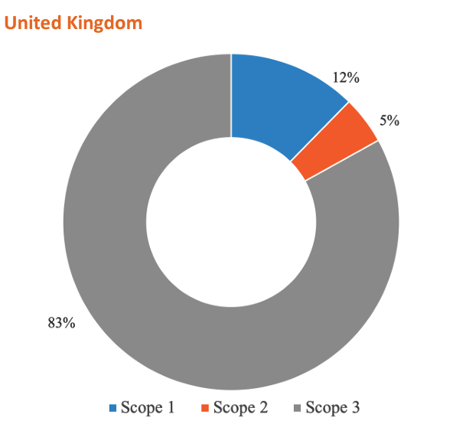
5.4 % of UK footprint
Equivalent to:
11 coal-fired power stations
8.9m passenger vehicles

Slide 13
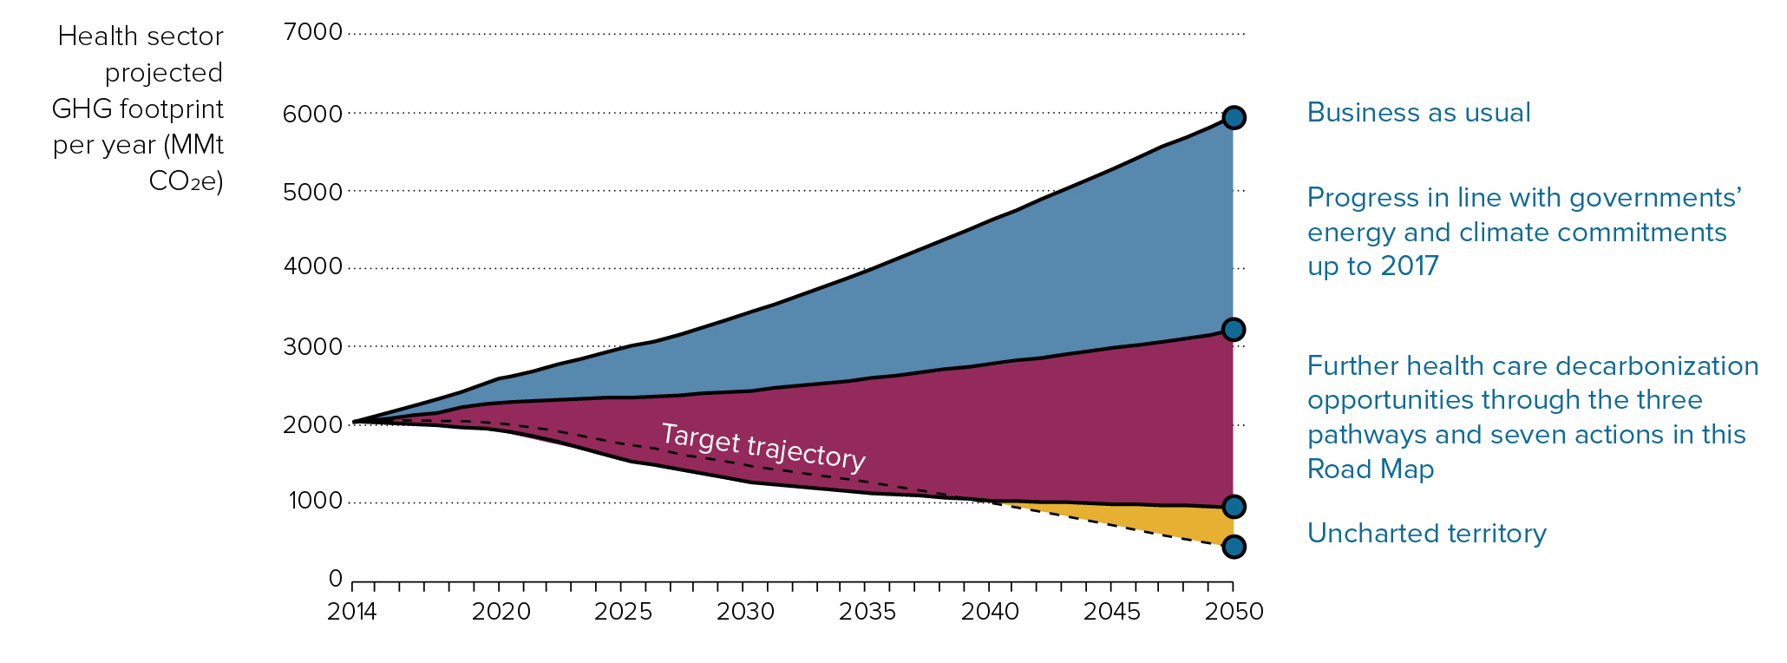

Slide 14
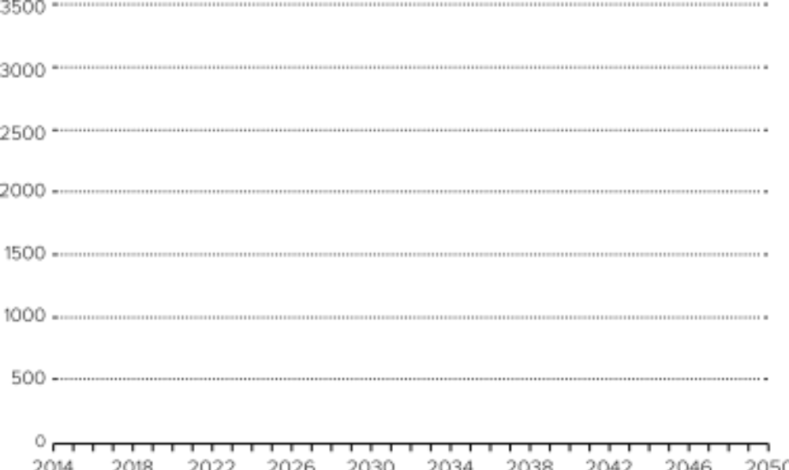





















Slide 15
CONTACT
Scott Brady
Climate Programme Manager
scott.brady@hcwh.org
noharm.org
2021 © HCWH Europe

Slide 16
Alifia Chakera
Head of Pharmaceutical Sustainability
Scottish Government

Slide 17
Anaesthetic Gas Footprint 2018/19

Slide 18

Anaesthetists = Sinners?
Anaesthetic gas 0.12% total Footprint
Anaesthetists 0.0002% of population
Dr Kenneth Barker, Principal Environmental Anaesthetist SG

Slide 19
Anaesthetist 2016
8 hours of N2O/O2/Desflurane at 2l/min @ 1 MAC
= 4672km
            in an average car‎

Slide 20
Anaesthetists and theatre staff
Quality Improvement hub
Pharmacy services and procurement
Medical Physic's
Clinical director buy in
PROJECT STAKEHOLDERS

Slide 21
Don’t be
Blue
Go
Yellow
1kg Desflurane
=2540 kg CO2
1 kg Nitrous Oxide
=298 kg CO2
1kg Sevoflurane
= 130 kg CO2
Need 1/3 the dose of desflurane

Slide 22
Anaesthetist 2016
Anaesthetist 2022
8 hours of N2O/O2/Desflurane at 2l/min @ 1 MAC
= 4672 km
in an average car
8 hours of O2/sevoflurane at 0.5l/min @ 1 MAC
= 20 km
in an average car

Slide 23
Anaesthetic Gases

Slide 24

A dinnae kin….

Slide 25
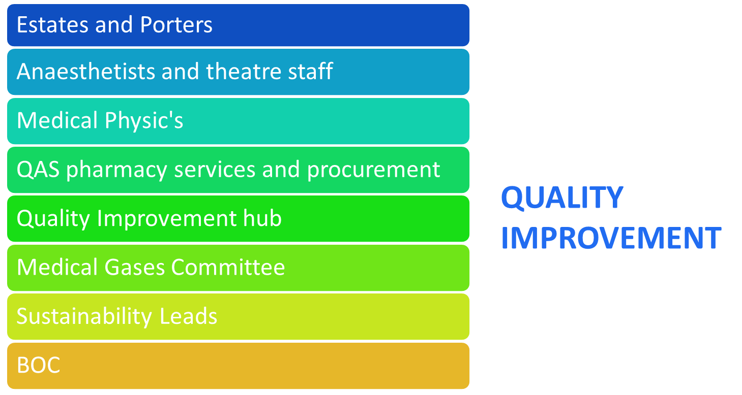

Slide 26
System leaks
Poor security
Stock management
System design
Inefficient clinical utility
System Loss

Slide 27
Anaesthetic Gases

Slide 28
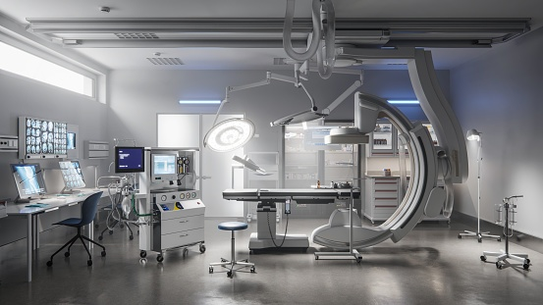
Developing a Green Theatres programme
> 52 sustainability activities identified
Supporting teams to undertake SUSQI
Most activities are COST SAVING or COST NEUTRAL

Slide 29
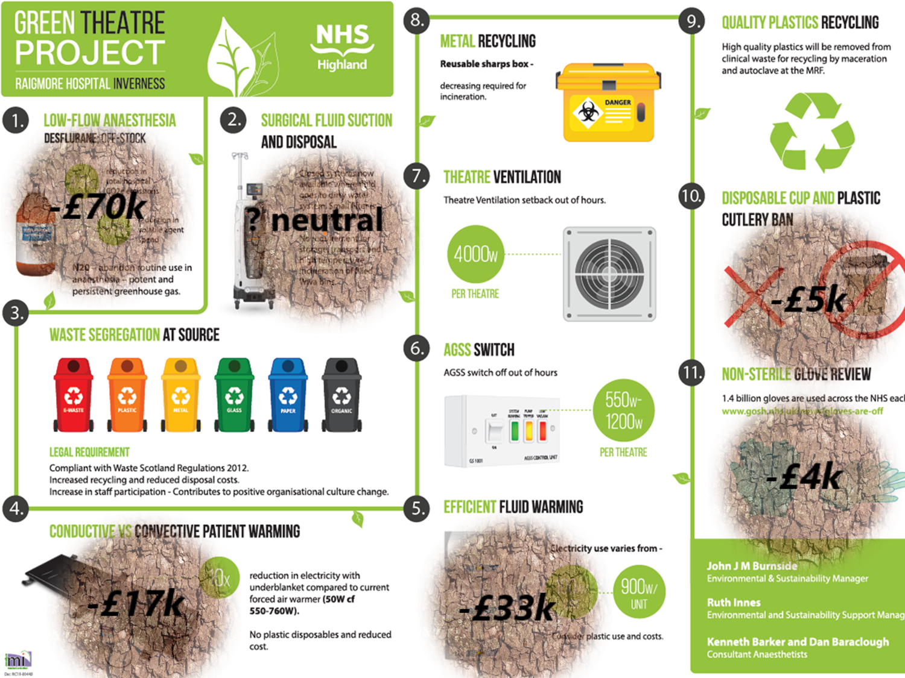

Slide 30


One Health Breakthrough Partnership
Vision
Mission
A “non-toxic environment”
To improve healthcare & the environment, inform legislation, drive research & innovation
https://ohbp.org/

Slide 31
Gregor Smith
Chief Medical Officer
NHS Scotland

