Slide 1
Collaborative Cancer Care During COVID-19
Dr Mark MacGregor, Medical Director, NHS Golden Jubilee Elaine Stewart, Service Manager, National Elective Services Division, NHS Golden Jubilee

Slide 2
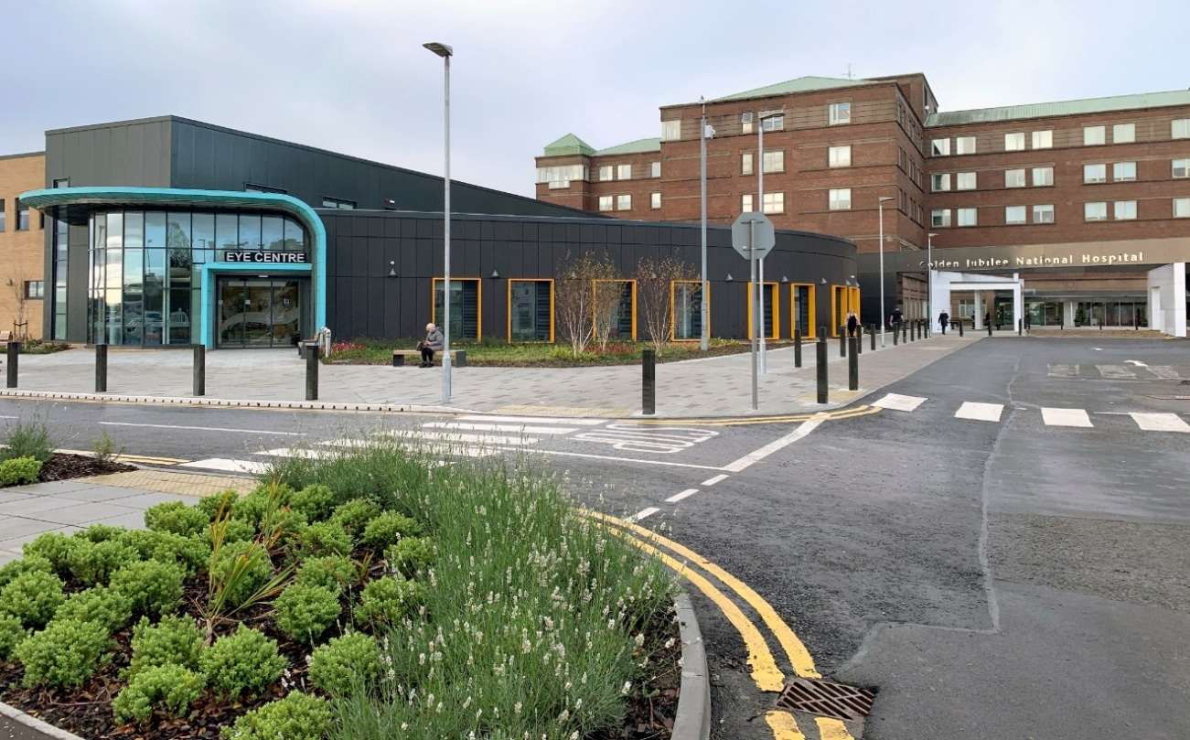
Introduction
NHS Golden Jubilee normal business
National Elective Services Division
Heart, Lung and Diagnostics Division
Elective activity suspended
Support additional ICU capacity
Uniqueness = 'COVID Light' site
Recognition of cancer backlogs starting to develop

Slide 3
Mutual Aid for Urgent Cancer Surgery
“Voluntary reciprocal exchange of resources and services for mutual benefit”
Patient Coordination Centre
Pre-operative Assessment
Theatres
Anaesthetics
Nursing
Allied Health Professions
Intensive Care Unit
Ward Capacity
Multi Disciplinary Team
Operators
Theatre Kit
Specialist Nurses
Follow-up
NHS Golden Jubilee
Health Boards
Patient care

Slide 4
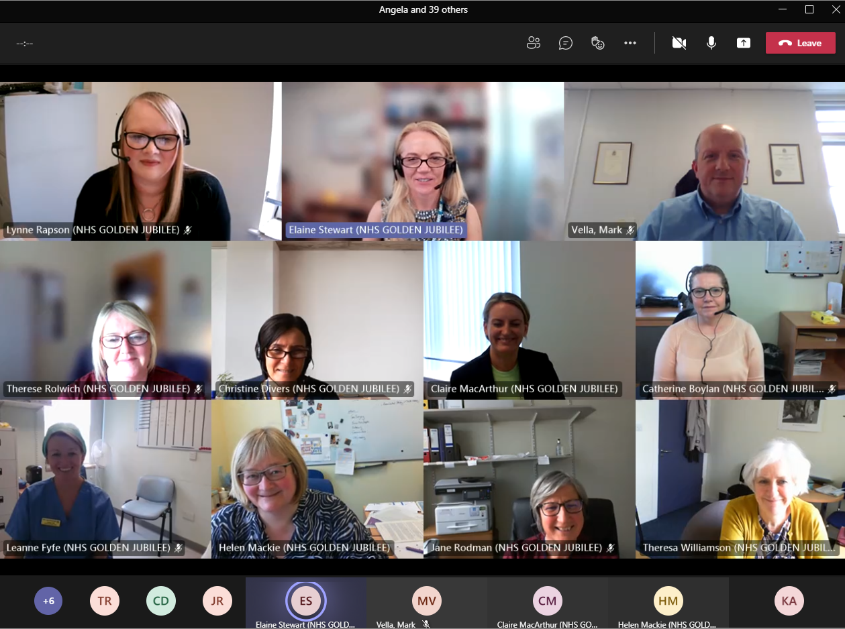
The will – how did we do it?
  Shared sense of purpose: clear patient need
  Patient-centred – urgency
  Brought teams together
  Working beyond boundaries and silos

Slide 5
Highly complex
eHealth
Referral process
Anaesthetics
COVID testing
Theatre kit
Training
Patient coordination centre
Central Sterile Processing Department
Theatre staff
Training
Site familiarisation
Recovery
Training
Recruitment
Governance
Visiting teams
Critical Care
Recruitment
Patient
Care
Bed modelling
Training
Pre operative assessment
Nursing staff
eHealth
Ward
Specialist Nurses
Patient information
Consumables
Access to
Golden Jubilee systems
Pharmacy
Advanced Nurse Practitioners
Total Parenteral Nutrition
Diagnostics
Rehabilitation
Junior doctors
Documentation
Speech and Language Therapy
Integrated care plans
Physiotherapy
Standard Operating Procedures
Dietetics

Slide 6
The will – how did we do it?
  Safely
  Working in collaboration to develop Standard Operating Procedures (SOPs)
  Safe and effective
  Robust and agile governance

Slide 7
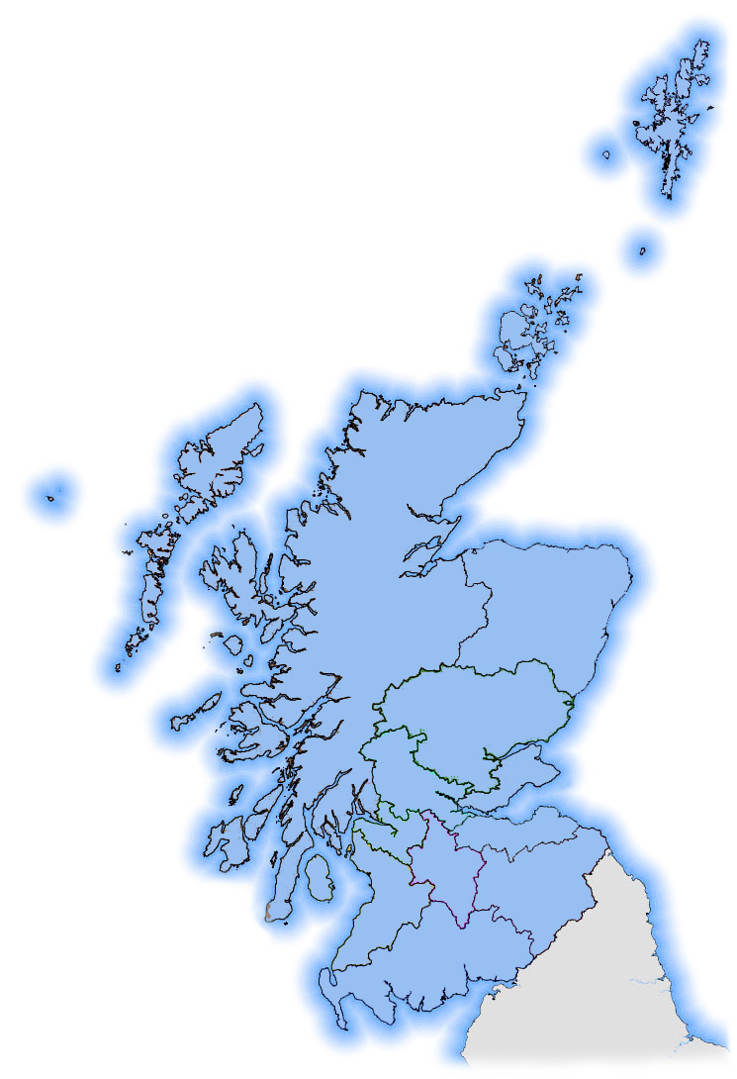







How did we start?
One Board and one service – NHS Greater Glasgow and
Clyde Osteosarcoma
NHS Lanarkshire – five specialties
Seven Boards and 14 Standard Operating Procedures (SOPs)
Greater Glasgow & Clyde
Lanarkshire
Ayrshire & Arran
Forth Valley
Highlands
Tayside
Western Isles

Slide 8
Total delivered to date
1,082 Patients had cancer or urgent P2 surgery
1,225 Patients treated through our thoracic surgical programme
2,923 Patients had a diagnostic endoscopy
45,076 Patients underwent imaging examinations
2,766 Patients had orthopaedic surgery
5,045 Patients had cataract surgery

Slide 9
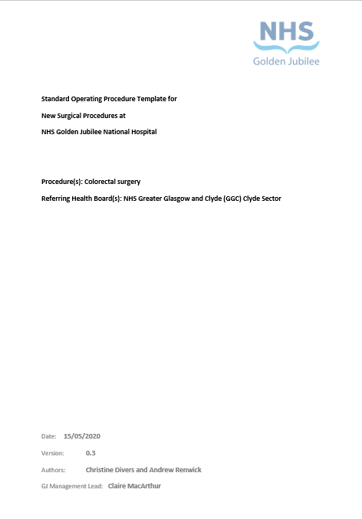
Case Study 1 – Agility (Colorectal)
‘New Service’ request received, then noted by Gold command
Working together to produce Standard Operating Procedure (SOP)
SOP presented to Clinical Governance Risk Management Group for endorsement
Approved through Gold Command, service introduced June 2020

Slide 10


Slide 11
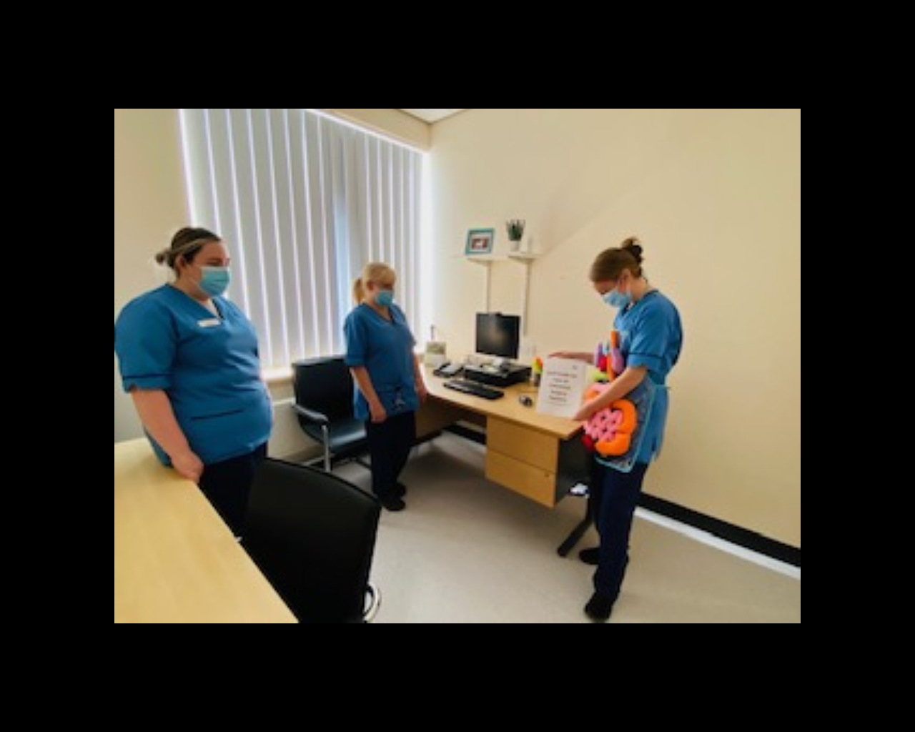
Developing new skills
Collaboration with GG&C Specialist Nurses
Staff information booklet
Education session inclusive of wider MDT
Multiple 1:1 education sessions within clinical area
1:1 working with staff on ward with Clinical Educator or Senior Charge Nurse

Slide 12



Slide 13
Case Study 1 video

Slide 14
Case Study 2 – Collaboration (ENT)
Individual level
Between NHS Boards
Internal collaboration

Slide 15
Case Study 2 video

Slide 16
Case Study 3 – Patient Safety (Urology)
Referring Board and patient perspective:
  Referring Board perspective
  Referring Board anxieties
  Level of detail requested by NHS Golden Jubilee
  Safe, effective and high quality

Slide 17
Case Study 3 video

Slide 18
Patient Safety
Inclusion of all relevant stakeholders:
  Advanced Nurse Practitioners, Hospital at Night and Critical Care
  Initial introductions
  Building robust relationships with relevant personnel in referring Boards

Slide 19
Identifying skills and knowledge gaps
Right skills, right time, right place
Educational gaps and transferable skills
Allocated study time
Collaboration with external nurse specialists, consultants and Allied Health Professionals

Slide 20
Identifying skills and knowledge gaps
Safe staffing levels:
  Nurse to patient ratio and skill mix
  Recruitment drive
  Duty rotas
  Staff confidence and utilising existing skills

Slide 21
Clinical Governance
Sharing learning opportunities
Learning “On the job”
Openness and transparency

Slide 22
Learning from NHS Golden Jubilee perspective
Dr Mark MacGregor, Medical Director,
NHS Golden Jubilee
Jane Rodman, Head of Nursing – Elective Services, NHS Golden Jubilee

Slide 23
Video - Learning from NHS Golden Jubilee perspective

Slide 24
Feedback
Hi Elaine, the lists went really well, and the staff are great.
On behalf of the ENT department thank you all for your hard work and flexibility. It is fantastic that the Head and Neck cancer patients are still getting excellent care when things are so difficult and different from our normal ways of working.
Many thanks for GJ's ongoing support for our H&N operations.
The service have been fantastic.
Dear Elaine,
all went perfectly fine, staff were all brilliant, venue is excellent, we felt at really at home like we were in Wishaw although first time in GJ. please send a big thank you.
Let me know when we can come back and do some cases.
A big thank you from Forth Valley.
What became immediately evident, was how safe, secure and well cared for she felt. I am writing to express my deepest gratitude for the compassionate quality care my mother consistently experienced from staff at all organisational levels.
Patient cannot thank the staff on 4 East for being so kind and caring during his long stay. He expressed they 'have became like family’.
While being in hospital and with the stimulation of chatting to staff I notice that she is 'brighter', her voice is stronger and her humour has returned – all without drugs! Just because the connection of people who care and take an interest.
The patient wanting to thank medical staff for being clear, caring and patient.
Was absolutely fantastic. Thanks to the team if you could let them know.

Slide 25

Questions?

