Slide 1
Delivering excellent children's palliative care in a pandemic
Children’s Hospices Across Scotland (CHAS)

Slide 2
We support families through the terrifying heartbreak of knowing their child may die young.
With love and compassion, we offer highly personalised care at home, hospice and hospital.

Slide 3
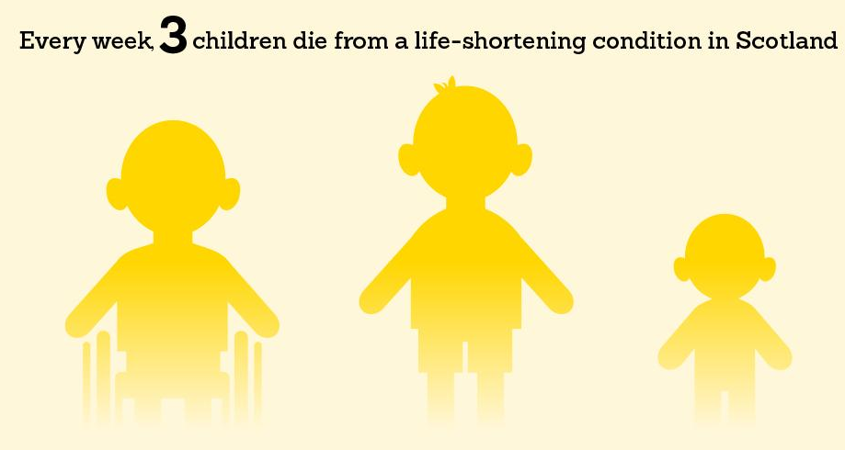

Slide 4
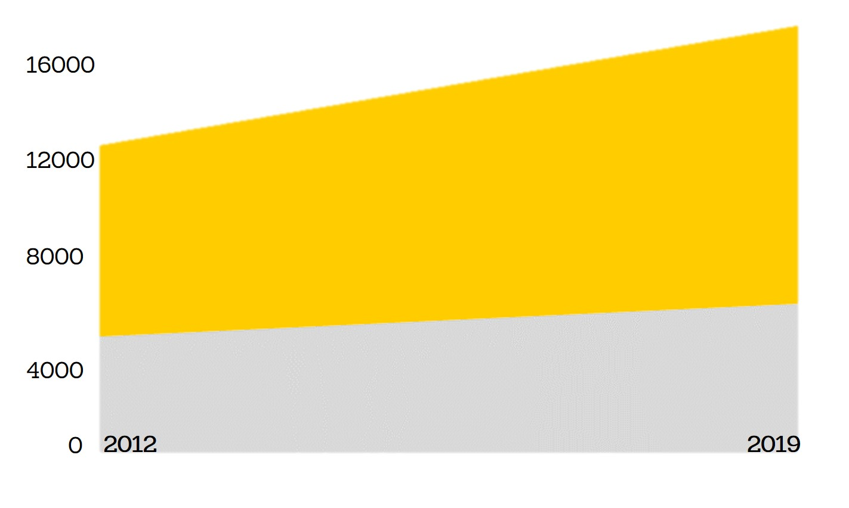
total prevalence of children with life-shortening conditions
hospital prevalence

Slide 5
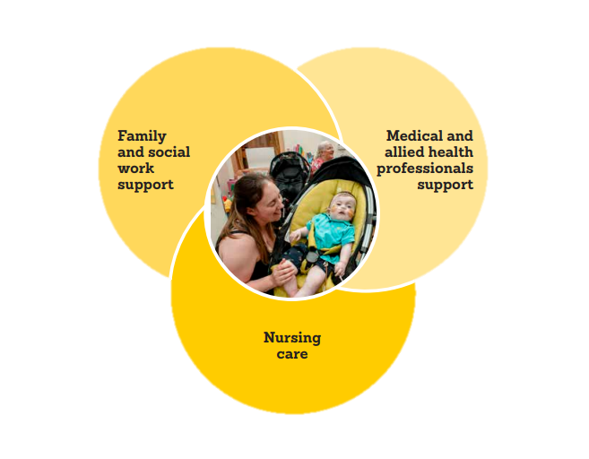
Multi-disciplinary teams

Slide 6

Reconfiguring our services
Sue Hogg
Director for Children and Families
@SKHogg

Slide 7
What we did to rapidly adapt our services
We will cover
1
2
The experience of children and families
3
How we supported our people
Notes:
In my presentation, I will cover… (3 bullets)
But before I begin, I want to start by telling you a bit more about the children and families we support – and their needs during this time.
The children and families we support often have very complex lives – juggling to balance caring for their child’s condition and needs, as well as often other siblings and work commitments.
The pandemic made families lives more complex – and also more isolated.
Many families shielded early, and were reluctant to let car einto their homes at first.

Slide 8
What we did to rapidly adapt
1
Pre-pandemic
During pandemic
Hospices – 8 beds + Rainbow room
Hospices – 3 beds + Rainbow room
CHAS at Home - expanded
CHAS at Home
Hospital teams – closer working
Hospital teams
Virtual delivery
Notes:
In adapting our services, we were guided by five priorities centred on keeping vital services going:
Delivering as much care as we can, safely, in the ways that support families the most.
Ensuring our services adapt in ways that are right for the children and families we support.
Using technology to deliver care through our virtual children's hospice in a way that will see it become integrated into future service offering.
Working closely with the NHS and Local Authorities to ensure joined up efforts.
Maintaining fundraising and funding to ensure care continues in this continuously challenging time.
Also knew we needed to work to pace, while being a good partner to others

Slide 9
Placeholder slide – Play ‘Returning to Robin House video’
Notes:
Making sure our hospices operated safely has obviously been a huge priority for us.
We appointed Nicky Bridges – who you’ll hear from next – as our pandemic lead across all settings, and worked closely with Health Protection Scotland and the Care Inspectorate to update them on our plans. We kept lines of communication open with other children’s hospices across the UK, adult hospices in Scotland, and hospital teams to learn from best practice. We also worked closely with NHS Lothian – and would like to thank Julie McGill and others there who helped source us PPE at the start of the pandemic when it was short on the ground.
And importantly, we worked hard to reassure families that our hospices were safe places to come to.
Here’s a short video we made to tell families about the changes they could expect.

Slide 10
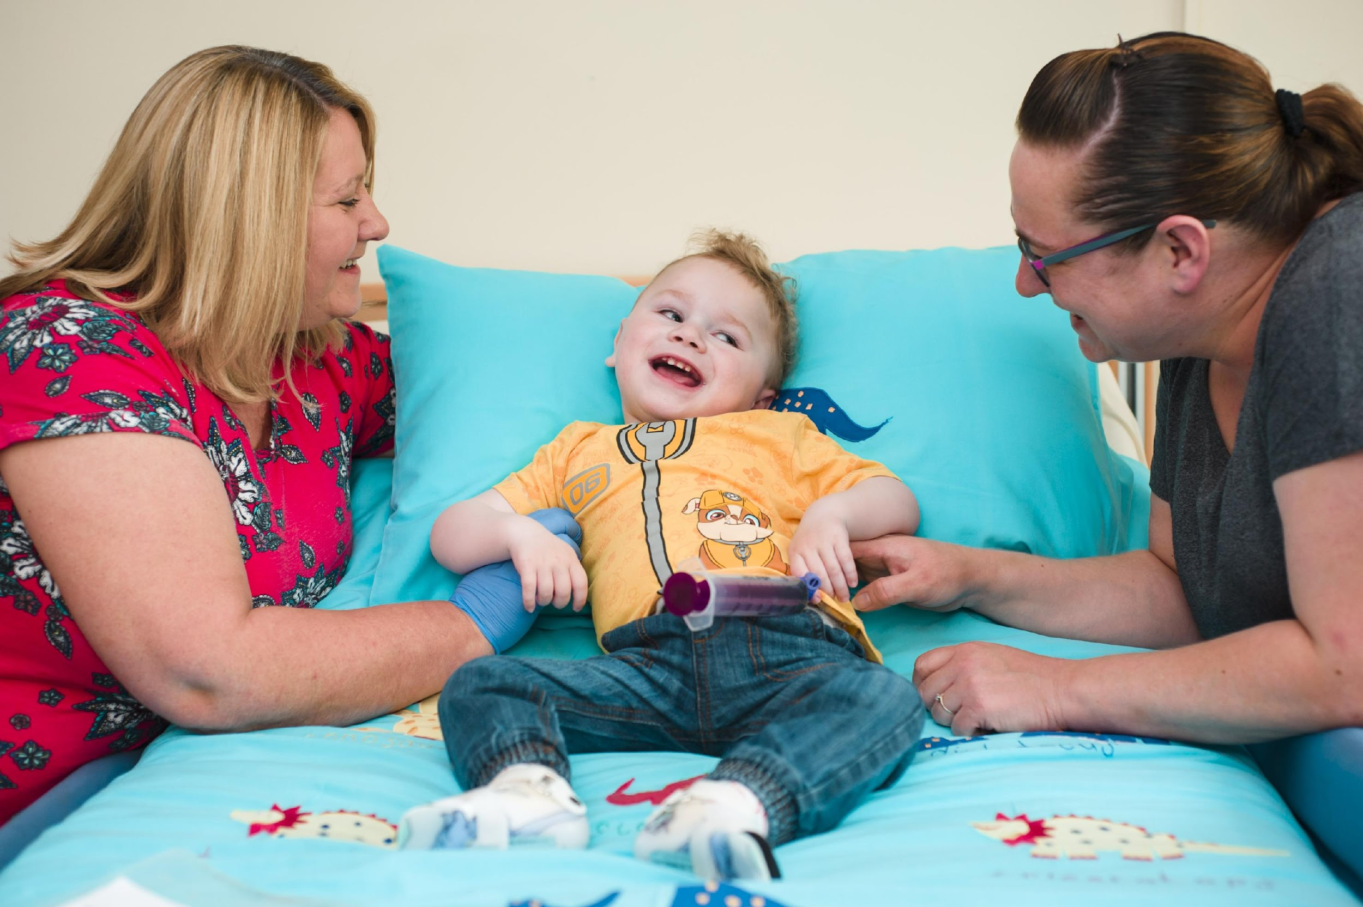
2
The experience of children and families
Notes:
Children and families are at the heart of everything we do, and making sure we thought about their safety and wellbeing in all aspects of what we did was a huge part of our service redesign.
[Content will depend on what Sharon says and what needs to be added to tee that up]

Slide 11
Placeholder slide - play ‘Suzi’s story’ video
Notes:
Introduce the video

Slide 12
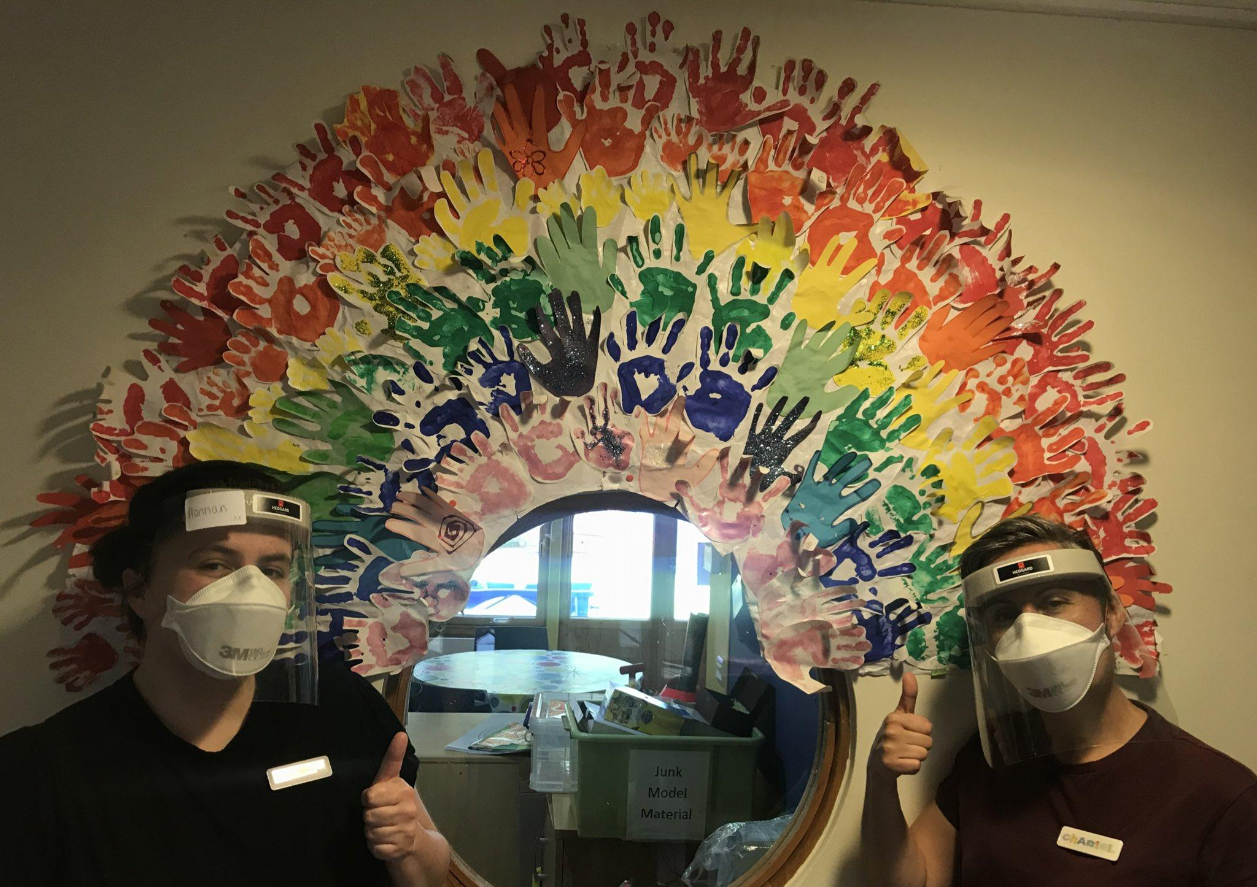
3
How we supported our people
Notes:
Central to achieving what we set out to do was taking our staff with us – creating the conditions in which they could excel, and ensuring that they felt safe, supported and resilient.
Like every workplace, our staff had their own challenges – be it that they had to shield for health reasons, had to juggle children at home, or were struggling with feeling isolated if living alone. [Sue to outline what we did to ensure staff felt psychologically supported].
But there was also the challenge of shifting staff from the hospice to the community. While staff could see if was the right service model, some team members understandably felt apprehensive as they had not done home care before. [Sue to outline what we did to ensure staff got training, support etc to upskill into new roles].

Slide 13
Placeholder slide – play ‘Libby edit’ video

Slide 14
Rapid change needs to be underpinned by clear priorities
Key learnings
1
2
Listening to the needs of those you support is crucial
3
Staff wellbeing is essential on a change journey

Slide 15
Re-mobilising our relationships
Nicky Bridges
Associate Director for Outreach Services

Slide 16
How we deepened our partnership working
We will cover
1
2
Ensuring the right team is in place, at the right time
3
Providing choice of setting at end-of-life

Slide 17

How we deepened our partnership working
1
Local Authorities
Community Children’s Nurses
Care providers
District Nurses
Hospital teams
Third sector
Notes:
And then talk about Calum’s story

Slide 18
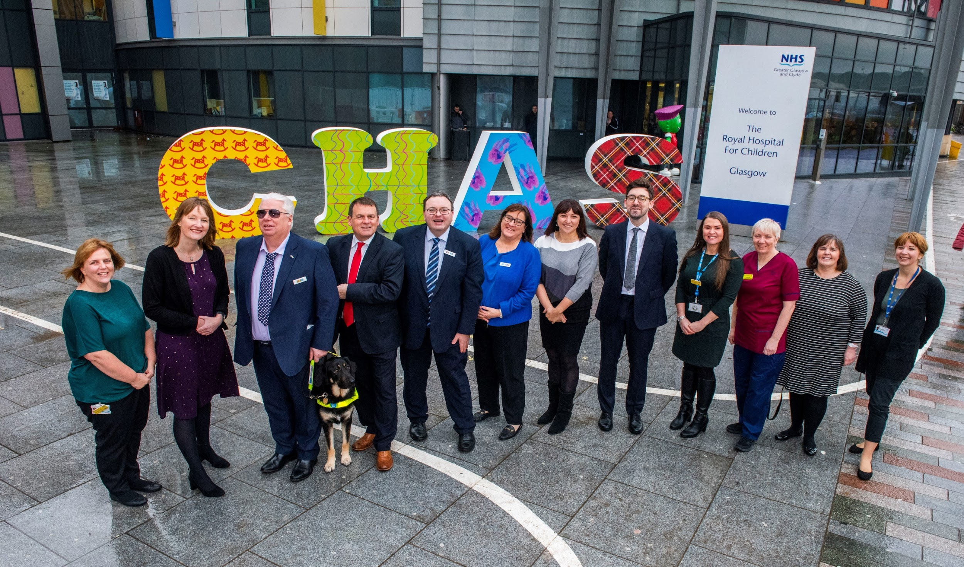
2
Ensuring the right team is in place, at the right time

Slide 19
Placeholder slide – play ‘Jonny on partnership working video

Slide 20
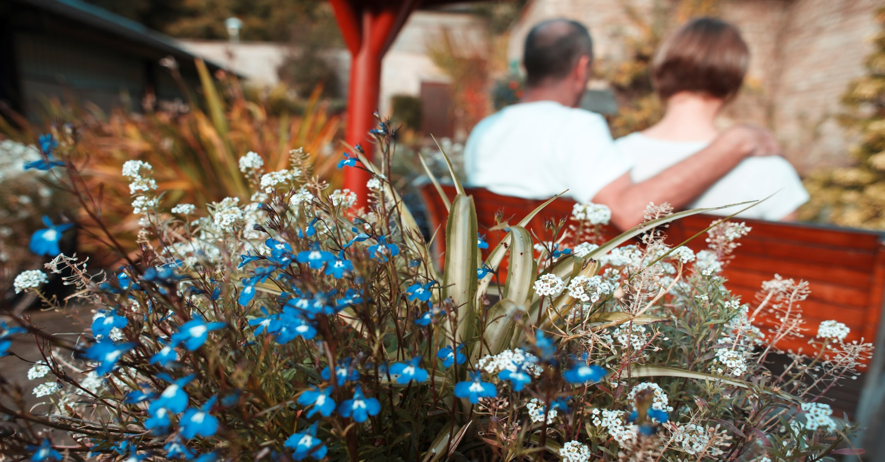
3
Providing choice of setting at EOL

Slide 21
Placeholder slide – play ‘Holly’s story’ video

Slide 22
Partnership working enables real choice at end-of-life
Key learnings
1
Partnership working ensures holistic family care delivered by t the right people at the right time
2
Recognise unique contributions of services, and utilise them
3

Slide 23
Re-inventing services virtually
Rami Okasha
Chief Executive
@RamiOkasha

Slide 24
What remote technology can (and can’t!) deliver
We will cover
1
2
Adapting service design to meet family needs
3
How families responded

Slide 25

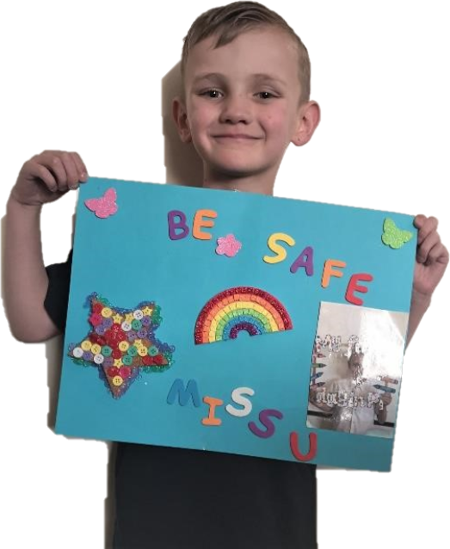
After the pandemic, we want families to say “CHAS was there for us”
Notes:
… If families can’t come to the hospice right now, we will bring the hospice to them.
Ref the various ways we did this – kindness calls/ phone calls / Zoom/ NHS Near Me etc

Slide 26
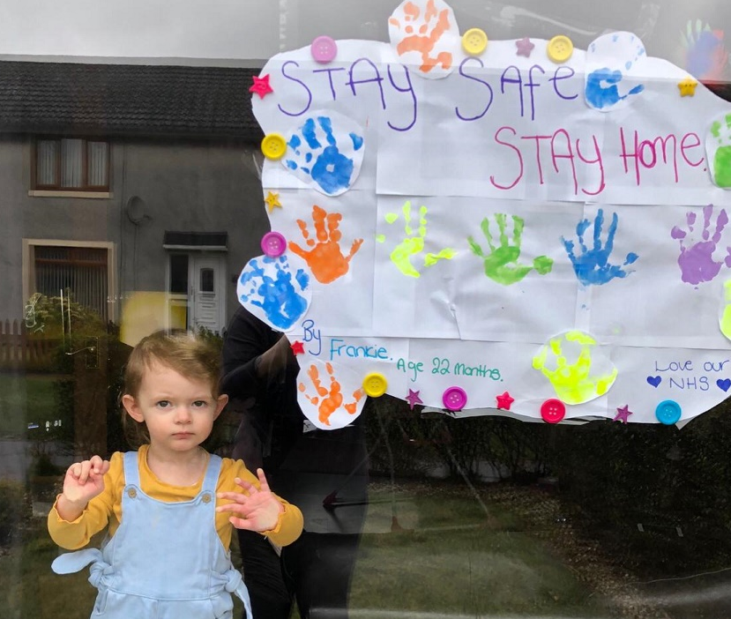

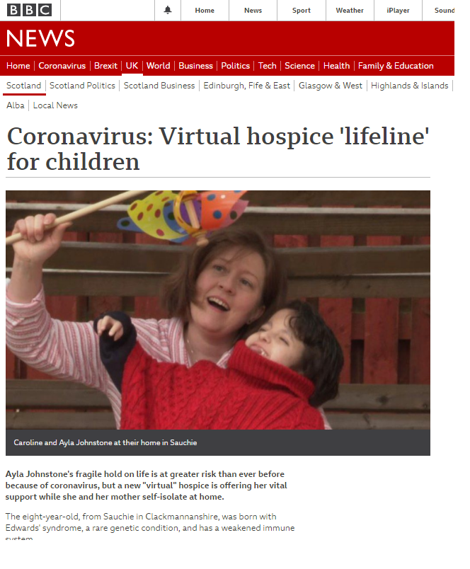
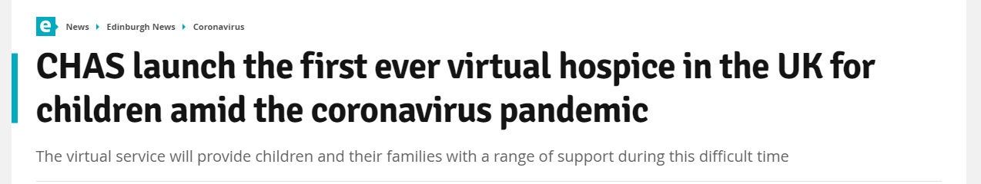
Notes:
Getting it off the ground
Clear leadership vision
2 managers with permission and empowered to fail
Start quick and small
Cross-team working involving IT, IG as well as clinical staff
Be led by family need

Slide 27

Kindness call triage
Hospice
Social work
Bereavement
Nurse, doctor & pharmacist advice
Virtual Children’s Hospice
CHAS at Home
Connecting isolated families
Therapeutic care, activities and fun
Notes:
Proactively calling families to understand their needs
Often the only person to call
Nurse-led
Immediate needs addressed, including child protection

Slide 28
“We’re not going near anybody. We’ve not seen anybody. Your calls have been absolutely amazing.” - Mum

Slide 29
Placeholder slide – play ‘Our Kindness Calls’ video

Slide 30
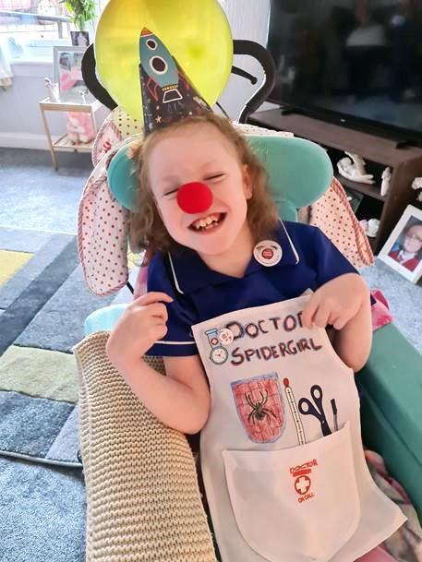
Kindness call triage
Bereavement
Nurse, doctor & pharmacist advice
Virtual Children’s Hospice
Connecting isolated families
Therapeutic care, activities and fun
Notes:
Advice on symptom management & medicines
Doctors can consult more
Families gain assurance without leaving the house
Mostly children already known to CHAS

Slide 31
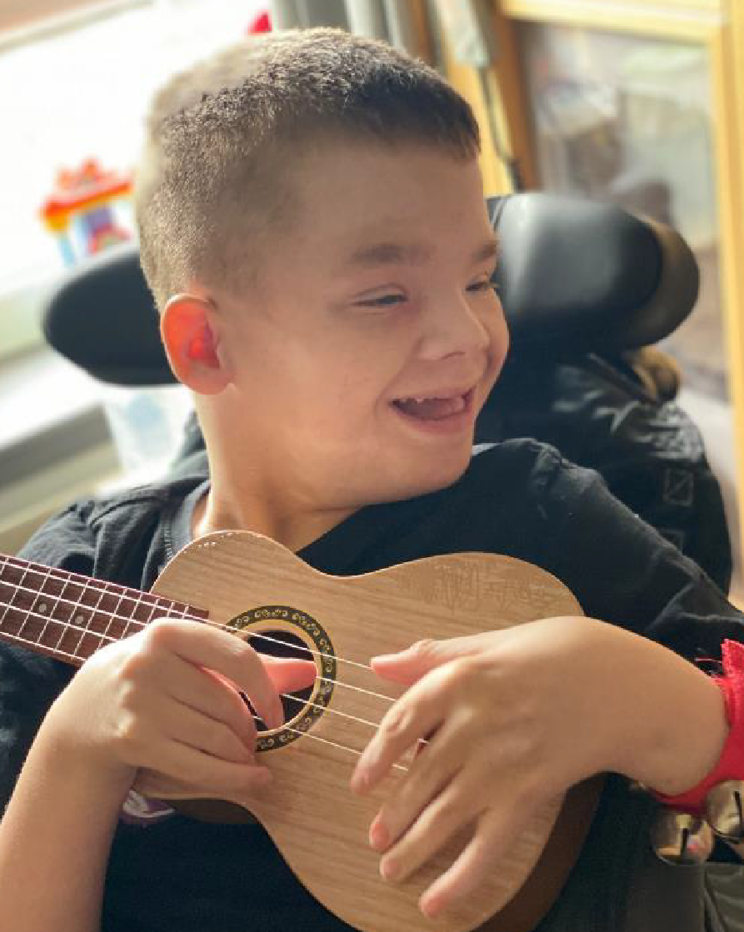
Kindness call triage
Bereavement
Nurse, doctor & pharmacist advice
Virtual Children’s Hospice
Connecting isolated families
Therapeutic care, activities and fun
Notes:
Led by play therapists
Activity packs in home
Story-reading
Letter-writing
Art classes for children and parents

Slide 32
“It brings so much calm. Ruby's breathing relaxes during her sessions and she is so chilled … They are building a relationship through music … Ruby has started laughing which makes me cry. It's so magical to see her light up. We have been shielding for almost a year.”
- Mum
Notes:
Sally, mum to Sia

Slide 33

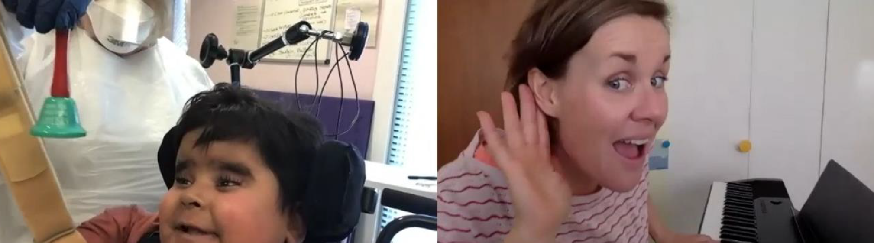
Notes:
Rayhan is 3 years old. He has lived most of his life in hospital due to a spinal injury. Before covid Rayhan would visit Robin House for respite. When lockdown happened he was unable to leave his room and only his parents could visit. We started Music Therapy with Rayhan, we were unsure how he would benefit from these sessions due to him having very little movement. Rayhan almost immediately showed interest and focus on the music. Janet our music therapist began to develop his sessions to allow Rayhan to explore and take part in his sessions. Janet asked the nursing team to hold out some chimes to Rayhan not touching his hands but close enough for him to reach. During the song Rayhan moved his hand and hit the chimes, he then did this again and again. It was clear that this was most definitely controlled by Rayhan and not by chance. The surprised reaction from the nursing team showed that this was something unusual and great progress for Rayhan. Since then Rayhan continues to enjoy his sessions and join in by using his instrument. What is also good is that the nursing team in the hospital often say I’m going to try that with him again later, which is hugely beneficial for Rayhan and his care.

Slide 34
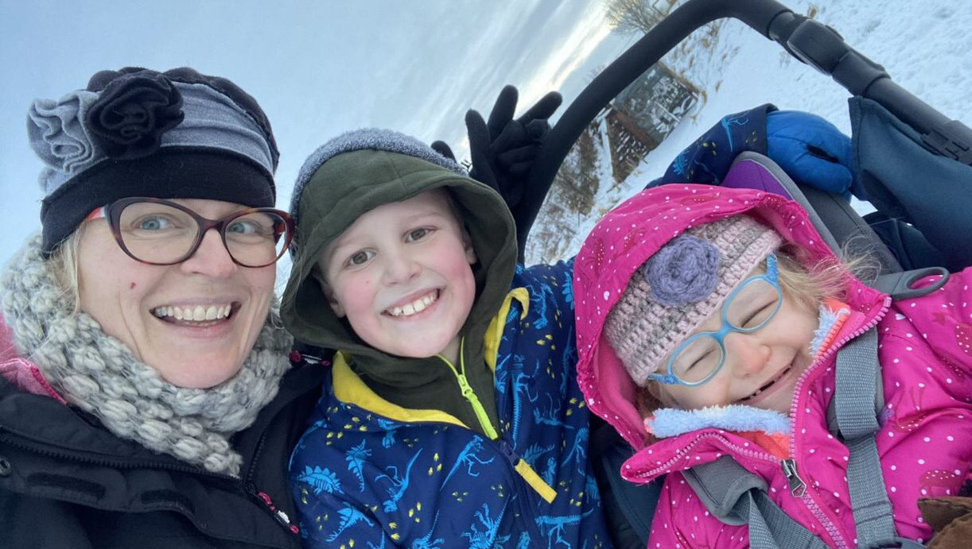
“We weren't sure she would be able to use Zoom as Sia has a visual impairment but she made very clear she absolutely could.”
“From her first session, Sia engaged in a way we'd never seen before. It was like watching our child come to life, completely transforming, and brought tears to our eyes.”
Notes:
Sally, mum to Sia

Slide 35
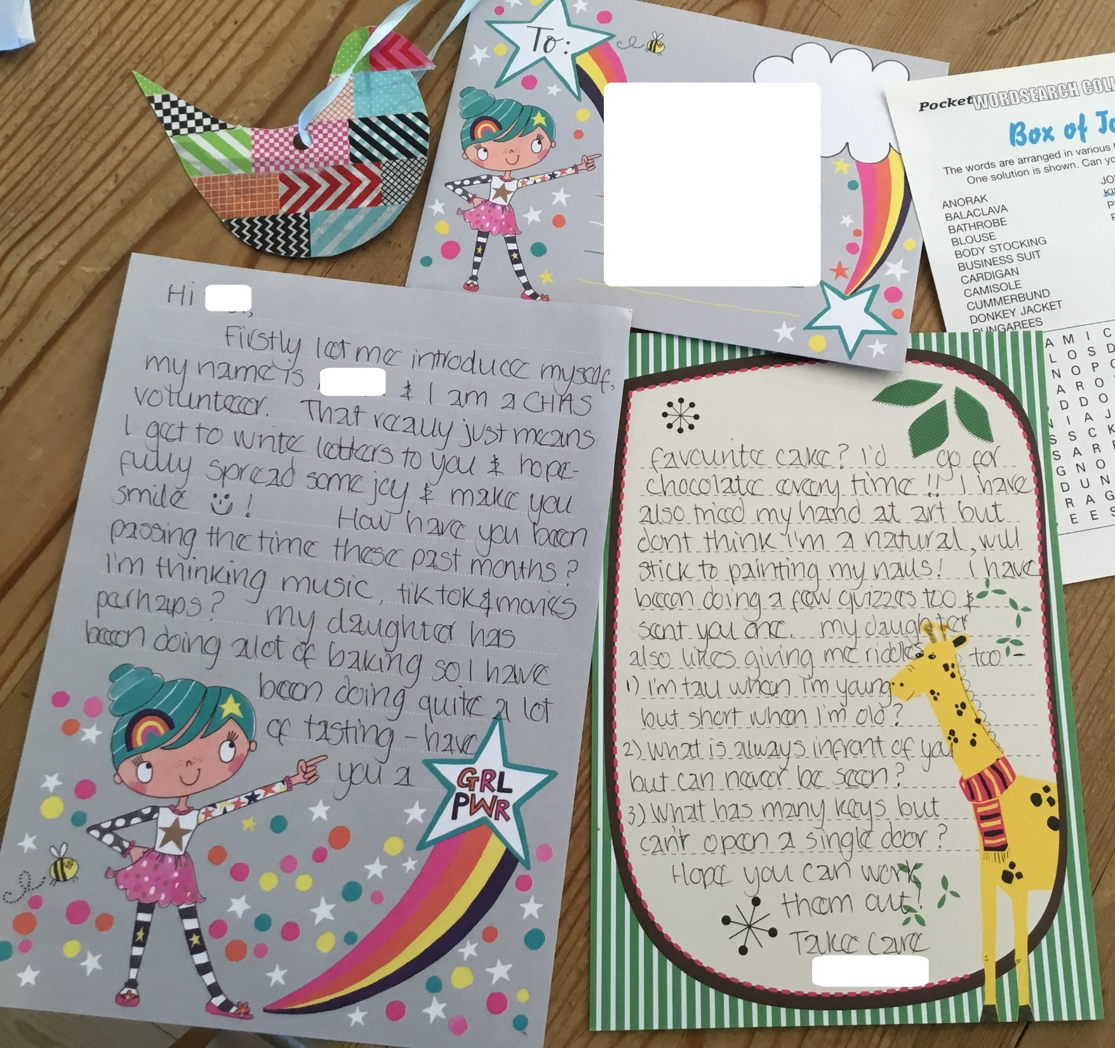
Kindness call triage
Bereavement
Nurse, doctor & pharmacist advice
Virtual Children’s Hospice
Connecting isolated families
Therapeutic care, activities and fun
Notes:
Family groups, discussion and activities for all stages of the palliative journey
Often only social experience for parents
Youth groups for children to connect
Closed Facebook group, moderated by parents

Slide 36
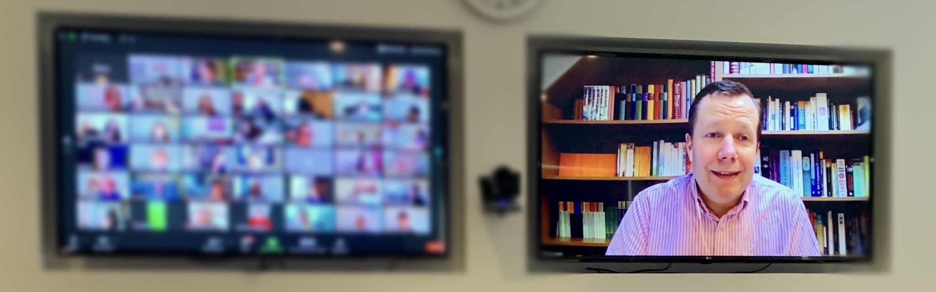
“The family Zoom sessions help me feel more informed on Covid, PPE, money and loads of stuff. Parents feel extremely anxious, alone and overwhelmed. Support from an experienced team helps me navigate this stormy journey. I’m coping because CHAS are alongside me.”
- Mum

Slide 37
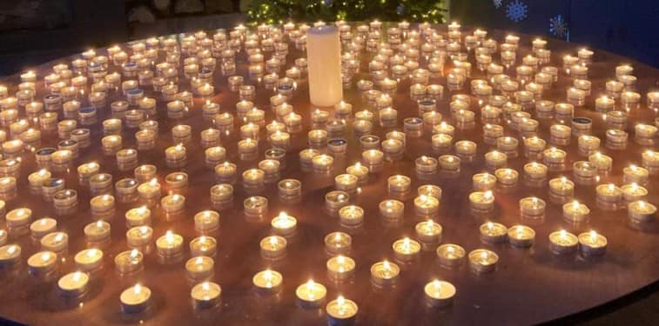
“I used a Facebook page linked to my child’s condition for bereavement support. Its OK, but it’s really about families stuck in their grief.
Having a group run by someone experienced helps me see things differently and begin to live a new life without my child.”
- Parent
Kindness call triage
Bereavement
Nurse, doctor & pharmacist advice
Connecting isolated families
Therapeutic care, activities and fun
Notes:
Pandemic has rekinled issues of grief, etc.
Face-to-face bereavement sessions
Groups for all stages of the palliative journey
Bereavement care & remembering days

Slide 38
Start small with staff keen to innovate
Key learnings
1
2
Keep tech simple & accessible (staff & families)
3
Not everything works virtually – but much does
4
Services must respond to family preferences
5
Clinical skills are vital
6
Partnerships and relationships are key
More care, more often, more places

Slide 39
Placeholder slide – play ‘Sum up CHAS in one word’ video

