Slide 1
Embracing innovation and thinking differently to improve outcomes and maximise resource.

Slide 2
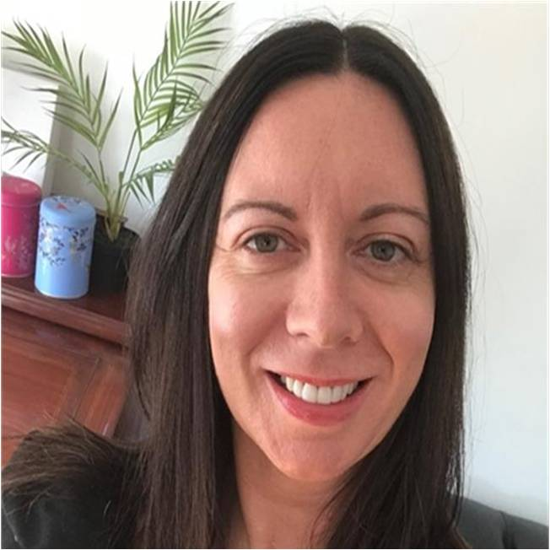
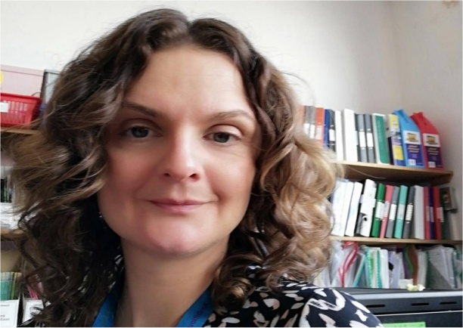
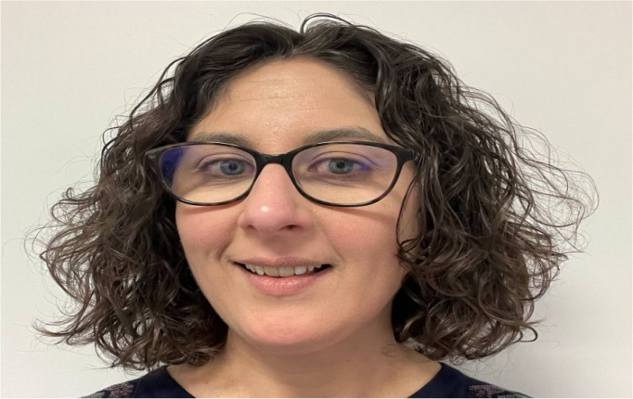
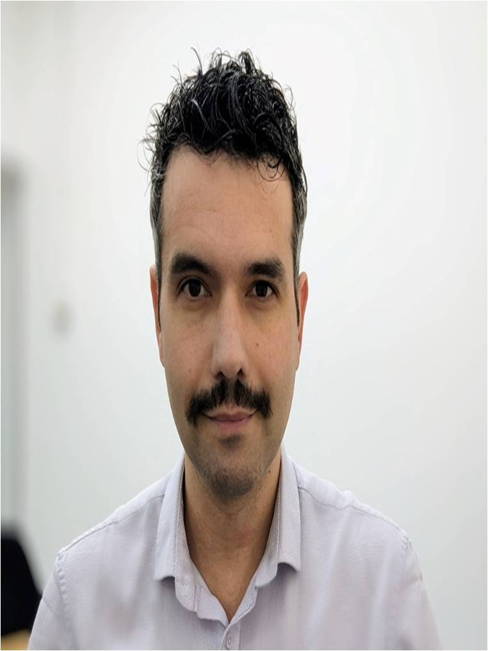
Speakers
Louisa McGuire
AHP Coordinator, Children’s Speech and Language Therapy
NHS Forth Valley
Katie Clark
Speech and Language Therapy Deafness Advisor & Team Lead
NHS Forth Valley
Barbara-Anne Cleaver
Children’s Speech and Language Therapist & Team Lead
NHS Forth Valley
Noel Kenely
Certified Auditory Verbal Therapist
Auditory Verbal UK

Slide 3
NHS Forth Valley Children and Young People Speech and Language Therapy’s ‘Leap of Faith’

Slide 4
Context
The prevalence and impact of communication difficulties
A study identified that in some of the most deprived areas in Scotland:
  a) 50% of children were coming to school without adequate spoken language skills to access learning
  b) 25% of children were coming to school without adequate spoken language skills to access learning
  c) 15% of children were coming to school without adequate spoken language skills to access learning
2.Vocabulary difficulties at the age of 5 are significantly associated with what at age 34
  a) poor literacy
  b) poor mental health
  c) poorer chance of employment
  d) All of the above
3. What percentage of young offenders present with speech, language & communication needs?
  a) 28%
  b) 37%
  c) 65%
Notes:
There is strong evidence to demonstrate a rise in prevalence of children with communication needs in Scotland. Moreover, research highlights the connection between communication difficulties and adverse outcomes in children’s wellbeing, attainment, behaviour and future life chances.

Slide 5
Context
Speech, language and communication skills are the foundation of children’s intellectual, social and emotional development
The children most in need of our help were not accessing our service
The need to interrupt the intergenerational cycle of poverty and deprivation
Take a whole systems approach
Notes:
Katie
Mentimeter quiz re importance of SLC and later life chances????
Background:
Children’s Speech and Language Therapy Community based Service within NHS Forth Valley
FV has a population of 62,500 children of which, 16,400 of these children and young people are predicted to have a speech, language or communication need
Speech, language and communication skills are the foundation of children’s intellectual, social and emotional development
often the children most in need of our help were not accessing our service
1,260 children and young people who were on the caseload
If the service stayed working at a specialist level, we would only meet the needs of around 8-10% of the population who had predicted SLCNs.
Drivers:
‘Ready to Act’ 2016, the first children and young people’s services plan in Scotland to focus on the support provided by allied health professionals.
The plan set the direction of travel for the design and delivery of AHP services to meet the well-being needs of children and young people. It was underpinned by the Children and Young People (Scotland) Act 2014, the principles of Getting it Right for Every Child ( GIRFEC) and the United Nations Convention on the Rights of the Child.
The plan highlighted the critical place of prevention and enablement and promoted least intrusive interventions through a tiered model of service design and delivery (universal, targeted and specialist levels of provision) directly linked to well-being outcomes.
As a result of this national driver, project work was underway in the service to develop universal and targeted offers within the most deprived communities. This work highlighted that it was no longer ok to carry on with a traditional refer, assess, treat model as it was not going to achieve the wellbeing outcomes we needed for our population. The team had the evidence that working with whole communities around the child was effective at interrupting the intergenerational cycle of poverty and deprivation and was enabling people to take the responsibility for the wellbeing outcomes they want for themselves.

Slide 6



Forth Valley
Notes:
Katie Kelpies, Castle Campbell, Dollar, Stirling Castle
NHS Forth Valley is in the Central Scotland, covers the three council areas of Falkirk, Stirling and Clackmannanshire.
The team is made of 40.5 wte SLTs that traditionally offered a community clinic based service for children with speech, language and communication difficulties and a small school based service to children with additional support needs.
Each of the three teams were jointly funded by Health and Education, with education funding coming from various funding streams such as ASN money, Early Years money and short life attainment initiatives
A crucial first stage in the transformational redesign of our service was to bring together our three education partners and ask them to work with us to design a service for the CYP of Forth Valley to support their wellbeing needs.
We needed to put what children needed as the priority and not let funding and who was paying for what impact of the change
So in 2019 we embarked on a transformational journey in partnership with our three education authorities to understand what CYP need in order for their wellbeing needs to be met.
The process was framed using quality improvement methodology and the solutions were co-produced in partnership with Families, Health and Education.
We took time to stop and listen to families, our education partners and our health partners to ask what was important to them. This ensured that the transformational change ideas were driven by the needs and views of the local population.

Slide 7
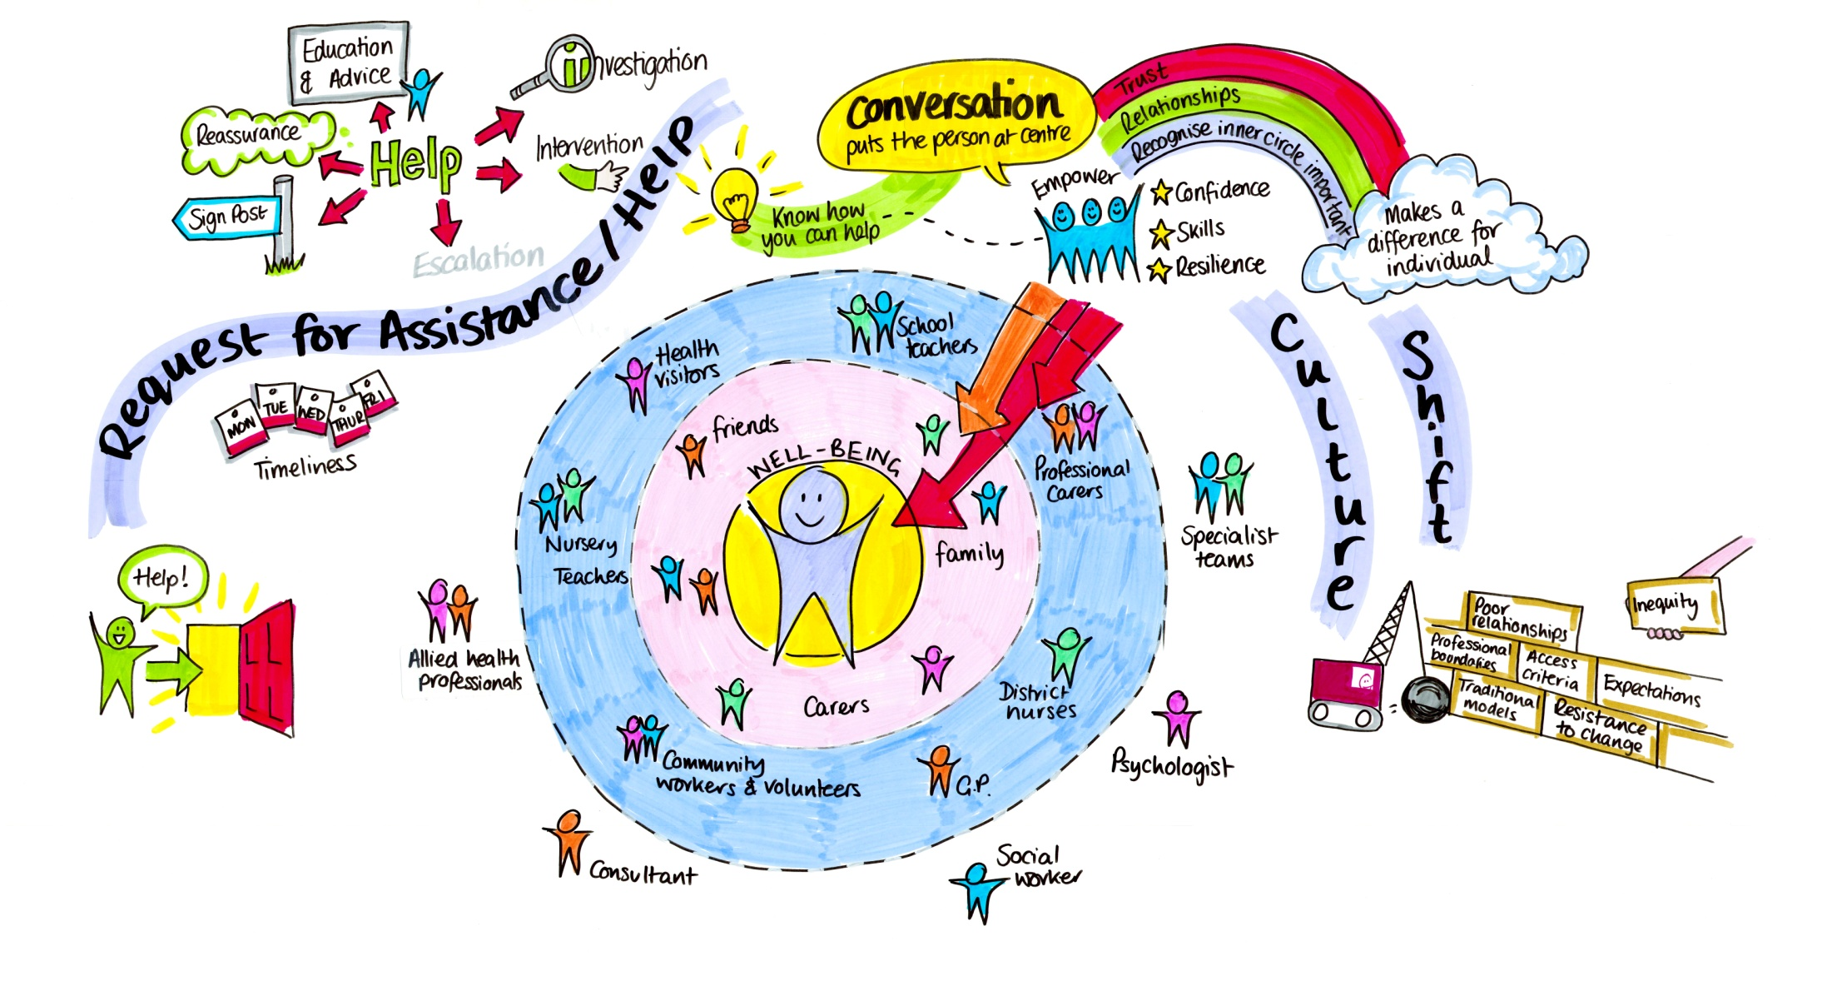
Our ideas
Ensure the child at centre of all decisions
Share expertise with people closest to the child
Prioritise early intervention, prevention and self-management
Deliver wellbeing outcomes
Provide easy access to help
Notes:
Katie
In line with national drivers, the team wanted to change the history of practice by moving away from ‘specialist knows best’ and putting the child and young person’s voice at the heart of every decision we made, every action we took and every outcome we set.
We wanted to share our expertise and build resilience in the people who were closest to the child as we knew that they are crucial in delivering children and young people’s wellbeing outcomes. We wanted to build an environment of protective, tolerant and enhancing relationships around the child and young person and address the needs/well-being of everyone around the child or young person.
We wanted to focus on moving resource upstream and prioritise early intervention, prevention and self-management.
We wanted to promote least intrusive interventions that were directly linked to wellbeing outcomes in collaboration with the CYP and the most proximal adults
We wanted people to access our expertise without need for referral.
We wanted to ensure everyone around the child or young person knew the red-flags that would trigger action and what action to take.
We also wanted to ensure everyone knew they could ask for help if they are worried or concerned.

Slide 8
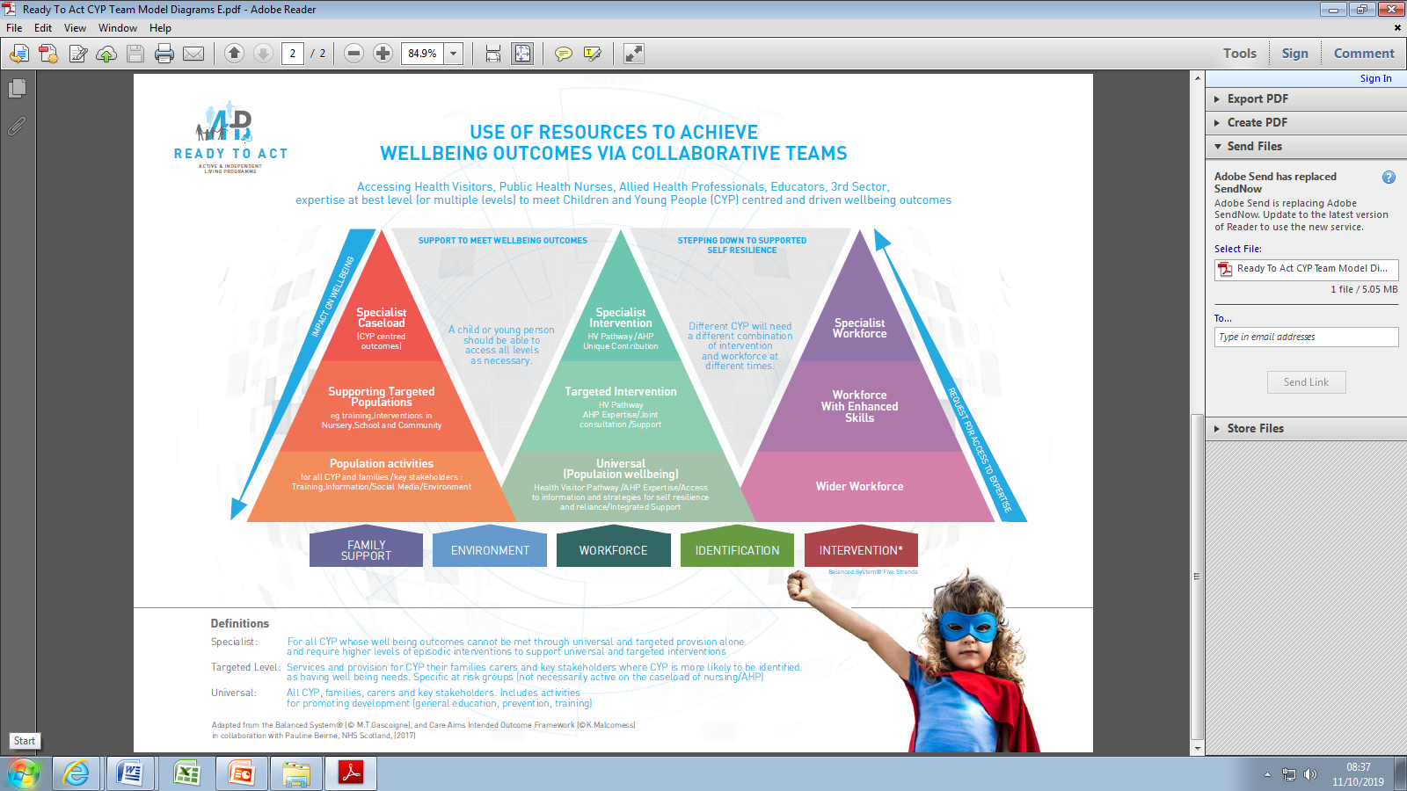
Tools and resources
Partnership working with Families, Education and health
Co-produce solutions to ensure change ideas were driven by the needs and views of the local population.
Implement The Balanced System Framework to underpin our offer
Notes:
Katie
So in 2019 we embarked on a transformational journey in partnership with our three education authorities to understand what CYP need in order for their wellbeing needs to be met.
A crucial first stage in the transformational redesign of our service was to bring together our three education partners and ask them to work with us to design a service for the CYP of Forth Valley to support their wellbeing needs.
We needed to put what children needed as the priority and not let funding and who was paying for what impact of the change
The process was framed using quality improvement methodology and the solutions were co-produced in partnership with Families, Health and Education.
We took time to stop and listen to families, our education partners and our health partners to ask what was important to them. This ensured that the transformational change ideas were driven by the needs and views of the local population.
The process aimed to answer the fundamental question of; ‘What do children with communication needs require in order to be safe, healthy, achieving, nurtured, active, respected, responsible and included?’
Our service worked in partnership with Better Communication CIC (community interest company) and now implements The Balanced System framework to underpin our offer.
This is a whole systems approach that includes quality approaches across Universal, Targeted and Individualised levels and across the five strands of Family Support, Environment, Workforce, Identification and Intervention.

Slide 9

What we did
Combined our resource and moved closer to the community
Became visible and present within Education Establishments
Prioritised building relationships with adults around the child
Changed how we engaged with new requests into the service
Changed the conversation to ‘what matters to you?’
Notes:
Barbara Anne
We pulled our team and resource together and combined our community teams and ASN teams in terms of the people and the funding and we went to where the children were, typically in nurseries and school.
We became visible and present with educational establishments and prioritised building relationships with the key adults around the child.
We delivered positive and sustainable outcomes for children, taking a whole systems approach that includes quality approaches across Universal, Targeted and Individualised levels and across the five strands of Family Support, Environment, Workforce, Identification and Intervention.
This allowed us to build an environment of protective, tolerant and enhancing relationships around the child and young person
We also had to consider how we engaged with new requests into the Service. We introduced having an outcomes focused conversation at point when people were asking for help and we changed the conversation from ‘what’s wrong’ to ‘what matters to you’
We moved away from intervening based on a problem but intervening based on impact on wellbeing. As we listened to people tell us their story, we listened for the strengths in the situations, the support networks available and any resilience demonstrated and reflected this back to the person. We identified the priority risk by finding out the thing they were most trying to avoid. Once we had identified strengths and priority risks, we began to work towards agreeing the desired outcome and partner with them about how to get there.

Slide 10
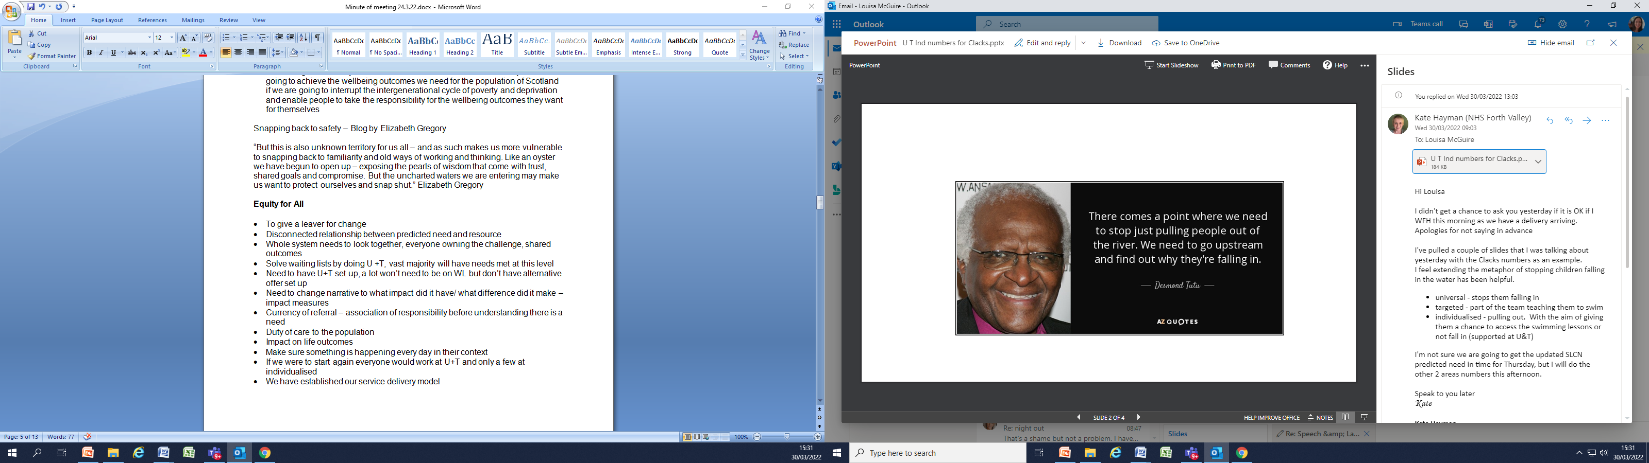
The impact
Notes:
Barbara Anne
Because of that
The services started reaching more children and families. In the academic year 2022/23:
We had 6,800 followers on Facebook and 1589 followers on Twitter which enabled Families to access advice in order to support them to be effective communication partners with their child
We awarded 50 Educational placements as communication friendly environments as they demonstrated appropriate enhancements for all children, and adaptations for children with identified communication support needs
We provided 196 training sessions for education workforce to develop the skills and knowledge to support learners with communication needs plus HV training
We provided 1177 early intervention conversations with education and health visiting staff to support their concerns about a child’s SLC skills. 82% of conversations with education colleagues and 70% of conversation with HV provided sufficient early advice and reassurance to enable them to self manage the on-going support needs without the child having to be stepped into individualised care.
We provided 420 conversations to parents through our helpline. The helpline enables the service to support early intervention and prevention for children and young people when families have concerns. The ability to be responsive to concerns through the helpline is reflected in the data showing that 34% of requests to the SLT team received initial support within one week, 92% within 12 weeks.
We provided a further 771 conversations with parents of children referred into the service. Again advice and reassurance enabled 398 of the children and young people (34%) to return to education support or self management by families, without the need for direct intervention from SLT.
We provided 313 Universal and targeted interventions in 58 establishments focusing on reducing the impact for all children and young people.
The individualised caseload and the number of referrals reduced despite increased demand which is a strong indicator that universal and targeted activity is supporting more children.
Many children and young people’s needs are now being supported within their home and educational environments without needing to be stepped into individualised care.

Slide 11
“I have been able to reach children by supporting teachers/SfLAs to use appropriate strategies or approaches to enhance their speech, language and communication at the Universal and Targeted Levels - leading to more access to SLT and more positive outcomes for children's SLC.”
Children’s SLT, Falkirk
“In nursery we have found it very helpful having a link SaLT assigned to us, this has supported children, families, staff and multi-agency TAC meetings. The model gives easy and supportive access to support which has enabled staff and families to access support and guidance in a timely and effective way.”
Early Years Practitioner, Stirling
“Previously, some children, especially those living in poverty may have been discharged due to not being brought to clinic appointment but working in this way allows our service to plan for and support for these children in a different way if required.”
Children’s SLT, Stirling
What have we
noticed for Children
and Young People?
Notes:
Barbara Anne

Slide 12
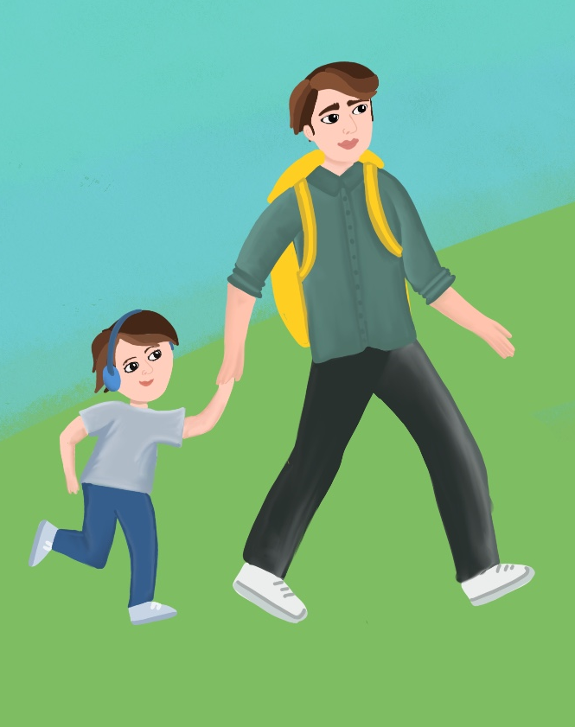
Lily’s story
Breaking the intergenerational cycle
Family perception of Speech and Language Therapy Services
Barriers to access
Building a relationship
Working together for Lily
Notes:
Barbara Anne

Slide 13

Our learning and next steps
Engage with stakeholders
Bring people on the journey with you
Move from being reactionary to proactive
Improve reach and access
Better outcomes for Children and Young People
“When we are under significant pressure the temptation is to snap back to a place of safety. However, we can’t snap shut. We need to stay open to innovation for the CYP of today and the parents of tomorrow.”
Elizabeth Gregory
Notes:
Barbara Anne
Being willing to think differently and take a leap of faith has enabled us to reach more children
Sharing our knowledge and skills with the adults in the child’s everyday life as these people are crucial in delivering children’s wellbeing’s outcomes
In challenging financial times, we need to keep a focus moving resource upstream and prioritising early intervention, prevention and self-management and promote least intrusive interventions, directly linked to wellbeing outcomes, in collaboration and without need for referral.
We can not be drawn back into a refer, assess, treat system with focus on individualised care.
We need to continue to have a strong focus on self management and building capacity within families, placements and communities
I leave you with this quote from a blog by Elizabeth Gregory as I recognise that when we are under significant pressure the temptation is to snap back to a place of safety. However, we can’t snap shut. We need to stay open to innovation for the CYP of today and the parents of tomorrow.

Slide 14
Supporting families through telepractice: improving outcomes, reaching communities, maximising resources.

Slide 15
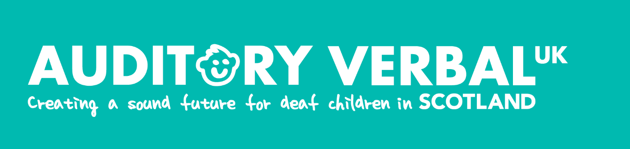
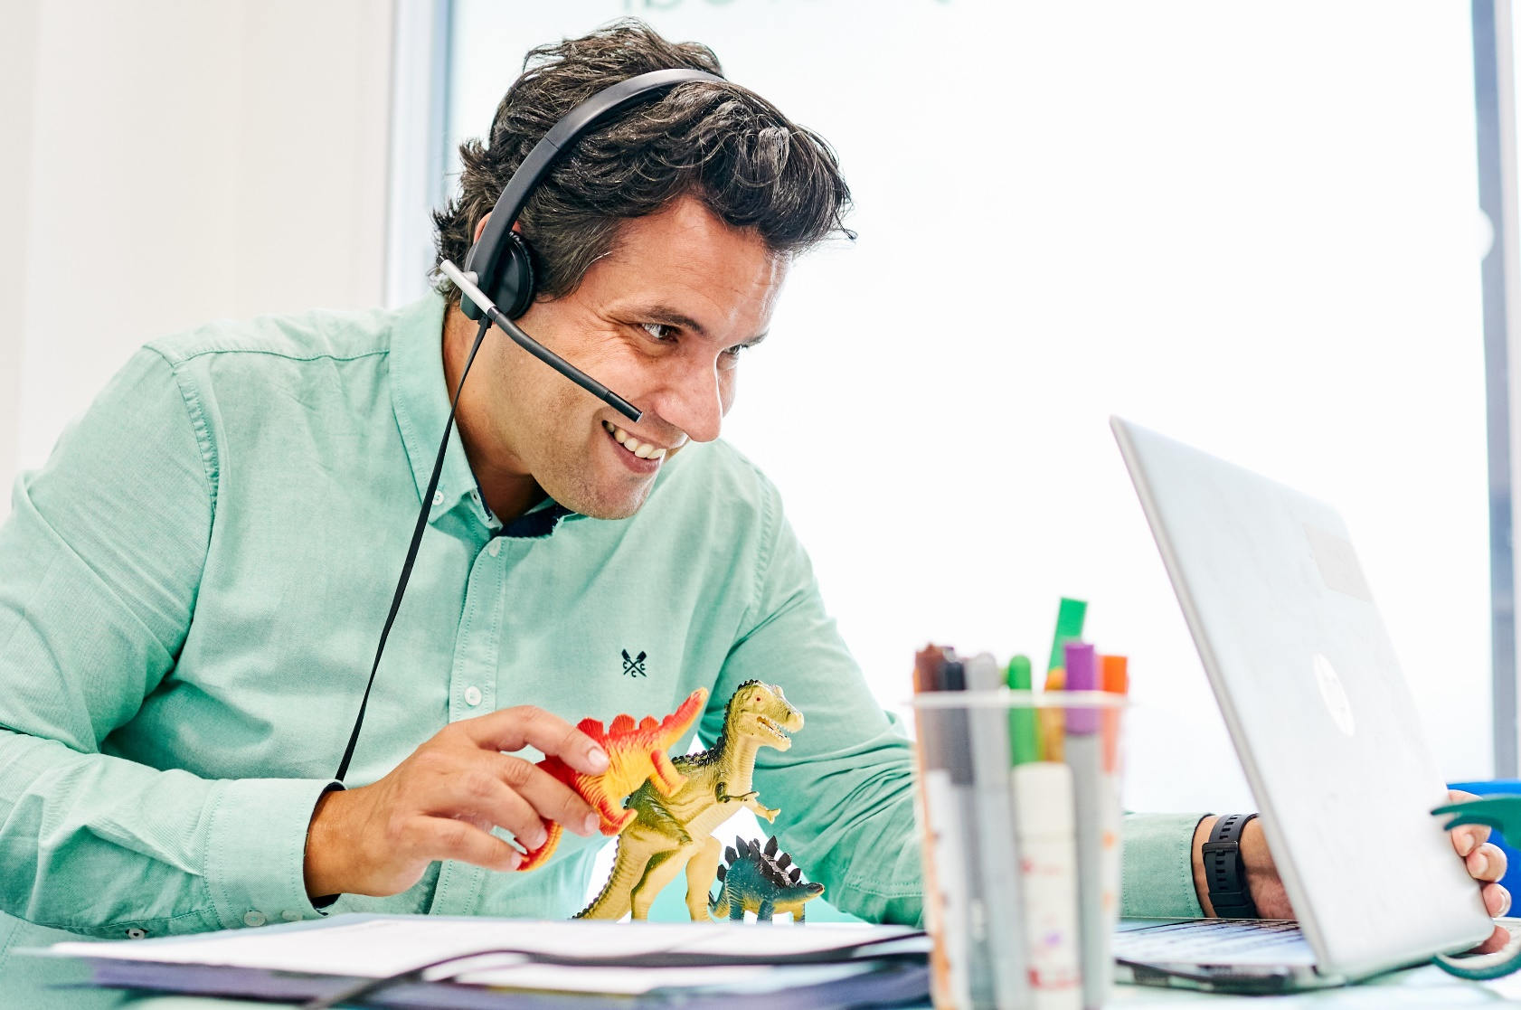
Embracing telepractice
Delivery of services using telecommunications and online technology to remotely connect clinicians to service users
Notes:
Embracing telepractice – as a way of thinking Differently to Improve Outcomes and Maximise Resources.
Showing how telepractice, as an innovative delivery model, can be used to support communities across Scotland access essential health and social care services – and we’ll be showing how telepractice is used to support deaf children to learn to listen and talk with Auditory Verbal therapy.
Telepractice is defined as delivery of services using telecommunications and online internet technology to remotely connect clinicians to service users for assessments and intervention.

Slide 16


Auditory Verbal therapy
A specialist, family-centred, parent-coaching approach to developing spoken language through listening for deaf children.
Notes:
What is Auditory Verbal therapy?
A family-centred specialist approach to developing spoken language through listening for deaf children. It supports deaf children aged between 0 and 5 learn how to make sense of the sound they receive through their hearing technology, like cochlear implants and hearing aids, and develop spoken language so they can learn to talk like their hearing friends.
It is delivered by teachers of the deaf, speech and language therapists and audiologists who have undergone a minimum of three years additional post-graduate training, alongside their current role, to become a certified Auditory Verbal Therapist.
One approach for families of deaf children – all deaf children need early and effective support to develop language and communication, wether they use sign language, spoken language or both.
NOEL TO ADD FURTHER INFO

Slide 17
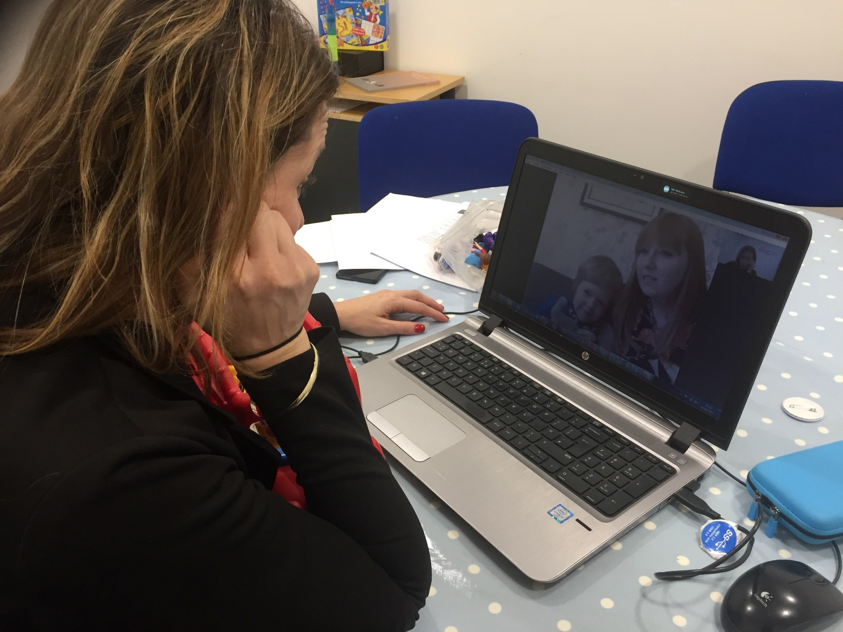
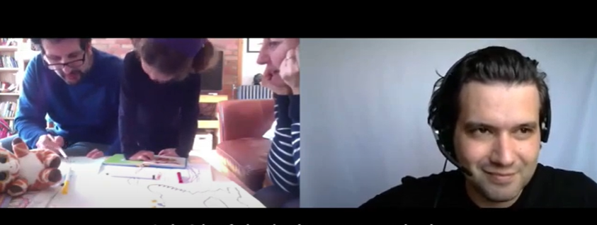
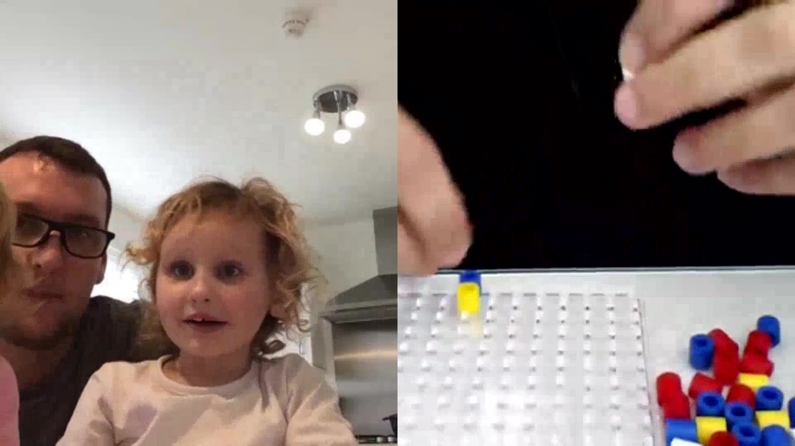
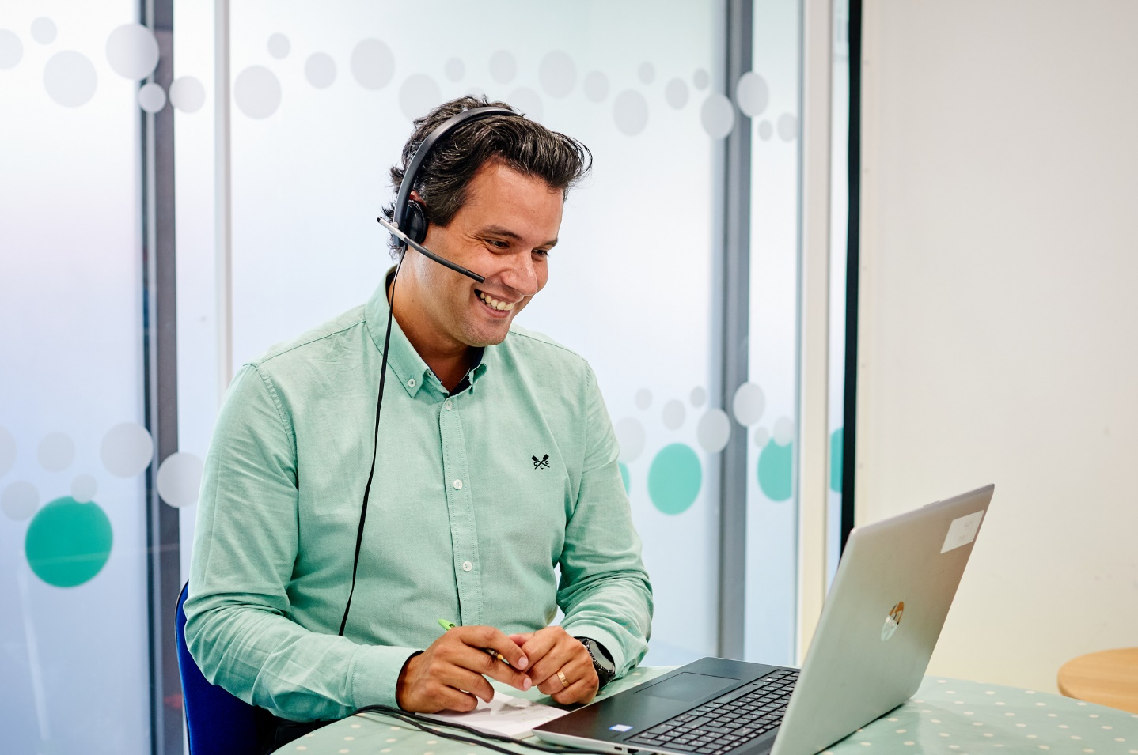

Title
Presentations are communication tools.
Notes:
When did we start using telepractice to deliver AV therapy? – about 12 years ago
Families had to travel great distances to come for therapy sessions. as a charity we initially only had therapists in England and families in Scotland had to travel for their appointments.
Started delivering telepractice before the pandemic – seeing families from Scotland travelling to England, and embraced telepractice to support them.

Slide 18


Is there a difference between
online & in-person therapy?

Slide 19




Core Elements of Telepractice
Parent coaching
Goals
Joint planning
Observation
Feedback
Adult learning styles
Planned and decided with parents
Clear and SMART
Sessions are goals-led rather than content-led
Technology
Content
Discuss with family prior to session
Functional for the family
Developmentally appropriate
Focus on process rather than outcome
Camera
Screen
Online platform
Internet connection

Slide 20
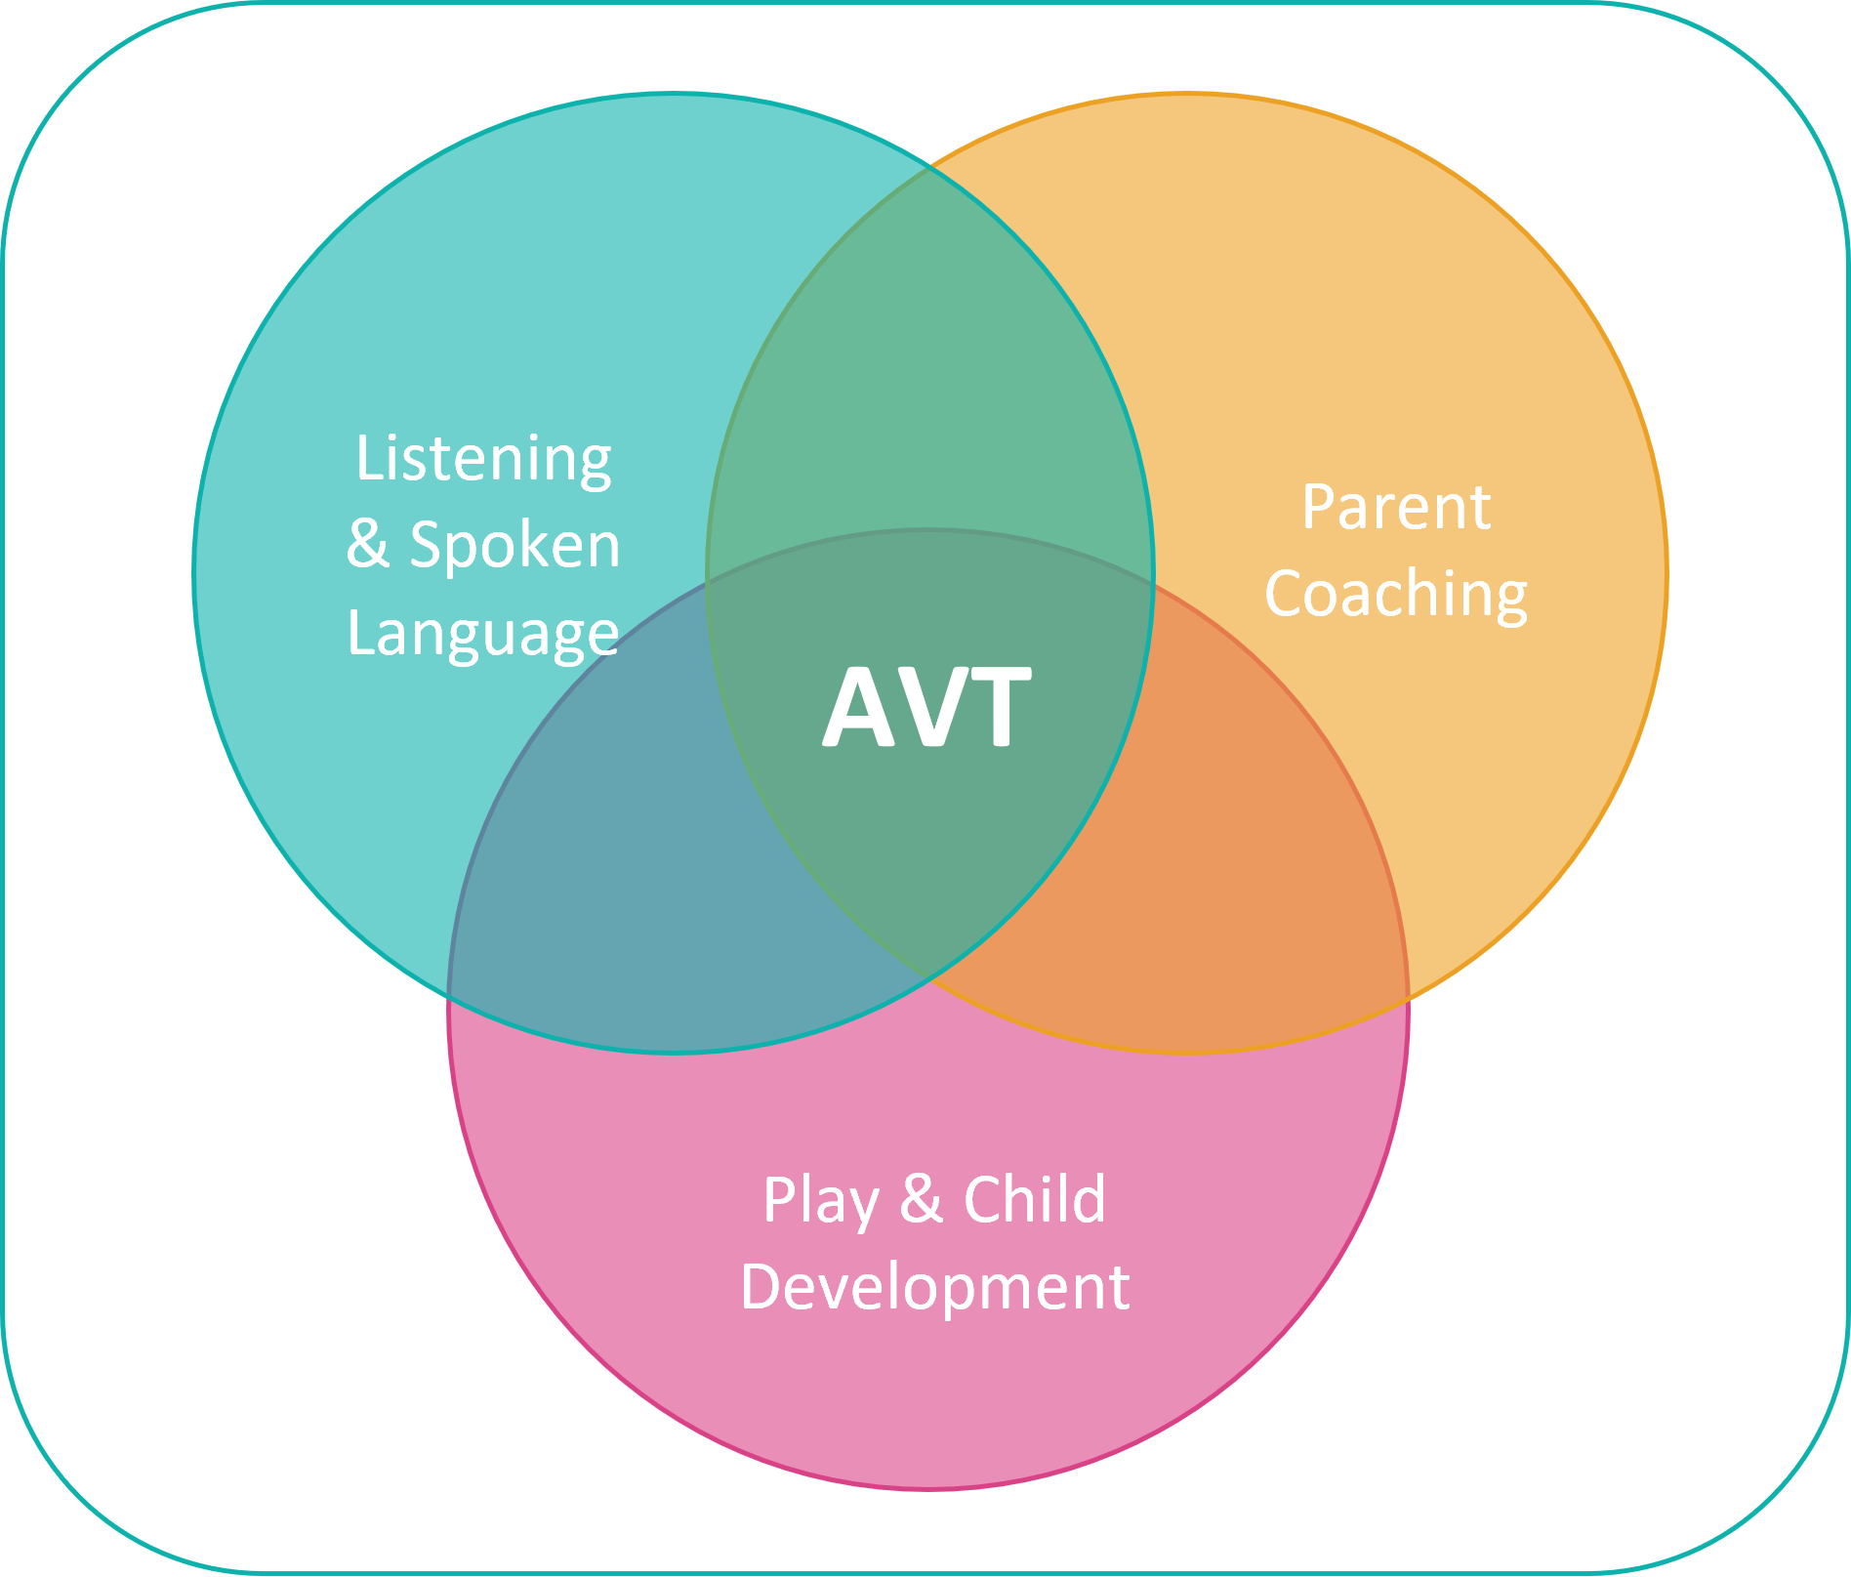
How do we achieve
listening & spoken language in deaf children?
Key Elements
of AV therapy
High Expectations
Notes:
In AV we will always work through a parent-coaching model. AVT is all about coaching the parents to stimulate and develop listening and spoken language in their child. It will always be done through play and through an in-depth understanding of child development.

Slide 21
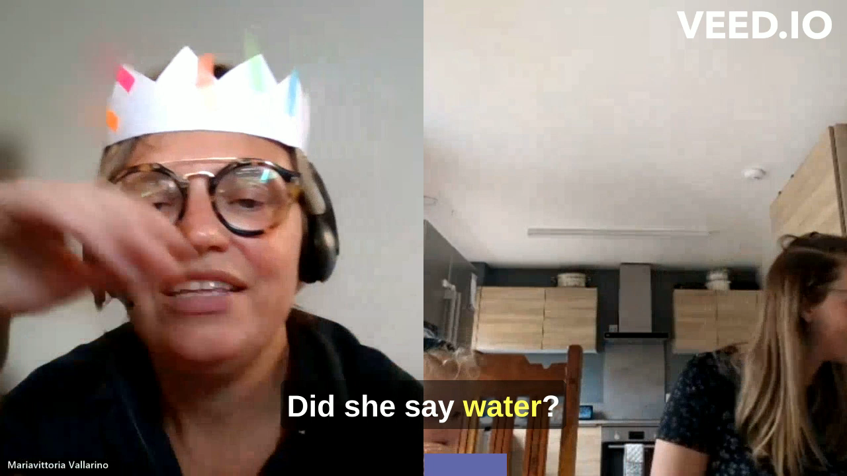
Notes:
YouTube version

Slide 22
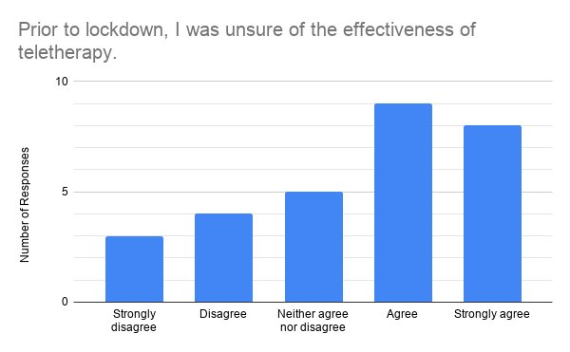
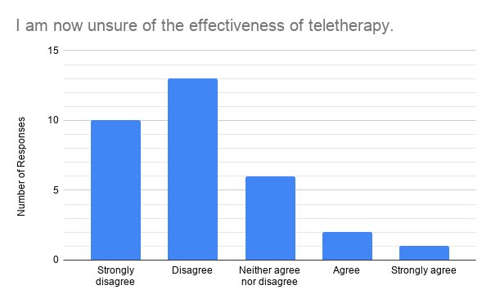
Benefits
85% of parents opted to continue with their Auditory Verbal sessions solely via telepractice or a blend of telepractice and in-person sessions following the
COVID-19 pandemic.
Notes:
For families:
Parent questionnaire, 2020.
Prior to lockdown, 60% of parents either agreed or strongly agreed that they were unsure of the effectiveness of teletherapy, 15% neither agreed nor disagreed, and 25% either disagreed or strongly disagreed​
During lockdown, 10% of parents either agreed or strongly agreed that they were unsure of the effectiveness of teletherapy, 20% neither agreed nor disagreed, and 70% disagreed or strongly disagreed.
Research has shown that children with hearing loss who, together with their parents, receive telepractice sessions perform at least as well in multiple measures of language outcomes as those who receive in-person sessions⁵². Furthermore, parents have been found to be more engaged during teletherapy than traditional sessions^{52,53,54} and may also favour telepractice because of the reduced disruption to their everyday routine^{53,54.} Telepractice also breaks down geographical barriers and facilitates global communication⁵⁵.
Telepractice had been used at AVUK on an ad hoc basis for more than a decade when the global pandemic of the COVID-19 began in early 2020⁵⁴.
In March 2020, following the social restrictions imposed due to the global pandemic, all families at AVUK received therapy via telepractice. An audit of their experiences with telepractice found that approximately 80% of parents felt their child was making good progress with telepractice sessions, while 89% of therapists felt that telepractice sessions were equally or more effective than in-person sessions⁵⁴.
Additionally, 85% of parents opted to continue with their Auditory Verbal sessions solely via telepractice or a blend of telepractice and in-person sessions⁵⁴. With appropriate technology, telepractice is a viable means of providing Auditory Verbal therapy⁵⁵. In 2022, AVUK continued to see families both in person (34%), via telepractice (42%) and as part of a blended programme of both in-person and telepractice sessions (24%).

Slide 23
“Telepractice has been really effective for teaching us strategies. I like the fact that my son is more comfortable in his own environment.. my husband can more easily join the sessions, and the toys/objects we use in everyday life can easily be incorporated into the sessions.”
“We encourage Grace to use the power of words, express her thoughts, ask questions about the world around her… and we’ve managed to do this all through video calls. Albeit, tough on occasions where Grace finds it difficult to equalise her emotions, and her focus can be limited. But working from a home setting, Grace can be relaxed in her environment. Grace has just started school this month, and we are now implementing her online sessions within her school.”
”I love them. They are so convenient, especially living in Shetland. It is just like
Mariavittoria [Auditory Verbal Therapist] is in the room with is. She hands Maci things and for us it is no different to face-to-face.”
“I would highly recommend distance learning for families who are unable to access AV in person. You work with your AV therapist setting the plan/goals for each session and have achievable take home messages at the end of each session.”
Notes:
Experiences of families using telepractice

Slide 24
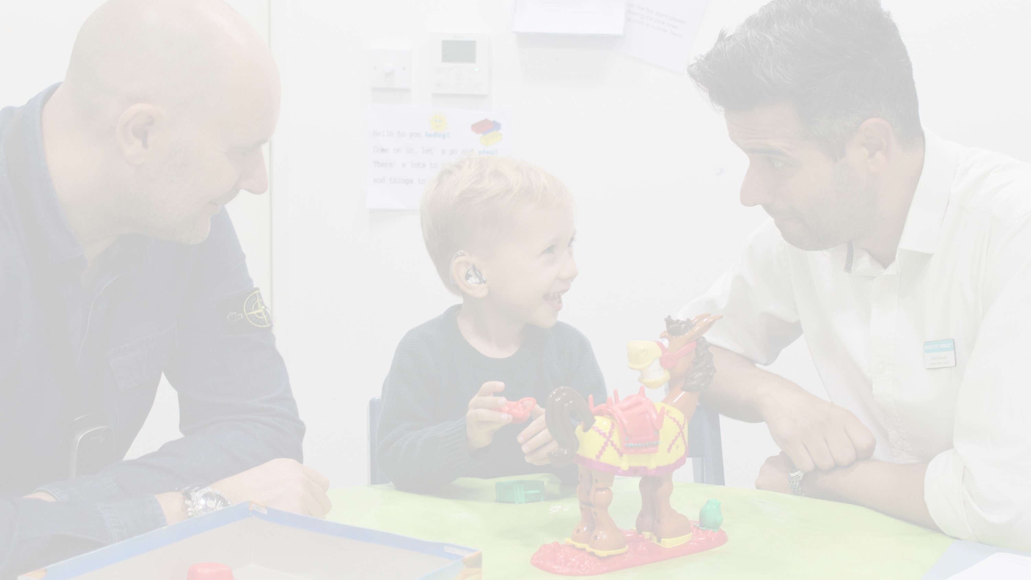

“I can be more of an observer, without feeling the need to keep things going all of the time”
Benefits for professionals
Stronger parent-coaching skills
More opportunities to see the child in the home-environment
More opportunities to see the parent interact with the child
Children are not tired from the journey to the clinic
Children are more comfortable as they are in their home-environment
Fewer appointment DNAs
Involvement of wider team
Reduced travel-time between appointments
“I provide a lot more in-the-moment feedback about the use of strategies by the parents”
“I am able to ‘hold back’ for a little longer before ‘jumping in’”
“I am taking much less of an active role in the session and much more of a guiding role from the sidelines”
Notes:
Quote are: Pollard & Hogan: Views of Telepractice for AV Therapy (2021).
In addition, against the backdrop of limited resources and the need to work across Health Board boundaries to provide access to specialist clinical support, telepractice has the potential to deliver excellent outcomes through collaboration and innovative working as our health services recover and reform.
Involvement of the wider team in the sessions e.g. nursery teachers or teaching assistants, in the case of deaf children we can often have the teacher of the deaf join in the session as well.

Slide 25
UK and international evidence base
80%
97%
Of all deaf children who spend at least two years on an Auditory Verbal therapy programme achieve age-appropriate spoken language.
Of deaf children without additional needs who spend at least two years on an Auditory Verbal therapy programme achieve age-appropriate spoken language.
Notes:
Outcomes of AV therapy for families who want their deaf child to learn to listen and talk.
International research has shown that 89% of children with hearing loss graduating from Auditory Verbal therapy programmes demonstrated language skills on par with their hearing peers (Sound Outcomes, 2021).
In the UK as many as 80% of deaf children who spent two or more years on an Auditory Verbal therapy programme achieved age-appropriate language skills. This rose to 97% of children without additional needs (Hitchins, A.R. & Hogan, S.C., 2018).
1 in 2 deaf children with additional needs reach at least age appropriate language, and all double their rate of language development.

Slide 26
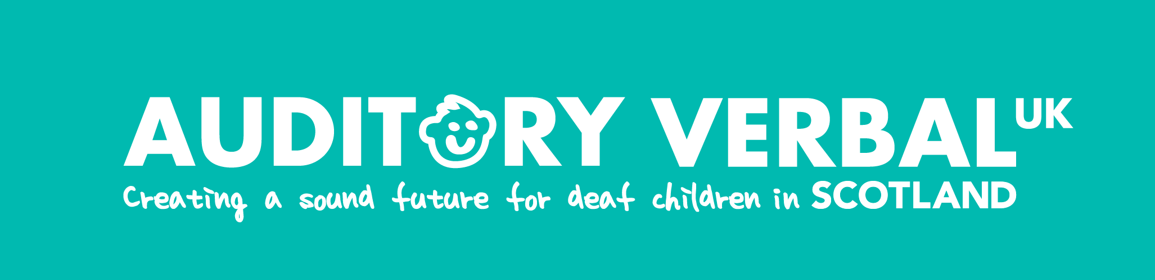





www.avuk.org
@AuditoryVerbal
Auditory Verbal UK
@auditoryverbaluk
@AuditoryVerbalUK
Auditory VerbalUK
Auditory Verbal UK is a registered charity
(charity no: 1095133 in England & Wales and charity no: SC052499 in Scotland).
Registered company number: 4569764.
Auditory Verbal UK is the operating name of the Auditory Verbal Centre

Slide 27
Questions

