Slide 1
Children and Young People's Mental Health and Wellbeing - A Whole-System Approach

Slide 2
SPEAKERS
Stephen McLeod
Ruth Christie
Elizabeth Archibald
Della Robb

Slide 3

Getting to know who’s in the room…
Where do you work?
What do you do?
What are your interests?

Slide 4

Children and Young People’s Mental Health and Wellbeing Joint Delivery Board

Slide 5
Finding out what you know about Children and Young People’s Mental Health…

Slide 6
Our approach to Children & Young People’s Mental Health & Wellbeing
Children & Young People
Distress Response
Safe & Effective treatment for mental illness
Support through Education & in the Community
Population Health
Responses
Notes:
Critical part of how we will #KeepThePromise by ensuring families can access support before reaching crisis point.

Slide 7
Support provided to Children & Young People through Scottish Government Investment
3000 parents, expectant parents and infants have been supported by 34 charities in the first year of the Perinatal & Infant Mental Health fund.
18,500 children and young people accessed 230 new community-based supports between July and December 2021.
12,149 children and young people were supported by school counselling between July and December 2021
Over 2000 students supported by 89 additional FTE counsellors in universities and colleges.
13,352 children and young people started CAMHS treatment between July 2021 and March 2022.
18, 256 people supported through the Relationships Helpline provided by The Spark
6,500 children, young people, and adults, parents and carers affected by eating disorders supported by BEAT through their helpline and specialist workshops.
16,000 parents and professionals registered for Solihull online parenting programmes since May 2020
138,915 views of AyeFeel webpages and 130,644 views and engagement through social media campaigns.

Slide 8
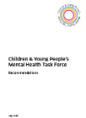



Children and Young People’s Mental Health Task Force
The Taskforce was jointly commissioned by the Scottish Government and COSLA with the aim that children, young people, their families and carers should know that they are supported in good mental health and able to access services which are local, responsive and delivered by people with the right skills. The Taskforce investigated how to improve the way mental health services are organised, commissioned, and provided and how to make it easier for young people to access help and support when needed.
Taskforce Report and Recommendations:
[July 2019]
Youth Commission for Mental Health
The Scottish Government, Young Scot and the Scottish Association for Mental Health (SAMH) worked in partnership to deliver a 16-month Youth Commission on Mental Health Services - made up of young people aged 15 to 25, from different backgrounds and with a variety of experiences from across Scotland. This involved discussions and gathered evidence to develop recommendations to improve the experiences of young people when accessing mental services in Scotland.
Youth Commission Report and Recommendations: [May 2019]
Rejected Referrals Child and Adolescent Mental Health Services (CAMHS)
Action 18 of the Mental Health Strategy committed to an audit of CAMHS rejected referrals, to investigate barriers and explore how to support appropriate referrals and further act upon these findings.
Report and Recommendations: [June 2018]
Child and Adolescent Mental Health Services (CAMHS) Audit Scotland Report
Audit Scotland undertook a review of Child and Adolescent Mental Health Services in Scotland, reporting on: access to support, effectiveness of support for children and young people, resources and policy and strategic direction.
Report and Recommendations: [September 2018]

Slide 9

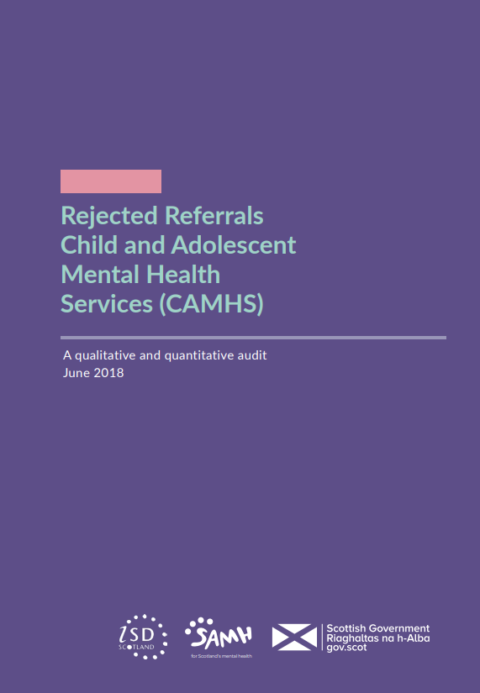
June 2018

Slide 10

July 2018
Dame Denise Coia, Chair
@taskforcescot #TaskforceMH C&YPMHT@gov.scot

Slide 11
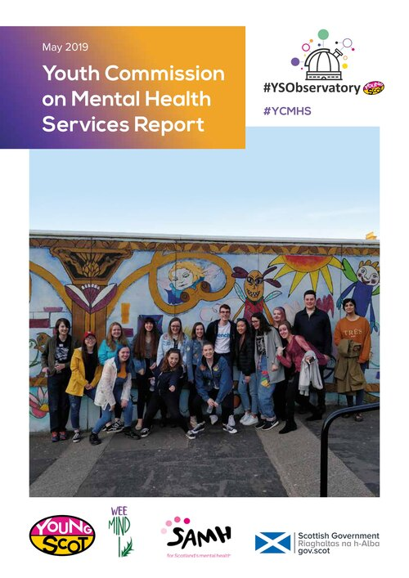

Slide 12
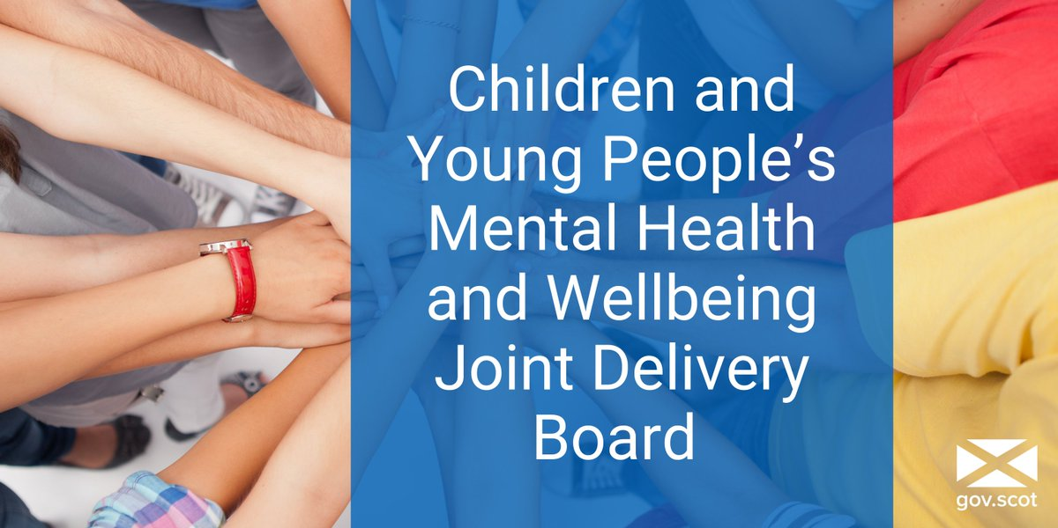
The Children and Young People’s Mental Health and Wellbeing Joint Delivery Board
The Children and Young People’s Mental Health and Wellbeing Joint Delivery Board was formed in Spring 2021 to continue to progress the revised aims of the Mental Health and Wellbeing Programme Board.
Children and Young People’s Mental Health and Wellbeing Programme Board was established in August 2019 to mobilise and implement the recommendations developed from the above research, engagement and reports, through 9 key deliverables.
Views of children, young people and families at the heart of this work.

Slide 13
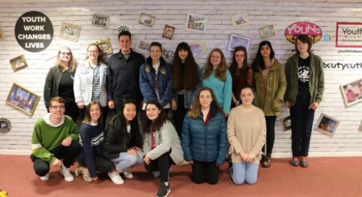

Slide 14

Supports and services for 5-24 year olds and their families
Since January 2021 the Scottish Government have provided local authorities with an additional £15 Million per annum to deliver new and enhanced mental health & wellbeing
>New or enhanced
>Focus on prevention and treatment of emotional distress
>Developed with service users
>Links in and out of CAMHS
>Self-referral
>Support the Family as well as child or young person
>Part of whole system approach
>Based on local need
Services are based on a Framework which requires that they are:

Slide 15
Current provision of services
230 new and enhanced supports and services in place
  Physical Hubs
  Digital Services
  Drama, Art and music therapy
  Play therapy
  Talking therapies
  Mentoring projects
  Peer Support Services
  Targeted support
18,500 service users over 6 months
  58% Secondary School
  33% Primary School
  9% Post School
Notes:
LAs report on a six monthly basis
This will rise to 250 services this year
A total of 17,786 children and young people accessed the community-based supports and services, with 792 family members and carers also using them. These numbers are up significantly from the data for January to June 2021, which showed that 13,143 children and young people and 210 family members and carers used the services. Overall, there was a 39% increase in the number of service users between the two reporting periods.
Where known, service users’ gender was 53% female, 43% male and 4% other.
59% of the children and young people using the services were of secondary school age, 33% of primary school age or under and 8% of post-school age.
.

Slide 16
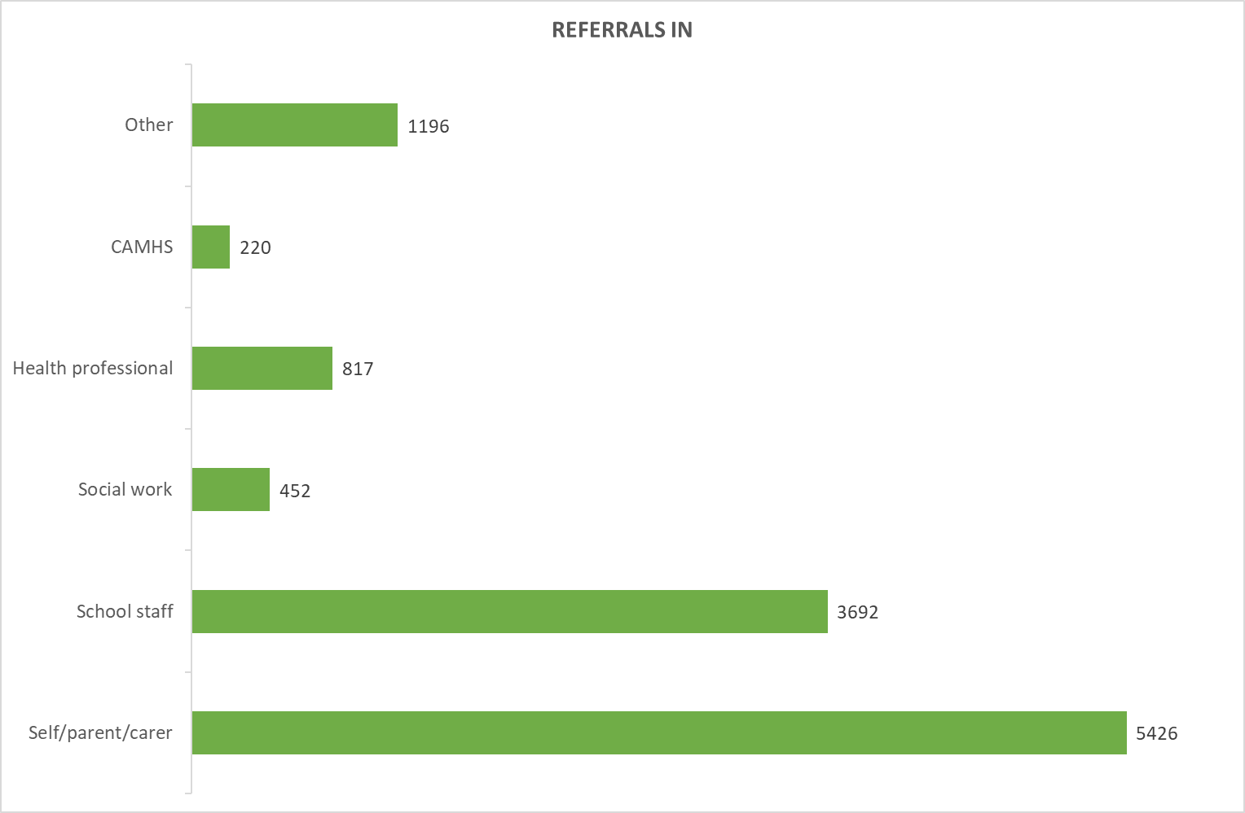
How are people accessing services?
Notes:
As shown in the chart, the most common routes in to the services were referral by self, parent or carer (5,426) and referral by school staff (3,692). Compared to the previous data, the number of referrals by self, parent or carer increased by 4,417 (438%). Also notable is the number of referrals to the services made by CAMHS and other health professionals (1,037), which rose by 600 (137%) from the previous reports.

Slide 17
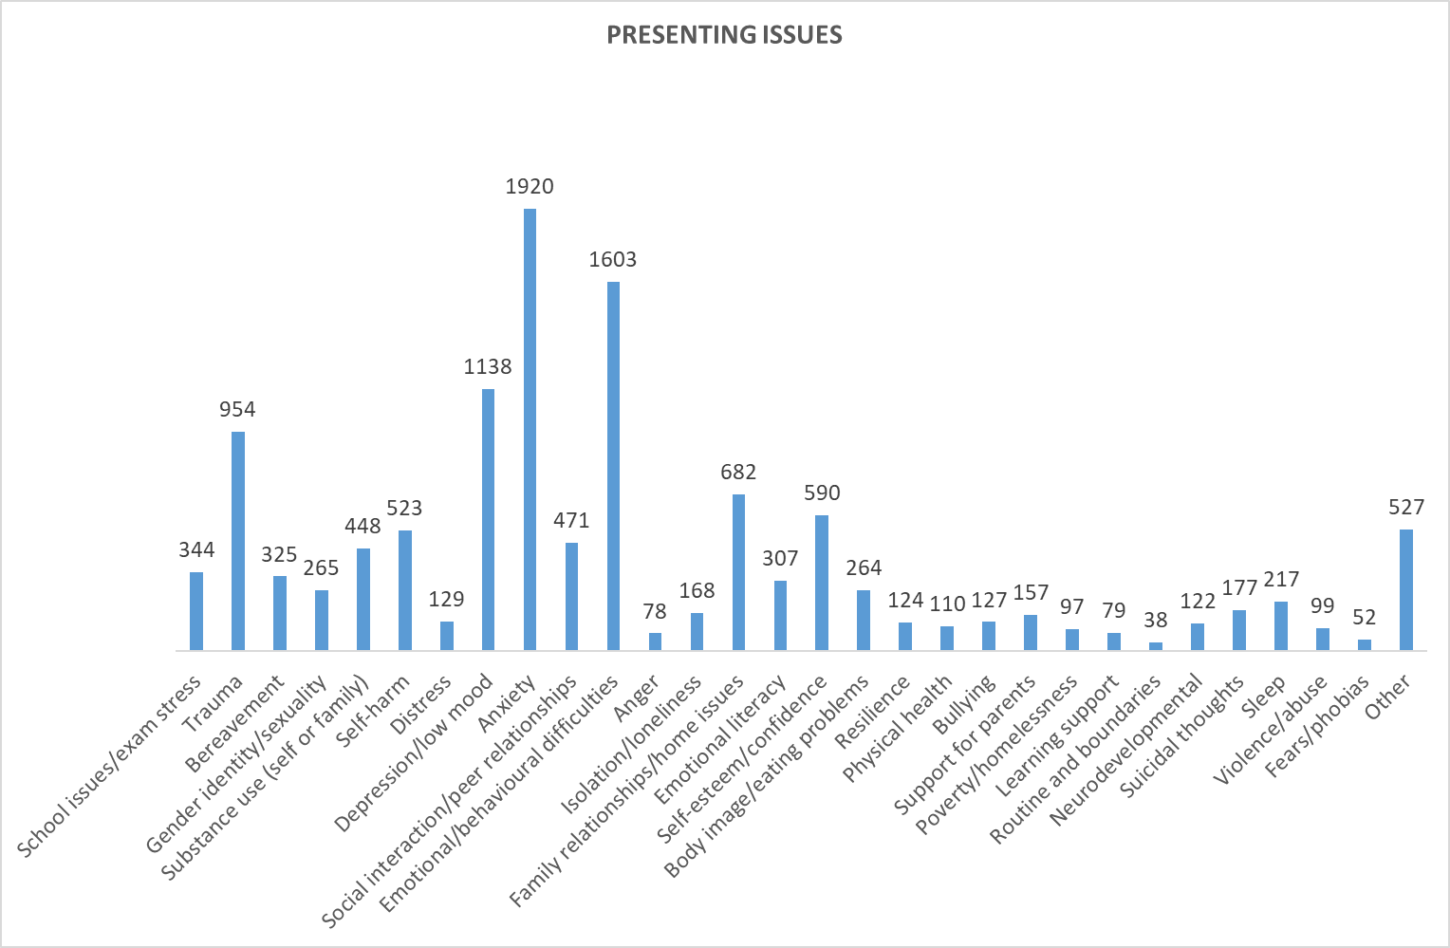
Why are people accessing services?
Notes:
Children and young people most frequently presented to the services with the following issues: anxiety (1,920); emotional/behavioural difficulties (1,603); depression/low mood (1,138); and trauma (954). This replicates the most common issues reported in the previous period, albeit trauma was marginally more prevalent than depression/low mood at that time. It should be noted that children and young people may have presented more than once and/or with more than one issue.

Slide 18
How can we best integrate these services into the support the NHS offers children and young people?
Going forward should the focus for this fund be on providing universal services or more targeted support for at risk groups ?
Notes:
Thankyou and questions

Slide 19
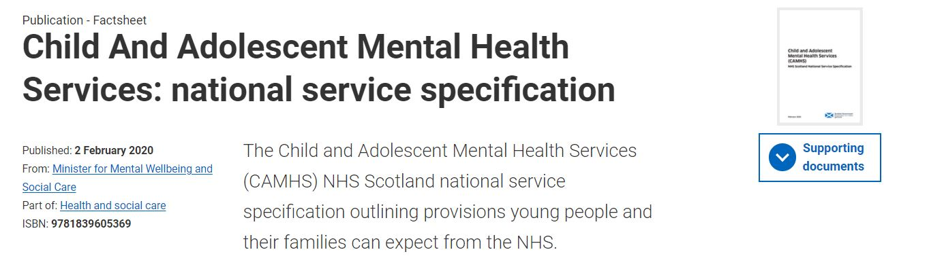
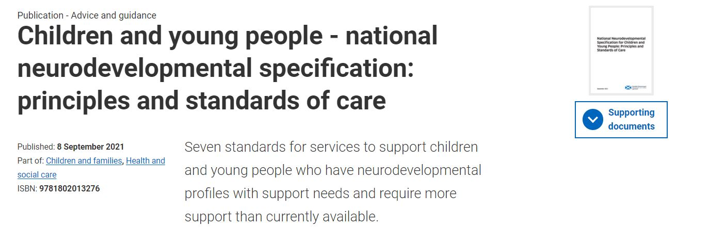

Slide 20
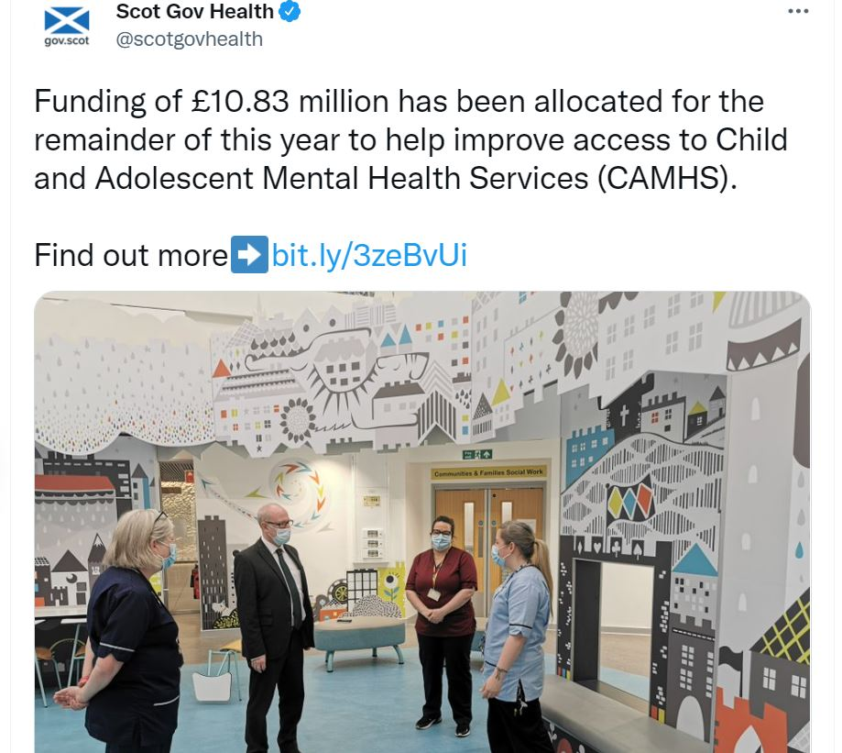
£40m funding to implement the CAMHS and Neurodevelopmental Specifications

Slide 21
Are the priorities right?
Are there any gaps?
What should we change?
How will we know?

Slide 22
Eating Disorders Policy
Where we’ve been, where we are, and where we’re going…
March 2021
August 2021
June 2022
October 2020
National Review of Eating Disorder Services in Scotland was commissioned by Scottish Government.
This followed the Mental Welfare Commission for Scotland's Themed Visit of the care, treatment and support for people with eating disorders in Scotland.
National Review published 15 recommendations, broken up into short, medium and long term. These included key issues such as:
Covid-19 emergency response
Implementation planning and Lived Experience involvement
Co-ordination of national activity
Education and training
Workforce planning
Quality Standards and data improvement
Emergency funding was allocated to NHS Boards to respond to increase in ED presentations.
National Review of Eating Disorder Services Implementation Group was established, identifying 3 priority areas:
Quality Standards
Training and Skills
Data Improvement
Implementation Group due to conclude in August 2022.
Next steps are being developed including:
Final report from Implementation Group
Establishment of National Network for Eating Disorders
Establishment of Lived Experience Panel
Delivery Plan for Eating Disorder Policy

Slide 23
Links across CAMHS, Adult Mental Health & Acute Care
CAMHS
Acute
Adult
Large number of C&YP in CAMHS suffer with an eating disorder.
National Review covered both CAMHS and Adult Eating Disorder services.
Many people with an eating disorder attend acute services, such as:
Emergency departments
Gastroenterology
Dietetics
ICU

Slide 24
Are you aware of this work?
Share any thoughts on what you’ve heard today.
Are there any areas that need prioritised more, and why?

Slide 25

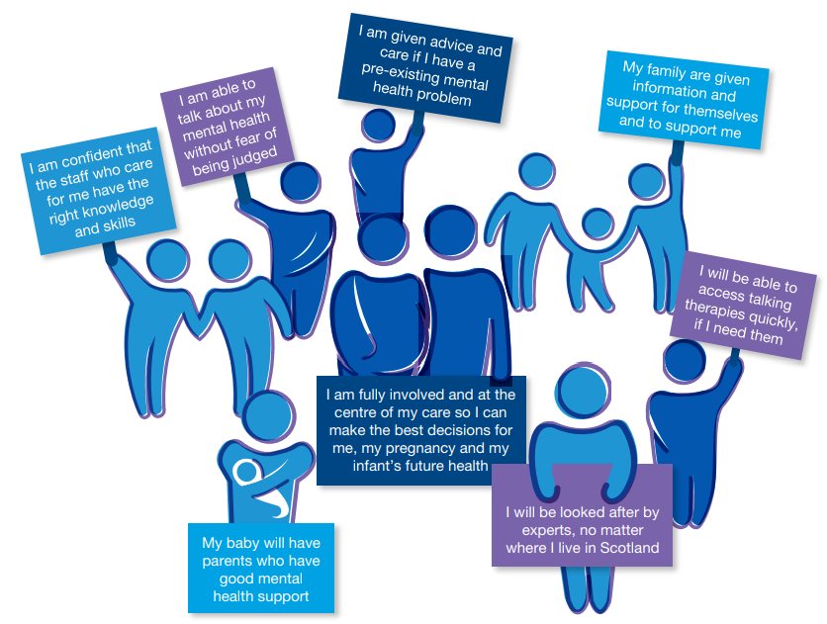


Slide 26
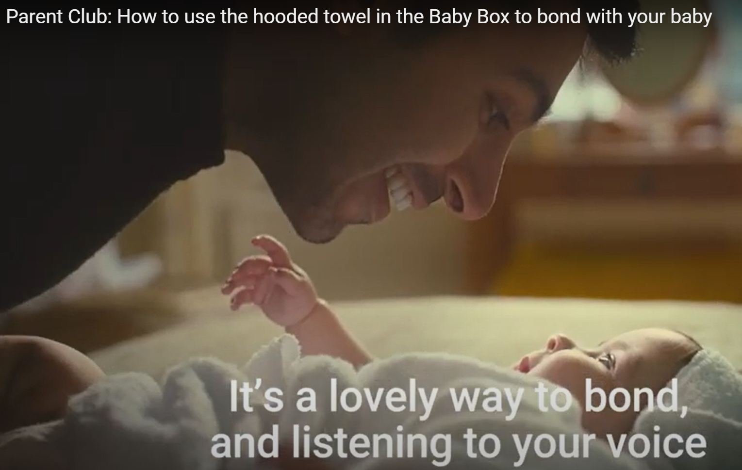
Since 2019, we have invested over £18m in perinatal and infant
mental health across Scotland. This includes:
  Specialist Community Perinatal Mental Health Teams and Maternity/Neonatal Psychological Interventions services in every Health Board
  Integrated infant mental health teams in 6 Health Boards so far
  Setting up two national third sector funds providing up to £1m per annum to 33 organisations
  Supporting inpatient provision by increasing Mother and Baby Unit (MBU) staffing, launching the MBU Family Fund and running a consultation on future inpatient care
  Increasing awareness of infant mental health by running a national campaign called Wellbeing for Wee Ones, ensuring that every parent within Scotland has access to evidence based information on relationships and child development

Slide 27

Wellbeing for Wee Ones

Slide 28
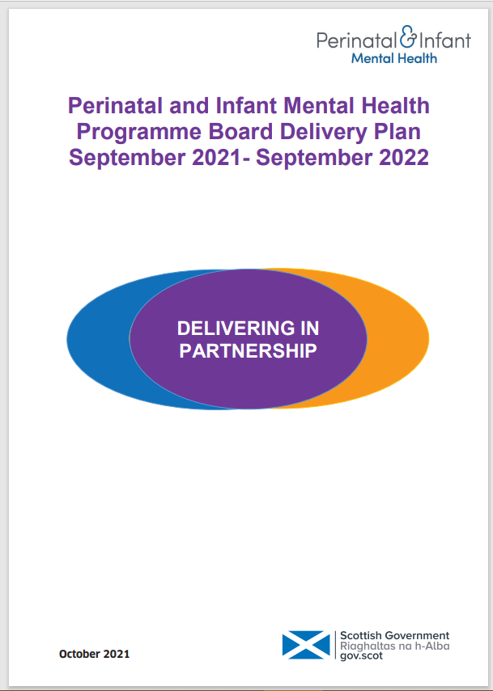
Perinatal and Infant Mental Health Next Steps
The 2021/22 Delivery Plan has two strategic actions:
to develop and sustain services in challenging times (Recover and Restore)
to ensure a systems approach to service development and delivery across perinatal and infant mental health (Renew).
The plan also remains driven by the Women and Families Perinatal Mental Health Pledge though we have reflected the Pledge principles in the expectation that infants should also have services provided to meet their needs.

Slide 29
What are the really important points to keep in mind as we look to support the mental health and wellbeing of parents, young children and families?
The early years are a critical time for mental, physical and emotional development.
Do you feel there is enough awareness of Infant Mental Health and why it is important?

Slide 30
Thank you for attending today.
Children and Young People, Family and Relationships Mental Health Unit, Scottish Government
Stephen McLeod – Professional Adviser
Stephen.mcleod@gov.scot
Ruth Christie – Co-Unit Head
Ruth.christie@gov.scot
Della Robb – Team Leader – CAMHS Improvement and Eating Disorders
Della.robb@gov.scot
Lizzie Archibald – Development Adviser Perinatal and Infant Mental Health
Elizabeth.archibald@gov.scot

