Slide 1
Hospital at Home - Innovating Acute Care in the Community

Slide 2
SPEAKERS
Belinda Robertson – CHAIR
Nathan Devereux
Leanne Marshall-Wood
Gail Black
Denise Johnson
Rowan Wallace
Latana Munang

Slide 3
Session aim
Learn about Hospital at Home
Learn about the Hospital at Home services in:
      Aberdeen City
      Ayrshire and Arran
      Western Isles, and
      West Lothian
Ask questions to the local and national Hospital at Home teams
Notes:
Belinda:
Thank everyone for registering for this fully booked session and their interest in the H@H work.
Introduce the session aims:
We have tried to give as much time as possible to the local teams to celebrate their successes and share their experience.
There will be an opportunity at the end to ask any questions
We are keen to connect with as many people as possible, so if you are

Slide 4

Join in the conversation…
@ihubscot
#NHSScot22
Notes:
Belinda:
We will be tweeting throughout the session. Feel free to join us by ‘@’ing us and using the event hashtag

Slide 5

Supporting better quality health and social care for everyone in Scotland.
We enable health and care systems to apply improvement methodologies to the design and implementation of changes that deliver sustainable improvements in the health and wellbeing outcomes of people in Scotland.
Notes:
Belinda

Slide 6
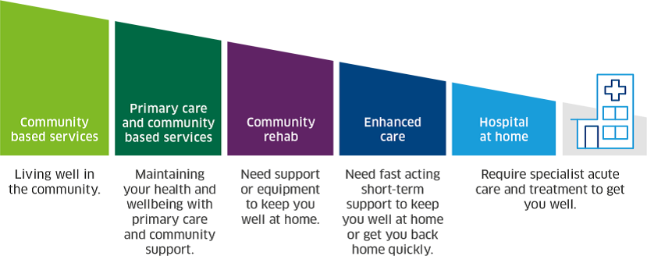
Hospital at Home in Scotland
Notes:
Belinda:
Set the context for how H@H sits in the wider H&SC system in Scotland.
Scottish Government committed to seeing the H@H model spread throughout Scotland. Part of efforts to redesign urgent care
Not about bolting on a new service but is about changing how we think about delivering care.

Slide 7
Hospital at Home (H@H)
H@H is a short-term, targeted intervention that provides a level of acute hospital care in an individual’s own home that is equivalent to that provided within a hospital.
Notes:
Nathan
The definition of H@H is on the slide – this definition ensures a common understanding of the purpose of a H@H service, and importantly, how it differ to other community based services

Slide 8
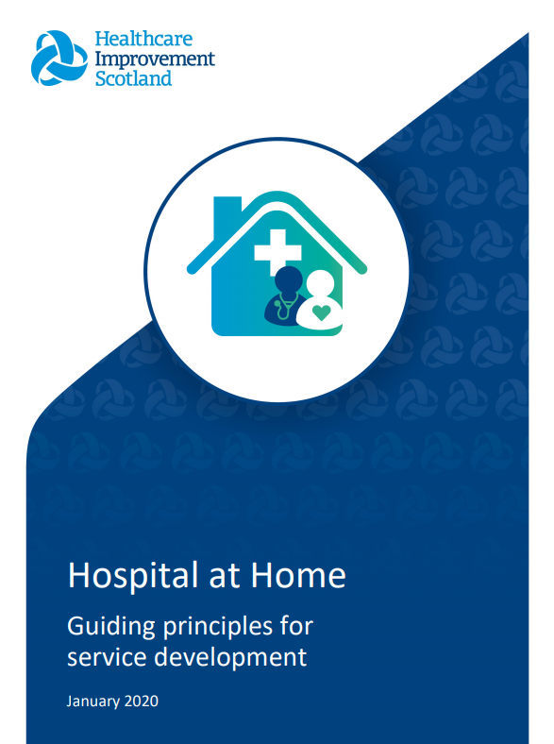
Hospital at Home in Scotland
A hospital consultant acts as senior decision maker and responsible medical officer
Short, time-limited acute episodes of care
Urgent access to hospital-level diagnostics
It provides a different level of interventions, such as access to IV fluids and oxygen
Care delivered by multidisciplinary teams
Notes:
The definition was published in 2020 by the ihub in the guiding principles for service development. These guiding principles provide a framework to support the development of the model throughout Scotland, and include the core elements of a H@H service that are required to meet the national definition, listed on the slide

Slide 9




Evidence of impact
Notes:
For a relatively new service model, its important to consider the evidence base, and in the guiding principles you will find a review of the evidence relating to H@H.
A review of the evidence found a number of key positive factors to H@H that provide assurance when looking to spread the model throughout Scotland.
The review has been refreshed to include the outcomes of a UK study which included some of the H@H services currently being delivered in Scotland.

Slide 10
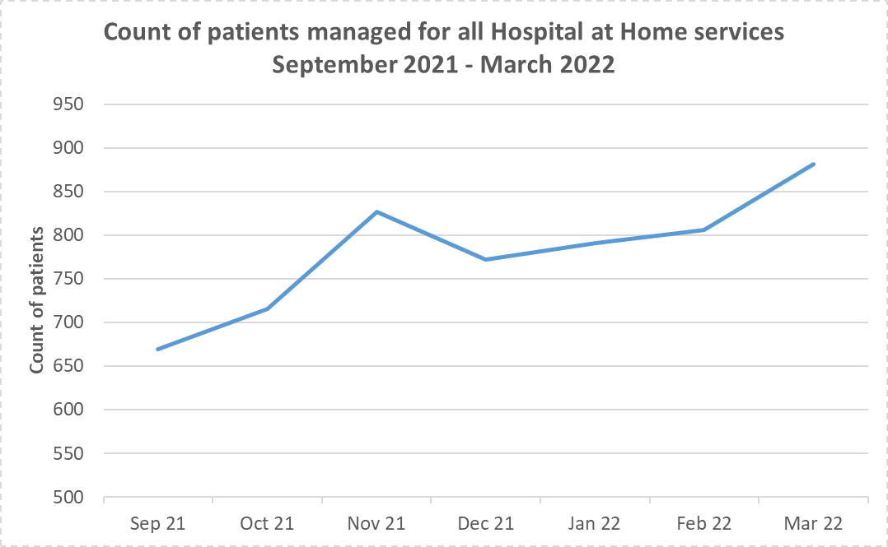
Impact of Hospital at Home
Notes:
We have seen significant growth of the model particularly since the guiding principles were published in 202.
As you can see this chart displays data on the total number of patients that are treated by H@H services inScotland. This data is reported to the ihub as part the national quality improvement programme.
Using this data, we can see that even durin a 6 month period, we experienced a near 30% increase in the number of patients receiving treatment from a H@H service, meaning that those patients are able to access acute level care whilst remaining in their home.

Slide 11
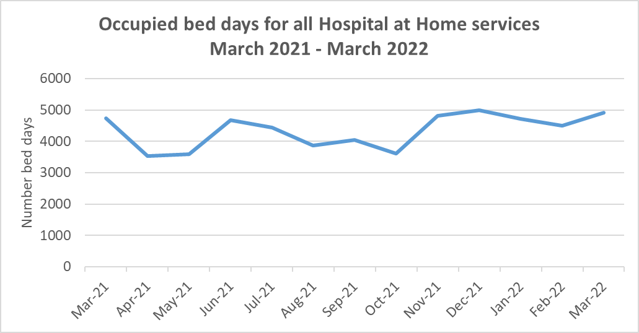
Impact of Hospital at Home
Notes:
Using the same data source, we can also see the number of occupied bed days that are delivered by H@H services.
As H@H is a meaningful alternative to hospital inpatient stay, its important to consider how these bed days would have been delivered if it weren’t for these services delivering acute care in the community.

Slide 12
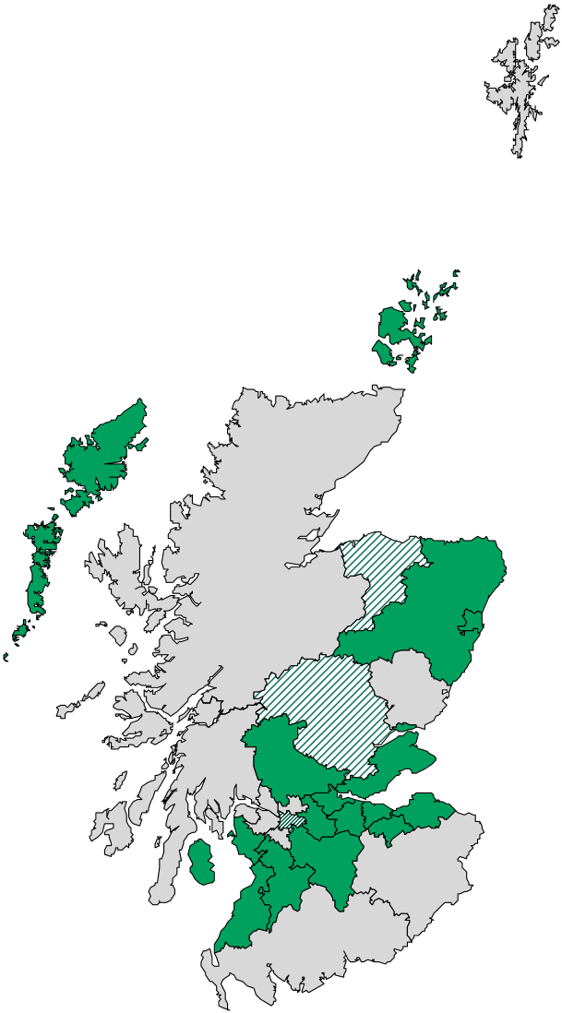
Spreading the Hospital at Home model
Quality improvement support to NHS boards and health and social care partnerships
Working with national partners to address national challenges such as workforce, training and technology
Learning system
  Peer to peer support
  Knowledge exchange
  National Hospital at Home community
Implementation toolkit
Notes:
The ihub is delivering a programme to support the development and growth of the H@H model.
Since 2020 we have been working with boards and HSCPs to support them to design new H@H services and optimise the delivery of existing ones.
In 2 years, we have seen the total number of boards with a service increase from 3 to 10,
As well as the increase in patient numbers treated, we are also seeing an increase in the geographical spread.
We are working with national partners to address the conditions and infrastructure needed for H@H to develop, This includes work in workforce such a developing a competency framework with NHS Education for Scotland.
We have built on the experience and lessons learned from established services to create a H@H implementation toolkit, which is available on the Ihub website, and we have a thriving community for H@H in Scotland, with over 40 members, and we hold regular networking sessions bringing teams together, case studies, podcasts

Slide 13
Challenges
Changing mind-sets and culture
Workforce
Geography
Funding

Slide 14

Challenges
Notes:
Acknowledge that there are significant challenges to developing sustaining and expanding H@H sevices, some of which are represented on the slides.
Wider H&SC SYSTEM – H@H sits within the wider health and social care system, and therefore needs to have effective pathways, and strong relationships to ensure a positive experience for patients
Culture: H@H is an innovative way of delivering acute care, and like any change, there is a variation on how ready people are to realise it
Workforce: The skill set needed for members of the H@H team make it a truly multidisciplinary environment, however it can present challenges when trying to recruit and expand.
Geography: As H@H enables people to remain in their own home, it is unlike having a ward of people in one place. This can present logistical challenges for the team, but also means the capacity of a H@H team is dynamic, and adapts to the type of patient and location.
As part of this session, we wil hear form a selection of services about how they are addressing these challenges, to show that with creative thinking, its possible to deliver acute care in the community.
Each service we will hear from today meets the national definition for H@H in Scotland, and it importantly aligned to its local contect, and the specific challenges that brings.

Slide 15
Aberdeen City HSCP
Hospital at Home (H@H)
Denise Johnson, Deputy Lead Nurse, ACHSCP

Slide 16
H@H in Aberdeen City HSCP
Established as key team in the Frailty Pathway
Multi-professional team
New and developing pathways – clinical/referral routes

Slide 17
Aberdeen City HSCP H@H model
Frailty Pathway
Nursing ANP / NP / HCSW
Alternative to Admission Referrals - GP Referrals / 102 ARI
Active Recovery Referrals – ARI / Rosewell
OOHs
AHPs – OT/PT/ Pharm / SLT
Patient receiving Hospital @ Home
Consultant / Medical staff
GP / Acute
Admin

Slide 18
Frailty Pathway: Some challenges throughout our journey
Responsible clinician
Engagement
Managing risk
Awareness & understanding/communication
Pandemic

Slide 19
Alternative to Admission: Ward 102, ARI referrals assessed by H@H

Slide 20
Our aspirations: Potential clinical pathways
Hospital at Home, ACHSCP
Frailty
EOLC
Speciality (Resp/ Med)
Rehab

Slide 21
Developing new patient pathways: Challenges
Workforce – recruitment and development of current team
Project Team and Project Delivery Group
Tests of Change – acute medicine; respiratory
Tests of Change –Nursing Home direct admissions; Rehab – in-reach
Leadership, Collaborations, Networking, Creative thinking, New ways of Working

Slide 22
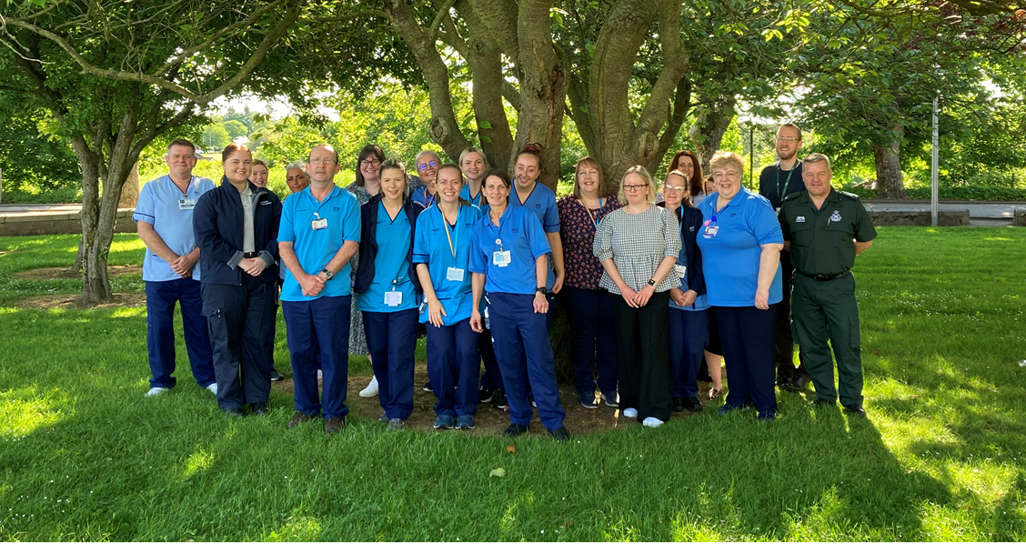

Slide 23
NHS Ayrshire & Arran
Why workforce matters
Maryann McEwen, Acute Care of the Elderly Practitioner
Ayrshire Hospital at Home Team

Slide 24
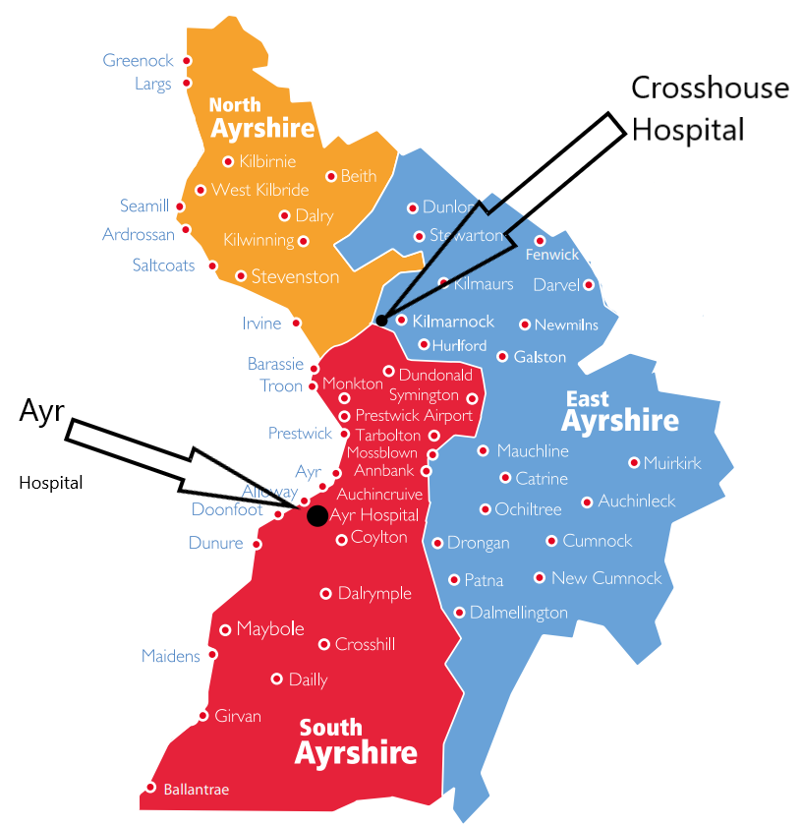
Spreading the Hospital at Home model
3 HSCP
2 Acute Hospitals
2 EDs
3 Minor injury units
3 Integrated Care Teams
4 Mental Health bases
6 Community Hospitals
2 Acute Frailty Teams
59,802 people >65
And 2 islands……

Slide 25
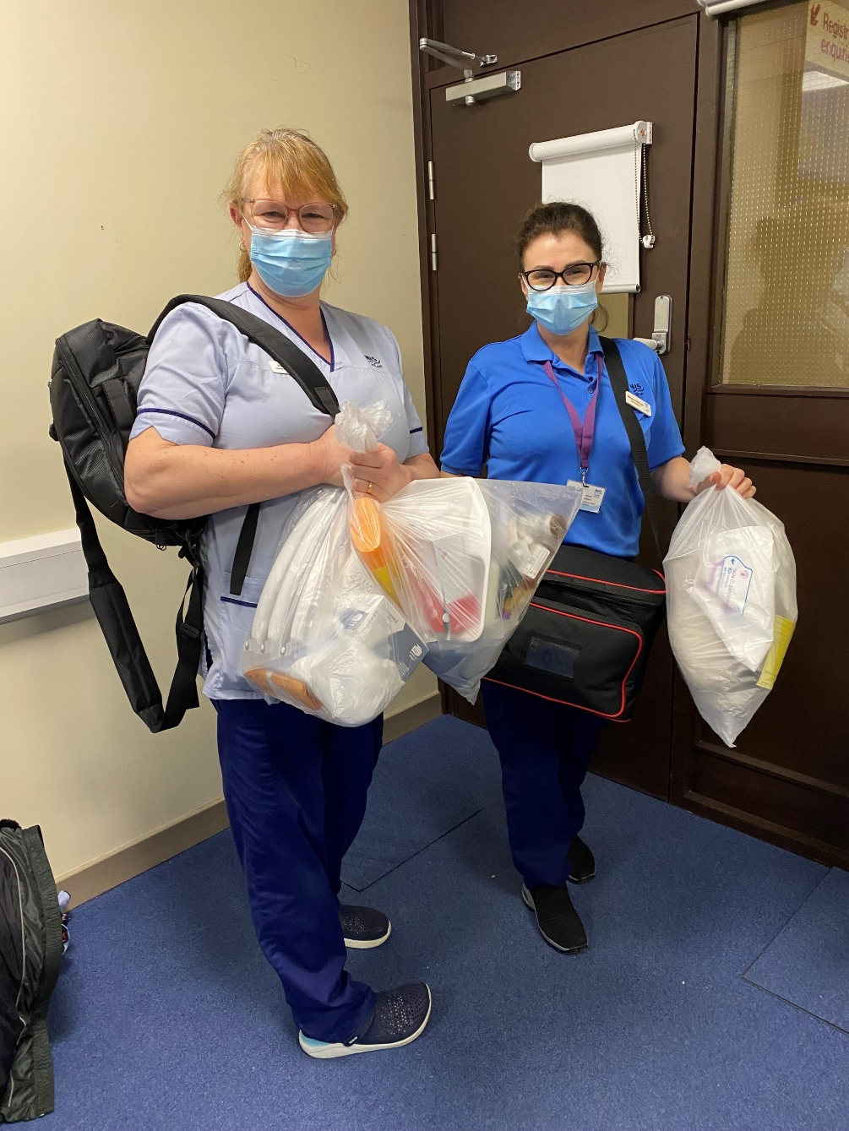

Slide 26
What the person sees
A quick response within an hour
Initial triage by a band 4 associate practitioner. Able to do baseline observations, NEWS, take an ECG, take bloods
More in depth clinical and functional assessment (and comprehensive geriatric assessment) by band 7 advanced practitioner
Senior clinician review – a consultant geriatrician in Ayrshire
Someone who can speak with their family, GP, carers and other involved teams
A co-ordinated plan of action with daily follow up until discharged
A follow on plan

Slide 27
Building a sustainable team
‘Like creating your ideal pub quiz team’
Who have you already got?
What’s your model?
What skills do you need? Core vs extended team
Can you start now?
Spreading the word
Wellbeing and team development
Education and training needs
Career progression

Slide 28
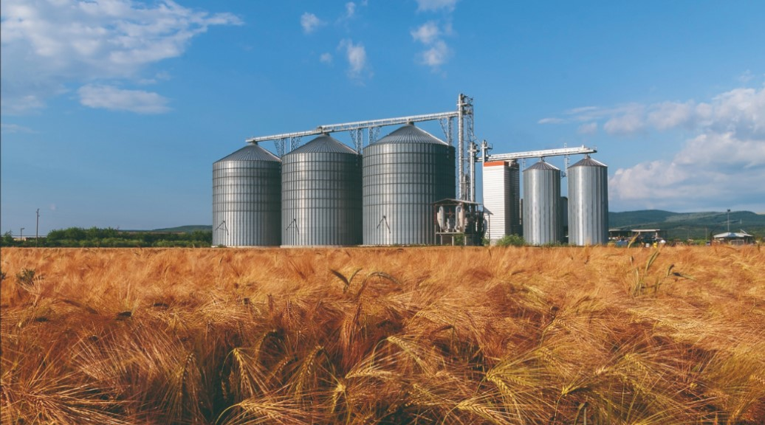

Slide 29
Avoiding the silos
Essential and desirable characteristics
‘Can do’ approach. ‘Supportive and motivated team worker’
Effective listening and communication skills – how can you know this?
Ability to work ‘unsupervised’ (lone working)
Acute vs community experience
Have you worked with older and frail people who are acutely unwell?
Advanced clinical practice and independent prescribing
Keenness to learn and progress
MIX OF BACKGROUNDS AND SKILLS

Slide 30
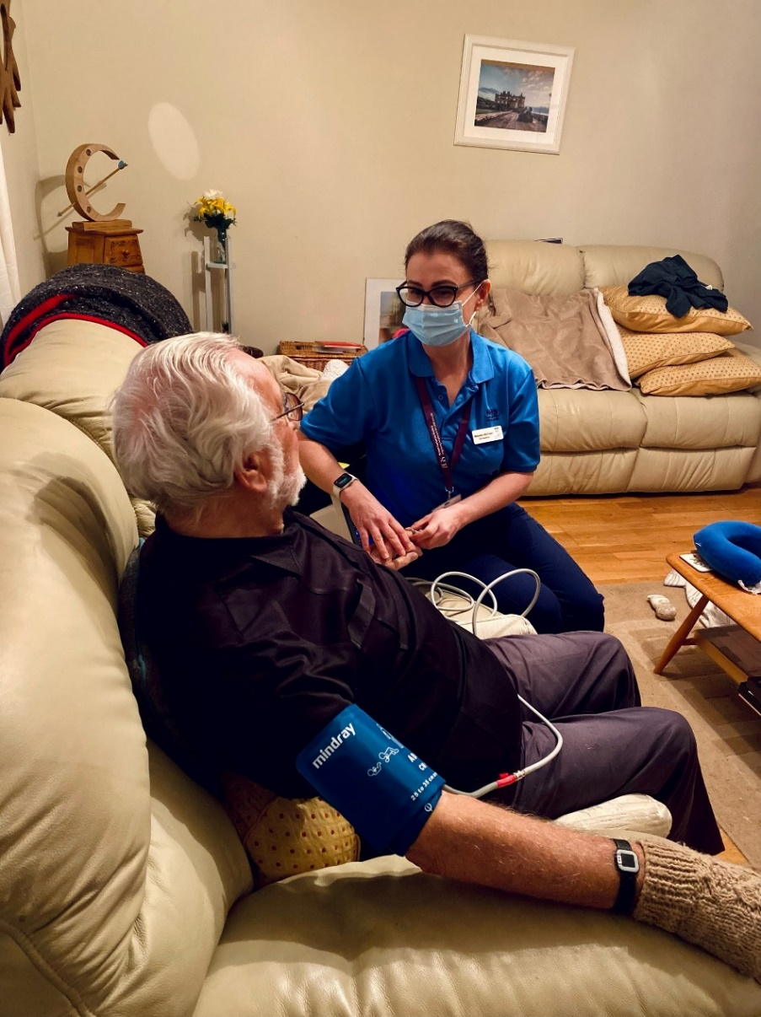
Where are we now?
2 consultant geriatricians contributing sessions
x7 band 7 practitioners (SAS, Nursing, Mental Health) with one working towards advanced practice
x5 band 3/4 associate practitioners
An office (with a kettle…)
ADMIN SUPPORT***
A website
Part of an amazing network of knowledge

Slide 31
NHS Western Isles
Hospital at Home
Gail Black, Hospital at Home Coordinator
Laura Crockett, Nurse Practitioner

Slide 32
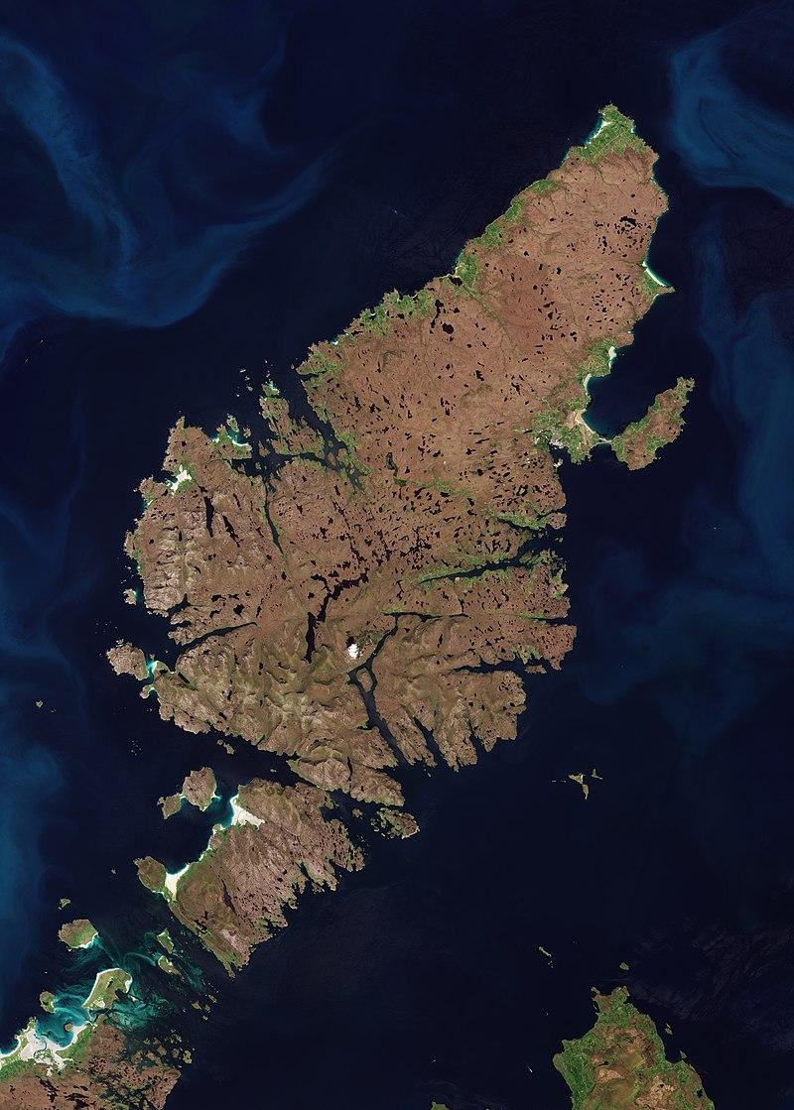
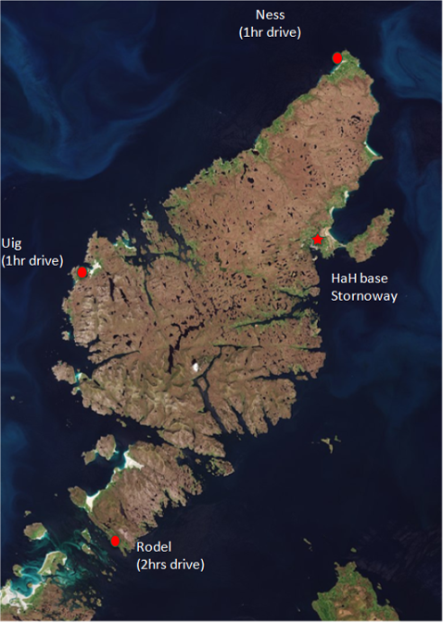
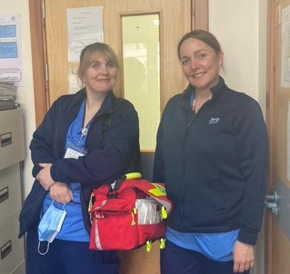
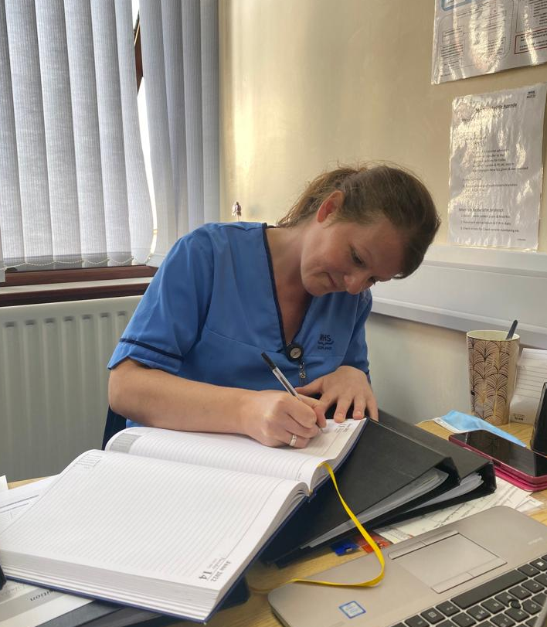
The NHS WI model
Nurse Led – small team
Small Island Board 20k patients covering area approx. 2,200 km²
Wide patient cohort

Slide 33
Activity
HOSPITAL AT HOME
OPAT

Slide 34
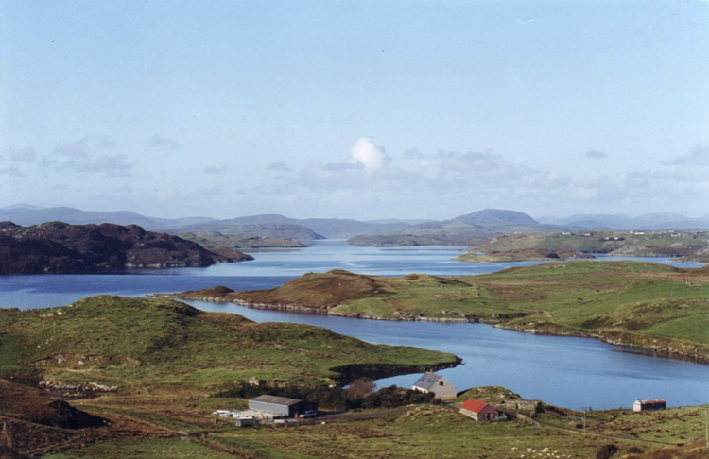

Adapting to a local context: H@H in a remote and rural setting
CHALLENGES
Developing a unique model for the needs of a remote and rural HB
Changing culture
Staffing structure
Financial & operational support from HIS
Engagement with key stakeholders
Unique but strong team/small but knowledgeable
Series of PDSA cycles and implementation of change methodology
Gaining confidence
Development and progression
SOLUTIONS
LEARNING

Slide 35
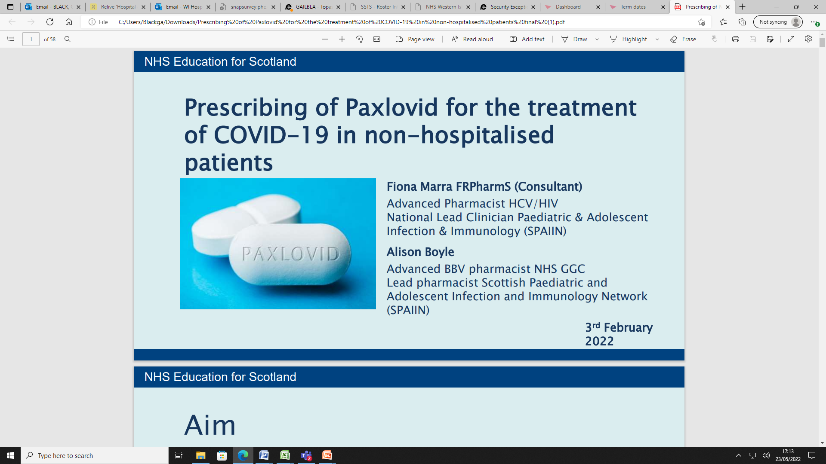
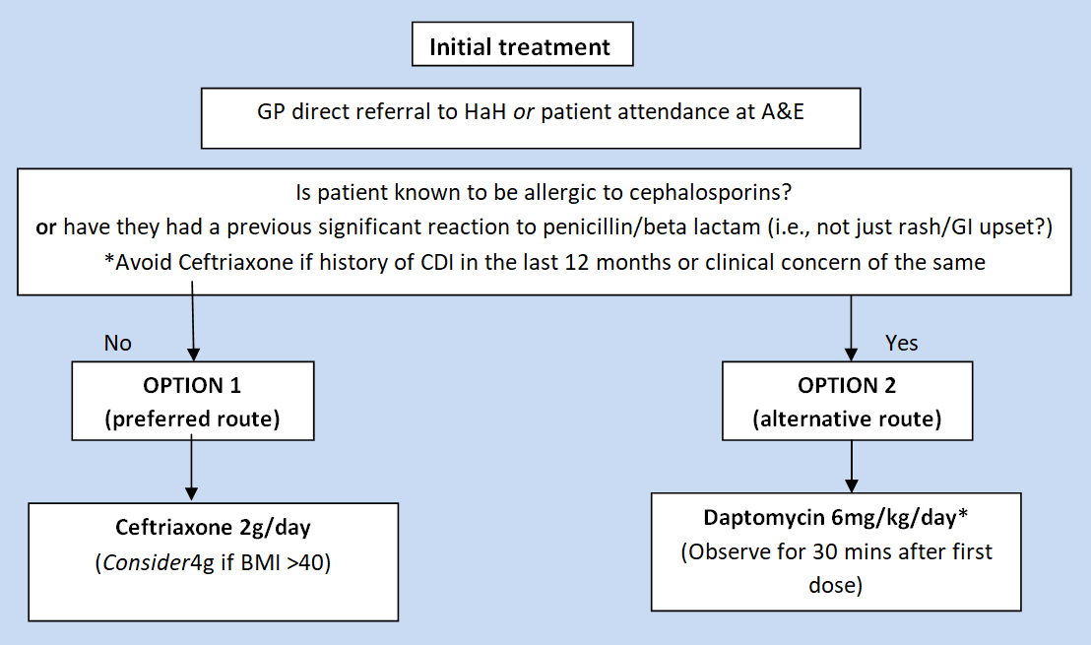
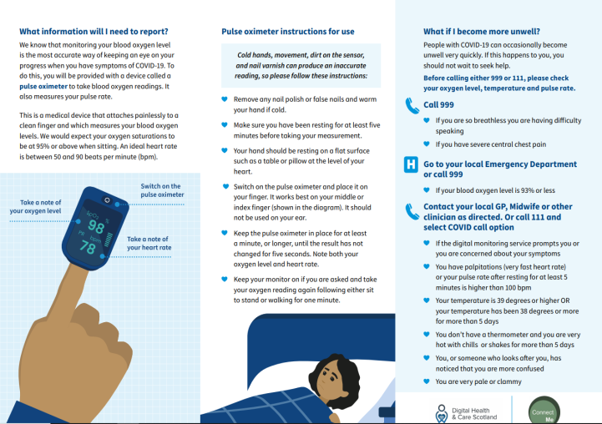
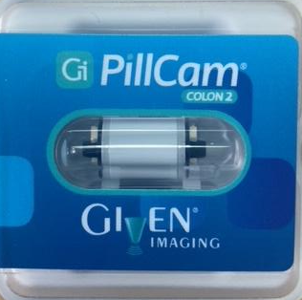
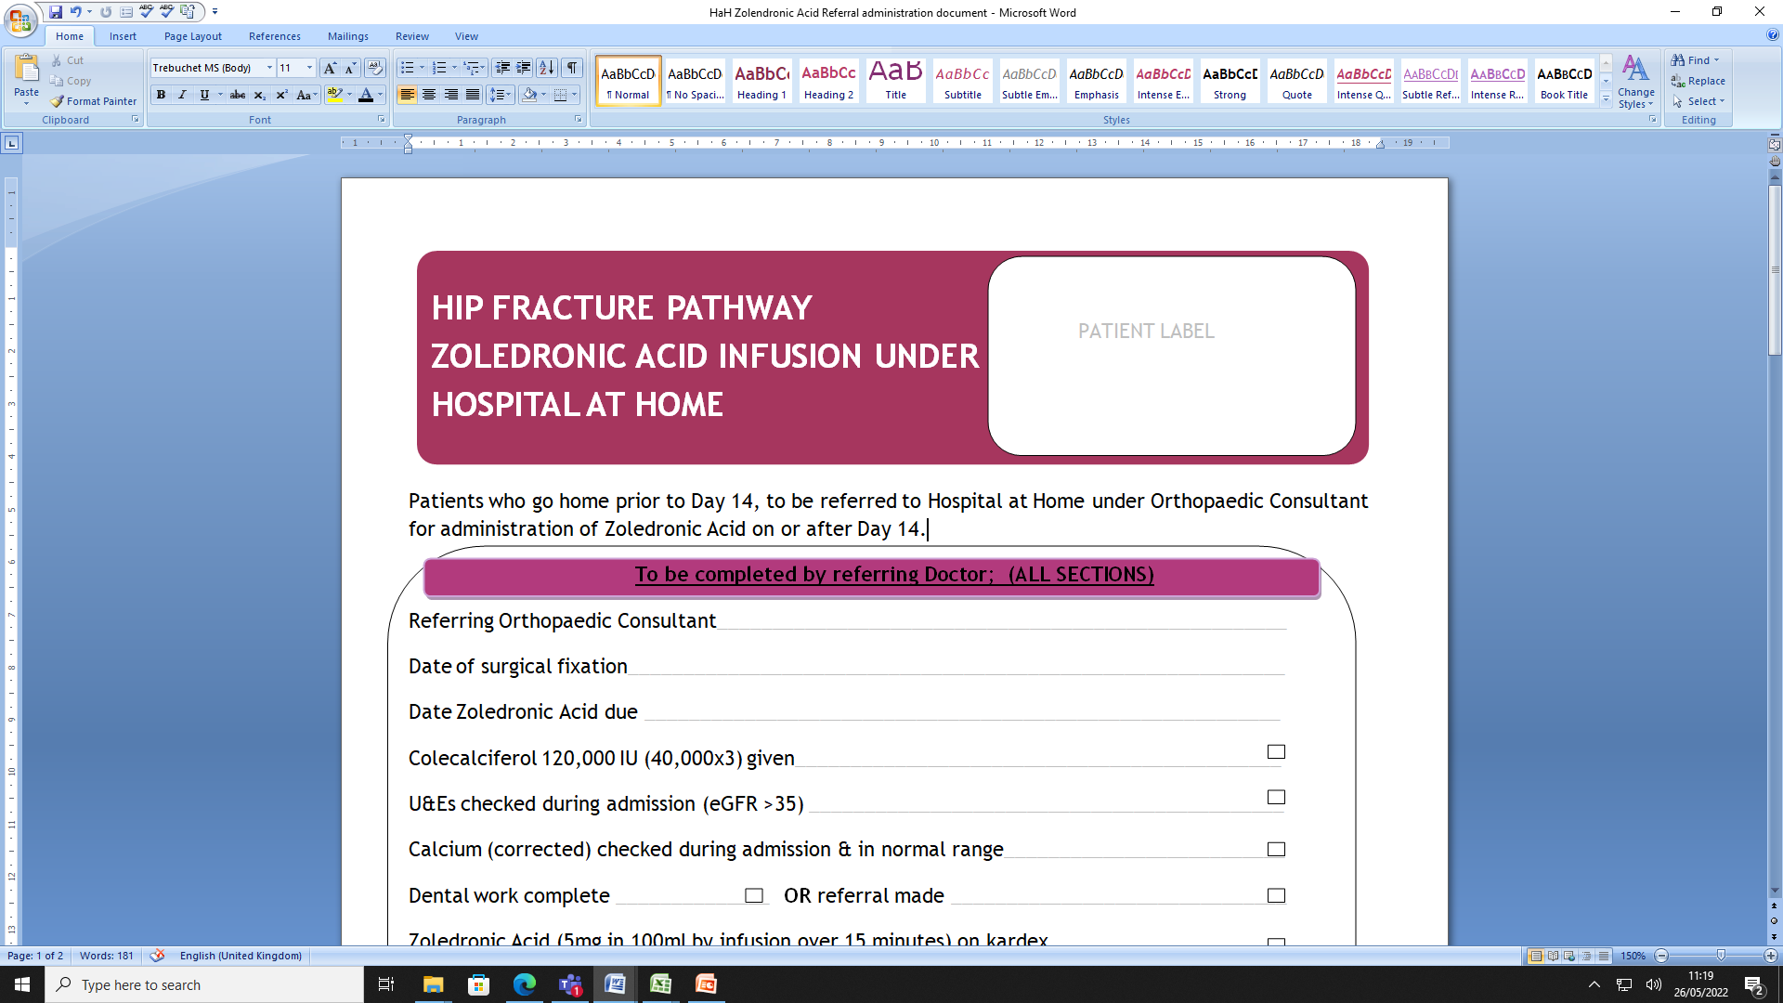
Progress and development
NMAB/ANTIVIRAL ASSESSMENT AND TREATMENT
CELLULITIS PATHWAY
COVID +VE MONITORING
COLON CAPSULE ENDOSCOPY
ZOLEDRONATE INFUSIONS

Slide 36
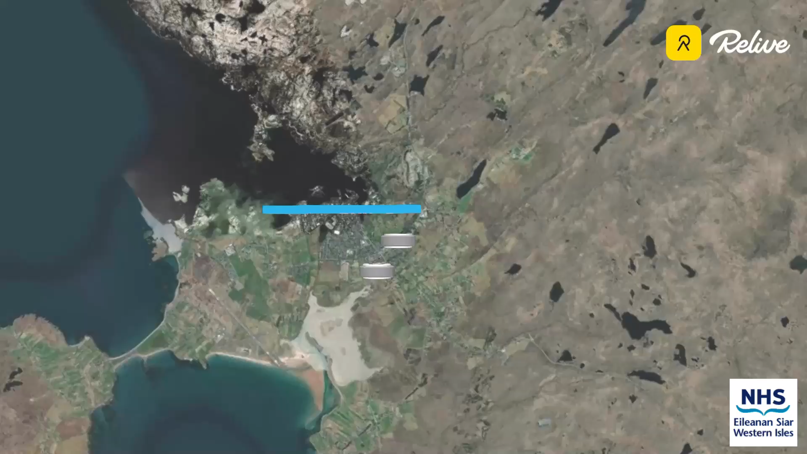

Slide 37
West Lothian Hospital at Home
Rapid Elderly Assessment & Care Team (REACT)
Dr. Latana Munang, Consultant Geriatrician

Slide 38
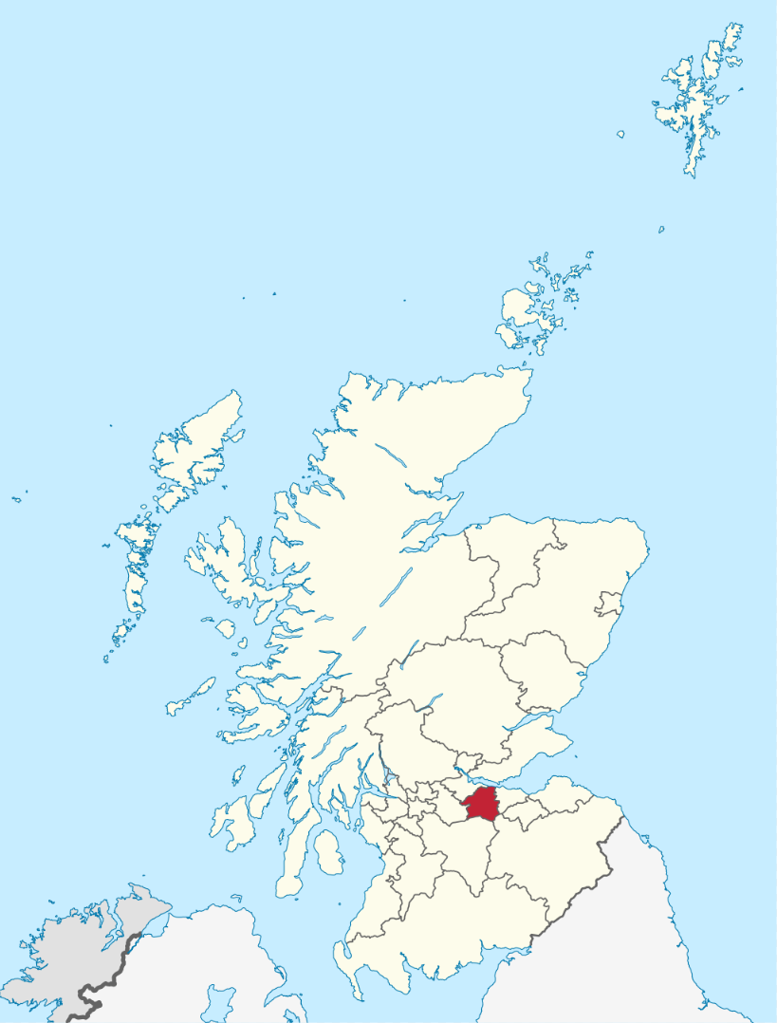
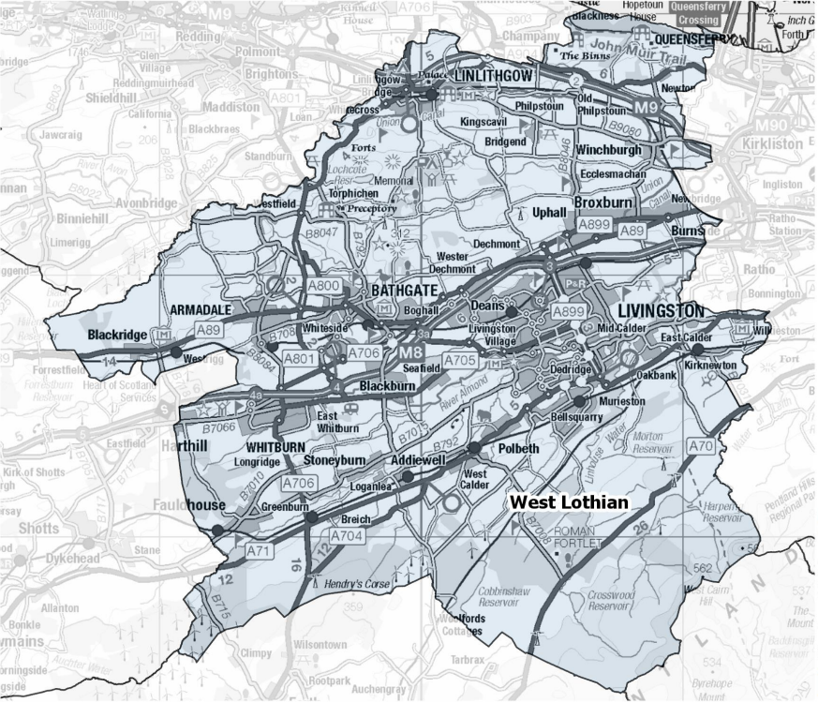
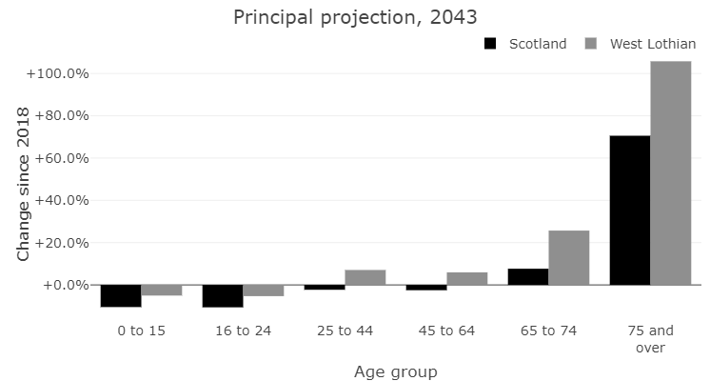

West Lothian
Population 183,820
Notes:
West Lothian mixture of urban and rural communities. Population 184k.
Our demographic is ageing at a faster rate than the Scotland average, our over 75s are projected to more than double over the next 20 years.

Slide 39
H@H West Lothian
Physio 1 B6, 3 B5
OT 1 B6, 3 B5
Medical 1 Consultant
Nursing 1 B7, 3B6
SLT 0.5
Admin 1
Medical 1.1 Consultant, 2 CF
Nursing 2 B7, 5.8 B6, 1 B5, 1 B3
Pharmacist 0.9
Admin 1
AHP Rapid Response / D2A
Notes:
We had an existing Intermediate Care Team providing rehab in the community.
In 2013 with funding from SG Change Fund, we added a H@H component to the team with medical and nursing input.
We started seeing 20-30 patients a month, and over the years the service has grown – we now see over100 a month with ALOS 3.1 days.
Our current staffing model reflects professional development within the team – we grow our own ANPs from our Band 5 nurses. We have 2 Clinical Fellows each year who have then gone on to become GPs or geriatricians.
AHP support now comes from whenever we need it from our Rapid Response team – we are co-located in the same Hub and they join our huddles.

Slide 40
H@H West Lothian
H@H Guiding Principles
7 day working
NHS Lothian Team of the Year
ACP in Care Homes
Respiratory team
Covid-19
West Lothian Care Home Team
Oxford H@H RCT
Rapid Access Clinic
Lothian H@H Forum
Notes:
Changing mindsets – through data. Share our work and outcomes with wider world
BGS poster showcasing our ACP work with Care homes

Slide 41
Rehab D2A
Frailty Clinic
Respiratory
GP
Microbiology
Lothian H@H Clinical Oversight Group
Care Homes
Community Nursing
Social care
Cardiology
H@H
Medical Day Unit
iHUB H@H community
Medical Admissions Unit
Wards
3rd sector
Palliative Care
A&E
D&E
Neurology
Rheumatology
Gastro
Dementia ANP
Community hospital
Notes:
Challenge scale, spread & sustainability
Overcome by lots of joint working, flexibility, saying YES to everything and working out how later
Good skill mix within team – recruit from different backgrounds, prof development and team support
Open culture – every week there are visiting students, doctors/nurses/AHPs from other units/wards

Slide 42
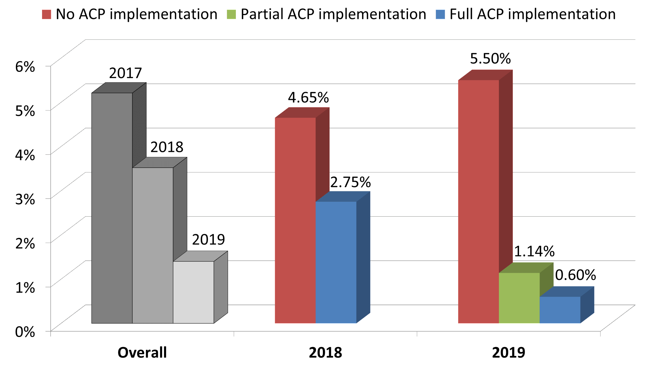
Rate of Medical Unit Admissions for care homes in West Lothian
Medical admission rates
from care homes
decreased by 60%
from 6 patients per week
to 2.2 patients per week.
Residents in care homes
without ACP implementation were
9 times more likely to be admitted compared to care homes with
full ACP implementation.
British Geriatrics Society Autumn Conference, Nov 2020
Notes:
We had an existing Intermediate Care Team providing rehab in the community.
In 2013 with funding from SG Change Fund, we added a H@H component to the team with medical and nursing input.
We started seeing 20-30 patients a month, and over the years the service has grown – we now see over100 a month with ALOS 3.1 days.
Our current staffing model reflects professional development within the team – we grow our own ANPs from our Band 5 nurses. We have 2 Clinical Fellows each year who have then gone on to become GPs or geriatricians.
AHP support now comes from whenever we need it from our Rapid Response team – we are co-located in the same Hub and they join our huddles.

Slide 43
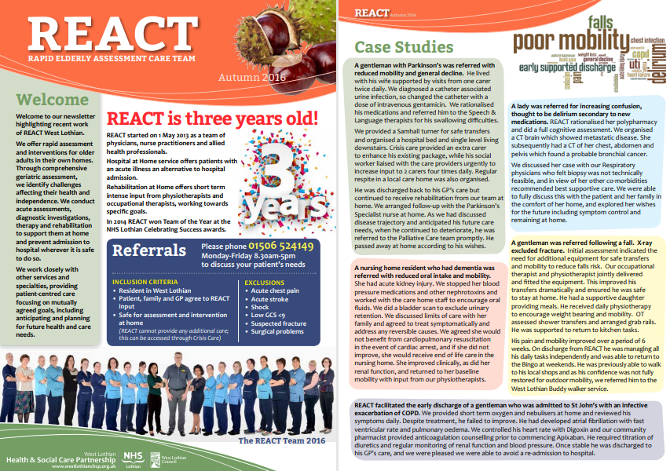
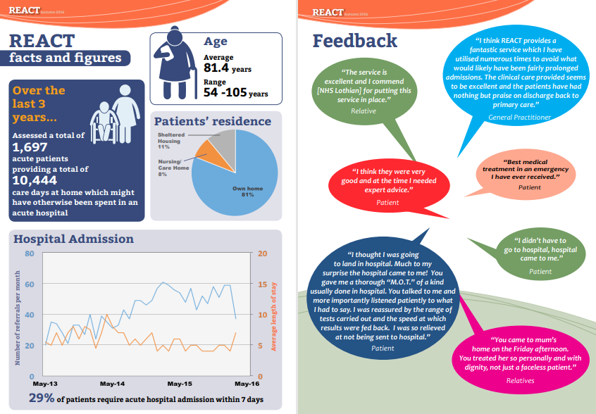
Notes:
Feedback to referrers through newsletters, increase awareness and profile of our service

Slide 44
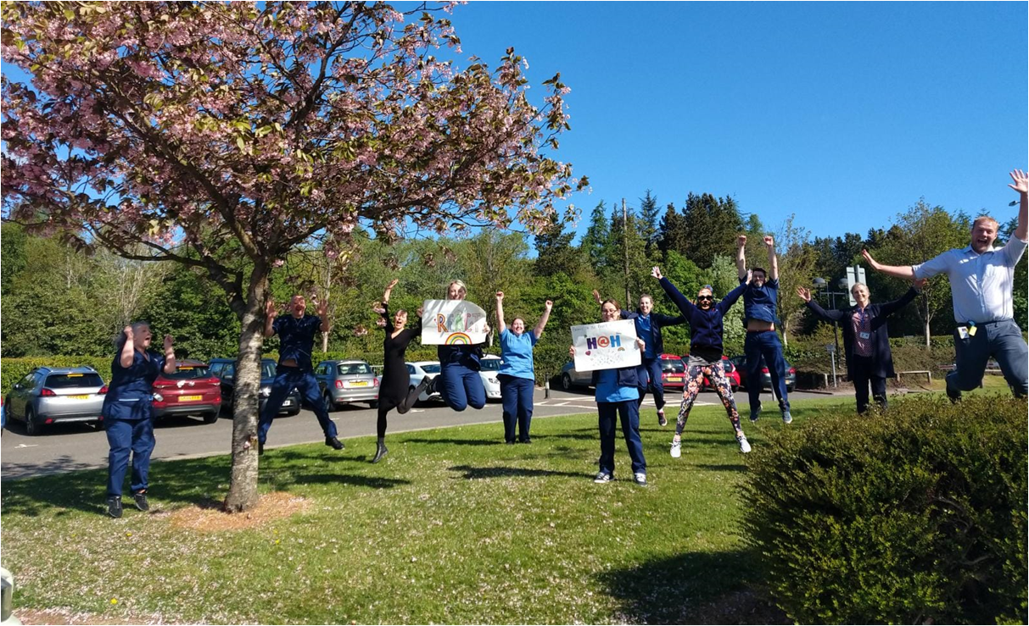

Slide 45

Q&A

Slide 46
Get in touch
his.communitycare@nhs.scot
www.ihub.scot

Slide 47


