Slide 1
Integrated, Innovative and Ambitious Rehabilitation in a Post-Covid Era
Join the conversation online: #NHSScot22 #goodrehab

Slide 2
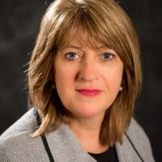
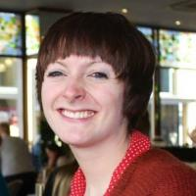
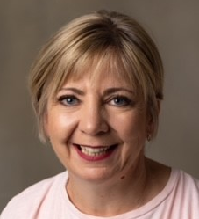
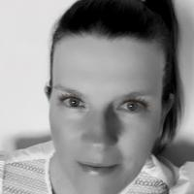
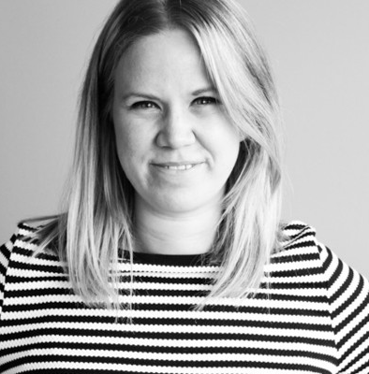
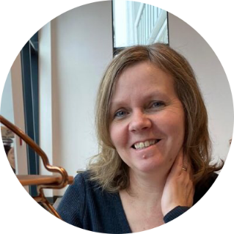
Speakers
Carolyn McDonald,
Chief Allied Healthcare Professions Officer,
Scottish Government
Sara Redmond, Chief Officer of Development, the Health and Social Care Alliance
Bette Locke,
Allied Healthcare Professions Advisor,
Scottish Government
Lynn Bauermeister, Head of Health and Wellbeing, High Life Highland
Lois Lobban,
Senior Policy Manager,
Scottish Government
Lynn Morrison, AHP Lead, Aberdeen City Health and Social Care Partnership

Slide 3
Session overview
Introductions and welcome: Carolyn McDonald
A ‘Once for Scotland’ Approach to Rehabilitation
  Bette Locke and Lois Lobban
  Lynn Bauermeister
  Lynn Morrison
  Sara Redmond
Breakout discussion: All
Take home messages: Carolyn McDonald

Slide 4
Context
August 2020
Rehabilitation Framework Self-Assessment Tool
December 2021
Self-Assessment Tool: Analysis of Survey Responses
December 2020
Framework for Supporting People through Recovery and Rehabilitation during and after the COVID-19 Pandemic
National Advisory Board Rehabilitation set up
Spring 2022
Consultation and engagement period
Summer 2021
First rehabilitation webinar for rehabilitation professionals
Report of third sector responses to self-assessment tool

Slide 5
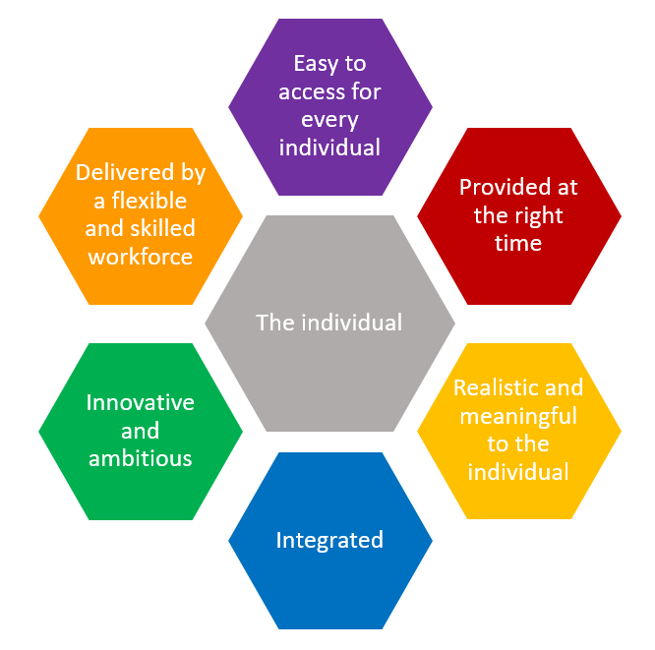
A ‘Once for Scotland’ Person-Centred Approach to Rehabilitation in a Post-COVID Era

Slide 6
Integrated, Innovative and Ambitious Rehabilitation in a Post-Covid Era
Join the conversation online: #NHSScot22 #goodrehab

Slide 7

Breakout discussion

Slide 8

Save the Date: 8th September
A Once for Scotland Person-Centred Approach to Rehabilitation in a Post-COVID era: from ambition to action.
Join us to continue the conversation. Follow @NESnmahp for further information.

Slide 9

Notes:
Include reference to: Spotlight session which is at 2pm on Wednesday 22nd of June. Our session is titled: Cancer Prehabilitation - A toolkit to Inspire Local Service Development.

