Slide 1
The Expanded General Practice Team
NHS Forth Valley’s Approach to Primary Care Reform and Pandemic Recovery

Slide 2


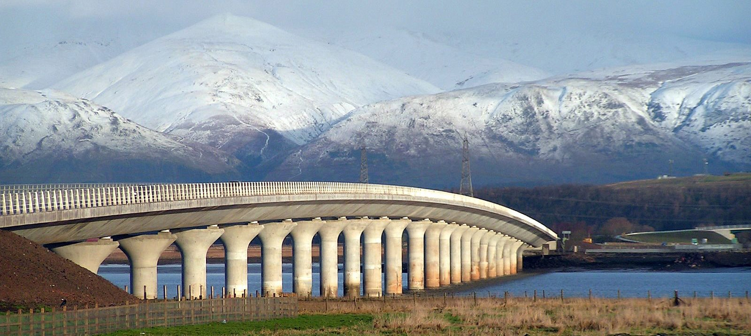
Primary Care
Forth Valley
Notes:
Forth Valley serves about 320000 patients in Stirling, Clackmannanshire, Falkirk and surrounding areas. A mix of rural and urban with areas of both deprivation and significant wealth. Geographically it is a large area stretching from Bo,ness in the South East to Tyndrum in the North West. One Health Board and 2 IJBs, 3 local authorities and 52 practices
In the years leading up to the new 2018 contract we had seen increasing concerns with GP sustainability. Practices had performed well against the ever shifting targets of QOF but we had some of the lowest numbers of GPs per head of population. We did have a long history of collaboration with local partners.
By this time we had already taken on 3 large 2c practices with over 20,000 patients between them and due to an ageing GP and PN population there were others that were very vulnerable at that time.

Slide 3
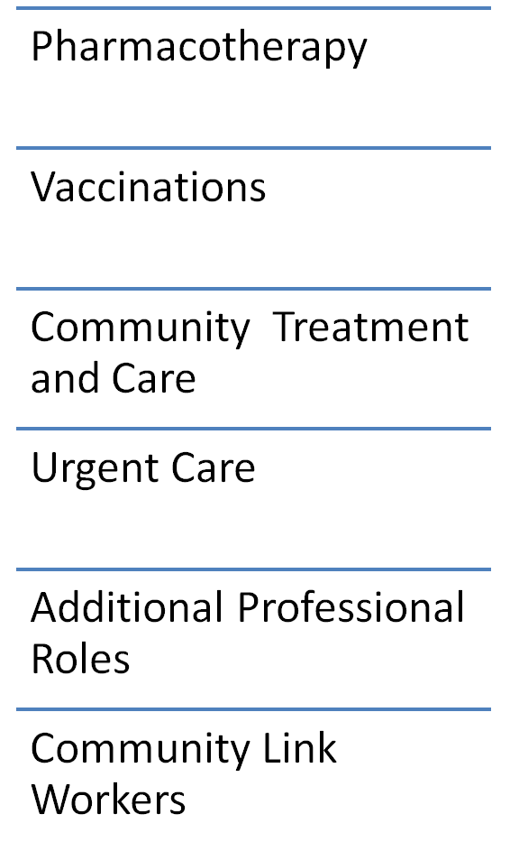
6 MOU Priorities over 4 years
Notes:
The new GMS contract was negotiated with clear aims to
improve access for patients, address health inequalities and improve population health including mental health
provide financial stability for GPs, and reduce GP workload through the expansion of the primary care multidisciplinary team
redefines the role of the GP as an expert medical generalist focusing on complex care, reduce the risks associated with becoming a GP partner, like premises ownership, and encourage new entrants to the profession as well as help retain existing GPs
The memorandum of understanding set out an extremely ambitious implementation ask on 6 priority areas within 3 years.
Pharmacotherapy, Vaccinations, CTAC, Urgent care, Additional Professional Roles and Community Link Workers
4 years of funding was outlined.
So we set about creating our plan - Against a backdrop of some scepticism within General Practice

Slide 4
Recognise and Build on our Strengths
Strong Collaborative and Distributed Leadership
Project Team
GPs
Service leadership
Practice Managers
Successful Primary Care Transformation Fund
Mental health nurses in 9 GP practices
Care home support in one cluster
Treatment Room service
Several years' experience in developing MDT in several 2C practices.
Knowledge that it can work – but costly
Practice Admin Collaborative
Notes:
Where to Start? Step back and recognise our strengths. We were already in a strong position. We had a track record of working well across the interfaces, with Whole System Working projects. These were done annually with priorities identified locally and then implementation of changes to services and pathways to improve outcomes for patients and service efficiencies.
In 2015 we had come together to take on and support our 2c practices and had developed MDT working across them that we would see reflected in the MOU document that was presented to General Practice – we had pharmacotherapy, PCMHN, ANPs and APPs and piloted a paramedic home visiting service.
We also had a Board that had historically invested in Community Nursing run treatment rooms that provided some of the support we saw in the proposed CTAC service.
Hand over to Lesley for pre-covid development of PCIP

Slide 5
Our Approach to Implementing
The New General Medical Services Contract
Lesley Middlemiss
Programme Management

Slide 6




1) A Forth Valley "Tripartite" Commitment to deliver all 6 Priorities.
2) collaborative leadership:
  Strive for collective ambition through a common plan across both our partnerships.
  Accept Multiple routes to outcome
  Govern and lead openly and collectively
  Build on our strengths
  Work together to challenge each other and disrupt our system
  Take risks
Notes:
Our Tripartite was actually a Quadpartite agreement – we took a cross partnership approach together with NHS Forth Valley and the Local Medical Committee – reduced duplication, increased standardisation and helped manage GP expectations – It allowed us, I think, to be more ambitious and spend more time on implementation, being agile and adaptive. Having a detailed agreed plan which extended beyond the PCIP resource enabled the implementation team to be adaptive.
There was no one "right" plan and there was no " prescribed" route to fulfilling the MOU
We put together a small leadership team which met fortnightly – enabling the programme between workstream sub groups and governing implementation group. LMC, GP leads, Programme Team, Gen Manager, Primary Care contract manager, Finance, Partnership finance. communications, actions, vacancy management, variation requests -

Slide 7
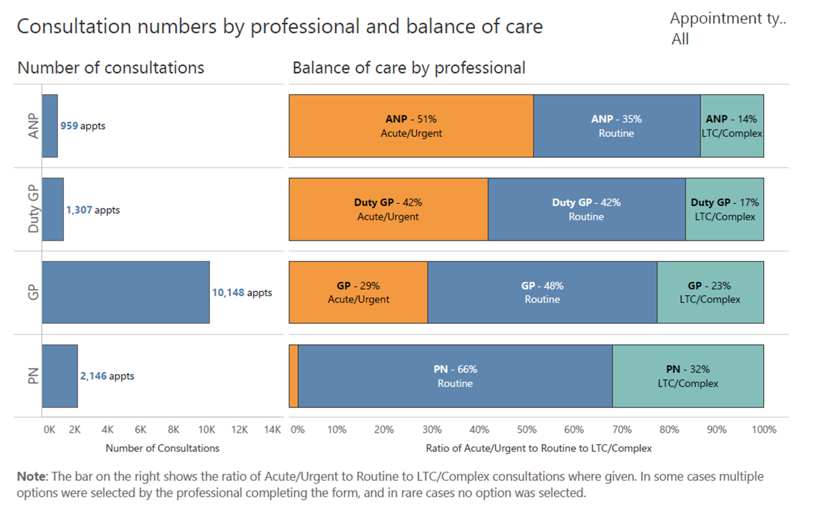
What did we Know about GP Workload?
Notes:
What did we know about GP demand? What is it we were redirecting?
Not a lot to be honest – we embarked on out plan through experience and consensus and sense checked our assumptions through the first year – for example we conducted a week of care study with 20 practices – 15,000 consultations – we got an understanding of the balance of urgent v's routine care, of which what proportions were for single condition consults, mental health, MSK urgent care and a perspective on the proportion of care spent with complex or undifferentiated cases – tho this was difficult to define and largely subjective. This informed our plan, we hoped to redo the study with the aim of moving the balance of GP care towards complexity.

Slide 8
Acute Prescription Workload
1800 Acute Items
PER DAY
(average)
Data from manual count - March 21
Notes:
We also delved into the world of medicines management – some might wish we hadn't! what we discovered was significant levels of variation in acute prescribing workload. The reasons for this are not within my ability to explain but each practice has different ways of working, pressured workloads don't leave space to improve overall processes to be more efficient e.g. serial prescribing and permissable repeats. The variation, however, has been raised nationally – how can we deliver all acute activity with variation like this? practices with efficient systems get much less input than those who don'T -- Ask Clare about the whole system working and HIS improvement work later – and all for one cant be one for all when variation is 5 fold.

Slide 9
What mattered most to GPs?
Notes:
Given the high degree of sceptisism within general practice and the risks around sustainability it was essential that we listened to our GPs.
Building relationships, Trust and buy in.
We held GP sub workshops, protected learning sessions, used cluster meetings and survey tools.
We heard a very strong message at the beginning, in the middle and still now that what would make most difference to GPs was the additional professional roles who provided consultation and pharmacotherapy capacity. Immnisations, Phlebotomy and link workers were not percieved as the priorities which would make the impact GPs wanted to see first.
We set out our plan in this regard and by time of MOU2 which, whilst not advising us to change direction, was directing prioritisation for CTAC, IMMs and pharmacotherapy by 2023

Slide 10
A plan which was meaningful to practices
Additional professional roles within the practice team. (per 5000 patients)
1wte pharmacy team
1wte mix of advanced practitioners.
Also
all bloods and treatment room services delivered
all immunisations delivered
Support to deliver urgent care home consultations
Access to a Link worker within practices in most deprived communities
Practice Admin Teams skilled in Signposting

Slide 11

4 year - Workforce Optimisation Approach​
Pharmacotherapy – 4 clusters
Additional Professional Roles - 5 clusters:
  Urgent Care Advanced Practitioner
  Advanced practice Physio
  Mental Health Practitioner
Phlebotomy & Immunisations
Link workers
Notes:
We anticipated workforce supply challenges and that spreading a little thinly would not generate the impact or the learning that we needed. We therefore set out clusters off on different journeys, crossing over at mid point to grow to the full model.
Resource optimisation – We had tripartite agreement to overcommit to our plan by £1.2m (15%). This allowed us to plan for a fuller implementation across all workstreams.
We also recognised early that slippage was a reality... accumulating slippage was not in the interest of the programme. In an attempt to mitigate turnover loss – we approved a level of "over recruitment"

Slide 12


March 2020. PCIP Iteration 3
125 of 197 new posts in place
Every Practice in Forth Valley had a significant level of PCIP service in place

Slide 13

Notes:
Then along came covid.
Practices had to rapidly adapt to new ways of working.
There was a rebalancing of remote versus F2F contact with patients and the rapid development of new workstreams. The Covid Triage Hubs and Assessment Centres were clinically led by GPs and ANPs mainly taken from primary care, both in hour and OOH. Managing the High Risk / shielding lists, and having ACP discussions with many of these patients placed a significant workload on 1y care. When the issues with care home patients escalated, the majority of the workforce initially came from primary care supported by colleagues from 2y care and paramedics. Some practices were hit badly by covid absences. It became clear quite quickly that the PCIP team that we already had in place were playing a crucial role in supporting the practices through the crisis so it seemed only logical that they would also be key in supporting primary care recovery and remobilisation. We took the decision to keep as much of the current team in place to support primary care rather than redeploy them, and we were all agreed that we would embed PCIP progression as a key part of our remobilisation plan. This was not easy as there were many competing issues for our attention, but we had a strong leadership and support team who were determined to push it through to support patients by supporting primary care and general practice. We already had a draft of iteration 3 of our plan so were able to submit that, despite that no longer being required at that time.
We pushed on with service development and recruitment plans.
We rapidly developed our VTP, who were already doing most of the childhood imms, to take on increasing numbers of the seasonal flu and then the covid vaccinations, releasing significant amount of clinical time for practices.
Hand over to Lesley to do the postcovid bit

Slide 14
Where are we now?
some challenges on the way..
Workforce Supply
Lack of clinical space
Remote working
Fragile practice sustainability
COVID FATIGUE
TEAMWORK
it isn't perfect and we aren't fully there but......

Slide 15
March 2022 - Phase 1 Contract Implementation
180 of 197 new posts in place
All practices with multiple services, some partial

Slide 16
Notes:
169.8 wte on the table in place = 158 direct posts, 12 training technicians and mat leaves -
15 or so vacancies
10 service leads / AP trainers

Slide 17
PCIP Service Capacity 52 practices
> 350,000 appts per year
> 200,000 non covid immunisations last year
> 16,000 measurable level 1 pharmacotherapy activities per month
13 practices supported by link worker

Slide 18
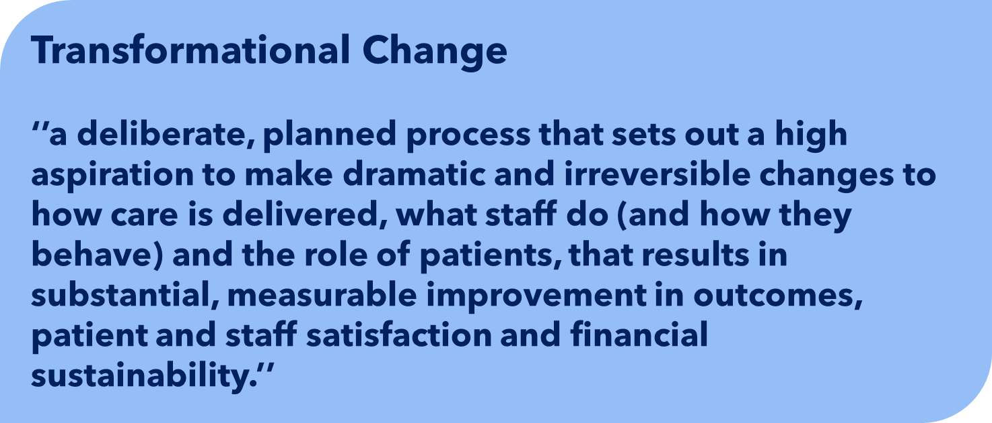
Notes:
Effective large scale transformational change is a bottom up emergent process that involves mobilising many people, teams and organisations toward a shared vision through collective action enabled by distributed leadership that embraces the principles of system leadership :
the authorising environment tolerates risk and accepts multiple paths to outcomes
there is willingness to cede organisational goals for collective ambition - Tripartite approach – joint statements, Ability to be fleet of foot. Authorising environment set out within the plan. Adaptively and agile to
positional authority is not the only source of legitimacy
it builds on local and place-based initiatives and networks
relationships and influence allow challenge and difficult conversations
challenge, conflict and ‘disturbing the system’ are integral

Slide 19
What we believe we do well....
  Held our focus on delivering our collective ambition through a common plan across both our partnerships.
  Take calculated risks.... together
  Promote Multiple routes to achieve our outcomes
  Govern and lead openly and collectively
  Utilise our strengths across our stakeholders
  Work together to challenge each other and disrupt without tipping the fine sustainability balance

Slide 20

Supported Patients
"Pharmacist helped my hip pain"
"...helped me understand my medicines when I got home from hospital"
Expanded Practice Team
Pharmacotherapy
GP Workload Reduced
Challenged and Developed Pharmacy Team
"Saved my marriage!"
"Improved patient safety"
"Knowledgeable resource"
"Lots of opportunities to develop"
"I feel a valued member of the team"

Slide 21
How did we know we were making a difference?
Ross Lawrie
Data Collection and Reporting

Slide 22
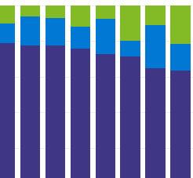
Introduction - Data & Reporting
This has involved:
Reporting from GP IT system extracts
Development & Maintenance of data collection tools
Reporting dashboards/HTML dynamic reporting
Development of performance indicators
Qualitative data from Surveys
Notes:
Forth Valley Primary Care managers and workstream leads have worked alongside PHS analysts to gather data and develop reporting to monitor primary care reform over the past 4 years as new health board staff were employed to support GP practices

Slide 23


Who are we working with?
Notes:
Primary Care Mental health Nurse
Advanced Practice Physio
Pharmacotherapy Service
Urgent Care Service (ANP, Paramedic)
Care Home Nurse service

Slide 24
How have we approached data/reporting?
1
2
3
4
5
Study conducted to understand how service was operating
Repeat (revised) study to back up findings and strengthen evidence
Tools were developed to collect activity/capacity data (MS Forms/Excel).
Capacity & Activity reporting developed to utilise the data collected in recording tools.
Maintain engagement to familiarise teams with data collections and improve data quality

Slide 25
How do we know we are making a difference?
Notes:
The following examples cover a few of the ways we’re measuring the impact of primary care reform

Slide 26
Example – Primary Care Mental Health Nurse
3 studies carried out over 2 years (>6,000 appointments)
All three studies produced very similar results and confirmed the service was seeing appropriate patients
Data collection reduced to simply monitor the activity and capacity
Excel online data collection
Dashboard reporting

Slide 27
PC Mental Health Nurse - Outputs
Increasing confidence of PCMHN staff represented in >50% outcomes recorded as “self help”
Referral Back to GP – insignificant in all three audits
Prescription issued by PCMHN – steady improvement over 3 audits
Notes:
A few examples of learnings from the 3 studies carried out over 18 months to determine if service operating correctly

Slide 28
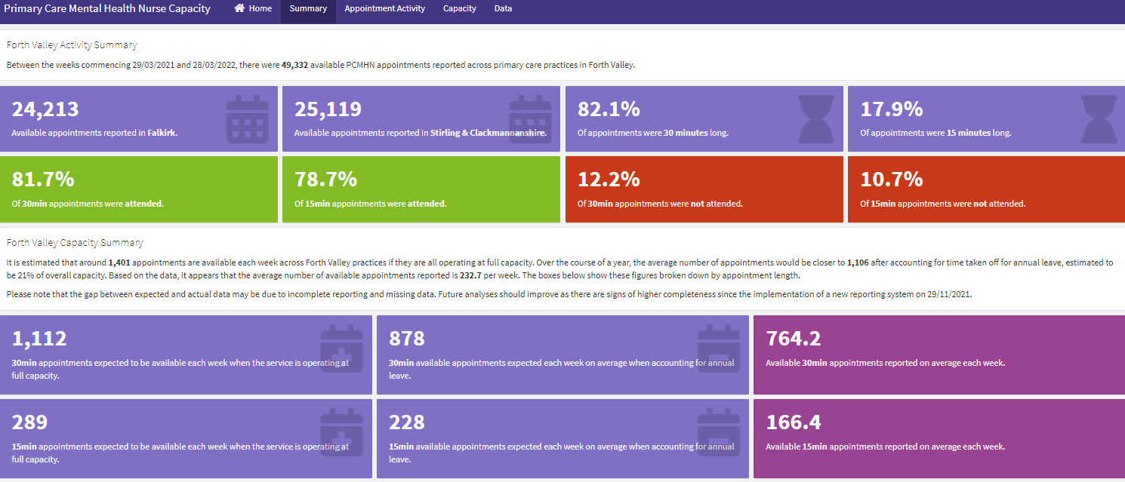
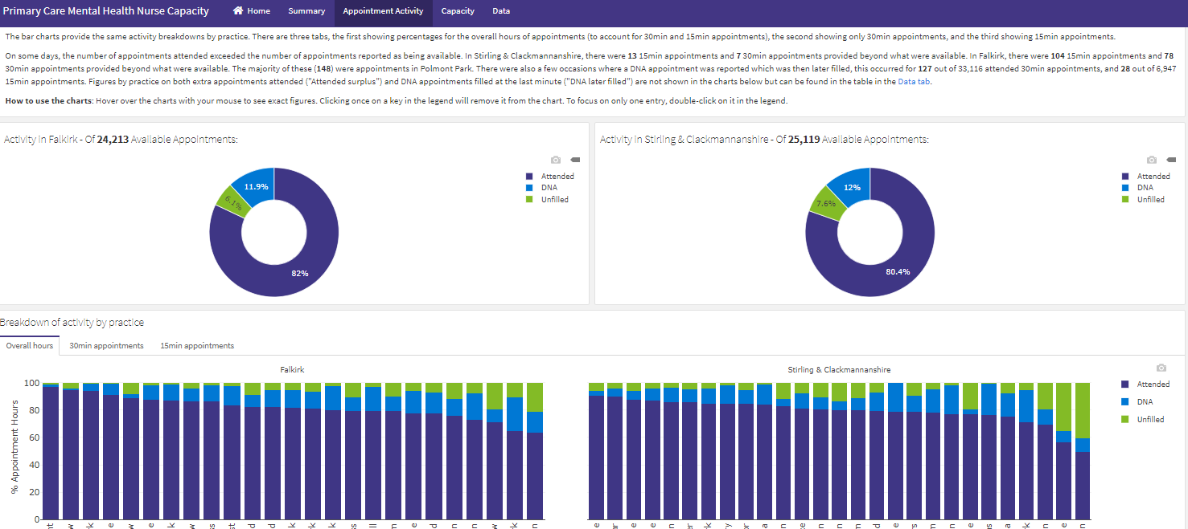
PC Mental Health Nurse – Activity & Capacity
3 Dashboards Updated Monthly
Data fed directly from Excel online data collection
Split by HSCP area
GP practice level
Allows service leads to see what capacity theoretically possible in each practice and current activity (filled, unfilled and DNA)

Slide 29
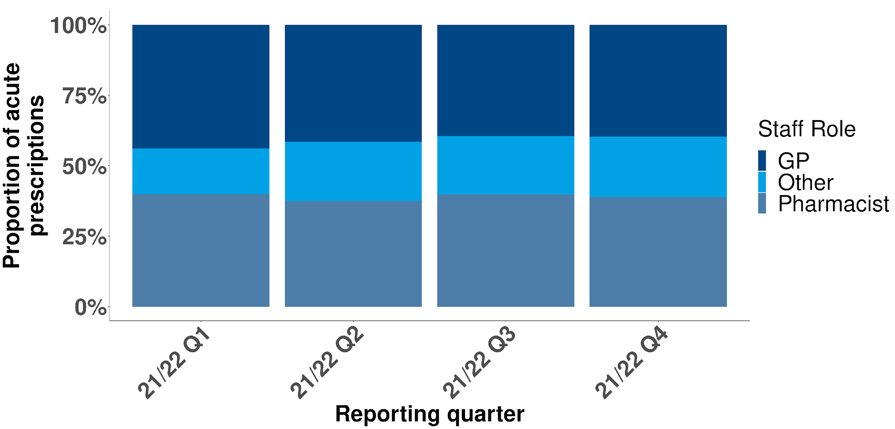
Measuring Workload shift - Pharmacotherapy
Notes:
One of the difficulties with other workstreams is measuring the true workload shift
With Acute prescriptions we are able to get an EMIS extract with all prescriptions by all staff
We produce a quarterly report which shows the proportions of acute prescriptions actioned by different staff types.

Slide 30
Advanced Practice Physio
Total Number of Referrals to Physiotherapy Pre- and Post-APP Service commencement - Data collected from 5 GP clusters with APP Service
median = 490
median = 386
21% decrease
Notes:
APP service collected considerable data for many years
New digital data collection launched April 2022 to cover all appointments (to national minimum data spec)
Aside from new capacity created and positive patient outcomes, reduction in outpatient referrals is one notable success
More recent data shows Physio referrals (summer 2021) ~ 380 per month
Physio OP referrals – 21% reduction (APP service)
Physio OP referrals – 13% reduction
Orthopaedic referrals – 9% reduction (APP service)
Orthopaedic referrals – 13% increase

Slide 31
Bounce Audit – Polmont park practice
28 Day rate broadly similar
Negligible difference between ANP and GP Appointments
Notes:
No sign that patients seen by ANP will “bounce” back to see GP
7 day return rate reflects different way of working, but more importantly 28 day rate is broadly similar

Slide 32
Challenges we have encountered
GP IT systems
Practices & Staff
Data
Lack of workload/activity data
Errors in job role
Lack of standardisation
Different ways of working
reluctance to collect data in an already busy role
IT access limitations
Data all anonymised so difficult to track completion rate
Reliance on particular data analyst skillset to make up for the challenging data

Slide 33

Next Steps
Continue to develop our routine data and reporting
MDT experience survey (summer 2022)
Consider more robust evaluation options – currently still at planning stage
Continue to link in with national Primary Care evaluators network

Slide 34
What does this mean for GPs?
Dr Scott Williams

Slide 35
GP Survey – Primary Care Reforms
NHS Scotland Survey – Nov/Dec 2021
Overall generally positive results and indication of support for primary care reform
Positive impacts from introduction of new staff in terms of easing workload
Useful free text responses with suggestions of how new services could be improved
Figure 4. Potential of the different staff groups to make a positive difference to GPs
Notes:
76 Forth Valley GP respondents
Findings still in line with our approach to put additional professional roles at the forefront as well as the 3 priority areas from MOU2.
There is very little of the skepticism we mentioned earlier as all practices were seeing direct benefit in their practices.
With regards the CLW, although it is not a negative response, in the areas we now have them we are receiving very positive reports of the benefits that both patients and practices feel from having them in post. As we further develop the role we are confident that the perception and realisation of the benefits to practices will be reflected in any future surveys.

Slide 36
“The pharmacotherapy service seems to make a real impact on our workload that visibly helps every single day”
Forth Valley GP
Notes:
Here is an example of some of the feedback we got about the pharmacotherapy team. It speaks for itself and helps validate our decision to make PCIP an important part of our recovery planning.

Slide 37
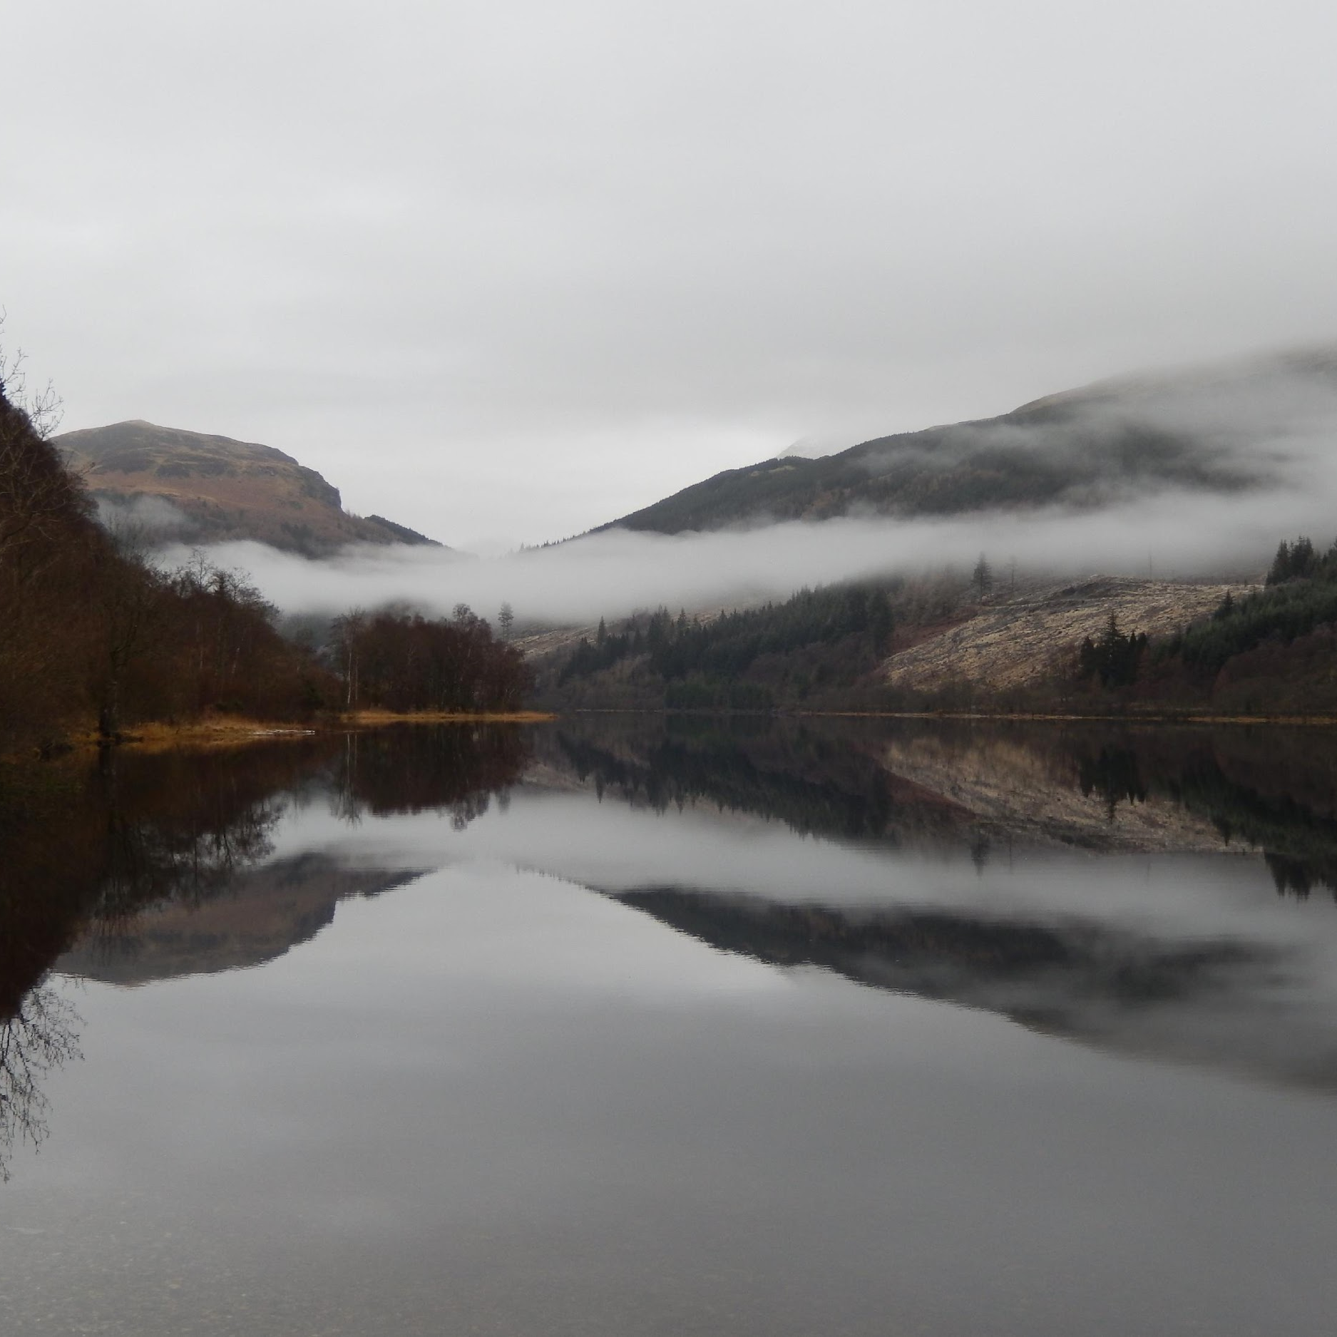
Personal
Reflections
Notes:
The reason I have a quote from another GP there is that my practice, roughly 10,000 patients, hasn't yet had the benefit of the full pharmacotherapy service. What resource we do have is mainly being focused on medicine reconciliation for patients being seen by secondary care either as in patients or at OPD. We are looking forward to getting up to full pharmacotherapy service at some point in the future.
The CTAC service has freed up significant amounts of admin time in the practice. They have needed that time to cope with the increasing calls and admin tasks generated by the new ways of working and covid.
VTP took childhood vaccinations away completely quite early on in the process and as they have taken on increasing amounts of work have released significant capacity in the PN team, allowing them to focus on chronic disease management.
The Care Home liaison nurse has significantly reduced the care home house calls, allowing the GPs more time in the practice.
The PCMHN and APP have been a huge asset to the practice. They are seeing a significant number of patients that would have previously required a GP appointment. They bring their own skillset and knowledge to the practice. We have supported them both to become independent prescribers which helps increase their independence as clinicians.
The ANPs support the urgent / unscheduled flow which has allowed us to redesign our day so that if you are not the duty GP you can focus on routine appointments without fear of repeated interruption with unscheduled workload. They manage a significant portion of the urgents, allowing that all important space for the duty GP to support the wider team and interface with colleagues from outwith the practice. (Our first ANP was so good we have now employed her directly and we are now benefitting from the different experience our PCIP paramedic practitioner brings.)
Due to difficulties recruiting locally, we would have struggled as a practice, especially recently when we had a run of clinicians being off consecutively with covid, just at the time that the Covid Assessment Pathways were handed back to general practice.
Could we do without them? No. We might see more burnout, retention issues and that would not be good for patient care.
Could we do with more? Yes. We have yet to experience full pharmacotherapy so don't know if we would need more than our full allocation yet. If, however, we are to reach our full potential as expert medical generalists then we do need more support to manage the significant numbers coming to our doors. Increasing self-management and wholesale adoption of realistic medicine also have a part to play, but the wider PCMDT are crucial.
As Lesley said, it is not perfect but it is helping support general practice at a time that it needs a lot of support. General practice is a creative, flexible and adaptable environment and consistently delivers beyond it's level of funding. The PCMDT is now an important part of that and we need to ensure that we remain committed to investing in the future of our primary care teams. We can't afford not to, just as we in FV couldn't afford to delay progress in our PCIP through covid.
Hand over to Kathy to finish this section with service user feedback.

Slide 38
What this means for Service Users
Kathy O'Neill

Slide 39

Positive for patients: https://www.youtube.com/watch?v=QGhlUf-b8C4
The PCMHN Service is seeing the right people at the right time:
96% of patients felt they saw the right person for their issue.
Data collected over 2 weeks, with 79 respondents.
“gave me lots of hope and a better outlook on life"
“given me tools to help me when I need it"
"has been invaluable to me"
“Information was explained “in a clear & concise manner, so that I felt I could cope better and improve”​
“listened to what I had to say and was easy to talk to”
Notes:
https://youtu.be/NAdNUIYj_EI - From 2 min 59 secs. Full film on Clacks and Stirling YT Channel.

Slide 40
Q&A
Meet the Team
Clare Colligan – Pharmacotherapy
Cameron Marr – Advanced Practice Physio
Kara Connor – Primary Care Mental Health Nurse
Stacey McIntosh – Primary Care Mental Health Nurse
Christina Haining – Advanced Practice Nursing

