Slide 1
The Impact of the COVID-19 Vaccination Programme on Vaccine Transformation
Kerry McKenzie – Head of Service, Public Health Scotland

Slide 2
The Impact of the COVID-19 Vaccination Programme on Vaccine Transformation: Public Health Scotland Perspective
Scottish Immunisation Programme – vaccines, system and successes
Vaccine Transformation Programme – service delivery transformation
Covid Vaccination
Scottish Vaccination and Immunisation Programme

Slide 3

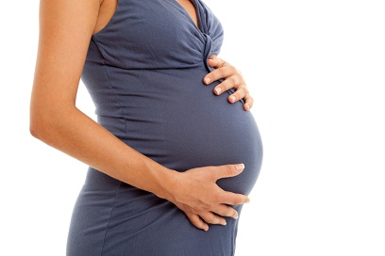
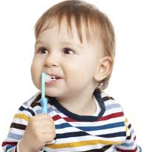

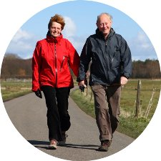


Diptheria
Rotavirus
Meningitis B & C & ACWY
Whooping cough
Tetanus
Hib
HepB
Polio
Measles
Shingles
Pneumococcal
Mumps
Covid
Rubella
Flu
Cancers caused by HPV

Slide 4
BCG
RSV
Anthrax
Diptheria
Rotavirus
Meningitis B & C & ACWY
Whooping cough
Hib
Varicella
Tetanus
HepB
Smallpox
Monkeypox
Polio
HepA
Measles
Shingles
Typhoid
Pneumococcal
Mumps
Covid
Tick borne encephalitis
Rubella
Yellow fever
Flu
Rabies
Cancers caused by HPV
Japanese encephalitis

Slide 5
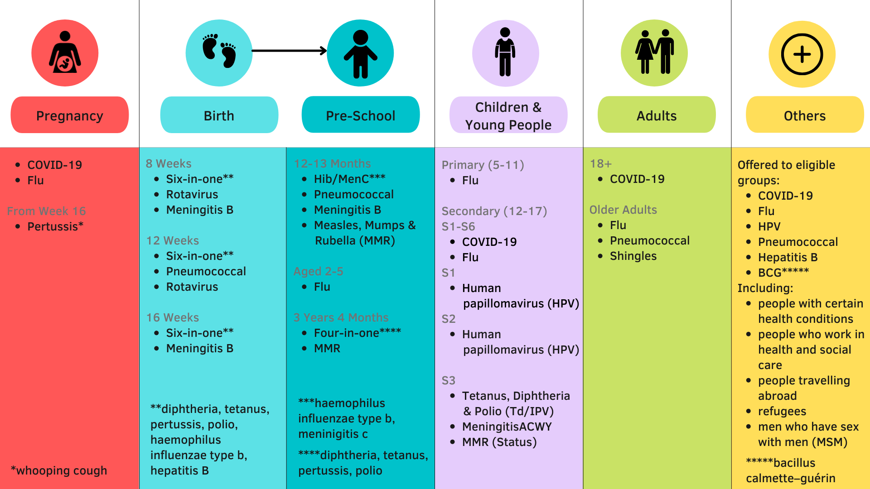

Slide 6
Diptheria
Rotavirus
Ageing well
Quality of life
Care
Meningitis B & C & ACWY
Whooping cough
Maternal & child health
Inequalities
Education & learning
Tetanus
Hib
Polio
HepB
Measles
Shingles
Pneumococcal
Mumps
Disease elimination
Measles
Cervical cancer
Outbreak management
Covid
Rubella
Pandemic response
Winter planning & pressures
Workforce protection
Flu
Cancers caused by HPV

Slide 7
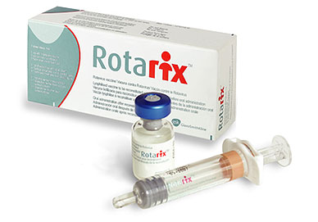
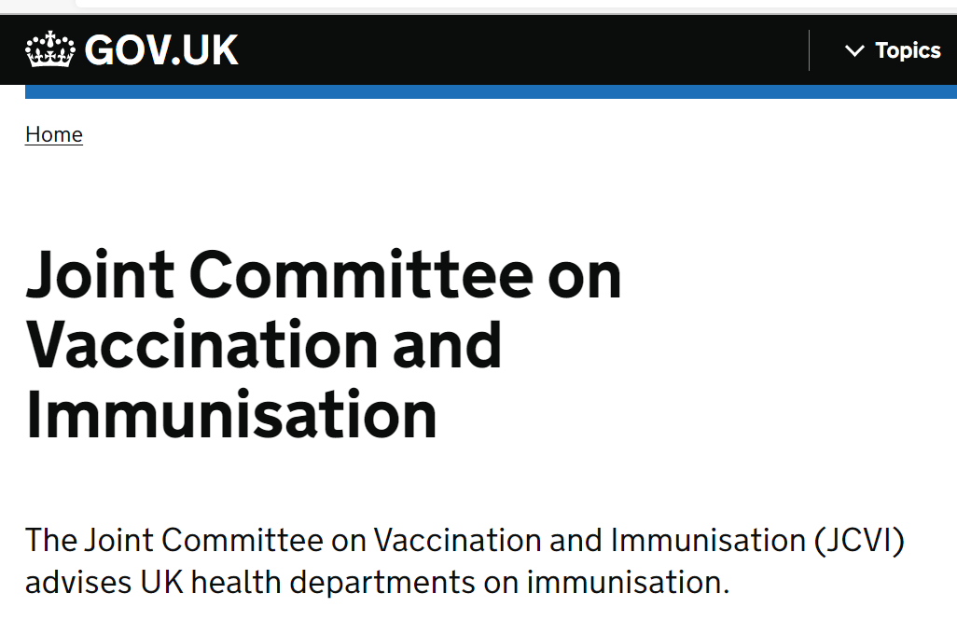
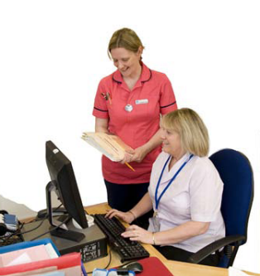
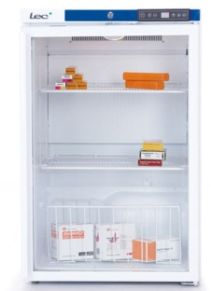
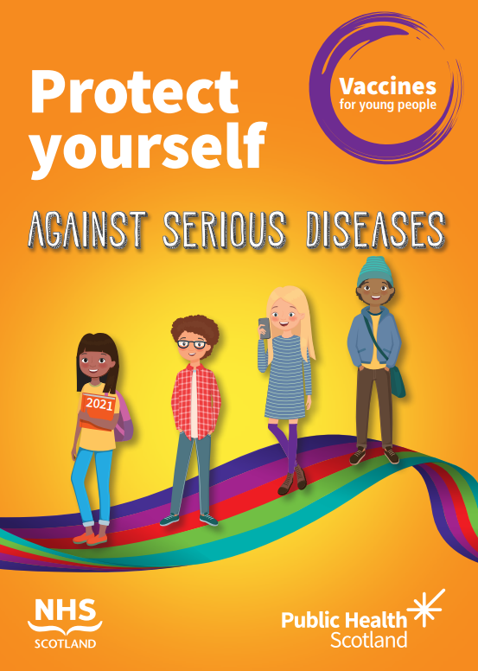
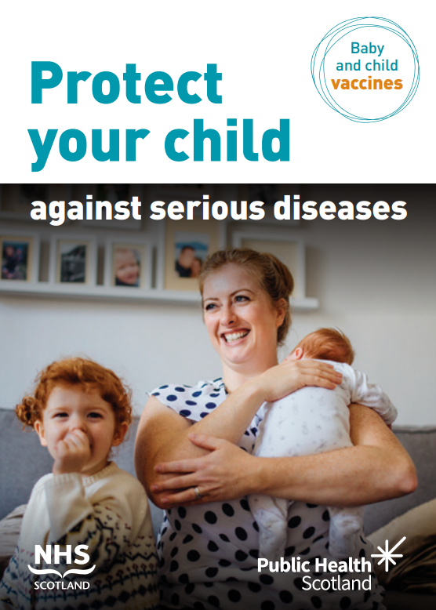
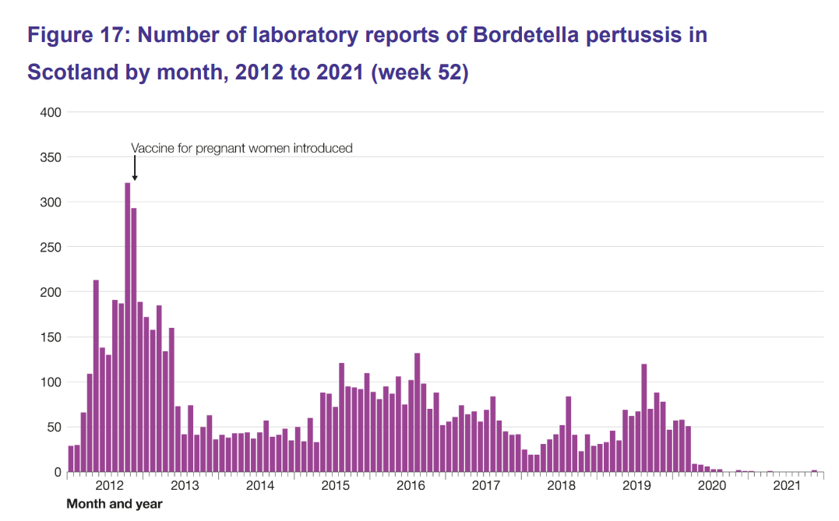
Immunisation Programme Elements
Policy
Procurement
Cold chain and transport
Workforce
Data and digital
Call and recall system
Vaccine uptake
Communications
Expert advice
Epidemiology and surveillance
Safety monitoring

Slide 8
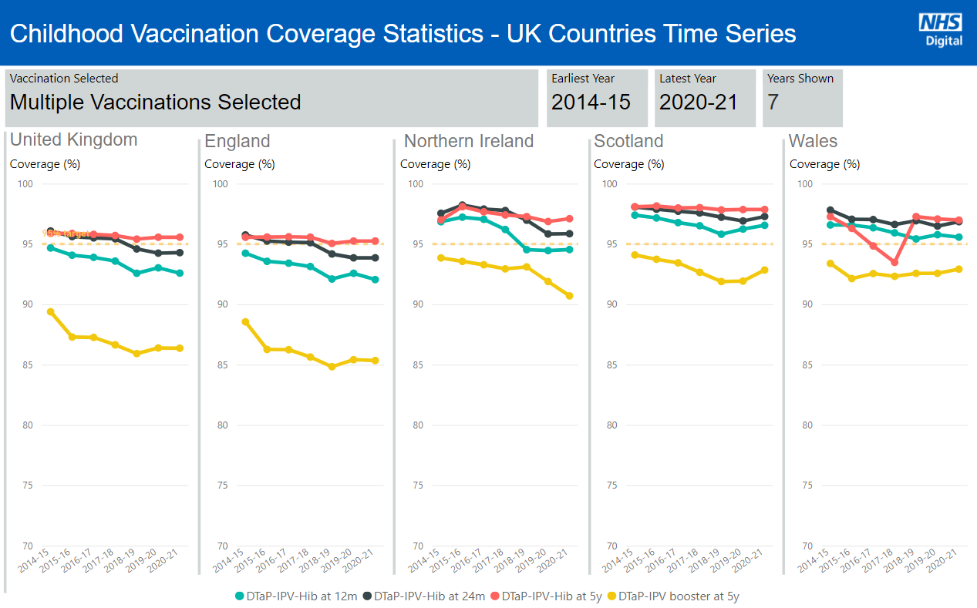
Source: UKSHA http://bit.ly/child_vacc_stats_annual

Slide 9
High Impact Programmes
Measles deaths in Scotland fell from over 200 in 1940 to approximately one death annually by the 1980s. The last measles death in Scotland occurred in 1995.
More than 61,000 diphtheria cases with 3,283 deaths notified in the UK in 1940, compared with 28 cases and six deaths in 1957.
Average annual notifications of pertussis in the 1950s exceeded 11,000 and by 1972 this had fallen to 226 notifications.
Following the introduction of the MenC campaign in the UK in 1999 the number of reported and laboratory confirmed group C cases fell by over 90% in all age groups immunised.
HPV immunisation programme for girls demonstrated a 89% reduction in pre-cancerous cells (cervical intraepithelial neoplasia 3) in the cohort of girls who were vaccinated at 12-13 years compared to unvaccinated women.

Slide 10
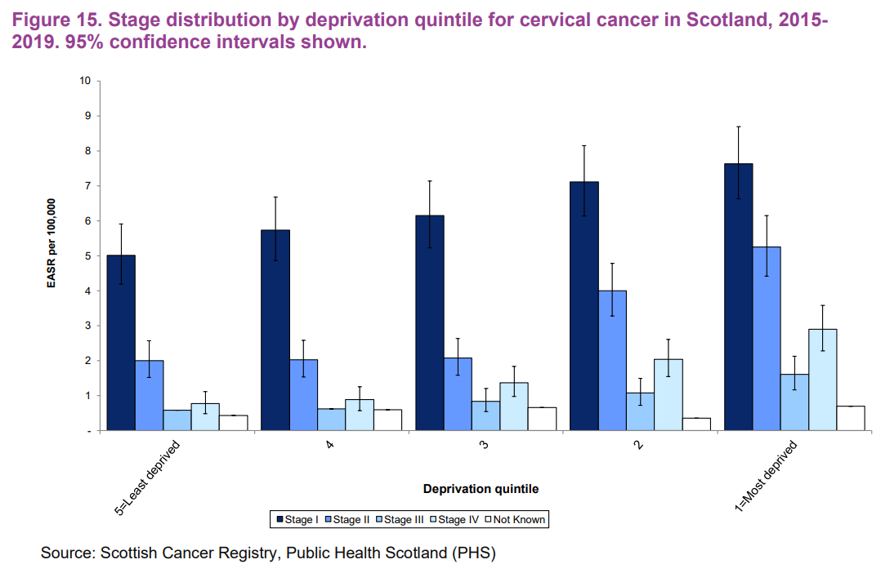

Slide 11
Vaccine Transformation Programme
Agreed in 2017 by Scottish Government and Scottish General Practitioners’ Committee (SGPC)
Transfer of vaccination services from GP led delivery to NHS Board/Health and Social Care Partnership (HSCP) model
Initially indicated for April 2021; transfer completed 1 April 2022
Includes all routine childhood and adult immunisations
Also travel vaccines and ad hoc vaccines required for clinical risk or health protection response
Scottish Government have led this Programme
Vaccines for school aged children already Board-led
Some Boards were already transitioning to different staff and clinics for efficiency and sustainability. Some changes visible to public; others not
Pandemic has both disrupted and facilitated this transition

Slide 12
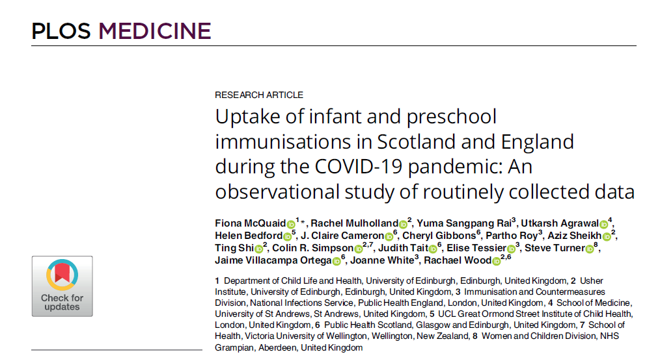
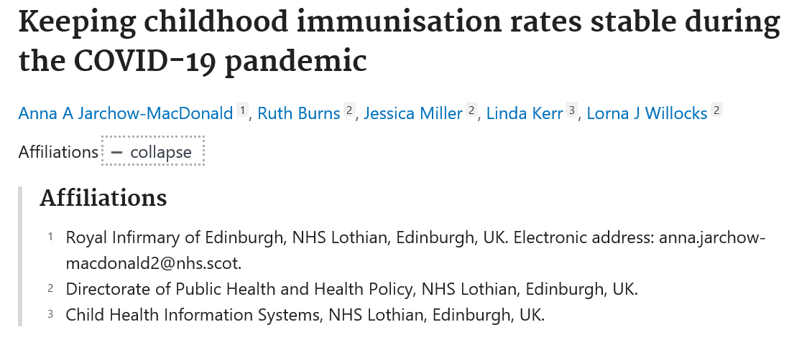
High uptake maintained during pandemic
Lockdown associated increase in timely immunisation for Scotland; fell in England
7000 more children immunised on time
Active measures at local and national levels
Detailed timely vaccine uptake data
Attendance stable in first lockdown
Vaccine Transformation programme facilitated adaptation
Access; home vaccination if shielding
Rapid data analysis
Personal telephone reminders
National support

Slide 13
Covid and Flu Vaccination
Massive endeavour
Opportunity for development and learning
  Greater focus on addressing health inequalities
  Improved citizen experience and public awareness
  Strengthened clinical governance at local and national level
  Digital services, with non-digital pathways for inclusion
  Agile and scalable solutions
  Partnership working with trusted community intermediaries
  Strengthened collaboration between national organisations and local NHS Boards
  Future pandemic preparedness
PHS focus
Clinical Governance
Vaccine safety
Clinical advice
Vaccine confidence and informed consent
Workforce education
Uptake, surveillance, impact evaluation
Evaluation

Slide 14
Future Immunisation Programme Governance
Scottish
Immunisation
Programme
Vaccine
Transformation
Programme
Flu Vaccination
Covid Vaccination
Programme
Scottish Vaccination and Immunisation Programme

Slide 15
Exciting Future in Immunisation
New vaccines
mRNA vaccines developed fo covid could be applied to other diseases
Therapeutics in addition to preventables
Elimination strategies
Cervical cancer elimination
Measles elimination
Meningitis outbreak elimination
New challenges
Covid
Monkeypox
Improved approaches
Patient experience
Service delivery efficiency and reduced health inequalities; whole system approach
Data and digital, including to inform and tailor delivery through evaluation

Slide 16
The Impact of the COVID-19 Vaccination Programme on Vaccine Transformation
Experience of Delivery of the Covid-19 Vaccination Programme
Karen Duffy

Slide 17
Aim of the session:
Giving an overview of:
Context and Frameworks: the formal advice, policy and clinical frameworks we work in within the UK and Scotland
What we have delivered in Scotland – who, where, when, uptake rates, trends across variants and waves
How we did it – the collective effort across services, vaccines, venues, workforce, digital innovations, buy in from public
Reflections and Learning – positives and challenges

Slide 18

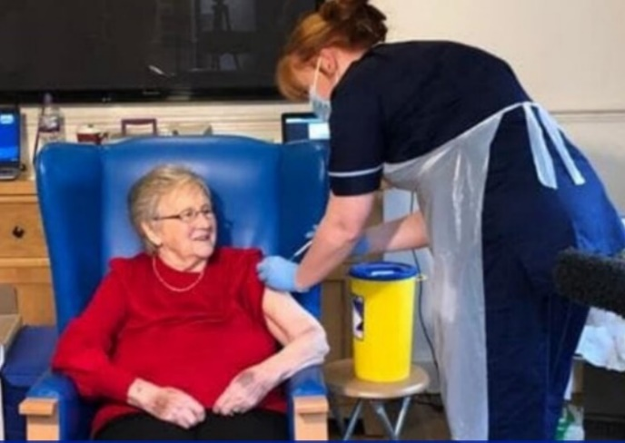
19 Months of Covid Vaccination Programme
On 8th of December 2020, the UK became the first country in the world to deploy an approved COVID-19 vaccine (outside of clinical trials)
19 months on – Covid Vaccination across the UK has been a phenomenal success with almost 120 million doses administered across the UK, saving countless lives and reducing pressure on the NHS
Largest post war logistical public health endeavour – with herculean joint working across all parts of Scotland (and the UK)
The planning phase to set up ‘FVCV’ (Flu Vaccination/Covid Vaccination) programme commenced at pace in Sept ’20 – ahead of Vaccine Go Live
In Scotland, we have administered 12.44m Covid vaccines:
Completing primary courses for adults
Boosting all adults in Autumn/Winter 2021/22
Provided 3rd primary doses to those with SIS
Boosted over 75’s, care home residents and IS/SIS again in Spring 22
Offered primary and booster dose to 16/17 yr olds
Offered primary course to 12-15 year olds
Offering primary course to 5-11 year old
For some citizens with SIS – they have had 5 doses already

Slide 19

Process of Advice to Changes in Delivery
SG team will consider JCVI advice &
- from a policy, clinical, operational, legal perspective and advise Scottish CS
JCVI
Advice to SoS and CS for Devolved Nations
Builds an Operational Delivery Plan
- to be enacted – nationally planned and locally delivered by 14 HBs
SG decisions – have been to follow JCVI advice throughout programme
Delivery to Local Population

Slide 20
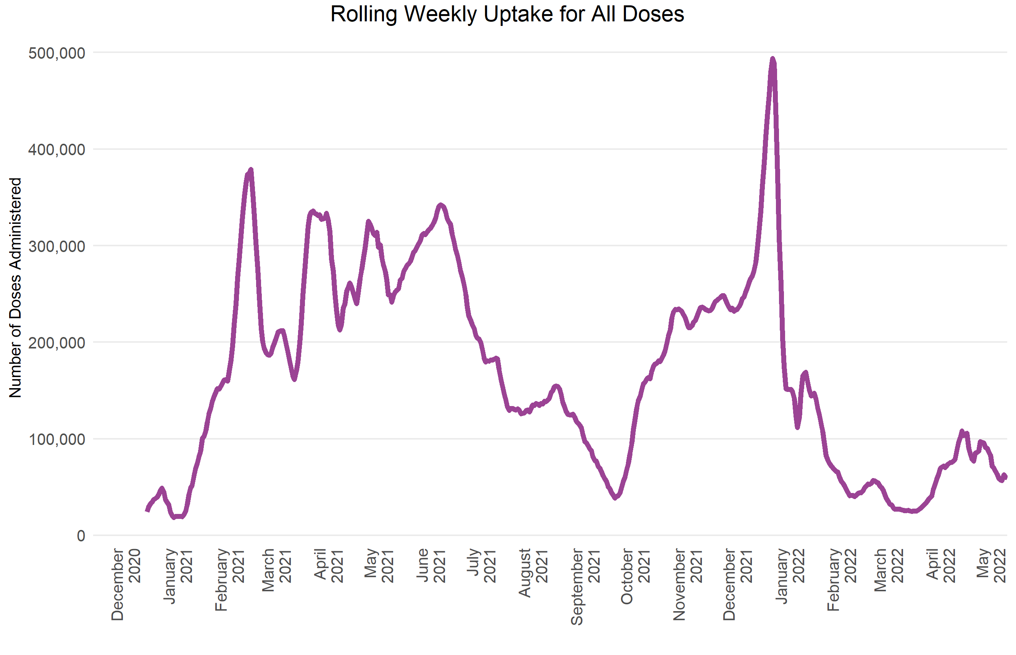
Vaccines Administered
Online Portal for Autumn/Winter vaccination programme launched for eligible cohorts
Scotland administers first vaccinations against COVID-19 – Progresses through JCVI 1-9 cohorts
Scotland brings forward second vaccine doses for over 40’s to combat Delta variant
Confirmation of Omicron variant in Scotland
Vaccine certification becomes enforceable
Spring campaign - second boosters for 75+, care home residents and immunosuppressed people
Mass vaccination centres open in more cities + JCVI extension to cohorts 10-12
Autumn/winter – booster one programme launched in Scotland

Slide 21
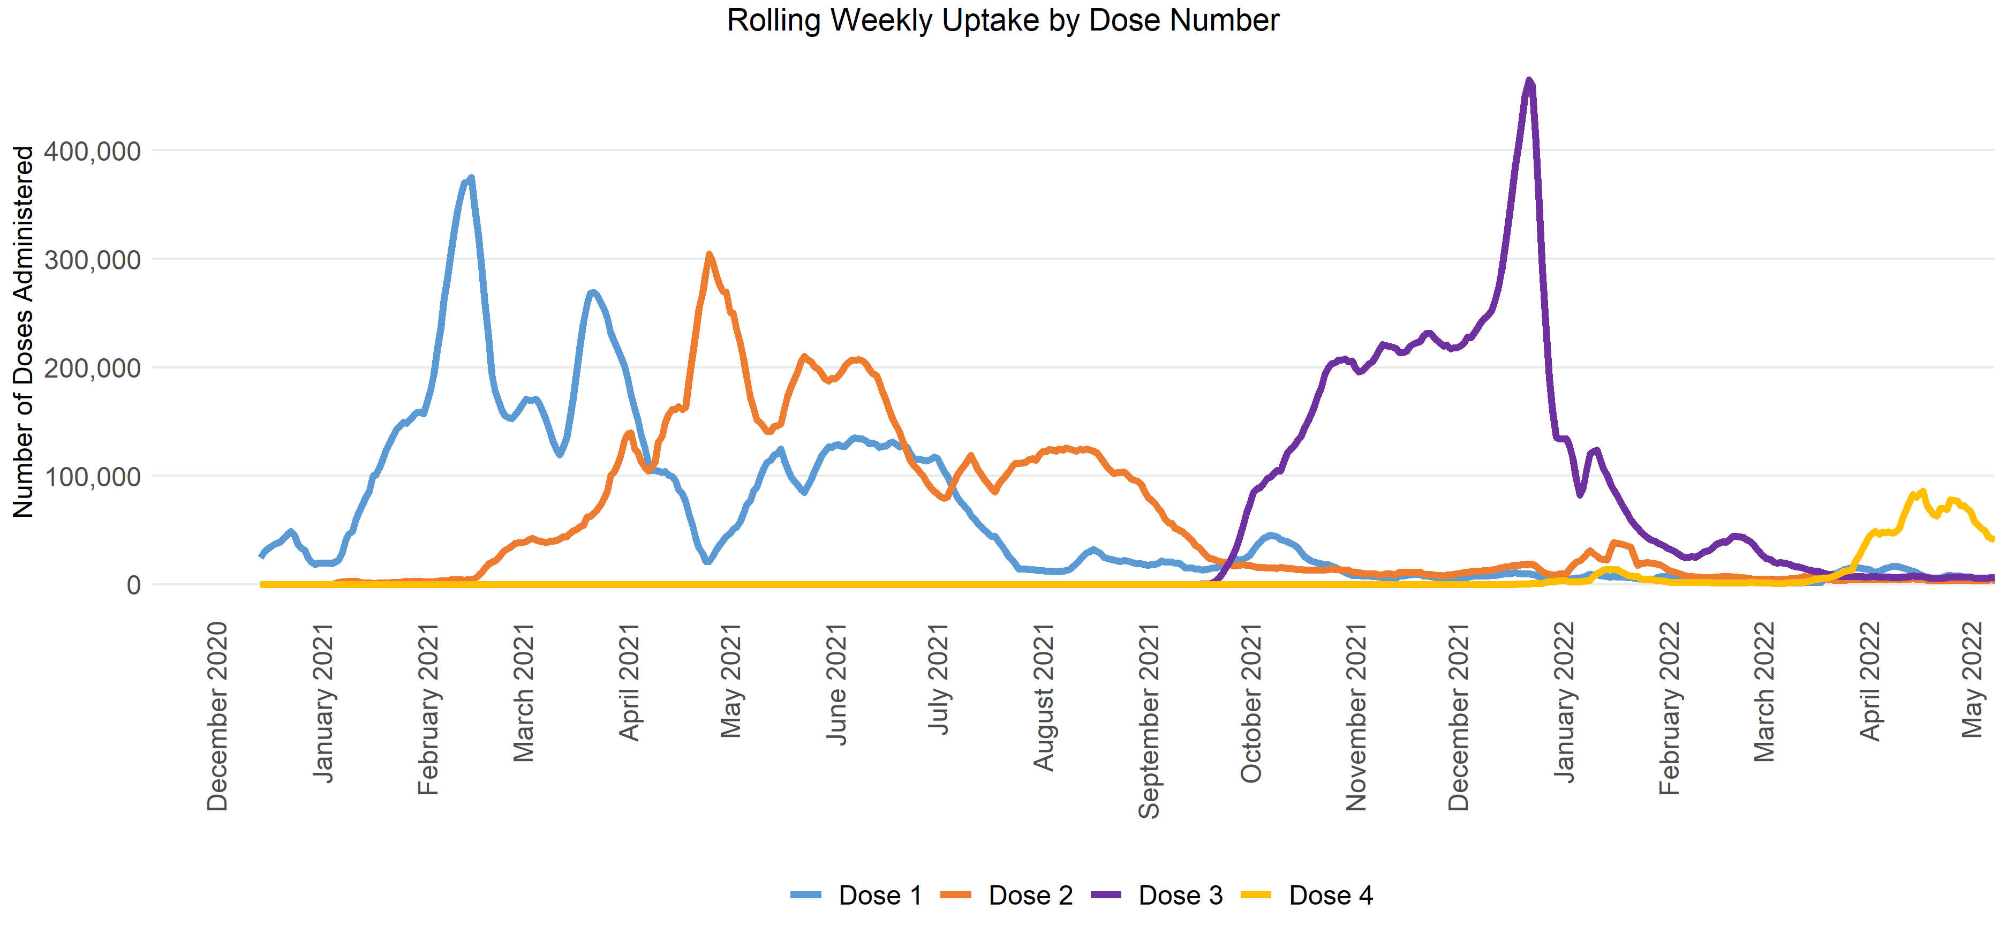
Breakdown by dose

Slide 22
Reach across SIMD and Ethnicity

Slide 23
Whole System of National Effort
Vaccination Teams – clinics, care homes etc
Territorial HBs – Organising all local delivery
NHS National Team – planning, & overseeing all Delivery
Scottish Government
FM
CS
CMO
SG Vaccine Directorate
3rd Sector Support e.g. Red Cross
Military Support – logistical
and vaccine delivery
Volunteers – in clinics, taxis
Police Scotland – security advice
Call to Arms :
for retired Registrants;
part time staff to up hrs;
Doctors, dentists, pharmacists, opticians etc
Local Authority :
Venues
Transport
Infrastucture
Care environments

Slide 24









Many Delivery Channels – Venues and Staff
Board run walkthrough clinics – likely less use of mass settings with more medium sized community clinics
Care Homes onsite vaccination
Care Home residents and staff vaccinated on site for convenience and to maximise uptake.
Mobile vaccination units
Mobile clinics used to target specific communities\groups
Home Visit
Home visit to vaccinate individuals who can’t get outside of their house for medical reasons.
Flu and Covid Booster Vaccinations
Schools programme to deliver flu vaccinations to pupils and teachers
Midwifery Care Settings
Specific Locations (e.g. Prisons) – targeted visits to specific locations
Community Pharmacies
Occupational health settings to cater for healthcare and social care workers
Drop in Clinics – settings where an appointment is not necessary

Slide 25
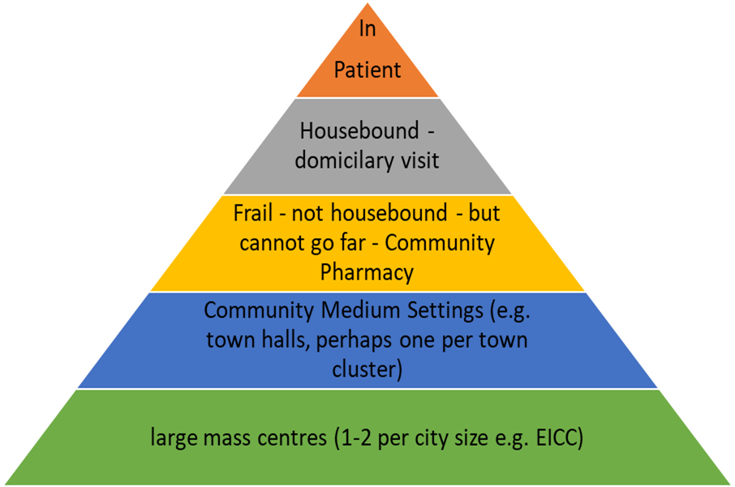
To Vaccinate – you need Venues to bring people to (and need to consider accessibility and reach)
Around 200+ community vaccination clinics
Mobile buses, lorries, drive troughs, SAS cars
800 older adult care homes
Other residential settings
Rising domiciliary visits with frail or housebound
Staff clinics
Pharmacies doing flu for NHS in some regions
Going out to traveller sits, homelessness units, ferry ports, farms

Slide 26
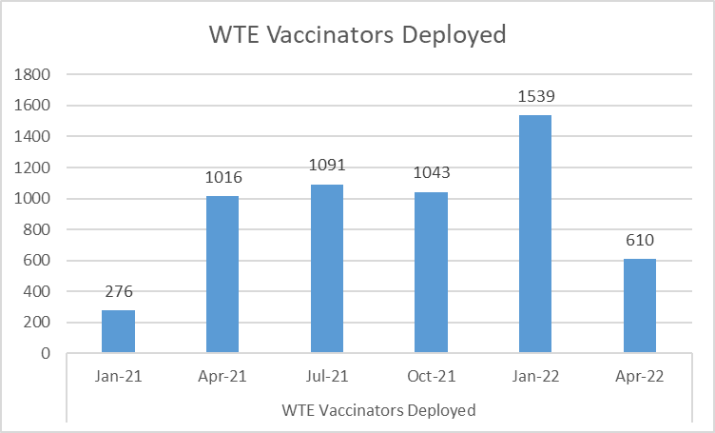
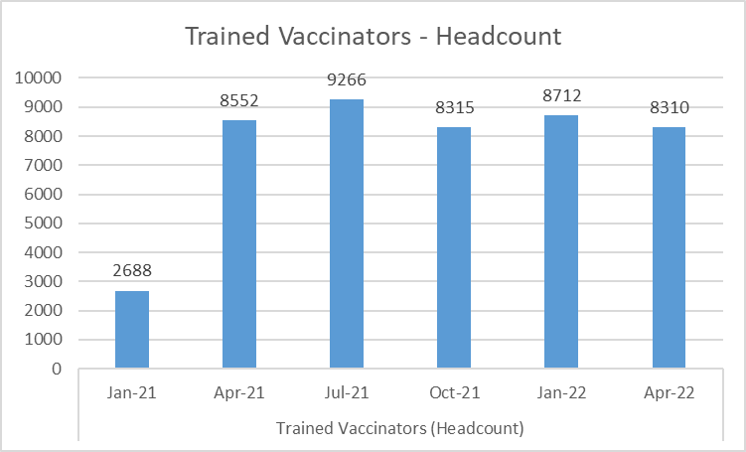
Clinical Vaccination Teams
May-21 GDC 8.5% GMC 15.3% GOC 2.5% GPhC 2.5% NMC 54.3% HCSWs 15.4% Uni Stu 1.4%

Slide 27
Surge Planning – if required
Logistics – Venues and Inviting
Workforce Elements
Extra-ordinary Surge – delivery of 400k run rate – £ consequential emergency state)
All the below staff working
All live, and number of appointments at 400k or upping fast
Get extra new buildings prepped for opening + Call centres prepared for phone up bookers, portal
Book stand by extra vaccinators in for shifts - & book shifts for all agreed escalation staff groups
Instigate Emergency – for extra-ordinary surge (14 day lead in)
Up to the funded 200K normal ceiling
Normal Vaccs staff – part timers doing more shifts and bank shifts
Normal expanded level (local 25% surge/expansion of cohorts – amber level)
Up to the funded 200K normal ceiling
Using your current community venues – longer hours + normal scheduling options
Normal Vaccs staff delivering full year
Normal base level
(green level)
Normal community venues and scheduling

Slide 28
Innovation (digital and models of working
Vaccine Management Tool (VMT) – new digital system in TURAS for recording vaccinations
National Vaccination Scheduling System (NVSS) – new digital system created using the service now platform, built to be system for covid in 20/21 and then for covid and adult flu from 21/22 onwards.
Portal – for self booking in the NVSS system (either going via NHS Inform or straight to NSS portal) – first of its kind for Scotland for self booking for a vaccination
National Contact Centre – Non digital options for people to book, rescheduled, seeking verbal advice
Mobile Vaccinations – working with SAS, with boards having their own bus, lorries, pop up shops
Skill Mix – using of military vaccinators, healthcare support workers doing IM vaccinations, the use of volunteers, retired returning staff, independent contractors
Multitude of Communications – mass media, local media, popular voices, bespoke video with targeted messaging, working with universities, churches, schools, carers organisations, young scot etc

Slide 29

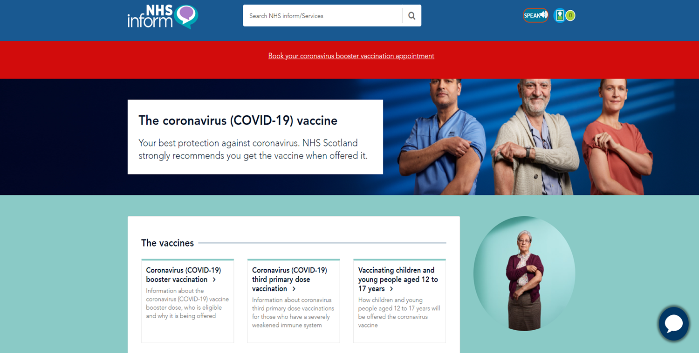


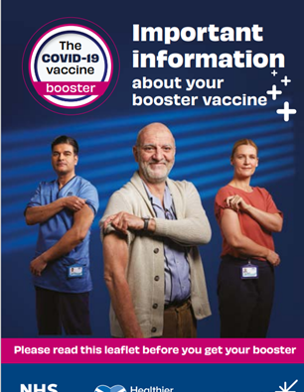
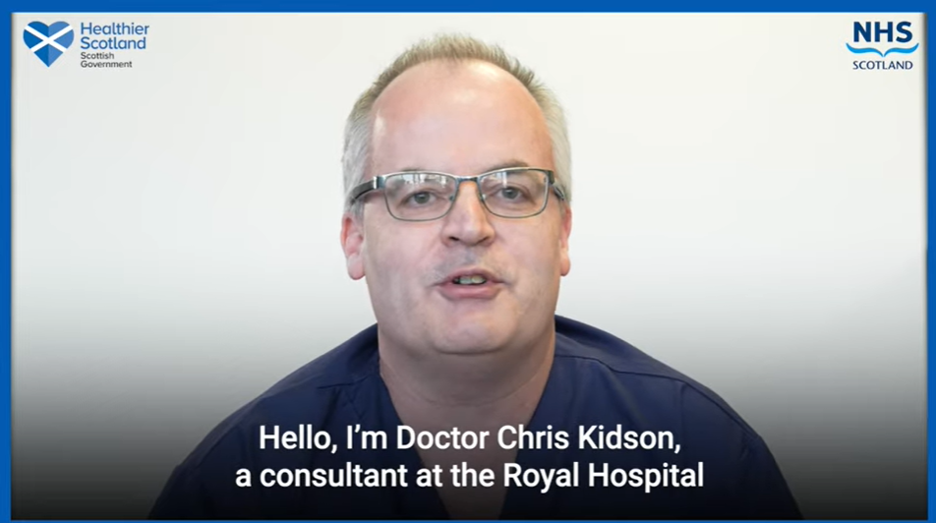
Bringing the public with us – buy-in to Covid vaccination in Scotland
The coronavirus (COVID-19) vaccine (nhsinform.scot)
Lots of Online videos, sharing on Social media – Trusted Voices

Slide 30
Reflections: Positives and Challenges
Challenges:
Engaging younger people
Most detailed and mass logistical programme – therefore tough to see all the parts and delivery and harmony
Complex digital environment and increased number of systems – more complexity = more unexpected problem solving to do
Constantly needing to adapt messaging to public
Highly challenging political environment –high pressure
Positives:
Uptake exceptional
Systems working together for greater good
Huge innovation and new systems and ways of working created at speed and with huge personal contributions
Learning environment – each phase aimed to learn from past endeavours
More than the sum of the parts – the way all national boards, territorial boards, SG, national team, military, councils, police, voluntary sector and the public came together created a strong vaccine outcome for Scotland

Slide 31
Huge Success – Euro Surveillance 25th Nov’21
Estimated number of deaths directly averted (>60 yrs age) as a result of COVID-19 vaccination in the WHO European Region, (Dec ’20 – Nov ‘21
Since the Covid-19 Pandemic started - in excess of 1.5 million coronavirus disease (COVID-19) fatalities in the WHO European Region until week 45 in 2021
90.2% deaths in people 60 years and older
Scotland 2nd of 33 countries for deaths averted – over 27,000
Country | Vaccines used | Vaccination uptake (%) |  | Number of deaths |  |  |  | Mortality rate per 100,000
 |  | Partial | Full | Observed | Averted after one dose | Averted after two doses | Averted total | Observed | Total expected | % expected deaths averted by vaccination
United Kingdom (Scotland) | AZ-COM-MOD | 100 | 100 | 4,585 | 454 | 27,202 | 27,656 | 333.3 | 2,343.8 | 86

Slide 32
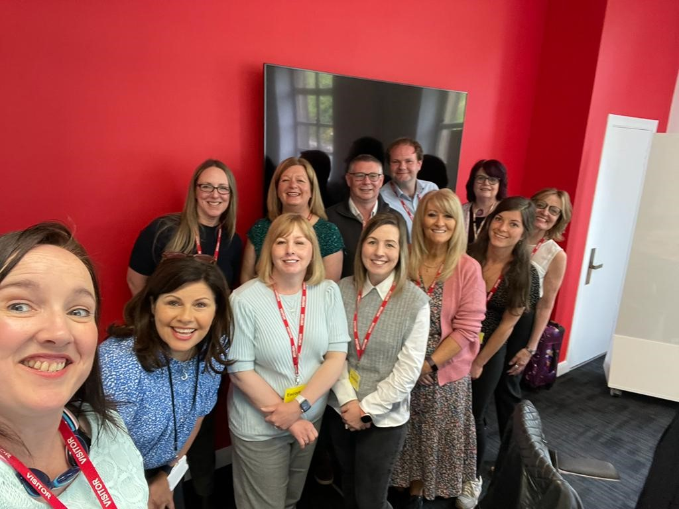
Thank you!

Slide 33
NHS Tayside
Vaccination Programme Journey
“The Sprinted Marathon!”
Lynne Hamilton
Public Health Programme Director
Notes:
Hi My name is Lynne Hamilton and i am the Programme Director working with Public Health Team in NHS Tayside. I would like to finish off the presentation today with a brief insight into our Health Boards vaccination programme journey. I have described it as our sprinted marathon as these phrases were used on a few occasions throughout the programme where although overall roll our was a marathon we often needed to accelerate beyond capacity to meet needs of the population

Slide 34

The Before ……!
Pre Covid – General Practice delivery models
Health visitor delivery in communities and care homes, small staff flu clinics with occupational Health and Peer vaccinations
No central team established or venues available. Pilot undertaken in one NHS hospital site in rural area.
Notes:
So The Before ... Where were we at the start of VTP pre covid.... In Tayside preliminary work had commenced with a pilot in an outpatient hospital department using outpatient staff to vaccinate the public in Forfar... The pilot had worked well but hadn’t really prepared us for what lay ahead...
In Tayside we were fortunate enough to have a very active general practices who we still relied on heavily to deliver the flu programme when covid struck so our 2020 flu campaign was in the main still delivered by general practice supplemented by some clinics arranged with bank staff and HSCP staff in hospital settings. We ran small flu clinics supplemented by Occupational Health Team and had our most successful peer vaccination campaign in acute settings to date

Slide 35

During ….. the waves!!
6th Dec 2020 – first staff clinic opens with 6 lanes of vaccinators delivering Pfizer vaccination
4th January 2021 – first GP delivery of AZ for those over 80 and central teams established to support care home delivery in partnership with General Practice and health visitors
Notes:
The first stages of the covid vaccination programme were described as waves... I remember using these images on slides to describe what was coming and will see form next slide the final or third wave got even bigger!..
We began our campaign with our first staff clinic opening on the Ninewells Hospital site for all staff ... Pfizer vaccine arrived first and training for thawing and reconstitution of these new mRNA vaccines began. Supplies were tight and so were vaccinators and we struggled in early days to cover 6 vaccinators on shifts 7 days a week as we started to plan for the roll out for carehomes and housebounds.... By 4th of January we had our GPs lined up to deliver the first Astra Zeneca vaccine to the over 80s in Scotland and its roll out of first doses began across the region

Slide 36

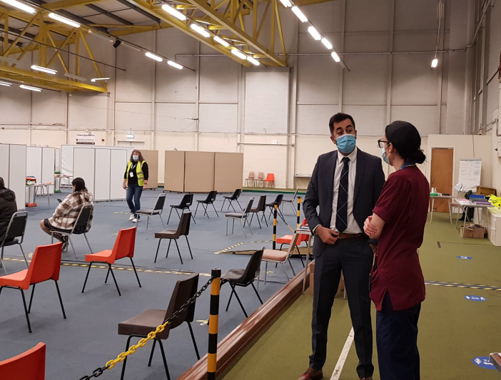
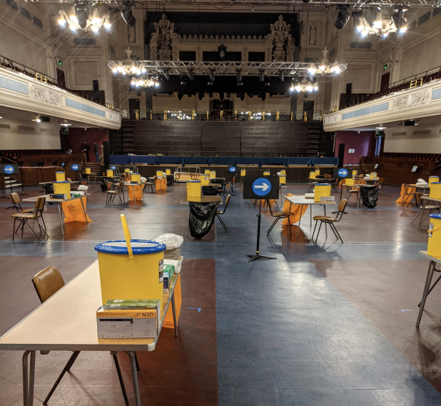
March 2021 and beyond –
2 Mass Vaccination centres and 3 medium vaccination venues mobilised within a week
Notes:
Then the tsunami stuck or Wave 3...!
We knew by this stage we require to be delivering over 30,000 vaccines a week and we needed to move quickly... Within a weeks notice working with critical friends we managed to open and staff 2 mass vaccination centres and 3 smaller centres in Angus within outpatient departments by the beginning of March

Slide 37

Critical Friends!!
Local Resilience Partnerships
Local Authorities
Police
Scottish Ambulance Service
Voluntary Organisations
Acute services & 3 HSCPs
Primary Care
Community Pharmacies
Notes:
I Mentioned critical friends....
We would not have delivered what we have delivered had it not been for the close working and new relationships built with our partner agencies noted above... In Tayside our Local Resilience Partnerships with reps from all partner organisations moved mountains to ensure we had venues and support for venues across the region to best serve the population of Tayside. From securing recreational facilities such as the large Caird concert Hall in Dundee, the ice rink in Perth and local concert halls, town halls to multiple community and leisure centres in rural areas and deprived communities. Local Authorities and third sector partners also supported with staff volunteers and contacts of those working with those who need more support to access services.
Local Police leads have supported us with vaccine safety and anti vax campaigns and protests , SAS have supported all Boards with the use of mobile bus for vaccinations and team of vaccinators which we have used locally for both remote and rural areas and areas of deprivation in cities and communities
Acute services and HSCPs have supported with release of staff to be deployed and trained for bank shifts and with contacts and links to patients in inpatient settings and vulnerable groups
Our General Practice colleagues who supported 1st dose roll out and both flu campaigns to support uptake and person centred approach
And finally community pharmacies who have supported flu vaccinations for staff in opast and now through a local Service level agreement will deliver our travel vaccines

Slide 38
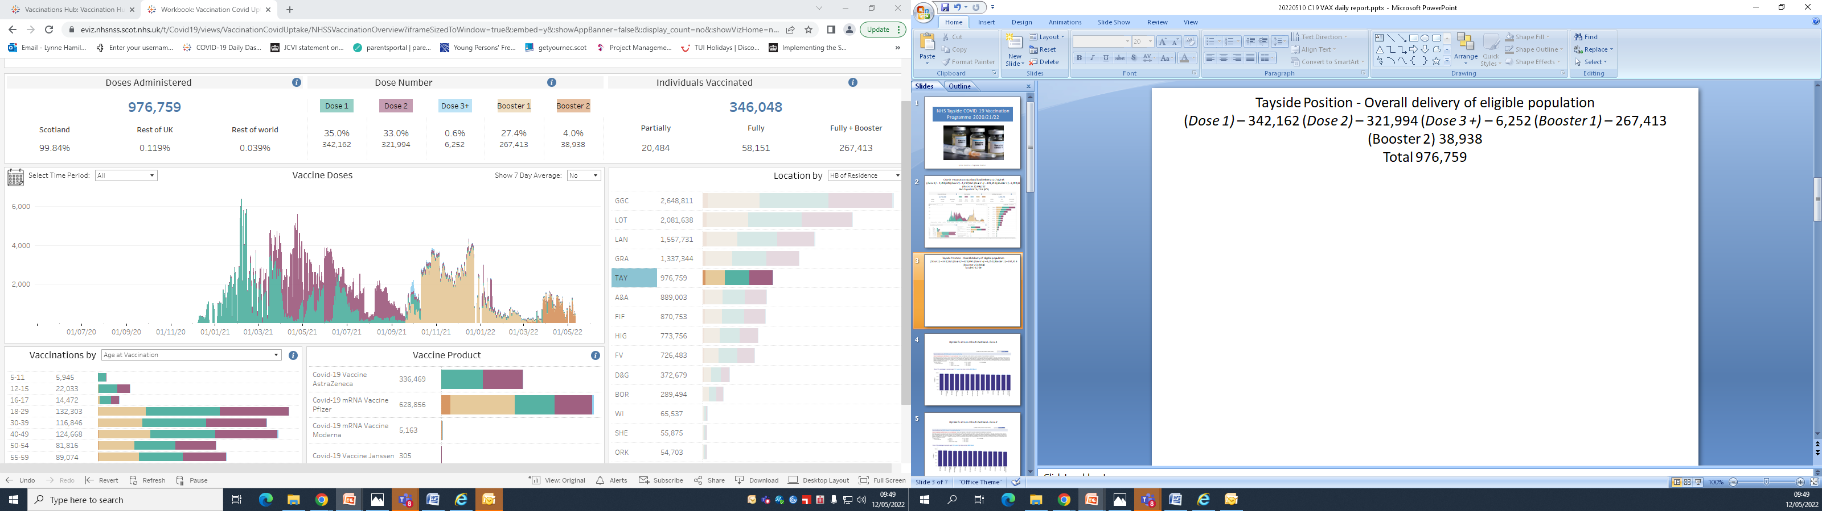
Mass delivery V’s reducing health inequalities
Priority to vaccinate the masses as quickly as possible
Supporting access
Reaching out
Monitoring uptake and flexing models
Child friendly clinics
Notes:
Critical to moving out of the pandemic was the rapid roll out of vaccinations to the masses . The more vaccinated the greater the reduction on nhs services therefore in the early stages and waves priority had to be given to those most vulnerable and able to be accessed quickly to deliver most protection. As the programme expanded attention then shifted to how we encouraged uptake in those who have traditionally found it more difficult to access services. Work commenced through an inclusivity SLWG to look at vaccination of those from BAME network, seasonal workers, Travelling communities, those who are homeless or have substance misuse issues or those who have mental health and learning difficulties to name some of the groups
We moved then to an outreach model and open drop in model to further support increased uptake and provided clinics in areas of deprivation, mosques, farms, Football matches, carnoustie Golf open, Homeless shelters, Supermarket car parks , rural and remote villages and even on a moving Boat!
These clinics were all well attended and vaccinations were given to those who would have never actively sought out vaccination
Laterally the teams have risen to the challenge of providing vaccinations to those firstly 12 and 15 and most recently have enjoyed dressing up and decorating centres to make them as child friendly as possible

Slide 39
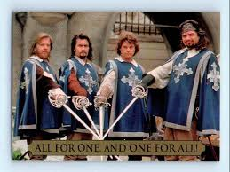
One for All and All for One!
Ensuring roll out consistent and timely
Appointing systems and vaccine recording
Clear eligibility and communication strategies
Vaccine supply and ordering
Workforce – training/models/skill mix
Legal requirements/clinical governance
Notes:
Critical to the success of the programme was the one for all approach and the significant effort which went into ensuring all Boards rolled out the programme to the different age cohorts in a timely and consistent manner.... From the blue envelopes and appointing systems to vaccine ordering and clear communication plans , messaging all had to be in sync to avoid confusion and risk losing public confidence in the programme. This not only involved working with c omplex appointing and scheduling systems, ensuring enough vaccine had been ordered, planning clincis and making sure clinics had the correctly skilled and trained staff to support and ran hours to suit patients and encourage uptake. In addition to ensuring tight governance and standards were updated and maintained by all to ensure patient safety
I think is fair to say this has been the biggest logistical challenge we have seen since a War

Slide 40
The After ……!
2 mass vaccination centres on the High Street
5 medium rural centres
7 small rural/remote pop up venues
3 outreach teams
Scheduling and booking/call handing teams
Community Pharmacy delivery of travel vaccines
Over 200 wte vaccination staff
Over 600 trained vaccinators on bank
Notes:
So the after... Where are we now... Well in Tayside we now have 2 mass vaccination centres now moved out into high street venues as leisure and recreation services began to mobilise . These come with own challenges re lease agreements and durations of lease and degree of uncertainty re tenure
We have 5 main medium size venues in five main centres of population across the region and we have now access through local authorities and local churches to 7 smaller more rural pop up venues which we have used successfully for the spring campaign reducing travel time for some patients in these areas
We have a team in each area covering carehome vaccinations, housebound visits and providing ongoing inclusivity work in each area
We have established an internal team of call handlers who can book and schedule appointments both locally and nationally
We have as noted secured community pharmacy support for travel vaccination delivery and we currently have over 200 wte vaccinators on our books and have trained over 600 vaccinators with around 300 still on local bank

Slide 41
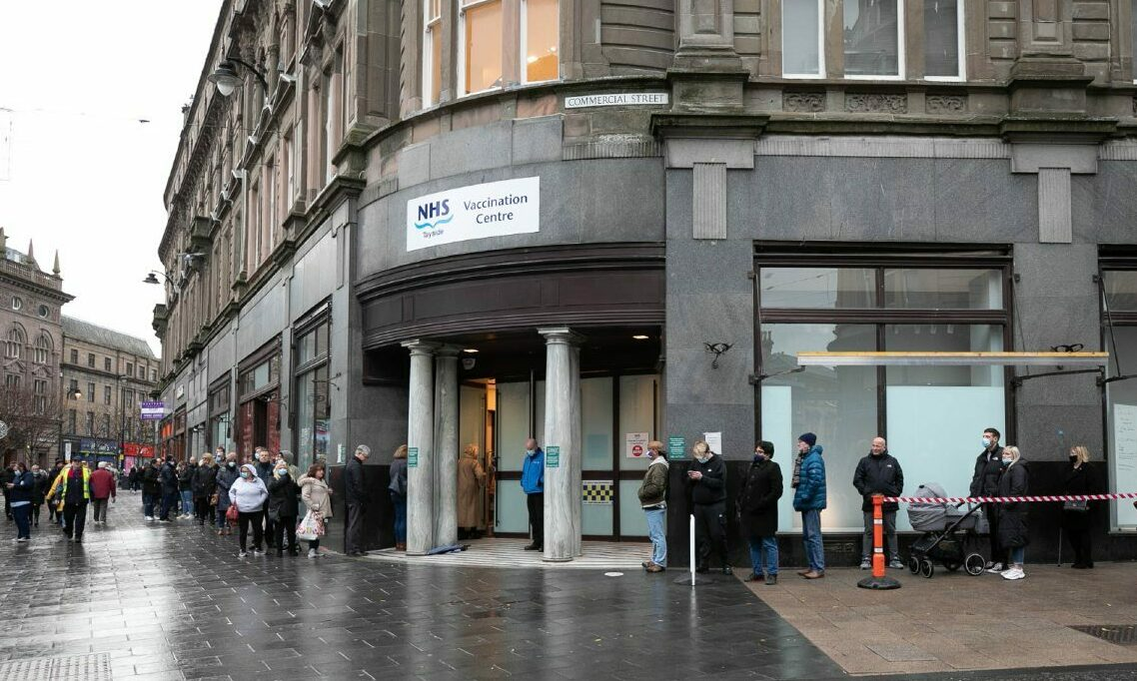
Dundee Central Vaccination Centre
Notes:
Just wanted to show a couple of images of our larger centres this is dundee central which occupies a former Zara store

Slide 42
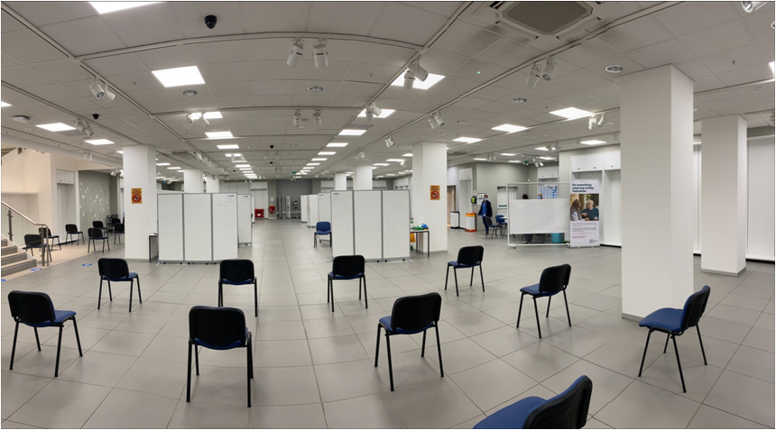
Perth Central Vaccination Centre
Notes:
And this is our Perth centre which is currently sited in the St Johns shopping centre in former H&M store

Slide 43

Key lessons learned re. person-centred approach
Public confidence is critical
Clear communication
Appointments encourage uptake
Tailoring delivery to support access
Drop Ins/pop ups/inclusivity
Notes:
For us the key lessons of the programme to ensure the most person centred approach going forward is to maintain public confidence in the programme, to ensure we get it right re appointments and letters and patient experience
To have clear communications with the public and teams regarding who is eligible and when and for what
That appointing people does yield a higher uptake than asking people to contact /book online or drop in
That one size doesnt fit all and that the delivery model needs to be flexible to support those who find it harder to reach services and make accessibility as easy as possible whilst being efficient in delivery through our use of drop ins pop ups and work in local communities to ensure we are as inclusive as possible for all

Slide 44

Thank you for listening
Happy to take any questions at the end of the session.
Notes:
Thank you for listening to our Journey and we are all happy to take questions

Slide 45
The Impact of the COVID-19 Vaccination Programme on Vaccine Transformation
Stephen Gallagher

Slide 46
Audit Scotland Report
“The delivery of the vaccine programme has been a success so far, with good collaboration, joint working and new digital tools developed at pace. There are opportunities for the Scottish Government to use learning from this programme to inform the implementation of further stages of the vaccine programme.”

Slide 47
Vision for the new Scottish Vaccination & Immunisation Service
Scotland’s vision for a world-class person-centred and public-health led vaccination and immunisation service is critical to building a sustainable and resilient healthcare infrastructure that meets Scotland’s present and future healthcare needs, in line with our National Performance Framework

Slide 48
Person centred approach
Informed by research evidence, insight, and stakeholder feedback and experience of
COVID-19 vaccine
Flu vacine
Existing vaccination portfolio
Record management, scheduling
Delivery models
Governance, performance management
Workforce

Slide 49
Finance
In 2019-20, circa £24m was spent on vaccines
In 2021-22, circa £309m was spent on vaccines
In 2022-23, projected to spend circa £200m on vaccines

Slide 50
Clinical Governance
Based on robust clinical governance structure established for FVCV
Approach extended and formalised, providing clinical governance across all immunisation programmes and enabling partnership working across PHS, SG and Health Boards

Slide 51
Reporting, performance, and surveillance
National scrutiny
Streamlined throughout the COVID-19 vaccination programme
Vaccine Management Tool (VMT)

Slide 52
Whole system workforce
A dedicated, flexible and sustainable whole system vaccination workforce
Looking at the roles beyond the vaccinators
Empowering of the workforce

Slide 53
Premises and delivery models
Local decision with national guiding principles
Person can choose convenient location
Outreach options including mobile facilities
Central locations particularly within areas of deprivation
Options to co-locate with other primary care services
Access via sustainable travel to meet government targets for reducing carbon emissions

Slide 54
Data and digital systems
Opportunities to build on the digital systems that have been put in place through FVCV
COVID-19 certification process and wider development of the ‘Digital Front Door’ (DFD)
Use of NHS Inform both in support of trusted information on FVCV and as a route to the vaccine portal for the public
Ensure design of digital tools includes diverse user-groups

Slide 55

And finally, to everyone involved in the Covid/Flu programme AND Vaccine Transformation…

Slide 56
Thank you for attending our session
Any questions?

