Slide 1

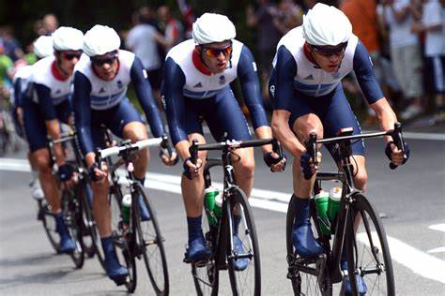
Improving Type 1 Diabetes Care
It’s a Team Sport! ​
1

Slide 2









Prof Brian Kennon
National Lead for Diabetes
Consultant Diabetes and Endocrinology,
NHS Greater Glasgow & Clyde
Improving
Type 1 Diabetes Care
Dr Anna Barnett​
NHS Research Scotland ​
Diabetes Network Manager​
​​Ed Clifton
Unit Head – Scottish Health Technologies Group (SHTG),
Healthcare Improvement Scotland ​
Alison Grant
Engagement Manager Diabetes Scotland
It’s a Team Sport! ​
Alan Morrison
Capital Accounting and Policy Manager,
Health Finance and Infrastructure Team
​​
The Team
Kenny Rees -
Category Manager,
NSS PCF
National Procurement
​​
Prof Sam Philip
Clinical Lead SCI-Diabetes,
Consultant Diabetes and Endocrinology ,
NHS Grampian​​
NES

Slide 3

Initial Slido Question
In one or two words
What do you perceive to be the greatest challenge to a whole system approach within NHS Scotland?
Improving Type 1 Diabetes Care: It’s a Team Sport!

Slide 4
Audience Response

Slide 5
Improving Type 1 Diabetes
Care
It’s a Team Sport!
Brian Kennon, Consultant Diabetologist, NHSGGC
National Lead for Diabetes
5

Slide 6
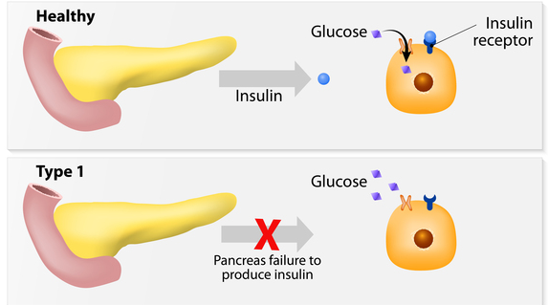
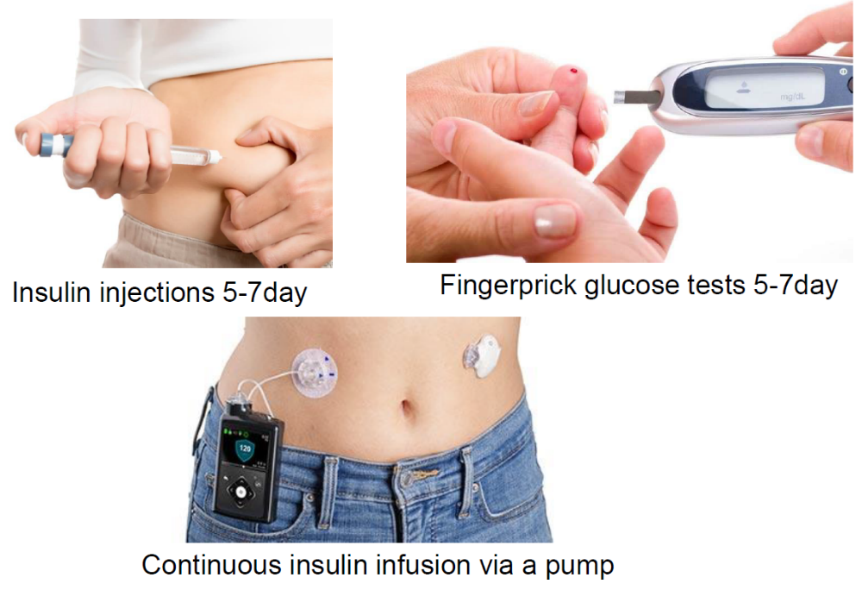

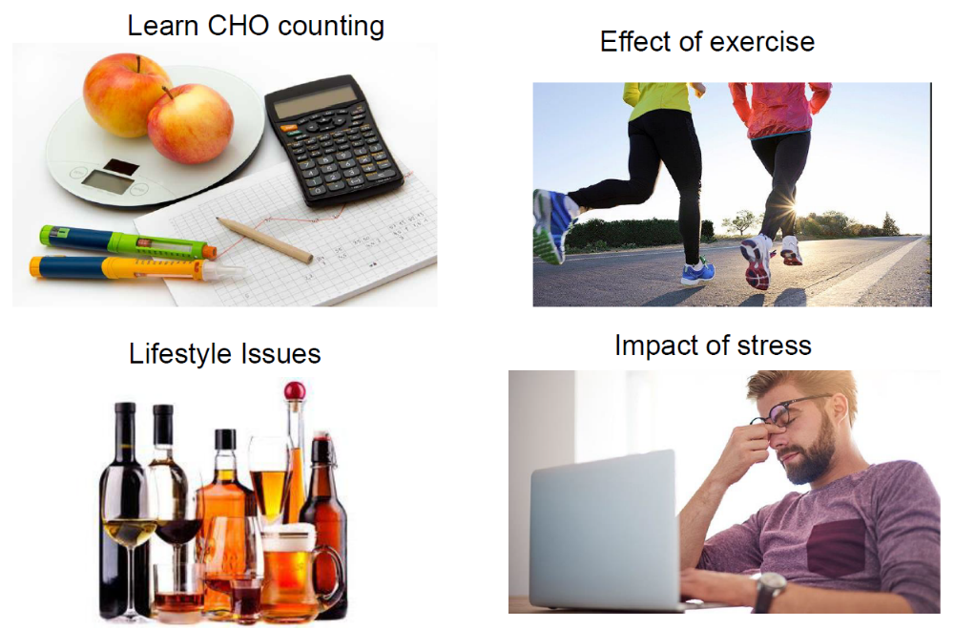
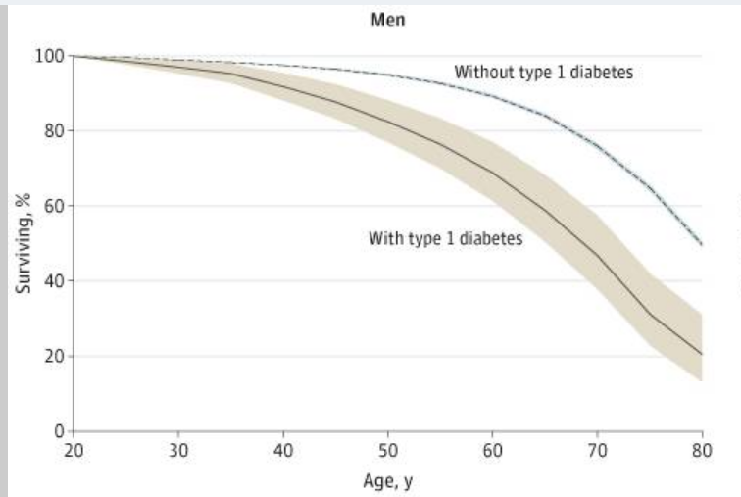
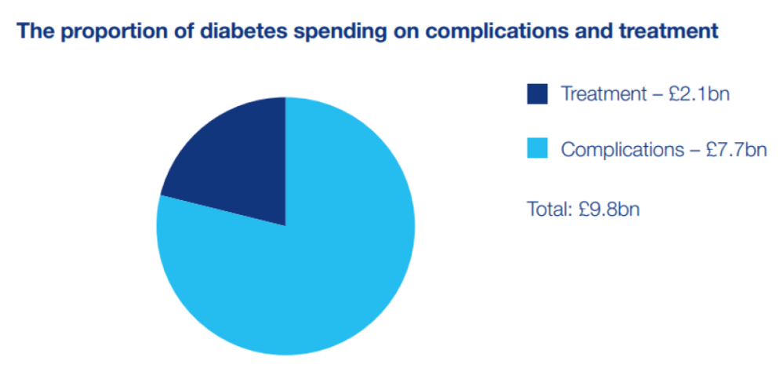
Setting the Scene
6

Slide 7

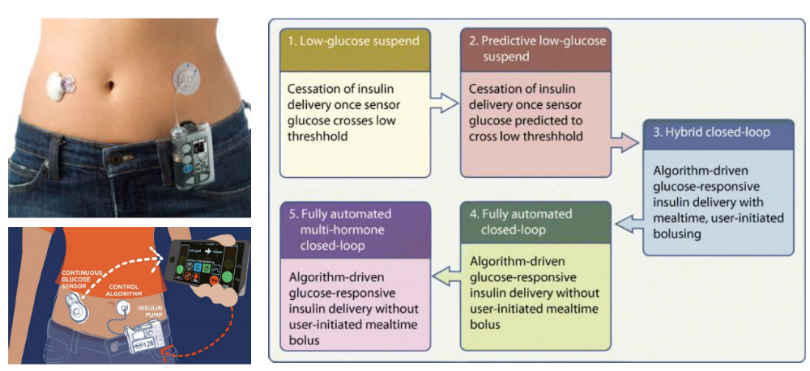

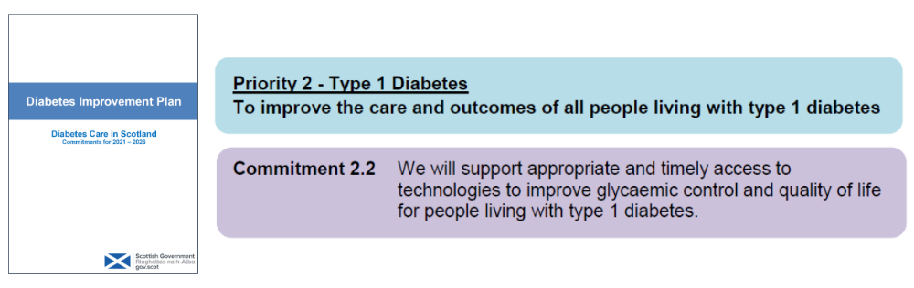
Technological Advances
7

Slide 8
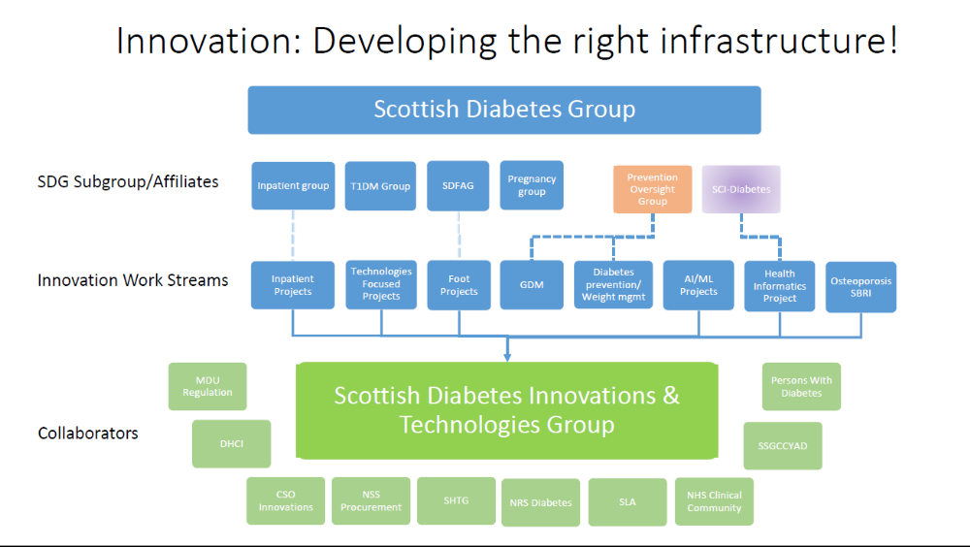
Whole System Approach: Evolution not revolution….
8

Slide 9

Developing the Infrastructure
National
Policy
SHTG
NSS Procurement
Scottish Government
Scottish Diabetes Group
Diabetes Improvement Plan
Diabetes Scotland/JDRF
Clinical
Research
NRS Diabetes Network
Epidemiology Group
SSGCYAD
MCN network
Type 1 leads network
SCI-diabetes
Individual with T1DM/family/carers
9

Slide 10

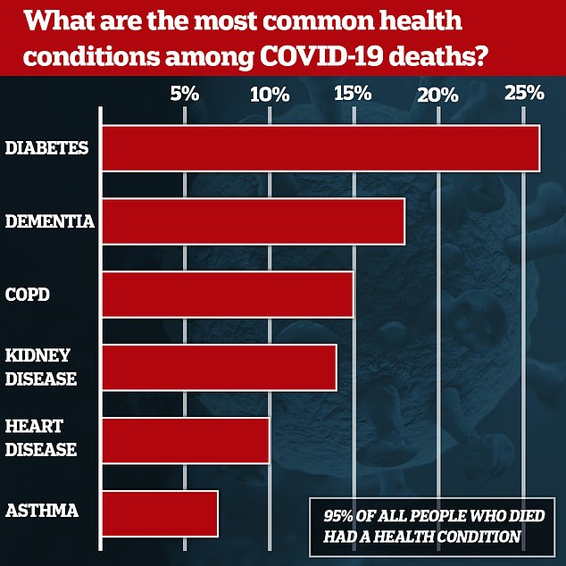
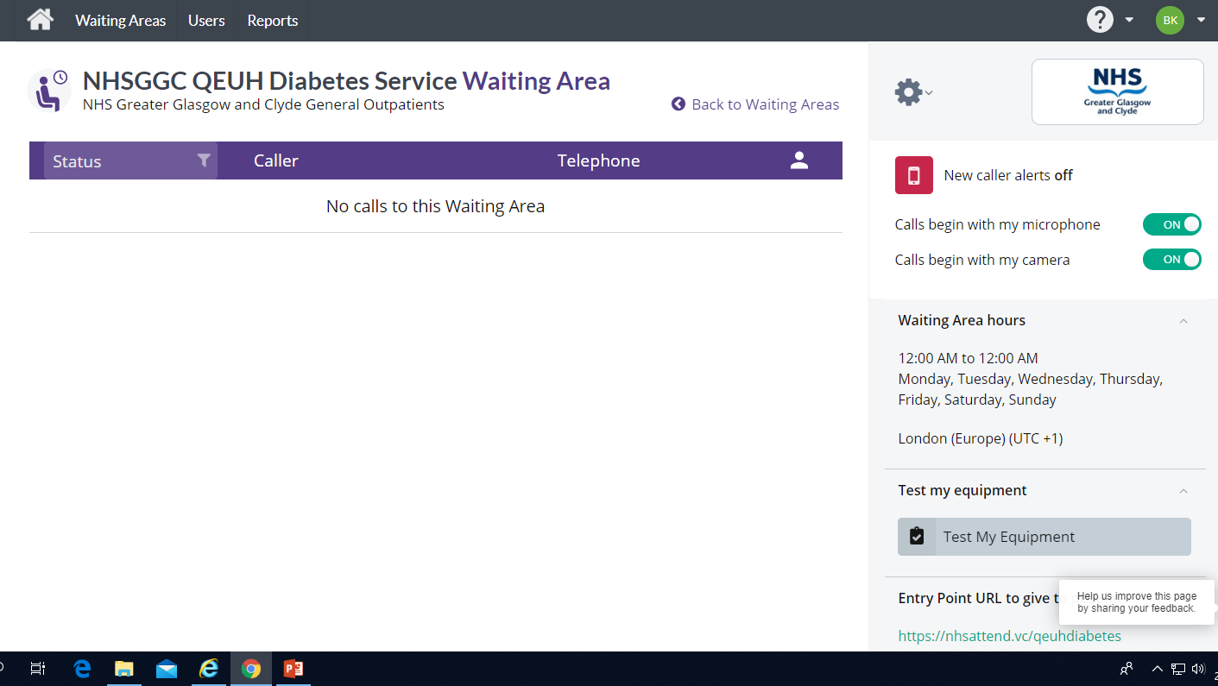
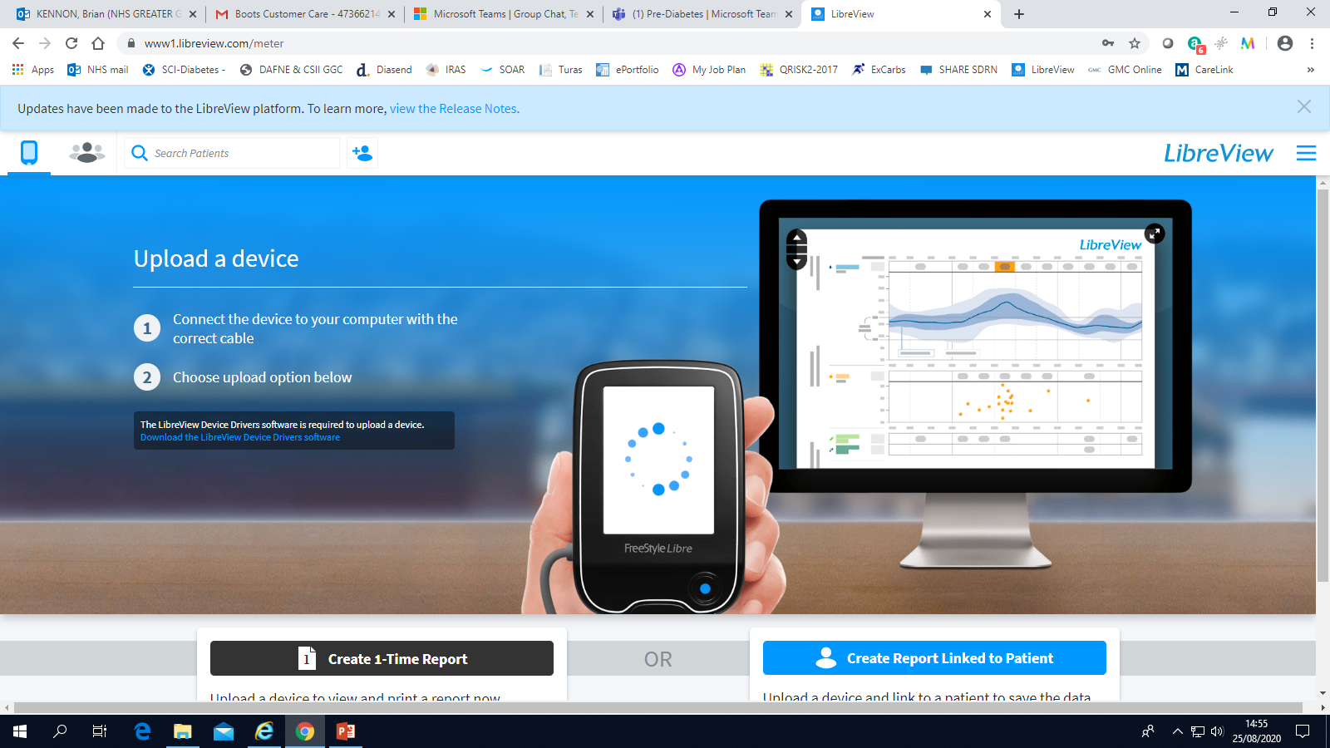
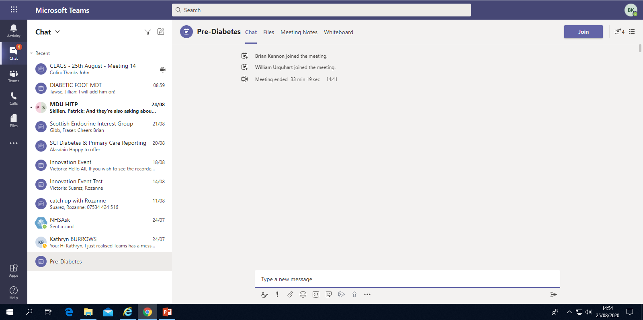
Impact of COVID
Virtual Care: New norm
10

Slide 11
Challenges
Remotely accessing data
Optimise diabetes control
Rapidly evolving technology
Variable availability
Staff expertise
Standardised approach
11

Slide 12
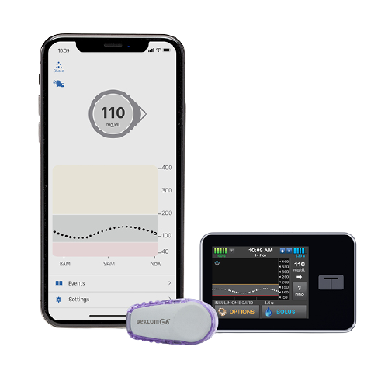
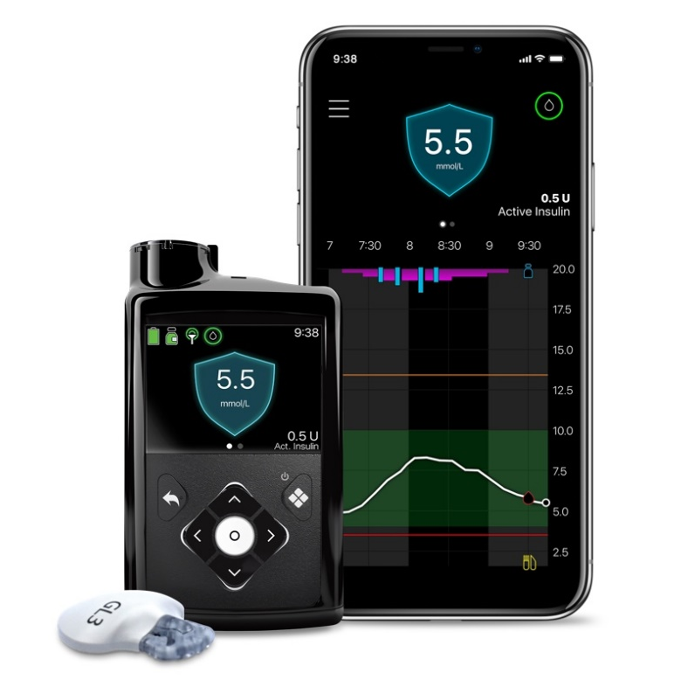
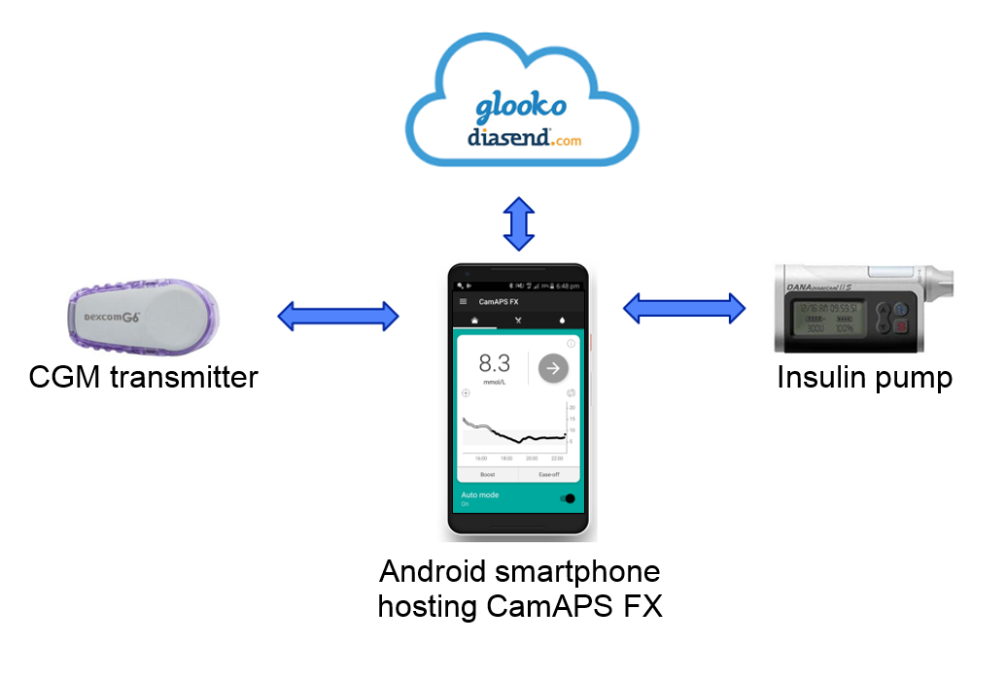
Evolving Technologies:
Closed Loop Systems
12

Slide 13


Supporting Whole System Change
Diabetes attempt at lining up ducks…..
13

Slide 14



Evidence and value
Ed Clifton, Scottish Health Technologies Group (SHTG) Healthcare Improvement Scotland
14

Slide 15
The role of SHTG
Part of Healthcare Improvement Scotland
SHTG provides national advice on the use of health technologies
Health technology assessment (HTA) underpins our work
Status: NHS Scotland is required to consider our advice
15

Slide 16




The remit of SHTG
What are
health technologies?
Health technologies considered by SHTG include:
tests, devices, procedures, talking therapies, digital healthcare, programmes or systems.
SHTG does not consider medicines.
16

Slide 17
Drivers for our work
Our advice supports informed decision making that improves health and care for the people of Scotland.
The efficient and sustainable use of resources
A focus on value
‘Once for Scotland’ decision-making
The rapid pace of technology innovation
Across health and care there are demands to adopt health technologies
New regulatory processes for health technologies in the UK
17

Slide 18
SHTG advice includes...
Cost effectiveness
(health economics)
Core to our advice is impartiality and transparency; acting as an ‘honest broker’ for decision makers.
Our advice promotes effective, patient focused and best value use of health technologies, based on evidence.
Clinical effectiveness (published research)
Views of patients and healthcare professionals
People’s quality
of life
Safety
Patient and healthcare outcomes
18

Slide 19
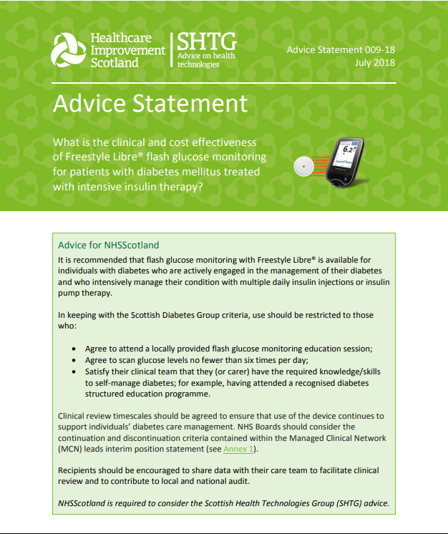

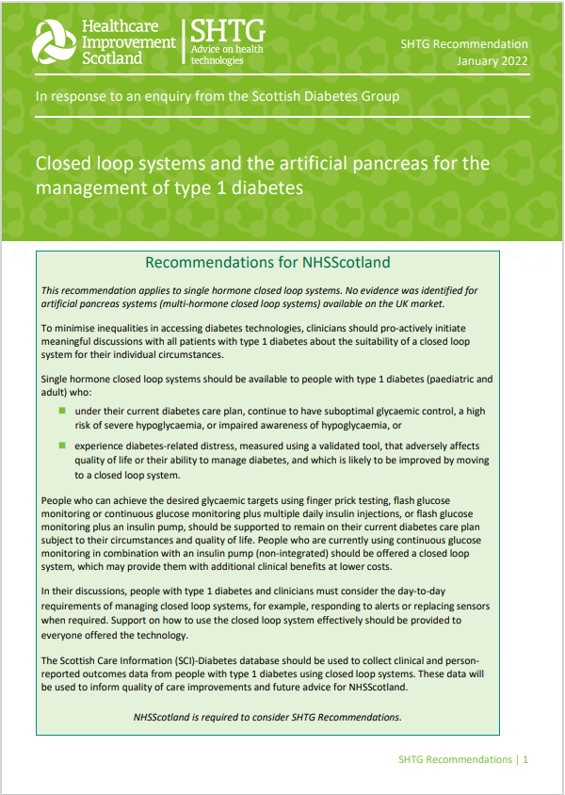
Diabetes technologies – evidence and value
  SHTG Recommendations on the use of flash (2018), continuous (2020) glucose monitoring and closed loop systems (2022):
  Effectiveness versus current standards of care
  Health economic analyses for Scotland
  Patient group submissions
  Clinical input
  Mental health and wellbeing considerations
  Inequity of access considerations
19

Slide 20


HTA within the health and care system
  SHTG provides evidence and objectivity to support decision making.
  Inclusion and alignment of stakeholders is vital in ensuring our work has relevance and a ‘home’ for the advice:
  National priorities and groups/networks
  Expert (incl. patient and public) engagement
  HTA skills and resource
  Scottish research and outcome data
  Procurement and funding
20

Slide 21
Improving Type 1 Diabetes Care: It’s a Team Sport!
Alison Grant
Engagement Manager
Angela Mitchell
National Director, Diabetes Scotland
21

Slide 22
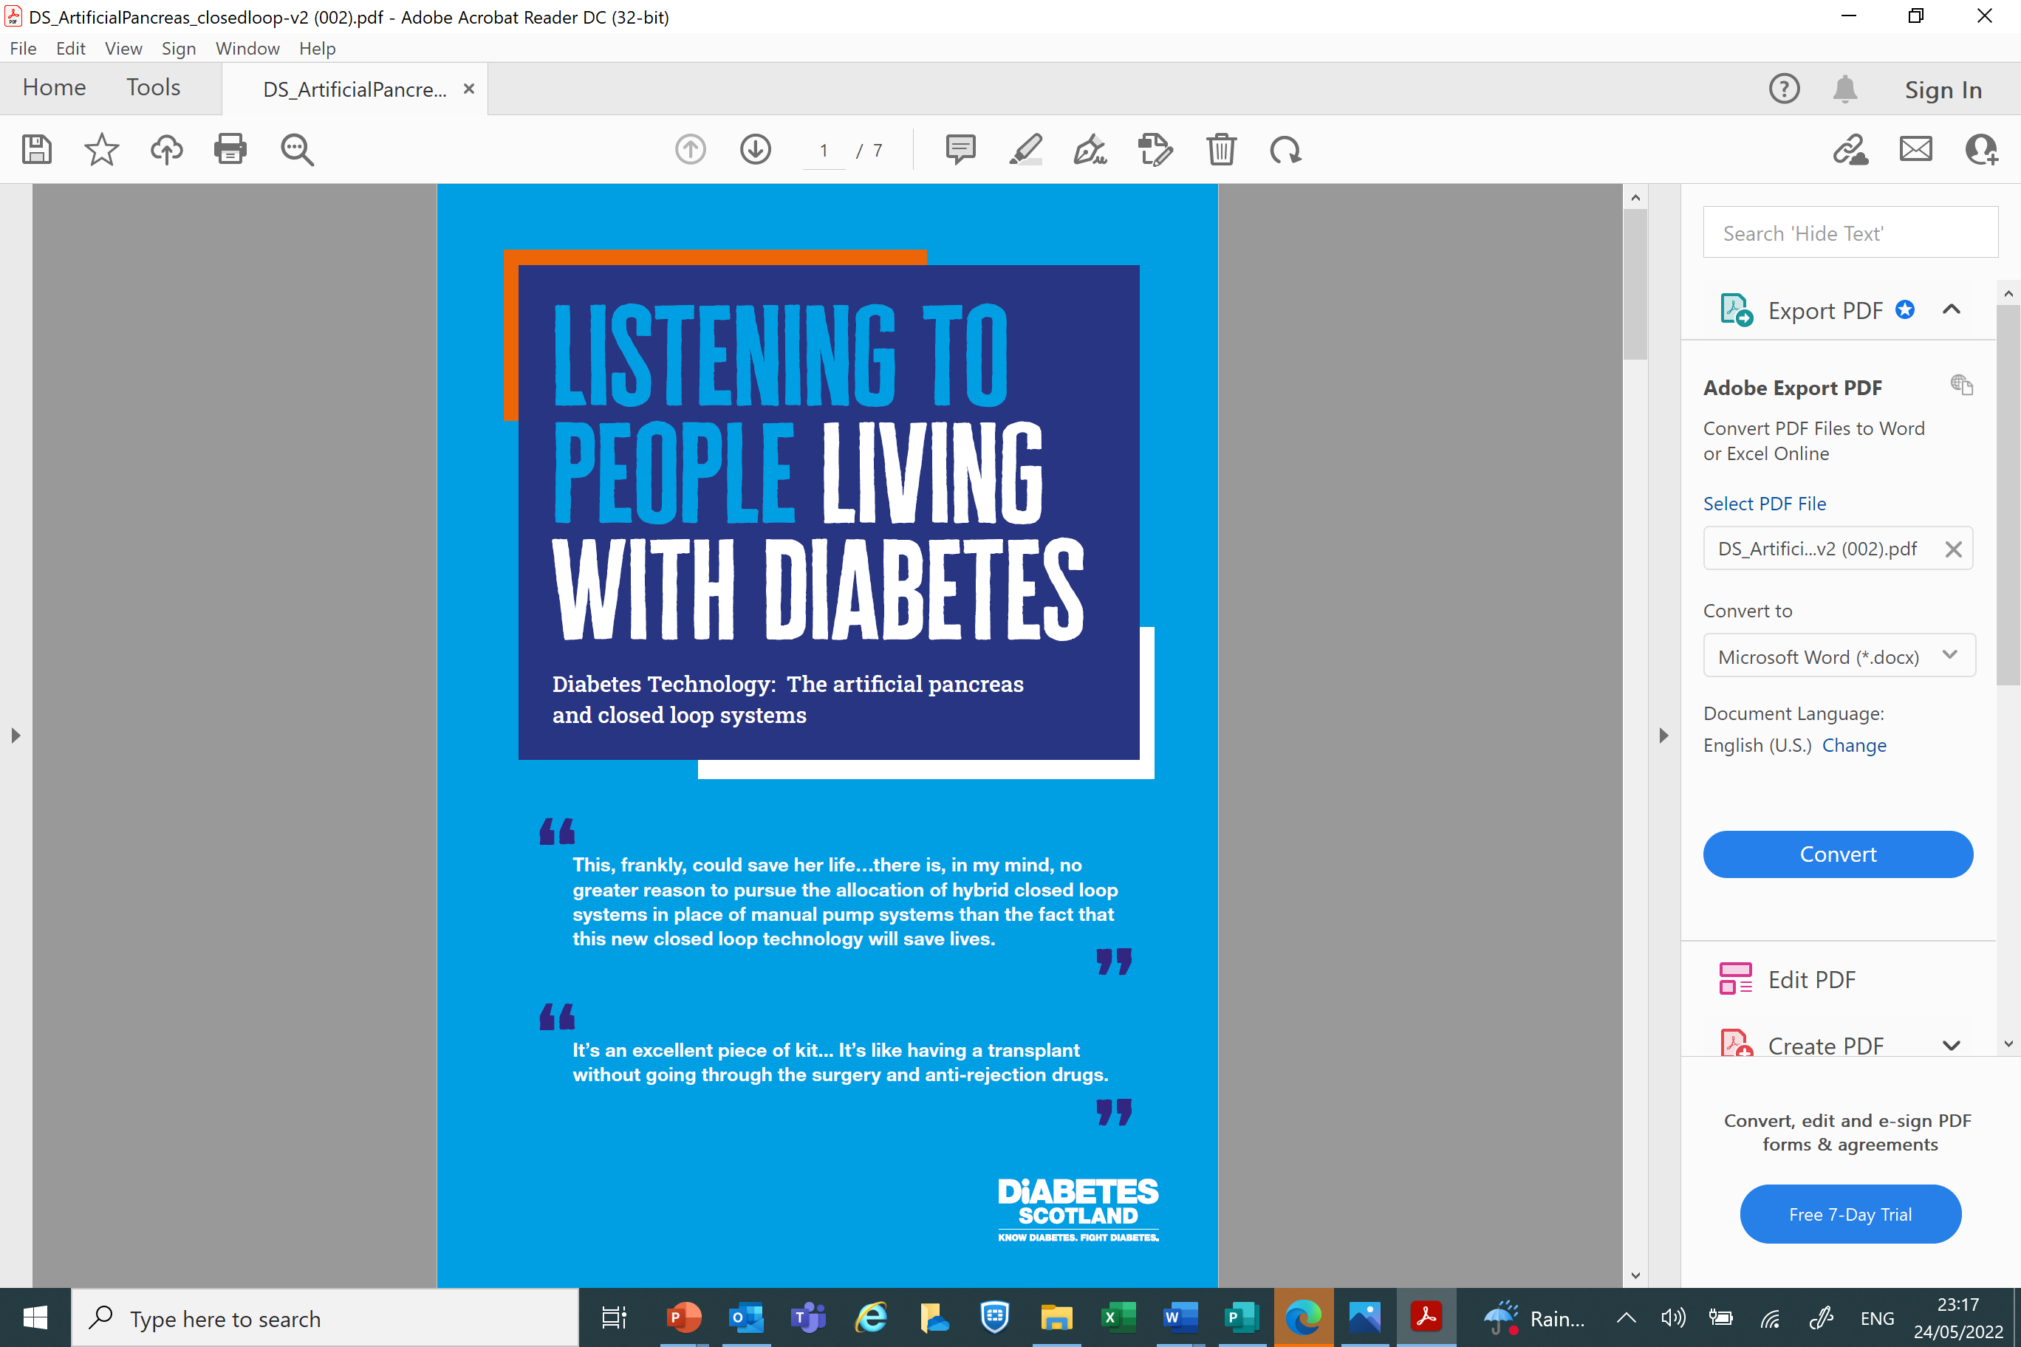
22

Slide 23
Diabetes is relentless
Up to 180 extra health-related decisions per day
2-3 hours a year with HCP
8757 hours self-managing
Fear of short-term complications
Fear of long-term complications
Wish: A good night’s sleep for all
“It is difficult to explain just how unreliable blood glucose (BG) numbers can be despite our best efforts… stress, periods, exercise, food choices, infections, weather temperature all influence them…. often BG numbers change overnight for no discernible reason.”
23

Slide 24
Technology helps
“It took almost three years to get a pump. It wasn’t the one I wanted but I was told the other one was too expensive. My ‘cheaper’ pump has had to be replaced three times in 15 months and it’s not compatible with the closed loop systems others have.
At times I felt as though I should hand the technology back because I was costing the NHS too much.
Getting access to tech should be a medical decision not a financial one – do they tell cancer patients treatment is too expensive?”
But access is far from equal
1 in 5 had difficulty
Nearly 50% of people who tried to access tech were refused in last 10 years
#WeAreNotWaiting
84% (UK) said technology helped self-management during pandemic
Widening inequalities
24

Slide 25
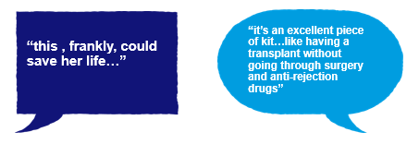

It’s not just a numbers game!
25

Slide 26
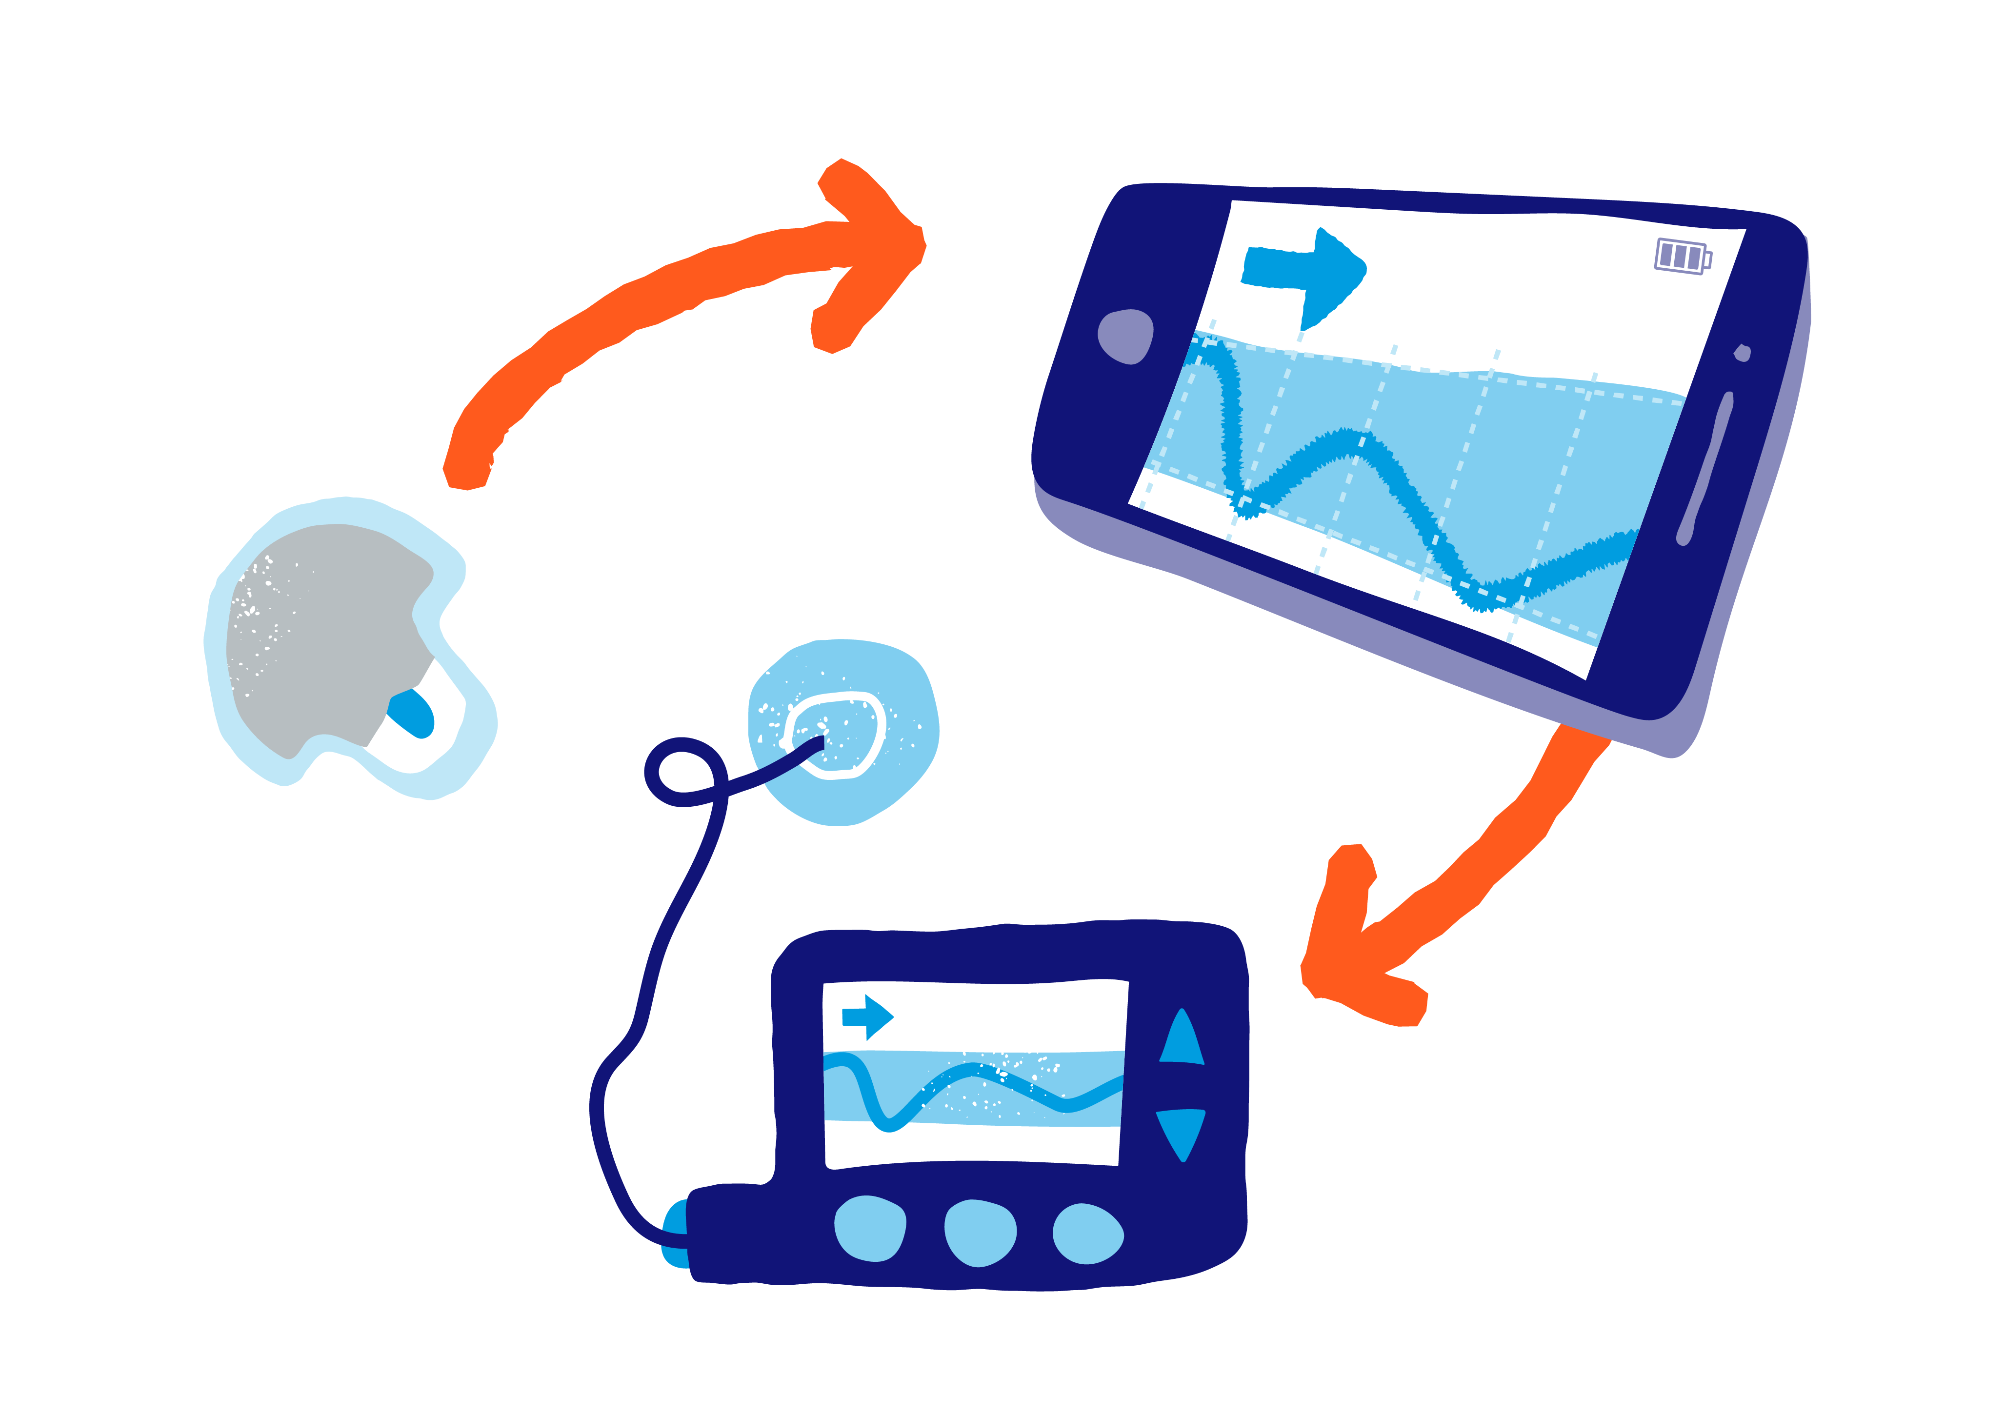
Joining the dots…
Working together really does work!
Working together really does work!
Diabetes Improvement Plan
Scottish Health Technology Group
Funding for tech
#Tech Collective
26

Slide 27
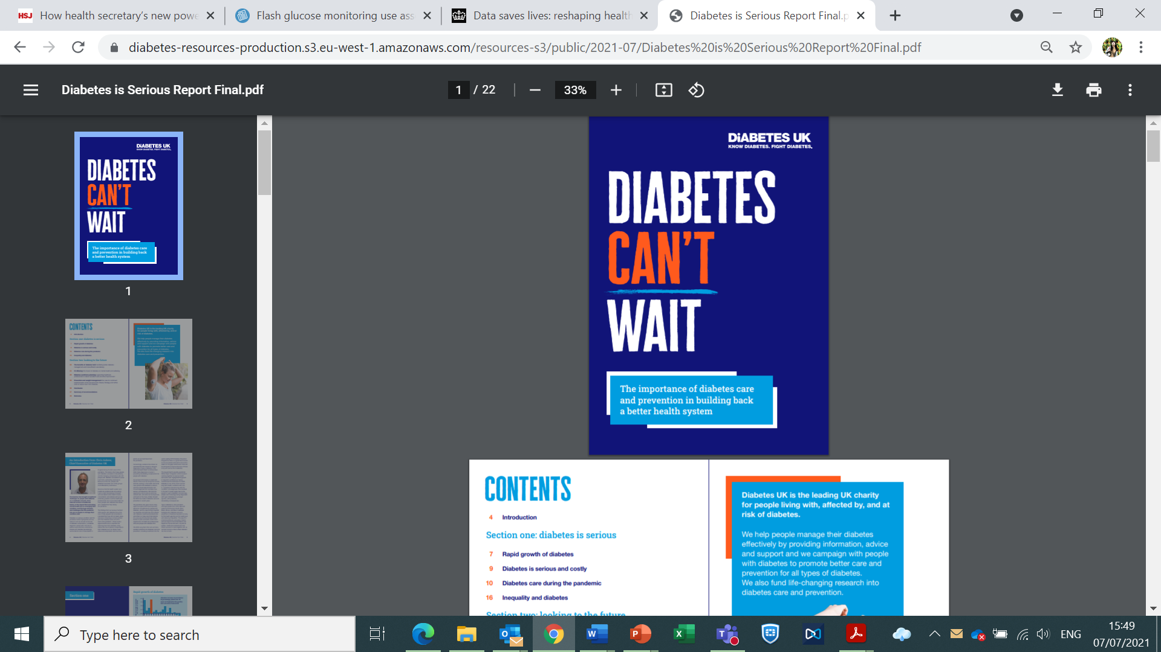
#DiabetesisSerious
27

Slide 28

Research Underpinning
Type 1 Diabetes Care
Dr Anna Barnett
NHS Research Scotland
Diabetes Network Manager
28

Slide 29
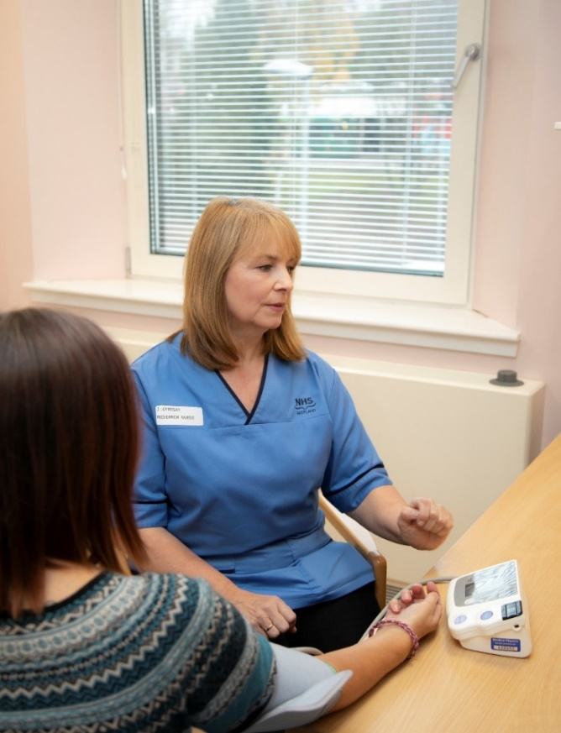
Planning Research:
Is a proposed study possible in Scotland?
Who are the people we must involve as participants?
Where are the potential participants?
Which sites could help with recruitment and retention?
29

Slide 30
Planning Research:
Type 1 Diabetes patients
BMI>27 increased risk of cardiovascular complications
Answer:
Number with BMI >= 27: 15668 of 35027 (ORANGE + YELLOW)
Of these 1369 have BMI >= and increased risk of CV complications (ORANGE)
Where located?
238 in GGC, 213 in Grampian, 200 in Lanarkshire, 163 in Lothian, 136 in A&A etc
30

Slide 31

Whole system working:
Connecting NHS teams to research opportunities
NIHR or NHS Research Scotland central feasibility
R&D Departments
Individual or company organising research
Research Network
Research teams who may have an interest
INNOVATION
(SDTIG)
31

Slide 32

Connecting to patients:
“take part in research”
Permission to contact
Diabetes research registry
32

Slide 33
Features to support research are embedded in SCI Diabetes
Research staff can record research participation details
Appears in the prescribing timeline – research intervention visible
Diabetes research register fully integrated
Flexible query function
33

Slide 34
Research or Service Evaluation: Using data to evaluate clinical care changes
Retrospective analysis – how it looked before
Forward looking real world evaluation of a technology
Advantages:
Can assess quickly the impact of a newly deployed technology
No subjectivity, no delay in data
Routine data collection as part of clinical care can be used
34

Slide 35

Previous case study
Prospective assessment of the impact of introducing Flash Glucose Monitoring in a Type 1 Diabetes Clinic
Results supported the wider use of Flash Glucose Monitoring to improve outcomes in people with type 1 diabetes.
Benefits realized across a number of important domains including improved HbA1c, hypoglycaemia, and quality of life.
Dover AR, Stimson RH, Zammitt NN, Gibb FW. Flash Glucose Monitoring Improves Outcomes in a Type 1 Diabetes Clinic. J Diabetes Sci Technol. 2017;11(2):442-443. doi:10.1177/1932296816661560
35

Slide 36
Assessing the impact of closed loop technology:
Preparation for real world data analysis
Adding data fields to SCI Diabetes to support collection of routine data
Building a “Research ready” system
Linking to researchers/evaluators to ensure data fit for their purpose
Future proofing
36

Slide 37

Advancing the evidence base for new technologies and devices
Case study: CE mark study benchtop device
Study April-May 2022
CE mark awarded end of May 2022
37

Slide 38
COVID recovery and research
More use of real world data for research
Remote monitoring devices and Patient reporting tools
Fewer at site research visits
Workforce remote working enabled
38

Slide 39
Ongoing research:
Impact of long COVID in diabetes
Patient facing survey (Scotland wide)
Nested CRF visits to evaluate biomarkers and physical tests
39

Slide 40
Funded by the CSO as part of the NHS Board allocation.
The Diabetes Network is hosted and administered via The University of Dundee and works across Scotland.
Clinical Lead: Prof Rory McCrimmon
Network Manager: Anna Barnett
Thank you to the entire research community - NHS staff, health and social care professionals, and members of the public - for their incredible contribution to research in Scotland.
40

Slide 41

Role of Procurement in the
Multi-Disciplinary
Healthcare Team
Kenny Rees
Medical Equipment Category Manager
NHSS NSS National Procurement
41

Slide 42
Stirling - October 2016
"If everyone is moving forward together, then success takes care of itself." - Henry Ford
42

Slide 43

The Role of Procurement?
Transactional – Are you the person that places the order for this purchase I have agreed?
To be avoided – they stop you getting what you want or make you buy cheap rubbish! If you see them coming – RUN AWAY!
NHS – do we collaborate effectively? Why are we so different from every other “industry”, even private healthcare organisations?
Aggregation – one size doesn’t fit all! We’re different from them!
43

Slide 44
Actual Role of Procurement
Lead on Procurement matters in collaboration with other teams
Release clinical and other teams to concentrate on their job roles
Take care of supply and regulatory issues
Attract new suppliers to NHSS – Horizon Scan
44

Slide 45
2016 - 2022
Clinical teams connected / Support services not so!
Tendered the framework agreement in 2017 – as one team
Researched market and Tandem launched T-Slim in NHSS
Scottish Diabetes Technology & Innovation Group
“Bulk Deals”
45

Slide 46
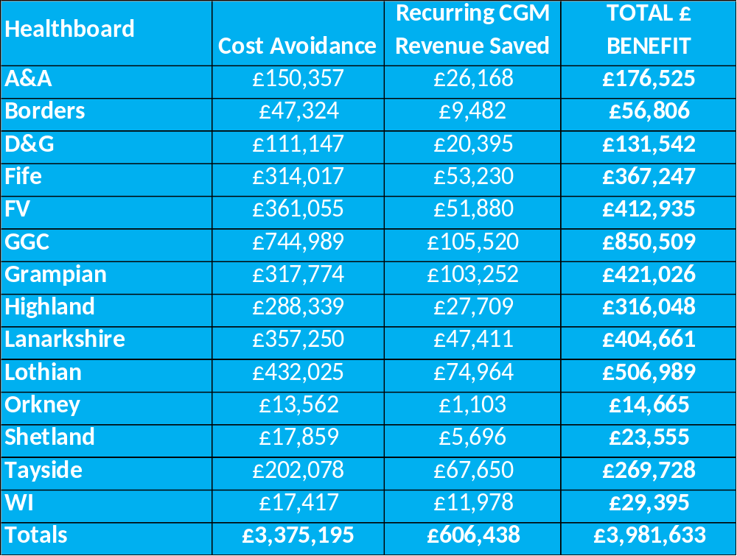
National Bulk Purchasing
Scottish Government funding support to access > tech
2021/22 - £5M and 2022/23 - £14.64M

Slide 47
Whole System Approach - Internal
National Groups – SDG, MCN & SDTIG – Policy, Strategy and Communications
Links to other relevant National Groups, Organisations & Key Supplier Leaders
Multi-Disciplinary Health Board Teams
Shared Learnings, Consistent Approach and act as “One-NHSS”
47

Slide 48
Whole System Approach - External
SDTIG – Presenting Diabetes care in Scotland as an integrated system
Gain Share (Win – Win)
Purchasing Power – no divide and conquer in NHSS!
Attractive proposition for suppliers – 1st in?!
48

Slide 49
Thanks for listening!
49

Slide 50


Finance
Alan Morrison –
Deputy Director of Health Infrastructure and Investment
Health Finance and Infrastructure Team
50

Slide 51
Finance
Engagement – speak regularly to your finance contact
Evidence – demonstrate that your idea will work
Be Prepared – be ready just in case funding become available at short notice
Be Persistent – don’t be discouraged if your idea is not immediately supported
51

Slide 52

Improving Type 1 Diabetes Care
It’s a Team Sport
Concluding remarks​
Brian Kennon, Consultant Diabetologist, NHSGGC
National Lead for Diabetes
52

Slide 53
Whole system…..
NSS Procurement
Innovation Teams
Scottish Diabetes Group
SCI-Diabetes
HIS
CfSD: ANIA
Person with Diabetes
SG Finance
Research Community
SHTG
Diabetes MCN Network
Families & Carers
Industry Partners
Healthboards
Clinical Community
Third Sector
53

Slide 54
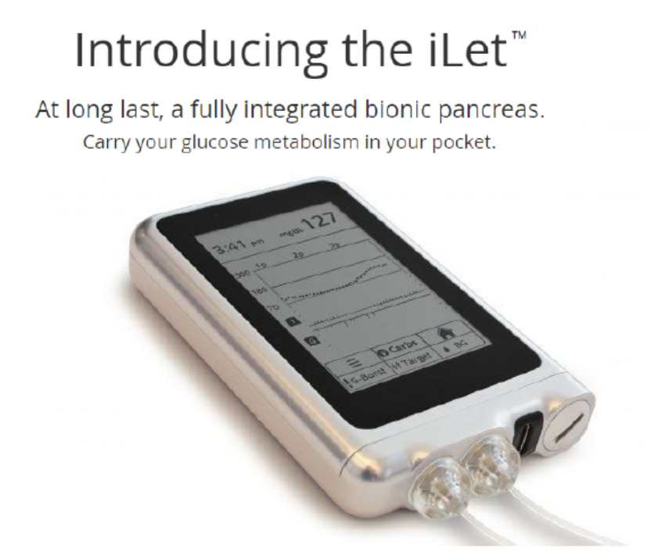
Futureproof …..
Device agnostic
Emerging technology
Standardised approach
Equity of Access
Evaluation
Reassess
54

Slide 55





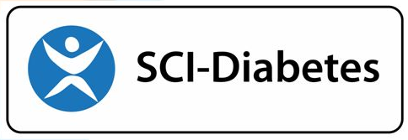

Acknowledgements
Entire Scottish Diabetes Community
55

Slide 56
Concluding
Slido Question
In one or 2 words..
What do you now feel about whole system approaches within NHS Scotland (now!)?
Improving Type 1 Diabetes Care: It’s a Team Sport!
56

Slide 57

Audience Response
57

Slide 58

Panel Discussion

Slide 59
Improving Type 1 Diabetes Care
It’s a Team Sport! ​
Thank You
59

