Slide 1


Artificial intelligence and Machine Learning in Ambulance Control Centres

Slide 2
SPEAKERS
Angela Harkness – Chair
Paul Gowens
Shaun Marshall

Slide 4
“
The greater our knowledge increases the more our ignorance unfolds
John F Kennedy

Slide 5


Slide 6
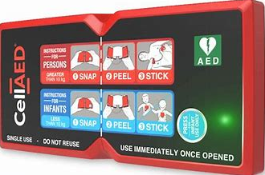
Evolution of Innovation
1947
1970
2022

Slide 7


Slide 8
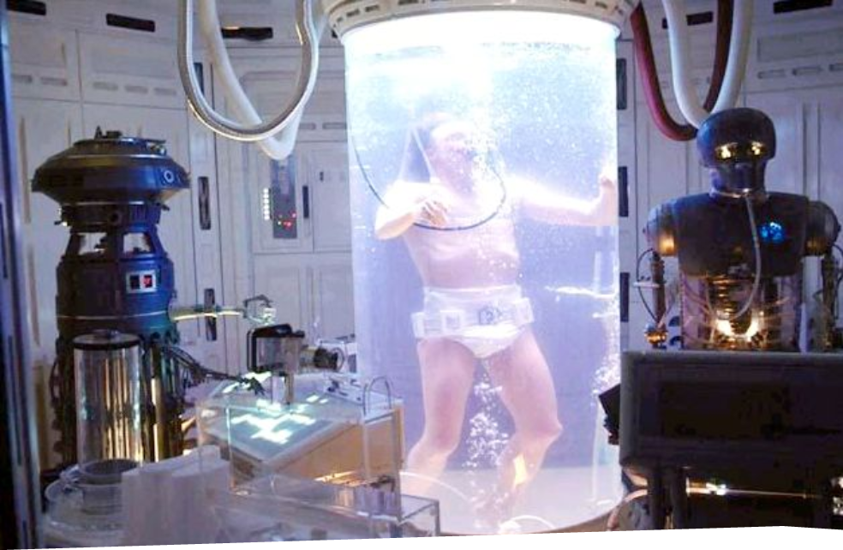

Slide 9


Slide 10
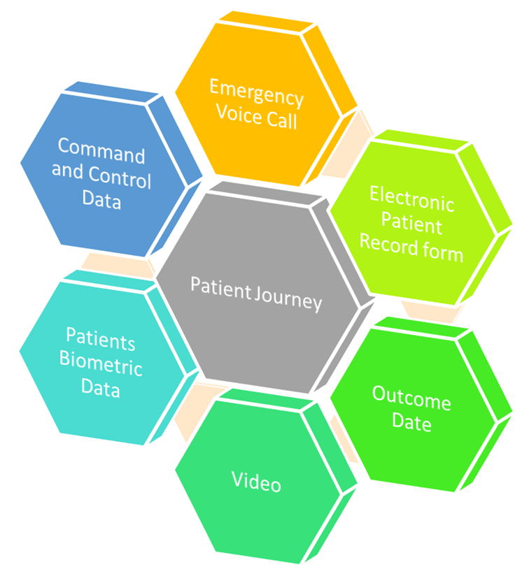
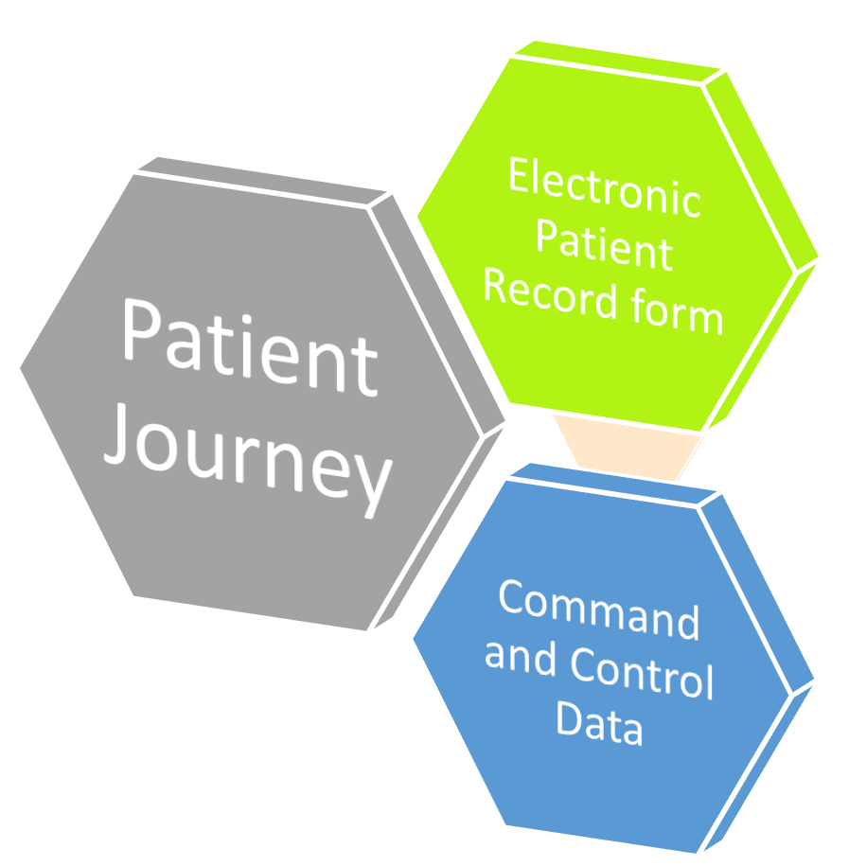

Slide 11
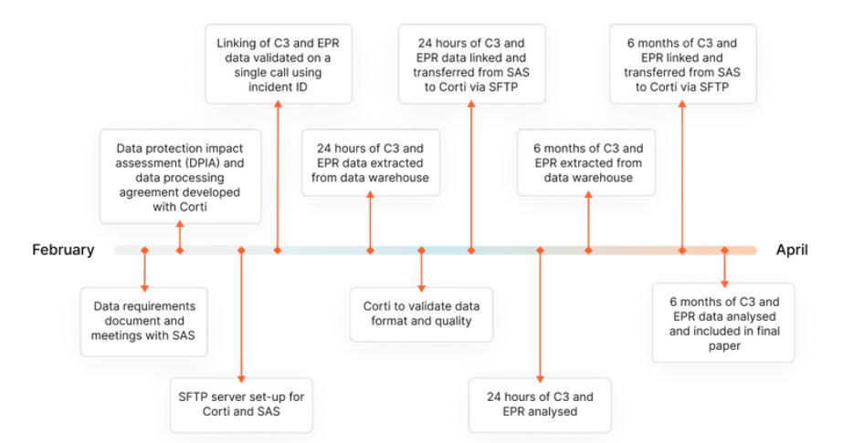

Slide 12
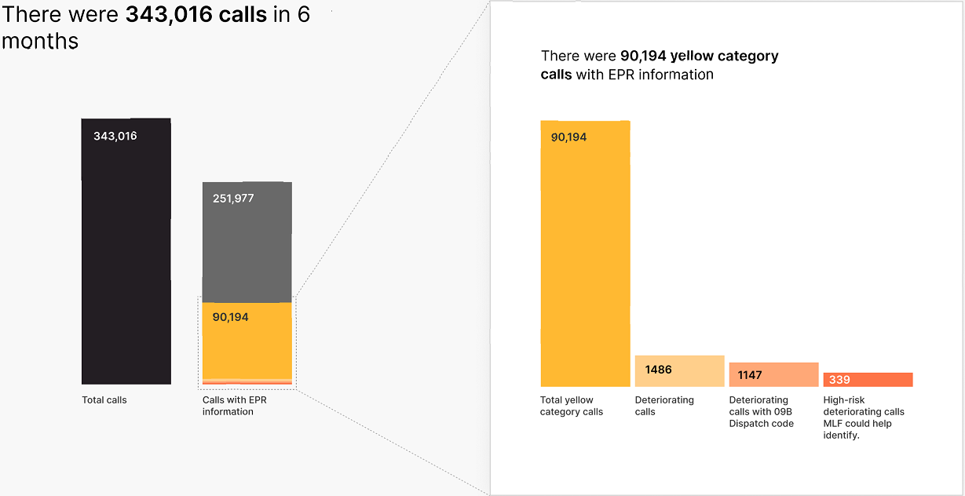

Slide 13






Remote Patient
Monitoring
High Priority
Triage and pre-hospital care provided
Patient transported to hospital
Hospitalisation
Patient
Ambulance Control
Centre
Community First Responder
Ambulance Control
Centre
Screen for remote monitoring enrollment criteria
Visit patient home and setup Current Health
Monitor patient health data in Current Health’s clinical dashboard
Prioritise paramedic care using real-time data
Patient monitored at home
Low Priority
Patient triage
Hospitalisation
Confidential and Proprietary © 2022 Current Health

Slide 14
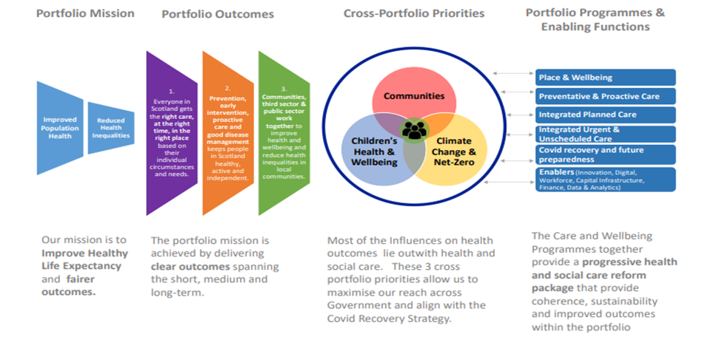

Slide 15
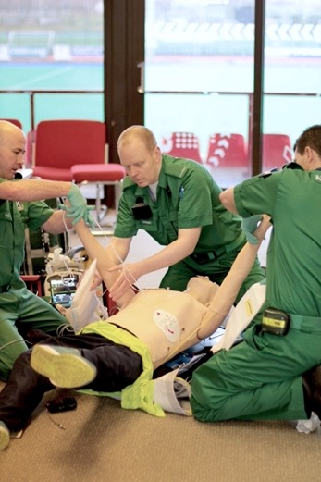
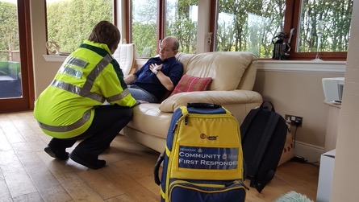

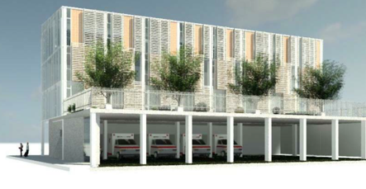
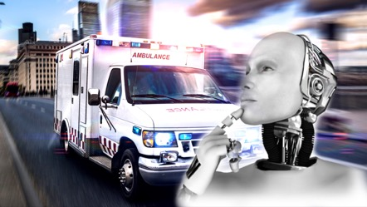

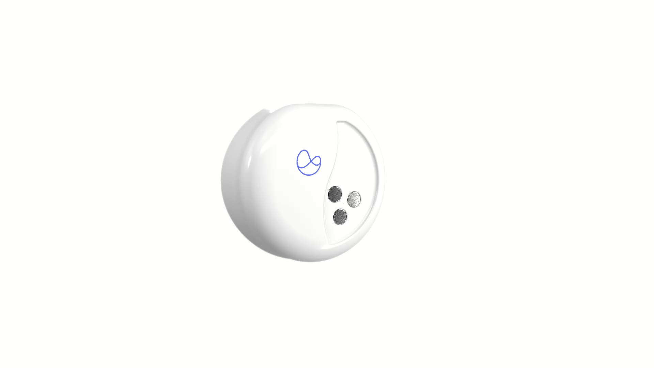
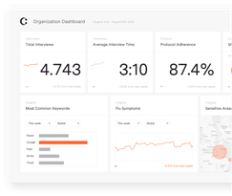





Innovation into Transformation
Notes:
Therefore I have directed our involvement in a number of new key innovations, and governance has been vital understanding that while risks need to be taken it needs to be within a structured and strong governance environment, good governance enables that not hinders innovation, we have M O U and N D As in place for all the current projects that’s to support from on of the team members EMMA. Using new links and joining with business partners such as Scottish Enterprise, CORTI and Current health has been possible by leaning into the business contacts in the team through Angela out strategic business advisor, in a well governed way, with a way out .

Slide 16

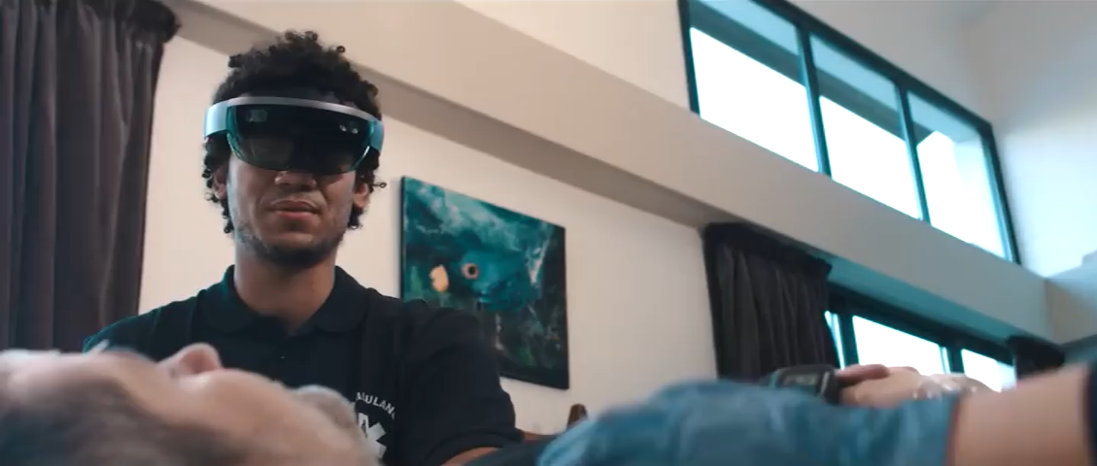

Slide 17
“
We do these things, not because they are easy, but because they are hard, because that goal will serve to organize and measure the best of our energies and skills, because that challenge is one that we are willing to accept, one we are unwilling to postpone
John F Kennedy

Slide 18
F. Byrsell, A. Claesson, M. Ringh, L. Svensson, M. Jonsson, P. Nordberg, S. Forsberg, J. Hollenberg, and A. Nord. Machine learning can support dispatchers to better and faster recognize out-of-hospital cardiac arrest during emergency calls: A retrospective study, 2021.
Scottish Ambulance Service. Scottish Ambulance Service Annual Report and Accounts for year ended 31 March 2020. Retrieved from; https://www.scottishambulance.com/media/lbodg32k/2020-07-27-signed-annual-report-and-accounts-2019-20.pdf
Scottish Ambulance Service. Scottish Ambulance Service. Unscheduled Care Operational Statistics. Experimental Statistics Publication, 16 March 2022. Retrieved from; https://www.scottishambulance.com/media/a2ceqsgx/2022-03-16-summary-report.pdf
Scottish Ambulance Service. Scottish Ambulance Service clinical model credited with saving 43% more lives. 2019. Retrieved from; https://scottishamb-newsroom.prgloo.com/news/scottish-ambulance-service-clinical-model-credited-with-saving-43-percent-more-lives
K. Stoddart, J. Cowie, T. Robertson, C. Bugge, J. Donaldson, and F. Andreis. The Scottish Ambulance Service. New Clinical Response Model Evaluation Report. University of Stirling. 2019. Retrieved from; https://dspace.stir.ac.uk/bitstream/1893/28955/2/University%20of%20Stirling%20-%20NCRM%20Evaluation%20Report.pdf
S. N. Blomberg, H. C. Christensen, F. K. Lippert et al. Effect of Machine Learning on Dispatcher Recognition of Out-of-Hospital Cardiac Arrest During Calls to Emergency Medical Services. A Randomized Clinical Trial. 2021, JAMA Network.
Driver First Assist. Every minute counts. The case for Automatic External Defibrillators to be included in a standard business first aid kit. 2020 Retrieved from; https://driverfirstassist.org/wp-content/uploads/2020/07/DFA_Every-minute-counts_Whitepaper_V3.pdf
Scottish Ambulance Service. Feedback, Comments, Concerns and Complaints Annual Report. 2019-2020. Retrieved from; https://www.scottishambulance.com/media/edvgp0e2/patient-experience-annual-report-2019-20.pdf

Slide 19


paul.gowens@nhs.scot
shaun.marshall@nhs.scot

