Slide 1
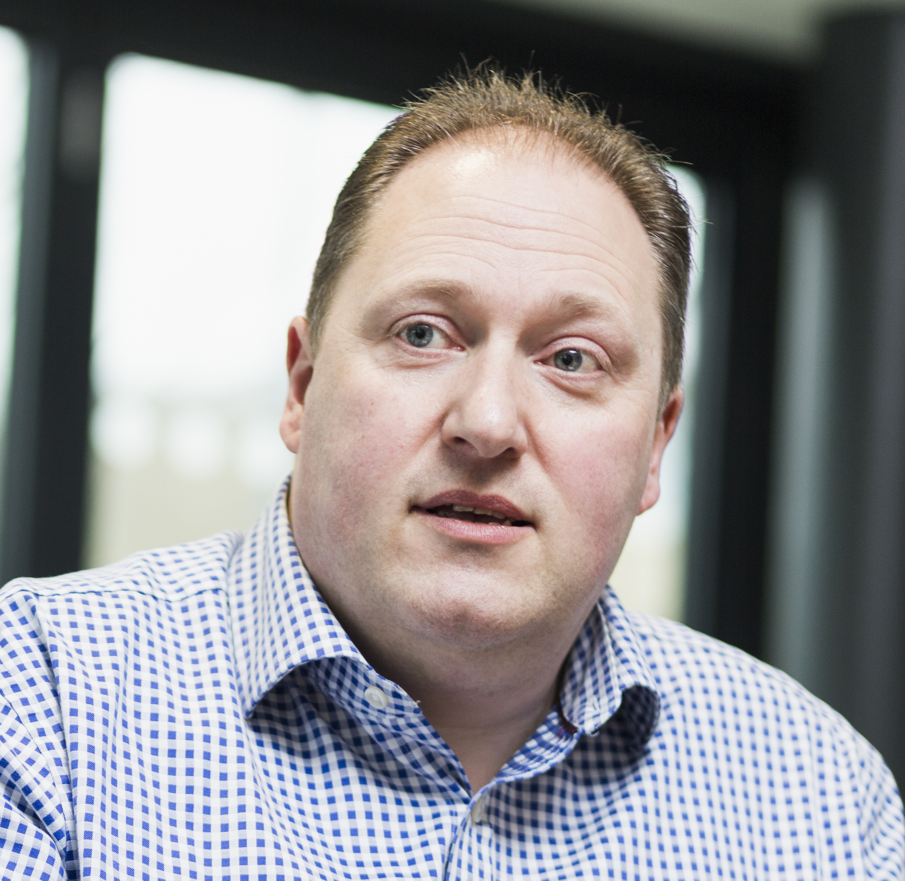


National AI Hub for Life Sciences, Health & Care
JD Blackwood
SHIP AI Lead
Scottish Health and Industry Partnership (SHIP) | ship@gov.scot

Slide 2
Why is an AI Hub needed
The use of AI is critical - the NHS cannot address demand through human effort alone
Adoption of AI is slow - we must accelerate delivery of all aspects of the ecosystem
We could move quickly if we had the infrastructure to deliver AI sustainably and at scale
Innovation is a complex and uncoordinated landscape - but we can focus and amplify what already exists
AI is a specialist field - we should plug the gaps in support for industry and the public sector
Scotland has a world-leading research sector - need to convert more research into commercial opportunity
AI in health and social care is a manageable proposition worthy of the cluster-based approach

Slide 3










What will the AI Hub do
Design health & care AI innovation and delivery architecture - once for Scotland
National pathfinder projects, using AI to deliver against clinical and economic priorities
Deploy and manage national AI infrastructure and platforms – democratising innovation
Help align health & care organisations and innovators and curate investable ideas
Streamlined access to data at scale, for AI delivery – integration with research & clinical data
Develop nationally-consistent AI standards, protocols and toolkits
National, full-lifecycle AI advisory, education and support service – amply existing services
Work with technology accelerators to build Scottish companies and attract inward investment
Work in partnership with existing organisations to amplify, not duplicate.
Support the development of a growing, well-funded Health & Care AI ecosystem for Scotland

Slide 4
How can the AI Hub help
Research
Research advice
Federated learning platform
Orchestration within international federated network
Access to data
Research partner matching
Demand matching
Funds matching
Regulate
Regulation advice
Near-clinical simulation platform
Access to data
Priority access to notified body
Sponsor matching
Investor and funds matching
Adopt
Procurement and adoption advice
Deployment platforms
Link to procurement pathway
Link to adoption pathway
Develop
Product and roadmap advice
Systems and clinical context advice
Near-clinical simulation platform
Access to data
Partner, investor and funds matching
Business support
Evaluate
Evaluation and trials advice
Evaluation platform
Access to curated benchmark data
Sponsor and site matching
Investor and funds matching
Scale
Post-implementation surveillance advice, monitoring and feedback
National scale-out orchestration
Link to export and growth pathways
Investor and funds matching

Slide 5
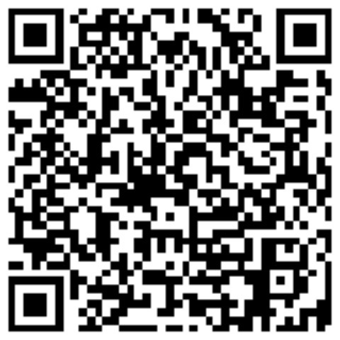
Thank you!
JD Blackwood
SHIP AI Lead
james.blackwood@ggc.scot.nhs.uk
linkedin.com/in/james-blackwood/

