Slide 1

Care When It Counts (CWIC)
Mental Health:
Rapid re-design of a direct access mental health pathway
Alastair Clubb, Primary Care Clinical Lead, East Lothian Health and Social Care Partnership, NHS Lothian
Melissa Goodbourn, Primary Care Service Manager, East Lothian Health and Social Care Partnership
Fiona Graham, CWIC Team Lead, Mental Health Occupational Therapist, East Lothian Health and Social Care
Dr Alyson McClure, General Practitioner, Tranent Medical Centre, East Lothian

Slide 2

Session Aims
Forward
Increased awareness of the process to rapidly redesign Primary Care Mental Health services
Improved understanding of opportunities and challenges to consider in developing a direct access Primary Care Mental Health service
Greater understanding of the complexities for HSCPs working with Primary Care independent contractors within a rapidly changing environment.
Notes:
Jo
Should we add in something about principles within the MOU?
Safe
Person-Centred
Equitable
Outcome focused
Effective
Sustainable
Affordability and value for money

Slide 3

Pre-Covid
Forward
Local Context
Geographic variability of access
Complicated criteria to access services (third sector and HSCP)
Lack of low-level community based and brief treatment interventions
Need for increased communication across primary care, secondary care, and third sector.
Notes:
Policy and Strategic Context
New GP Contract agreed with Scottish Government in 2018
Focus on a wider multi-disciplinary team offering Primary Care services
Mental Health Strategy 2017-2027
East Lothian IJB Strategic Plan 2019-22 and Primary Care Improvement Plan.
Should we add in something about principles within the MOU?
Safe
Person-Centred
Equitable
Outcome focused
Effective
Sustainable
Affordability and value for money

Slide 4



Developing services in a whole new world…
Forward
Changes to pace and ways of working, including greater risk of isolation
Escalation of demand and levels of distress
Higher risk of fatigue, burn-out and secondary trauma
Changes in systems, premises, teams and service protocols
Individual circumstances with loss or anticipated loss in relation to Covid.
Notes:
• the pace and changes to how we work, including greater risk of isolation
• escalation in both the demand and levels of distress of patients requiring support
• difficulties managing staff and co-worker absences
• higher potential risk of fatigue, burn-out and secondary trauma
• each individual’s own personal circumstances dealing with loss or anticipated loss in relation to COVID-19.
Increased risk for isolation
Limited access to current support systems and coping strategies
Increased responsibilities and stress for carers
Increased likelihood for trauma and abuse
Nearly 3 fold increase county-wide in Mental Health A&E related presentations
Domestic abuse reports up 33%
Anecdotal evidence - individuals presenting in distress to Contact Centre and local Connected Communities Resilience Bases
Establishment of Covid Assessment Centre
Planning for 40% staff absence
Additional risk of fatigue and burn-out
Reliance on video and phone conferencing – limited face-to-face

Slide 5
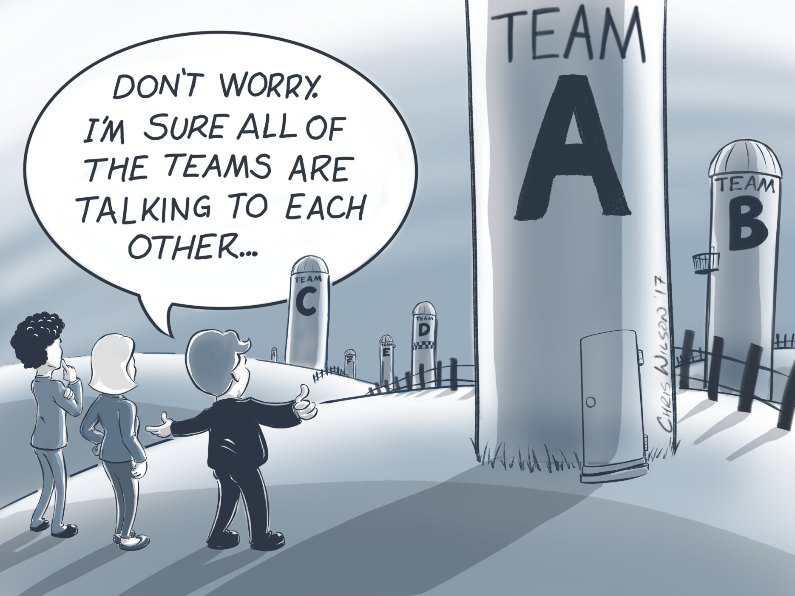
Rapid Redesign and Collaborative Working
Forward
Need to address silo working
Short-life implementation group with Primary and Secondary Care partners
Clear governance and decision-making
Informal and formal communication with GP partners
Notes:
Increasing pressure in Primary Care with estimated 30% of all Primary Care presentations in relation to Mental Health
Separate funding streams and governance leading to two distinct local models for Primary Care Mental Health
Should we add in something about principles within the MOU?
Safe
Person-Centred
Equitable
Outcome focused
Effective
Sustainable
Affordability and value for money

Slide 6
Rapid Review of Existing Service Models
Forward
Traditional, embedded model
CWIC Model
Co-location
Continuity in relationships
GPs highly value staff member
Timely access
Short-term brief interventions
AHP work reports and MED3
5% DNA rate
Benefits
______________
Challenges
18-28% DNA rate
High caseloads
Isolated staff
Creation of additional waiting lists
Prescribing needs
Demanding for staff
Notes:
Jo
Should we add in something about principles within the MOU?
Safe
Person-Centred
Equitable
Outcome focused
Effective
Sustainable
Affordability and value for money

Slide 7

Launch of the CWIC Mental Health service
Forward
30th March
Primary Care Centre turned Covid Hub
OTs and MHNs re-locate to ELCH
Initial Team meeting
28th April CWIC MH launches to West Cluster
OTs re-locate temporarily to GP Practice
Workaround system built in TRAK
Team Induction
5th May CWIC MH launches to East Cluster
Notes:
Jo
Should we add in something about principles within the MOU?
Safe
Person-Centred
Equitable
Outcome focused
Effective
Sustainable
Affordability and value for money

Slide 8
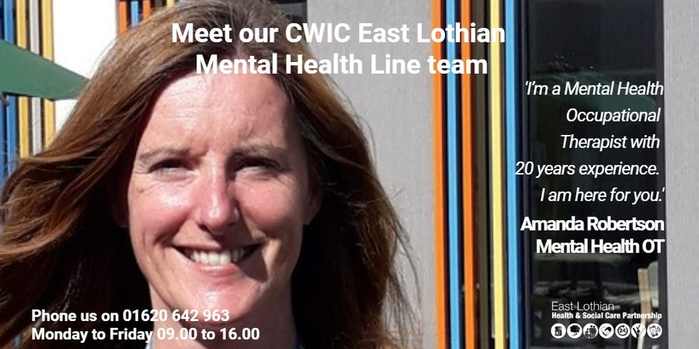
Launch of the CWIC Mental Health service
Forward
Notes:
Jo
Should we add in something about principles within the MOU?
Safe
Person-Centred
Equitable
Outcome focused
Effective
Sustainable
Affordability and value for money

Slide 9

Highlights
Forward
Over 4,000 contacts
91% of all contacts had no further referral to PTS, CMHT, IHTT or Psychiatry
37% reduction in GP referrals to PTS
Increase in number of individuals directly accessing service – in 2021 33% of all appointments
Increase in demand from January to March by 67%.

Slide 10
Quality Improvement and Evaluation
Forward
Staff development sessions
GP Survey
Patient Survey
Collaborative QI Work with GPs
Clinical Time and Appointment Audit
Service Activity analysis
Trial and Error

Slide 11

Service Overview
Forward
Direct, easy-to-access pathway to specialist service. Single point of contact
Appointment available within 36 hours
Access to right professional at the right time. Reduce touchpoints to access other services
No wrong door – seamless patient pathway to access wider primary and secondary care services
Experienced team of Mental Health Nurses and Occupational Therapists
No caseloads.
Notes:
Jo
Should we add in something about principles within the MOU?
Safe
Person-Centred
Equitable
Outcome focused
Effective
Sustainable
Affordability and value for money

Slide 12
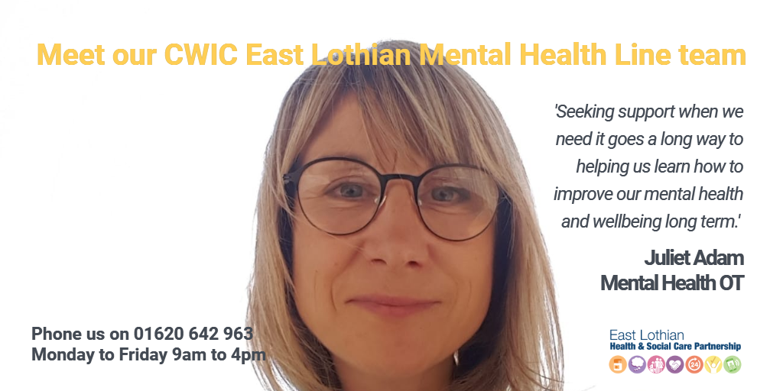

The Team - almost 200 years of mental health experience between us!
Forward
Dynamic, innovative and experienced
Culture of team values, staff development and leadership
Support and supervision central
Skilled in assessment and brief intervention approaches
Trauma informed practice.
Notes:
Jo
Should we add in something about principles within the MOU?
Safe
Person-Centred
Equitable
Outcome focused
Effective
Sustainable
Affordability and value for money

Slide 13
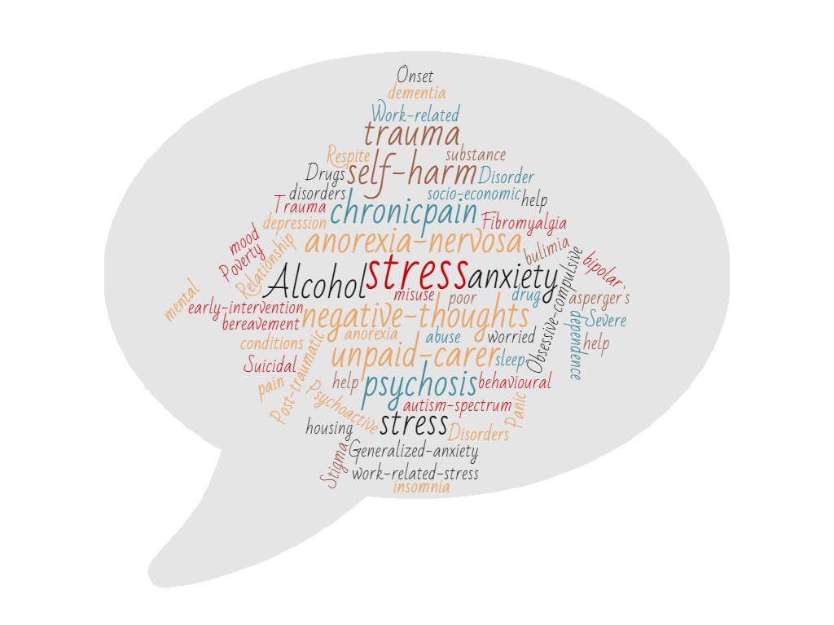

Why might people use the service?
Forward
Primary presenting issues:
Anxiety/panic
Low mood
Stress
Depression
Complex trauma
Work related stress.
Notes:
Jo
Should we add in something about principles within the MOU?
Safe
Person-Centred
Equitable
Outcome focused
Effective
Sustainable
Affordability and value for money

Slide 14
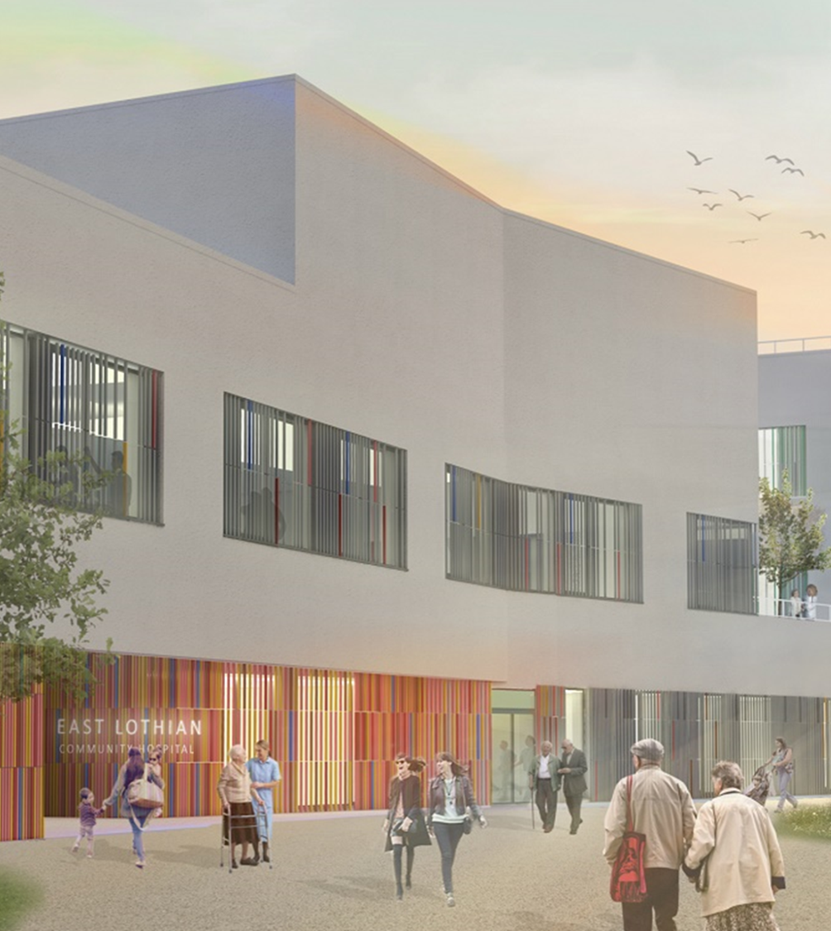
Assessment: Abridged Mental Health Assessment
Forward
Symptoms/mood
Risk – self and others
Previous medical and personal history
Social factors and stressors
Plan and outcome.

Slide 15

Intervention and Treatment
Forward
Self-management/solution-focused approaches
Psychologically informed approaches – CBT, Decider Skills
Safety and stabilisation – risk management plan
Psycho-educational work
Vocational support – AHP Health and Work Report
Referrals to other services including secondary care.

Slide 16





Impact of Pandemic
Mental wellbeing
Restrictions
Financial / housing / socioeconomic
Young people
Trauma

Slide 17
Case Study
Forward

Slide 18
The Patient Perspective
49 survey responses (84% female)
Relatively even distribution of age representation with slightly less representation of >66yr group
High satisfaction scores for ease of access and timing of initial contact (82% and 88% respectively)
Slightly less patient satisfaction relating to the information provided about the service (67%)
Feedback relating to practitioner skills mostly “excellent”.

Slide 19

Patient Perspective: Timely and Accessible
“That they put me in touch with a practitioner so quickly - the same day. And that the practitioner was able to give me the option of reconnecting with them again personally in a couple of weeks - it wasn't a one-off signposting service.”
“I live day to day with anxiety and mostly manage it but when it spirals out of control I know I need help fast and just being able to touch base with someone easily via this service today has been amazing and I know it’s accessible for any future need.”

Slide 20
Patient Perspective: Caring and Compassionate Approach
“The woman I spoke with saved me from entering one of the darkest holes I could ever imagined. I’m not 100% back to my usual self but I’m certainly on the right path… your care and compassion was second to none.”
“I felt not alone, great to be able to share my feelings and not think I am a nutcase, quick response was great, professional staff that are there to listen.”
“The staff member with whom I talked was caring and attentive and there was never a point at which I thought that I was taking up anyone's time or anything like that. The speed with which the process took place was also quite amazing and in itself helped to alleviate some of the concerns I had going into the process.

Slide 21
Areas for Improvement
Patient Identified:
Better Communication and awareness of service
Email or online chat contact option
Prescribing
Waiting for information to arrive by post.
Notes:
Areas for improvement by patient
Make people more aware that the line exists, I was only aware from my GP
It would be good if there was also a non-phone contact option e.g. email or online chat. I find phone calls very stressful and difficult especially when I don't know who will answer or how they will treat me. Something a little less direct (e.g. online text chat) would enable me to use this more easily without having to arrange support to help me.
I’m not sure if any medication help can be given if not it would help if this was available
Waiting for information to arrive by post taken 2 weeks. Having this information electronically and sending it via email would be a great benefit.
Need for better communication prior to service starting and the detail of how service works, and more information regarding pathways to secondary care services
Concerns regarding practical telephony capacity.
Query from one respondent regarding whether traditional access routes via GP aided greater patient compliance.
Concerns re: patients with long-term mental health needs, and ensuring long-term relational approaches
Ability for GP Practice staff to care navigate and potential risks of patient drop-off after being given the number. One respondent highlighted the view that without care navigation the service would not be in direct support of GPs.
Mixed views regarding prescribing
Actions:
Social Media Campaign and development of comms materials
Information can now be sent via email
Staff link in with third sector groups

Slide 22
GP Perspective: Positive points
Additional service to support patient mental health in a timely manner
Multidisciplinary working
Self referral by patients
Interface working, links with both GP and secondary care mental health services
Increased acceptance of population and practices for change in systems as coincided with Covid-19 lockdown.

Slide 23
GP Perspective: Key Highlights
Improving access to mental health care for patients
Useful professional-to-professional telephone contact point
Allows patients sufficient time to discuss MH issues
Potential reduction in GP workload e.g. self referral
Able to direct patients more appropriately to community resources.

Slide 24



Improving access
“Better access for patients to obtain help with their mental health. Helps in patient's taking initiative for their mental health.”
“Easy and quick access to initial assessment, patients feel engaged early and even if then added to waiting list for CBT/psychology they have been assessed promptly and given support”
“Same day access for patients, no need for GP to generate a referral as patients can self-refer, patients get timely appropriate mental health support/intervention/
signposting”
Notes:
The primary benefit identified by respondents was improving access and timeliness of mental health support for patients. In addition respondents highlighted the benefit of an additional resource for professionals.
Respondents wrote:
‘Easy and quick access to initial assessment, patients feel engaged early and even if then added to waiting list for CBT/psychology they have been assessed promptly and given support’
‘Same day access for patients, no need for GP to generate a referral as patients can self-refer, patients get timely appropriate mental health support/intervention/signposting’
‘Better access for patients to obtain help with their mental health. - Helps in patient's taking initiative for their mental health.’
‘Rapid access to appropriate help at a time when more people are struggling with mental health.’
‘Easy and straight forward to access. Very good idea. Much needed at this time. Useful to have’
‘one port of call for various problems and to have good signposting for patients.’

Slide 25



Support from Specialist Staff
“One stop shop for assessment and initiation of treatment, quick access, potential reduction in GP workload.
“The service provided appears individual and more time is spent with the patient than GP's have. Ensure patients get the time and care that they need on the day that they need it. Especially in these times.”
”
“Team of highly trained staff…Different approach of professionals. More time with a professional More emphasis on recovery/supported self-management for patients and less emphasis on medication.”
“Separate number for professionals to call to discuss a case if required.”

Slide 26
Areas for Improvement
GP Identified:
Better communication needed
Practical telephony capacity
Query from one respondent regarding whether traditional access routes via GP aided greater patient compliance.
How to ensure relational approaches
Meeting needs for people with long-term mental health needs
Care Navigation pathway – potential risks re: patient drop-off
Impact on GP workload?
Mixed views regarding prescribing.
Notes:
Areas for improvement by patient
Make people more aware that the line exists, I was only aware from my GP
It would be good if there was also a non-phone contact option e.g. email or online chat. I find phone calls very stressful and difficult especially when I don't know who will answer or how they will treat me. Something a little less direct (e.g. online text chat) would enable me to use this more easily without having to arrange support to help me.
I’m not sure if any medication help can be given if not it would help if this was available
Waiting for information to arrive by post taken 2 weeks. Having this information electronically and sending it via email would be a great benefit.
Need for better communication prior to service starting and the detail of how service works, and more information regarding pathways to secondary care services
Concerns regarding practical telephony capacity.
Query from one respondent regarding whether traditional access routes via GP aided greater patient compliance.
Concerns re: patients with long-term mental health needs, and ensuring long-term relational approaches
Ability for GP Practice staff to care navigate and potential risks of patient drop-off after being given the number. One respondent highlighted the view that without care navigation the service would not be in direct support of GPs.
Mixed views regarding prescribing
Actions:
Book in with same practitioner where possible
Improvements to telephone and business support capacity
Development of care navigation pathway for trialling
Upcoming QI project focused on prescribing
Clear escalation policy

Slide 27
Challenges
Opportunities
New service
Indemnity
Challenges traditional ways of working
Variability across practices
Working with multiple independent practitioners
Care navigation pathway
Workforce development
Prescribing
Young People ages 16-18
Closer working with GP Clusters.

Slide 28
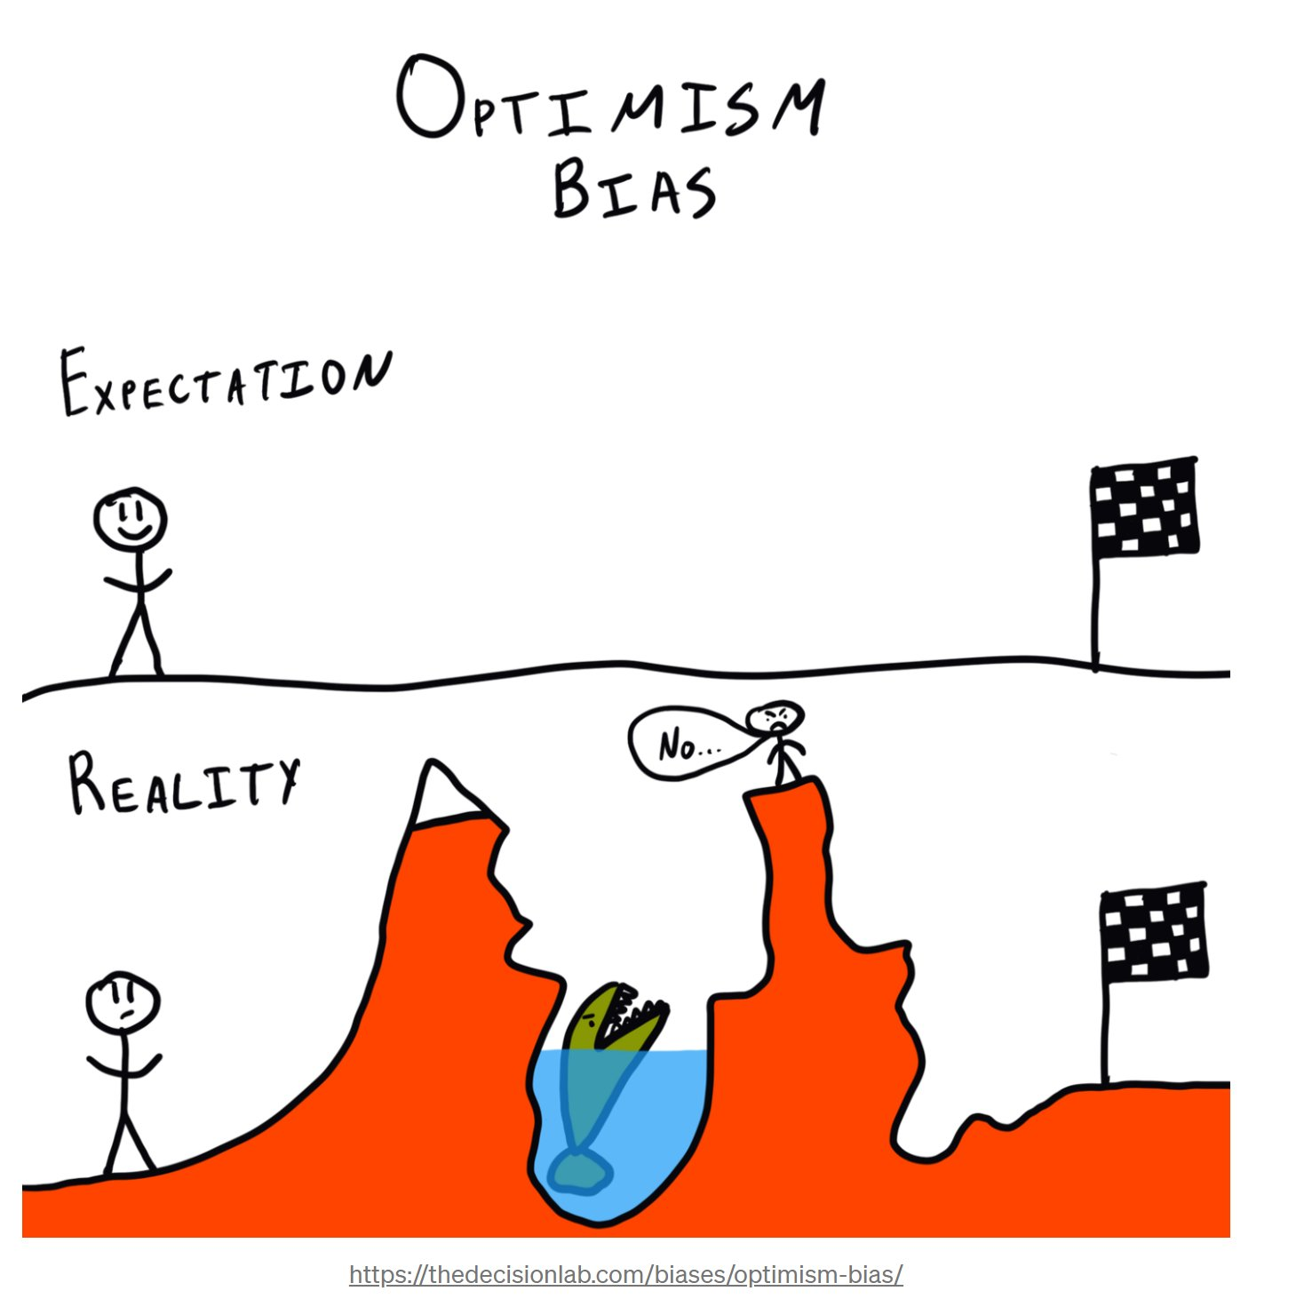
Reflections
Kindness and compassion at the core of service delivery – for staff and patients
Importance of critical friends and people who can help you take the balcony view
Always room for improvement
Engagement should be a priority but you will never have 100% buy-in
Staff need to be invested in service models and to lead the way in problem-solving

Slide 29

CWIC
Mental Health Service
“When things get a little overwhelming in life, it helps to direct you in a new positive path to get all the support and help you need to move on.”

Slide 30
References
Forward
2018 GMS Contract
(https://www.gov.scot/publications/gms-contract-scotland/)
Mental Health Strategy 2017-2027
(https://www.gov.scot/publications/mental-health-strategy-2017-2027/)
IJB Strategic Plan 2019-2022 (https://www.eastlothian.gov.uk/downloads/file/28278/east_lothian_ijb_strategic_plan_2019-22)
East Lothian HSCP Primary Care Improvement Plan
(https://www.eastlothian.gov.uk/downloads/download/13190/primary_care_improvement_plan)
Notes:
Jo
Should we add in something about principles within the MOU?
Safe
Person-Centred
Equitable
Outcome focused
Effective
Sustainable
Affordability and value for money

