Slide 1
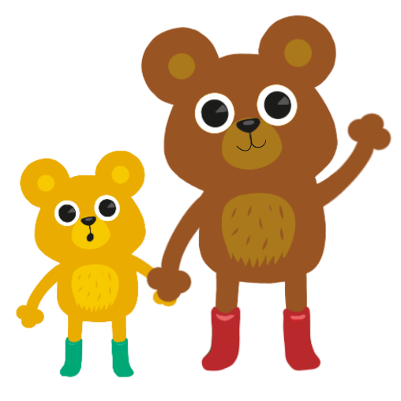
Charity Number: SC006016
The creation of an online, award-winning,
self-management service for children and
young people with long-term health conditions.
Presented by
Gill Sutherland
Head, Children’s Health and Wellbeing Services
Beth Davidson
Coordinator, Children’s Health and Wellbeing Services

Slide 2

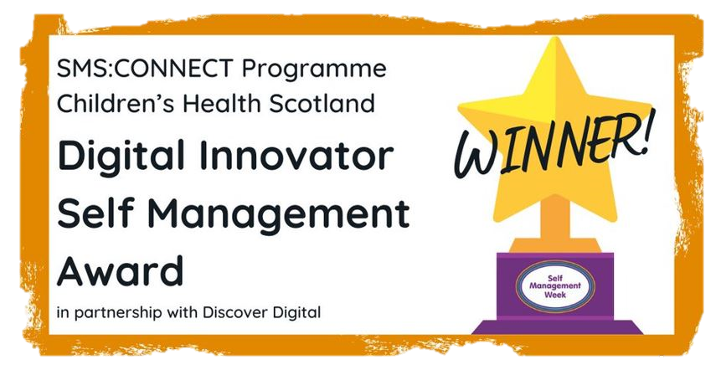
We are the leading Scottish children’s healthcare charity.
The health and wellbeing of children and young people lies at the heart of our work.
We are the only charity dedicated to informing, promoting, and campaigning on behalf of the needs and rights of all children and young people with health conditions.
We deliver award-winning Self-Management Services (SMS) Programmes for children and young people ages 9-17, who are living with a health condition in Scotland.

Slide 3
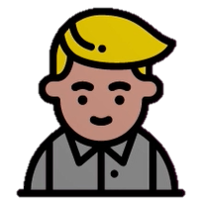
“I loved the variety of games. The relaxations were really nice to unwind at the end of the day and I will be using some of the things again. I found the digital story really helpful to help myself and others understand my condition.”
You can join in from anywhere in Scotland.
No diagnosis is required.
Everyone can login at the exact time it starts.
You can be comfortable in your own home, even in your PJs. We don’t mind.
You can turn your camera off and can still take part.
You can socialise and meet others facing similar challenges and going through similar experiences.

Slide 4


Slide 5
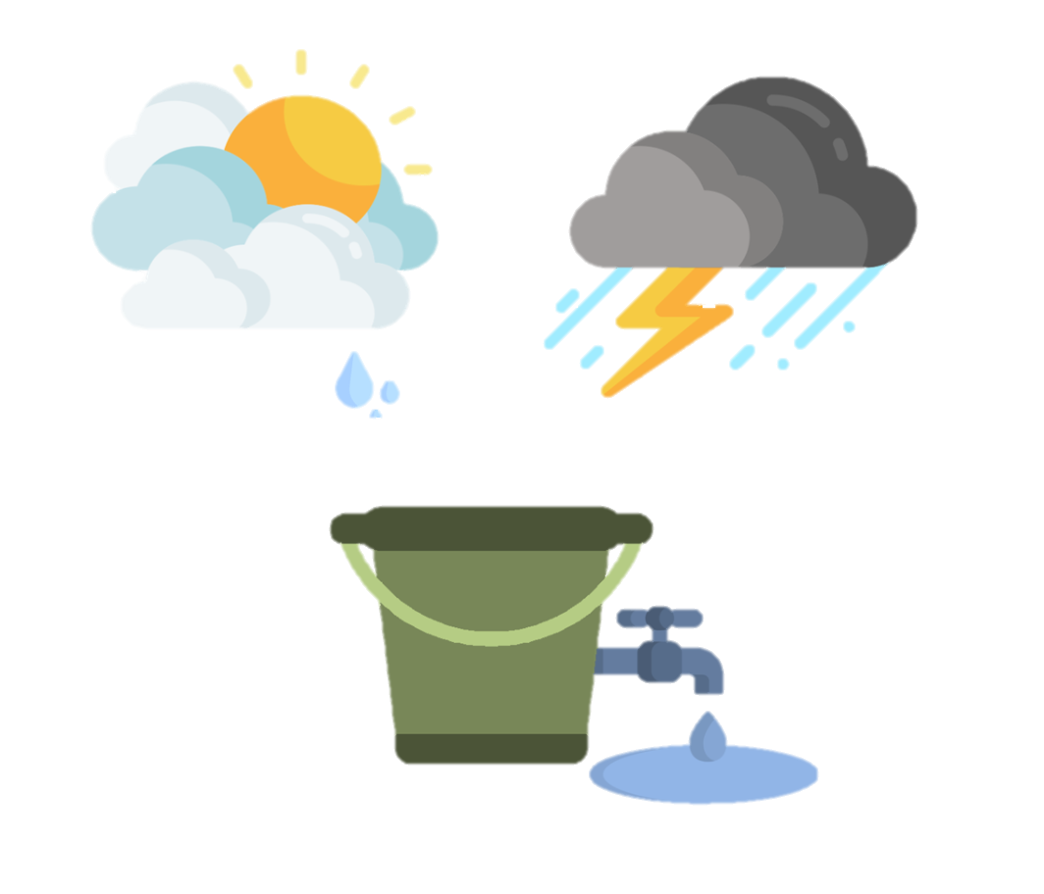
THE STRESS BUCKET ACTIVITY
Imagine we each have a bucket where we put all of our stress. Each stress or worry is like water, filling the bucket. Sometimes, we may feel able to cope with stress, whilst at other times it is really overwhelming.
If you are having a good day your bucket might feel quite empty. If something bad happens that day it might not fill up your bucket.
If you are having a bad day your bucket might feel quite full. If something else happens it could make your bucket overflow and that does not make you feel good.
It is really important that we try to keep our stress buckets from overflowing.

Slide 6
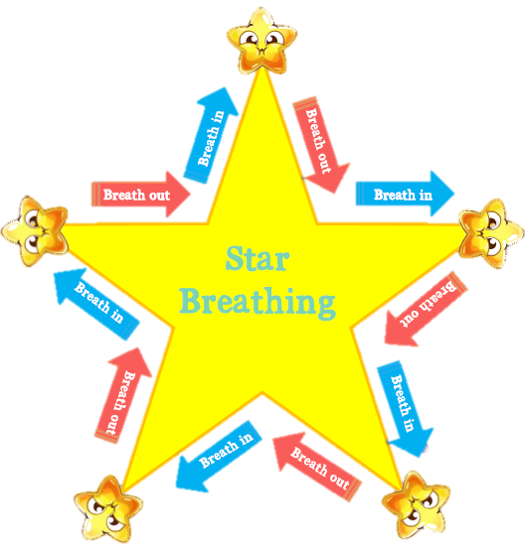

THE STAR BREATHING
TECHNIQUE
Just like a star has 5 points, you can use the 5 fingers on your hand to guide your breathing. Trace up and down each finger, breathing in through your nose and breathing out through your mouth.

Slide 7
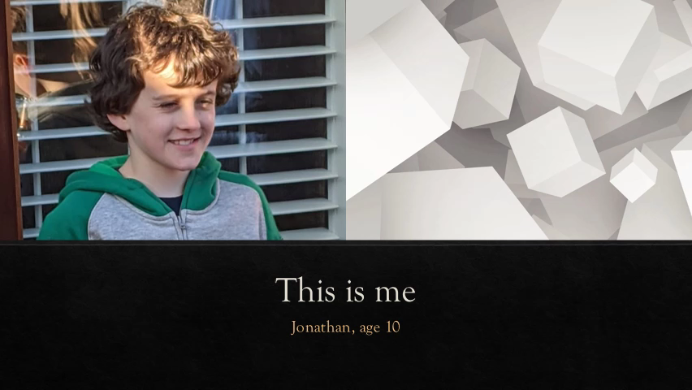

Slide 8
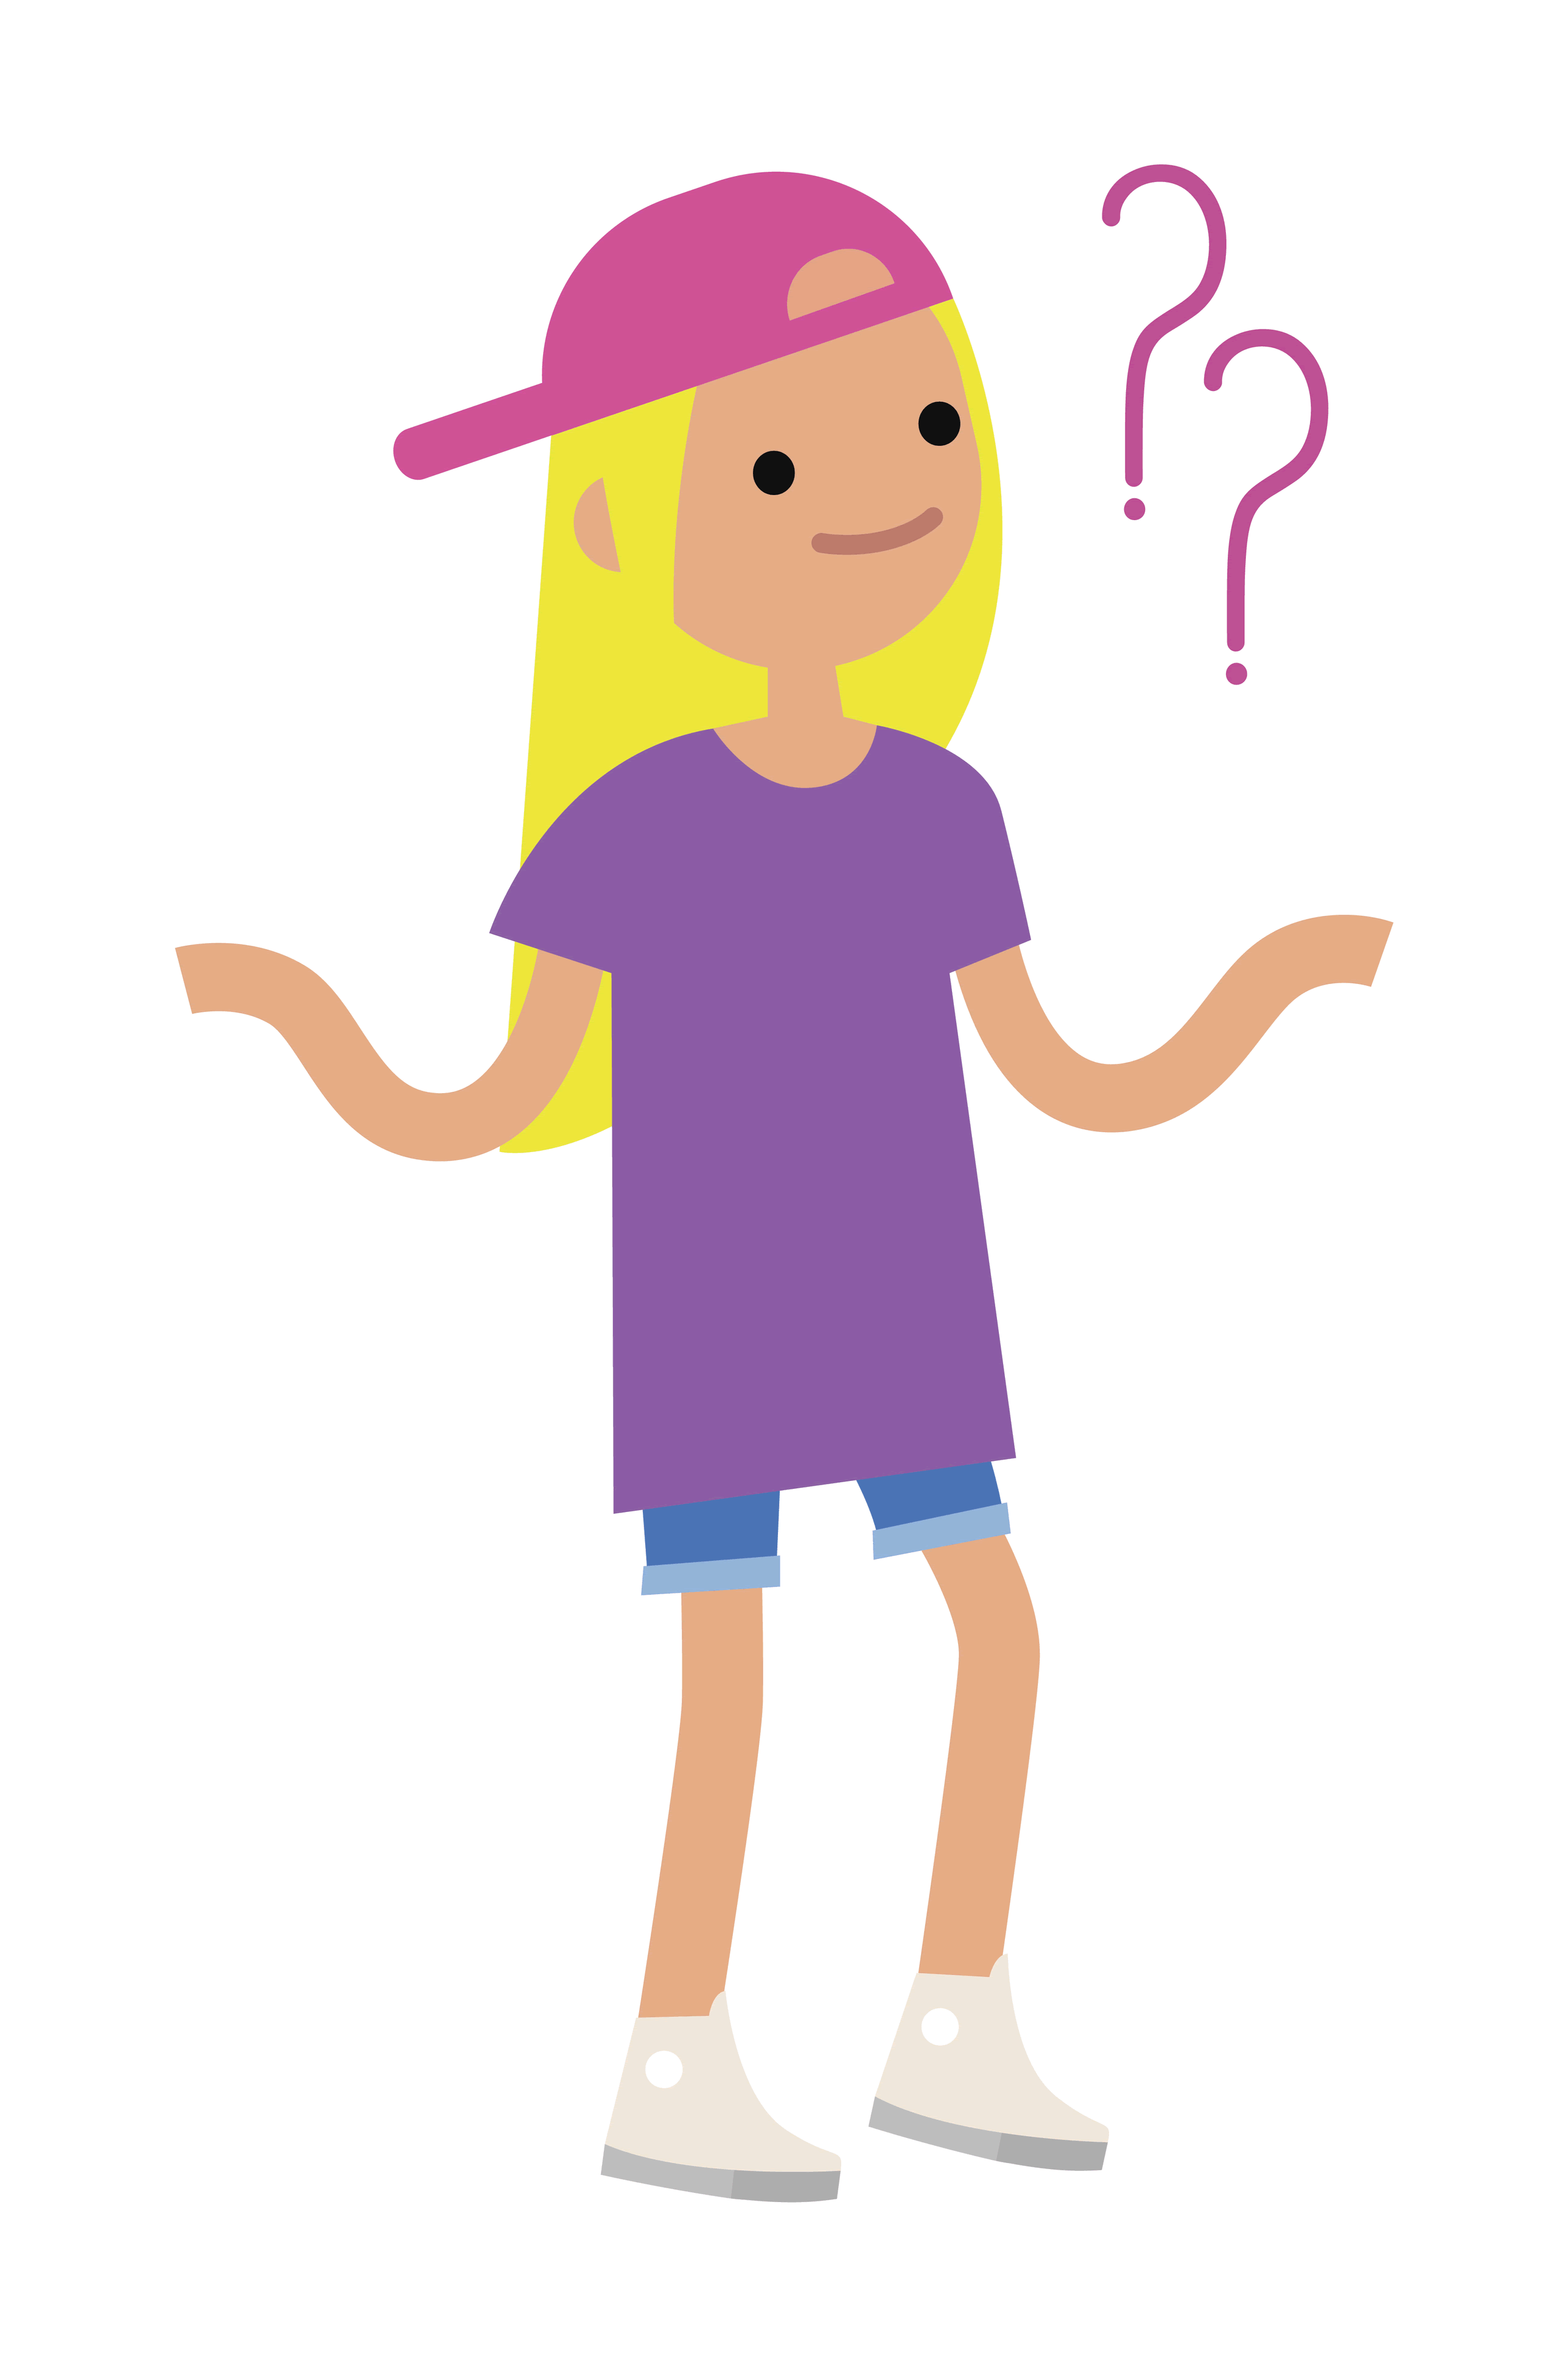
Do you have any questions about
SMS:CONNECT?
Please go to https://www.menti.com/1t7npn99z2

Slide 9
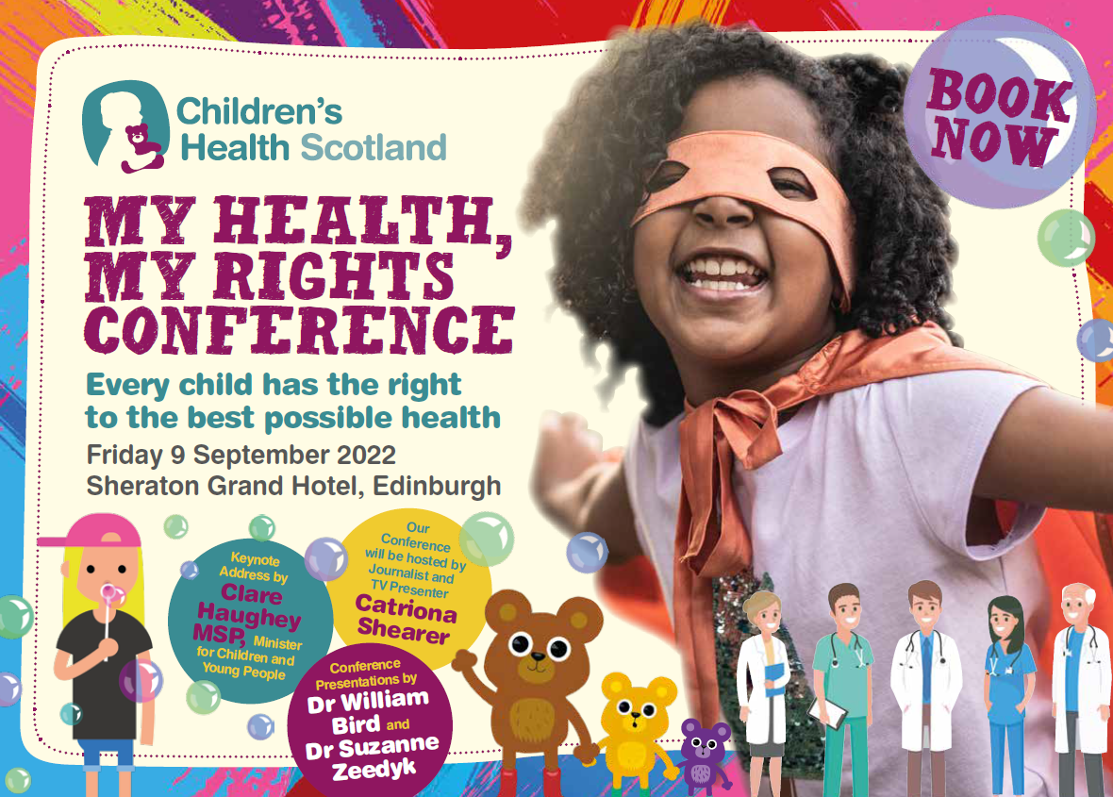






www.childrenshealthscotland.org
@ChildrensHealthScotland
@ChildHealthScot
gill.sutherland@childrenshealthscotland.org
beth.davidson@childrenshealthscotland.org
07483 230 078
07483 973 320

