Slide 1
How Teamwork Triumphed
Improvement through Collaboration
NHS Lothian and Edinburgh Health and Social Care Partnership

Slide 2


Discharge without Delay (DwD)
What is Discharge without Delay (DwD)?
The Discharge without Delay Programme is centred around preventing delay in all patient journeys and ensuring stays in hospital are only as long as is clinically and functionally necessary, using a pathways-based approach.
Aim
Reduce the rate of bed occupancy by Medicine of the Elderly patients from Edinburgh HSCP who had a delayed discharge on Wards 50 and 51 at the WGH by 50% by March 2023.

Slide 3
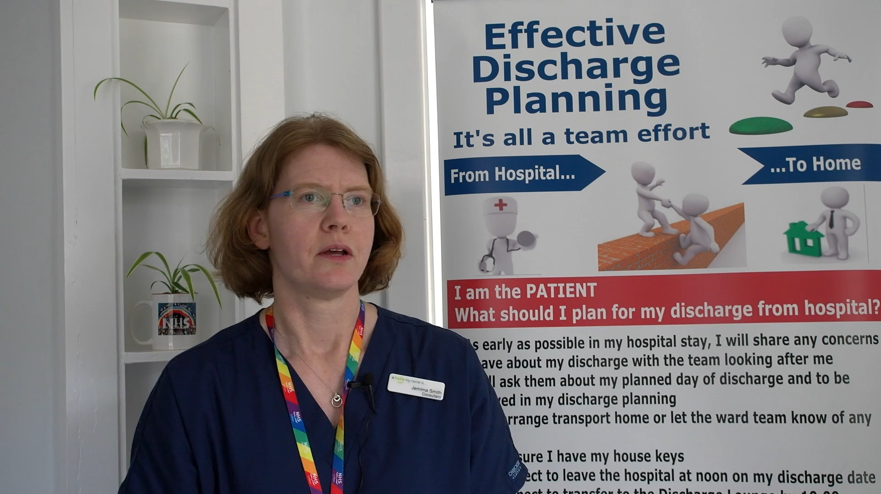
Discharge without Delay (DwD)

Slide 4
Process
Quality Planning/
Quality Improvement
Engagement, Communication and Collaboration
Project Management / Governance
Data and development of a Measurement Framework
- Pareto data to identify focus
- Process Map Current State
- Identify ideal future state
- Implemented through PDSAs
- Engaged with all key stakeholders
- Provided regular communications
- Collaboration is key – joint decision making
How we did it?
- Set strategic intent
- Developed project plan
- Established Oversight Group
- Developed Measurement Framework
- Identified data capture process
- Used and presented real-time data

Slide 5

Culture

Slide 6
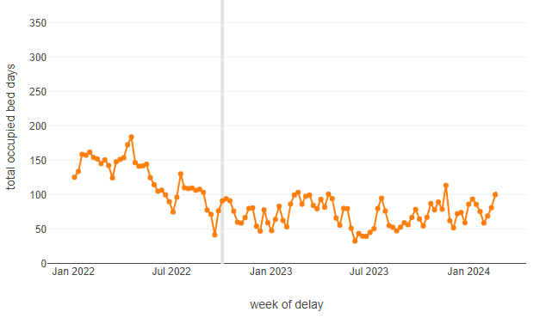
Total OBDs for delayed discharges
Total Occupied Bed Days in ward for delayed discharge patients. PHS definition of delayed discharges - ie excluding 100s, Local Health Delays and CM (case management).
Edinburgh HSCP patients in WGH wards 50,51.
Oct 2023 – Jan 2024: Sustained general downward trend in Occupied Bed Days lost to delay and sustained improvement throughout 2023.

Slide 7
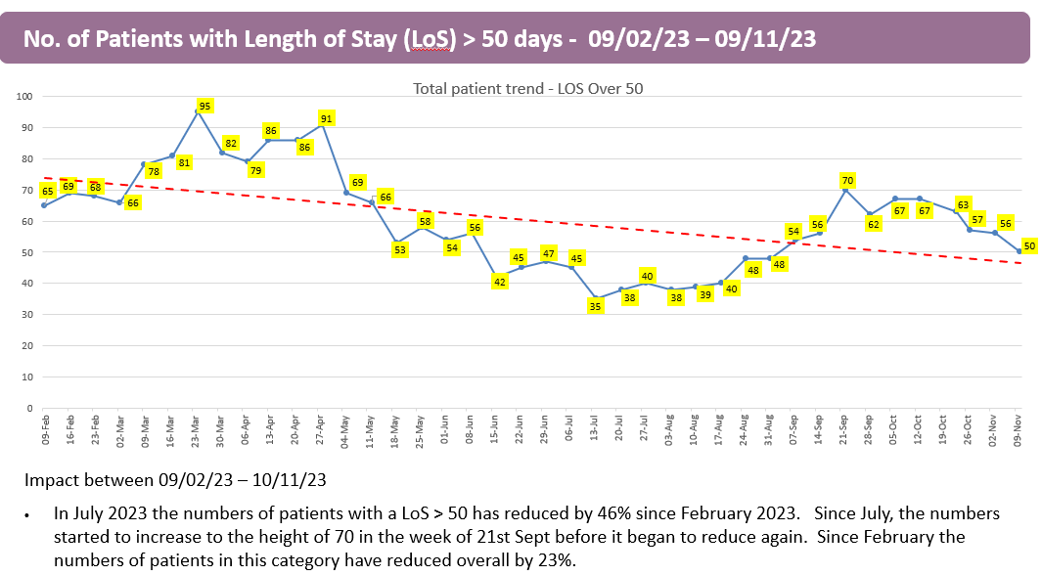
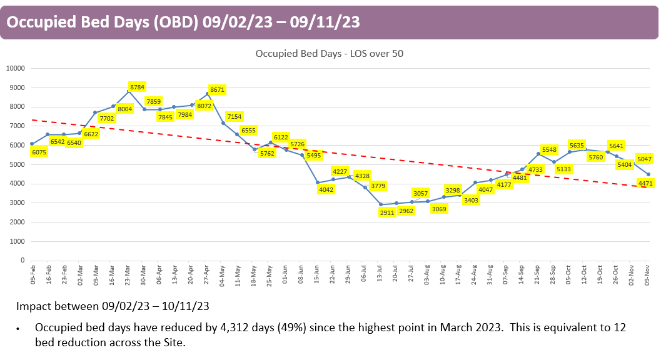
Spin-off Benefits
Critical Friends
Relationships
Long Length of Stay Reviews
Shared Understanding

Slide 8
