Slide 1
The Impact of Transition in and out of the (COVID-19) pandemic for Care Experienced Young People

Slide 2

Nurses for Care Experienced Young People's Service
Established to Improve health outcomes for Care Experienced Young People and to implement the Promise.
Care Leavers are between 4 or 5 times more likely, than their peers, to attempt suicide. (NYAS, 2019)
Feelings of anxiety have increased, in care leavers, by 86% during lockdown.(The Children’s Society, 2020)
75% of the young people living in residential houses meet the criteria for a psychiatric disorder compared to 10% of the general population. (NSPCC 2014; Coram Voice 2015, Social Marketing Foundation 2018)

Slide 3
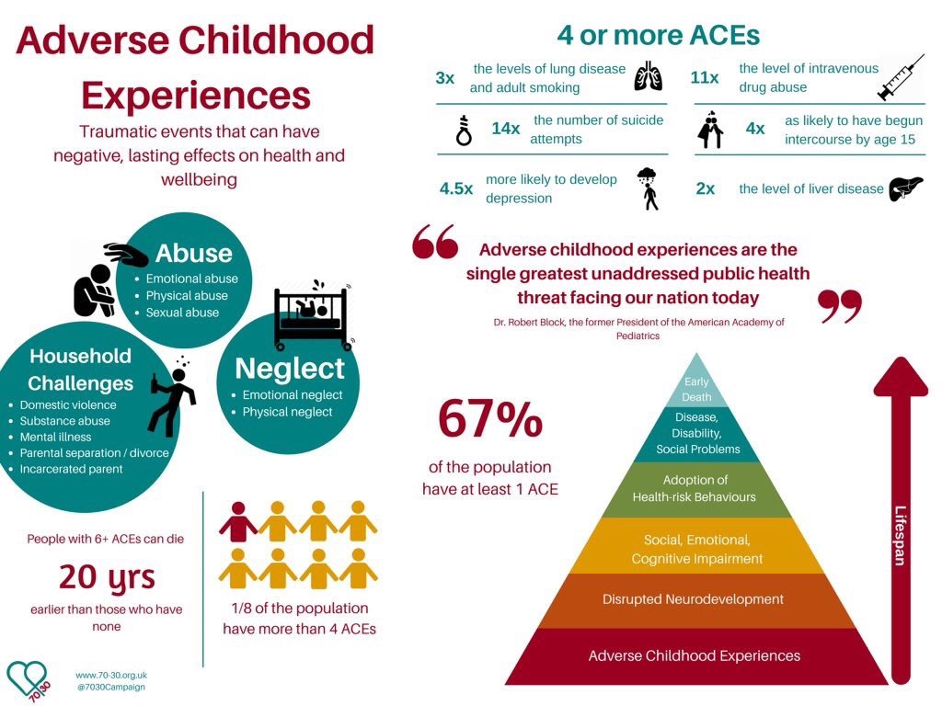
Trauma doesn’t just affect mental health...

Slide 4

CEYPS Through the Pandemic and Beyond Video

Slide 5
Based on our learning from the Pandemic, there are some things we will continue to use and further develop....
The continued use of technology approved by young people.
Further develop a health assessment.
Build on existing collaborative relationships.
A service that is flexible and responsive to change.

Slide 6
The foundations that we have laid throughout the pandemic have resulted in new exciting service developments....
Young People’s advisory group.
QR codes for information on the service and qualitative and quantitative data.
Unaccompanied asylum-seeking children.
Women’s Custody Unit.

Slide 7
Any Questions?
We hope you have enjoyed our presentation and would
welcome your questions.
For further information on the service please call our team on 01382 660111 ext 55429 or 55428.

