Slide 1
Digitally Enabled Services: collaborative and sustainable
Chair: Jonathan Cameron, Head of Digital Health and Care, Scottish Government
Speakers: Chris Wright, National Advisor for Digital Mental Health, Scottish Government
Tracey Baxter, Head of Product & Delivery, NES Digital, NHS Education for Scotland
Angela Gregg, Senior Product Manager, NES Digital, NHS Education for Scotland

Slide 2

Impact of COVID
Demand for mental health services increase with the impact of COVID leading to great prevalence or depression, anxiety, sleep problems and OCD
Access to mental health services decreases with services limited by COVID through deployment of staff, reduced service capacity and reduction in referrals through primary care
Digital identified early on as key to addressing increase demand and service accessibility

Slide 3
History of Digital Delivery
Prior to COVID -19 development of digital mental health services established through the TEC Programme
2014-2017 – MasterMind EU Project
2016-2019 - cCBT National Implementation TEC Programme
2019 – Internet Enabled CBT Test of Change
2019 – cCBT Long Term Conditions Test of Change
National rollout of cCBT completed 2019

Slide 4



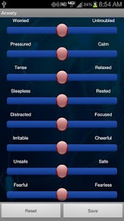

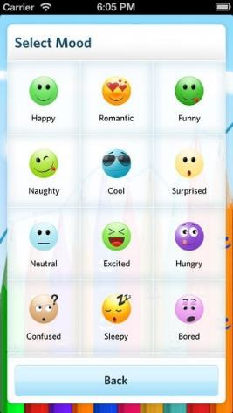
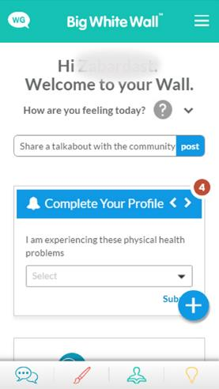

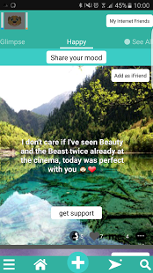

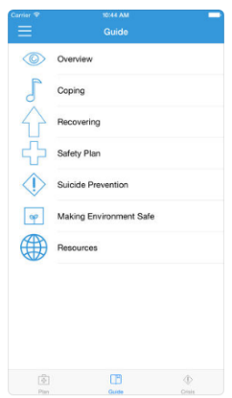


Different Digital Options
Self-managed Treatment, Self Monitoring, Mindfulness/Relaxation, Reminders, Peer Support, Mood Trackers, Self & Risk Management
Assess, simplify, integrate and collaborate

Slide 5
Assessment of Digital Products
Evidence and
Evidence and Safety
Need
Fit
Capacity
Usability
Support
Technical
7 areas of assessment are carried out with, Evidence, Safety, Need and Fit
being the primary focus of this process, but implementation also a consideration
Evidence and safety is contextual to technology but will look at Clinical Guidance, RCT’s, underpinning theoretical approach and risk management

Slide 6
Focused Response
Development of a national programme
Rapid expansion of digital therapy services, cCBT and ieCBT
Introduction of self-referral options for digital treatments
Expansion of interactive self-help on NHS Inform
Supported rollout of video enabled therapy
Establish a Test of Change Programme
Digital mental health services made available for health and care staff
Expand service capacity and accessibility to provision of remote treatments

Slide 7
Rapid Expansion in Year
March 2020
March 2021
Single cCBT treatment – depression/anxiety only
cCBT LTC in Test of Change
ieCBT in Test of Change
14 cCBT treatments covering depression, anxiety disorders, LTC – (chronic pain, diabetes, CHD, RA, respiratory), stress, sleep problems, resilience, COVID-19
cCBT Self-referral options
Internet Enable CBT, national implementation
Test of Change Programme Established – CYP and perinatal
13 Online digital psychological self-help guides published on NHS Inform
National Programme and Programme Board established
Funding for national evaluation structure and Innovation Hub secured
cCBT and self-management made available for staff through Wellbeing Hub

Slide 8
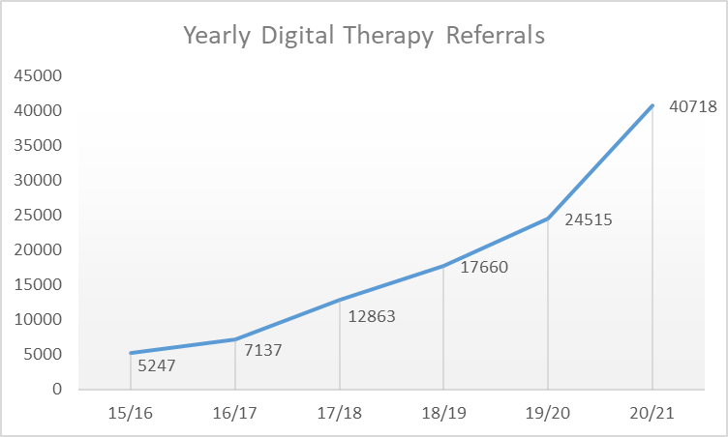
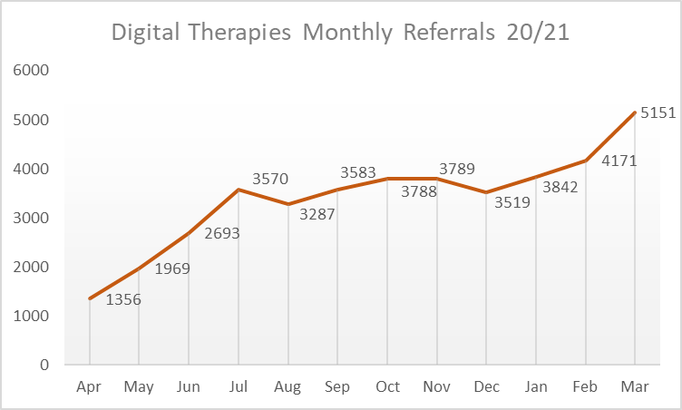
Increase in Usage
March 2021 = 5,151
Biggest month to date
3,393 average compared to 2,101 last year
Over 4,300 in last 3 months
Over 7,500 self-referrals
108,140 referrals since 2016
308,834 self-help guides accessed through NHS Inform
25% of referrals to psychology now digital
Suicide ideation of over 3,600 citizens actively monitored per month
> 6,100 video consultations

Slide 9
Foundations for Rapid Expansion

Slide 10



Grounding in Policy
Mental Health Strategy Action 25: “Develop more accessible psychological self-help resources and support national rollout of computerised CBT with NHS 24 by 2018”
Programme for Government: “In partnership with NHS Health Boards we will expand Computerised Cognitive Behavioural Therapy (cCBT) service provision by increasing the number of treatment options”
Suicide Prevention Action Plan Action 6: “The NSPLG will work with partners to develop and support the delivery of innovations in digital technology that improve suicide prevention”

Slide 11
Partnership Network
Government Policy Makers
Patient Groups
Mental Health Services
NHS Education Scotland
NHS Health Boards
GPs
Psychology – Heads of Service
NHS 24
3rd Sector Organisations
National Services Scotland

Slide 12

Collaborative Approach
Clinical
Implementation
Service Delivery
Technical
Policy
Partners from all regional health and care territories
Psychology
Education Scotland
Workforce Planning
Digital Health and Care
Nursing
Commercial Partners
Housing
Policy Leads
Trauma Teams
Social Care
Primary Care
Care Homes
Development of shared understanding of need
Ownership and buy in
Common Goals

Slide 13
Shared Responsibilities
Strategic
Technical Expertise
Clinical
Information Governance
Development
Marketing
Evaluation
Policy
Achievement
Drive and Commitment
Maximise impact of partnership through the application of skill, expertise and experience in the right areas

Slide 14
Built on Trust and Acceptance
Building common goals and aims
Learning about our partners
Developed a clear understanding of need
Continue to Communication and Inform
Respond and react
Built trust through transparency
Shared knowledge, learned together
Ensured strategic alignment with national profile

Slide 15
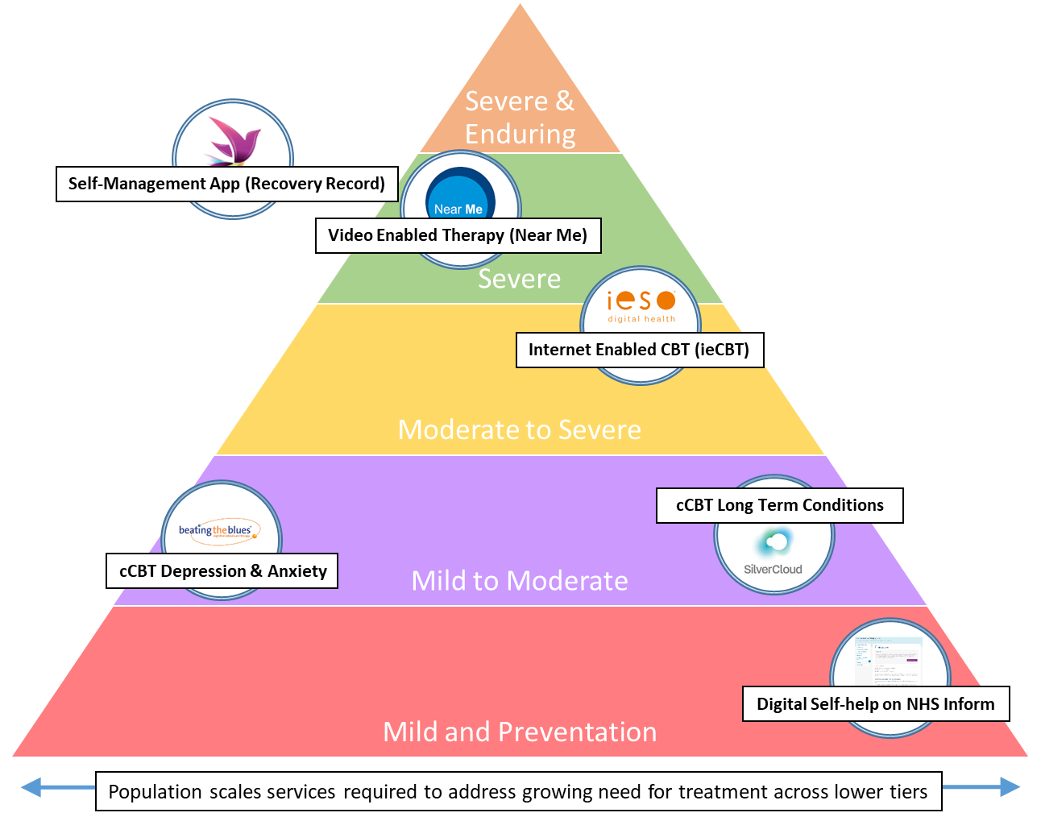

Integration into Clinical Models
Multiple digital services embedded in stepped care delivered at national and local levels

Slide 16
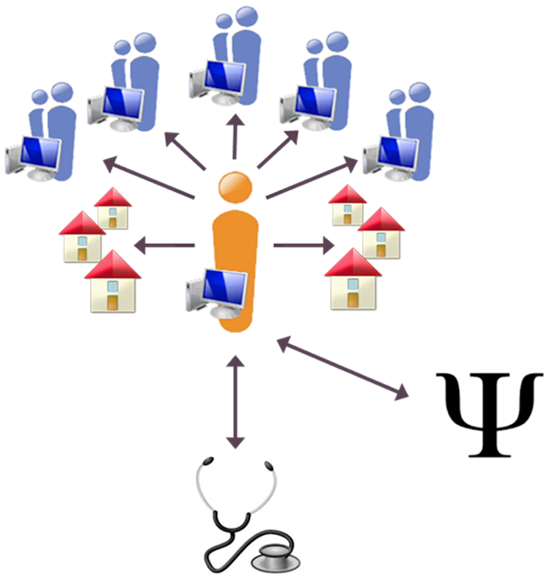
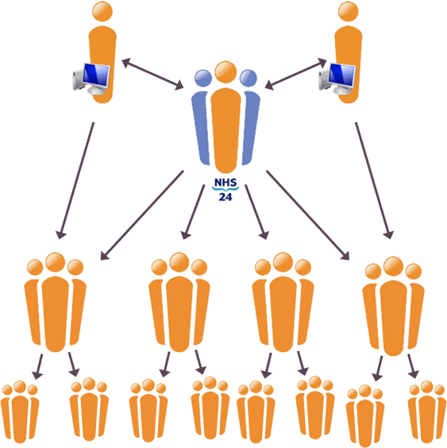
Established Models and Approaches
Service model and implementation approaches designed to overcome a number of barriers
Considerations should be given to the sustained service model and ability to move beyond current aspirations

Slide 17
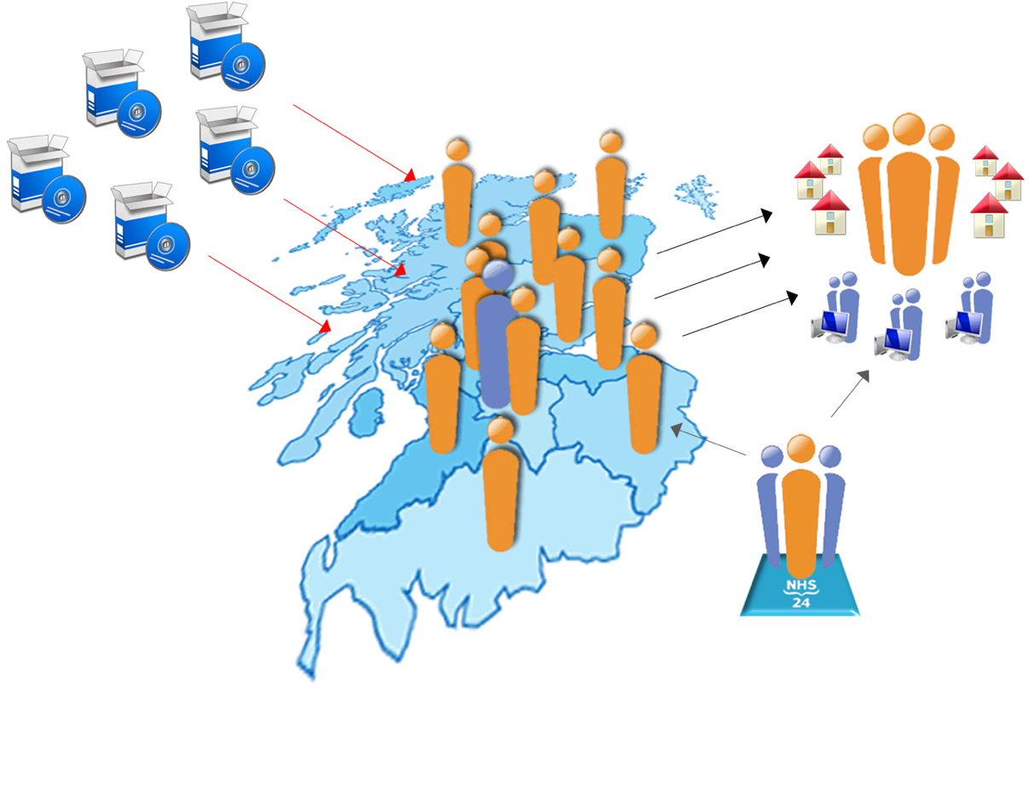
Service Platforms for Delivery
Current digital services act as delivery platform for range of e-Mental Health solutions
Range of digital services offered through single services embedded in health care
Developing service platforms greatly reduced implementation time as structures are reused, this enhanced when using a shared learning approach to implementation

Slide 18
Influence of COVID

Slide 19
Shaping Future Work
Service Development
Child and Young People
Expansion of Adult Services
Self-referral Services
Self-management
Infrastructure
Patient management systems
Interoperability of digital therapies
Digital inclusion
Workforce training, skills development
Evaluation and innovation
Data
Cultural Change
Priority Areas
Older Adults inc. Care Home Residents
Drug Deaths and Homelessness
Autism and Learning Disability
Suicide Prevention
Staff Wellbeing

Slide 20
Continued Need to Build Evidence
Focused on
Evidence to support claims of technologies
Technical, user satisfaction, safety, effectiveness
Research focused
Demonstrates at scale in appropriate live environment
Evidence should be build throughout design, testing and implementation phases
Development of understanding, trust and acceptance is dependant on good evidence

Slide 21
Focus on Innovation
Creation of Innovation Hubs and Clusters through partnerships with DHI to support the development of the next generation of technologies
Emerging Technologies
AI Chatbots for CYP – AlliChat, Think Ninja for Signposting
Gamification Technology – Mindfulness and Relaxation
Virtual Reality – Phobias
Machine Learning – Informing Clinical Practice

Slide 22
Getting Clinical Acceptance
One of the biggest barriers to the adoption of technologically enabled care
Acceptance has increased greatly over past 12 months
This acceptance is not universal and there remains resistance to new technologies
Needs extensive programme of clinical engagement, evaluation and appropriate evidence
This to reinforce what has been experienced during COVID and build on the cultural change

Slide 23
Thank You

Slide 24
Turas Care Management​
(Safety Huddle Tool)
Tracey Baxter, Principal Lead Product & Delivery, NHS Education for Scotland (NES) Digital​
​Angela Gregg, Senior Product Manager, NHS Education for Scotland (NES) Digital​

Slide 25
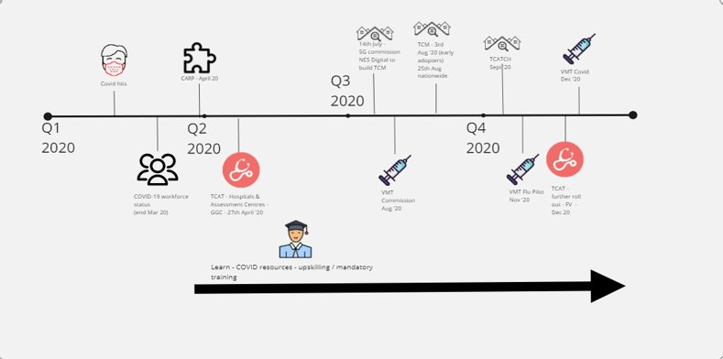

NES Digital’s response to C-19 Pandemic

Slide 26
Response to COVID-19 Pandemic in care homes
Drivers for change
Core Principles
Care homes most impacted by pandemic​
>40% of all COVID -19 related deaths in care home​
↑ Risk factors for Resident​
↑Risk of atypical presentation ​
↑Demands to provide data to multiple sources
Tool designed with the sector for the sector​
Safety huddle – methodology used to help collate data​
One data capture for multiple purposes​
Focus on outbreak management and contributory factors​
Data repository/escalation situational awareness tool​
Future proofed and easy data entry
Notes:
How TCM came about

Slide 27
What is a safety huddle?
They are short multidisciplinary / team meeting held at a predictable time and place daily. ​
​Effective safety huddles can: ​
Enhance team work through communication and co-operative problem solving​.
Support a shared understanding of the focus and priorities of the day​.
Support situational awareness and safety concerns​.
Supports prioritisation of care with a focus on safety​.
Enables early escalation and intervention. Captures mitigation actions.​
Enable trend monitoring and support improvements in care.
Notes:
This demonstrates how health stepped up to support care

Slide 28
Background to the NES Digital technology
Built in-house by NHS Education for Scotland (NES Digital) teams.​
Built on the NES Turas platform – web based, accessible anywhere, on mobile or desktop devices.​
Microsoft Azure technology.
Users authenticate using e-mail address.​
Agile development methodology – working with stakeholders / users to iterate and respond to changing needs and demands (from August to May >30 deployments of code – little & often).
Notes:
How we delivered – highlight reusing existing technology allowed us to scale up quickly​
​
Update on deployment – small and often, building confidence and trust in us as a technology supplier

Slide 29
Design & Delivery Principles
AIM: Support care homes to identify factors that may impact on the health, safety and wellbeing of residents by providing one place to capture information on activity and staffing requirements within the care home local context, and to identify any associated risks.​
​
Future proof​
Deliver small and often​
Less is more!​
​
Involve the users in shaping the product​
​
Continuous feedback and improvement

Slide 30
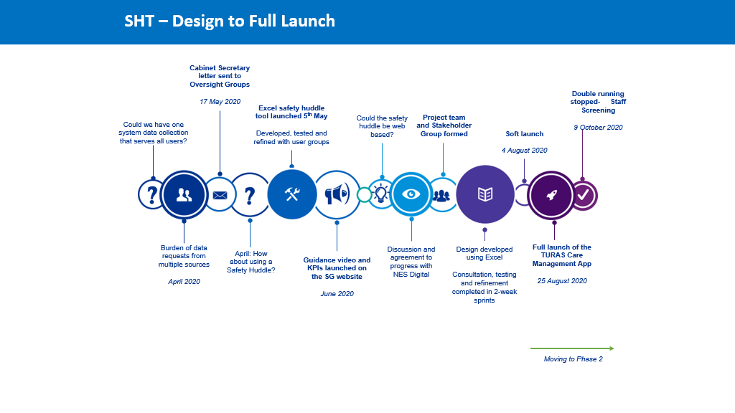

Slide 31
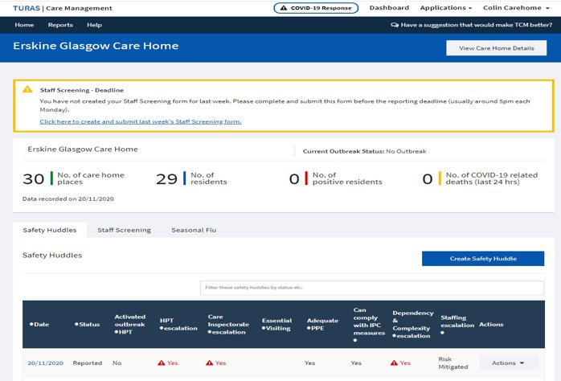
Care Home Manager View
This is test data

Slide 32
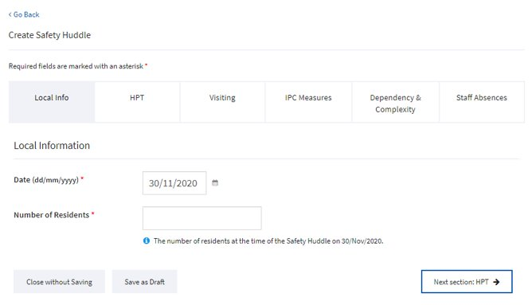
Care Home Manager View

Slide 33
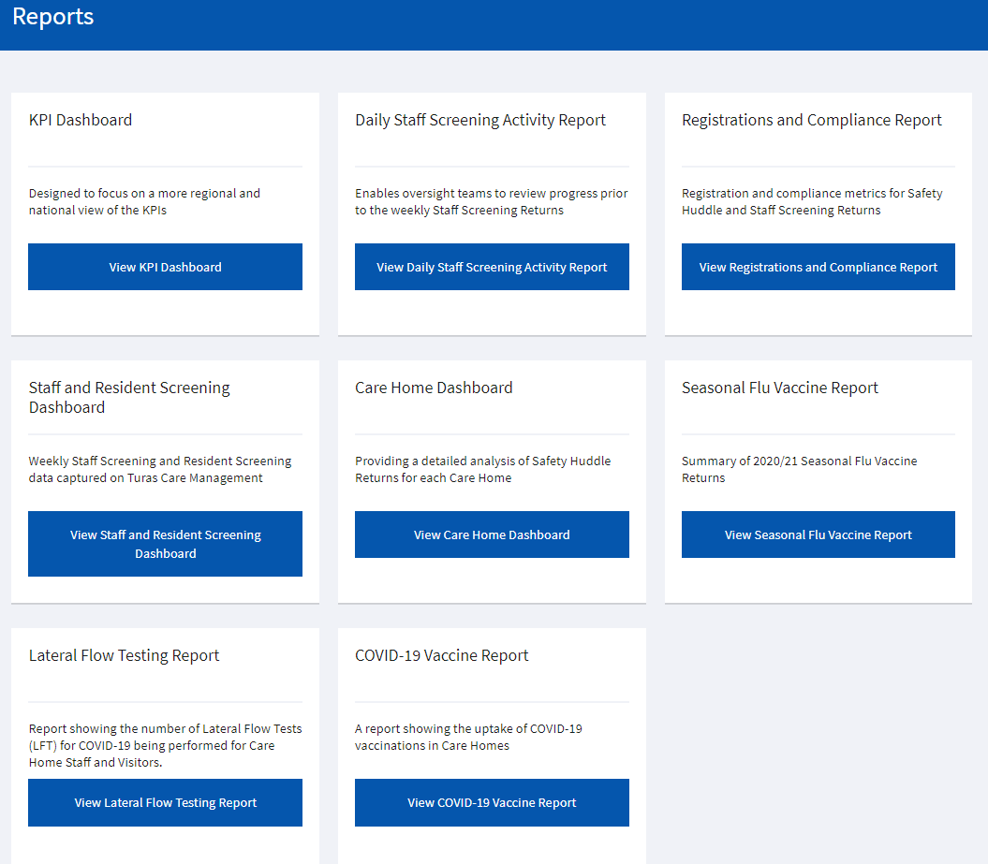
Reporting suite

Slide 34
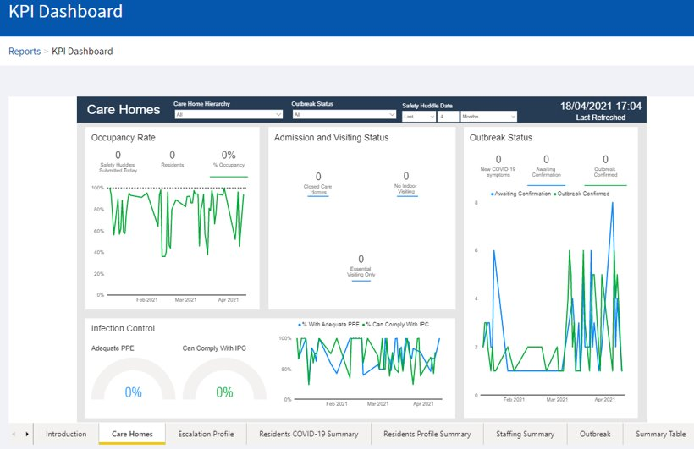
Reporting Dashboards

Slide 35
Date Usage and Purpose – During COVID-19 Pandemic​
Care Home/Care Home Provider ​ | Input data​ Review local reports / wider care home group reports​ Situational awareness, Care Prioritisation and Escalation of safety concerns ​ Trend monitoring, resilience planning​ Quality Improvement​ Reduction in duplication of reporting​
Oversight Groups in NHS Boards and Health and Social Care Partnerships​ | Over view of carehome KPI reports and compliance for care homes in their area​ Support with Mutual aid/PPE and IPC compliance when required​
Commissioning/Contract Monitoring​ | Captures information requested by commissioners of services​
Incident Management Teams​ | Supports escalation to Health Protection Teams​ Supports outbreak management​
The Care Inspectorate​ | Captures information which care inspectorate had asked for e.g. staffing/outbreak etc as part of pandemic response andinspection​
Public Health Scotland​ | Allows overview of outbreaks Nationally vs local prevalence ​
The Scottish Government​ | National Pandemic overview of all data fields/compliance​ National Overview of outbreaks, Escalation​ National Overview of staff and resident testing for official data publication​ National Overview uptake of flu vaccine and visiting​
Notes:
Single source of data for multiple agencies

Slide 36
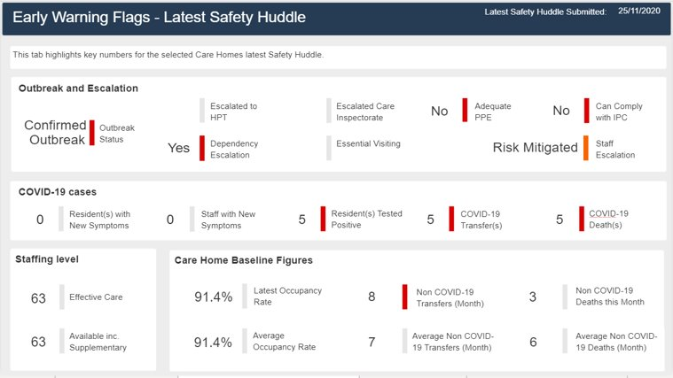
Care Home Manager dashboards – developed with and for the Care Homes
Notes:
This was giving something back to the care homes – their own dashboard

Slide 37
What did we learn and what’s next
What did TCM give us: ​
A visibility of data at an LA/HSCP/Board level that was previously not available​.
Helped to build pathways between Care Sector and Health Sector – improving collaboration​.
Care Homes now have an easily accessible digital platform, which they are using on a daily basis, they are comfortable with and which can be used as a basis to deliver other technologies into the sector.​
Registration dashboard gave us easy to understand metrics on take up by home, by HSCP, by board​ which helped to facilitate the rollout of TCM and inclusion of all Adult and Older Person homes.
Sharing of data sources – TCM surfaces data from Vaccination and Testing systems, reporting to one place and reducing data entry.​
TCM data is shared to PHS and SG for national publications, reducing burden on homes.​
Future developments
Development of functionality to support Health and Care (Staffing) Act, Quality Measures and other Outbreak types.
Improved data sharing between TCM and Care Inspectorate to reduce data entry burden on care homes.
How can you get involved?
The are a range stakeholders groups focussing on specific elements of the tool – if you would be interested in learning more, please contact Tracey.Baxter@nhs.scot or Angela.Gregg@nhs.scot
Notes:
Want to cover:​
​
Lessons Learned – ​
Governance has to be baked in from start, otherwise can be a blocker​
Metrics on uptake helped us target users to promote uptake​
Metrics on use within homes and oversight partners help target to enourage adoption/buy in​
Metrics on what reports were being used and which weren’t – so we could focus on what was valuable​
Sharing data sources​
Have a clear purpose and define outcomes – otherwise scope creep​
Join the dots to maximise value​
​
​
What’s ahead?​
Care homes asking for more functionality​
Use the technology platform we have in care homes to integrate health and care – anyone can build on the Turas platform, doesn’t have to be NES​
Want to do more to support the care homes and reduce the burden​
​
​
Service improvement​
How boards can get involved​
​
Platform in sector – highlight positive response. Highlight doesn’t have to be NES tech

Slide 38
Technology as an enabler for health sustainability……….
Transforming great ideas into real solutions
Prof George Crooks OBE

Slide 39

Our vision is that innovation in digital health and care will help Scotland’s people to live longer, healthier lives, create sustainable services and help Scotland’s economy grow.
COPYRIGHT – DHI Scotland
Notes:
Scotland has a strong tradition for innovation, and have an equally strong ambition to create sustainable services and grow the economy – so as yesterdays Dr Marvel pointed out, we also need to embrace this for not just the benefit of Heath and Care, but for wellbeing and economic development purposes

Slide 40


Slide 41


Slide 42
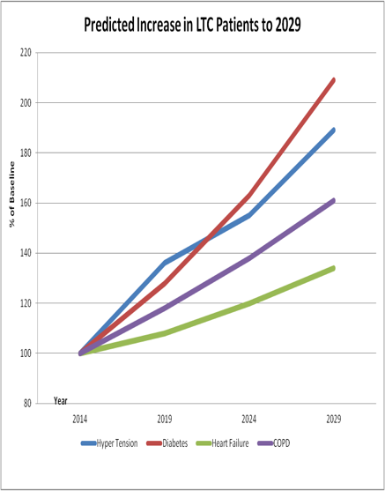




Slide 43







Slide 44
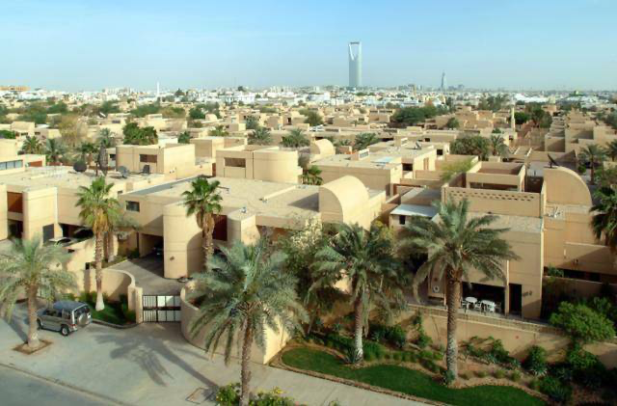

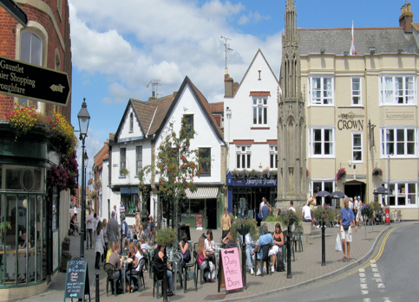

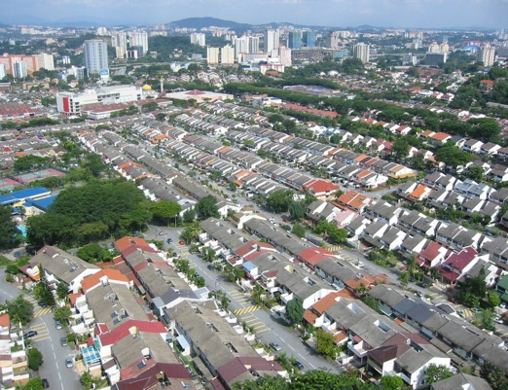

Slide 45

Notes:
But this can only be realised if you start to merge the innovation streams… in my experience which is over 12 years working in this domain – my realisation is that the service needs much more attention to ensure they are ready, able and willing to change! And once they are we also need to be aware that the business model to purchase such as service also needs to be in place and ready to integrate into the system seamlessly.
So the interoperability and integrations is not just a technical challenge – in some respect that is the easy bit!

Slide 46


Slide 47


Slide 48

Communities & technologies are getting smarter
5G/6G
LORANET
CLOSED
DATA
IOT
DATA SCIENCE
OPEN DATA
AI
SMART
METERS
SMART INFRASTRUCTURE
CONSUMER DATA
SENSORS
WEARABLES
Notes:
Along with this shifting focus
Communities, citizens and places are getting smarter and at yesterday plenary a question was asked about Smart cities and urbanisation is an enormous movement with over 70% of population living in cities by 2050… so keep that in mind as I speak later about data integration and how IOT and new communication technology like 5G will start really enabling us to do things that we thought years ago would be impossible……

Slide 49


Slide 50
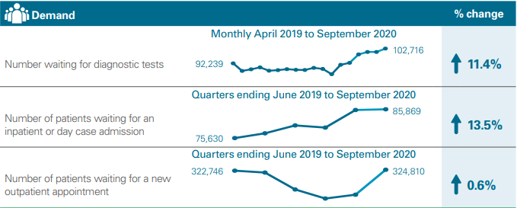
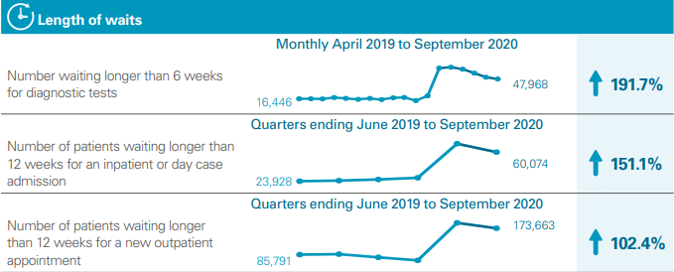
Finite supply of physical space and clinical staff
Increased demands on hospital services
Realistic Medicine – empower citizens, reducing waste
Hidden demand

Slide 51
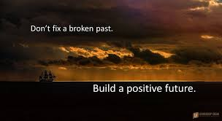

Slide 52
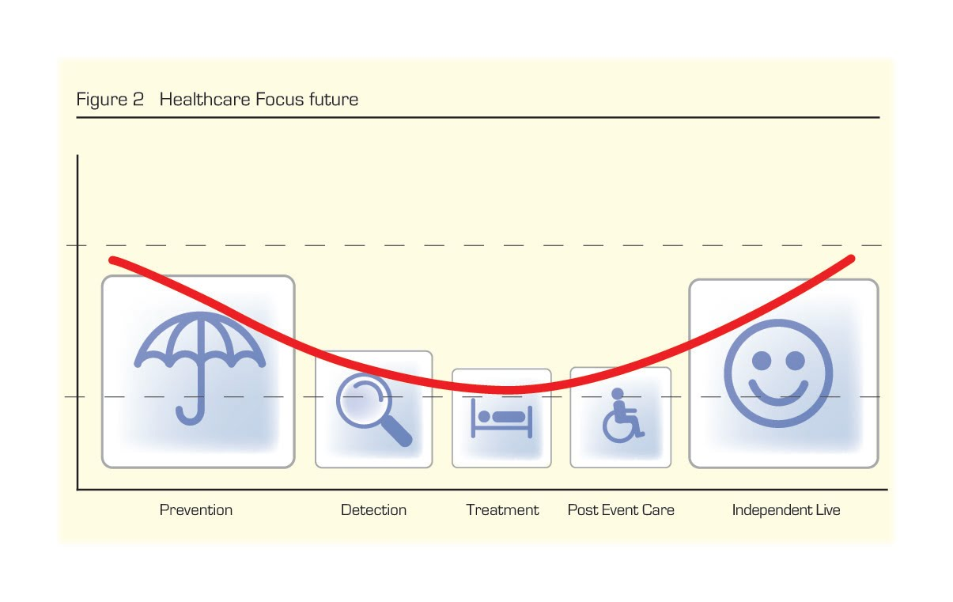
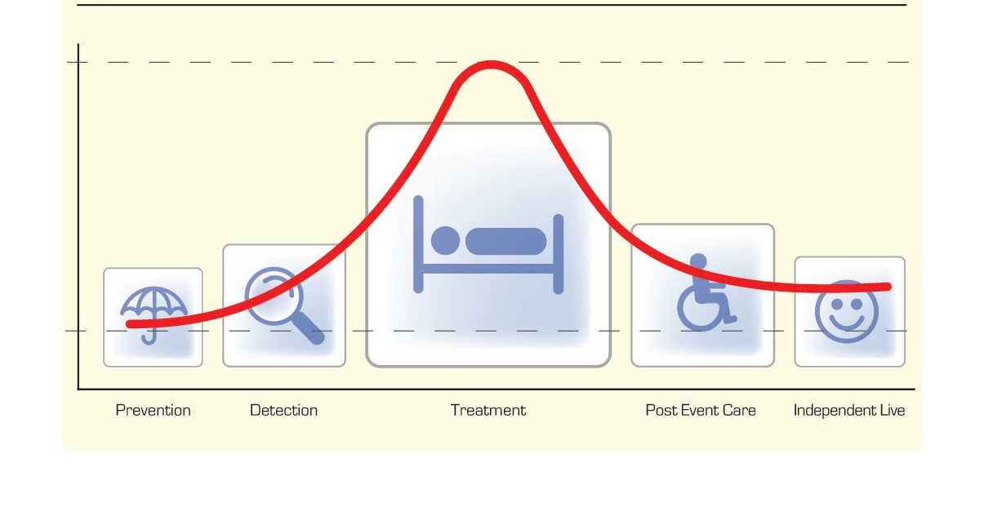
Vision and focus
SHIFTING THE BALANCE OF CARE
COPYRIGHT – DHI Scotland
Notes:
So we all know how this world has looked in the past, with unsustainable resource being consumed in treating ill citizens
Less attention has always been given to help prevent and allow folk to live independently………
The DHI vision is about shifting the balance of care and integration is at the heart of that…….

Slide 53


Slide 54


Slide 55


Slide 56
Next Generation Services

Slide 57

Citizen-centred data sharing
Notes:
Citizen-centred data sharing
The Scottish vision is that citizens will be able to access, add to and share a personalised view of their health and care information.
Background
The Scottish Government wants citizens to be able to access, add to and share a personalised view of their health and care information. This ‘portal’ would also allow individuals to communicate securely with health and care providers, book or change appointments, order repeat prescriptions and access ‘virtual clinics’.
If this can be achieved with the necessary privacy, security and consent controls, then it could offer major benefits, such as greater convenience for patients and lower running costs for the NHS.
Two models are currently being looked at. One is to have centralised data accessed through a single, closed point of entry. A second is to have a more open IT infrastructure that allows different methods to be used to access the data, that would again be stored centrally.
Although the first option is likely to be simpler, it also severely restricts citizen choice and the ability to develop more personalised services.
We're working with the Scottish Government on the next steps towards developing the necessary IT infrastructure that could work for the second model.
This work will involve Scottish SMEs, charities and other groups with an interest in a more open, distributed and citizen-controlled model of data sharing.
Work to date
Some work has already been carried out to scope out the steps necessary for proving the concept of a national patient portal. In parallel to this, we ran a two-year development project called Next Generation Digital Records with Scottish industry, academia and the Scottish Government.

Slide 58

BLEND CITIZEN GENERATED DATA
WITH
FORMAL HEALTH AND CARE DATA
DELIVERS THE TRUE LIVED EXPERIENCE OF A CITIZEN

Slide 59
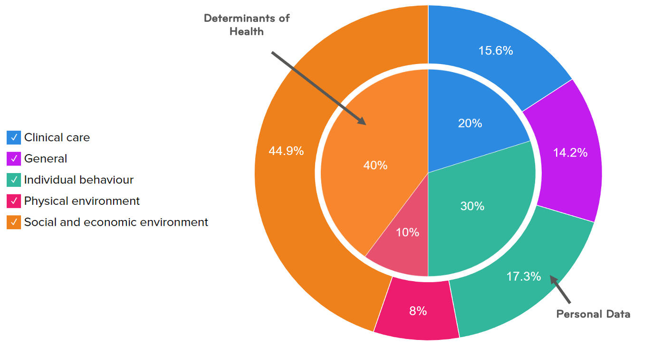
Personal Data by Determinants of Health
Notes:
The Relative Contribution of Multiple Determinants to Health, " Health Affairs Health Policy Brief, August 21, 2014.DOI: 10.1377/hpb20140821.404487​
https://www.healthaffairs.org/do/10.1377/hpb20140821.404487/full/healthpolicybrief_123.pdf​
https://www.sycamoreinstitutetn.org/2018/07/18/drivers-of-health/#!​
​
225 personal data items categorised in broad alignment with the drivers of health.​
​
Link to harry burns​

Slide 60


Slide 61
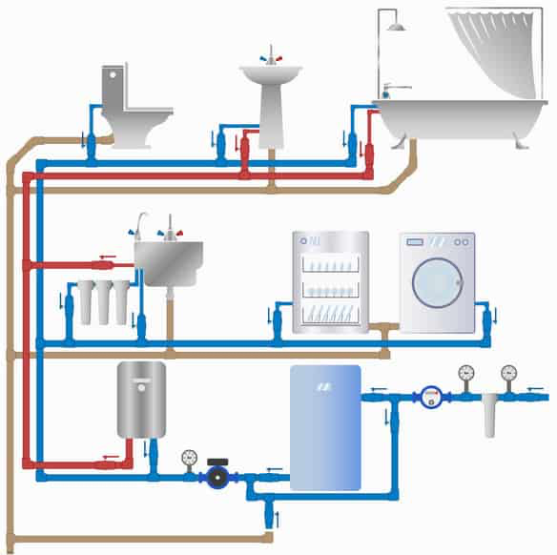

Slide 62
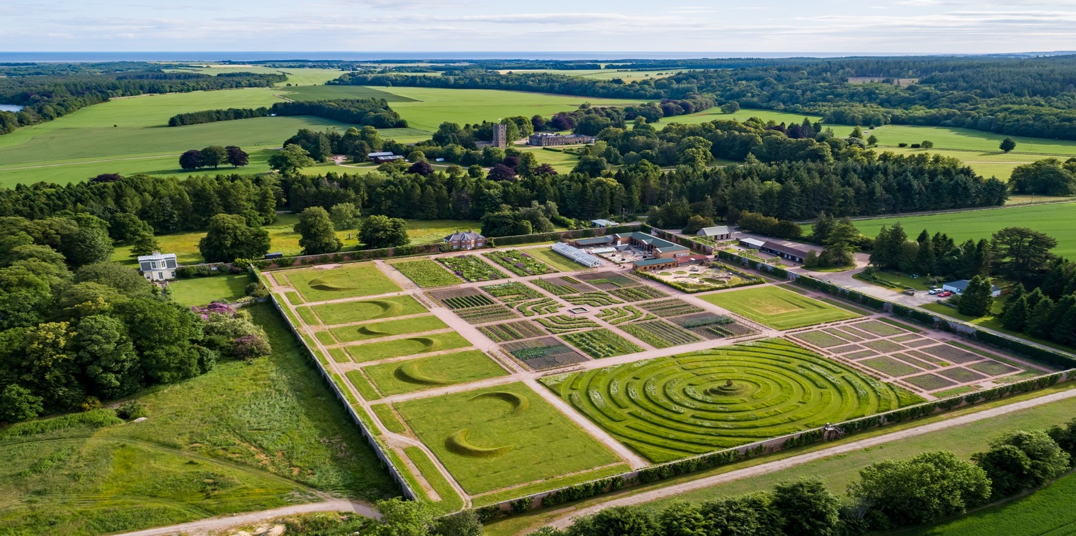
CONTROL CAN BE OK!

Slide 63

LET INNOVATION FLOURISH

Slide 64



Integrating Innovation
Service model innovation
Technical/Digital innovation
DEMONSTRATING
READINESS TO ADOPT/ SCALE
Accepted service models
INTEROPERABLE
Business model innovation
COPYRIGHT – DHI Scotland
Notes:
But this can only be realised if you start to merge the innovation streams,,,,,,,,,,,,,in my experience which is over 12 years working in this domain – my realisation is that the service needs much more attention to ensure they are ready, able and willing to change! And once they are we also need to be aware that the business model to purchase such as service also needs to be in place and ready to integrate into the system seamlessly.
So the interoperability and integrations is not just a technical challenge – in some respect that is the easy bit!

Slide 65
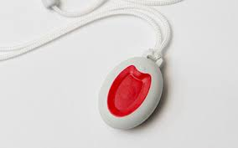

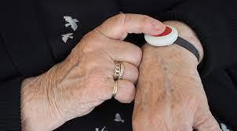


Slide 66



Slide 67


Slide 68


Slide 69

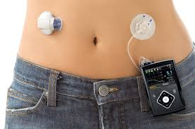


Slide 70
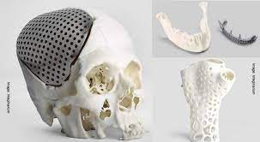

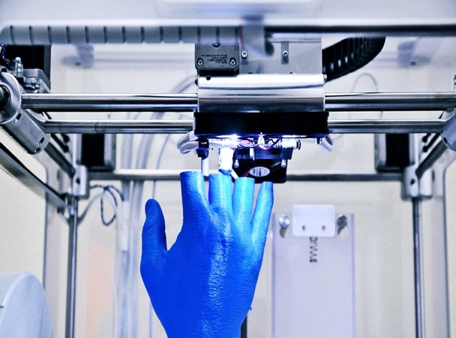
3D Printing

Slide 71
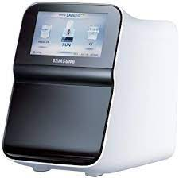
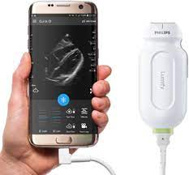
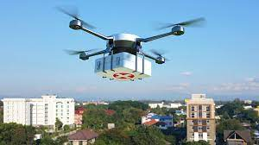

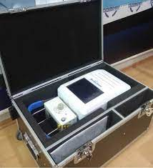

Slide 72


Slide 73


Slide 74


Slide 75

Join our network
@dhiscotland
www.dhi-scotland.com

Slide 76
Thank You

